Slide 1


Development Workshop 1
Frontend Web Dev & Vue.js
1

Slide 2

Key Ideas
What makes up a frontend service?
What is a Javascript framework?
What makes Vue work?
2

Slide 3
What is a Frontend?
All the code that is running in your browser when you go to a website
The frontend defines how a website looks and all the ways that a user can interact with it
3

Slide 4
1
2
3
What Makes a Frontend Service?
JavaScript
HTML
CSS
4
The structure of the web page, what components are where
The styling of the web page, how components look
The interactiveness of a web page, how components change

Slide 5
A Brief History of JavaScript in Web Development
Throughout the early 2000s there weren’t many good JavaScript developers and the confusing quirks of the language slowed its adoption
In 2010 Angular was the first large scale release of a JavaScript framework that could handle all aspects of web development
JavaScript was first developed in 1990 as a companion scripting language to Java, it no longer has much semblance to Java outside of syntax
JavaScript began to become more standardized and introduce new features that allowed developers to do more with the language
5
Notes:
Important to note: Angular came out less than 10 years ago, Vue came out only 3 years ago, all of this technology is still very new and changes fairly frequently.
If the human body created new organs as often as Javascript frameworks come into existence then doctors would be googling it too.

Slide 6
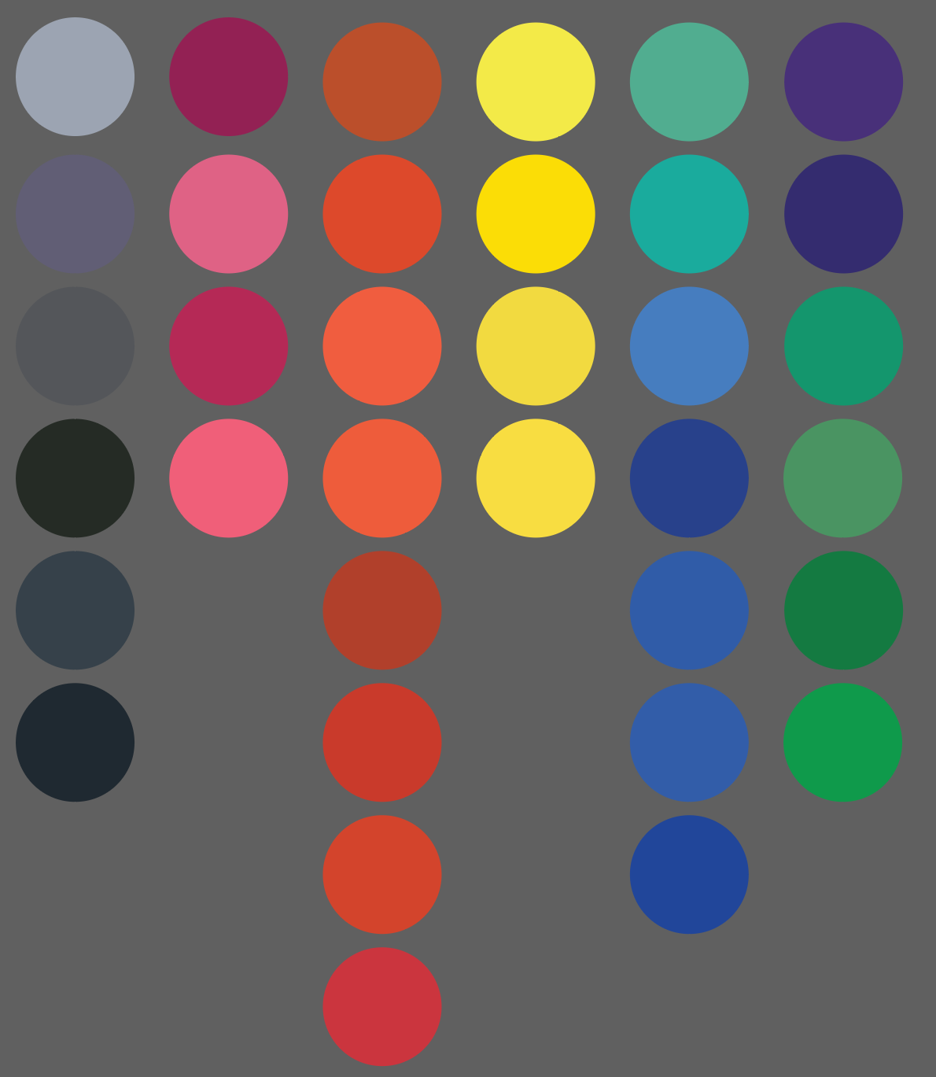
What is a Code Framework?
A way of organizing and developing code to handle routine functions
A library is a collection of code that a developer may use to handle specific task.
Building JSON Web Tokens, keeping track of the date, doing some complex math
A framework is a collection of libraries that typically defines how a developer can use them together to complete a more complicated task.
Building a website, creating a web server, making a microservice
6

Slide 7
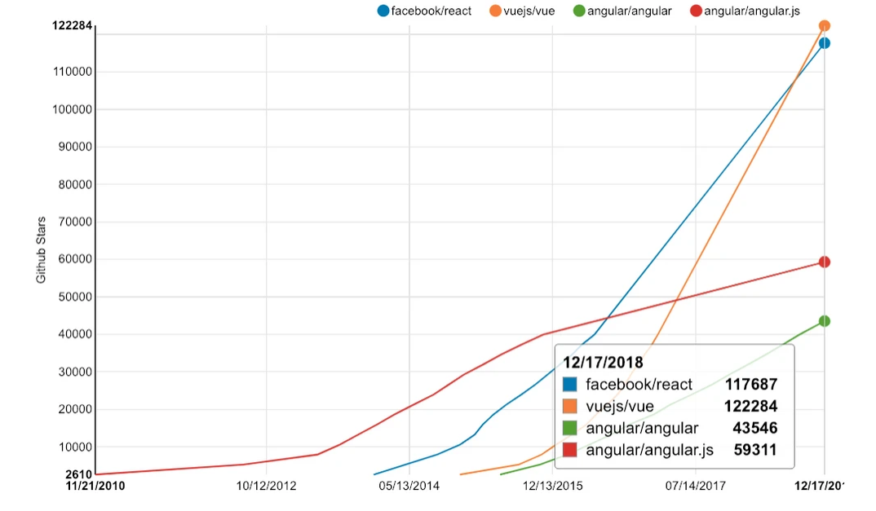
Three Main JavaScript Frameworks
1
Angular
2
React
3
Vue
https://www.codeinwp.com/blog/angular-vs-vue-vs-react/
7
Notes:
Angular: Created by Google, in 2015 upgraded to a new version that is incompatible with the old version
React: Created by Facebook, uses XML you look cool if you use this
Vue: Created independently, we like it because it has an easier learning curve and is a little more applicable because it uses HTML and CSS more directly than angular or react

Slide 8
Why Would We Use a JavaScript Framework?
JavaScript frameworks make it easy to make websites dynamic
They allow us to change our HTML and CSS code seamlessly for our users as they interact with our web page
This makes our website faster, more interactive, and allows us as developers to make more interesting websites
8
Notes:
Seamlessly - without any page reloading
Without Javascript if you wanted to update the text in a paragraph you would have to reload the whole page

Slide 9
So What’s Vue Like?
Let’s learn by making an app!
9

