Slide 1
Website Category Classification
Submitted By: Abhiram P
Abin P Thomas
Darsana A S
Devanand C R
Guided By: Mr. Arun Kumar

Slide 2
Contents
INTRODUCTION
LITERATURE SURVEY
PROBLEM STATEMENTS
OBJECTIVE
METHODOLOGY
IMPLEMENTATION STATUS AND PLAN
TESTING AND VALIDATION
RESULTS AND DISCUSSION
RESULTS AND CONCLUSION
UI DESIGN
CONCLUSION
FUTURE SCOPE

Slide 3
Introduction
World Wide Web is providing users with rich content every second.
Increase in content can contain harmful or misleading information, including adult content.
Developing a website category classification system that accurately assigns categories to given URLs.
The vast amount of information available online, website categorization plays a crucial role in organizing and retrieving relevant content.
Utilizing BiLSTM and LSTM machine learning algorithms to analyze website content and assign them to relevant categories.

Slide 4
Literature Survey
No | Name of the Author | title | Name of publication | Techniques used | findings
1 | R.Rajalakshmia Hans Tiwari Jay Patel Ankit Kumar Karthik.R | Classification-based adaptive web scraper | International Conference on Computational Intelligence and Network (2020) | RCNN | Pros: Handle large volume of URLs. Cons: Complexity

Slide 5
Literature Survey
No | Name of the Author | title | Year of publication | Techniques used | findings
2 | Wing Thand Aung. | Random forest classification for multi-category classification of web pages | IEEE Asia-Pacifi Services Computing Conference (APSCC) -2009 | Decision tree | Pros: Used with large dataset. Cons: Difficult to interpret and understand.

Slide 6
Literature Survey
No | Name of the Author | title | Year of publication | Techniques used | findings
3 | S. Liu T. Fross | Text classification models for web content filtering and online safety | IEEE International conference on Data Mining Workshop (2015) | Naive Baise, SVM | Pros: Handle a large volume of web contents. Cons: Limited context.

Slide 7
Literature Survey
No | Name of the Author | title | Year of publication | Techniques used | findings
4 | Devlin Jacob MingWei Chang Kenton Lee Kristina Toutanova | Bert: Pre-training of deep bidirectional transformers for language understanding. | arXiv preprint arXiv:1810.04805 (2018) | BERT | Pros: Utilizes a pre-training phase where it learns from vast amounts of unlabeled text data. Cons: Computationally expensive and time consuming.

Slide 8
Literature Survey
Gap identified:
Low accuracy
High training time.
Improvements:
BiLSTM and LSTM models outperform the existing BERT system in terms of accuracy.
Both models offer faster training times compared to BERT

Slide 9
Problem Statements
Existing system uses BERT technology
Fine-tuning BERT requires powerful computers and memory.
Lengthy training process potentially impacts project timelines.
The system heavily relies on high-quality training data. Inadequate data adversely affects performance.

Slide 10
Objective
Develop an accurate website classification model to categorize websites, including potentially harmful content such as adult content, for enhanced user safety.
Compare the accuracy of machine learning algorithms, specifically LSTM and BILSTM, in categorizing websites to determine the most effective approach.
Evaluate the performance of the model by testing it on a dataset of websites and analyzing its accuracy in assigning categories.
Create a reliable and accurate website classification model that safeguards users from harmful content and promotes a safer online experience.

Slide 11
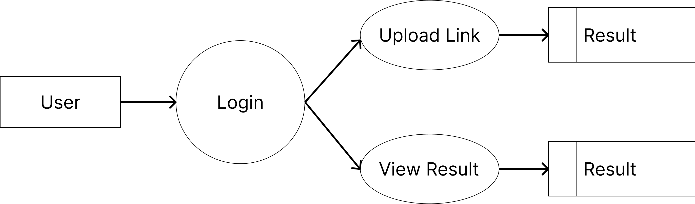
Methodology
Data Flow Diagram Level 1

Slide 12
Methodology
Flow of Model
Web Crawling
Collecting Data
Data Pre-processing
Splitting Data into Training and Testing
Model Training
Comparison of Accuracies and Selecting the Best Model
Data Extraction
Model Training
LSTM and
BiLSTM

Slide 13
Methodology
Dataset
Collection of websites and their corresponding categories.
The dataset contains a total of 16 categories.
Algorithms for Training
LSTM
BiLSTM
The accuracy of both LSTM and BiLSTM models is assessed on the same dataset to determine which algorithm performs better for website category classification tasks.

Slide 14
Methodology
LSTM
Effective for processing sequential data.
LSTM has been widely used in various applications such as speech recognition and natural language processing.
It consists of an input layer, LSTM layer with hidden units, and an output layer using softmax activation for multi-class classification.

Slide 15
Methodology
BiLSTM
BiLSTM is a variant of LSTM that processes data in both forward and backward directions.
It uses two LSTM layers, with one analyzing the data forward and the other backward.
The outputs from the two layers are combined to create the final output for classification.

Slide 16
Implementation Status and Plan
Sl No | Tasks | Status | Completion Date
01 | Literature Review | Completed | //2023
02 | GUI Interface design | Completed | //2023
03 | Data Collection | Completed | //2023
04 | Preprocessing of data | Completed | //2023
05 | Model Selection | Completed | //2023
06 | Model Building | Completed | //2023
07 | Training | Ongoing | //2024
08 | Testing | Ongoing | //2024

Slide 17
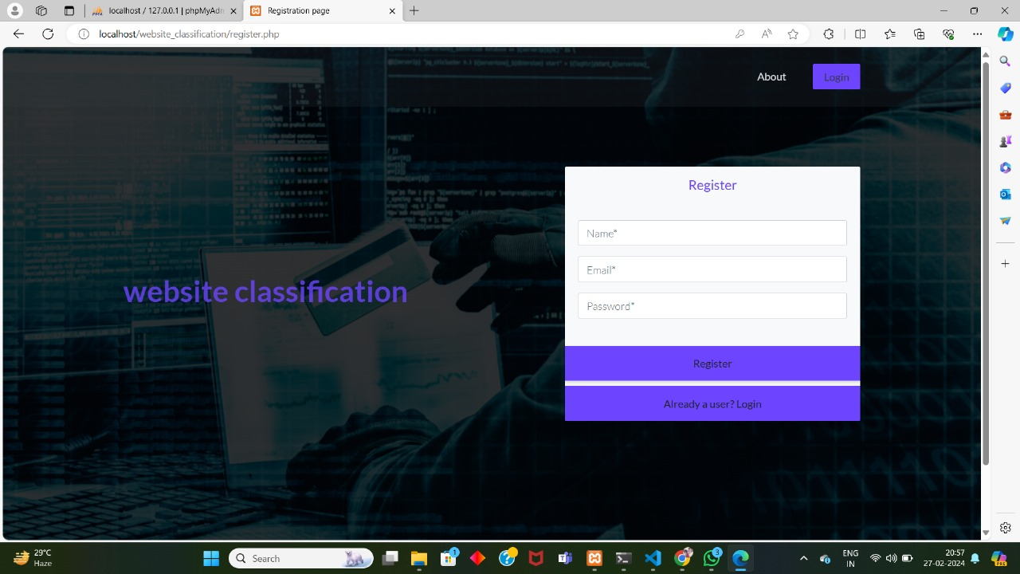
Screenshots
Registration Page

Slide 18
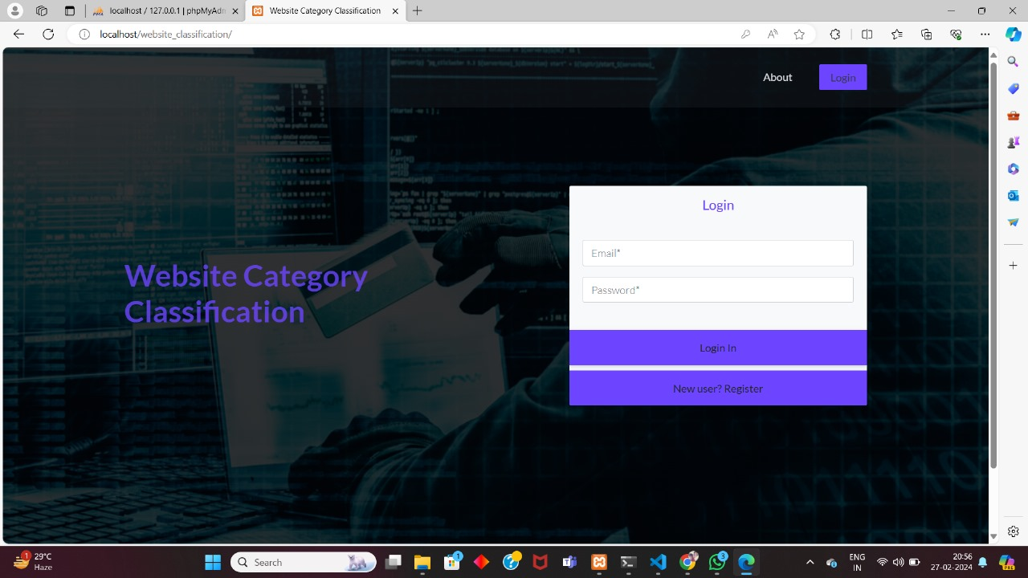
Screenshots
Login Page

Slide 19
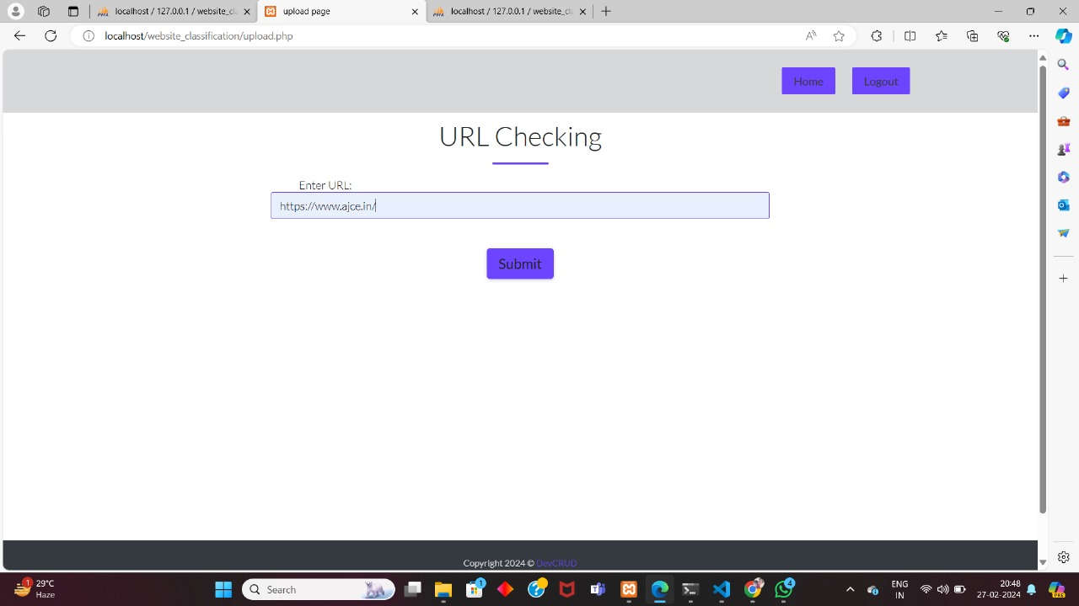
Screenshots
Upload Page

Slide 20
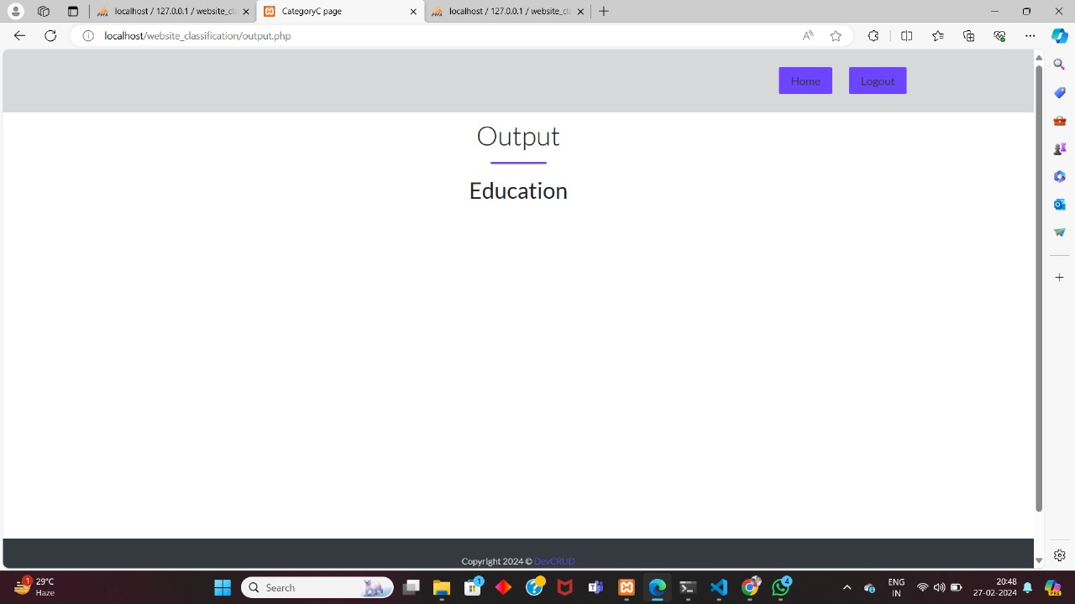
Screenshots
Upload Page

Slide 21
Testing and validation
Sl No | Website URL | Expected Output | Processed Output
01 | https://www.travelocity.com/ | Travel | Travel
02 | http://www.sexstories-archive.com/ | Adult | Adult
03 | https://www.ajce.in/ | Education | Education
04 | http://www.chessdom.com/ | Games | Games
05 | https://olivebarandkitchen.com/ | Food | Food
06 | https://www.cbsnews.com/ | News | News
07 | https://www.cnbc.com/ | Business/Corporate | Business/Corporate
08 | https://www.amazon.com/ | E-Commerce | E-Commerce
09 | http://fusionlayer.com/ | Computers and Technology | Computers and Technology
10 | https://www.flirt.com/ | Social Networking and Messaging | Social Networking and Messaging

Slide 22
Testing and validation
Sl No | Website URL | Expected Output | Processed Output
11 | https://tv.youtube.com/ | Streaming Services | Streaming Services
12 | https://www.cbssports.com/ | Sports | Sports
13 | https://www.eevblog.com/ | Forums | Forums
14 | https://www.bodybuilding.com/ | Health and Fitness | Health and Fitness
15 | https://www.interpol.int/en | Law and Government | Law and Government
16 | https://www.popphoto.com/ | Photography | Photography
17 | https://www.tripadvisor.com/ | Travel | Travel
18 | https://mail.google.com/ | Computers and Technology | Computers and Technology
19 | https://m.facebook.com/ | Business/Corporate | Business/Corporate
20 | https://www.spotify.com/ | Business/Corporate | Business/Corporate

Slide 23
Results and Discussion
Evaluated the model’s performance and compared the accuracy of BiLSTM and LSTM algorithms.
BiLSTM algorithm achieved 99% accuracy.
LSTM algorithm achieved 81% accuracy.
BiLSTM algorithm demonstrated superior performance in handling complex sequential data.

Slide 24
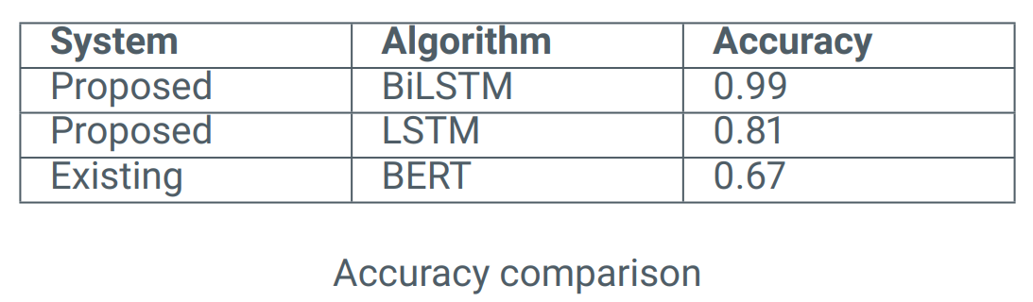
Results and Discussion
Comparison with Existing System

Slide 25
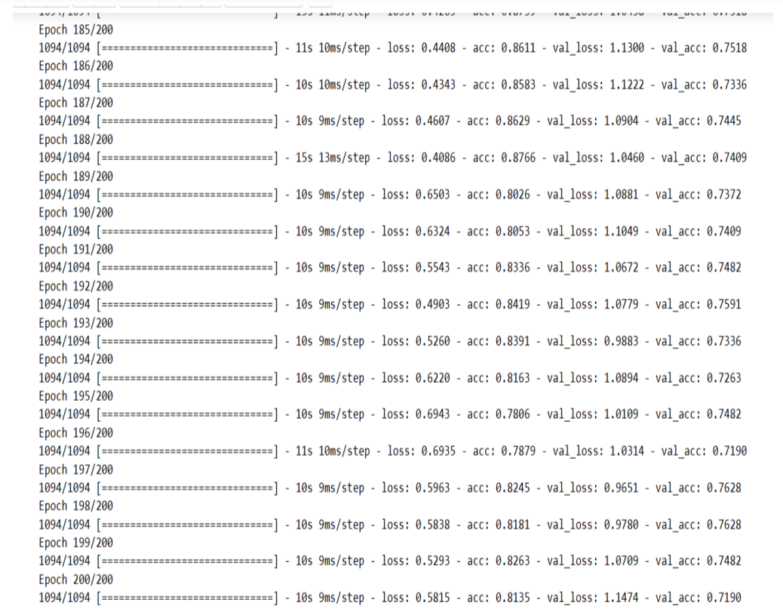
Results and Conclusion
Accuracy of LSTM

Slide 26
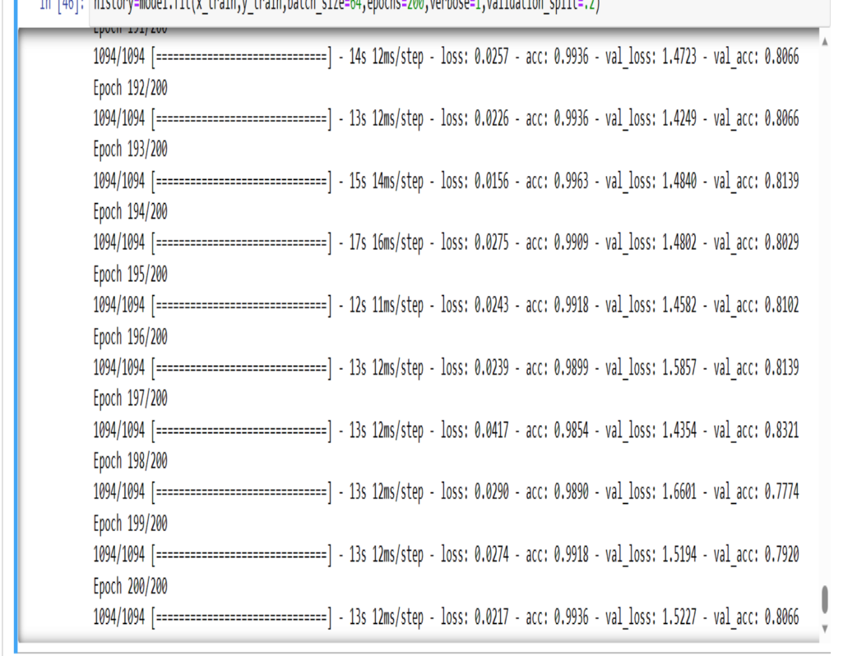
Results and Conclusion
Accuracy of BiLSTM

Slide 27
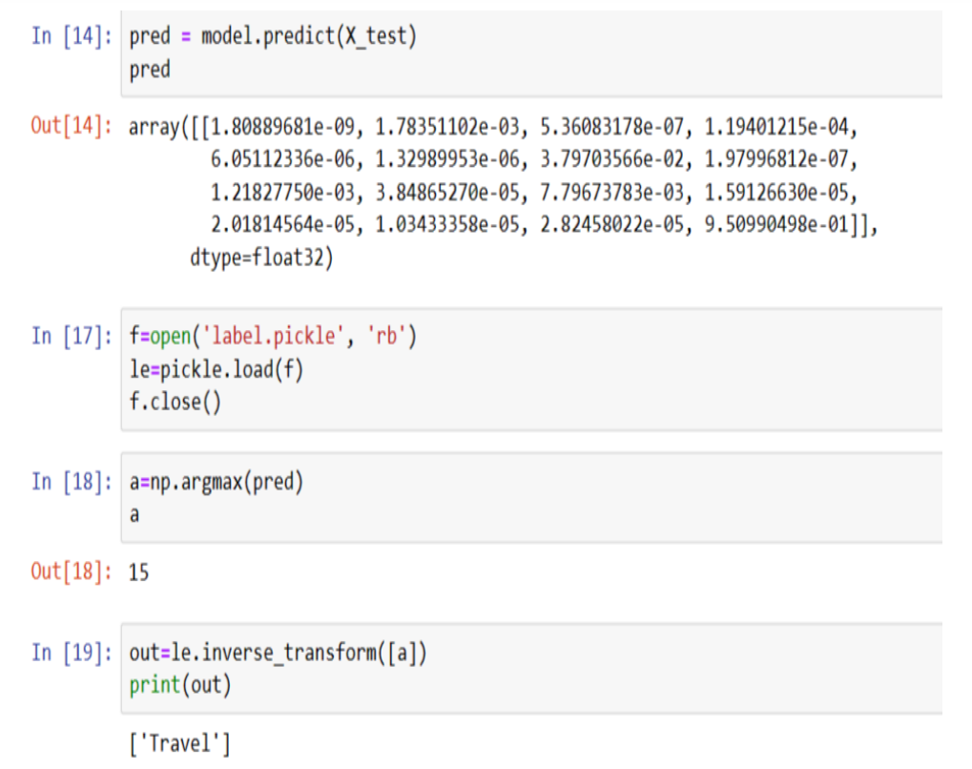
Results and Conclusion
Test Result Using BiLSTM

Slide 28
Conclusion
Developed a reliable machine learning model using BiLSTM to categorize websites and protect users from harmful content with 99% accuracy.
Outperformed the traditional LSTM algorithm, which achieved 81% accuracy in website classification.
Proposed algorithm benefits internet service providers, parents, schools, and organizations in safeguarding web users and creating a safer online environment.
BiLSTM’s bi-directional processing of sequential data captured complex patterns, resulting in more accurate and efficient website classification.
Some websites lack SSL certificates, leading to category inaccuracies.

Slide 29
Future Scope
Website classification can be expanded to include diverse web material such as photographs and videos.
The developed website classification model can be utilized as a browser extension to provide content warnings to users.
Exploring innovative solutions to SSL certificate issues.

Slide 30
Thank You.

