Slide 1
Code Score App Project Preview
By Seth West
snw6@uw.edu
Github: theuwtseth
CodePen: uwtseth
Code Alliance/CHI4Good Day of Service
May 7, 2016

Slide 2
Project Team
Deep Datta – Project Coordinator
Seth West – Point Person
Nick Sellen – Technical Guru
You – Code Warriors!!!

Slide 3
Overview
Project At a Glance
Work Completed So Far
Work To Be Done

Slide 4
Project at a Glance
“Code Score”
Open source survey app for nonprofits
Gauge participant feedback at hackathons/coding events

Slide 5
Project at a Glance (cont.)
User Requirements
Survey admin can add questions of any style (open-ended, quantitative, qualitative, etc.)
Admin can group related questions into sets
Admin can set arbitrary percentage weights for question sets out of 100%
Example: Three sets of questions, set 1 is 45% of survey total weight, set 2 is 30%, and set 3 is 25%
Admin can set arbitrary relative percentage weights within each question set out of 100%
Example: Set 1 has 3 questions, question 1 is 45% of set weight, question 2 is 30%, and question 3 is 25%
Admin can adjust survey questions and weights in real-time

Slide 6
Project at a Glance (cont.)
Technical Requirements
Client-side technologies:
HTML
CSS
AngularJS
Server-side technologies:
Apache/XAMPP/etc.
PHP
MySQL
Usability/UX
Security

Slide 7
Project at a Glance (cont.)
User assumptions:
Admins need no more than 8 question sets
We don’t care about the questions, only about implementing functionality
Technical assumptions:
Question and answer entry can use text input
Initial usage on individual machine
Database attached
Desktop-based system

Slide 8
Project at a Glance (cont.)
Constraints/Limitations:
Major development phase limited to today
Some members joining via Skype, contingent on time zone difference and Internet connection
Unknowns:
Only worked in Firefox on my end when not running web server
Ran fine on my end when running web server
Other considerations:
Backbone.JS and other lightweight client-side database frameworks not suitable
Laravel suggested for PHP/MySQL development

Slide 9
Work Done So far
Implemented basic skeleton form of user interface for survey editing, with HTML, CSS and AngularJS functionality
Ability to switch from edit mode to live survey mode
Ability to set questions, set weights, and question weights
Ability for user to fill out all 8 sets or fewer
Currently displays user-entered data on bottom of screen
Begun implementing PHP functionality
Wrote initial scope document
Prepared this PowerPoint project summary preview

Slide 10
Work to Be Done
Each team member: fork into codescore directory on CodeAlliance Github repo if haven’t already
Implement client-side to server-side functionality
Finish PHP post from HTML/CSS/Angular to MySQL for storing saved surveys
Server-side validation (to prevent XSS/XSF, SQL injection, etc.)
Setup of web server/database (Apache, XAMPP, Heroku, AWS, localhost?)
Implement survey administration
PHP get from database for participant response to saved surveys
PHP post to database of survey responses
Edits to code as needed/suggested for style, formatting, functionality, usability, etc.
Directives for survey edits on single HTML page (suggested)
Capability to dynamically add/remove number of questions in each set (open to consideration)
Scroll boxes? Single page vs. multi-page? PHP/HTML or all PHP? Other edits?
Draft documentation
Excerpts for May 8, 2016 conference plenary (important)
Others as needed/suggested: Manuals? Diagrams?

Slide 11
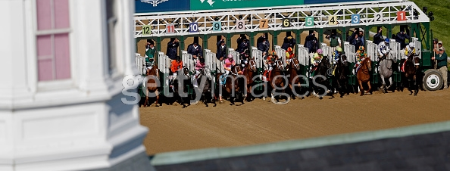
Questions/Go Time
“Ask and ye shall receive”
“Carpe diem”
Image courtesy:
http://cache1.asset-cache.net/xc/471856922-the-pack-sprints-out-of-the-starting-gate
-during-the.jpg?v=2&c=IWSAsset&k=2&d=GkZZ8bf5zL1ZiijUmxa7QWgrBDeC2DY
QKvvrl1c1e7PcDMgFqLs6paldr06NJifm0&b=RDE=

