Slide 1
Unit – 4
Java Server Pages
Santushti Betgeri
Assistant Professor
Dept. of CE

Slide 2
Content
Introduction to JSP
Comparison with Servlet
JSP Architecture
JSP: Life Cycle
Scripting Elements
Directives
Action Tags
Implicit Object
Expression Language(EL)
JSP Standard Tag Libraries(JSTL)
Custom Tag
Session Management
Exception Handling
CRUD Application

Slide 3
Introduction to JSP
JSP Stands for Java Server Pages.
A JSP page consists of HTML tags and JSP tags.
The JSP pages are easier to maintain than servlet because we can separate designing and development logic.
JSP is a server side scripting language.

Slide 4
Introduction to JSP
Example code showing different types of JSP Tags:
<%-- Counter.jsp --%> <%-- Comment Tag --%>
<%@ page language="java" %> <%-- Directive Tag --%>
<%! int count = 0; %> <%-- Declaration Tag --%>
<% count++; %> <%-- Scriptlet Tag --%>
Welcome! You are visitor number
<%= count %> <%-- Expression Tag --%>

Slide 5
Problems with Servlet
Inside the one and only one class in servlet alone, we will perform various task:
Acceptance of request
Process the request
Handling the business logic
Generation of response
For creating a servlet knowledge of java and html both is needed.
While developing an app if the look and feel of program changes we have to change the entire servlet class.

Slide 6
Advantage of JSP over Servlet
There are many advantages of JSP over servlet. They are as follows:
Extension to Servlet
JSP technology is the extension to servlet technology. We can use all the features of servlet in JSP. In addition to, we can use implicit objects, predefined tags, expression language and Custom tags in JSP, that makes JSP development easy.
Easy to maintain
JSP can be easily managed because we can easily separate our business logic with presentation logic. In servlet technology, we mix our business logic with the presentation logic.

Slide 7
Advantage of JSP over Servlet
Fast Development: No need to recompile and redeploy
If JSP page is modified, we don't need to recompile and redeploy the project. The servlet code needs to be updated and recompiled if we have to change the look and feel of the application.
Less code than Servlet
In JSP, we can use a lot of tags such as action tags, jstl, custom tags etc. that reduces the code. Moreover, we can use EL, implicit objects etc.

Slide 8
JSP VS SERVLET
Sr. No. | JSP | SERVLET
1 | JSP is a scripting language which generates dynamic content | Servlet are java program that can be compiled to generate dynamic content
2 | JSP runs slower than servlet | Servlet runs faster than JSP
3 | In MVC JSP acts as view. | In MVC Servlet acts as controller.
4 | JSP can build custom tags | No facility for creating custom tags
5 | It is easier to code a JSP | The servlet are basically complex java programs

Slide 9
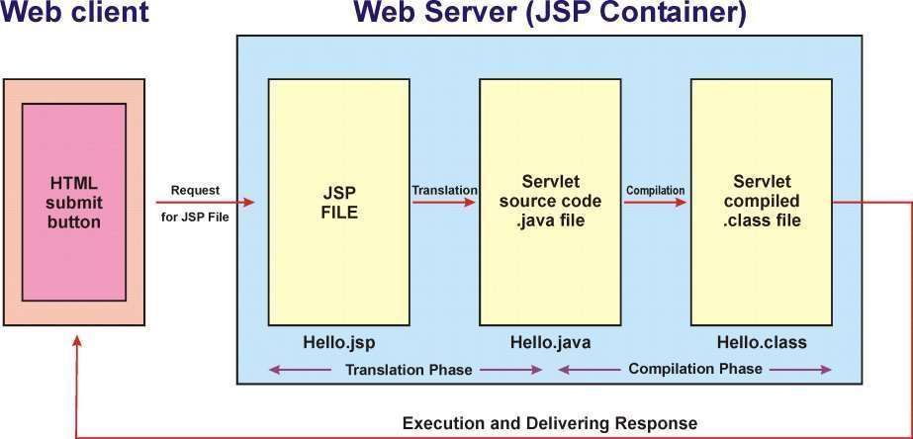
JSP Architecture

Slide 10
JSP Architecture
Following steps includes the JSP Architecture as shown in the above figure.
Web client sends request to Web server for a JSP page (extension .jsp).
As per the request, the Web server (here after called as JSP container) loads the page.
JSP container converts (or translates) the JSP file into Servlet source code file (with extension .java). This is known as translation.
The translated .java file of Servlet is compiled that results to Servlet .class file. This is known as compilation.
The .class file of Servlet is executed and output of execution is sent to the client as response.

Slide 11
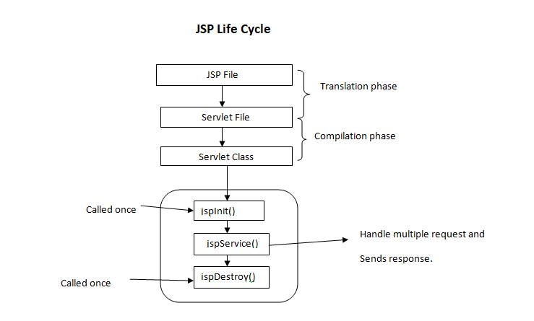
JSP Architecture
Translation of JSP page to Servlet
Compilation of JSP page(Compilation of JSP into test.java)
Classloading (test.java to test.class)
Instantiation(Object of the generated Servlet is created)
Initialization(jspInit() method is invoked by the container)
Request processing(jspService()is invoked by the container)
JSP Cleanup (jspDestroy() method is invoked by the container)

Slide 12
First JSP Program
Write a program to print hello using JSP.
Step 1: In NetBeans Start new Project. Give name “FirstJsp”
Step 2: Right click on web page folder add new JSP file. Name it as MyJsp
Step 3: Add below line in <body> tag
<h1>Hello From JSP</h1>
Step 4: Run File

Slide 13
JSP DIRECTIVES
The JSP
directives are messages that tells the web
container how to translate a JSP page into the corresponding
servlet.
There are three types of directives:
page directive
include directive
taglib directive
Syntax of JSP Directive
<%@ directive attribute="value" %>

Slide 14
1.PAGE DIRECTIVE
The page directive defines attributes that apply to an entire JSP page.
import,
contentType,
extends,
info,
buffer,
isELIgnored
language,
errorPage,
isErrorPage
IsThreadSafe,

Slide 15
import
The import attribute is used to import class, interface or all the members of a package. It is similar to import keyword in java class or interface.
<html>
<body>
<%@ page import="java.util.Date" %>
Today is: <%= new Date() %>
</body>
</html>

Slide 16
contentType
The contentType attribute defines the MIME (Multipurpose Internet Mail Extensions) type of the HTTP response.
The default value is “text/html”.
<html>
<body>
<%@ page contentType=text/html %>
</body>
</html>

Slide 17
Buffer
The buffer attribute sets the buffer size in kilobytes to handle output generated by the JSP page.
The default size of the buffer is 8Kb.
<html>
<body>
<%@ page buffer="16kb" %>
Today is: <%= new java.util.Date() %>
</body>
</html>

Slide 18
Example
Prog 2: Use import, contentType and buffer JSP PAGE Directive
<%@page contentType="text/html" pageEncoding="UTF-8"%>
<!DOCTYPE html>
<html>
<head>
<title>Import,contentType and buffer tag Example</title>
</head>
<body>
<%@page buffer="16kb" %>
<%@ page import="java.util.Date" %>
Today is: <%= new Date() %>
</body>
</html>

Slide 19
isThreadSafe
Servlet and JSP both supports multithread.
If you want to control this behaviour of JSP page, you can use
isThreadSafe attribute of page directive.
The value of isThreadSafe value is true.
If you make it false, the web container will serialise the multiple requests, i.e. it will wait until the JSP finishes responding to a request before passing another request to it.
Its syntax is:
<%@ page isThreadSafe="false" %>

Slide 20
info
This attribute simply sets the information of the JSP page.
<html>
<body>
<%@ page info="Composed by RK KEYNOTES" %>
Today is: <%= new java.util.Date() %>
</body>
</html>

Slide 21
errorPage
The errorPage attribute is used to define the error page, if exception occurs in the current page, it will be redirected to the error page.
index.jsp
<html>
<body>
<%@ page errorPage="myerrorpage.jsp" %>
<%= 100/0 %>
</body>
</html>

Slide 22
isErrorPage
The isErrorPage attribute is used to declare that the current page is the error page.
myerrorpage.jsp
<html>
<body>
<%@ page isErrorPage="true" %>
Sorry an exception occured!<br/>
The exception is: <%= exception %>
</body>
</html>

Slide 23
isELIgnored
We can ignore the Expression Language (EL) in jsp by the isELIgnored attribute.
By default its value is false i.e. Expression Language is
enabled by default.
Syntax:
<%@ page isELIgnored="true" %>//Now EL will be ignored

Slide 24
language
The language attribute specifies the scripting language used in the JSP page. The default value is "java".
Extends
The extends attribute defines the parent class that will be inherited by the generated servlet. It is rarely used.

Slide 25
2. JSP Include Directive
The include directive is used to include the contents of any resource
it may be jsp file, html file or text file.
Syntax of include directive
<%@ include file="resourceName" %>

Slide 26
Example
In this example, we are including the content of the index.html file in a include_action.jsp page.
<html>
<body>
<%@ include file="index.html" %>
</body>
</html>

Slide 27
3. JSP Taglib directive
This directive allows user to use custom tags in JSP. The custom tags
are those that are created by user.
Syntax JSP Taglib directive:
<%@ taglib uri="uriofthetaglibrary" prefix="prefixoftaglibrary" %>

Slide 28
JSP SCRIPTING ELEMENTS
There are three types of scripting elements:
scriptlet tag
expression tag
declaration tag

Slide 29
1. scriptlet tag
In JSP, java code can be written inside the jsp page using the scriptlet tag.
Syntax:
<%
………………………………
……………………. ………….
%>

Slide 30
Example
welcome.jsp
<html>
<body>
<%
String name=request.getParameter ("uname");
out.print("welcome "+name);
%>
</body>
</html>
index.html
<html>
<body>
<form action="welcome.jsp">
<input type="text" name="uname">
<input type="submit" value="go">
<br/>
</form>
</body>
</html>

Slide 31
2. JSP expression tag
The code placed within JSP expression tag is written to the output
stream of the response.
Syntax of JSP expression tag:
<%= statement %>

Slide 32
Example
<html>
<body>
Expression: <%= java.util.Calendar.getInstance().getTime() %>
</body>
</html>

Slide 33
Example
index.html
<html>
<body>
<form action="welcome.jsp">
<input type="text" name=“uname">
<input type="submit" value="go">
<br/>
</form>
</body>
</html>
welcome.jsp
<html>
<body>
<%= "Welcome "+request.getParameter("uname") %>
</body>
</html>

Slide 34
3. JSP Declaration Tag
The JSP declaration tag is used to declare fields and methods. Syntax of JSP declaration tag
The syntax of the declaration tag is as follows:
<%! field or method declaration %>
Example: index.jsp
<html>
<body>
<%! int data=50; %>
<%= "Value of the variable is:"+data %>
</body>
</html>

Slide 35
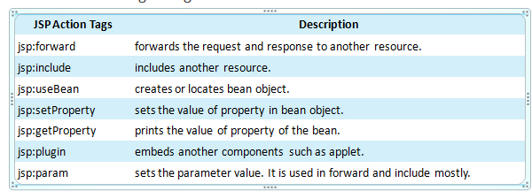
JSP Action Tag
The action tags are used to control the flow between pages and to use Java Bean.
The JSP action tags are given below:
Notes:
According to Java white paper, it is a reusable software component. A bean encapsulates many objects into one object so that we can access this object from multiple places. Moreover, it provides easy maintenance.

Slide 36
FORWARD ACTION AND PARAM TAG:
The jsp:forward action tag is used to forward the request to another resource it may be jsp, html or another resource.
Syntax of jsp:forward action tag:
<jsp:forward page="relativeURL">
<jsp:param name="parametername" value="parametervalue" />
</jsp:forward>
OR
<jsp:forward page="relativeURL“/>

Slide 37
Example
second.html
<html>
<head>
<title>TODO supply a title</title>
</head>
<body>
<h1>You are in a forwarded page</h1>
</body>
</html>
index.jsp
<%@page contentType="text/html"
pageEncoding="UTF-8"%>
<!DOCTYPE html>
<html>
<head>
<title>JSP Page</title>
</head>
<body>
<h1>This page contains forward</h1>
<jsp:forward page="second.html"/>
</body>
</html>

Slide 38
INCLUDE ACTION
Using the <jsp:include> action we can include different files in current
jsp page.
Example: ( files = index.html , newjsp.jsp, includejsp.jsp) index.html
<!DOCTYPE html>
<html>
<head>
<title>TODO supply a title</title>
</head>
<body>
<h3>This is a html page</h3>
</body>
</html>

Slide 39
Example
Example: ( files = index.html , newjsp.jsp, includejsp.jsp)
newjsp.jsp
<%@page contentType="text/html" pageEncoding="UTF-8"%>
<!DOCTYPE html>
<html>
<head> <title>JSP Page</title> </head>
<body>
<%--returns hour--%>
<br> Time is <%= new java.util.Date().getHours() %>
<%--returns min--%>
: <%= new java.util.Date().getMinutes()%>
<%--returns sec--%>
: <%= new java.util.Date().getSeconds()%>
</body>
</html>

Slide 40
Example
Example: ( files = index.html , newjsp.jsp, includejsp.jsp)
includejsp.jsp
<%@page contentType="text/html" pageEncoding="UTF-8"%>
<!DOCTYPE html>
<html>
<head>
<title>JSP Page</title>
</head>
<body>
<h1>This page contains include action</h1>
<jsp:include page="index.html"/>
<jsp:include page="newjsp.jsp"/>
</body>
</html>

Slide 41
jsp:useBean action tag
The jsp:useBean action tag is used to locate or instantiate a bean class.
If bean object of the Bean class is already created, it doesn't create the bean depending on the scope.
But if object of bean is not created, it instantiates the bean.
<jsp:useBean id= "instanceName" scope= "page | request | session | appli
cation" class= "packageName.className" " >
</jsp:useBean>

Slide 42
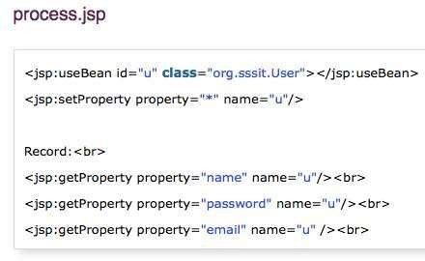
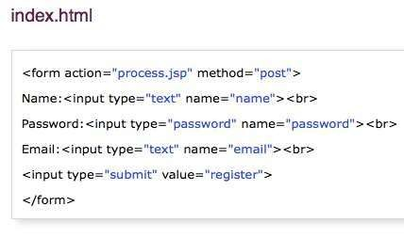
jsp:setProperty and jsp:getProperty action tags
The setProperty and getProperty action tags are used for developing web
application with Java Bean.
Example ( Files : index.html , process.jsp, user.java)

Slide 43
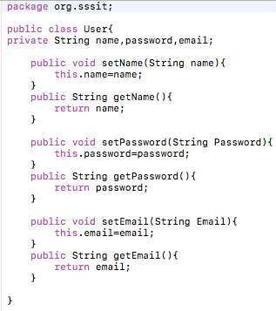
Example
User.java

Slide 44
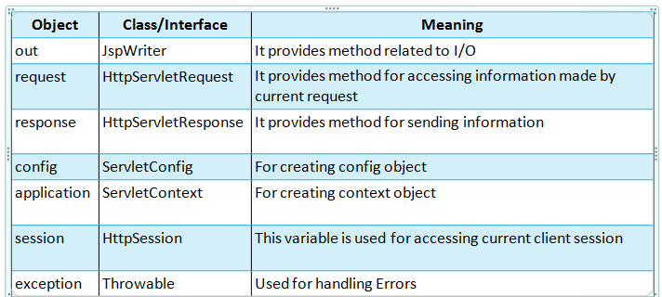
JSP implicit Objects
The implicit objects are pre-defined variable used to access request and application data. JSP implicit objects are:

Slide 45
JSP Session Objects
session is an implicit object of type HttpSession. The Java developer can use this object to set, get or remove attribute or to get session information.
Example files required → index.html, welcome.jsp , second.jsp
index.html
<html>
<body>
<form action="welcome.jsp">
<input type="text" name="uname">
<input type="submit" value="go">
<br/>
</form>
</body>
</html>

Slide 46
JSP Session Example
welcome.jsp
<html>
<body>
<%
String name=request.getParameter("uname"); out.print("Welcome "+name); session.setAttribute("user",name);
<a href="second.jsp">second jsp page</a>
%>
</body>
</html>

Slide 47
JSP Session Example
second.jsp
<html>
<body>
<%
String name=(String)session.getAttribute("user");
out.print("Hello "+name);
%>
</body>
</html>

Slide 48
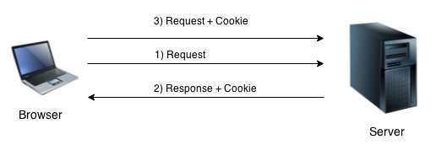
JSP Cookie Handling
By default, each request is considered as a new request. In cookies technique, we add cookie with response from the Server. So cookie is stored in the cache of the browser.
After that if request is sent by the user, cookie is added with request by default. Thus, we recognize the user as the old user.

Slide 49
JSP Cookie Handling
Cookies are small text file that are stored in the client computer. These are
basically used to keep track of user who browse the web.
The info stored in the cookie are generally name, age , id, city and so on.
The servlet container sends a set of cookies to the web browser. The browser stores the cookies on the local machine and makes use of this information next time when the browser is browsing the web.
Cookies are usually set in HTTP header.
Advantage of Cookies:
Simplest technique of maintaining the state.
Cookies are maintained at client side.
Disadvantage of Cookies:
It will not work if cookie is disabled from the browser.

Slide 50
Example: to create, delete and read cookies
Files needed → index.html, createcookie.jsp, readcookie.jsp, deletecookie.jsp
index.html
<html>
<head>
<title>TODO supply a title</title>
</head>
<body>
<form action="createCookie.jsp" method="post"> USERNAME:<input type="text" name="name"><br> CITY:<input type="text" name="city"><br>
<input type="submit" value="submit">
</form>
</body>
</html>

Slide 51
Cookie in JSP
createCookie.jsp
<body>
<%
String name = request.getParameter("name");
String city = request.getParameter("city");
Cookie nameCookie = new Cookie("name", name); //creating cookie object
Cookie cityCookie = new Cookie("city", city);
//creating cookie object
response.addCookie(nameCookie); //adding cookie in the response
response.addCookie(cityCookie);
//adding cookie in the response
nameCookie.setMaxAge(60*60*24);
cityCookie.setMaxAge(60*60*24);
%>
//changing the maximum age
//changing the maximum age
<a href="readCookie.jsp" >Click here</a> to read the cookies
</body>

Slide 52
Example
readCookie.jsp
<body>
<h3>Reading the cookie</h3>
<%
Cookie [] cookies = request.getCookies();
for(int i =0;i<cookies.length;i++)
{
//return all the cookies from the browser
//printing name and value of cookie
out.println("Cookie_name"+cookies[i].getName()+"<br>");
out.println("Cookie_value"+cookies[i].getValue()+"<br>");
}
%>
<a href="deletecookies.jsp">Click here</a>To delete the cookie..!!
</body>

Slide 53
Example
deleteCookie.jsp
<body>
<%
Cookie nameCookie = new Cookie("name", ""); nameCookie.setMaxAge(0); nameCookie.setValue(""); response.addCookie(nameCookie);
Cookie cityCookie = new Cookie("city", ""); cityCookie.setMaxAge(0); cityCookie.setValue(""); response.addCookie(cityCookie);
%>
<a href="readCookie.jsp">Click here</a> to check the deletion..!!
</body>

Slide 54
JSP Expression Language
The Expression Language (EL) simplifies the accessibility of data stored in the Java Bean component, and other objects like request, session, application etc.
There are many implicit objects, operators and reserve words in EL.
Syntax:
${ expression }

Slide 55
JSP Expression Language
Implicit Objects | Usage
pageScope | it maps the given attribute name with the value set in the page scope
requestScope | it maps the given attribute name with the value set in the request scope
sessionScope | it maps the given attribute name with the value set in the session scope
applicationScope | it maps the given attribute name with the value set in the application scope
param | it maps the request parameter to the single value
paramValues | it maps the request parameter to an array of values
header | it maps the request header name to the single value
headerValues | it maps the request header name to an array of values
cookie | it maps the given cookie name to the cookie value
initParam | it maps the initialization parameter
pageContext | it provides access to many objects request, session etc.

Slide 56
EL Param Example
In this example, we have created two files index.jsp and process.jsp. The index.jsp file gets input from the user and sends the request to the process.jsp which in turn prints the name of the user using EL.
index.jsp
<form action="process.jsp">
Enter Name:<input type="text" name="name" /> <br/><br/>
<input type="submit" value="go"/>
</form>
process.jsp
Welcome, ${ param.name }

Slide 57
EL sessionScope example
In this example, we printing the data stored in the session scope using EL.
For this purpose, we have used sessionScope object.
index.jsp
<h3>welcome to index page</h3>
<%
session.setAttribute(“user”, ”RK Keynotes!!”);
%>
<a href="process.jsp">visit</a>
process.jsp
Value is ${ sessionScope.user }

Slide 58
EL cookie example
index.jsp
<h1>First JSP</h1>
<%
Cookie ck=new Cookie(“name”,”RK Keynotes!”);
response.addCookie(ck);
%>
<a href="process.jsp">click</a>
process.jsp
Hello, ${cookie.name.value }

Slide 59
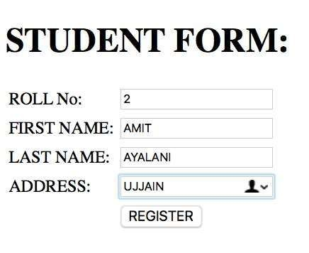
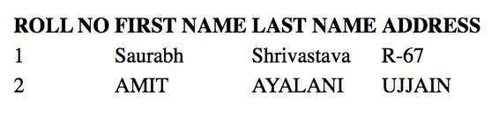
JSP DATABASE ACCESS
index.html
newjsp.jsp
……………
…………..
……………
………….
Database
Web Browser

Slide 60
Example : JSP-JDBC
Files needed → index.html, newjsp.jsp
<h1>STUDENT FORM:</h1>
<form action="newjsp.jsp" method="GET">
<table>
<tr>
index.html
<td>ROLL No:</td><td><input type="text" name="rollno" ></td>
</tr>
<tr>
<td>FIRST NAME:</td><td><input type="text" name="fname" ></td>
</tr>
<tr>
<td>LAST NAME:</td><td><input type="text" name="lname" ></td>
</tr>
<tr>
<td>ADDRESS:</td><td><input type="text" name="addr" ></td>
</tr>
<tr>
<td></td><td><input type="submit" value="REGISTER" ></td>
</tr>
</table>
</form>

Slide 61
Example
newjsp_1.jsp
<%@page language="java" import="java.sql.*" %>
<%@page import="java.io.*" %>
<%@page contentType="text/html" pageEncoding=“UTF-8”%>
<html>
<body>
<table>
<tr>
<td><b>ROLL NO</b></td>
<td><b>FIRST NAME</b></td>
<td><b>LAST NAME</b></td>
<td><b>ADDRESS</b></td>
</tr>

Slide 62
Example
<%
//read request parameter
String rollno = request.getParameter("rollno");
String fname = request.getParameter("fname"); String lname = request.getParameter("lname"); String addr = request.getParameter("addr");
//initialize variable of driver
String driverClassName="com.mysql.jdbc.Driver"; String url="jdbc:mysql://localhost:3306/mu"; String user="root";
String pwd="";
//register jdbc driver or load driver
Class.forName(driverClassName).newInstance();

Slide 63
Example
//Open connection
Connection con=DriverManager.getConnection(url,user,pwd);
//making a prepared statement
PreparedStatement ps = con.prepareStatement("insert into student values(?,?,?,?)");
ps.setString(1, rollno); ps.setString(2, fname); ps.setString(3, lname); ps.setString(4, addr);
int p = ps.executeUpdate();
PreparedStatement st = con.prepareStatement("select * from
student");

Slide 64
Example
ResultSet rs= st.executeQuery();
while(rs.next()){
%>
<tr>
<td><%= rs.getString("rollno") %></td>
<td><%= rs.getString("fname") %></td>
<td><%= rs.getString("lname") %></td>
<td><%= rs.getString("addr") %></td>
</tr>
<%
}
out.print("</table>");
rs.close();
ps.close();
st.close();
con.close();
%>
</table> </body> </html>

Slide 65
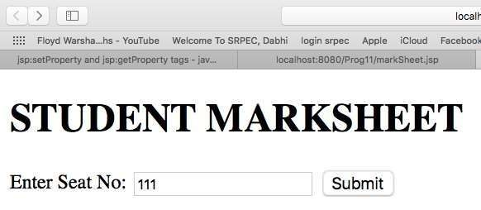
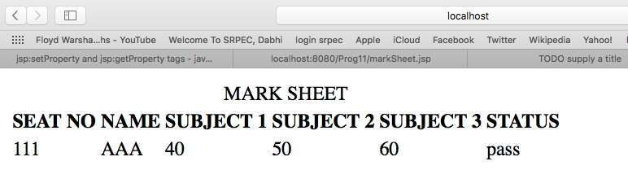
Exercise
Write a JSP to display semester mark sheet. Give necessary file to deploy it.

Slide 66
JSP Standard Tag Library (JSTL)
The JSP Standard Tag Library (JSTL) represents a set of tags to simplify the JSP development.
Advantage of JSTL:
Fast Developement: JSTL provides many tags that simplifies the JSP.
Code Reusability: We can use the JSTL tags in various pages.
No need to use scriptlet tag: It avoids the use of scriptlet tag.

Slide 67
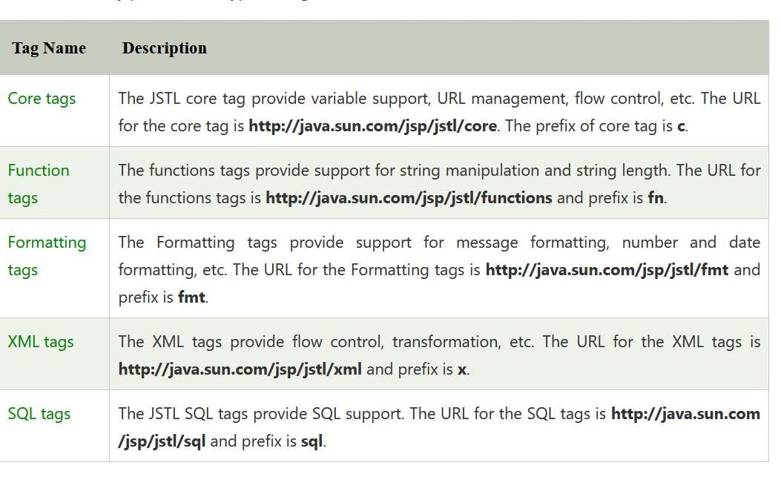
JSTL Tags

Slide 68
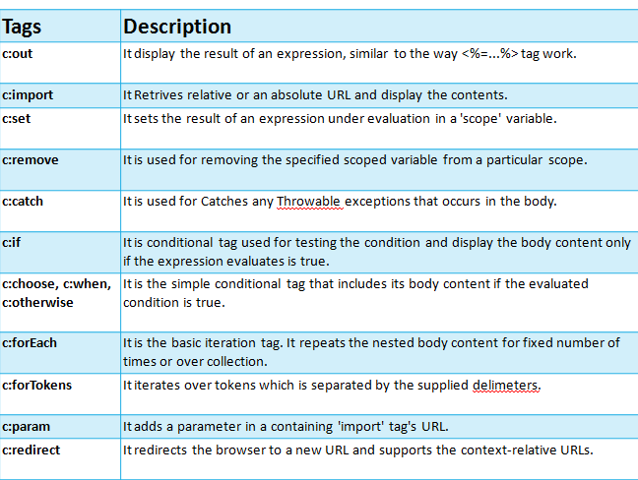
JSTL Core Tags

Slide 69
JSTL Core <c:out> Tag
The <c:out> tag is similar to JSP expression tag. It will display the result of an expression, similar to the way < %=...% > work.
<%@ taglib uri="http://java.sun.com/jsp/jstl/core" prefix="c" %>
<html>
<head>
<title>Tag Example</title>
</head>
<body>
<c:out value="${'Welcome to JSTL'}"/>
</body>
</html>

Slide 70
JSTL Core <c:set> Tag
It is used to set the result of an expression evaluated in a 'scope'. The <c:set> tag is helpful
because it evaluates the expression and use the result to set a value of JavaBean.
<%@ taglib uri="http://java.sun.com/jsp/jstl/core" prefix="c" %>
<html>
<head>
<title>Core Tag Example</title>
</head>
<body>
<c:set var="Income" scope="session" value="${4000*4}"/>
<c:out value="${Income}"/>
</body>
</html>

Slide 71
JSTL Core <c:remove> Tag
It is used for removing the specified variable from a particular scope.
<%@ taglib uri="http://java.sun.com/jsp/jstl/core" prefix="c" %>
<html>
<head>
<title>Core Tag Example</title>
</head>
<body>
<c:set var="income" scope="session" value="${4000*4}"/>
<p>Before Remove Value is: <c:out value="${income}"/></p>
<c:remove var="income"/>
<p>After Remove Value is: <c:out value="${income}"/></p>
</body>
</html>

Slide 72
JSTL Core <c:if> Tag
The < c:if > tag is used for testing the condition and it display the body
content, if the expression evaluated is true.
<%@ taglib uri="http://java.sun.com/jsp/jstl/core" prefix="c" %>
<html>
<body>
<c:set var="income" scope="session" value="${4000*4}"/>
<c:if test="${income > 8000}">
<p>My income is: <c:out value="${income}"/><p>
</c:if>
</body>
</html>

Slide 73
JSTL Core <c:catch> Tag
It is used for Catches any Throwable exceptions that occurs in the body and optionally exposes it. In general it is used for error handling and to deal more easily with the problem occur in program.
<%@ taglib uri="http://java.sun.com/jsp/jstl/core" prefix="c" %>
<html>
<head>
<title>Core Tag Example</title>
</head>
<body>
<c:catch var ="catchtheException">
<% int x = 2/0;%>
</c:catch>
<c:if test = "${catchtheException != null}">
<p>The type of exception is : ${catchtheException} </p>
</c:if>
</body>
</html>

Slide 74
JSTL Core <c:choose>,
<c:when>, <c:otherwise> Tag
The <c:choose> tag is a conditional tag that establish a context for mutually exclusive conditional operations. It works like a Java switch statement in which we choose between a numbers of alternatives.
The <c:when > is subtag of <choose > that will include its body if the condition evaluated be 'true'.
The < c:otherwise > is also subtag of < choose > it follows & <when >
tags and runs only if all the prior condition evaluated is 'false'.
The c:when and c:otherwise works like if-else statement. But it must be
placed inside c:choose tag.

Slide 75
Example
<%@ taglib uri="http://java.sun.com/jsp/jstl/core" prefix="c" %>
<html>
<head>
<title>Core Tag Example</title>
</head>
<body>
<c:set var="income" scope="session" value="${4000*4}"/>
<p>Your income is : <c:out value="${income}"/></p>
<c:choose>
<c:when test="${income <= 1000}">
Income is not good.
</c:when>
<c:when test="${income > 10000}">
Income is very good.
</c:when>
<c:otherwise>
Income is undetermined...
</c:otherwise>
</c:choose>
</body>
</html>

Slide 76
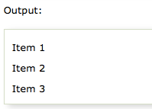
JSTL Core <c:forEach> Tag
The <c:for each > is an iteration tag used for repeating the nested body content for
fixed number of times or over the collection.
<%@ taglib uri="http://java.sun.com/jsp/jstl/core" prefix="c" %>
<html>
<head>
<title>Core Tag Example</title>
</head>
<body>
<c:forEach var="j" begin="1" end="3">
Item <c:out value="${j}"/><p>
</c:forEach>
</body>
</html>

Slide 77
JSTL Core <c:redirect> Tag
The < c:redirect > tag redirects the browser to a new URL.
<%@ taglib uri="http://java.sun.com/jsp/jstl/core" prefix="c" %>
<html>
<head>
<title>Core Tag Example</title>
</head>
<body>
<c:set var="url" value="0" scope="request"/>
<c:if test="${url<1}">
<c:redirect url="http://www.marwadieducation.edu.in"/>
</c:if>
<c:if test="${url>1}">
<c:redirect url="http://facebook.com"/>
</c:if>
</body>
</html>
.

Slide 78
JSTL FUNCTION TAG LIBRARY
The JSTL function provides a number of standard functions, most of these functions are common string manipulation functions.
The syntax used for including JSTL function library in your JSP is:
<%@ taglib uri="http://java.sun.com/jsp/jstl/functions"
prefix="fn" %>

Slide 79
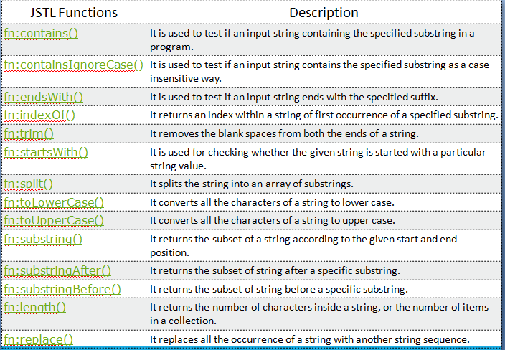
URL Rewriting

Slide 80
Example
<%@ taglib uri="http://java.sun.com/jsp/jstl/core" prefix="c" %>
<%@ taglib uri="http://java.sun.com/jsp/jstl/functions" prefix=
"fn" %>
<html>
<head>
<title>Using JSTL Function </title>
</head>
<body>
<c:set var="str1" value=“I LOVE INDIA"/>
<c:set var="str2" value=“${fn:toLowerCase(str1)}”/>
<p><b>Original :</b>${str1}</p>
<p><b>Conversion :</b>${str2}</p>
</body>
</html>
OUT PUT:
Original : I LOVE INDIA
Conversion : i love india

Slide 81
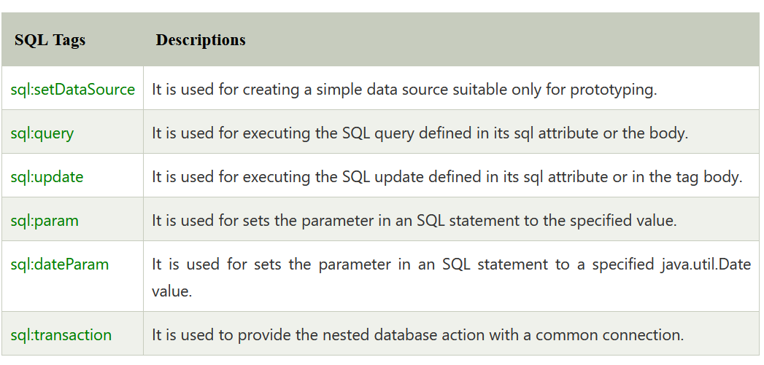
SQL TAG LIBRARY
The JSTL sql tags provide SQL support. The url for the sql tags is
http://java.sun.com/jsp/jstl/sql and prefix is sql.
<%@ taglib uri="http://java.sun.com/jsp/jstl/sql" prefix="sql" %>

Slide 82
Example
<%@ taglib uri="http://java.sun.com/jsp/jstl/core" prefix="c" %>
<%@ taglib uri="http://java.sun.com/jsp/jstl/sql" prefix="sql"%>
<html>
<head>
<title>sql:setDataSource Tag</title>
</head>
<body>
<sql:setDataSource var="db" driver="com.mysql.jdbc.Driver"
url="jdbc:mysql://localhost/test"
user="root" password="1234"/>
<sql:query dataSource="${db}" var="rs">
SELECT * from Students;
</sql:query>
<table border="2" width="100%">
<tr>
<th>Student ID</th>
<th>First Name</th>
<th>Last Name</th>
<th>Age</th>
</tr>

Slide 83
Example
<c:forEach var="table" items="${rs.rows}">
<tr>
<td><c:out value="${table.id}"/></td>
<td><c:out value="${table.First_Name}"/></td>
<td><c:out value="${table.Last_Name}"/></td>
<td><c:out value="${table.Age}"/></td>
</tr>
</c:forEach>
</table>
</body>
</html>

Slide 84
JSP XML tags
The XML tags are useful for creating and manipulating the XML
documents through the JSP.
The url for the xml tags is http://java.sun.com/jsp/jstl/xml and prefix
is x.
The syntax used for including JSTL XML tags library in your JSP is:
<%@ taglib uri="http://java.sun.com/jsp/jstl/xml" prefix="x" %>

Slide 85
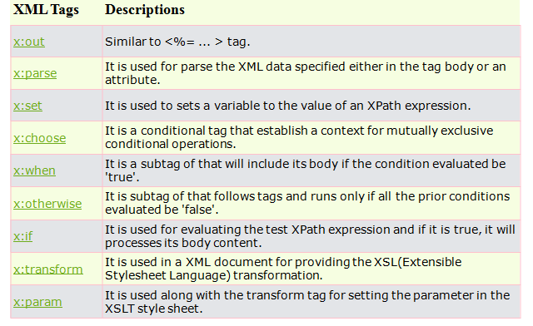
ServletContextEvent

Slide 86
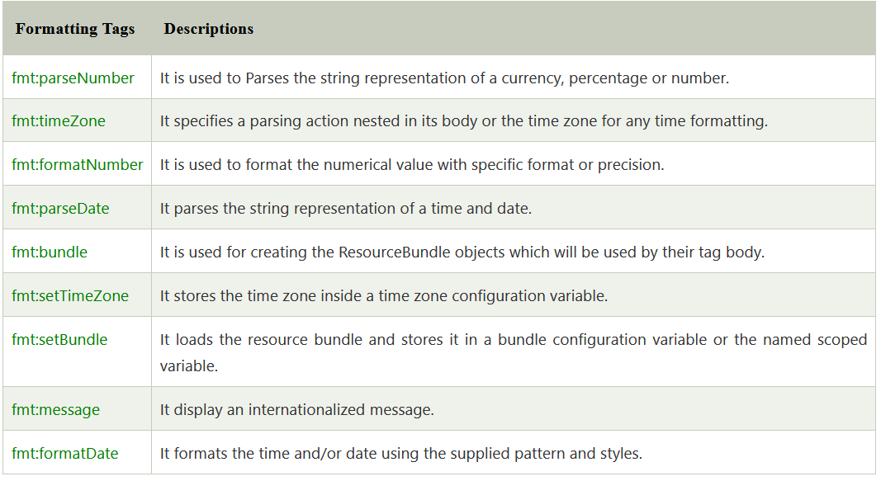
Formatting

Slide 87
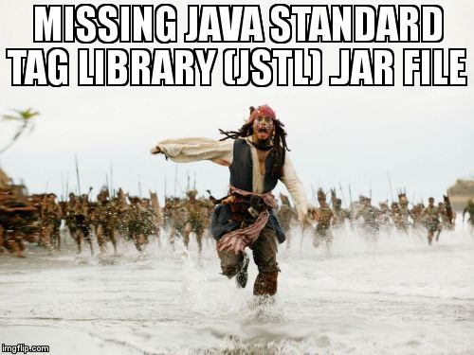
Missing JSTL Library??

Slide 88
JSP Custom Tags
Tags are made available within a JSP page via the taglib directive:
<%@ taglib uri=”uri” prefix=”prefix” %>
Directive’s uri attribute references the TLD (established via WAR file’s
web.xml)
Directive’s prefix attribute provides a local namespace for the TLD’s tags

Slide 89
Steps for implementing, using & deploying custom tags
The steps you follow in order to implement and deploy custom tags
are relatively straight-forward.
First, you write tag handlers. Under JSP 2.0 architecture, tag handlers are
Java classes.
Second, you write so called tag library descriptor, TLD file, in short.
Third, you package a set of tag handlers and TLD file into what is called tag
library in either unpacked or packed form.
Then, you write JSP pages that use these tags. Then you deploy the tag
library along with JSP pages.
Now let's talk about 3 things here by using examples - tag handler, TLD file,
and JSP pages.

Slide 90
JSP Custom Tag Example: Create "Hello" Tag
To write a custom tag you can simply extend SimpleTagSupport class and override the doTag() method, where you can place your code to generate content for the tag.
Consider you want to define a custom tag named <ex:Hello> and you want to use it in the following fashion without a body:
<ex:Hello />
To create a custom JSP tag, you must first create a Java class that acts as a tag handler.

Slide 91
JSP Custom Tag Example: Create "Hello" Tag
So let us create HelloTag class as follows:
package myTags;
import javax.servlet.jsp.tagext.*;
import javax.servlet.jsp.*; import java.io.*;
public class HelloTag extends SimpleTagSupport {
public void doTag() throws JspException, IOException {
JspWriter out = getJspContext().getOut();
out.println("Hello Custom Tag!");
}
}

Slide 92
JSP Custom Tag Example: Create "Hello" Tag
Above code has simple coding where doTag() method takes the current JspContext object using getJspContext() method and uses it to send "Hello Custom Tag!" to the current JspWriter object.
Let us compile above class and copy it in a directory available in environment variable CLASSPATH. Here we have copied it to ROOT\WEB- INF\classes\myTags
Note :You need to include the following to compile:
TOMCAT_HOME/lib/jsp-api.jar
to your CLASSPATH
Finally create following tag library file: <Tomcat-Installation-Directory>
webapps\ROOT\WEB-INF\custom.tld.

Slide 93
JSP Custom Tag Example: Create "Hello" Tag
<taglib>
<tlib-version>1.0</tlib-version>
<jsp-version>2.0</jsp-version>
<short-name>Example TLD</short-name>
<tag>
<name>Hello</name>
<tag-class>myTags.HelloTag</tag-class>
<body-content>empty</body-content>
</tag>
</taglib>

Slide 94
JSP Custom Tag Example: Create "Hello" Tag
Now it's time to use above defined custom tag Hello in our JSP program(Hello.jsp)
as follows: (Note : Hello.jsp should also be saved in WEB-INF folder)
<%@ taglib prefix="ex" uri="WEB-INF/custom.tld"%>
<html>
<head>
<title>A sample custom tag</title>
</head>
<body>
<ex:Hello/>
</body>
</html>
Start Tomcat server and Try to call above JSP in a browser using:
http://localhost:8080/Hello.jsp
This should produce following result:
Hello Custom Tag!

Slide 95
Summary
Introduction to JSP
Comparison with Servlet
JSP Architecture
JSP: Life Cycle
Scripting Elements
Directives
Action Tags
Implicit Object
Expression Language(EL)
JSP Standard Tag Libraries(JSTL)
Custom Tag
Session Management
Exception Handling
CRUD Application

Slide 96
Up Next??
Introduction to Hibernate
Exploring Architecture of Hibernate
Object Relation Mapping(ORM) with Hibernate
Hibernate Annotation
Hibernate Query Language (HQL)
CRUD Operation using Hibernate API

Slide 97
END OF UNIT - 4

