Slide 1
Unit 5
Hibernate
Prepared By
Prof. Santushti Betgeri
Assistant Professor, CE Dept.

Slide 2
Introduction to Hibernate
Hibernate is an Object-Relational Mapping (ORM) solution for JAVA. It is an open source persistent framework created by Gavin King in 2001. It is a powerful, high performance Object- Relational Persistence and Query service for any Java Application.
Hibernate maps Java classes to database tables and from Java data types to SQL data types and relieves the developer from 95% of common data persistence related programming tasks.

Slide 3
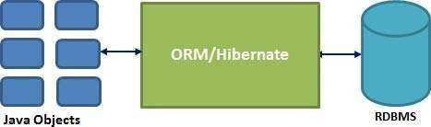
Introduction to Hibernate
Hibernate sits between traditional Java objects and database server to handle all the works in persisting those objects based on the appropriate O/R mechanisms and patterns.

Slide 4
Hibernate Advantages
Hibernate takes care of mapping Java classes to database tables using
XML files and without writing any line of code.
Provides simple APIs for storing and retrieving Java objects directly to and from the database.
If there is change in the database or in any table, then you need to
change the XML file properties only.
Abstracts away the unfamiliar SQL types and provides a way to work around familiar Java Objects.
Hibernate does not require an application server to operate.
Manipulates Complex associations of objects of your database.
Minimizes database access with smart fetching strategies.
Provides simple querying of data.

Slide 5
Supported Databases
Hibernate supports almost all the major RDBMS. Following is a list of few of the database engines supported by Hibernate −
HSQL Database Engine
DB2/NT
MySQL
PostgreSQL
FrontBase
Oracle
Microsoft SQL Server Database
Sybase SQL Server
Informix Dynamic Server

Slide 6
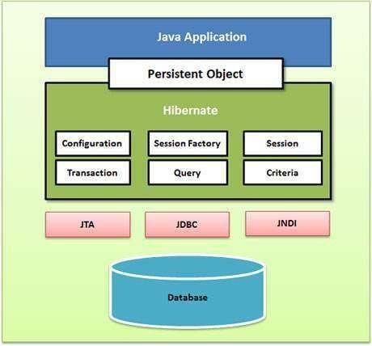
Hibernate Architecture
JDBC provides a rudimentary
level of abstraction of
to
functionality common
relational databases, allowing almost any database with a JDBC driver to be supported by Hibernate.
JNDI and JTA allow Hibernate to be integrated with J2EE application servers.
Notes:
Java Naming and Directory Interface, Java Transaction API

Slide 7
Configuration Object
The Configuration object Hibernate application. It initialization.
is the
is usually created only once during application
first Hibernate object you create in any
The Configuration object provides two keys components −
Database Connection − This is handled through one or more configuration files supported by Hibernate. These files are hibernate.properties and hibernate.cfg.xml.
Class Mapping Setup − This component creates the connection between the Java classes and database tables.

Slide 8
SessionFactory Object
Configuration object is used to create a SessionFactory object which in turn configures Hibernate for the application using the supplied configuration file and allows for a Session object to be instantiated.
The SessionFactory is a thread safe object and used by all the threads of an
application.
The SessionFactory is a heavyweight object; it is usually created during
application start up and kept for later use.
You would need one SessionFactory object per database using a separate configuration file. So, if you are using multiple databases, then you would have to create multiple SessionFactory objects.
Notes:
Responsible for session objects

Slide 9
Session Object
A Session is used to get a physical connection with a database.
The Session object is lightweight and designed to be instantiated each time an interaction is needed with the database.
Persistent objects are saved and retrieved through a Session
object. (Java classes whose objects or instances will be stored in database tables are called persistent classes in Hibernate.)
The session objects should not be kept open for a long time because they are not usually thread safe and they should be created and destroyed them as needed.

Slide 10
Transaction Object
A Transaction represents a unit of work with the database and most of the RDBMS supports transaction functionality.
Transactions in Hibernate are handled by an underlying
transaction manager and transaction (from JDBC or JTA).
This is an optional object and Hibernate applications may choose not to use this interface, instead managing transactions in their own application code.

Slide 11
Query Object
Query objects use SQL or Hibernate Query Language (HQL)
string to retrieve data from the database and create objects.
A Query instance is used to bind query parameters, limit the number of results returned by the query, and finally to execute the query.

Slide 12
Criteria Object
Criteria objects are used to create and execute object oriented criteria queries to retrieve objects.

Slide 13
Advantages of Hibernate
Open source and light weight
Fast performance
Database independent query
Automatic table creation
Simplifies complex join
Provides query statistics and database status
Notes:
GNU Lesser General Public License, Fast performance – two cache

Slide 14
Hibernate Configuration
Hibernate requires to know in advance — where to find the mapping information that defines how your Java classes relate to the database tables.
Hibernate also requires a set of configuration settings related to
database and other related parameters.
All such information is usually supplied as a standard Java properties file called hibernate.properties, or as an XML file named hibernate.cfg.xml.

Slide 15
Hibernate Properties
hibernate.dialect
This property makes Hibernate generate the appropriate SQL for
the chosen database.
hibernate.connection.driver_class
The JDBC driver class.
hibernate.connection.url
The JDBC URL to the database instance.
hibernate.connection.username
The database username.

Slide 16
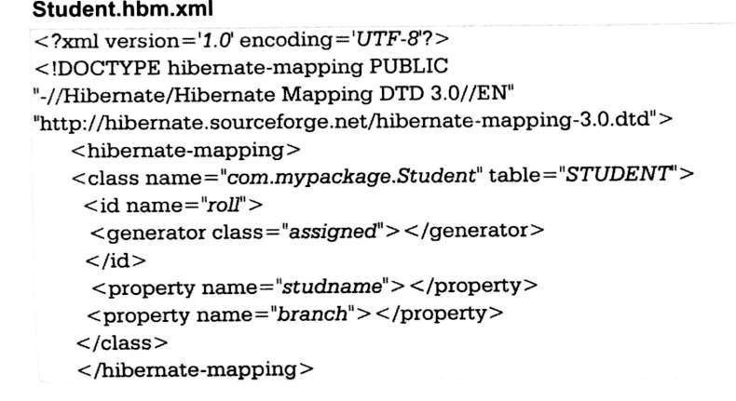
HIBERNATE O/R MAPPING
O/R Mapping is usually defined in XML document.
The mapping language is java-centric, meaning that mapping is
constructed around persistence class declaration.

Slide 17
HIBERNATE O/R MAPPING
The mapping document is an XML document having <hibernate- mapping> as the root element which contains <class> elements corresponding class.
The <class> elements are used to define specific mappings from a Java classes to the database tables. The Java class name is specified using the name attribute of the class element and the database table name is specified using the table attribute.
The <id> element maps the unique ID attribute in class to the primary key of the database table. The name attribute of the id element refers to the property in the class.

Slide 18
HIBERNATE O/R MAPPING
The <generator> element within the id element is used to generate the
primary key values automatically.
The class attribute of the generator element is set to native to let hibernate pick up either identity, sequence to create primary key depending upon the capabilities of the underlying database.
The <property> element is used to map a Java class property to a column in the database table. The name attribute of the element refers to the property in the class and the column attribute refers to the column in the database table.
The type attribute holds the hibernate mapping type, this mapping types will
convert from Java to SQL data type.

Slide 19
HIBERNATE ANNOTATION
Hibernate Annotations is the powerful way to provide the metadata for the Object and Relational Table mapping. All the metadata is clubbed into the POJO java file along with the code, this helps the user to understand the table structure and POJO simultaneously during the development.
If you going to make your application portable to other EJB 3 compliant ORM applications, you must use annotations to represent the mapping information, but still if you want greater flexibility, then you should go with XML-based mappings.

Slide 20
Environment Setup for Hibernate Annotation
First of all you would have to make sure that you are using JDK 5.0 otherwise you need to upgrade your JDK to JDK 5.0 to take advantage of the native support for annotations.
Second, you will need to install the Hibernate 3.x annotations distribution package and copy hibernate-annotations.jar, lib/hibernate-comons-annotations.jar and lib/ejb3-persistence.jar from the Hibernate Annotations distribution to your CLASSPATH.

Slide 21
Annotated Class Example
In Hibernate Annotation, all the metadata is clubbed into the POJO java file along with the code, this helps the user to understand the table structure and POJO simultaneously during the development.
Consider we are going to use the following EMPLOYEE table to store
our objects −
create table EMPLOYEE (
id INT NOT NULL auto_increment, first_name VARCHAR(20) default NULL, last_name VARCHAR(20) default NULL, salary INT default NULL,
PRIMARY KEY (id)
);

Slide 22
public int getId()
{ return id; }
Example Continue… mapping of Employee class with annotations to map objects with the defined EMPLOYEE table
import javax.persistence.*;
@Entity
@Table(name = "EMPLOYEE")
public class Employee
{
@Id @GeneratedValue @Column(name = "id") private int id;
@Column(name = "first_name") private String firstName;
@Column(name = "last_name")
private String lastName;
@Column(name = "salary")
private int salary;
public Employee() {}
public void setId( int id )
{ this.id = id; }
public String getFirstName()
{ return firstName; }
public void setFirstName( String first_name )
{ this.firstName = first_name; }
public String getLastName()
{ return lastName; }
public void setLastName( String last_name )
{ this.lastName = last_name; }
public int getSalary()
{ return salary; }
public void setSalary( int salary )
{ this.salary = salary; }
}

Slide 23
Example Continue…
Compilation and Execution
Create an application class with main( ) method.
Database Configuration
create hibernate.cfg.xml configuration file to define database related parameters.
Compilation and Execution
Make sure, you have set PATH and CLASSPATH appropriately before proceeding for the
compilation and execution.
Delete Employee.hbm.xml mapping file from the path.
Create Employee.java source file as shown above and compile it.
Create ManageEmployee.java source file as shown above and compile it.
Execute ManageEmployee binary to run the program.

Slide 24
HIBERNATE ANNOTATION
@Entity Annotation
@Entity annotation to the Employee class, which marks this class as an entity bean, so it must have a no-argument constructor that is visible with at least protected scope.
@Table Annotation
The @Table annotation allows you to specify the details of the table
that will be used to persist the entity in the database.
The @Table annotation provides four attributes, allowing you to override the name of the table, its catalogue, and its schema, and enforce unique constraints on columns in the table. For now, we are using just table name, which is EMPLOYEE.

Slide 25
HIBERNATE ANNOTATION
@Id and @GeneratedValue Annotations
Each entity bean will have a primary key, which you annotate on the class with the @Id annotation. The primary key can be a single field or a combination of multiple fields depending on your table structure.
By default, the @Id annotation will automatically determine the most appropriate primary key generation strategy to be used but you can override this by applying the @GeneratedValue annotation, which takes two parameters strategy and generator.

Slide 26
HIBERNATE ANNOTATION
@Column Annotation
The @Column annotation is used to specify the details of the column to which a field or property will be mapped. You can use column annotation with the following most commonly used attributes −
name attribute permits the name of the column to be explicitly specified.
length attribute permits the size of the column used to map a value particularly for a String value.
nullable attribute permits the column to be marked NOT NULL when the schema is
generated.
unique attribute permits the column to be marked as containing only unique values.

Slide 27
HIBERNATE QUERY LANGUAGE(HQL)
Hibernate is supported by a very powerful query language which is just similar to SQL.
The Hibernate query language is an object oriented query language.
It works with persistent object and its property.
HQL does not depends upon table of database. Instead of table name we use class name in HQL.
The Hibernate query are converted into conventional query that in turn perform
operation.
These query are case sensitive.

Slide 28
Advantages of HQL:
The HQL can perform bulk of operation at a time on Hibernate.
HQL supports object oriented feature such as inheritance,
polymorphism, association and so on.
Instead of returning plain data HQL return object. These objects can be easily accessed or programmed.
HQL is database independent. The same HQL can be executed on different databases.

Slide 29
SQL Vs HQL
HQL stands for Hibernate Query Language and SQL stands for
Structured Query Language
The structure of HQL is similar to SQL, but the main deference is that HQL makes use of class name instead of table and property name.
HQL is object oriented query language and sql is not.
4. HQL is
database independent where as SQL is database
dependent.

Slide 30
HQL Interface:
public int executeUpdate() is used to execute the update or delete
query.
public List list() returns the result of the ralation as a list.
public Query setFirstResult(int rowno) specifies the row number
from where record will be retrieved.
public Query setMaxResult(int rowno) specifies the no. of
records to be retrieved from the relation (table).

Slide 31
SOME COMMON QUERY IN HQL
HQL to get all the records
Query query=session.createQuery("from Emp");//here
persistent class name is Emp
List list=query.list();
HQL to get records with pagination
Query query=session.createQuery("from Emp"); query.setFirstResult(5); query.setMaxResult(10);
List list=query.list();//will return the records from 5 to 10th
number

Slide 32
SOME COMMON QUERY IN HQL
HQL delete query
Query query =
session.createQuery("delete from Emp where id=100");
//specifying class name (Emp) not tablename query.executeUpdate();

Slide 33
END OF UNIT - 5

