Slide 1

AJT - 01CE0411
Unit 6
Spring Framework
Prepared By
Prof. Santushti Betgeri
Assistant Professor, CE Dept.

Slide 2
Contents
Spring: Introduction,
Architecture,
Spring MVC Module,
Life Cycle of Bean Factory,
Explore: Constructor Injection, Dependency Injection,
Inner Beans, Aliases in Bean, Bean Scopes,
Spring Annotations,
Spring AOP Module, Spring DAO,
Database Transaction Management,
CRUD Operation using DAO and Spring API

Slide 3
Introduction to Spring
Spring was developed by Rod Johnson in 2003. Spring framework makes the easy development of JavaEE application.
It is helpful for beginners and experienced persons.

Slide 4
Introduction to Spring
Spring enables developers to develop enterprise-class applications using POJOs. The benefit of using only POJOs is that you do not need an EJB container product such as an application server but you have the option of using only a robust servlet container such as Tomcat or some commercial product .
Spring is organized in a modular fashion. Even though the number of packages and classes are substantial, you have to worry only about ones you need and ignore the rest.
Spring's web framework is a well-designed web MVC framework, which provides a great alternative to web frameworks such as Struts or other over engineered or less popular web frameworks.

Slide 5
Spring Framework
Spring is a lightweight framework. It can be thought of as a framework of frameworks because it provides support to various frameworks such as Struts, Hibernate, Tapestry, EJB, JSF etc. The framework, in broader sense, can be defined as a structure where we find solution of the various technical problems.
The Spring framework comprises several modules such as IOC, AOP, DAO, Context, ORM, WEB MVC etc. We will learn these modules in next page. Let's understand the IOC and Dependency Injection first.
Notes:
inversion of control (IoC)

Slide 6
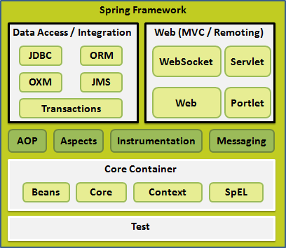
Spring Architecture
The Spring Framework provides about 20 modules which can be used based on an application requirement.
OXM (Object XML Mapping),
JMS (Java Message Service),
Spring Expression Language (SpEL)

Slide 7
Spring Architecture
Core Container:
The Core Container consists of the Core, Beans, Context, and Expression Language modules whose detail is as follows:
The Core module provides the fundamental parts of the framework, including
the IoC (Inversion of Control) and Dependency Injection features.
The Bean module provides BeanFactory.
The Context module builds on the solid base provided by the Core and Beans
modules and it is a medium to access any objects defined and configured.
The SpEL (Spring Expression Language) module provides a powerful expression
language for querying and manipulating an object graph at runtime.

Slide 8
Spring Architecture
Data Access/Integration:
The Data Access/Integration layer consists of the JDBC, ORM, OXM, JMS and Transaction modules whose detail is as follows:
The JDBC module provides a JDBC-abstraction layer that removes the need to do tedious JDBC related coding.
The ORM module provides integration layers for popular object-relational mapping APIs, including JPA, JDO, Hibernate, and iBatis.
The OXM module provides an abstraction layer that supports Object/XML mapping implementations for JAXB, Castor, XMLBeans, JiBX and XStream. The Java Messaging Service JMS module contains features for producing and consuming messages.
The Transaction module supports programmatic and declarative transaction management for classes that implement special interfaces and for all your POJOs.
Notes:
Java Architecture for XML Binding, Java Persistsnce API,

Slide 9
Spring Architecture
Web:
The Web layer consists of the Web, Web-MVC, Web-Socket, Portlet modules whose detail is as follows:
The Web module provides basic web-oriented integration features such as multipart file-upload functionality and the initialization of the IoC container using servlet listeners and a web-oriented application context.
The Web-MVC module contains Spring's model-view-controller (MVC) implementation for web applications.
The Web-Socket module provides support for WebSocket-based, two-way communication between client and server in web applications.
The Web-Portlet module provides the MVC implementation to be used in a portlet environment and mirrors the functionality of Web-Servlet module.
Notes:
inversion of control (IoC)

Slide 10
Spring Architecture
Miscellaneous:
There are few other important modules like AOP, Aspects, Instrumentation, Web and
Test modules whose detail is as follows:
The AOP module provides aspect-oriented programming implementation allowing you to define method-interceptors and pointcuts to cleanly decouple code that implements functionality that should be separated.
The Aspects module provides integration with AspectJ which is again a powerful and mature aspect oriented programming (AOP) framework.
The Instrumentation module provides class instrumentation support and class loader implementations to be used in certain application servers.
The Messaging module provides support for STOMP (Streaming Text Oriented Messaging Protocol) as the WebSocket sub-protocol to use in applications. It also supports an annotation programming model for routing and processing STOMP messages from WebSocket clients. The Test module supports the testing of Spring components with JUnit or TestNG frameworks.

Slide 11
Spring Advantages
1) Predefined Templates
Spring framework provides templates for JDBC, Hibernate, JPA etc. technologies. So there is no need to write too much code. It hides the basic steps of these technologies.
Let's take the example of JdbcTemplate, you don't need to write the code for exception handling, creating connection, creating statement, committing transaction, closing connection etc. You need to write the code of executing query only. Thus, it save a lot of JDBC code.

Slide 12
Spring Advantages
2) Loose Coupling
The Spring applications are loosely coupled because of
dependency injection.
3) Easy to test
The Dependency Injection makes easier to test the application. The EJB or Struts application require server to run the application but Spring framework doesn't require server.
4) Lightweight
Spring framework is
lightweight because of
its POJO force the
implementation. The Spring Framework doesn't
programmer to inherit any class or implement any interface. That
is why it is said non-invasive.

Slide 13
Spring Advantages
Fast Development
The Dependency Injection feature of Spring Framework and it support to various frameworks makes the easy development of JavaEE application.
Powerful abstraction
It provides powerful abstraction to JavaEE specifications such as JMS, JDBC, JPA and JTA.
Declarative support
It provides declarative support for caching, validation, transactions
and formatting.

Slide 14
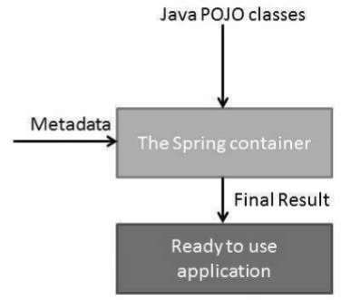
The Spring container is at the core of the Spring Framework. The container will create the objects, wire them
Spring - IoC Containers (Inversion of Control)
together, configure them, manage their complete life from creation till destruction.
and
cycle
The Spring container uses DI (Dependency Injection) to manage the components that make up an application. These objects are called Spring Beans.
Notes:
inversion of control (IoC)

Slide 15
Spring provides the following
two distinct types of containers.
Spring BeanFactory Container
This is the simplest container providing the basic support for DI and is defined by the org.springframework.beans.factory.BeanFactory interface. The BeanFactory and related interfaces, such as BeanFactoryAware, InitializingBean, DisposableBean, are still present in Spring for the purpose of backward compatibility with a large number of third-party frameworks that integrate with Spring.
Spring ApplicationContext Container
This container adds more enterprise-specific functionality such as the ability to resolve textual messages from a properties file and the ability to publish application events to interested event listeners. This container is defined by the org.springframework.context.ApplicationContext interface.

Slide 16

Inversion Of Control (IOC) and
Dependency Injection
These are the design patterns that are used to remove dependency from the programming code. They make the code easier to test and maintain. Let's understand this with the following code:
class Employee{ Address address; Employee(){ address=new Address();
}
}
In such case, there is dependency between the Employee and
Address (tight coupling).

Slide 17
Inversion Of Control (IOC) and
Dependency Injection
In the Inversion of Control scenario, we do this something like this: class Employee{
Address address;
Employee(Address address){
this.address=address;
}
}
Thus, IOC makes the code loosely coupled. In such case, there is no
need to modify the code if our logic is moved to new environment.
In Spring framework, IOC container is responsible to inject the dependency. We provide metadata to the IOC container either by XML file or annotation.

Slide 18
Advantages of Dependency Injection
makes the code loosely coupled so easy to maintain
makes the code easy to test

Slide 19
Dependency Injection
DI exists in two major variants:
Constructor-based dependency injection Constructor-based DI is accomplished when the container invokes a class constructor with a number of arguments, each representing a dependency on the other class.
Setter-based dependency injection Setter-based DI is accomplished by the container calling setter methods on your beans after invoking a no- argument constructor or no-argument static factory method to instantiate your bean.
You can mix both, Constructor-based and Setter-based DI but it is a good rule of thumb to use constructor arguments for mandatory dependencies and setters for optional dependencies. The code is cleaner with the DI principle and decoupling is more effective when objects are provided with their dependencies.

Slide 20

Dependency Injection
Consider you have an application which has a text editor component and you want to provide a spell check. Your standard code would look something like this −
public class TextEditor
{
private SpellChecker spellChecker;
public TextEditor()
{ spellChecker = new SpellChecker(); }
}
What we've done here is, create a
public class TextEditor
{
private SpellChecker spellChecker;
public TextEditor(SpellChecker spellChecker)
{ this.spellChecker = spellChecker; }
}
In an inversion of control scenario, the TextEditor should not worry about SpellChecker implementation. The SpellChecker will be implemented independently and will be provided to the TextEditor at the time of TextEditor instantiation. This entire procedure is controlled by the Spring Framework.
dependency between the TextEditor and the
SpellChecker.

Slide 21
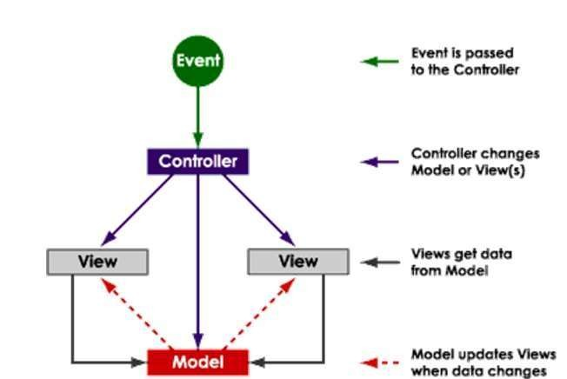
Spring MVC
MVC: instances of the following:
M – Model: Eg. Java Bean,POJO etc
V – View: org.springframework.web.servlet.View
C – Controller: org.springframework.web.servlet.mvc.Controller

Slide 22
Spring MVC
MVC for Web
Event – HTTP request from client
Controller – Custom Spring Controller Class View – Eg. JSP
Model –Eg Java Beans
Model is passed to the server-side View which is returned to the client

Slide 23
Spring MVC
Spring MVC Lifecycle
Step 1: Incoming HTTP request is mapped to the Spring DispatcherServlet.
Step 2: The DispatcherServlet creates a container using the bean definitions found in the Servlet configuration file.
Step 3: The container finds an appropriate Controller to process the request.
Step 4: The Controller performs some custom logic and returns a ModelAndView to the container.
Step 5: The container renders the ModelAndView using the appropriate ViewResolver bean.
Step 6: An HTTP response is sent to the browser

Slide 24
Spring MVC Example..
link.html
<html>
<body>
<a href="Link.spring">GO TO SPRING HOME PAGE</a>
</body>
</html>

Slide 25
Spring MVC
Spring MVC Step 1
Incoming HTTP request is mapped to the Spring DispatcherServlet.
This is configured like any other Servlet mapping. Pick a URI-Pattern and associate it
with the DispatcherServlet
web.xml
<servlet>
<servlet-name>Dispatcher</servlet-name>
<servlet-class>
org.springframework.web.servlet.DispatcherServlet
</servlet-class>
</servlet>
<servlet-mapping>
<servlet-name>Dispatcher</servlet-name>
<url-pattern>*.spring</url-pattern>
</servlet-mapping>

Slide 26
Spring MVC
Spring MVC Step 2
The DispatcherServlet creates a container using the bean definitions found in the
Servlet configuration file.
The DispatcherServlet locates the configuration file using the naming convention
servletname-servlet.xml.
Dispatcher-servlet.xml <?xml version="1.0" encoding="UTF-8"?>
<beans xmlns="http://www.springframework.org/schema/beans" xmlns:xsi="http://www.w3.org/2001/XMLSchema-instance" xmlns:p="http://www.springframework.org/schema/p" xsi:schemaLocation="http://www.springframework
.org/schema/beans http://www.springframework
.org/schema/beans/spring-beans-2.5.xsd">
<bean name="/Link.spring" class="LinkController"/>
</beans>

Slide 27
Spring MVC
Spring MVC Step 3
The container finds an appropriate Controller to process the request.
For example, a request for /Link.spring is mapped to the Controller defined by the
mycontroller.LinkController class
Spring MVC Step 4
The Controller performs some custom logic and returns a ModelAndView to the container.The Controller is a Java class that extends the rg.springframework.web.servlet.mvc.Controller class.
The request is handled by the handleRequest method.

Slide 28
Spring MVC
Spring MVC Step 4
- LinkController.java
import javax.servlet.http.HttpServletRequest;
import javax.servlet.http.HttpServletResponse;
import org.springframework.web.servlet.ModelAndView;
import org.springframework.web.servlet.mvc.Controller;
public class LinkController implements Controller {
public ModelAndView handleRequest(HttpServletRequest arg0, HttpServletResponse arg1) throws Exception {
return new ModelAndView("Welcome.jsp");
}
}

Slide 29
Spring MVC
Spring MVC Step 5
The container renders the ModelAndView using the appropriate View.
Welcome.jsp
<h2>
<font color="Green">
Welcome to Spring Home Page.
</font>
</h2>

Slide 30
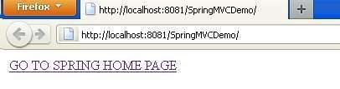
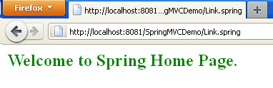
Spring MVC
Output:-

Slide 31
Spring – Bean Definition
The objects that form the backbone of your application and that
are managed by the Spring IoC container are called beans.
A bean is an object that is instantiated, assembled, and otherwise managed by a Spring IoC container. These beans are created with the configuration metadata that you supply to the container. For example, in the form of XML <bean/> definitions.
Bean definition contains the information called configuration metadata, which is needed for the container to know the following −
How to create a bean
Bean's lifecycle details
Bean's dependencies

Slide 32
The life cycle of a Spring bean is easy to understand. When a bean is instantiated, it may be required to perform some initialization to get it into a usable state. Similarly, when the bean is no longer required and is removed from the container, some cleanup may be required.
Spring – Bean Life Cycle
To define setup and teardown for a bean, we simply declare the <bean> with init method and/or destroy-method
parameters.
public void init()
{
// do some destruction work
}
public void destroy()
{
// do some destruction work
}

Slide 33
Spring Example
create POJO class
create application class with main method
Bean Configuration

Slide 34
1) Create POJO Class
HelloWorld.java
public class HelloWorld {
private String message;
public void setMessage(String message)
{ this.message = message; }
public void getMessage()
{ System.out.println("Your Message : " + message); }
public void init()
{ System.out.println("Bean is going through init."); }
public void destroy()
{ System.out.println("Bean will destroy now."); }
}

Slide 35
2) Create application main method
import org.springframework.context.support.AbstractApplicationContext;
import org.springframework.context.support.ClassPathXmlApplicationContext;
public class MainApp
{
public static void main(String[] args)
{
AbstractApplicationContext context = new
ClassPathXmlApplicationContext("Beans.xml");
HelloWorld obj = (HelloWorld) context.getBean("helloWorld");
obj.getMessage();
context.registerShutdownHook();
}
}

Slide 36
3) Create configuration file
Beans.xml
<?xml version = "1.0" encoding = "UTF-8"?>
<beans xmlns = "http://www.springframework.org/schema/beans" xmlns:xsi = "http://www.w3.org/2001/XMLSchema-instance" xsi:schemaLocation = "http://www.springframework.org/schema/beans http://www.springframework.org/schema/beans/spring-beans-3.0.xsd">
<bean id = "helloWorld" class = "HelloWorld" init-method = "init" destroy-
method = "destroy">
<property name = "message" value = "Hello World!"/> </bean>
</beans>

Slide 37
Output
Bean is going through init. Your Message : Hello World! Bean will destroy now.

Slide 38
Inner Bean
Inner beans are the beans that are defined within the scope of another bean. Thus, a <bean/> element inside the <property/> or <constructor-arg/> elements is called inner bean. This page gives an example to inject inner bean in spring.
Example uses constructor based injection, the approach is similar for setter
based injection. ( Next Slide)
Here is a class called PaymentGateway, which requires Order object to be
injected.

Slide 39

Inner Bean Example
1) PaymentGateway.java
package com.java2novice.beans;
public class PaymentGateway { private Order order;
public PaymentGateway(Order ord){
this.order = ord;
}
public void setOrder(Order ord){
this.order = ord;
}
public void processOrder(){
System.out.println("Processing order: "+order.getItem());
}
}

Slide 40
Inner Bean Example
2) Order.java
public class Order {
private String item; private String price; private String address;
public String getItem() {
return item;
}
public void setItem(String item)
{
this.item = item;
}
public String getPrice() {
return price;
}
public void setPrice(String price) {
this.price = price;
}
public String getAddress() { return address;
}
public void setAddress(String
address) {
this.address = address;
}
}

Slide 41
Inner Bean Example
3) Bean Configuration
applicationContext.xml
Note: When you are using inner bean configuration, bean id is not required. The
approach is same for setter based injection
<beans xmlns="http://www.springframework.org/schema/beans" xmlns:xsi="http://www.w3.org/2001/XMLSchema-instance" xsi:schemaLocation="http://www.springframework.org/schema/beans http://www.springframework.org/schema/beans/spring-beans-3.0.xsd">
<bean id="paymentGwBean" class=“PaymentGateway">
<constructor-arg>
<bean class="Order">
<property name="item" value="JavaTextBook" />
<property name="price" value="RS2 22.50" />
<property name="address" value="Bangalore" />
</bean>
</constructor-arg>
</bean>
</beans>

Slide 42
Inner Bean Example
4) Application Class with main()
SpringDemo.java
package com.java2novice.test;
import org.springframework.context.ApplicationContext;
import org.springframework.context.support.ClassPathXmlApplicationContext;
public class SpringDemo {
public static void main(String a[]){
String confFile = "applicationContext.xml";
ApplicationContext context = new ClassPathXmlApplicationContext(confFile);
PaymentGateway gateway = (PaymentGateway) context.getBean("paymentGwBean");
gateway.processOrder();
}
}

Slide 43
Inner Bean Example
Output
Processing order: JavaTextBook

Slide 44
Aliases in Beans
In Spring, Bean is accessed using id or name usually. Spring also provides an alias (second name) to bean. Hence we can also access a bean by bean alias name. To define a bean alias name, spring provides a <alias> tag as:
Syntax: <alias name = “bean-name” alias = “alias-name-for-defined-bean”/>
In the syntax, there is a <alias> tag that defines a “name” attribute, which represents the bean that is being aliased and attribute “alias” is used to specify the alias name for the bean.
Ex.: <alias name = “triangle” alias = “triangle_alias” />
In the example, we defined an alias for “triagle” bean. The “name” attribute refers to
“triangle” bean defined and “alias” attribute defines an alias to “triangle” bean.

Slide 45
Bean Scopes
In the spring bean configurations, bean attribute called 'scope' defines what kind of object has to created and returned. There are 5 types of bean scopes available, they are:
singleton: Returns a single bean instance per Spring IoC container.
prototype: Returns a new bean instance each time when requested.
request: Returns a single instance for every HTTP request call.
session: Returns a single instance for every HTTP session.
global session: global session scope is equal as session scope on portlet-based
web applications.
If no bean scope is specified in bean configuration file, then it will be by default
'singleton'.
Example:
<bean id="ticketBean" class=“TicketManager" scope="singleton"/>

Slide 46
Spring Annotations
Set spring bean scope using annotation
import org.springframework.context.annotation.Scope;
import org.springframework.stereotype.Service;
@Service
@Scope("prototype")
public class PaymentGateway {
private Order order;
public PaymentGateway(Order ord){
this.order = ord;
}
public void setOrder(Order ord){ this.order = ord;
}
public void processOrder(){
System.out.println("Processing order: “
+order.getItem());
}

Slide 47
Spring Annotations
Since we are using java based configuration using annotations, we need to enable
component scan in our configurations:
<beans xmlns="http://www.springframework.org/schema/beans" xmlns:xsi="http://www.w3.org/2001/XMLSchema-instance" xsi:schemaLocation="http://www.springframework.org/schema/beans http://www.springframework.org/schema/beans/spring-beans-3.0.xsd http://www.springframework.org/schema/context http://www.springframework.org/schema/context/spring-context-2.5.xsd">
<context:component-scan base-package="com.marwadi.beans" />
</beans>

Slide 48
Introduction to Spring AOP Module
Aspect-Oriented Programming (AOP)
complements Object-Oriented
Programming (OOP) by providing another way of thinking about program structure. The key unit of modularity in OOP is the class, whereas in AOP the unit of modularity is the aspect.
AOP breaks the program logic into distinct parts (called concerns). It is used to increase modularity by cross-cutting concerns.
Aspects enable the modularization of concerns such as transaction management that cut across multiple types and objects. (Such concerns are often termed crosscutting concerns in AOP literature.)
One of the key components of Spring is the AOP framework. While the Spring IoC container does not depend on AOP, meaning you do not need to use AOP if you don't want to, AOP complements Spring IoC to provide a very capable middleware solution.

Slide 49
Introduction to Spring AOP Module
AOP is used in the Spring Framework to...
... provide declarative enterprise services, especially as a replacement for EJB declarative services. The most important such service is declarative transaction management.
... allow users to implement custom aspects, complementing their use of OOP
with AOP.

Slide 50
AOP concepts
Aspect: a modularization of a concern that cuts across multiple classes. Transaction management is a good example of a crosscutting concern in J2EE applications. In Spring AOP, aspects are implemented using regular classes (the schema-based approach) or regular classes annotated with the @Aspect annotation (the @AspectJ style).
Join point: a point during the execution of a program, such as the execution of a method or the handling of an exception. In Spring AOP, a join point always represents a method execution.
Advice: action taken by an aspect at a particular join point. Different types of advice include "around," "before" and "after" advice. Many AOP frameworks, including Spring, model an advice as an interceptor, maintaining a chain of interceptors around the join point.

Slide 51
AOP concepts
Pointcut: a predicate that matches join points. Advice is associated with a pointcut expression and runs at any join point matched by the pointcut (for example, the execution of a method with a certain name). The concept of join points as matched by pointcut expressions is central to AOP, and Spring uses the AspectJ pointcut expression language by default.
Introduction: declaring additional methods or fields on behalf of a type. Spring AOP allows you to introduce new interfaces (and a corresponding implementation) to any advised object. For example, you could use an introduction to make a bean implement an IsModified interface, to simplify caching. (An introduction is known as an inter-type declaration in the AspectJ community.)
Target object: object being advised by one or more aspects. Also referred to as the advised object. Since Spring AOP is implemented using runtime proxies, this object will always be a proxied object.

Slide 52
AOP Concepts
AOP proxy: an object created by the AOP framework in order to implement the aspect contracts (advise method executions and so on).
Weaving: linking aspects with other application types or objects to create an advised object. This can be done at compile time (using the AspectJ compiler, for example), load time, or at runtime. Spring AOP, like other pure Java AOP frameworks, performs weaving at runtime.

Slide 53
Types of Advice
Before advice: Advice that executes before a join point, but which does not have the ability to prevent execution flow proceeding to the join point (unless it throws an exception).
After returning advice: Advice to be executed after a join point completes normally. For example, if a method returns without throwing an exception.
After throwing advice: Advice to be executed if a method exits by throwing an exception.
After (finally) advice: Advice to be executed regardless of the means by which a join point exits (normal or exceptional return).
Around advice: Advice that surrounds a join point such as a method invocation. This is the most powerful kind of advice. Around advice can perform custom behavior before and after the method invocation.

Slide 54
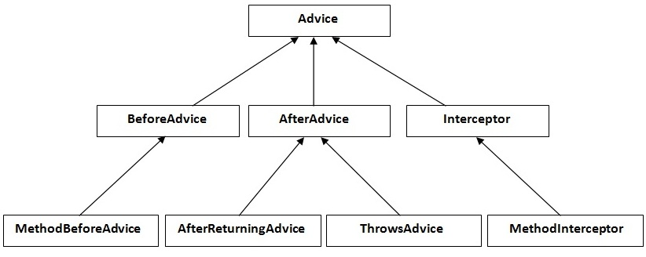
Advice Interface
All are interfaces in aop.
MethodBeforeAdvice interface extends the BeforeAdvice interface.
AfterReturningAdvice interface extends the AfterAdvice interface.
ThrowsAdvice interface extends the AfterAdvice interface.
MethodInterceptor interface extends the Interceptor interface. It is used in around advice.

Slide 55
Database Transaction Management
Comprehensive transaction support is among the most compelling reasons to use the Spring Framework. The Spring Framework provides a consistent abstraction for transaction management that delivers the following benefits:
Consistent programming model across different transaction APIs such as Java Transaction API (JTA), JDBC, Hibernate, Java Persistence API (JPA), and Java Data Objects (JDO).
Support for declarative transaction management.
Simpler API for programmatic transaction management than complex
transaction APIs such as JTA.
Excellent integration with Spring’s data access abstractions.

Slide 56
Spring DAO
The Data Access Object (DAO) support in Spring is aimed at making it easy to work with data access technologies like JDBC, Hibernate, JPA or JDO in a consistent way.
This allows one to switch between the aforementioned persistence technologies fairly easily and it also allows one to code without worrying about catching exceptions that are specific to each technology.
Annotations used for configuring DAO or Repository classes
@Repository
public class JdbcMovieFinder implements MovieFinder { private JdbcTemplate jdbcTemplate;
@Autowired
public void init(DataSource dataSource) {
this.jdbcTemplate = new JdbcTemplate(dataSource);
}
// ...
}
Notes:
Spring @Autowired annotation is used for automatic dependency injection.

Slide 57
Spring DAO
Autowiring feature of spring framework enables you to inject the object dependency implicitly. It internally uses setter or constructor injection. Autowiring can't be used to inject primitive and string values. It works with reference only.
Advantage of Autowiring
It requires the less code because we don't need to write the code to inject the dependency explicitly.
Disadvantage of Autowiring
No control of programmer.
Notes:
Spring @Autowired annotation is used for automatic dependency injection.

Slide 58
CRUD Operation Using DAO and Spring API
https://www.dineshonjava.com/spring-mvc-with-hibernate-crud-example/

Slide 59
Learning Resources
http://www.java2novice.com/spring/bean-scope-annotation/
https://www.journaldev.com/2583/spring-aop-example-tutorial-aspect-advice-
pointcut-joinpoint-annotations

Slide 60
Summary
http://www.java2novice.com/spring/bean-scope-annotation/
https://www.journaldev.com/2583/spring-aop-example-tutorial-aspect-advice-
pointcut-joinpoint-annotations

Slide 61
Summary
Spring: Introduction,
Architecture,
Spring MVC Module,
Life Cycle of Bean Factory,
Explore: Constructor Injection, Dependency Injection,
Inner Beans, Aliases in Bean, Bean Scopes,
Spring Annotations,
Spring AOP Module, Spring DAO,
Database Transaction Management,
CRUD Operation using DAO and Spring API

Slide 62
END OF UNIT - 6

