Slide 2
Outline
Basic concept of E-R diagram
Types of Attributes
Mapping Cardinality
Weak Entity Sets
Extended E-R features
Generalization and Specialization
Constraints on Specialization and Generalization
Aggregation
E-R diagram of Hospital Management System
Reduction to E-R Database Schema
Integrity Constraints

Slide 3
Basic concepts
What is Database Design?
Database Design is a collection of processes that facilitate the designing, development, implementation and maintenance of enterprise database management systems.
What is E-R diagram?
E-R diagram: (Entity-Relationship diagram)
It is graphical (pictorial) representation of database.
It uses different types of symbols to represent different objects of database.

Slide 4
Entity
An entity is a person, a place or an object.
An entity is represented by a rectangle which contains the name of an entity.
Entities of a college database are:
Student
Professor/Faculty
Course
Department
Result
Class
Subject
Entity Name
Symbol
Student
Faculty
Course
Exercise
Write down the different entities of bank database.
Exercise
Write down the different entities of hospital database.

Slide 5
Bank
Branch
Account
Customer
Loan
Hospital
Patients
Doctors
Medicine
Rooms
Exercise
Write down the different entities of bank database.
Exercise
Write down the different entities of hospital database.

Slide 6



Entity Set
It is a set (group) of entities of same type.
Examples:
All persons having an account in a bank
All the students studying in a college
All the professors working in a college
Set of all accounts in a bank

Slide 7

Attributes
Attribute is properties or details about an entity.
An attribute is represented by an oval containing name of an attribute.
Attributes of Student are:
Roll No
Student Name
Branch
Semester
Address
Mobile No
Age
SPI
Backlogs
Attribute Name
Symbol
RollNo
Name
Student
Exercise
Write down the different attributes of Faculty entity.
Exercise
Write down the different attributes of Account entity.

Slide 8
Name
Faculty No
Salary
Experience
DOB
Address
Account No
Type
Balance
Account Holder
Exercise
Write down the different attributes of Faculty entity.
Exercise
Write down the different attributes of Account entity.

Slide 9
Relationship
Relationship is an association (connection) between several entities.
It should be placed between two entities and a line connecting it to an entity.
A relationship is represented by a diamond containing relationship's name.
Relationship Name
Symbol
Student
Issue
Book

Slide 10
E-R Diagram of a Library System
Primary Key
Primary Key
Attributes
RollNo
Name
Relationship
BookNo
Name
Student
Issue
Book
Branch
Sem
Entities
Author
Price
Each and every entity must have one primary key attribute.
Relationship between 2 entities is called binary relationship.

Slide 11
Ternary Relationship
ProjectID
Project Name
Project
FacID
Name
RollNo
Name
Faculty
Guide
Student
Branch
Technology
Branch
Sem
Relationship between 3 entities is called ternary relationship.

Slide 12
Exercise
Draw an E-R diagram of following pair of entities
Customer & Account
Customer & Loan
Doctor & Patient
Student & Project
Student & Teacher
Note: Take four attributes per entity with one primary key attribute.
Keep proper relationship between two entities.

Slide 13
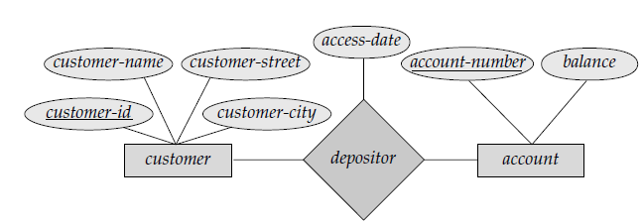
ER Diagram for Customer & Account
Customer & Account

Slide 14
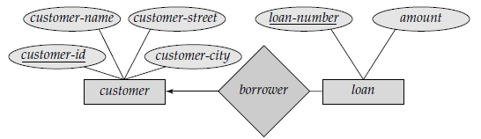
ER Diagram for Customer & Loan
Customer & Loan

Slide 15
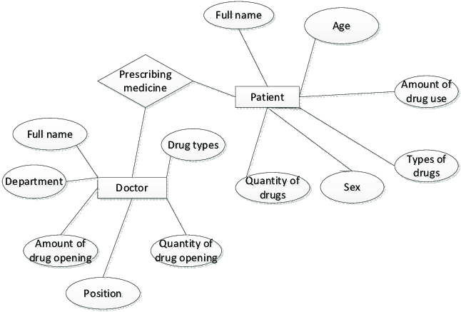
ER Diagram for Doctor & Patient
Doctor & Patient

Slide 16
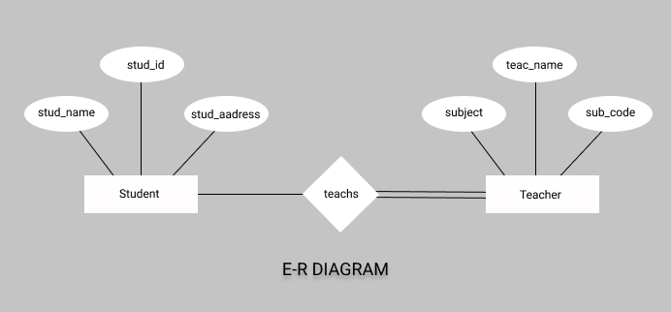
ER Diagram for Student & Teacher
Student & Teacher

Slide 17
Types of Attributes
Simple Attribute | Composite Attribute
Cannot be divided into subparts | Can be divided into subparts
E.g. RollNo, CPI | E.g. Name (first name, middle name, last name) Address (street, road, city)
Symbol | Symbol
Name
Roll No
First name
Last name
Middle name

Slide 18
Types of Attributes
Single-valued Attribute | Multi-valued Attribute
Has single value | Has multiple (more than one) value
E.g. RollNo, CPI | E.g. PhoneNo (person may have multiple phone nos) EmailID (person may have multiple emails)
Symbol | Symbol
Roll No
Phone No

Slide 19
Types of Attributes
Stored Attribute | Derived Attribute
It’s value is stored manually in database | It’s value is derived or calculated from other attributes
E.g. Birthdate | E.g. Age (can be calculated using current date and birthdate)
Symbol | Symbol
Birthdate
Age

Slide 20
Entity with all types of Attributes
Middle Name
First Name
Last Name
Single Value
Simple
RollNo
Name
Composite
Apartment
Derived
Composite
Student
Street
Age
Address
Multiple Value
Stored
Phone No
Birth Date
Area

Slide 21
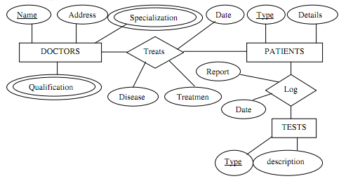
Exercise
Draw an E-R diagram of Hospital Management System.
Take only 2 entities
Keep proper relationship between two entities
Use all types of attributes

Slide 22
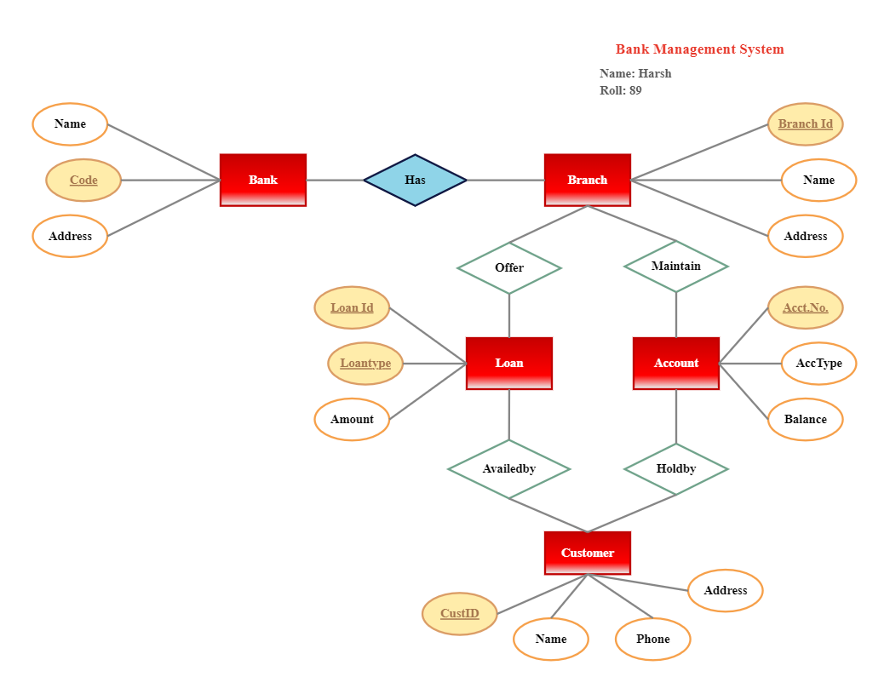
Exercise
Draw an E-R diagram of Banking Management System.
Take only 2 entities
Keep proper relationship between two
entities
Use all types of attributes

Slide 23
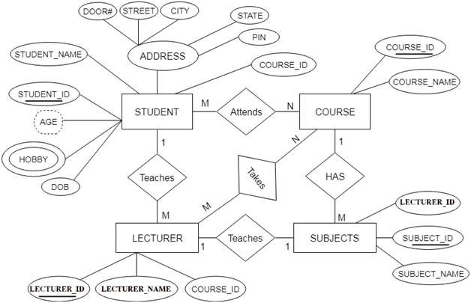
Exercise
Draw an E-R diagram of College Management System.
Take only 2 entities
Keep proper relationship between two entities
Use all types of attributes

Slide 24
Descriptive Attribute
Attributes of the relationship is called descriptive attribute.
Descriptive Attribute
Issue Date
RollNo
Name
BookNo
Name
Student
Issue
Book
Branch
Sem
Author
Price

Slide 25
Role
Roles are indicated by labeling the lines that connect diamonds (relationship) to rectangles (entity).
The labels “Coordinator” and “Head” are called roles; it specify the function that an entity plays in a relationship.
Role labels are optional, and are used to clarify semantics (meaning) of the relationship.
EmpID
Name
Faculty
Coordinator
Reports_To
Head
Branch
Experience

Slide 26
Recursive Relationship Set
The same entity participates in a relationship set more than once then it is called recursive relationship set.
FacID
FName
DeptID
DName
Faculty
Works
Department
Post
Recursive Relationship
Set
FName | Post
Ajay | Professor
Haresh | Professor
Ramesh | HOD
DName
Computer
Civil
Mechanical
Prof.
Prof.
Prof./
HOD

Slide 27
Mapping Cardinality (Cardinality Constraints)
It represents the number of entities of another entity set which are connected to an entity using a relationship set.
It is most useful in describing binary relationship sets.
For a binary relationship set the mapping cardinality must be one of the following types:
One to One
One to Many
Many to One
Many to Many

Slide 28
One-to-One relationship (1 – 1)
An entity in A is associated with only one entity in B and an entity in B is associated with only one entity in A.
Example: A customer is connected with only one loan using the relationship borrower and a loan is connected with only one customer using borrower.
customer
borrow
loan
A1
B1
C1
L1
A2
B2
C2
L2
C3
L3
A
B

Slide 29
One-to-Many relationship (1 – N)
An entity in A is associated with more than one entities in B and an entity in B is associated with only one entity in A.
Example: A loan is connected with only one customer using borrower and a customer is connected with more than one loans using borrower.
customer
borrow
loan
A1
B1
C1
L1
A2
B2
C2
L2
C3
L3
A
B
L4

Slide 30
Many-to-One relationship (N – 1)
An entity in A is associated with only one entity in B and an entity in B is associated with more than one entities in A.
Example: A loan is connected with more than one customer using borrower and a customer is connected with only one loan using borrower.
customer
borrow
loan
A1
B1
C1
L1
A2
B2
C2
L2
C3
L3
A
B
C4

Slide 31
Many-to-Many relationship (N – N)
An entity in A is associated with more than one entities in B and an entity in B is associated with more than one entities in A.
Example: A customer is connected with more than one loan using borrower and a loan is connected with more than one customer using borrower.
customer
borrow
loan
A1
B1
C1
L1
A2
B2
C2
L2
C3
L3
A
B
C4
L4

Slide 32
Mapping Cardinality (Cardinality Constraints) [Exercise]
Draw an E-R diagram and specify which type of mapping cardinality will be there in the following examples:
Each customer has only one account in the bank and each account is held by only one customer. [single account]
Each customer has only one account in the bank but an account can be held by more than one customer. [joint account]
A customer may have more than one account in the bank but each account is held by only one customer. [multiple accounts]
A customer may have more than one account in the bank and each account is held by more than one customer. [join account as well as multiple accounts]
A student can work in more than one project and a project can be done by more than one student.
A student can issue more than one book but a book is issued to only one student.
A subject is taught by more than one faculty and a faculty can teach more than one subject.

Slide 33
Exercise
Draw an E-R diagram of Banking Management System.
Draw an E-R diagram of Hospital Management System.
Draw an E-R diagram of College Management System.
Take only 3 to 4 entities
Keep proper relationship between two entities
Use all types of attributes
Use Mapping Cardinality

Slide 34
Participation Constraints
It specifies the participation of an entity set in a relationship set.
There are two types participation constraints
Total participation
Partial participation
Partial participation
some entities in the entity set may not participate in any relationship in the relationship set.
indicated by single line
Total participation
every entity in the entity set participates in at least one relationship in the relationship set.
indicated by double line
customer
borrow
loan
C1
L1
Each customer has maximum one loan
C2
L2
C3

Slide 35
Weak Entity Set
An entity set that does not have a primary key is called weak entity set.
Payment-date
loan-no
amount
payment-no
Payment-amount
loan
L_P
payment
Strong Entity Set
Weak Entity Relationship
Weak Entity Set
Weak entity set is indicated by double rectangle.
Weak entity relationship set is indicated by double diamond.

Slide 36
Weak Entity Set
The existence of a weak entity set depends on the existence of a strong entity set.
The discriminator (partial key) of a weak entity set is the set of attributes that distinguishes all the entities of a weak entity set.
The primary key of a weak entity set is created by combining the primary key of the strong entity set on which the weak entity set is existence dependent and the weak entity set’s discriminator.
We underline the discriminator attribute of a weak entity set with a dashed line.
Payment entity has payment-no which is discriminator.
Loan entity has loan-no as primary key.
So primary key for payment is (loan-no, payment-no).

Slide 37
Superclass v/s Subclass
Super Class | Sub Class
A superclass is an entity from which another entities can be derived. | A subclass is an entity that is derived from another entity.
E.g, an entity account has two subsets saving_account and current_account So an account is superclass. | E.g, saving_account and current_account entities are derived from entity account. So saving_account and current_account are subclass.
Account
Super Class
Saving_Account
Current_Account
Sub Class

Slide 38
Generalization v/s Specialization
Generalization | Specialization
It extracts the common features of multiple entities to form a new entity. | It splits an entity to form multiple new entities that inherit some feature of the splitting entity.
Name
Address
Name
Address
SPI
Salary
Person
Person
Name
Name
ISA
ISA
Bottom-up approach
Top-down approach
Address
Address
Student
Faculty
Student
Faculty
SPI
Salary
SPI
Salary

Slide 39
Generalization v/s Specialization
Generalization | Specialization
The process of creation of group from various entities is called generalization. | The process of creation of sub-groups within an entity is called specialization.
It is Bottom-up approach. | It is Top-down approach.
The process of taking the union of two or more lower level entity sets to produce a higher level entity set. | The process of taking a sub set of higher level entity set to form a lower level entity set.
It starts from the number of entity sets and creates high level entity set using some common features. | It starts from a single entity set and creates different low level entity sets using some different features.

Slide 40
Generalization & Specialization example
Name
Address
PID
City
Person
ISA
Salary
Employee
Customer
Balance
ISA
Full Time
Part Time
Days Worked
Hour Worked

Slide 41
Exercise
Give the examples of Generalization/Specialization in the following E-R diagram:
Hospital Management System.
College Management System.
Bank Management System.
Insurance Company.

Slide 42
Constraints on Specialization and Generalization
Constraints
Disjoint
Participation
Disjoint
Non-disjoint (Overlapping)
Total (Mandatory)
Partial (Optional)

Slide 43
Disjoint Constraint
It describes relationship between members of the superclass and subclass and indicates whether member of a superclass can be a member of one, or more than one subclass.
Types of disjoint constraints
Disjoint Constraint
Non-disjoint (Overlapping) Constraint

Slide 44



Disjoint Constraint
It specifies that the entity of a super class can belong to only one lower-level entity set (sub class).
Specified by ‘d’ or by writing disjoint near to the ISA triangle.
Employee
(Super class)
Cricketer
(Super class)
Disjoint
Batsman
(Sub class)
Bowler
(Sub class)
ISA
Full-time
(Sub class)
Part-time
(Sub class)
All the players are associated with only one sub class either (Batsman or Bowler).

Slide 45


Non-disjoint (Overlapping) Constraint
It specifies that an entity of a super class can belong to more than one lower-level entity set (sub class).
Specified by ‘o’ or by writing overlapping near to the ISA triangle.
Employee
(Super class)
Cricketer
(Super class)
Non-disjoint
Batsman
(Sub class)
Bowler
(Sub class)
ISA
Faculty
(Sub class)
Head
(Sub class)
One player (Yuvraj singh) is associated with more than one sub class.

Slide 46
Constraints on Specialization and Generalization
Constraints
Disjoint
Participation
Disjoint
Non-disjoint (Overlapping)
Total (Mandatory)
Partial (Optional)

Slide 47
Participation (Completeness) Constraint
It determines whether every member of super class must participate as a member of subclass or not.
Types of participation (Completeness) Constraint
Total (Mandatory) participation
Partial (Optional) participation

Slide 48
Total (Mandatory) Participation
Total participation specifies that every entity in the superclass must be a member of some subclass in the specialization.
Specified by a double line in E-R diagram.
Employee
(Super class)
Cricketer
(Super class)
Batsman
(Sub class)
Bowler
(Sub class)
ISA
Professor
(Sub class)
Head
(Sub class)
All the players are associated with minimum one sub class either (Batsman or Bowler).

Slide 49


Partial (Optional) Participation
Partial participation specifies that every entity in the super class does not belong to any of the subclass of specialization.
Specified by a single line in E-R diagram.
Employee
(Super class)
Cricketer
(Super class)
Batsman
(Sub class)
Not associated with any sub class
Bowler
(Sub class)
ISA
Professor
(Sub class)
Head
(Sub class)

Slide 50
Limitation of E-R diagram
In E-R model we cannot express relationships between two relationships.
Relation 1
Relation
Relation 2
Entity 1
Relation
Entity 2

Slide 51
Limitation of E-R diagram
Company
Customer
Employee
Works
Department
Customer
Can not connect two relationship
Borrow
Borrow
Loan
Loan
Process of creating an entity by combining various components of E-R diagram is called aggregation.

Slide 52
E-R diagram of Hospital Management System
MRID
PatID
Name
HosID
Name
Medical Record
Has
Patient
Admitted
Hospital
Report Name
ISA
Has
Treats
Indoor
Outdoor
Doctor
RoomNo
IPDID
OPDID
DrID
Dr Name
Charge

Slide 53
E-R diagram of Hospital Management System
For understanding Purpose Only:
MRID
PatID
Name
HosID
Name
M
1
M
1
Medical Record
Has
Patient
Admitted
Hospital
M
1
Report Name
ISA
Has
Treats
Indoor
Outdoor
M
M
Doctor
RoomNo
IPDID
OPDID
DrID
Dr Name
Charge

Slide 54
Reduce the E-R diagram to database schema
An entity of an ER diagram is turned into a table.
Each attribute (except multi-valued attribute) turns into a column (attribute) in the table.
Table name can be same as entity name.
Key attribute of the entity is the primary key of the table which is usually underlined.
It is highly recommended that every table should start with its primary key attribute conventionally named as TablenameID.
Step 1: Reduce Entities and Simple Attributes:
PersonID
Name
Person
Address
City
PhoneNo
Person (PersonID, Name, Address, City)

Slide 55
Reduce the E-R diagram to database schema
Multi-value attribute is turned into a new table.
Add the primary key column into multi-value attribute’s table.
Add the primary key column of the parent entity’s table as a foreign key within the new (multi-value attribute’s) table.
Then make a 1:N relationship between the Person table and PhoneNo table.
Step 2: Reduce Multi-valued Attributes:
PersonID
PhoneNo
Person
PhoneNo (PhoneID, PersonID, PhoneNo)
Foreign Key
Person (T1)
Person (T1)
1
Having
Having
M
PhoneNo (T2)
PhoneNo (T2)

Slide 56
Reduce the E-R diagram to database schema
Convert both entities in to table with proper attribute.
Place the primary key of any one table in to the another table as a foreign key.
Place the primary key of the PANCARD table PanNo in the table Persons as Foreign key.
OR
Place the primary key of the Person table PersonID in the table PANCARD as Foreign key.
PanNo
PHName
Step 3: Reduce 1:1 Mapping Cardinality:
PANCARD
Having
Person
PersonID
PName
Person (PersonID, PName)
PANCARD (PanNo, PHName, PersonID)
PANCARD (PanNo, PHName)
Person (PersonID, Pname, PanNo)

Slide 57
Reduce the E-R diagram to database schema
Convert both entities in to table with proper attribute.
Place the primary key of table having 1 mapping in to the another table having many cardinality as a Foreign key.
Place the primary key of the Person table PersonID in the table House as Foreign key.
HouseID
HName
Step 4: Reduce 1:N Mapping Cardinality:
House
Having
Person
PersonID
PName
Person (PersonID, PName)
House (HouseID, Hname, PersonID)

Slide 58
Reduce the E-R diagram to database schema
Convert both entities in to table with proper attribute.
Create a separate table for relationship.
Place the primary key of both entities table into the relationship’s table as foreign key.
Place the primary key of the Customer table CID and Account table Ano in the table Has_Acct as Foreign key.
ActNo
Balance
Step 5: Reduce N:N Mapping Cardinality:
Account
Has_Acct
Customer
CID
CName
Customer (CID, CName)
Account (ActNo, Balance)
Has_Acct (HasAcctID, CID, ActNo)

Slide 59
Summery of Symbols used in E-R diagram
Customer
Name
Hold
Entity
Attribute
Relationship
EmpID
Age
PhoneNo
Primary Key
Attribute
Derived
Attribute
Multi Valued Attribute
Payment
PymtID
Issue
Weak Entity
Discriminating
Attribute
Weak Entity
Relationship
Role
Name
E
R
E
R
ISA
Total
Participation
Role
Indicator
Specialization/
Generalization

Slide 60
Summery of Symbols used in E-R diagram
Disjoint
E
R
E
ISA
ISA
One to One
Total
Specialization/
Generalization
Disjoint
Specialization/
Generalization
E
R
E
One to Many
E
R
E
Overlapping
Many to One
ISA
ISA
E
R
E
Partial
Specialization/
Generalization
Overlapping
Specialization/
Generalization
Many to Many

Slide 61
Integrity Constraints
Integrity constraints are a set of rules. It is used to maintain the quality of information.
Integrity constraints ensure that the data insertion, updating, and other processes have to be performed in such a way that data integrity is not affected.
Thus, integrity constraint is used to guard against accidental damage to the database.
Various Integrity Constraints are:
Check
Not null
Unique
Primary key
Foreign key

Slide 62
Integrity Constraints
Check
This constraint defines a business rule on a column. All the rows in that column must satisfy this rule.
Limits the data values of variables to a specific set, range, or list of values.
The constraint can be applied for a single column or a group of columns.
E.g. value of SPI should be between 0 to 10.
Not null
This constraint ensures all rows in the table contain a definite value for the column which is specified as not null. Which means a null value is not allowed.
E.g. name column should have some value.
Unique
This constraint ensures that a column or a group of columns in each row have a distinct (unique) value.
A column(s) can have a null value but the values cannot be duplicated.
E.g. enrollmentno column should have unique value.

Slide 63
Integrity Constraints
Primary key
This constraint defines a column or combination of columns which uniquely identifies each row in the table.
Primary key = Unique key + Not null
E.g. enrollmentno column should have unique value as well as can’t be null.
Foreign key (referential integrity constraint)
A referential integrity constraint (foreign key) is specified between two tables.
In the referential integrity constraints, if a foreign key column in table 1 refers to the primary key column of table 2, then every value of the foreign key column in table 1 must be null or be available in primary key column of table 2.
Foreign Key
DeptID | Dept_Name | HOD
1 | Computer | Doshi
2 | IT | Vyash
RollNo | Student_Name | DeptID
101 | Raj Patel | 1
102 | Meet Shah | 2

Slide 64
Questions asked in Exam
Write a note on mapping cardinality in E-R diagram.
Explain the difference between a weak and a strong entity set.
Explain the difference between generalization and specialization. OR Explain specialization and generalization concept in E-R diagram with suitable example.
Write a note on constraints on specialization and generalization.
Explain aggregation in E-R diagram with example.
What do you mean by integrity constraints? Discuss various integrity constraints.

Slide 65
Questions asked in Exam [E-R diagrams]
Draw E-R diagram for Bank Management System.
Define E-R diagram. Draw an E-R diagram for Library Management System. Assume relevant entities and attributes for the given system.
Construct an E-R diagram for a car-insurance company whose customers own one or more cars each. Each car has associated with it zero to any number of recorded accidents.
Design a generalization–specialization hierarchy for a motor-vehicle sales company. The company sells motorcycles, passenger cars, vans, and buses. Justify your placement of attributes at each level of the hierarchy. Explain why they should not be placed at a higher or lower level.

Slide 66
Questions asked in Exam [E-R diagrams and Database]
Design a database for an airline. The database must keep track of customers and their reservations, flights and their status, seat assignments on individual flights, and the schedule and routing of future flights. Your design should include an E-R diagram, a set of relational schemas, and a list of constraints, including primary-key and foreign-key constraints.
Design a database for a hospital with a set of patients and a set of medical doctors. Associate with each patient a log of the various tests and examinations conducted. Your design should include an E-R diagram, a set of relational schemas, and a list of constraints, including primary-key and foreign-key constraints.

Slide 67
Thank
You

