Slide 1


Linear Data Structures & their representation
Unit-2 (Linked List)
Data Structure 01CE0301 / 3130702
Department of Computer Engineering

Slide 2
Unit-2 Linear Data Structures & their representation
In this unit you will be able to understand the following concepts:
Linked List Understanding and their Operations
Singly Linked List
Doubly Linked List
Circular Linked List
Circular Doubly Linked
Applications of Linked List

Slide 3
Why there is a need for a linked list?
If we want to store the value in a memory, we need a memory manager that manages the memory for every variable. For example, if we want to create a variable of integer type like:
1. int x;
In the above example, we have created a variable 'x' of type integer. As we know that integer variable occupies 4 bytes, so 'x' variable will occupy 4 bytes to store the value.
Suppose we want to create an array of integer type like:
1. int x[3];
In the above example, we have declared an array of size 3. As we know, that all the values of an array are stored in a continuous manner, so all the three values of an array are stored in a sequential fashion. The total memory space occupied by the array would be 3*4 = 12 bytes.

Slide 4
Why there is a need for a linked list?
There are two major drawbacks of using array:
We cannot insert more than 3 elements in the above example because only 3 spaces are allocated for 3 elements.
In the case of an array, lots of wastage of memory can occur. For example, if we declare an array of 50 size but we insert only 10 elements in an array. So, in this case, the memory space for other 40 elements will get wasted and cannot be used by another variable as this whole space is occupied by an array.
In array, we are providing the fixed-size at the compile-time, due to which wastage of memory occurs. The solution to this problem is to use the linked list.

Slide 5
Disadvantages of using array as a data structure:
Difficulty in dynamic allocation of memory.
Data stored at continuous memory locations.
Insertion or deletion of element is difficult.

Slide 6
Linked List
A linked list is an ordered collection of elements called nodes.
Each node contains a data portion and a pointer.
The data portions in all nodes are of the same type.
The pointer in a given node contains the location of the node, that follows the given node, in the linear ordering of the list.

Slide 7

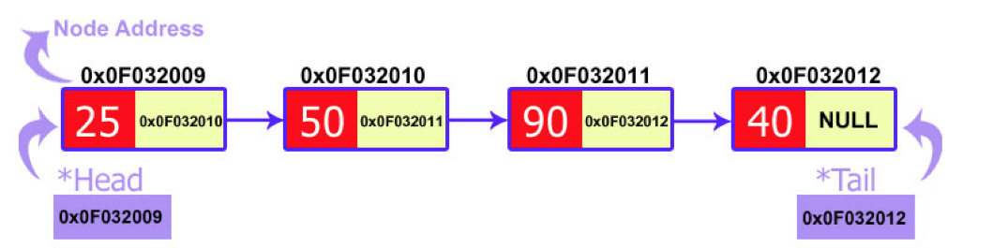
Node
Linked List

Slide 8
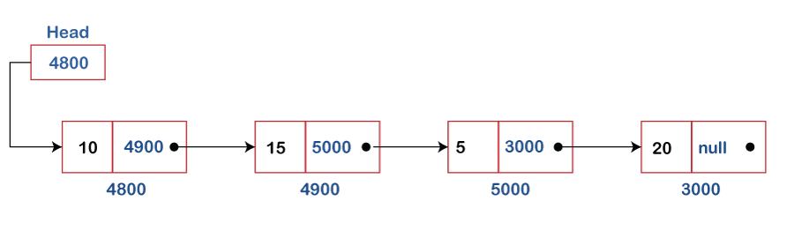
What is Linked List?
A linked list is also a collection of elements, but the elements are not stored in a consecutive location. A linked list can also be defined as the collection of the nodes in which one node is connected to another node, and node consists of two parts, i.e., one is the data part and the second one is the address part that stores the address of the next element is known as a pointer.
The last node of the linked list contains the NULL value in the address part.

Slide 9
How can we declare the Linked list?
We can declare the linked list by using the user-defined data type known as structure.
The structure of a linked list can be defined as:
1. struct node 2. {
int data;
struct node *next;
}
In the above declaration, we have defined a structure named as a node consisting of two variables: an integer variable (data), and the other one is the pointer (next), which contains the address of the next node.

Slide 10
Advantages of linked list over Arrays:
They are not fixed size and hence can grow as new nodes are added.
No need to know beforehand how many elements are going to be stored.
When keeping sorted items, we never have to shift elements.
We never have to shift elements when doing insertion & deletion.
Do not require contiguous memory allocation like arrays.
Disadvantages of linked list over Arrays:
Overhead to extra storage of pointers.
May be less efficient when accessing or modifying data randomly.

Slide 11
Advantages of using a Linked list over Array
The following are the advantages of using a linked list over an array:
Dynamic data structure:
The size of the linked list is not fixed as it can vary according to our requirements.
Insertion and Deletion:
Insertion and deletion in linked list are easier than array as the elements in an array are stored in a consecutive
location. In contrast, in the case of a linked list, the elements are stored in a random location. The complexity for insertion and deletion of elements from the beginning is O(1) in the linked list, while in the case of an array, the complexity would be O(n). If we want to insert or delete the element in an array, then we need to shift the elements for creating the space. On the other hand, in the linked list, we do not have to shift the elements. In the linked list, we just need to update the address of the pointer in the node.
Memory efficient
Its memory consumption is efficient as the size of the linked list can grow or shrink according to our requirements.
Implementation
Both the stacks and queues can be implemented using a linked list.

Slide 12
Disadvantages of Linked list
The following are the disadvantages of linked list:
Memory usage
The node in a linked list occupies more memory than array as each node occupies two types of variables, i.e., one is a simple variable, and another is a pointer variable that occupies 4 bytes in the memory.
Traversal
In a linked list, the traversal is not easy. If we want to access the element in a linked list, we cannot access the element randomly, but in the case of an array, we can randomly access the element by index. For example, if we want to access the 3rd node, then we need to traverse all the nodes before it. So, the time required to access a particular node is large.
Reverse traversing
In a linked list, backtracking or reverse traversing is difficult. In a doubly linked list, it is easier but requires more memory to store the back pointer.

Slide 13
Why and when to use Linked Structures ?
The total amount of information is not known beforehand.
It must be possible to add or remove information, relatively efficiently.
Information is stored in an "ordered" or "sequenced" manner.
The stored data has to be manipulated extensively.

Slide 14
General List
Data can be inserted and deleted from any end and no restrictions on the operations that can be performed on the list.
Random List – No ordering of data
Ordered List – data are arranged according to the key
Key: one or more fields within the structure that are used to identify the data or otherwise control their use.
Restricted List
LIFO (Stack)
FIFO (Queue)

Slide 15
Types of Linked list
The following are the types of linked list:
Simple/Singly Linked List − Item navigation is forward only.
Doubly Linked List − Items can be navigated forward and backward.
Circular Linked List − Last item contains link of the first element as next and the
first element has a link to the last element as previous.
Circular Doubly Linked List −Features of both circular linked list and doubly linked list.

Slide 16
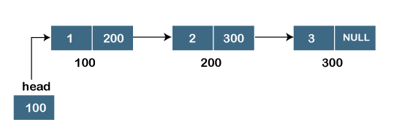
Singly Linked list
Suppose we have three nodes, and the addresses of these three nodes are 100, 200 and 300 respectively. The representation of three nodes as a linked list is shown in the below figure:
We can observe in the above figure that there are three different nodes having address 100, 200 and 300 respectively. The first node contains the address of the next node, i.e., 200, the second node contains the address of the last node, i.e., 300, and the third node contains the NULL value in its address part as it does not point to any node. The pointer that holds the address of the initial node is known as a head pointer.

Slide 17
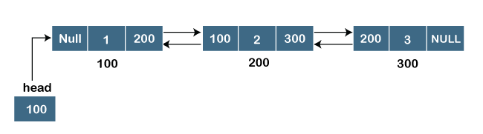
Doubly linked list
Doubly linked list as a linear data structure that has three parts in a single node, includes one data
part, a pointer to its previous node, and a pointer to the next node.
Suppose we have three nodes, and the address of these nodes are 100, 200 and 300, respectively. The representation of these nodes in a doubly-linked list is shown below:
As we can observe in the above figure, the node in a doubly-linked list has two address parts; one part stores the address of the next while the other part of the node stores the previous node's address. The initial node in the doubly linked list has the NULL value in the address part, which provides the address of the previous node.

Slide 18
Representation of the node in a doubly linked list
1.struct node
2. {
int data;
struct node *next;
struct node *prev;
6. }
In the above representation, we have defined a user-defined structure named a node with three members, one is data of integer type, and the other two are the pointers, i.e., next and prev of the node type. The next pointer variable holds the address of the next node, and the prev pointer holds the address of the previous node. The type of both the pointers, i.e., next and prev is struct node as both the pointers are storing the address of the node of the struct node type.

Slide 19
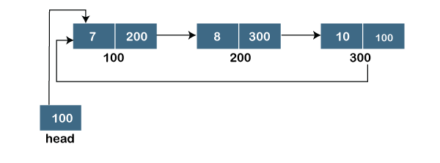
Circular linked list
A circular linked list is a variation of a singly linked list. The only difference between the singly linked list and a circular linked list is that the last node does not point to any node in a singly linked list, so its link part contains a NULL value.
In circular linked list is a list in which the last node connects to the first node, so the link part of the last node holds the first node's address. The circular linked list has no starting and ending node. We can traverse in any direction, i.e., either backward or forward. The diagrammatic representation of the circular linked list is shown below:

Slide 20
Representation of the node in a circular linked list
A circular linked list is a sequence of elements in which each node has a link to the next node, and the last node is having a link to the first node. The representation of the circular linked list will be similar to the singly linked list, as shown below:
1. struct node
2. {
int data;
struct node *next;
5. }

Slide 21
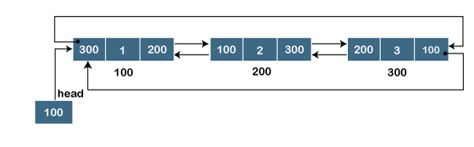
Doubly Circular linked list
The doubly circular linked list has the features of both the circular linked list and doubly linked list.
The above figure shows the representation of the doubly circular linked list in which the last node is attached to the first node and thus creates a circle. It is a doubly linked list also because each node holds the address of the previous node also. The main difference between the doubly linked list and doubly circular linked list is that the doubly circular linked list does not contain the NULL value in the previous field of the node. As the doubly circular linked contains three parts, i.e., two address parts and one data part so its representation is similar to the doubly linked list.

Slide 22
Representation of the node in a doubly circular linked list
1.struct node
2.{
int data;
struct node *next;
struct node *prev; 6.}

Slide 23
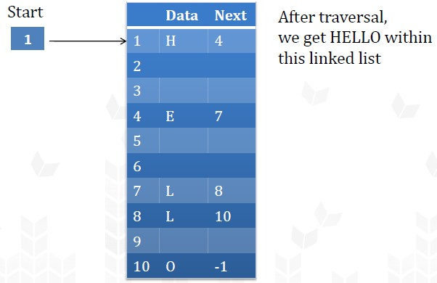
Memory Representation of linked list
Operating system bears the responsibility to change the status of the memory occupied to available and vice versa without intervention from user.

Slide 24
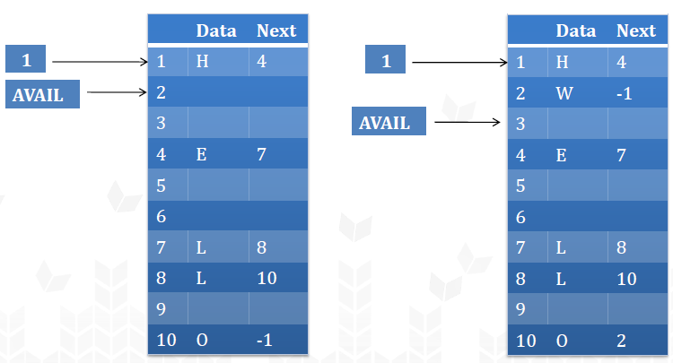
Memory Allocation and Deallocation
Consider, we have a pointer AVAIL which stores the address of the ﬁrst free address. (Free Pool)
AVAIL will be useful to
store new value

Slide 25
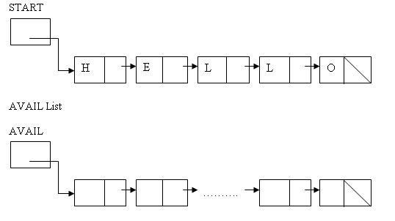
Memory Allocation and Deallocation
Avail is a list of free nodes in the memory. It contains unused memory cells and these memory cells can be used in future. It is also known as ‘List of Available Space’ or ‘Free Storage List’ or ‘Free Pool’.
Whenever a new node is to be inserted in the linked list, a free node is taken from the AVAIL List and is inserted in the linked list.
Similarly, whenever a node is deleted from the linked list, it is inserted in
the AVAIL List. So that it can be used in future.

Slide 26
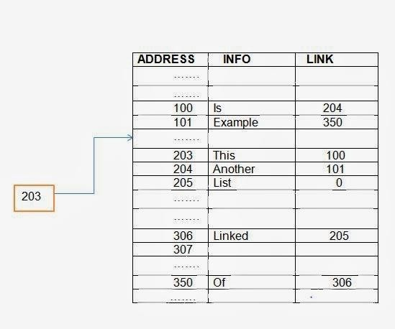
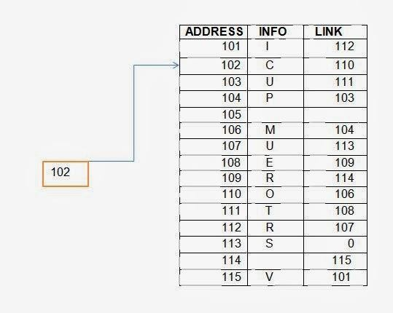
Q. What is stored in the linked list shown below?

Slide 27
Operations on Singly Linked List
1.Insertion Operations on Link List.
2.Deletion Operations on Link List.
3.Traversing in a Single Link List. 4.Printing the Elements of Single Link List.
5.Counting the Number of Nodes in a Single Link List.
6.Searching an Element in unsorted Single Link List.
7.Searching an element in sorted Single Link List.

Slide 28
Operations on Singly Linked List
Node Creation
1.struct node
2.{
int data;
struct node *next;
5.};
6.struct node *head, *newNode;
7.newNode = (struct node *)malloc(sizeof(struct node *));

Slide 29
Insert Node in linked list
Procedure
Allocate memory for new node and initialize it
struct node *newNode;
newNode = (struct node *) malloc(sizeof(struct node *));
newNode → data = item
Point new node to its successor
newNode → next= successor
Point new node’s predecessor to it.
Predecessor=newNode

Slide 30
Insertion Operations on Link List
Inserting a new node in Singly Linked List
Case 1: New node is inserted at the beginning
Case 2: New node is inserted at the end
Case 3: New node is inserted after a given node
Case 4: New node is inserted before a given node
Case 5: New node is inserted in a sorted LL

Slide 31
Insertion in a SLL
Algorithm for New Node is inserted at the Beginning
START
1000
1 | 1050 |  | 4 | 2000 |  | 7 | 3000 |  | 2 | 4000 |  | 9 | X
1000 |  |  | 1050 |  |  | 2000 |  |  | 3000 |  |  | 4000
VAL | NULL
8000
New_Node
New_Node → NEXT = START
VAL | 1000
8000
START = New_Node
New_Node
START
8000
VAL | 1000 |  | 1 | 1050 |  | 4 | 2000 |  | 7 | 3000 |  | 2 | 4000 |  | 9 | X
8000 |  |  | 1000 |  |  | 1050 |  |  | 2000 |  |  | 3000 |  |  | 4000

Slide 32
Insertion in singly linked list at beginning
Algorithm
Step 1: IF NEW_NODE = NULL
Write Memory OVERFLOW Go to Step 5
[END OF IF]
Step 2: SET NEW_NODE -> DATA = VAL Step 3: SET NEW_NODE -> NEXT = HEAD Step 4: SET HEAD = NEW_NODE
Step 5: EXIT

Slide 33
Insertion in a SLL
New Node is inserted at the end
VAL | NULL
8000
3000
4000
1050
1000
START
1000
PTR
2000
New_Node
1 | 1050 |  | 4 | 2000 |  | 7 | 3000 |  | 2 | 4000 |  | 9 | NULL
1000 |  |  | 1050 |  |  | 2000 |  |  | 3000 |  |  | 4000
PTR
1 | 1050 |  | 4 | 2000 |  | 7 | 3000 |  | 2 | 4000 |  | 9 | NULL
1000 |  |  | 1050 |  |  | 2000 |  |  | 3000 |  |  | 4000
PTR
1 | 1050 |  | 4 | 2000 |  | 7 | 3000 |  | 2 | 4000 |  | 9 | NULL
1000 |  |  | 1050 |  |  | 2000 |  |  | 3000 |  |  | 4000
PTR
1 | 1050 |  | 4 | 2000 |  | 7 | 3000 |  | 2 | 4000 |  | 9 | NULL
1000 |  |  | 1050 |  |  | 2000 |  |  | 3000 |  |  | 4000
PTR
1 | 1050 |  | 4 | 2000 |  | 7 | 3000 |  | 2 | 4000 |  | 9 | NULL
1000 |  |  | 1050 |  |  | 2000 |  |  | 3000 |  |  | 4000
PTR
1 | 1050 |  | 4 | 2000 |  | 7 | 3000 |  | 2 | 4000 |  | 9 | 8000
1000 |  |  | 1050 |  |  | 2000 |  |  | 3000 |  |  | 4000
VAL | NULL
8000
New_Node

Slide 34
Insertion in singly linked list at the end
Algorithm
Step 1: IF NEW_NODE = NULL
Write Memory OVERFLOW Go to Step 8
[END OF IF]
Step 2: SET NEW_NODE -> DATA = VAL
Step 3: SET NEW_NODE -> NEXT = NULL
Step 4: SET PTR = HEAD
Step 5: Repeat while PTR -> NEXT != NULL
Step 6: SET PTR = PTR -> NEXT
[END OF LOOP]
Step 7: SET PTR -> NEXT = NEW_NODE Step 8: EXIT

Slide 35
Insertion in a SLL
New Node is inserted after the given node
PREPTR→Data != NUM
PTR
PREPTR
1000
1000
1050
2000
2000
Given Node NUM = 7
1000
3000
START
1000
1050
1 | 1050 |  | 4 | 2000 |  | 7 | 3000 |  | 2 | 4000 |  | 9 | NULL
1000 |  |  | 1050 |  |  | 2000 |  |  | 3000 |  |  | 4000
PTR
VAL | NULL
8000
PREPTR
New_Node
1 | 1050 |  | 4 | 2000 |  | 7 | 3000 |  | 2 | 4000 |  | 9 | NULL
1000 |  |  | 1050 |  |  | 2000 |  |  | 3000 |  |  | 4000
PREPTR
PTR
1 | 1050 |  | 4 | 2000 |  | 7 | 3000 |  | 2 | 4000 |  | 9 | NULL
1000 |  |  | 1050 |  |  | 2000 |  |  | 3000 |  |  | 4000
PREPTR
PTR
8000
1 | 1050 |  | 4 | 2000 |  | 7 | 3000 |  | 2 | 4000 |  | 9 | NULL
1000 |  |  | 1050 |  |  | 2000 |  |  | 3000 |  |  | 4000
PREPTR
PTR
VAL | 3000
8000

Slide 36
Insertion in singly linked list after specified Node
Algorithm
Step 1: IF NEW_NODE = NULL
Write Memory OVERFLOW Go to Step 10
[END OF IF]
Step 2: SET NEW_NODE -> DATA = VAL
Step 3: SET PTR = HEAD
Step 4: SET PREPTR = PTR
Step 5: Repeat Steps 7 and 8 while PREPTR -> DATA != NUM Step 6: SET PREPTR = PTR
Step 7: SET PTR = PTR -> NEXT
[END OF LOOP]
Step 8 : PREPTR -> NEXT = NEW_NODE Step 9: SET NEW_NODE -> NEXT = PTR Step 10: EXIT

Slide 37
Insertion in singly linked list before specified Node
Algorithm
Step 1: IF NEW_NODE = NULL
Write Memory OVERFLOW Go to Step 11
[END OF IF]
Step 2: SET NEW_NODE -> DATA = VAL
Step 3: SET NEW_NODE->NEXT=NULL
Step 4: SET PTR = HEAD
Step 5: SET PREPTR = PTR
Step 6: Repeat Steps 7 and 8 while PTR -> DATA != NUM Step 7: SET PREPTR = PTR
Step 8: SET PTR = PTR -> NEXT
[END OF LOOP]
Step 9 : NEW_NODE -> NEXT = PTR
Step 10: SET PREPTR -> NEXT = NEW_NODE Step 11: EXIT

Slide 38
New node is inserted in a Sorted Linked List
Step 1: IF New_Node = NULL then
Write Memory Overflow
Go to Step 11
[End of IF]
Step 2: Set New_Node → DATA = VAL
Step 3: Set New_Node → NEXT = NULL
Step 4: Set PTR = START Step 5: Set PREPTR = PTR
Step 6: Repeat Step 7 and 8 while PTR →DATA < VAL
Step 7:Set PREPTR = PTR
Step 8: Set PTR = PTR → NEXT
[End of Loop]
Step 9: Set New_Node → NEXT = PTR Step 10: Set PREPTR → NEXT = New_Node Step 11: Exit.

Slide 39
Deletion Operations on Link List
Deleting a node from Singly Linked List
Case 1: First node is deleted
Case 2: Last node is deleted
Case 3: Node after a given node is deleted
Case 4: Node before a given node is deleted
Case 5: Node is deleted from a sorted Link List

Slide 40
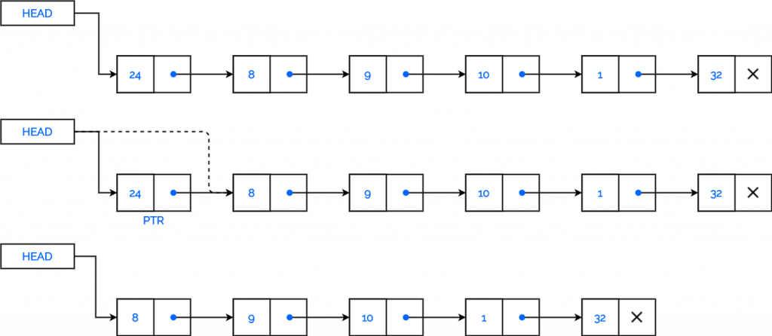
Deletion in singly linked list at beginning
Algorithm
Step 1: IF HEAD = NULL Write UNDERFLOW
Go to Step 5
[END OF IF]
Step 2: SET PTR = HEAD
Step 3: SET HEAD = HEAD -> NEXT Step 4: FREE PTR
Step 5: EXIT

Slide 41
Deletion in singly linked list at beginning
C Code:
if(head == NULL)
{
printf("Underflow");
}
else
{
ptr = head;
head = head -> next; free(ptr);
}

Slide 42
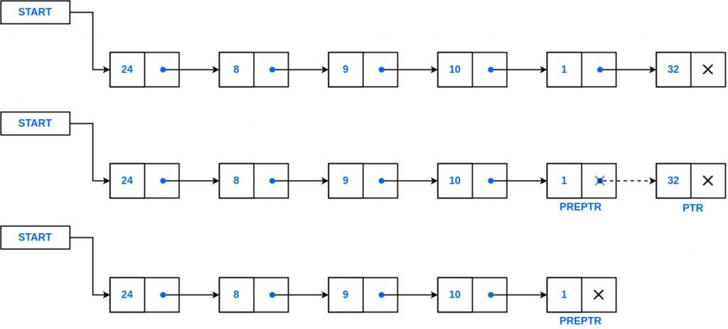
Deletion in singly linked list at the end
Algorithm
Step 1: IF HEAD = NULL
Write UNDERFLOW
Go to Step 8 [END OF IF]
Step 2: SET PTR = HEAD
Step | 3: | Repeat Steps 4 and 5 while PTR -> NEXT != NULL
Step | 4: | SET PREPTR = PTR
Step | 5: | SET PTR = PTR -> NEXT
[END | OF | LOOP]
Step | 6: | SET PREPTR -> NEXT = NULL
Step | 7: | FREE PTR
Step | 8: | EXIT

Slide 43
Deletion in singly linked list at the end
C Code:
if(head == NULL)
{
printf("Underflow");
}
else
{
struct node* ptr = head; struct node* preptr = NULL; while(ptr->next!=NULL){ preptr = ptr;
ptr = ptr->next;
}
preptr->next = NULL; free(ptr);
}

Slide 44
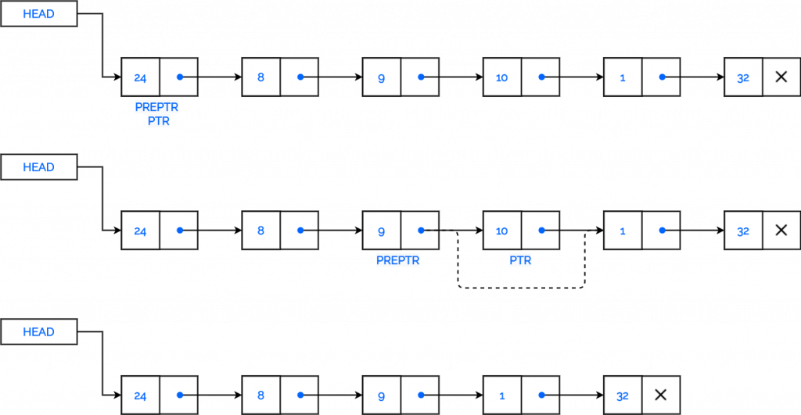
Deletion in singly linked list after specified Node
Algorithm
Step 1: IF HEAD = NULL Write UNDERFLOW
Go to Step 10
[END OF IF]
Step 2: SET PTR = HEAD Step 3: SET PREPTR = PTR
Step 4: Repeat Steps 5 and 6 while PREPTR -> DATA != NUM
Step 5: SET PREPTR = PTR
Step 6: SET PTR = PTR -> NEXT [END OF LOOP]
Step 7: SET TEMP = PTR
Step 8: SET PREPTR -> NEXT = PTR -> NEXT Step 9: FREE TEMP
Step 10 : EXIT

Slide 45
Deletion in singly linked list after specified Node
C Code:
if(head == NULL)
{
printf("Underflow");
}
else
{
struct node* ptr = head; struct node* preptr = ptr; while(preptr->data!=num){ preptr = ptr;
ptr = ptr->next;
}
struct node* temp = ptr; preptr -> next = ptr -> next; free(temp);
}

Slide 46
Deletion in singly linked list before specified Node
Algorithm
Step 1: IF START = NULL then
Write Underflow Go to Step 11
[End of IF]
Step 2: Set PTR = START Step 3: Set PREPTR = START Step 4: Set CUR = START
Step 5: Repeat Steps 5 to 8 while CUR DATA != NUM
Step 6:
Step 7:
Step 8:
Set PREPTR = PTR Set PTR = CUR Set CUR = CUR
NEXT
[END of LOOP]
NEXT = PTR->NEXT
Step 9: Set PREPTR
OR SET PREPTR
NEXT = CUR
Step 10: FREE PTR
Step 11: Exit

Slide 47
Node is Deleted from a sorted SLL
Step 1: IF START = NULL then
Write Underflow Go to Step 9
[End of IF] Step 2: Set PTR = START Step 3: Set PREPTR = PTR
Step 4: Repeat Steps 4 to 6 while PTR → DATA < NUM
Step 5:
Step 6:
Set PREPTR = PTR
Set PTR = PTR → NEXT [END of LOOP]
Step 7: IF PTR→DATA == NUM then
Set PREPTR → NEXT = PTR->NEXT FREE PTR
Else
Write “Data Not Found”
Step 9: Exit

Slide 48
Traversing in a Single Link List
Algorithm for traversing a linked list
Step 1: [INITIALIZE]
SET PTR = START
Step 2: Repeat Steps 3 and 4 while PTR != NULL
Step 3:
Step 4:
Apply Process to PTR -> DATA
SET PTR = PTR -> NEXT [END OF LOOP]
Step 5: EXIT

Slide 49
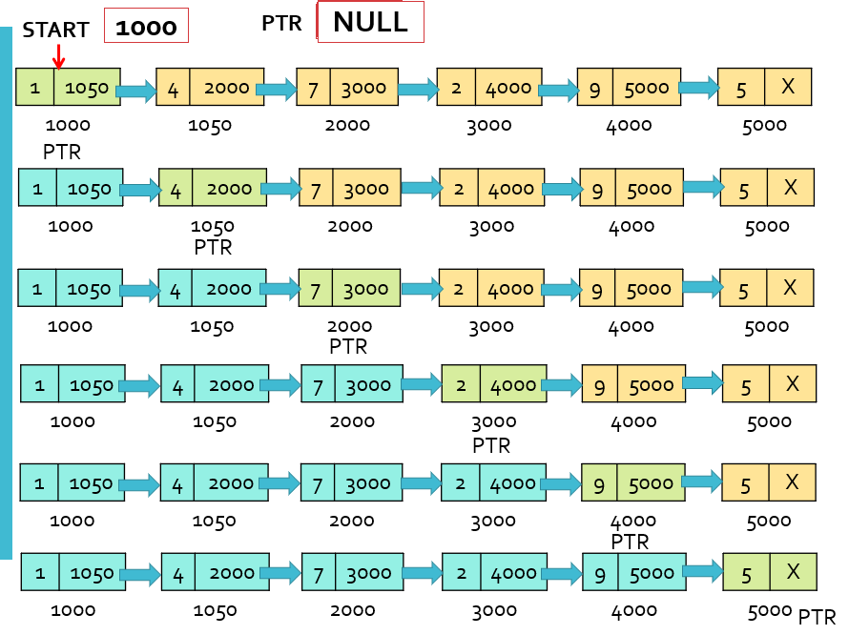

Slide 50
Printing the Elements of Single Link List
Algorithm to print each node of the linked list
Step 1: [INITIALIZE]
SET PTR = START
Step 2: Repeat Steps 3 and 4 while PTR != NULL
Step 3:
Step 4:
Write PTR -> DATA SET PTR = PTR -> NEXT [END OF LOOP]
Step 5: EXIT

Slide 51
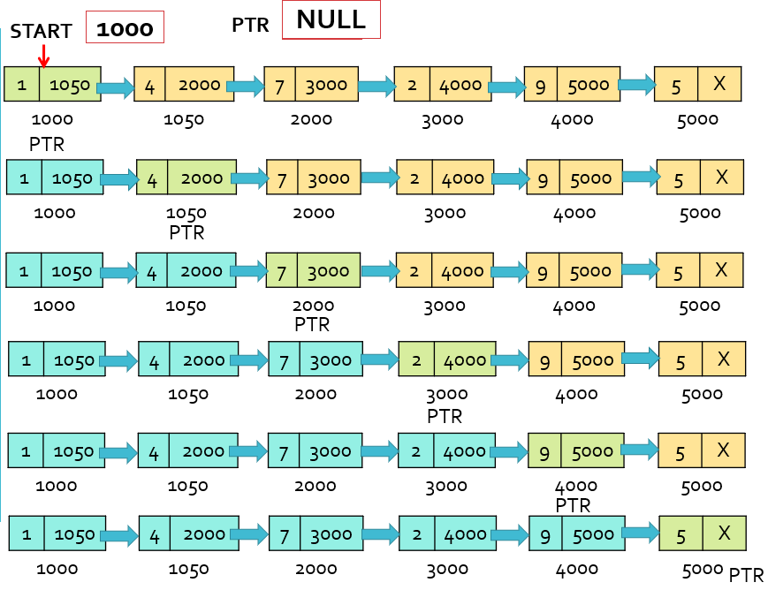

Slide 52
Counting the Number of Nodes in a Single Link List
Algorithm to print the number of nodes in the linked list
Step 1: [INITIALIZE]
SET PTR = START
SET Count = 0
Step 2: Repeat Steps 3 and 4 while PTR != NULL
Step 3:
Step 4:
SET Count = Count + 1 SET PTR = PTR -> NEXT [END OF LOOP]
Step 5: EXIT

Slide 53
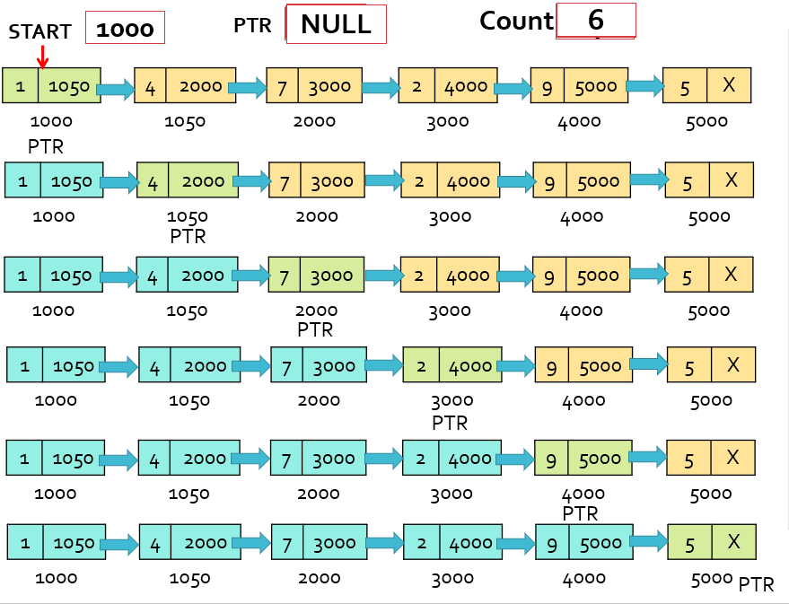

Slide 54
Searching an Element in unsorted Single Link List
Searching an element in Unsorted Linked List
Step 1: [INITIALIZE]
SET PTR = START
Step 2: Repeat Steps 3 while PTR != NULL
Step 3:
IF VAL = PTR -> DATA
SET POS = PTR
Go To Step 5
ELSE
SET PTR = PTR -> NEXT [END OF IF]
[END OF LOOP]
Step 4: SET POS = NULL Step 5: EXIT

Slide 55
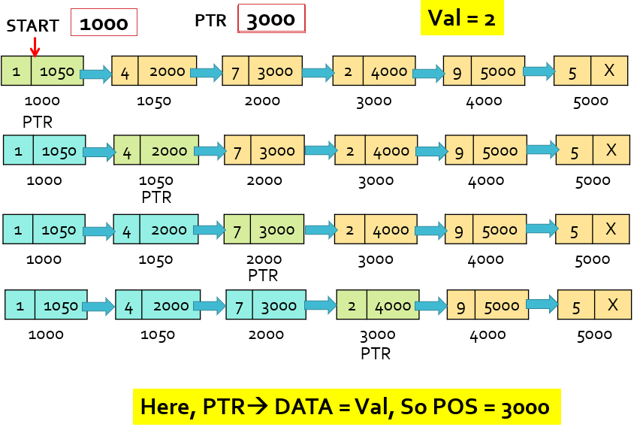

Slide 56
Searching an element in sorted Single Link List
Searching an element in Sorted Linked List
Step 1: [INITIALIZE]
SET PTR = START
Step 2: Repeat Steps 3 while PTR != NULL
Step 3:
IF PTR -> DATA = VAL then
SET POS = PTR
Go To Step 5 ELSE IF VAL > PTR -> DATA
SET PTR = PTR -> NEXT
ELSE
Go To Step 4 [END OF IF]
[END OF LOOP]
Step 4: SET POS = NULL Step 5: EXIT

Slide 57
Operations on Circular Linked List
Insertion Operations on Link List.
Deletion Operations on Link List.

Slide 58
Insertion Operations on Circular Link List
Inserting a new node in Singly Circular Linked List
Inserting a new Node at the beginning of a Circular Linked List.
Inserting a new Node at the end of a Circular Linked List.

Slide 59
Inserting a new Node at the beginning of a Circular Linked List.
Algorithm
Step 1: IF NEW_NODE = NULL
Write OVERFLOW Go to Step 9 [END OF IF]
Step 2: SET NEW_NODE -> DATA = VAL
Step 3: SET PTR = HEAD
Step 4: Repeat Step 5 while PTR -> NEXT != HEAD Step 5: PTR = PTR -> NEXT
[END OF LOOP]
Step 6: SET NEW_NODE -> NEXT = HEAD Step 7: SET PTR -> NEXT = NEW_NODE Step 8: SET HEAD = NEW_NODE
Step 9: EXIT

Slide 60
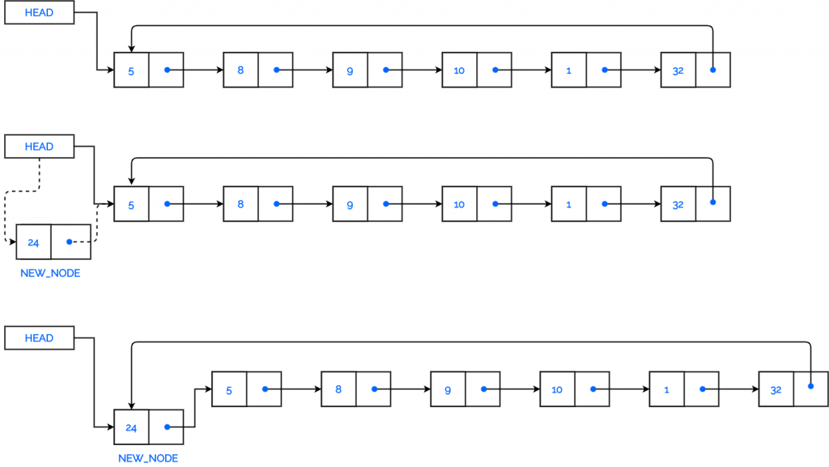
Operations on Circular Linked List
Allocate memory for new node and
initialize its DATA part to 24.
Add the new node as the first node of the list by pointing the NEXT part of the new node to HEAD.
Make HEAD to point to the first node of the list.
Make HEAD point to the new node.

Slide 61
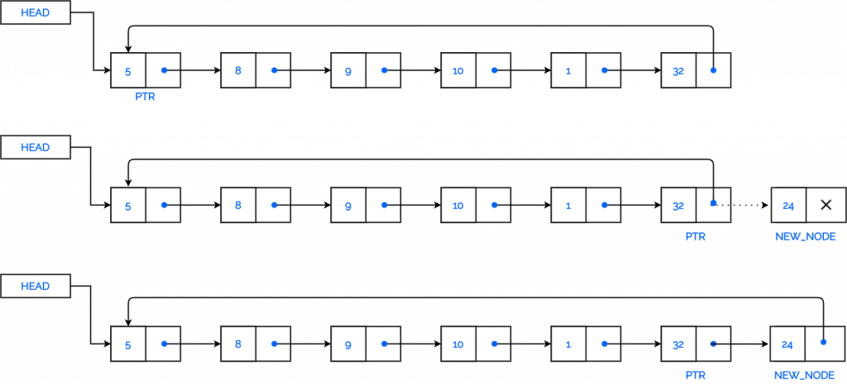
Inserting a new Node at the end of a Circular Linked List.
Algorithm
Step 1: IF NEW_NODE = NULL
Write OVERFLOW Go to Step 8 [END OF IF]
Step 2: SET NEW_NODE -> DATA = VAL
Step 3: SET NEW_NODE -> NEXT = HEAD
Step 4: SET PTR = HEAD
Step 5: Repeat Step 6 while PTR -> NEXT != HEAD Step 6: SET PTR = PTR -> NEXT
[END OF LOOP]
Step 7: SET PTR -> NEXT = NEW_NODE Step 8 : EXIT

Slide 62
Deletion Operations on Circular Link List
Deleting a node from Circular Singly Linked List
Case 1: First node is deleted
Case 2: Last node is deleted

Slide 63
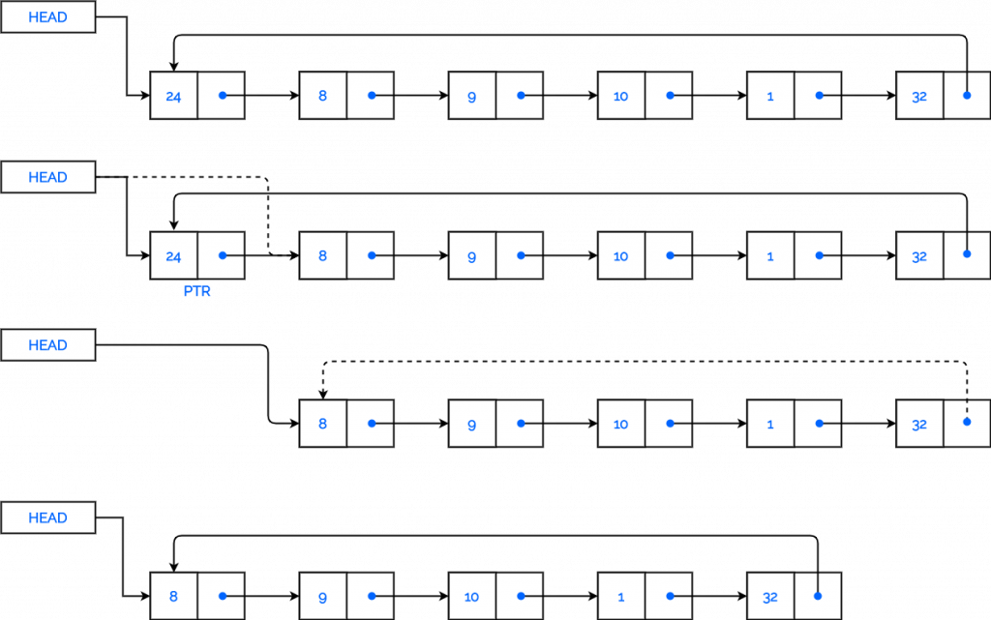
Deletion in Circular singly linked list at beginning
Algorithm
Step 1: IF HEAD = NULL
Write UNDERFLOW
Go to Step 8 [END OF IF]
Step 2: SET PTR = HEAD
Step 3: Repeat Step 4 while PTR -> NEXT != HEAD
Step 4: SET PTR = PTR -> NEXT [END OF LOOP]
Step 5: SET PTR -> NEXT = HEAD -> NEXT
Step 6: FREE HEAD
Step 7: SET HEAD = PTR -> NEXT
Step 8: EXIT

Slide 64
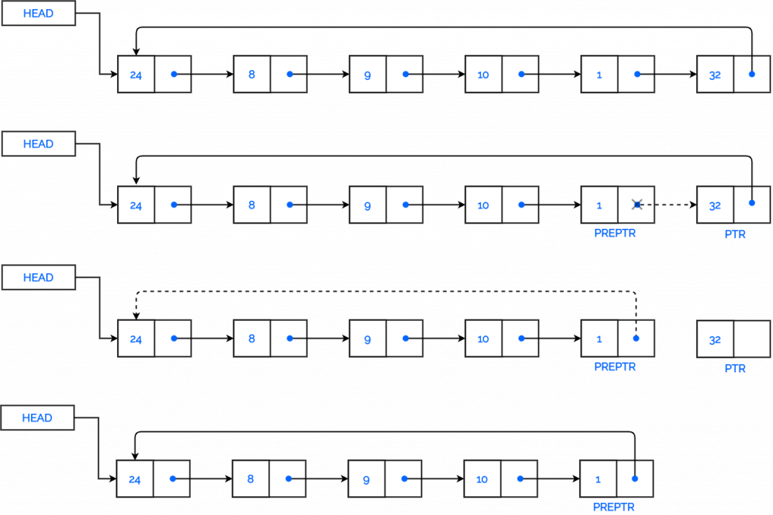
Deletion in Circular singly linked list at the end
Algorithm
Step 1: IF HEAD = NULL Write UNDERFLOW
Go to Step 8 [END OF IF]
Step 2: SET PTR = HEAD
Step 3: Repeat Steps 4 and 5 while PTR NEXT != HEAD Step 4: SET PREPTR = PTR
Step 5: SET PTR = PTR -> NEXT [END OF LOOP]
Step 6: SET PREPTR -> NEXT = HEAD
Step 7: FREE PTR
Step 8: EXIT

Slide 65
Double Link List
In Doubly-linked list each node has two links: one points to previous node and one
points to next node.
The previous link of first node in the list points to a Null and the next link of last node points to Null.
Representation of Doubly Linked List
Struct node_type
{ int info ;
struct node_type *prev;
struct node_type *next;
} node ;

Slide 66
Double Link List
Advantages
Traversal in either direction becomes convenient.
Reduces time requirement for the program execution.
The doubly linked lists can be used to represent other data- structure. The hierarchical structure of the tree can be easily represented using a doubly linked list. Graphs can be represented using doubly linked list.
Disadvantages
Each node requires extra space for storing the additional pointer.
While manipulating the lists, extra care should be taken to manipulate both links.

Slide 67
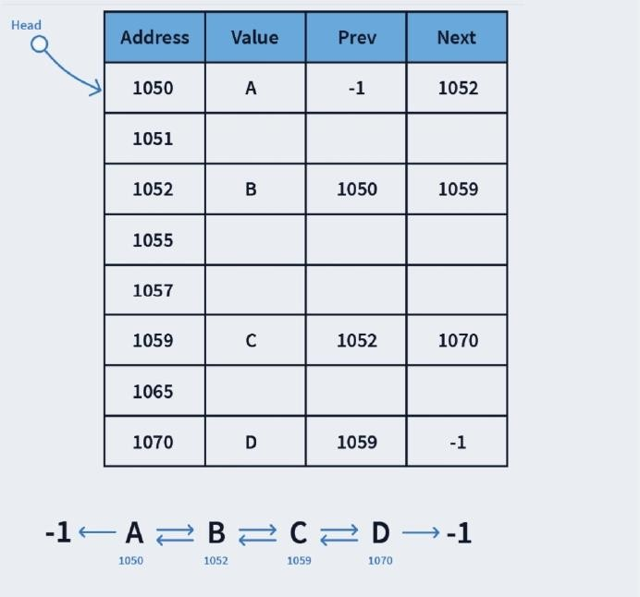
Memory Representation

Slide 68
Insertion Operations on Double Linked List
New node is inserted at the beginning.
New node is inserted at the end.
New node is inserted after a given node.
New node is inserted before a given node.
New node is inserted in a sorted linked list.

Slide 69
Insertion in double linked list at beginning
Step 1: IF NEW_NODE = NULL, then Write OVERFLOW GoTo Step 7 [END OF IF]
Step 2: SET New_Node-> DATA =VAL Step 3: SET New_Node-> PREV = NULL Step 4: SET New_Node-> NEXT = START Step 5: SET START -> PREV = New_Node Step 6: SET START = New_Node
Step 7: Exit

Slide 70
Insertion in double linked list at End
Step 1: IF New_Node = NULL, then
Write OVERFLOW GoTo Step 9
[END OF IF]
Step 2: SET New_Node-> DATA =VAL
Step 3: SET New_Node-> NEXT = NULL Step 4: SET PTR = START
Step 5: Repeat Step 6 while PTR->NEXT != NULL
Step 6: SET PTR = PTR -> NEXT [END OF LOOP]
Step 7: SET PTR -> NEXT = New_Node
Step 8: New_Node-> PREV = PTR Step 9: Exit

Slide 71
Insertion in double linked list after a given node
Step 7: SET New_Node-> NEXT = PTR
Step 8: SET New_Node-> PREV = PREPTR Step 9: SET PREPTR -> NEXT = New_Node
Step 10: SET PTR-> PREV = New_Node
Step 11: Exit
Step 1: IF New_Node = NULL, then
Write OVERFLOW Go To Step 11 [END OF IF]
Step 2: SET New_Node-> DATA = VAL
Step 3: SET PTR = START
Step 4: SET PREPTR = PTR
Step 5: Repeat Step 6 while PREPTR-> DATA != NUM Step 6: SET PREPTR = PTR
SET PTR = PTR -> NEXT
[END OF LOOP]

Slide 72
Insertion in double linked list before a given node
Step 1: IF New_Node = NULL, then
Write OVERFLOW Go To Step 11 [END OF IF]
Step 2: SET New_Node-> DATA = VAL
Step 3: SET PTR = START
Step 4: SET PREPTR = PTR
Step 5: Repeat Step 8 while PTR-> DATA != NUM Step 6:SET PREPTR = PTR
SET PTR = PTR -> NEXT
[END OF LOOP]
Step 7: SET New_Node-> NEXT = PTR
Step 8: SET New_Node-> PREV = PREPTR Step 9: SET PREPTR -> NEXT = New_Node
Step 10: SET PTR -> PREV = New_Node
Step 11: Exit

Slide 73
Insertion in double linked list in sorted list
Step 1: IF New_Node = NULL, then
Write OVERFLOW Go To Step 11
Step 7: SET New_Node-> NEXT = PTR
[END OF IF]
Step 2: SET New_Node-> DATA = VAL Step 3: SET PTR = START
Step 4: SET PREPTR = PTR
Step 5: Repeat Step 6 while PTR-> DATA < VAL
Step 6:SET PREPTR = PTR
SET PTR = PTR -> NEXT [END OF LOOP]
Step 8: SET New_Node-> PREV = PREPTR Step 9: SET PREPTR -> NEXT = New_Node
Step 10: SET PTR -> PREV = New_Node
Step 11: Exit

Slide 74
Deletion Operations on Double Linked List
Node is deleted at the beginning
Node is deleted at the end
Node is deleted after a given node
Node is deleted before a given node

Slide 75
Deletion in Double Linked List at beginning
Step 1: IF START = NULL, then Write UNDERFLOW
Go to Step 6 [END OF IF]
Step 2: SET PTR = START
Step 3: SET START = START -> NEXT
Step 4: SET START -> PREV = NULL
Step 5: FREE PTR
Step 6: Exit

Slide 76
Node is deleted at the end
Step 1: IF START = NULL, then
Write UNDERFLOW
Go to Step 8 [END OF IF]
Step 2: SET PTR = START Step 3: SET PREPTR = PTR
Step 4: Repeat Step 5 while PTR->NEXT != NULL Step 5: SET PREPTR = PTR
SET PTR = PTR -> NEXT
[END OF LOOP]
Step 6: SET PREPTR -> NEXT = NULL Step 7: FREE PTR
Step 8: Exit

Slide 77
Node is deleted after a given node
Step 1: IF START = NULL, then
Write UNDERFLOW
Go to Step 10
[END OF IF]
Step 2: SET PTR = START
Step 3: SET PREPTR = PTR
Step 4: Repeat Step 5 while PREPTR->DATA != NUM
Step 5: SET PREPTR = PTR
SET PTR = PTR -> NEXT
[END OF LOOP]
Step 6: SETTEMP = PTR -> NEXT
Step 7: SET PREPTR -> NEXT = PTR -> NEXT
Step 8: SETTEMP -> PREV = PTR -> PREV
Step 9: FREE PTR
Step 10: Exit

Slide 78
Node is deleted before a given node
Step 1:IF START = NULL,
then Write UNDERFLOW
Go to Step 10 [END OF IF] Step 2: SET PTR = START Step 3: SET PREPTR = PTR
Step 4: Repeat Step 5 while PTR->DATA != NUM
Step 5: SET PREPTR = PTR
SET PTR = PTR -> NEXT [END OF LOOP]
Step 6: SET TEMP = PREPTR -> PREV
Step 7: SETTEMP -> NEXT = PREPTR -> NEXT Step 8: SET PTR -> PREV = PREPTR -> PREV Step 9: FREE PREPTR
Step 10: Exit

Slide 79

Circular Doubly Linked List
The difference between a doubly linked and a circular doubly linked list is same as that exists between a singly linked list and a circular linked list.
The circular doubly linked list does not contain NULL in the previous field of the first node and the next field of the last node.
Rather, the next field of the last node stores the address of the first node of the list, i.e., START. Similarly, the previous field of the first field stores the address of the last node.

Slide 80
Operations on Circular Double Linked List
Insertion at beginning.
Insertion at End.
Deletion at beginning.
Deletion at End.

Slide 81
Insert a new node at the beginning of the node
Step 1: IF AVAIL = NULL, then
Write OVERFLOW GoTo Step 13 [END OF IF]
Step 2: SET New_Node= AVAIL
Step 3: SET AVAIL =AVAIL -> NEXT
Step 10: SET New_Node-> NEXT = START Step 11: SET START -> PREV = New_Node Step 12: SET START = New_Node
Step 13: Exit
Step 4: SET New_Node-> DATA =VAL Step 5: SET PTR = START
Step 6: Repeat Step 7 while PTR -> NEXT != START
Step 7:SET PTR = PTR -> NEXT
[END OF LOOP]
Step 8: SET PTR -> NEXT = New_Node
Step 9: SET New_Node-> PREV = PTR

Slide 82
New node is inserted at the end
Step 1: IF AVAIL = NULL, then
Write OVERFLOW
GoTo Step 12 [END OF IF]
Step 2: SET New_Node= AVAIL Step 3: SET AVAIL = AVAIL -> NEXT
Step 4: SET New_Node-> DATA =VAL Step 5: SET New_Node-> NEXT = START Step 6: SET PTR = START
Step 7: Repeat Step 8 while PTR -> NEXT != START
Step 8:SET PTR = PTR -> NEXT
[END OF LOOP]
Step 9: SET PTR -> NEXT = New_Node Step 10: SET START -> PREV = New_Node Step 11: SET New_Node-> PREV = PTR Step 12: Exit

Slide 83
Node is deleted at the beginning
Step 1: IF START = NULL, then
Write UNDERFLOW
Go to Step 10 [ENDOF IF]
Step 2: SET PTR = START
Step 3: SETTEMP = START -> NEXT
Step 4: Repeat Step 5 while PTR -> NEXT != START Step 5: SET PTR = PTR -> NEXT
[ENDOF LOOP]
Step 6: SET PTR -> NEXT =TEMP
Step 7: SETTEMP -> PREV = PTR Step 8: FREE START
Step 9: SET START =TEMP
Step 10: Exit

Slide 84
Node is deleted at the end
Step 1: IF START = NULL, then
Write UNDERFLOW
Go to Step 9 [ENDOF IF]
Step 2: SET PTR = START
Step 3: SET PREPTR = PTR
Step 4: Repeat Step 5 while PTR -> NEXT != START Step 5:SET PREPTR = PTR
SET PTR = PTR -> NEXT
[ENDOF LOOP]
Step 6: SET PREPTR -> NEXT = START Step 7: SET START -> PREV = PREPTR Step 8: FREE PTR
Step 9: Exit

Slide 85
Applications of Linked List in the field of Computer Science
Dynamic Memory Allocation: As we know, we can dynamically allocate memory in a linked list, so it can be veíy helpful when we don’t know the numbeí of elements we are going to use.
Implementing advanced data structures: We can implement data structures like stacks and queues with the help of a linked list.
Manipulating polynomials: We can do polynomials manipulation with the help of a linked list by storing the constants in the nodes of the linked list.
Arithmetic operations on long integers: As integers have a limit, we cannot perform arithmetic operations on long integers. But, if we use a linked list to represent the long integers, we can easily perform the operations.
Graph Adjacency list Representation: Linked List helps in storing the adjacent vertices of a graph in adjacency list representation.

Slide 86
Applications of Linked List in real world
In web browsers, you might have seen that we can always access the previous and next URL using the back and forward button. Access to previous and next URL searched is possible because they are linked using a linked list.
The songs in the Music Player are linked to the next and the previous song. We can play songs either from the starting or the end of the list.
In an Image Viewer, the next and the previous images are linked; hence they can be accessed by the previous and the next button.

Slide 87
THANK YOU

