Slide 1




Non linear Data Sructure
Unit-3 Part-1 Graph Theory
Data Structure 01CE0301 / 3130702
Department of Computer Engineering

Slide 2
Graph
Definition terminology
Representation of graphs
Types of Graphs
DFS and BFS Algorithm

Slide 3
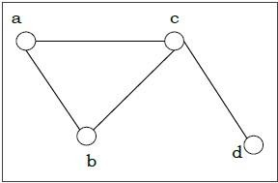
Graph
A graph is a set of points, called nodes or vertices, which are interconnected by a set of lines called edges.
Definition − A graph (denoted as G=(V,E)) consists of a non-empty set of vertices or nodes V and a set of edges E.
Example − Let us consider, a Graph
isG=(V,E) where V={a,b,c,d} and E={{a,b},{a,c},{b,c},{c,d}}

Slide 4
Vertex | Degree | Even / Odd
a | 2 | even
b | 2 | even
c | 3 | odd
d | 1 | odd
Degree of a Vertex − The degree of a vertex V of a graph G (denoted by deg (V)) is the number of edges incident with the vertex V.
Even and Odd Vertex − If the degree of a vertex is even, the vertex is called an even vertex and if the degree of a vertex is odd, the vertex is called an odd vertex.
Degree of a Graph − The degree of a graph is the largest vertex degree of that graph. For the above graph the degree of the graph is 3.
The Handshaking Lemma − In a graph, the sum of all the degrees of all the vertices is equal to twice the number of edges. 4*2=8

Slide 5
Pendant Vertex: A vertex with degree one is called a Pendant Vertex.
Pendant Edge: The only edge which is an incident with a pendant vertex is called the Pendant Edge.
Incident Edge: An edge is called incident with the vertices is connects.
Adjacent Vertices: Two vertices are called adjacent if an edge links them. If there is an edge (u, v), then we can say vertex u is adjacent to vertex v, and vertex v is adjacent to vertex u.
Self-Loop: A self-loop is an edge e if it has the same endpoint.
Isolated Vertex: A vertex with degree 0 is called Isolated Vertex

Slide 6
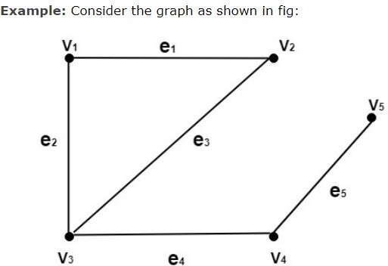
Determine the following:
1.Pendant Vertices
2.Pendant Edges
3.Odd vertices
4.Even Vertices
5.Incident Edges
6.Adjacent Vertices

Slide 7
Solution:
The vertex V₅is the pendant vertex.
The edge (V_{4,}V₅) or e₅ is the pendant edge.
The vertices V₃ and V₅ are odd vertices.
The vertices V_{1,} V_{2,}and V₄ are even vertices.
The edge e₁ is an incident on V_{1,} and V₂. The edge e₂ is an incident on V₁ and V₃. The edge e₃ is an incident on V₂ and V₃. The edge e₄ is an incident on V₃ and V₄. The edge e₅ is an incident on V₄ and V_{5.}
The vertex V₁ is adjacent to V₂ and V₃. The vertex V₂ is adjacent to V₁ and V₂. The vertex V₃ is adjacent to V₁ and V₄ The vertex V₄ is adjacent to V₃ and V₅ The vertex V₅ is adjacent to V₄.

Slide 8
Representation of Graphs
There are mainly two ways to represent a graph − Matrix - Adjacency Matrix
Incidence Matrix
Adjacency List

Slide 9
1.Adjacency Matrix
An Adjacency Matrix A[V][V] is a 2D array of size V×V where V is the number of vertices in a undirected graph.
If there is an edge between Vx to Vy then the value of A[Vx][Vy]=1 and A[Vy][Vx]=1, otherwise the value will be zero.
And for a directed graph, if there is an edge between Vx to Vy, then the value of A[Vx][Vy]=1, otherwise the value will be zero.

Slide 10
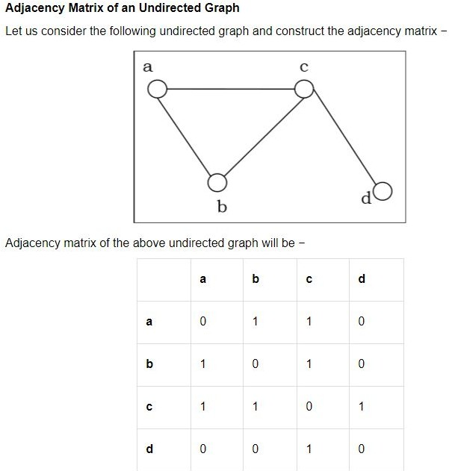

Slide 11

2. Incidence Matrix Representation: If an Undirected Graph G consists of n vertices and m edges, then the incidence matrix is an n x m matrix C = [c_{ij}] and defined by
There is a row for every vertex and a column for every edge in the incident matrix.
The number of ones in an incidence matrix of the undirected graph (without loops) is equal to the sum of the degrees of all the vertices in a graph.

Slide 12
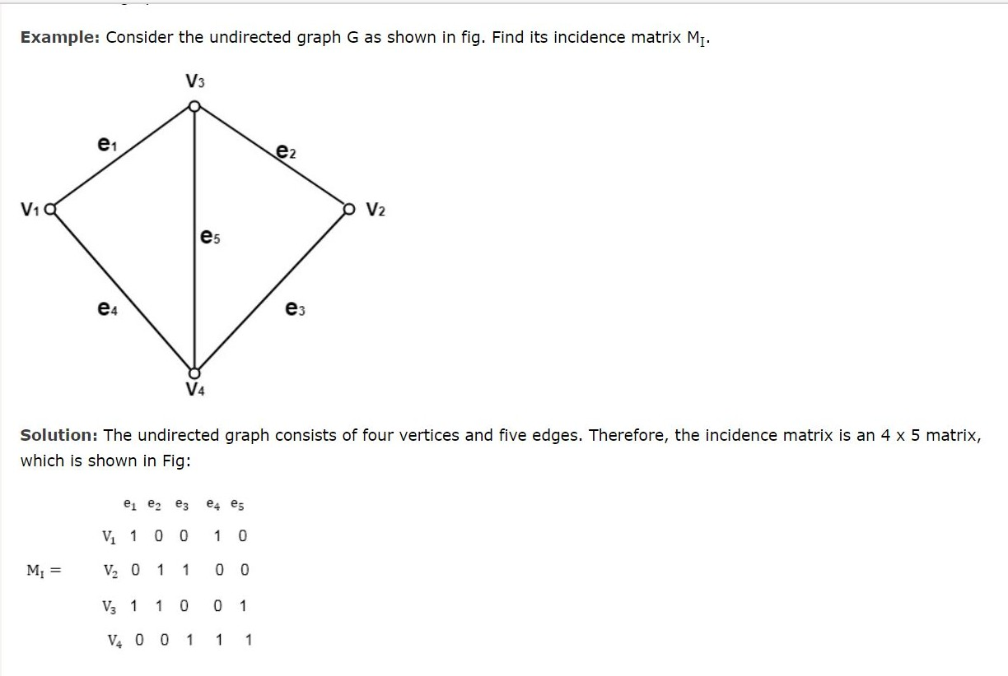

Slide 13
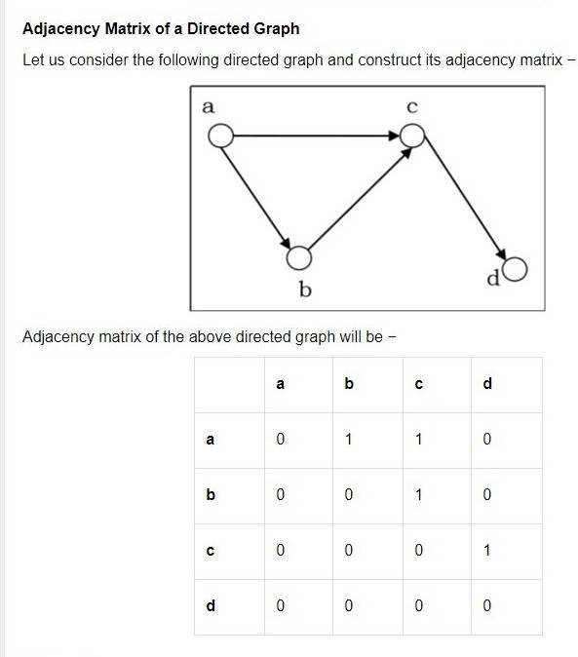

Slide 14

2. Incidence Matrix Representation of Directed Graph:
If a directed graph G consists of n vertices and m edges, then the incidence matrix is an n x m matrix C
= [c_{ij}] and defined by
The number of ones in an incidence matrix is equal to the number of edges in the graph.

Slide 15
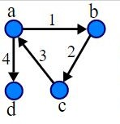
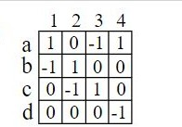

Slide 16
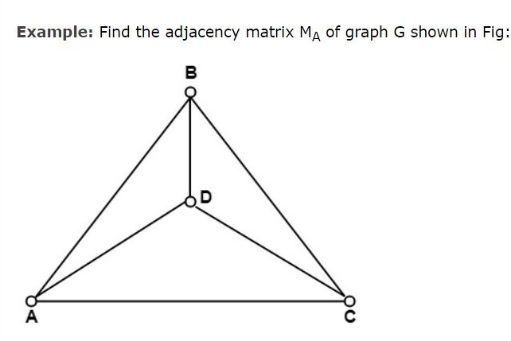
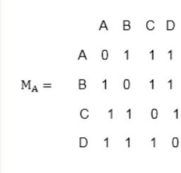

Slide 17
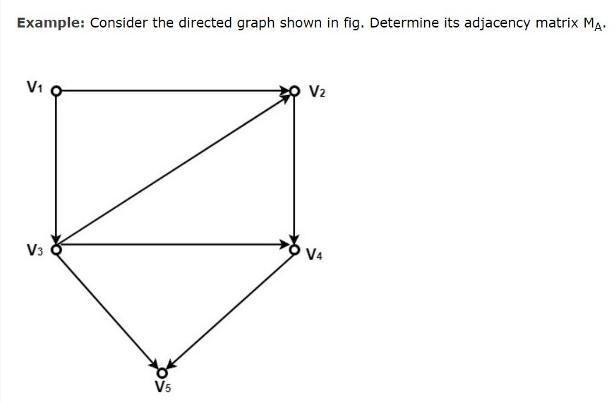
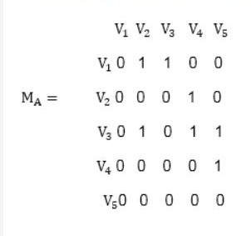

Slide 18
Adjacency List
Adjacency list is a linked representation.
In this representation, for each vertex in the graph, we maintain the list of its neighbors. It means, every vertex of the graph contains list of its adjacent vertices.
We have an array of vertices which is indexed by the vertex number and for each vertex v, the corresponding array element points to a singly linked list of neighbors of v.

Slide 19
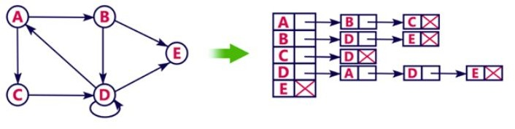
Adjacency List for Directed Graph

Slide 20
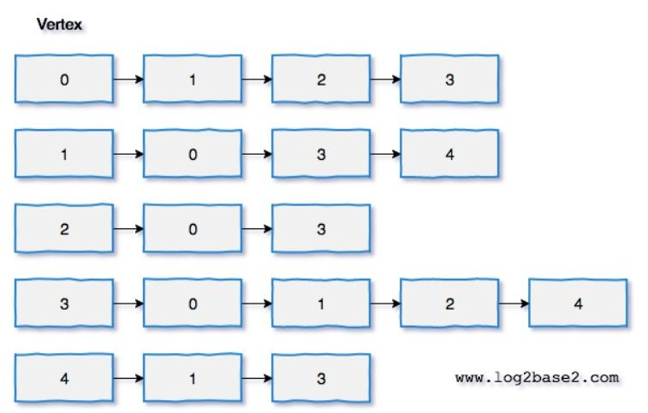
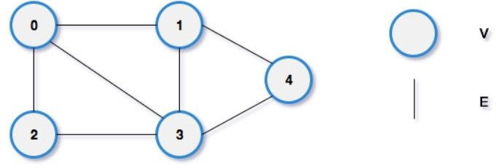
Adjacency list for Undirected Graph

Slide 21
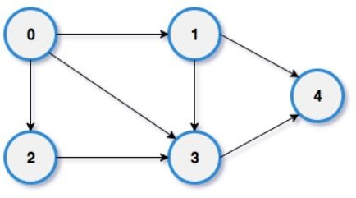
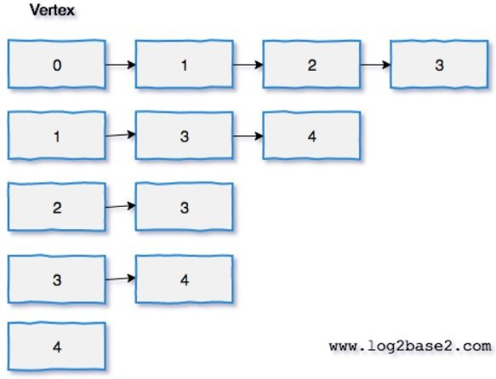
Question: Convert the following Graph to Adjacency List

Slide 22
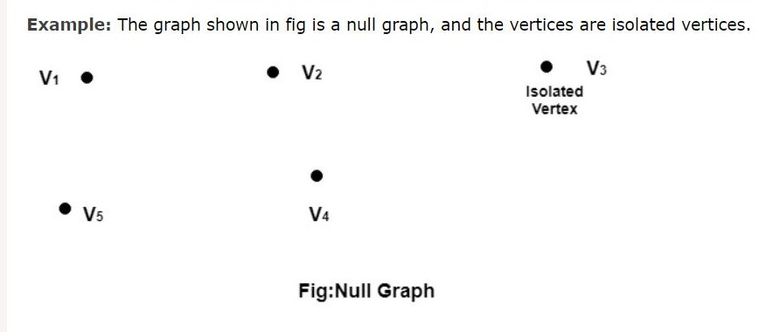
Types of Graph
1. Null Graph: A null graph is defined as a graph which consists only the isolated vertices.

Slide 23
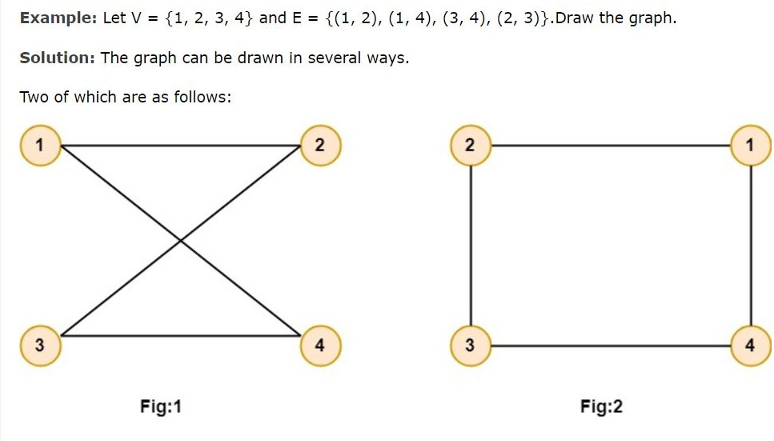
2. Undirected Graphs:
An Undirected graph G consists of a set of vertices, V and a set of edge E.
The edge set contains the unordered pair of vertices.
If (u, v)∈E then we say u and v are connected by an edge where u and v are vertices in the set V.

Slide 24
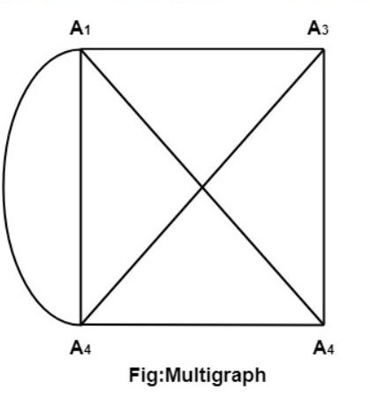
3. Multigraph: - If in a graph multiple edges between the same set of vertices are allowed, it is known as Multigraph. - In other words, it is a graph having at least one loop or multiple edges.

Slide 25
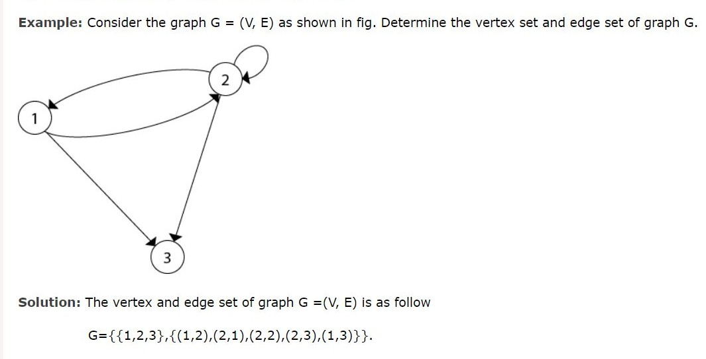
4. Directed Graphs: A directed graph or digraph G is defined as an unordered pair (V, E), where V is the set of points called vertices and E is the set of edges. Each edge in the graph G is assigned a direction and is identified with an ordered pair (u, v), where u is the initial vertex, and v is the end vertex.

Slide 26

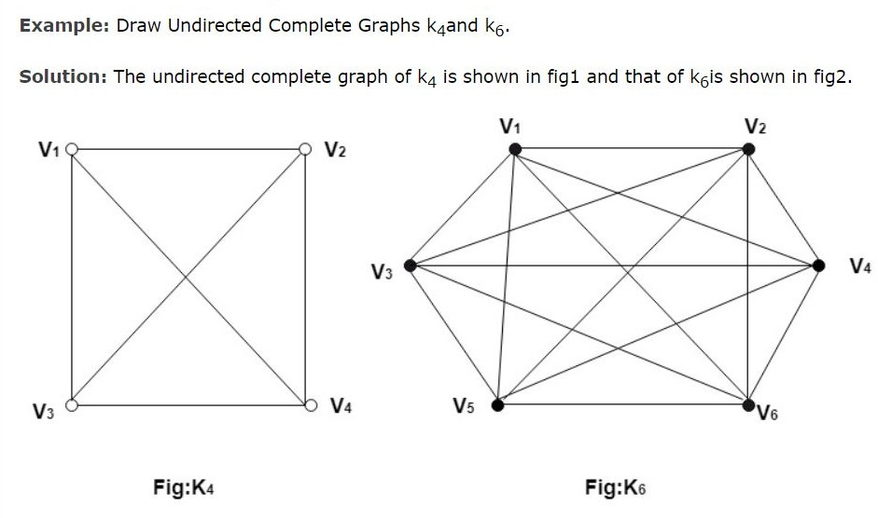
5. Undirected Complete Graph: An undirected complete graph G=(V,E) of n vertices is a graph in which each vertex is connected to every other vertex i.e., and edge exist between every pair of distinct vertices. It is denoted by K_{n}. A complete graph with n vertices will have edges.

Slide 27
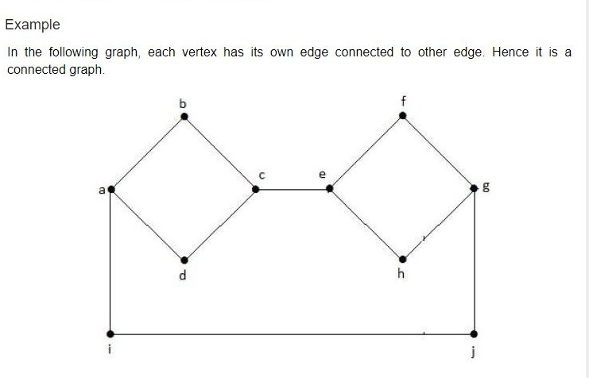
6.Connected Graph
A graph G is said to be connected if there exists a path between every pair of vertices.
There should be at least one edge for every vertex in the graph.
So that we can say that it is connected to some other vertex at the other side of the edge.

Slide 28
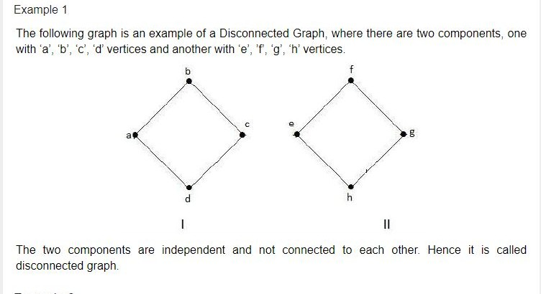
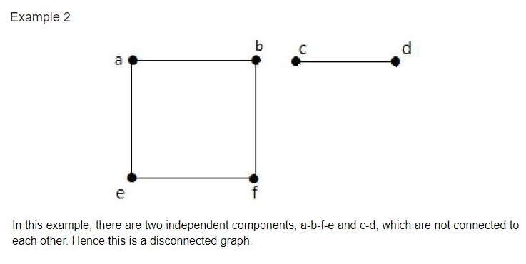
7.Disconnected Graph
A graph G is disconnected, if it does not contain at least two connected vertices.

Slide 29
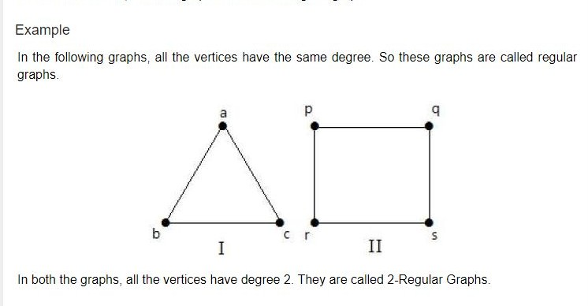
8. Regular Graph
A graph G is said to be regular, if all its vertices have the same degree.
In a graph, if the degree of each vertex is ‘k’, then the graph is called a ‘k-regular graph’.

Slide 30
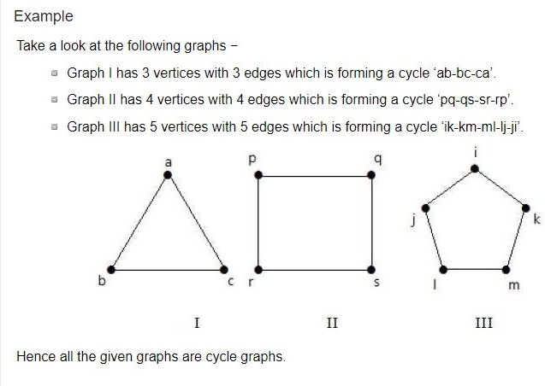
9. Cycle Graph
A simple graph with ‘n’ vertices (n >= 3) and ‘n’ edges is called a cycle graph if all its edges form a cycle of length ‘n’.
If the degree of each vertex in the graph is two, then it is called a Cycle Graph.
Notation − C_{n}

Slide 31
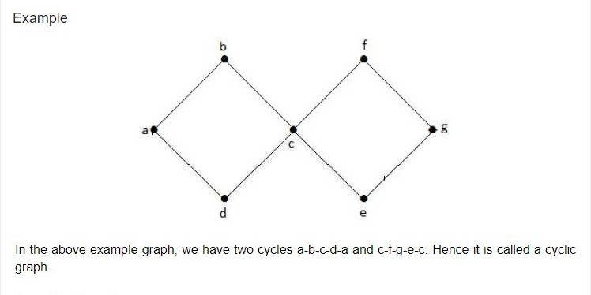
10.Cyclic Graph
A graph with at least one cycle is called a cyclic graph.

Slide 32
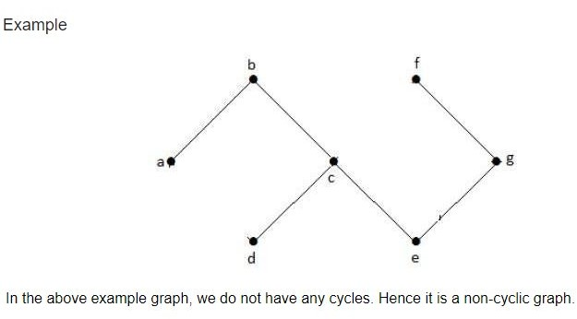
11.Acyclic Graph
A graph with no cycles is called an acyclic graph.

Slide 33
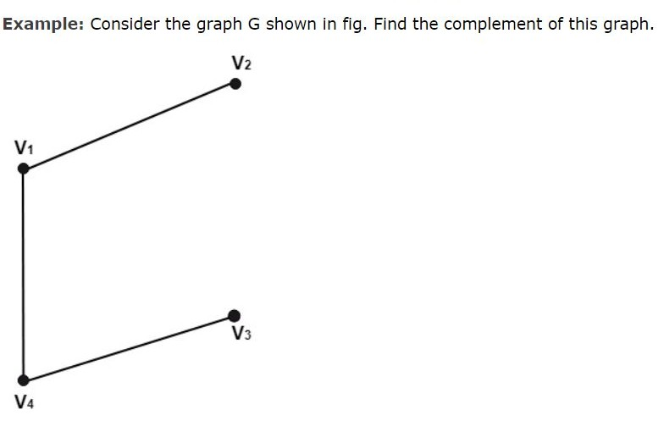
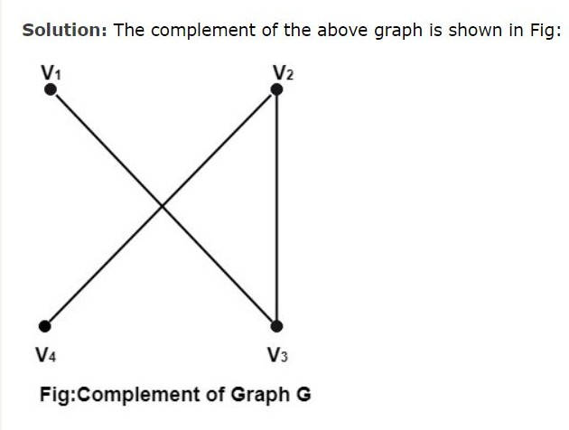
12. Complementary Graph: The complement of a graph G is defined to be a graph which has the same number of vertices as in graph G and has two vertices connected if and only they are not related in the graph.

Slide 34
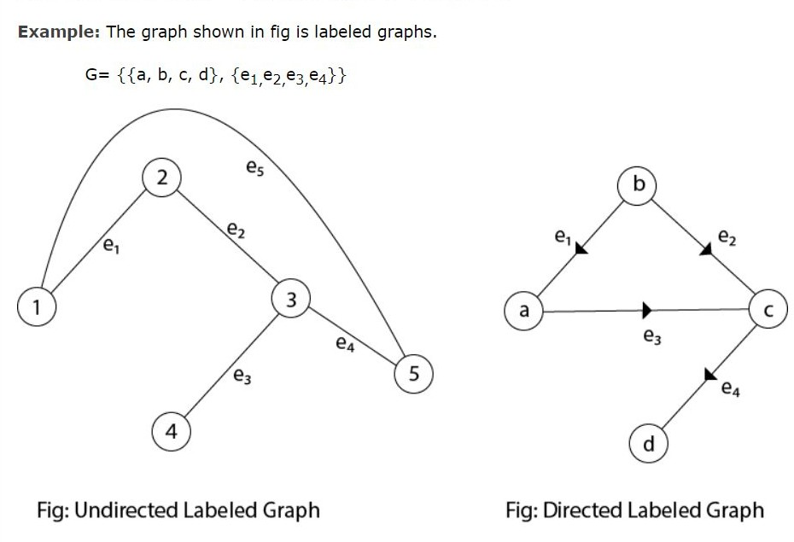
13.Labeled Graphs: A graph G=(V, E) is called a labeled graph if its edges are labeled with some name or data. So, we can write these labels in place of an ordered pair in its edges set.

Slide 35
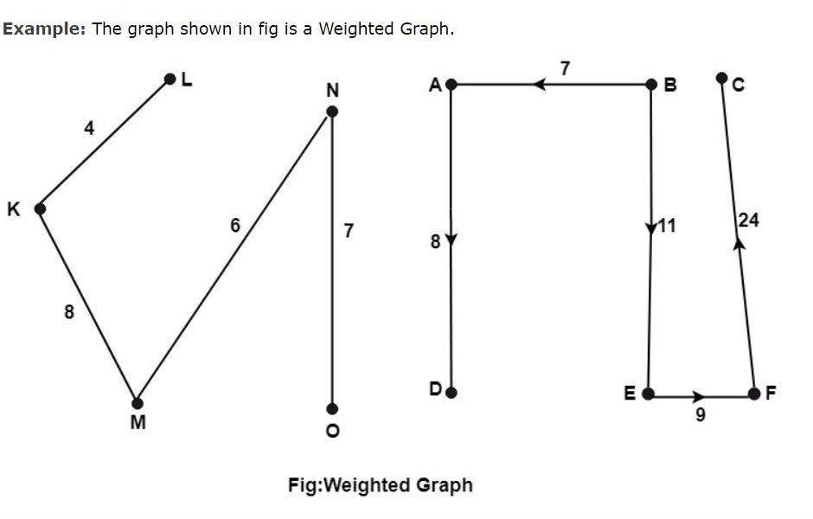
14.Weighted Graphs: A graph G=(V, E) is called a weighted graph if each edge of graph G is assigned a positive number w called the weight of the edge e.

Slide 36
Graph Traversal Algorithms
Graph traversal is a technique used for a searching vertex in a graph.
The graph traversal is also used to decide the order of vertices is visited in the search process.
A graph traversal ﬁnds the edges to be used in the search process without creating loops.
That means using graph traversal we visit all the vertices of the graph without getting into looping path.
There are two graph traversal techniques and they are as follows.
DFS (Depth First Search)
BFS (Breadth First Search)

Slide 37
DFS (Depth First Search)
DFS traversal of a graph produces a spanning tree as ﬁnal result. Spanning Tree is a graph without loops. We use Stack data structure with maximum size of total number of vertices in the graph to implement DFS traversal.
Steps to implement DFS traversal...
Step 1 - Deﬁne a Stack of size total number of vertices in the graph.
Step 2 - Select any vertex as starting point for traversal. Visit that vertex and push it on to the Stack.
Step 3 - Visit any one of the non-visited adjacent vertices of a vertex which is at the top of stack and push it on to the stack.
Step 4 - Repeat step 3 until there is no new vertex to be visited from the vertex which is at the top of the stack.
Step 5 - When there is no new vertex to visit then use back tracking and pop one vertex from the stack.
Step 6 - Repeat steps 3, 4 and 5 until stack becomes Empty.
Step 7 - When stack becomes Empty, then produce ﬁnal spanning tree by removing unused edges from the graph

Slide 38
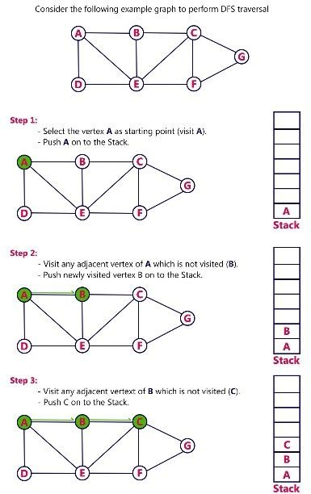

Slide 39
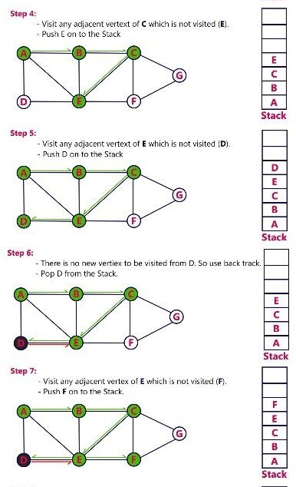

Slide 40
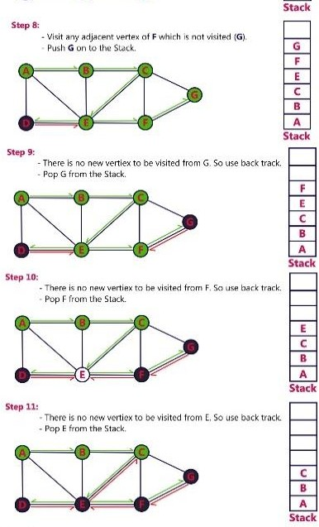

Slide 41
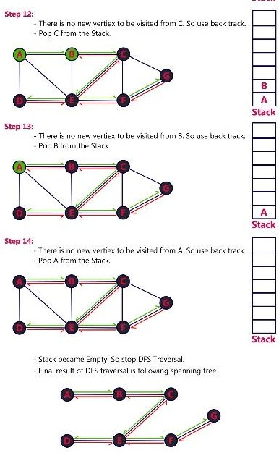

Slide 42
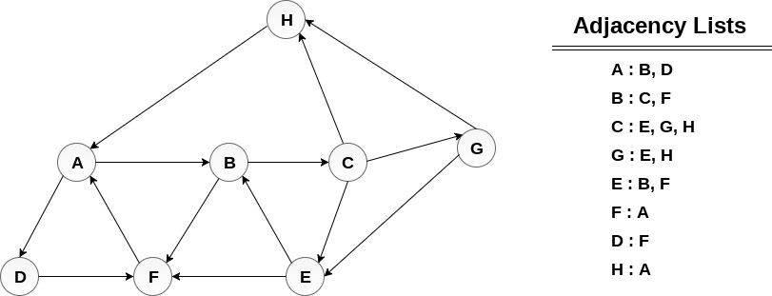
Example
Consider the graph G along with its adjacency list, given in the figure below. Calculate the order to print all the nodes of the graph starting from node H, by using depth first search (DFS) algorithm.

Slide 43
Solution :
Push H onto the stack
1.STACK : H
POP the top element of the stack i.e. H, print it and push all the neighbours of H onto the stack that are is ready state.
Print H
STACK : A
Pop the top element of the stack i.e. A, print it and push all the neighbours of A onto the stack that are in ready state.
Print A
Stack : B, D
Pop the top element of the stack i.e. D, print it and push all the neighbours of D onto the stack that are in ready state.
Print D
Stack : B, F
Pop the top element of the stack i.e. F, print it and push all the neighbours of F onto the stack that are in ready state.
Print F
Stack : B

Slide 44
Pop the top of the stack i.e. B and push all the neighbours
Print B
Stack : C
Pop the top of the stack i.e. C and push all the neighbours.
Print C
Stack : E, G
Pop the top of the stack i.e. G and push all its neighbours.
Print G
Stack : E
Pop the top of the stack i.e. E and push all its neighbours.
Print E
Stack :
Hence, the stack now becomes empty and all the nodes of the graph have been traversed.
The printing sequence of the graph will be :
1.H → A → D → F → B → C → G → E

Slide 45
BFS (Breadth First Search)
BFS traversal of a graph produces a spanning tree as ﬁnal result. Spanning Tree is a graph without loops. We use Queue data structure with maximum size of total number of vertices in the graph to implement BFS traversal.
Steps to implement BFS traversal.
Step 1 - Deﬁne a Queue of size total number of vertices in the graph.
Step 2 - Select any vertex as starting point for traversal. Visit that vertex and insert it into the Queue.
Step 3 - Visit all the non-visited adjacent vertices of the vertex which is at front of the Queue and insert them into the Queue.
Step 4 - When there is no new vertex to be visited from the vertex which is at front of the Queue then delete that vertex.
Step 5 - Repeat steps 3 and 4 until queue becomes empty.
Step 6 - When queue becomes empty, then produce ﬁnal spanning tree by removing unused edges from the graph

Slide 46
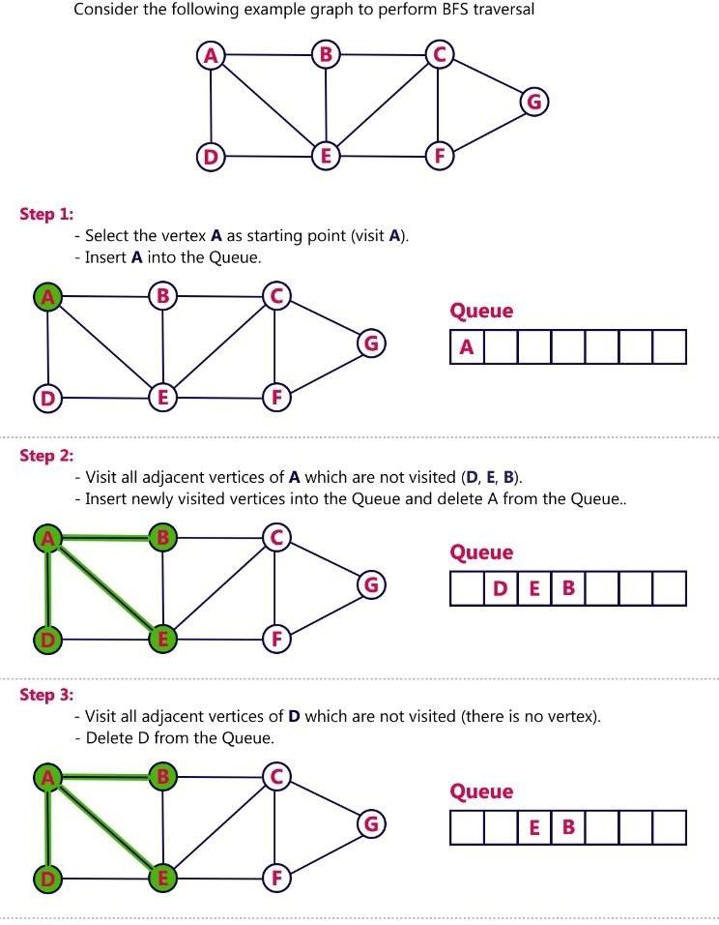

Slide 47
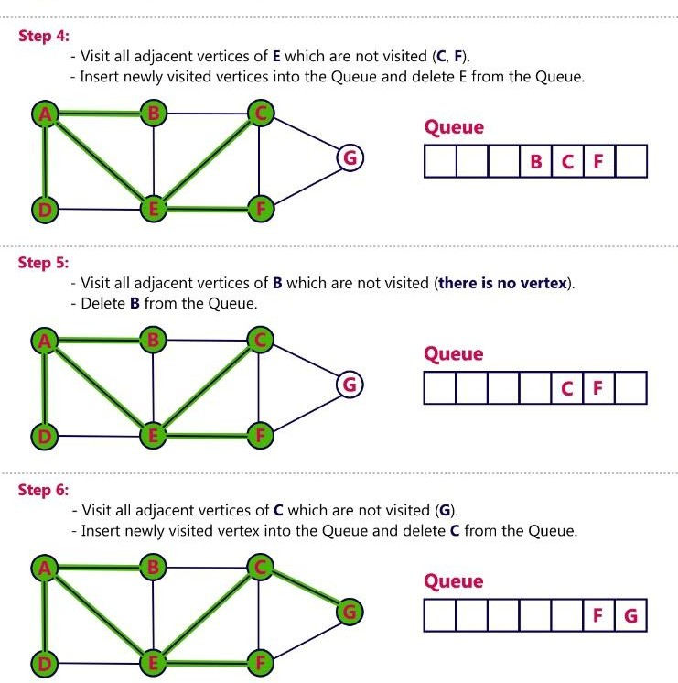

Slide 48
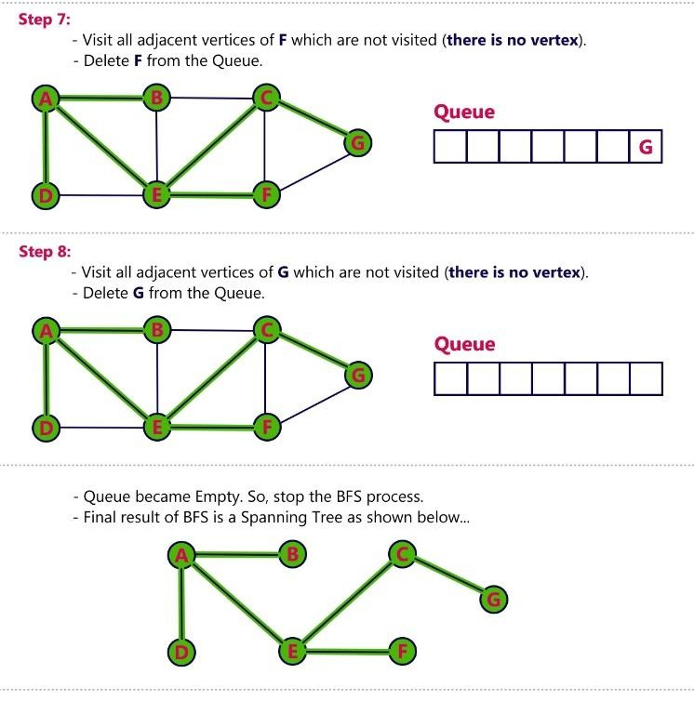

Slide 49
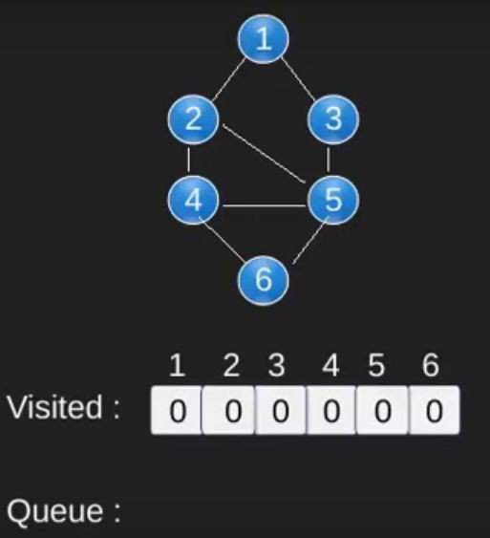
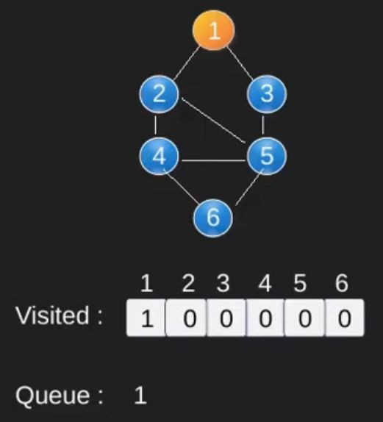
Example

Slide 50
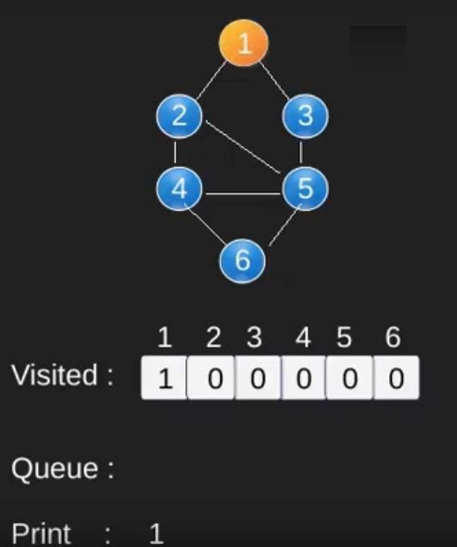
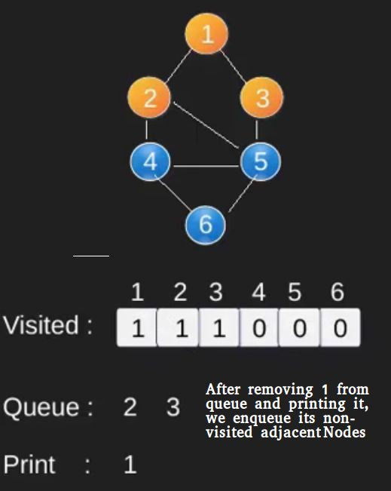

Slide 51
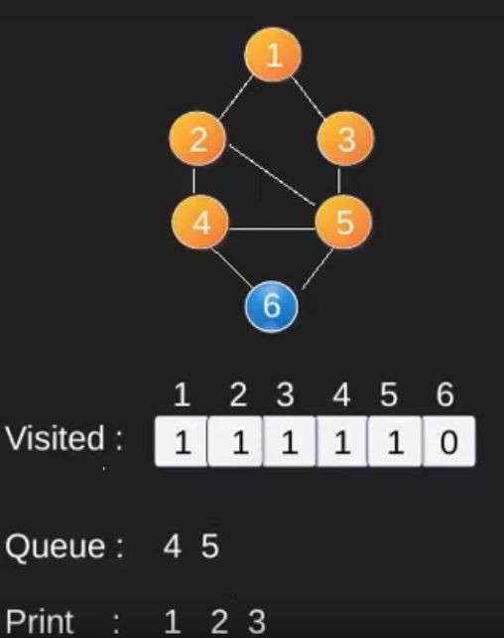
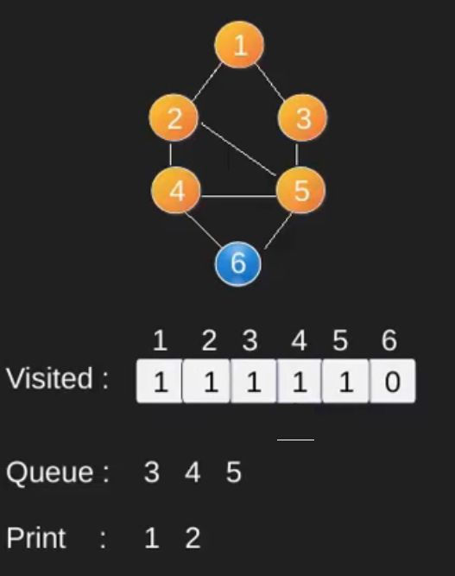

Slide 52
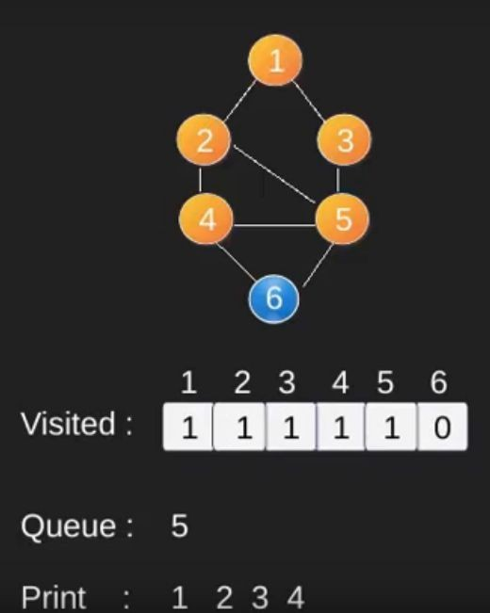
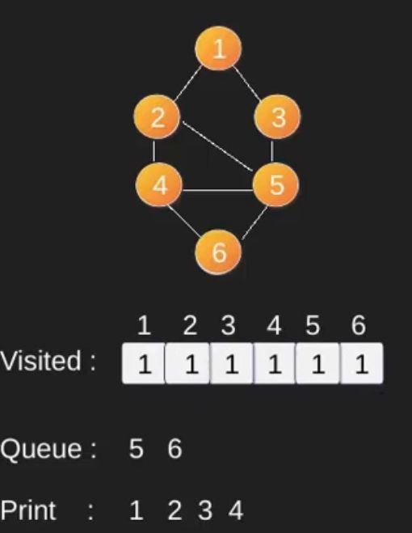

Slide 53
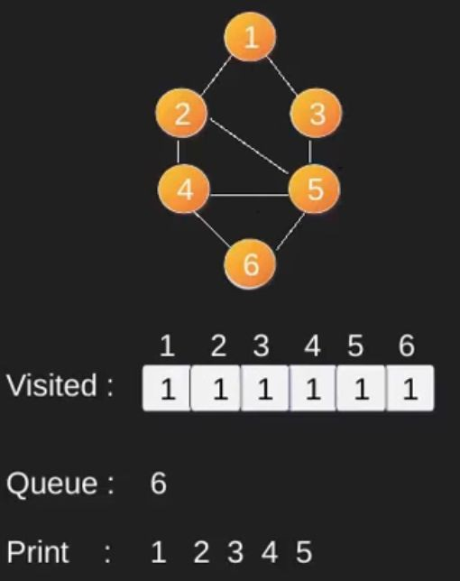
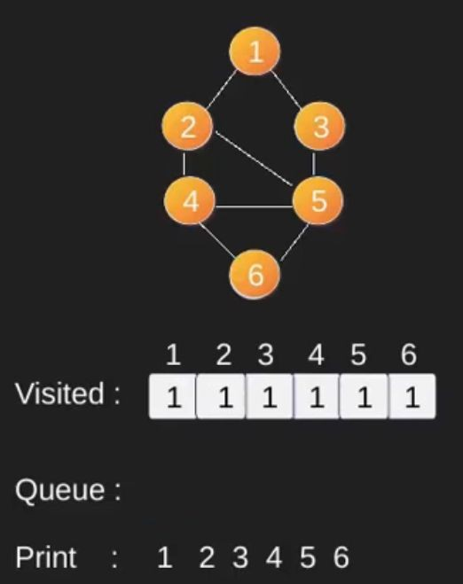

Slide 54

DFS BFS Example

Slide 55


Slide 56


Slide 57


Slide 58


Slide 59


