Slide 1

Department of CE
B.Tech. Sem : III (CE) (MU)
Subject Name: Probability and Statistics
Unit no:- 1
Unit title:
Basic Probability
Subject name : PS

Slide 2
Random Experiment
It is the one in which each trial conducted under identical condition where the outcome is not predictable. e.g tossing of coin, throwing a die, selection of card from a deck

Slide 3
Sample space
The sample space for a random experiment is the set of all experimental outcomes. Example: tossing of coin
Sample space= {H, T}
Example: Rolling a die
Sample space= {1,2,3,4,5,6}

Slide 4
Event
The set of favorable outcomes of an experiment is called an event. Example: tossing of coin
E: To win the toss I need Head
E = {H}

Slide 5
Example-1
Tossing of three coins simultaneously :
S = {(T , T , T) , (T , T , H) , (T , H , T) , (T , H , H ) , (H , T , T ) , (H , T , H) , (H , H, T) ,(H , H , H)}
Suppose, if we want to find only the outcomes which have at least two heads; then the set of all such possibilities can be given as:
E = { (H , T , H) , (H , H ,T) , (H , H ,H) , (T , H , H)}
Thus, an event is a subset of the sample space,
i.e., E is a subset of S.

Slide 6
Example-2
Rolling a die
F: In a game of Ludo, I need 2 or 5 to kill opponent’s token
F = {2,5}
Note that event set is always subset of sample space.

Slide 7
Equally Likely Events
Equally likely events are those events which have an equal chances of occurring.
Example:
When we roll a die, the probability of getting a one is 1/6, P(2) = 1/6, P(3) = 1/6…P(6)=1/6. Thus, this is also an equally likely event.
When we toss an unbiased coin, the probability of getting a heads is 1/2 and the probability of getting a tails is 1/2. So, it is an equally likely event

Slide 8
Mutually Exclusive Event
A set of events are called mutually exclusive if the occurrences of all the output cannot occur together.
If A and B are any events then , 𝐴⋂𝐵 = 𝜙; then A and B are mutually exclusive events.
In a six-sided die, the events “2” and “5” are mutually exclusive. We cannot get both the events 2 and 5 at the same time when we threw one die.

Slide 9
Exhaustive Events
Let S be any sample space and A and B are two events of S such that
𝐴 ⋃ 𝐵 = S; then A and B are said to be exhaustive events.

Slide 10
Independent Events
The events are said to be independent if the result of the second event is not affected by the result of the first event.
Example: Suppose we choose a ball randomly from a bag of six balls out of which 3 are red and remaining are blue.

Slide 11
Complementary Events
If S is the sample space and event A ∈ 𝑆 then 𝐴′ = S-A is said to be a complementary event.

Slide 12
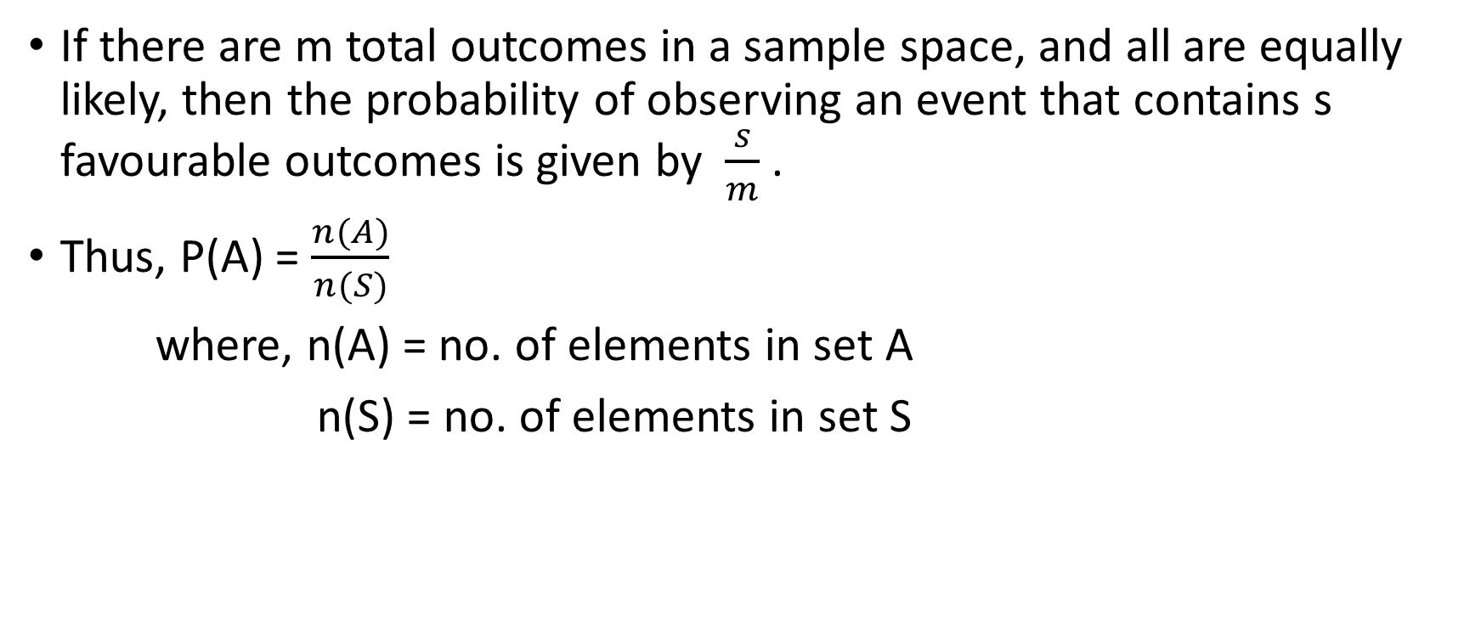
The classical definition of probability
If there are m total outcomes in a sample space, and all are equally likely, then the probability of observing an event that contains s favourable outcomes is given by $\frac{s}{m}$ .
Thus, P(A) = $\frac{n(A)}{n(S)}$
where, n(A) = no. of elements in set A
n(S) = no. of elements in set S

Slide 13
Axioms of probability
Suppose there is an event A belonging to the sample space S. Then P(A) is probability of event A which satisfies the following axioms:
Non-Negativity : 0 ≤ 𝑃(𝐴) ≤ 1; ∀ 𝐴
Certainty : P(S) =1
If A and B are mutually exclusive then P(A∩B) = 0.
𝐴 ⊂ 𝐵 𝑡ℎ𝑒𝑛 𝑃(𝐴) ≤ 𝑃(𝐵)

Slide 14

Theorems of probability
1. 𝑃(𝐴 ∪ 𝐵) = 𝑃(𝐴) + 𝑃(𝐵) − 𝑃(𝐴⋂𝐵)
A
𝐴⋂𝐵
B

Slide 15
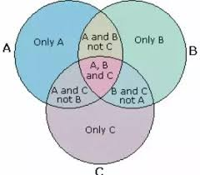
Theorems of probability
2. P(A∪𝐵 ∪ 𝐶) = 𝑃(𝐴) + 𝑃(𝐵) + 𝑃(𝐶) − 𝑃(𝐴 ∩ 𝐵) − 𝑃(𝐵 ∩ 𝐶) −𝑃(𝐴 ∩ 𝐶)
+ 𝑃(𝐴⋂𝐵 ∩ 𝐶)

Slide 16
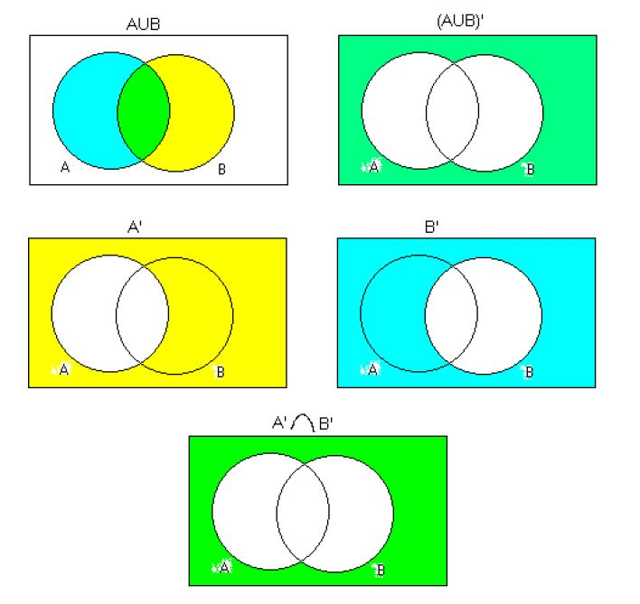
Theorems of probability
3. P(𝐴′ ∩ 𝐵′) = 1 − 𝑃(𝐴′ ∩ 𝐵′)′= 1 − 𝑃(𝐴 ∪ 𝐵) = 𝑃(𝐴 ∪ 𝐵)′

Slide 17
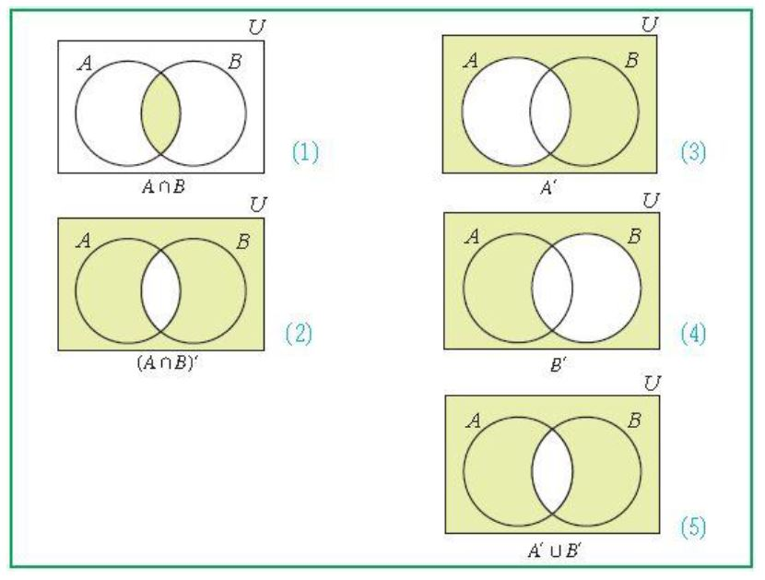
Theorems of probability
4. 𝑃(𝐴′ ∪ 𝐵′) = 1 − 𝑃(𝐴′ ∪ 𝐵′)′= 1- 𝑃(𝐴 ∩ 𝐵) = 𝑃(A ∩ 𝐵)′

Slide 18
Addition principal
If A and B are two mutually exclusive events and n(A) = N1, n(B) = N2
then n(𝐴 ∪ 𝐵) = n(𝐴) + n(𝐵) = N1 + N2
In general, If A1, A2, ----, Am are mutually exclusive and n(A1) = N1,
n(A2) = N2, ---, n(Am) = Nm then
n(𝐴1 ∪ A2 ∪ --- ∪ Am) = n(𝐴1) + n(A2) + --- + n(Am)
= N1 + N2 + --- + Nm

Slide 19
Multiplication principal
If A and B are two independent events then
P(A and B) = P(A)*P(B)
In general, If A1, A2, ----, Am are independent events then
P(A1 and A2 and ---- and Am) = P(𝐴1) * P(A2) * --- * P(Am)

Slide 20
Example 1: A fair die is thrown then what is the probability of getting (i) at least 4 (ii) at most 5.
Solution: Let S be the sample space.
A = Getting at least 4 when die is rolled and
B = Getting at most 5 when die is rolled
Therefore, S = { 1, 2, 3, 4, 5, 6 }
A= { 4, 5, 6} , B= { 1, 2, 3, 4, 5}
P(A) = 3/6 = 1/2
P(B)= 5/6

Slide 21
Example 2: An unbiased coin is tossed for three times. Find the probability of exactly two heads.
Solution: Let S be the sample space.
A = Getting exactly two heads when coin is tossed
Therefore, S= { HHH, HHT, HTH, THH, TTH, THT, HTT, TTT} ,
A= { HHT, HTH,THH}
P(A) = 3/8

Slide 22
Example 3: A bag contains 30 balls numbered 1 to 30. One ball is drawn at random find the probability that the number will be (i) multiple of 5 or 7 (ii) a multiple of 3 or 7
Solution: Let S be the sample space.
A = Getting number which is multiple of 5
B = Getting number which is multiple of 7
C = Getting number which is multiple of 3
Therefore, S = { 1, 2, 3, 4,----, 29, 30 }
A = {5, 10, 15, 20, 25 , 30}
B = {7, 14, 21,28}
C = {3, 6, ----, 27, 30}

Slide 23
Example 3: A bag contains 30 balls numbered 1 to 30. One ball is drawn at random find the probability that the number will be (i) multiple of 5 or 7 (ii) a multiple of 3 or 7
P(A) = 6/30 = 1/5
P(B)= 4/30 = 2/15
P(C)= 10/30 = 1/3
Now, (i) probability of getting multiple of 5 or 7 = 𝑃(𝐴 ∪ 𝐵)
Thus, 𝑃(𝐴 ∪ 𝐵) = 𝑃(𝐴) + 𝑃(𝐵) − 𝑃(𝐴⋂𝐵)
= 6/30 + 4/30 − 0 = 1/3

Slide 24
Example 3: A bag contains 30 balls numbered 1 to 30. One ball is drawn at random find the probability that the number will be (i) multiple of 5 or 7 (ii) a multiple of 3 or 7
P(A) = 6/30 = 1/5
P(B)= 4/30 = 2/15
P(C)= 10/30 = 1/3
Now, (ii) probability of getting multiple of 3 or 7 = 𝑃(C ∪ 𝐵)
Thus, 𝑃(C ∪ 𝐵) = 𝑃(C) + 𝑃(𝐵) − 𝑃(C⋂𝐵)
= 10/30 + 4/30 − 1/30 = 13/30

Slide 25

Example 4: A bag contains 8 white and 4 red balls. Now 5 balls are drawn at random then find the probability that 2 of them are white and 3 are red.
Solution: Let S be the sample space.
A = Getting 2 white and 3 red balls
Recall: Number of possible ways of choosing r balls from n balls = $C(n,r)= \frac{n!}{r!\left(n−r\right)!}$

Slide 26
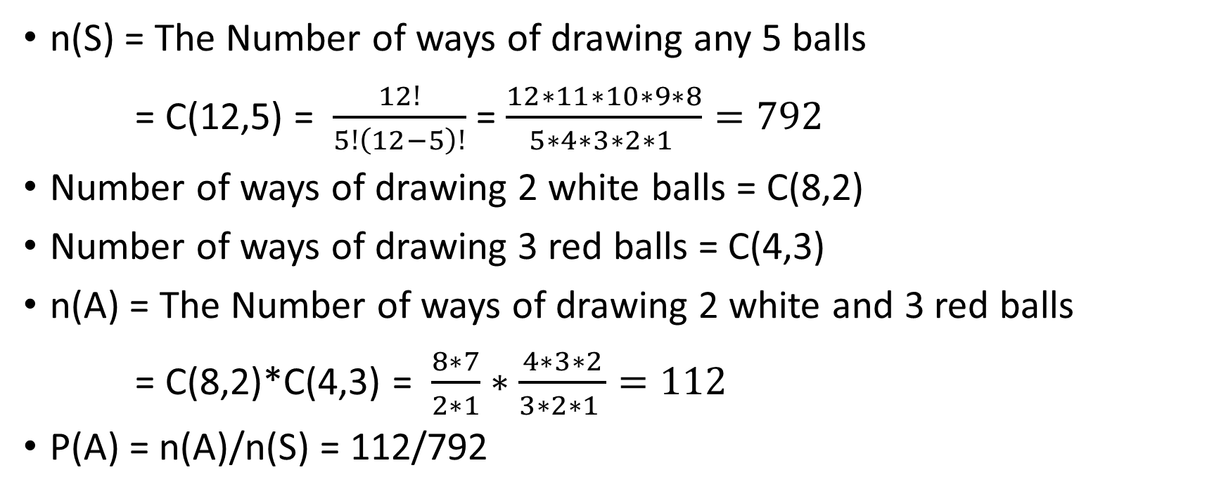
Example 4: A bag contains 8 white, 4 red balls. Now 5 balls are drawn at random then find the probability that 2 of them are white and 3 are red.
n(S) = The Number of ways of drawing any 5 balls
= C(12,5) = $\frac{12!}{5!\left(12−5\right)!}$ = $\frac{12∗11∗10∗9∗8}{5∗4∗3∗2∗1 }=792$
Number of ways of drawing 2 white balls = C(8,2)
Number of ways of drawing 3 red balls = C(4,3)
n(A) = The Number of ways of drawing 2 white and 3 red balls
= C(8,2)*C(4,3) = $\frac{8∗7}{2∗1}∗\frac{4∗3∗2}{3∗2∗1 }=112$
P(A) = n(A)/n(S) = 112/792

Slide 27
Example 5: Two dice are thrown simultaneously. Find the probability of getting (i) Total of 7 , (ii) an even total and (iii) an odd total.
Solution: Let S be the sample space.
A = Getting total of 7 from two dice
B = Getting an even total from two dice
C = Getting an odd total from two dice
There are 36 ordered pairs in sample space S. Thus, n(S) = 36.

Slide 28
Example 5: Two dice are thrown simultaneously. Find the probability of getting (i) Total of 7 , (ii) an even total and (iii) an odd total
A = {(1,6), (2,5), (3,4), (4,3), (5,2), (6,1) }
Thus n(A) = 6
P(A) = 6/36 = 1/6
B = {(1,1), (1,3), (1,5), -----, (6,4), (6,6) }
Thus n(B) = 18
P(B) = 18/36 = 0.5
P(C) = P(B’) = 1 – P(B) = 1 – 0.5 = 0.5

Slide 29
Example 6: If A and B are mutually exclusive with P(A) = 0.3 and P(B) = 0.45 then find the probability of (1) P(A’) (2) 𝑃(𝐴⋂𝐵) (3) 𝑃(𝐴 ∪ 𝐵) (4) 𝑃(𝐴’⋂𝐵’)
Solution: Let S be the sample space.
A and B are mutually exclusive thus 𝐴⋂𝐵 = ɸ
P(A’) = 1 – P(A) = 1 – 0.3 = 0.7
P(𝐴⋂𝐵) = 0
P(𝐴 ∪ 𝐵) = P(A) + P(B) = 0.3 + 0.45 = 0.75
P(𝐴’⋂𝐵’) = 1 - P (𝐴’ ⋂ 𝐵’)’ = 1 – P(𝐴 ∪ 𝐵) = 1 – 0.75 = 0.25

Slide 30
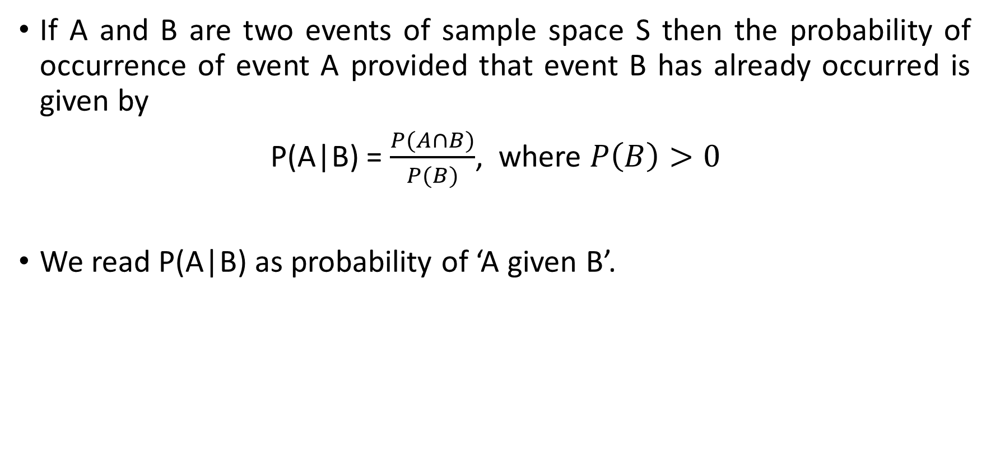
Conditional probability
If A and B are two events of sample space S then the probability of occurrence of event A provided that event B has already occurred is given by
P(A|B) = $\frac{P(A∩B)}{P(B)}$, where $P\left(B\right)>0$
We read P(A|B) as probability of ‘A given B’.

Slide 31
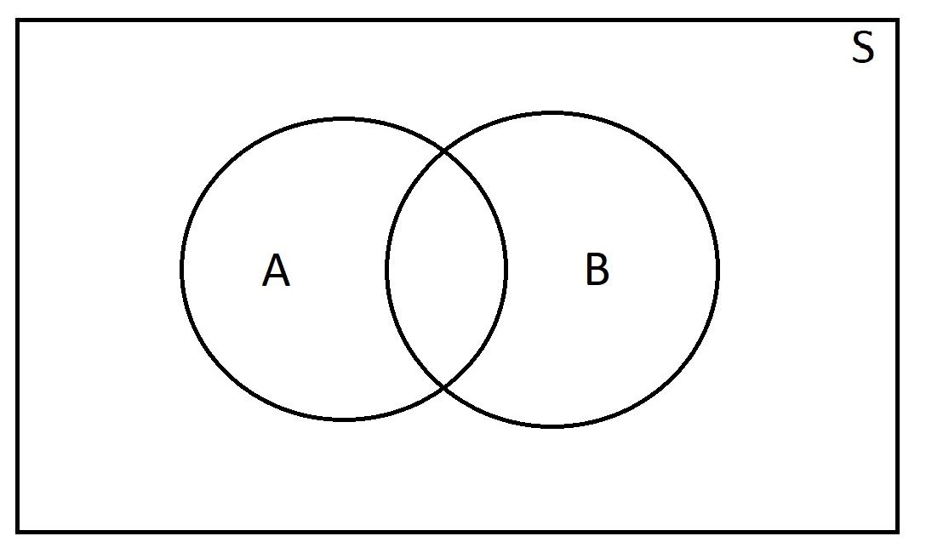
Conditional probability
Conditional probability is actually process of narrowing the sample space. If we want to find the occurrence of event A provided that event B has already occurred then for event A the new sample space narrow down to B.
P(A|B) = $\frac{P(A∩B)}{P(B)}$

Slide 32

Example-7 A math teacher gave her class two tests. 25% of the class passed both tests and 42% of the class passed the first test. What present of those who passed the first test also passed the second test?
Solution : Event A : Students passed first test
Event B : Students passed second test

Slide 33

Example 8 At MU University, the probability that a student takes OODP and WT is 0.087. The probability that a student takes OODP is 0.68. What is the probability that a student takes WT given that the student is taking OODP?
Event A : Students takes OODP .
Event B Student takes WT

Slide 34
Example 9 What is the probability of selecting two queen cards from the deck of 52 cards?
Solution : In a deck of 52 cards, there are 4 queen cards. Since we need to select the two cards from the deck, hence, first, we will find the probability of selecting the first card from the deck.
Number of queen cards in a deck = 4
Total number of cards in a deck = 52
The probability of selecting a queen card from a deck = 4/52 =1/13

Slide 35

Now, we will compute the probability of picking up the second card from the deck.
Number of queen cards left in a deck = 3
Total number of cards left in a deck = 51
The probability of picking up a queen card, given that a queen card has already been selected = 3/51 =P(B/A)
we need to tell the probability of picking up two queen cards, therefore we will multiply the probabilities above:

Slide 36
Example 10: Two dies are thrown simultaneously and the sum of the numbers obtained is found to be 7. What is the probability that the number 3 has appeared at least once?
Solution: The sample space S would consist of all the numbers possible by the combination of two dies.
Therefore S consists of 6 × 6 i.e. 36 events.
Event A indicates the combination in which 3 has appeared at least once.
Event B indicates the combination of the numbers which sum up to 7.

Slide 37

A = {(3, 1), (3, 2), (3, 3)(3, 4)(3, 5)
(3, 6)(1, 3)(2, 3)(4, 3)(5, 3)(6, 3)}
B = {(1, 6)(2, 5)(3, 4)(4, 3)(5, 2)(6, 1)}
P(B) = 6/36
A ∩ B = 2
P(A ∩ B) = 2/36
Applying the conditional probability formula we get,

Slide 38
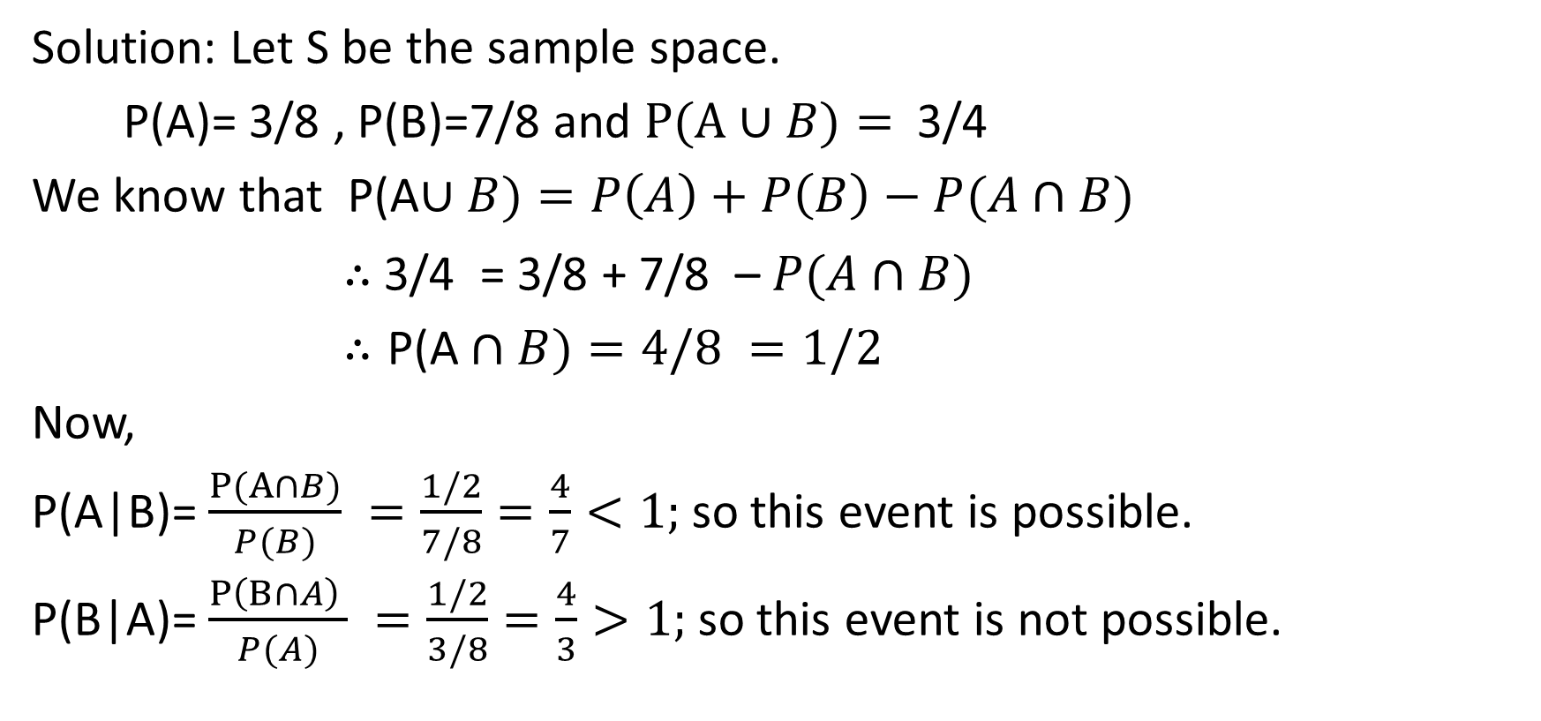
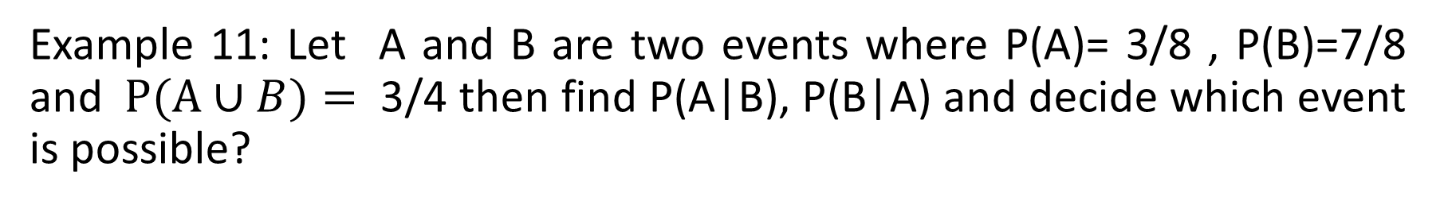
Example 11: Let A and B are two events where P(A)= 3/8 , P(B)=7/8 and $P(A∪B)=$ 3/4 then find P(A|B), P(B|A) and decide which event is possible?
Solution: Let S be the sample space.
P(A)= 3/8 , P(B)=7/8 and $P(A∪B)=$ 3/4
We know that P(A$∪B)=P\left(A\right)+P\left(B\right)−P(A∩B)$
$∴$ 3/4 = 3/8 + 7/8 – $P(A∩B)$
$∴\text{P}\text{(}\text{A}∩B)=4/8 =1/2$
Now,
P(A|B)=$\frac{P(A∩B)}{P(B)} =\frac{1/2}{7/8}=\frac{4}{7}<1;$ so this event is possible.
P(B|A)=$\frac{P\left(B∩A\right) }{P(A)} =\frac{1/2}{3/8}=\frac{4}{3}>1;$ so this event is not possible.

Slide 39
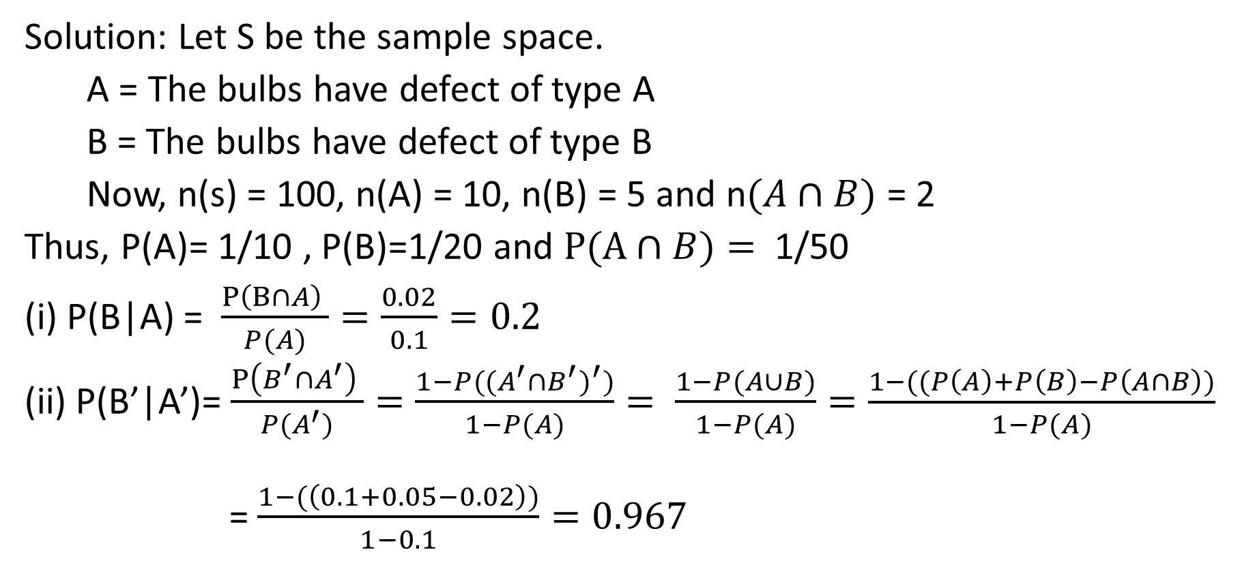
Example 12: A box contains 100 bulbs out of which 10 bulbs have defect of type A, 5 bulbs have defect of type B and 2 bulbs have defect of both the types. Find the probability of (i) P(B|A) (ii) P(B’|A’).
Solution: Let S be the sample space.
A = The bulbs have defect of type A
B = The bulbs have defect of type B
Now, n(s) = 100, n(A) = 10, n(B) = 5 and n$(A∩B)$ = 2
Thus, P(A)= 1/10 , P(B)=1/20 and $P(A∩B)=$ 1/50
(i) P(B|A) = $\frac{P\left(B∩A\right) }{P(A)}=\frac{0.02}{0.1}=0.2$
(ii) P(B’|A’)= $\frac{P\left(B^{′}∩A^{′}\right) }{P(A^{′})}=\frac{1−P({(A^{′}∩B^{′})}^{′})}{1−P(A)}= \frac{1−P(A∪B)}{1−P(A)}=\frac{1−((P\left(A\right)+P\left(B\right)−P\left(A∩B\right))}{1−P(A)}$
= $\frac{1−(\left(0.1+0.05−0.02\right))}{1−0.1}=0.967$

Slide 40
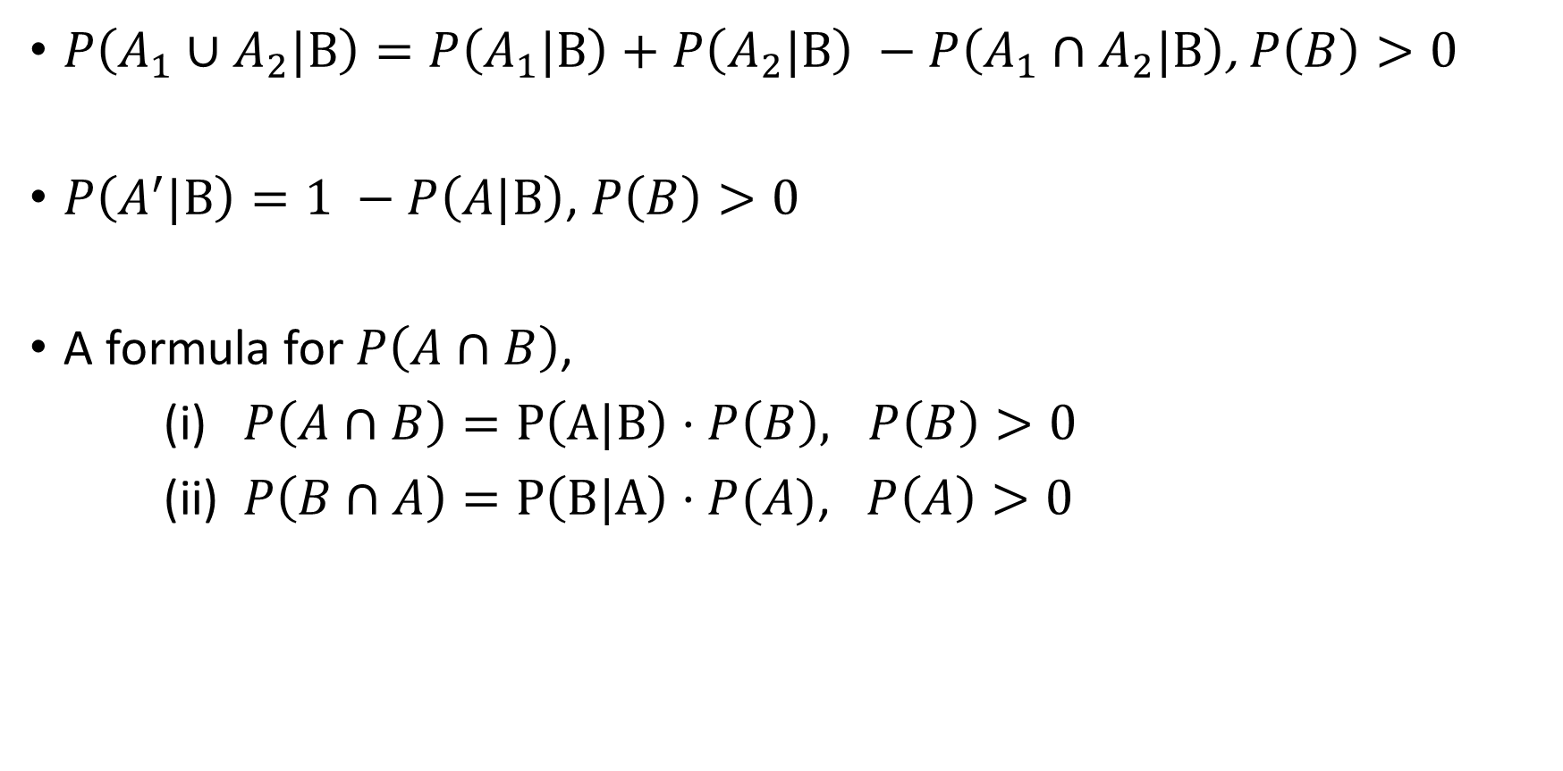
Properties of conditional probability
$P\left(A_{1}∪A_{2}|B\right)=P\left(A_{1}|B\right)+P\left(A_{2}|B\right) −P\left(A_{1}∩A_{2}|B\right)$, $P\left(B\right)>0$
$P\left(A^{′}|B\right)=1 −P\left(A|B\right)$, $P\left(B\right)>0$
A formula for $P\left(A∩B\right)$,
(i) $P\left(A∩B\right)=P\left(A|B\right)⋅P\left(B\right), P\left(B\right)>0$
(ii) $P\left(B∩A\right)=P\left(B|A\right)⋅P(A)$, $P\left(A\right)>0$
This property of conditional probability is called general multiplication rule of probability.

Slide 41

Properties of conditional probability
In the case of independent event,
P(A|B) = P(A) and P(B|A) = P(B)
Thus, $P\left(A|B\right)=P\left(A\right)= \frac{P(A∩B)}{P(B)}$
$⇒P\left(A∩B\right)=P\left(A\right)⋅P(B)$ (Multiplication rule)

Slide 42
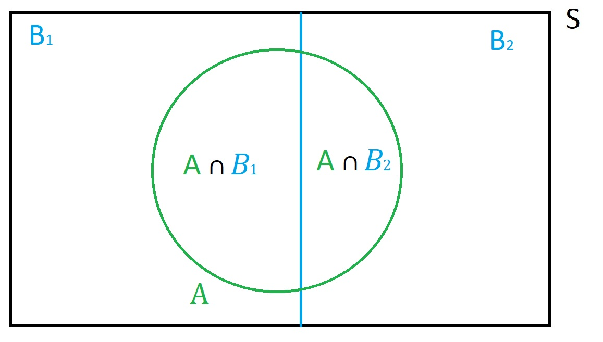
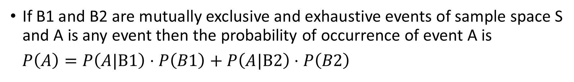
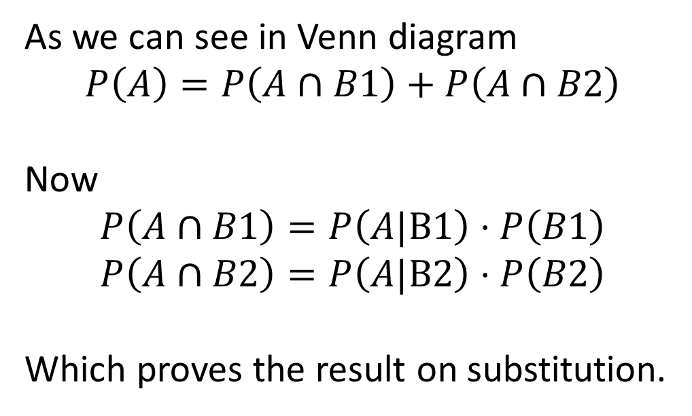
Total probability
If B1 and B2 are mutually exclusive and exhaustive events of sample space S and A is any event then the probability of occurrence of event A is
$P\left(A\right)=P\left(A|B1\right)⋅P\left(B1\right)+P\left(A|B2\right)⋅P\left(B2\right)$
As we can see in Venn diagram
$$P\left(A\right)=P\left(A∩B1\right)+P\left(A∩B2\right)$$
Now
$$P\left(A∩B1\right)=P\left(A|B1\right)⋅P\left(B1\right)$$
$$P\left(A∩B2\right)=P\left(A|B2\right)⋅P\left(B2\right)$$
Which proves the result on substitution.

Slide 43
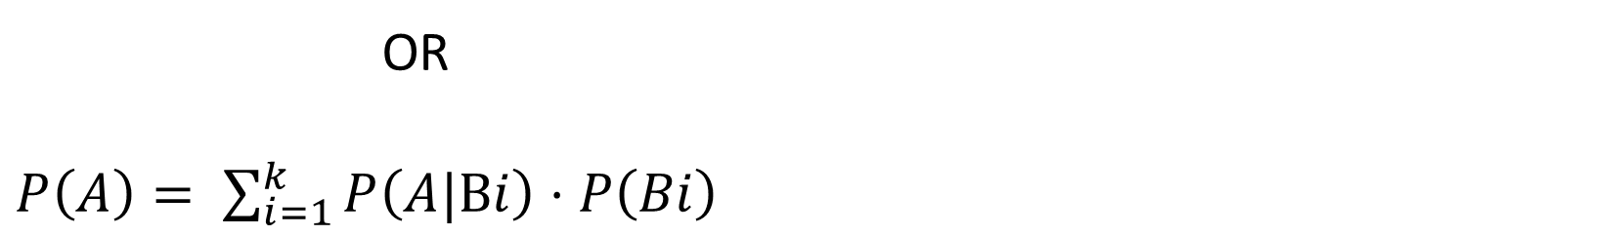
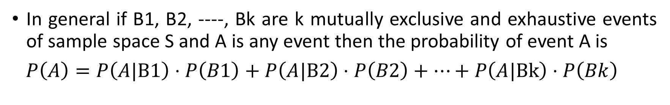
Total probability
In general if B1, B2, ----, Bk are k mutually exclusive and exhaustive events of sample space S and A is any event then the probability of event A is
$P\left(A\right)=P\left(A|B1\right)⋅P\left(B1\right)+P\left(A|B2\right)⋅P\left(B2\right)+⋯+P\left(A|Bk\right)⋅P\left(Bk\right)$
OR
$P\left(A\right)= \sum_{i=1}^{k}{P\left(A|Bi\right)⋅P\left(Bi\right)}$

Slide 44
Example 13: In a certain assembly plant, three machines B1, B2, and B3, make 30%, 45%, and 25%, respectively, of the products. It is known from past experience that 2%, 3%, and 2% of the products made by each machine, respectively, are defective. Now, suppose that a finished product is randomly selected. What is the probability that it is defective?
Solution: Let S be the sample space.
Consider the following events:
A: The product is defective
B1 : The product is made by machine B1
B2 : The product is made by machine B2
B3 : The product is made by machine B3

Slide 45
Example 14: In a certain assembly plant, three machines B1, B2, and B3, make 30%, 45%, and 25%, respectively, of the products. It is known from past experience that 2%, 3%, and 2% of the products made by each machine, respectively, are defective. Now, suppose that a finished product is randomly selected. What is the probability that it is defective?
We have P(B1) = 0.3, P(B2) = 0.45 and P(B3) = 0.25.
Also, we know that 2%, 3%, and 2% of the products made by each machine, respectively, are defective.
Thus, P(A|B1)= 0.02 , P(A|B2)=0.03 and P(A|B3)= 0.02
Applying the rule of total probability, we can write
P(A) = P(B1) P(A|B1 )+ P(B2) P(A|B2) + P(B3) P(A|B3)
= (0.3)(0.02) + (0.45)(0.03) + (0.25)(0.02) = 49/2000 = 0.0245

Slide 46
Example 15: The executive of a company uses either a train or a bus to reach his office. The probability of his being late if he travels by train is 0.1, and the probability of his being late if he travels by bus is 0.2. What is the probability that the executive reaches late to office? Use the concepts from the theorem of total probability to find the required solution.
Solution:
Let A: executive reaches office late
B1: Use train for travel B2: Use bus for travel
The probability of travelling by train is P(B1) = 0.5
The probability of travelling by bus is P(B2) = 0.5
The probability of being late by train is P(A/B1) = 0.1
The probability of being late by bus is P(A/B2) = 0.2
The probability of reaching office late by the executive
P(A) = P(B1).P(A/B1) + P(B2).P(A/B2)
= 0.5 x 0.1 + 0.5 x 0.2= 0.15
Therefore the probability of reaching late to the office by the executive is 0.15.

Slide 47
The formula representing total probability theorem proof is
P(A) = P(B₁).P(A|B₁) + P(B₂).P(A|B₂) + P(B₃).P(A|B₃)
P(A) = ⅓(0.75) + ⅓(0.6) + ⅓(0.45) = 0.25 + 0.2 + 0.15
= 0.6

Slide 48
Example 16. Sharon has three bags with 100 marbles in each bag. The first bag has 25 blue and 75 red marbles, the second bag has 40 blue and 60 red marbles, and the third bad consists of 55 blue and 45 red marbles. A marble is randomly chosen from one of the bags. What is the probability that it is a red marble? (Hint: Consider it as a total probability theorem example)
Let ‘A’ represent the event of choosing a red marble and Bi represents the event of choosing the bag. From the given data, we can infer the following.
Probability of choosing a red marble from bag 1 is
P (A | B1) = 75 / 100 = 0.75
Probability of choosing a red marble from bag 2 is
P (A | B2) = 60 / 100 = 0.6
Probability of choosing a red marble from bag 3 is
P (A | B3) = 45 / 100 = 0.45
The probability of choosing one among the three bags remains the same.
P (B1)=P(B2)=P(B3) = ⅓

Slide 49
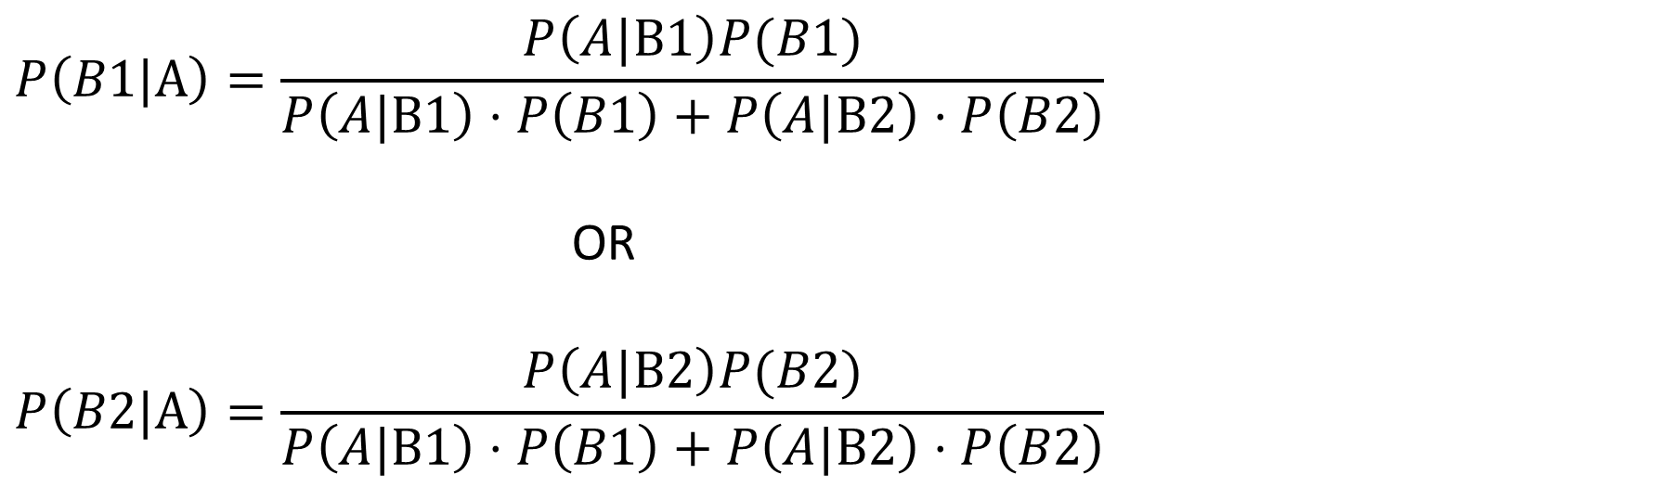
Bayes’ theorem
If B1 and B2 are mutually exclusive and exhaustive events of sample space S and A is any event then the probability of occurrence of event ‘B1 given A’ is
$$P\left(B1|A\right)=\frac{P\left(A|B1\right)P(B1)}{P\left(A|B1\right)⋅P\left(B1\right)+P\left(A|B2\right)⋅P\left(B2\right)}$$
OR
$$P\left(B2|A\right)=\frac{P\left(A|B2\right)P(B2)}{P\left(A|B1\right)⋅P\left(B1\right)+P\left(A|B2\right)⋅P\left(B2\right)}$$

Slide 50
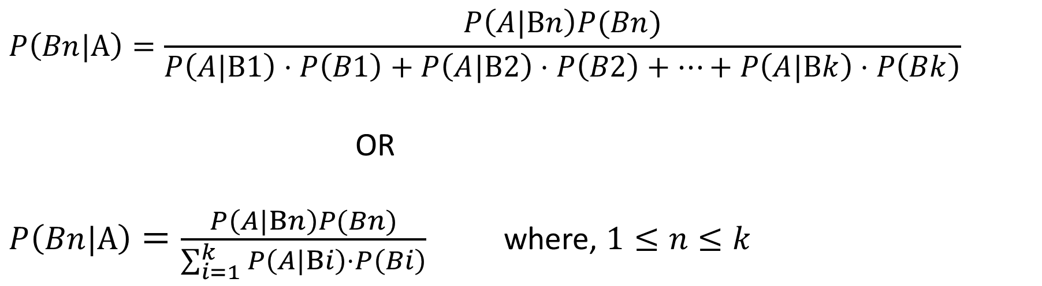
Bayes’ theorem
In general if B1, B2, ----, Bk are k mutually exclusive and exhaustive events of sample space S then the probability of event ‘Bn given A’ is
$$P\left(Bn|A\right)=\frac{P\left(A|Bn\right)P(Bn)}{P\left(A|B1\right)⋅P\left(B1\right)+P\left(A|B2\right)⋅P\left(B2\right)+⋯+P\left(A|Bk\right)⋅P\left(Bk\right)}$$
OR
$P\left(Bn|A\right)=\frac{P\left(A|Bn\right)P(Bn)}{\sum_{i=1}^{k}{P\left(A|Bi\right)⋅P\left(Bi\right)}}$ where, $1≤n≤k$

Slide 51
Bayes' rule is used in various occasions including a medical testing for a rare disease. With Bayes' rule, we can estimate the probability of actually having the condition given the test coming out positive.
Bayes’ theorem describes the probability of occurrence of an event related to any condition
Bayes theorem is also known as the formula for the probability of “causes” For example: if we have to calculate the probability of taking a blue ball from the second bag out of three different bags of balls, where each bag contains three different colour balls viz. red, blue, black.

Slide 52
EXAMPLE 17 A bag I contains 4 white and 6 black balls while another Bag II contains 4 white and 3 black balls. One ball is drawn at random from one of the bags, and it is found to be black. Find the probability that it was drawn from Bag I.
Let B1 be the event of choosing bag I, B2 the event of choosing bag II, and A be the event of drawing a black ball.
Then, P(B1) =P(B2) =1/2
Also,
P(A|B1) = P(drawing a black ball from Bag I) = 6/10 = 3/5
P(A|B2) = P(drawing a black ball from Bag II) = 3/7
By using Bayes’ theorem, the probability of drawing a black ball from bag I out of two bags,

Slide 53

$P\left(B1|A\right)=\frac{P\left(A|B1\right)P(B1)}{P\left(A|B1\right)⋅P\left(B1\right)+P\left(A|B2\right)⋅P\left(B2\right)}$
= $\frac{\left(\frac{3}{5}\right)∗(\frac{1}{2})}{\left(\frac{3}{5}\right)∗\left(\frac{1}{2}\right)+\left(\frac{3}{7}\right)∗(\frac{1}{2})}$
= 7/12

Slide 54
Example 18: Three boxes namely 1, 2 and 3 contain 10%, 20% and 30% of defective joints respectively. A joint is selected at random which was found defective then determine the probability that it comes from (i) box 1(ii) box 2 (iii) box 3.
Solution: Let S be the sample space.
Consider the following events:
A: Joint is defective
B1 : The joint comes from box 1
B2: The joint comes from box 2
B3 : The joint comes from box 3

Slide 55
We have P(B1) = 1/3, P(B2) = 1/3 and P(B3) = 1/3.
Also, we know that B1, B2 and B3 contain 10%, 20% and 30% of defective joints respectively.
Thus,
P(A|B1)= 0.1 , P(A|B2)=0.2 and P(A|B3)= 0.3

Slide 56
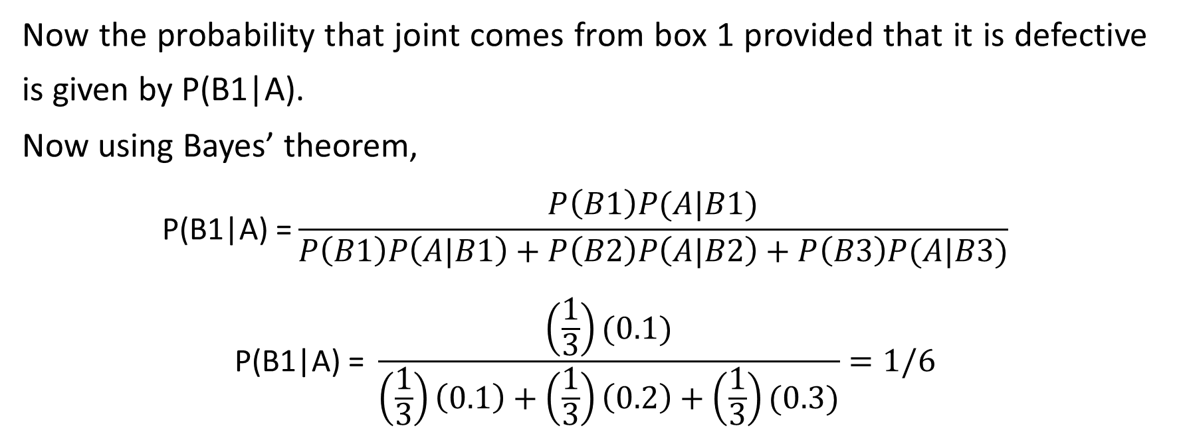
Now the probability that joint comes from box 1 provided that it is defective is given by P(B1|A).
Now using Bayes’ theorem,
$$\text{P}\text{(}\text{B}\text{1|}\text{A}\text{) =}\frac{P\left(B1\right)P(A|B1)}{P\left(B1\right)P\left(A|B1\right)+P\left(B2\right)P\left(A|B2\right)+P\left(B3\right)P(A|B3)}$$
$$\text{P}\text{(}\text{B}\text{1|}\text{A}\text{) = }\frac{\left(\frac{1}{3}\right)(0.1)}{\left(\frac{1}{3}\right)\left(0.1\right)+\left(\frac{1}{3}\right)\left(0.2\right)+\left(\frac{1}{3}\right)(0.3)}=1/6$$

Slide 57
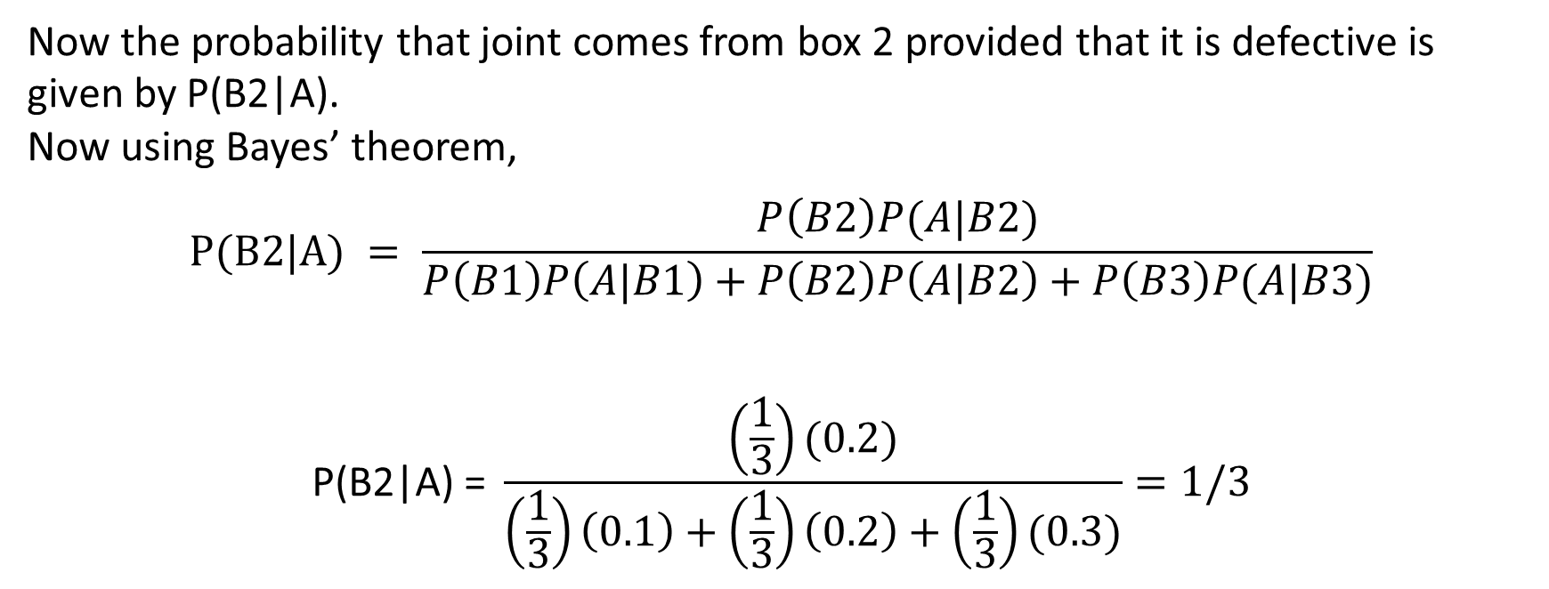
Now the probability that joint comes from box 2 provided that it is defective is given by P(B2|A).
Now using Bayes’ theorem,
$$P(B2|A) = \frac{P\left(B2\right)P(A|B2)}{P\left(B1\right)P\left(A|B1\right)+P\left(B2\right)P\left(A|B2\right)+P\left(B3\right)P(A|B3)}$$
$$\text{P}\text{(}\text{B}\text{2|}\text{A}\text{) = }\frac{\left(\frac{1}{3}\right)(0.2)}{\left(\frac{1}{3}\right)\left(0.1\right)+\left(\frac{1}{3}\right)\left(0.2\right)+\left(\frac{1}{3}\right)(0.3)}=1/3$$

Slide 58
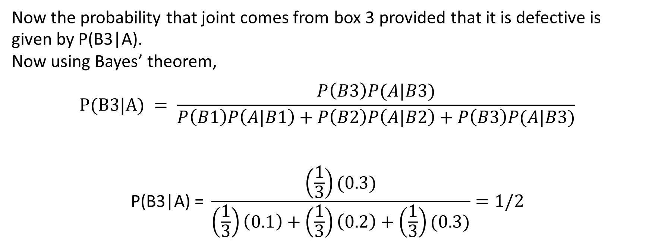
Now the probability that joint comes from box 3 provided that it is defective is given by P(B3|A).
Now using Bayes’ theorem,
$$P(B3|A) = \frac{P\left(B3\right)P(A|B3)}{P\left(B1\right)P\left(A|B1\right)+P\left(B2\right)P\left(A|B2\right)+P\left(B3\right)P(A|B3)}$$
$$\text{P}\text{(}\text{B}\text{3|}\text{A}\text{) = }\frac{\left(\frac{1}{3}\right)(0.3)}{\left(\frac{1}{3}\right)\left(0.1\right)+\left(\frac{1}{3}\right)\left(0.2\right)+\left(\frac{1}{3}\right)(0.3)}=1/2$$

Slide 59
A businessmen goes to hotel X,Y,Z for 20 %,50 % and 30 % of the time respectively. It is known that 5 % ,4% and 8% of the rooms in X,Y,Z hotels have faulty plumbing’s. What is probability that businessmen’s rooms having faulty plumbing is assigned to hotel Y and Hotel Z ?

Slide 60
An insurance company insured 2000 scooter drivers, 4000 car drivers, and 6000 truck drivers. The probability of an accident involving a scooter driver, car driver, and a truck is 0.01, 0.03, and 0.015 respectively. One of the insured persons meets with an accident.
1) What is the probability that he is a scooter driver?
2) What is the probability that he is a truck driver?
3) What is the probability that he is a car driver?

