Slide 1

Department of CE
Subject Name: Probability and Statistics
Unit 4 and 5

Slide 2
Large Sample
Z-test
Proportion
Small sample t-Test
Mean
F-Test
Ratio of Variances
χ² – Test
Mean
Goodness of Fit
Test of hypothesis
OR
Test of significance

Slide 3
TERMS RELATED TO TESTS OF HYPOTHESIS
Population
The group (say of size N) of units or items or individuals or observations or objects forming a subject matter of statistical investigation for their various characteristics is known as population.
The population may be finite or infinite. It may be real or hypothetical.
Sample
A finite subset of population is selected by some scientific method with a view of estimating population characteristics is known as sample.
The size of the sample is denoted by n. When n ≥ 30, the sample size is said to be large and when n < 30, the sample size is said to be small.
SAMPLE
POPULATION

Slide 4
TERMS RELATED TO TESTS OF HYPOTHESIS
Parameter
(The statistical constants of population)
Mean(μ)
Standard deviation(σ)
Statistic
(The statistical constants of Sample)
Mean($\overline{x}$)
Mean(𝑥 ̅)
Standard deviation(s)
Correlation coefficient(ρ)
Population proportion (P)
Correlation coefficient(r)
Sample proportion (p)
The values of parameters for a population does not change.
The values of statistics vary from sample to sample.

Slide 5
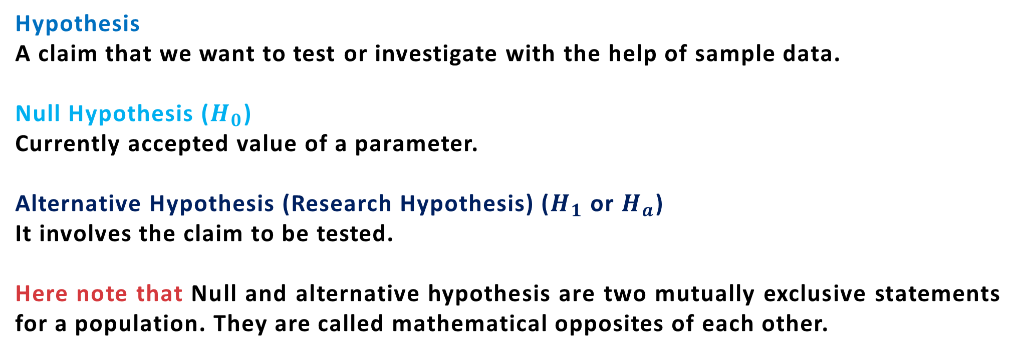
TERMS RELATED TO TESTS OF HYPOTHESIS
Hypothesis
A claim that we want to test or investigate with the help of sample data.
Null Hypothesis ($H_{0}$)
Currently accepted value of a parameter.
Alternative Hypothesis (Research Hypothesis) ($H_{1}$ or $H_{a}$)
It involves the claim to be tested.
Here note that Null and alternative hypothesis are two mutually exclusive statements for a population. They are called mathematical opposites of each other.

Slide 6
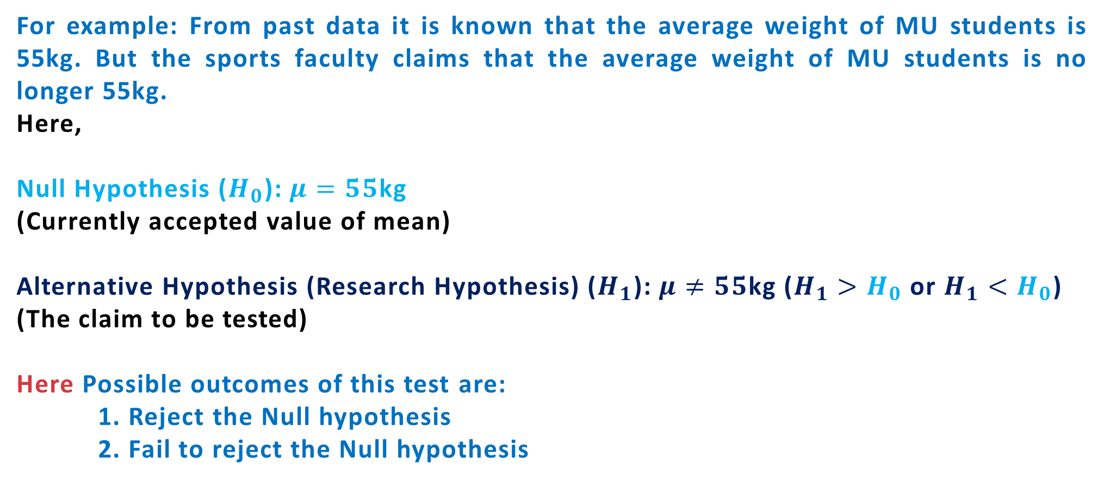
TERMS RELATED TO TESTS OF HYPOTHESIS
For example: From past data it is known that the average weight of MU students is 55kg. But the sports faculty claims that the average weight of MU students is no longer 55kg.
Here,
Null Hypothesis ($H_{0}$): $μ=55$kg
(Currently accepted value of mean)
Alternative Hypothesis (Research Hypothesis) ($H_{1}$): $μ≠55$kg ($H_{1}>H_{0}$ or $H_{1}<H_{0}$)
(The claim to be tested)
Here Possible outcomes of this test are:
1. Reject the Null hypothesis
2. Fail to reject the Null hypothesis

Slide 7
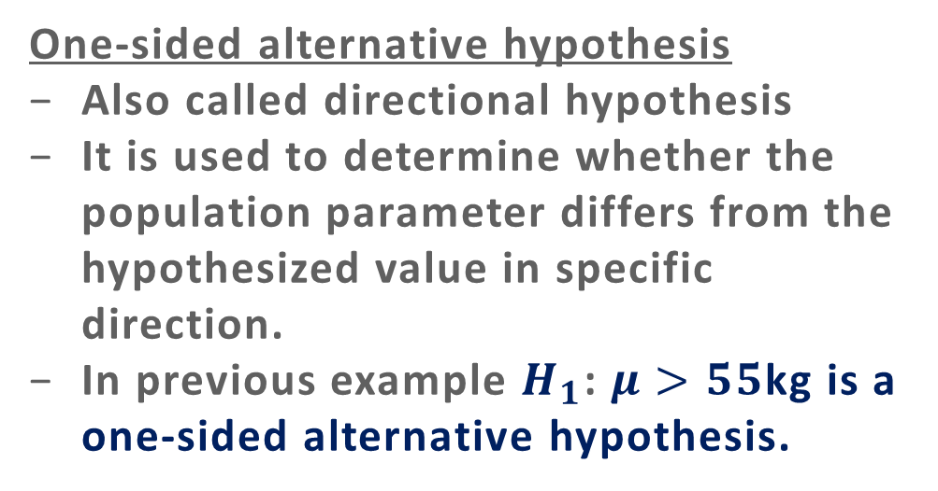
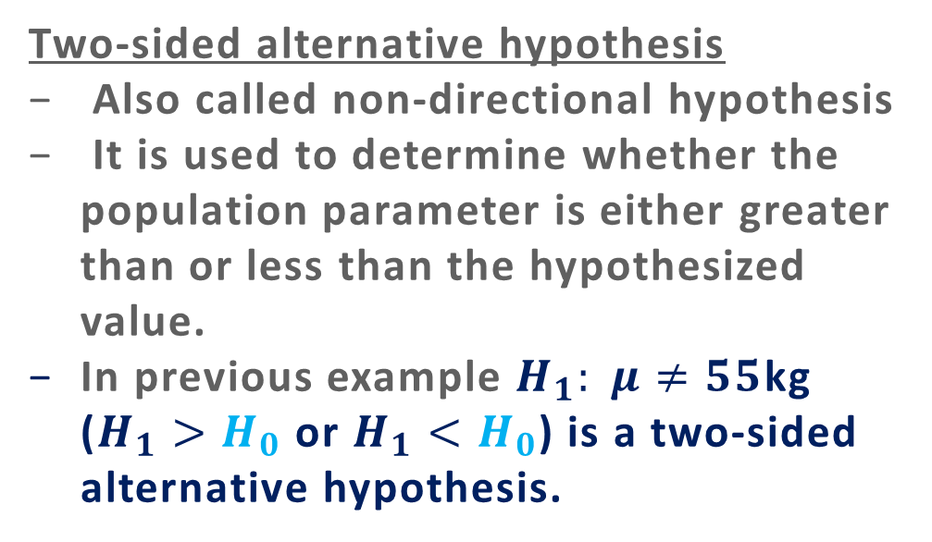
TERMS RELATED TO TESTS OF HYPOTHESIS
Two-sided and one-sided Hypothesis:
The alternative hypothesis can be two-sided or one-sided.
Two-sided alternative hypothesis
Also called non-directional hypothesis
It is used to determine whether the population parameter is either greater than or less than the hypothesized value.
In previous example $H_{1}: μ≠55$kg ($H_{1}>H_{0}$ or $H_{1}<H_{0}$) is a two-sided alternative hypothesis.
One-sided alternative hypothesis
Also called directional hypothesis
It is used to determine whether the population parameter differs from the hypothesized value in specific direction.
In previous example $H_{1}$: $μ>55$kg is a one-sided alternative hypothesis.

Slide 8
Type-I and type-II error:
No hypothesis test is 100% accurate. All the tests are based on probability so there are always chances of errors. For the hypothesis tests there are two types of errors.
Conclusion | H₀ is true | (H_{a} is true)
Accept H₀ | Correct Conclusion | Type II error
Reject H₀ | Type I error | Correct Conclusion
If the conclusion is to accept H₀ .
If the H₀ is true ,this conclusion is correct . However ,if H_{a} is true ,we make a Type 2 error, that is we accept H₀ when it is false.
The second row shows what can happen if the conclusion is reject to H₀. If H₀ is true ,we make type 1 error ; that is we reject H₀ when it is true. However if H_{a} is true, rejecting H₀ is correct.

Slide 9
TERMS RELATED TO TESTS OF HYPOTHESIS
Possible outcomes of any test:
1. Reject the Null hypothesis
2. Fail to reject the Null hypothesis
Now, the question here is how to do it?
Test statistics
A test statistic is a random variable which is calculated from the sample data. It is used to determine whether to reject null hypothesis or not.
Different tests uses different test statistics based on probability distribution.

Slide 10
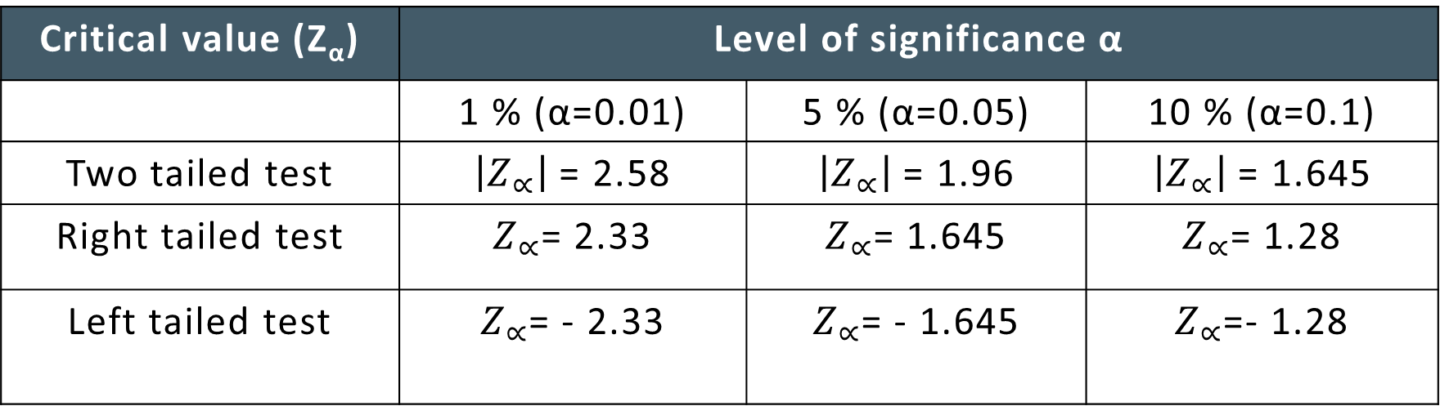
TERMS RELATED TO TESTS OF HYPOTHESIS
Confidence Limits
The limits within which a hypothesis should lie with specified probability are called confidence limits or fiducial limit.
Generally, the confidence limits are set up with 5% or 1% level of significance. If the sample value lies between the confidence limits, the hypothesis is accepted, if it does not, then the hypothesis is rejected at the specified level of significance.
Critical value (Z_{α}) | Level of significance α
 | 1 % (α=0.01) | 5 % (α=0.05) | 10 % (α=0.1)
Two tailed test | $\left|Z_{∝}\right|$ = 2.58 | $\left|Z_{∝}\right|$ = 1.96 | $\left|Z_{∝}\right|$ = 1.645
Right tailed test | $Z_{∝}$= 2.33 | $Z_{∝}$= 1.645 | $Z_{∝}$= 1.28
Left tailed test | $Z_{∝}$= - 2.33 | $Z_{∝}$= - 1.645 | $Z_{∝}$=- 1.28

Slide 11
TERMS RELATED TO TESTS OF HYPOTHESIS
P(Z)
Acceptance region
Rejection region
Rejection region
- α
O
α

Slide 12
TERMS RELATED TO TESTS OF HYPOTHESIS
P(Z)
Acceptance region
Rejection region
Z
O
α
Right tailed test

Slide 13
TERMS RELATED TO TESTS OF HYPOTHESIS
P(Z)
Acceptance region
Rejection region
Z
- α
O
Left tailed test

Slide 14
Which test to apply?
Criterion | test
If population is large (n ≥ 30) | Z-test
If population is small (n < 30) | T-test
Sample variance | F-test
To check compatibility of observed and expected frequency | Chi-Square test

Slide 15
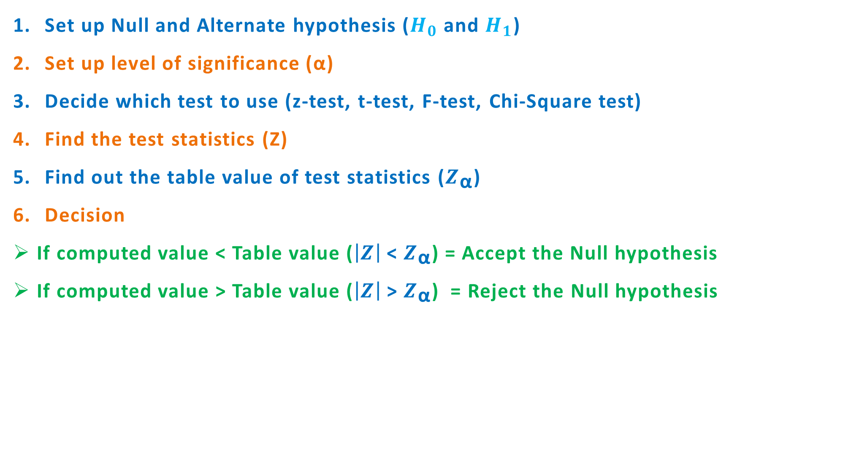
PROCEDURE FOR TESTING OF HYPOTHESIS
Set up Null and Alternate hypothesis ($H_{0}$ and $H_{1}$)
Set up level of significance (α)
Decide which test to use (z-test, t-test, F-test, Chi-Square test)
Find the test statistics (Z)
Find out the table value of test statistics ($Z_{\text{α}}$)
Decision
If computed value < Table value ($\left|Z\right|$ < $Z_{\text{α}}$) = Accept the Null hypothesis
If computed value > Table value ($\left|Z\right|$ > $Z_{\text{α}}$) = Reject the Null hypothesis

Slide 16
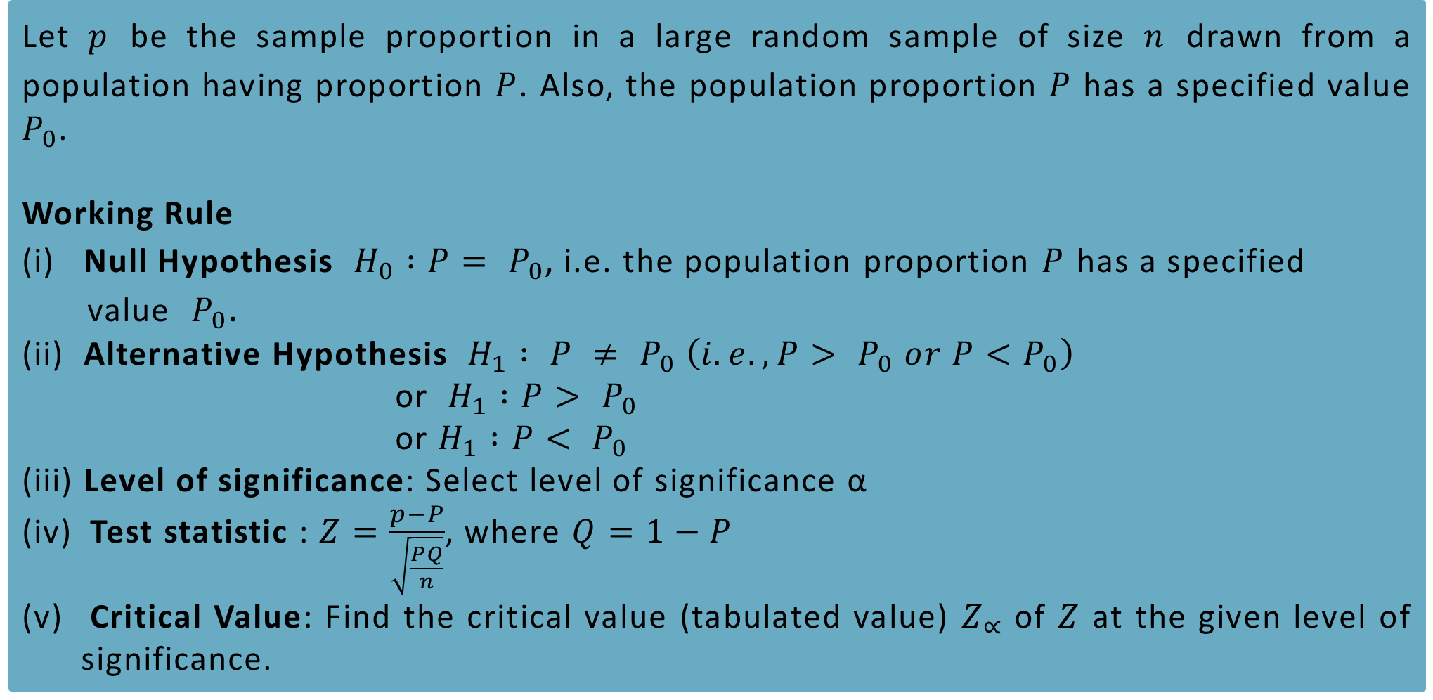
TEST OF SIGNIFICANCE FOR PROPORTION-LARGE SAMPLES
Let $p$ be the sample proportion in a large random sample of size $n$ drawn from a population having proportion $P$. Also, the population proportion $P$ has a specified value $P_{0}$.
Working Rule
(i) Null Hypothesis $H_{0} :P= P_{0}$, i.e. the population proportion $P$ has a specified
value $P_{0}$.
(ii) Alternative Hypothesis $H_{1} : P ≠ P_{0} \left(i.e., P> P_{0} or P<P_{0}\right)$
or $H_{1} :P> P_{0}$
or $H_{1} :P< P_{0}$
(iii) Level of significance: Select level of significance α
Test statistic : $Z=\frac{p−P}{\sqrt{\frac{PQ}{n}}}$, where $Q=1−P$
Critical Value: Find the critical value (tabulated value) $Z_{∝}$ of $Z$ at the given level of significance.

Slide 17
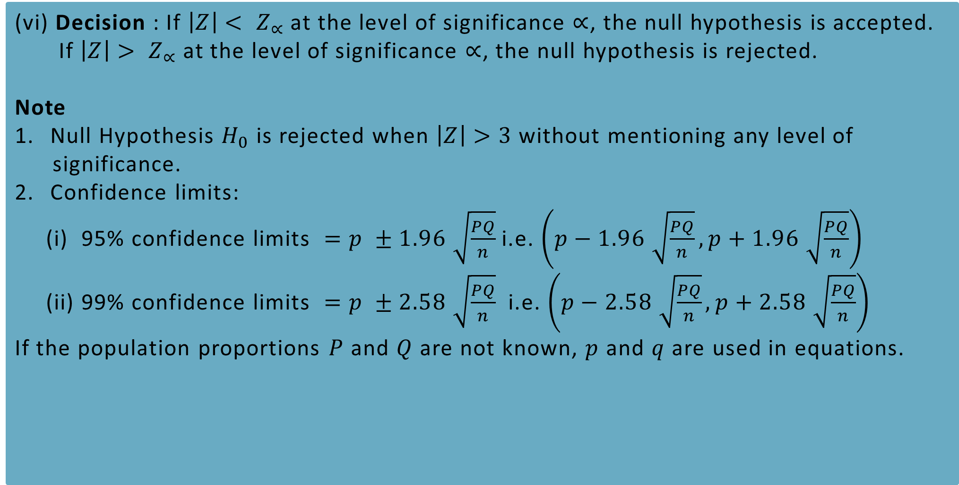
TEST OF SIGNIFICANCE FOR SINGLE PROPORTION-LARGE SAMPLES
(vi) Decision : If $\left|Z\right|< Z_{∝}$ at the level of significance $∝$, the null hypothesis is accepted.
If $\left|Z\right|> Z_{∝}$ at the level of significance $∝$, the null hypothesis is rejected.
Note
Null Hypothesis $H_{0}$ is rejected when $\left|Z\right|>3$ without mentioning any level of
significance.
Confidence limits:
(i) 95% confidence limits $=p ±1.96 \sqrt{\frac{PQ}{n}}$ i.e. $\left(p−1.96 \sqrt{\frac{PQ}{n}},p+1.96 \sqrt{\frac{PQ}{n}}\right)$
(ii) 99% confidence limits $=p ±2.58 \sqrt{\frac{PQ}{n}}$ i.e. $\left(p−2.58 \sqrt{\frac{PQ}{n}},p+2.58 \sqrt{\frac{PQ}{n}}\right)$
If the population proportions $P$ and $Q$ are not known, $p$ and $q$ are used in equations.

Slide 18
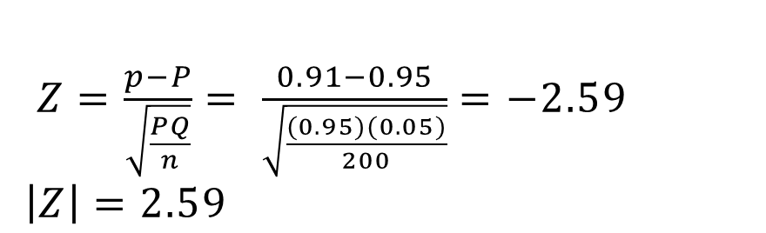

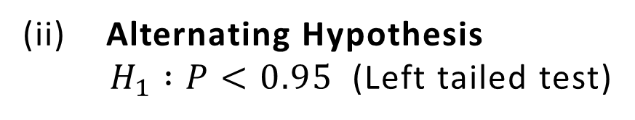
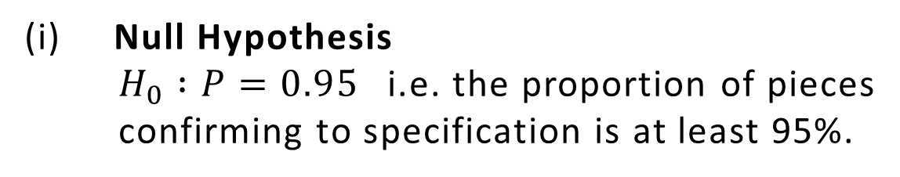


Example 1
A manufacturer claimed that at least 95% of the equipment which he supplied to a factory confirmed to specification. An examination of a sample of 200 pieces of equipment revealed that 18 were faulty. Test his claim at 5% level of significance.
Solution
n=200
Number of pieces conforming to specification = 200-18 = 182
$p=$ Sample proportion of pieces confirming to specification = $\frac{182}{200}$ = 0.91
$P=$ Population proportion of pieces confirming to specification = 0.95
$Z=\frac{p−P}{\sqrt{\frac{PQ}{n}}}= \frac{0.91−0.95}{\sqrt{\frac{(0.95)(0.05)}{200}}}=−2.59$
$\left|Z\right|=2.59$
$$Q=1−P=1−0.95=0.05$$
(i) Null Hypothesis
$H_{0} :P=0.95$ i.e. the proportion of pieces
confirming to specification is at least 95%.
(v) Critical value $\left|Z_{0.05}\right|=1.645$
(vi) Decision Since $\left|Z\right| > \left|Z_{0.05}\right|$,
the null hypothesis is rejected
at 5 % level of significance.
i.e., the manufacturer’s claim is
rejected.
(ii) Alternating Hypothesis
$H_{1} :P<0.95$ (Left tailed test)
(iii) Level of significance $∝ =0.05$
(iv) Test statistic

Slide 19
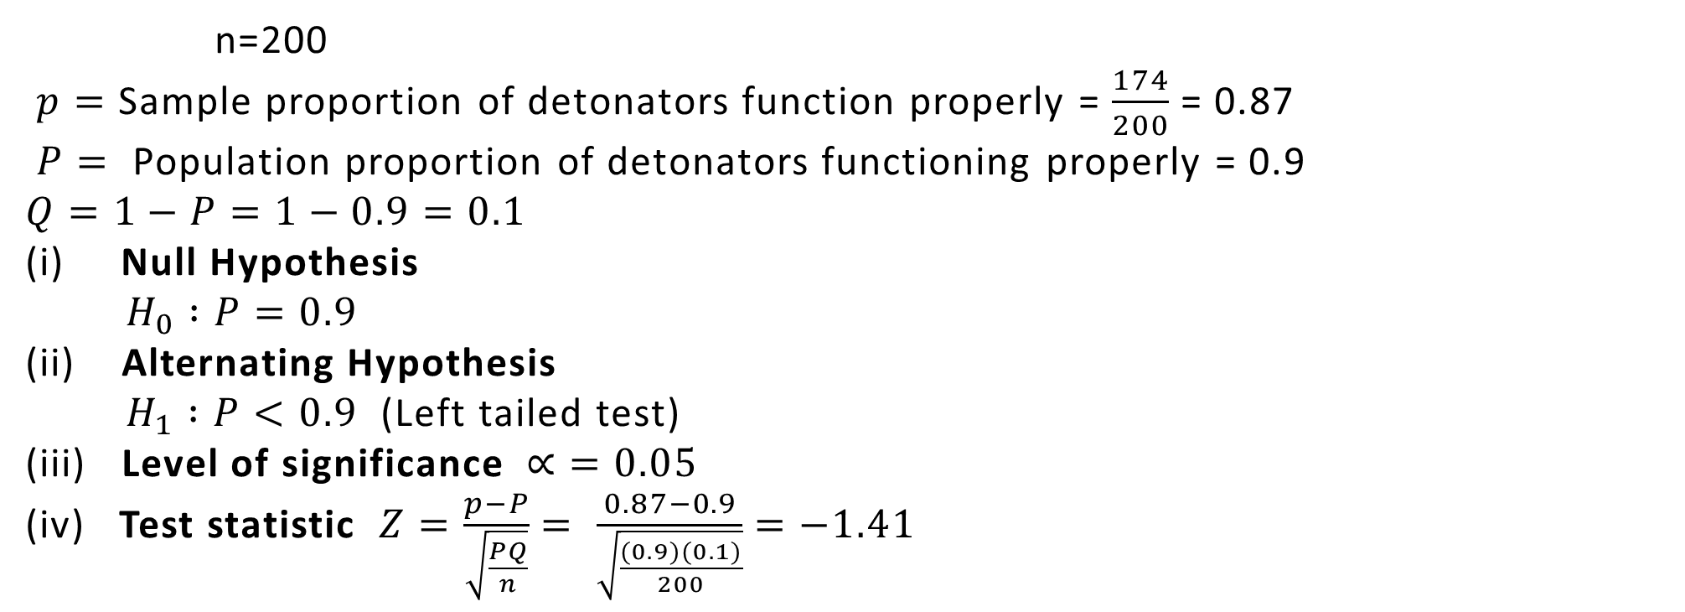
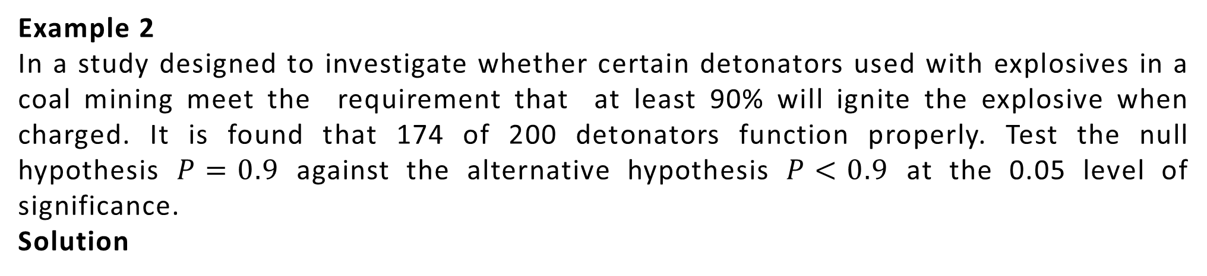

Example 2
In a study designed to investigate whether certain detonators used with explosives in a coal mining meet the requirement that at least 90% will ignite the explosive when charged. It is found that 174 of 200 detonators function properly. Test the null hypothesis $P=0.9$ against the alternative hypothesis $P<0.9$ at the 0.05 level of significance.
Solution
n=200
$p=$ Sample proportion of detonators function properly = $\frac{174}{200}$ = 0.87
$P=$ Population proportion of detonators functioning properly = 0.9
$$Q=1−P=1−0.9=0.1$$
(i) Null Hypothesis
$H_{0} :P=0.9$
(ii) Alternating Hypothesis
$H_{1} :P<0.9$ (Left tailed test)
(iii) Level of significance $∝ =0.05$
(iv) Test statistic $Z=\frac{p−P}{\sqrt{\frac{PQ}{n}}}= \frac{0.87−0.9}{\sqrt{\frac{(0.9)(0.1)}{200}}}=−1.41$
$\left|Z\right|=1.41$
Critical value $\left|Z_{0.05}\right|=1.645$
(vi) Decision Since $\left|Z\right|<\left|Z_{0.05}\right|$, the
null hypothesis is accepted at 5 %
level of significance.

Slide 20
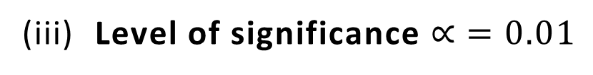
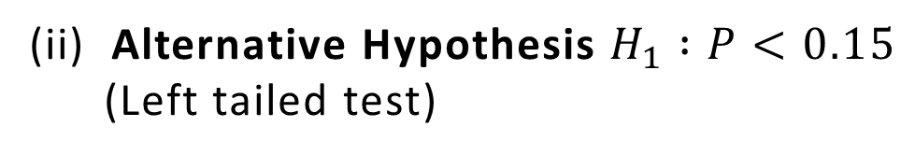
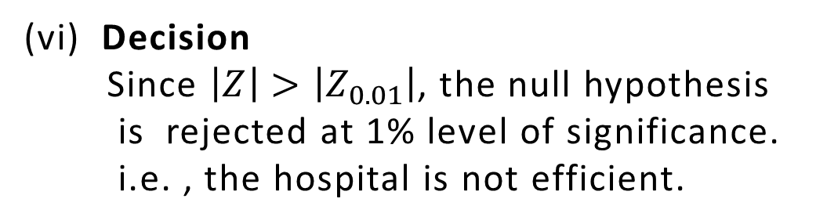

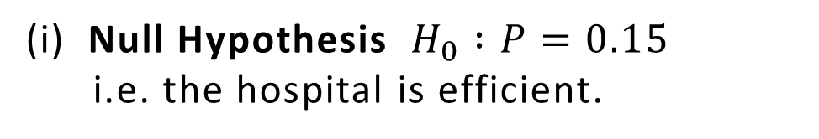
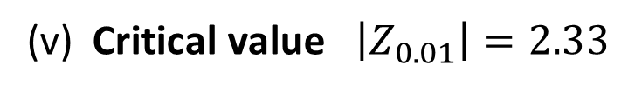


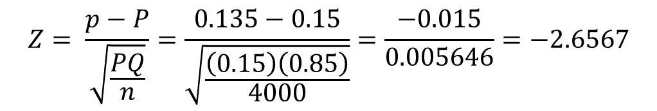
Example 3
The fatality rate of covid-19 patients is believed to be 15 %. In a current year, 4000 patients suffering from covid-19 in Baroda city were treated in a private hospital and 540 patient died. Can you consider the hospital efficient at 1% level of significance ?
Solution
$$n=4000$$
$p=$ Sample proportion of covid-19 patients died $= \frac{540}{4000}=0.135$
$P=$ Population proportion of covid-19 patients died $=0.15$
$$Q=1−P=1−0.15=0.85$$
$$Z= \frac{p−P}{\sqrt{\frac{PQ}{n}}}=\frac{0.135−0.15}{\sqrt{\frac{\left(0.15\right)\left(0.85\right)}{4000}}}=\frac{−0.015}{0.005646}=−2.6567$$
(i) Null Hypothesis $H_{0} :P=0.15$
i.e. the hospital is efficient.
$$\left|Z\right|=2.6567$$
(ii) Alternative Hypothesis $H_{1} :P<0.15$
(Left tailed test)
(v) Critical value $\left|Z_{0.01}\right|=2.33$
(vi) Decision
Since $\left|Z\right|>\left|Z_{0.01}\right|$, the null hypothesis
is rejected at 1% level of significance.
i.e. , the hospital is not efficient.
(iii) Level of significance $∝ =0.01$
(iv) Test statistics

Slide 21
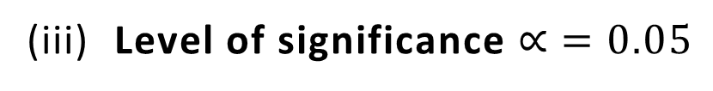
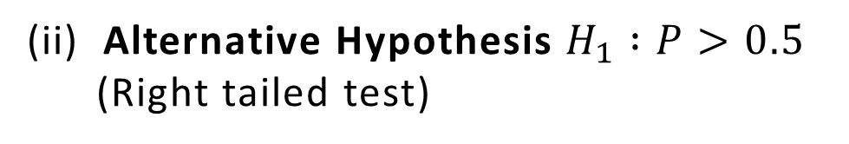
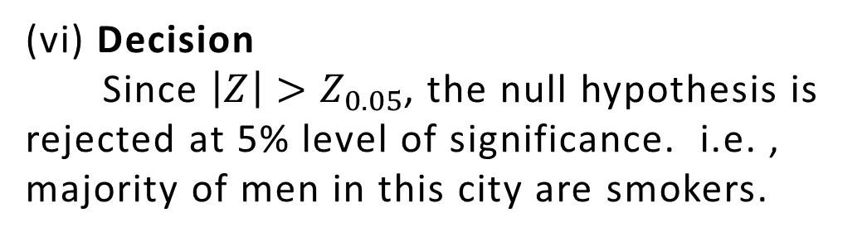


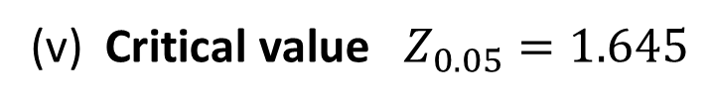


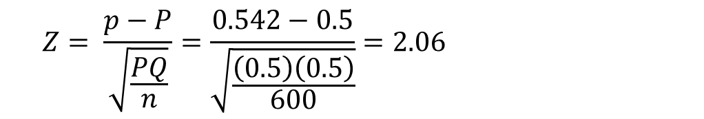
Example 4
In a big city, 325 men out of 600 were found to be smokers. Does this information support the conclusion that the majority of men in this city are smokers ?
Solution
$$n=600$$
$p=$ Sample proportion of smokers in city $= \frac{325}{600}=0.542$
$P=$ Population proportion of smokers in city $=0.5$
$$Q=1−P=1−0.5=0.5$$
$$Z= \frac{p−P}{\sqrt{\frac{PQ}{n}}}=\frac{0.542−0.5}{\sqrt{\frac{\left(0.5\right)\left(0.5\right)}{600}}}=2.06$$
(i) Null Hypothesis $H_{0} :P=0.5$
i.e. the proportion of smokers in the
city is 50%
$$\left|Z\right|=2.06$$
(ii) Alternative Hypothesis $H_{1} :P>0.5$
(Right tailed test)
(v) Critical value $Z_{0.05}=1.645$
(vi) Decision
Since $\left|Z\right|>Z_{0.05}$, the null hypothesis is rejected at 5% level of significance. i.e. , majority of men in this city are smokers.
(iii) Level of significance $∝ =0.05$
(iv) Test statistics

Slide 22
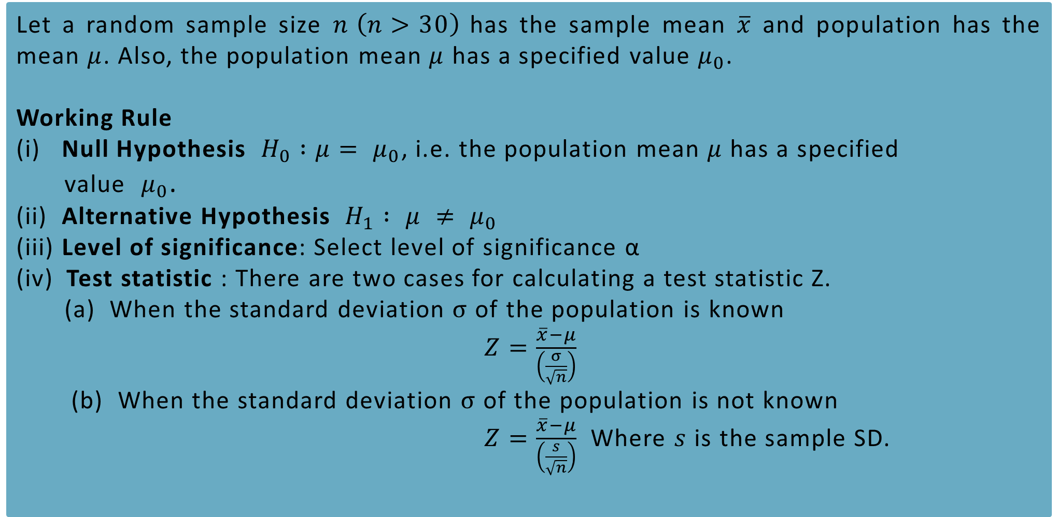
TEST OF SIGNIFICANCE FOR MEAN-LARGE SAMPLES
Let a random sample size $n \left(n>30\right)$ has the sample mean $\overline{x}$ and population has the mean $μ$. Also, the population mean $μ$ has a specified value $μ_{0}$.
Working Rule
(i) Null Hypothesis $H_{0} :μ= μ_{0}$, i.e. the population mean $μ$ has a specified
value $μ_{0}$.
(ii) Alternative Hypothesis $H_{1} : μ ≠ μ_{0}$
(iii) Level of significance: Select level of significance α
Test statistic : There are two cases for calculating a test statistic Z.
(a) When the standard deviation $σ$ of the population is known
$Z=\frac{\overline{x}−μ}{\left(\frac{σ}{\sqrt{n}}\right)}$
(b) When the standard deviation $σ$ of the population is not known
$Z=\frac{\overline{x}−μ}{\left(\frac{s}{\sqrt{n}}\right)}$ Where $s$ is the sample SD.

Slide 23
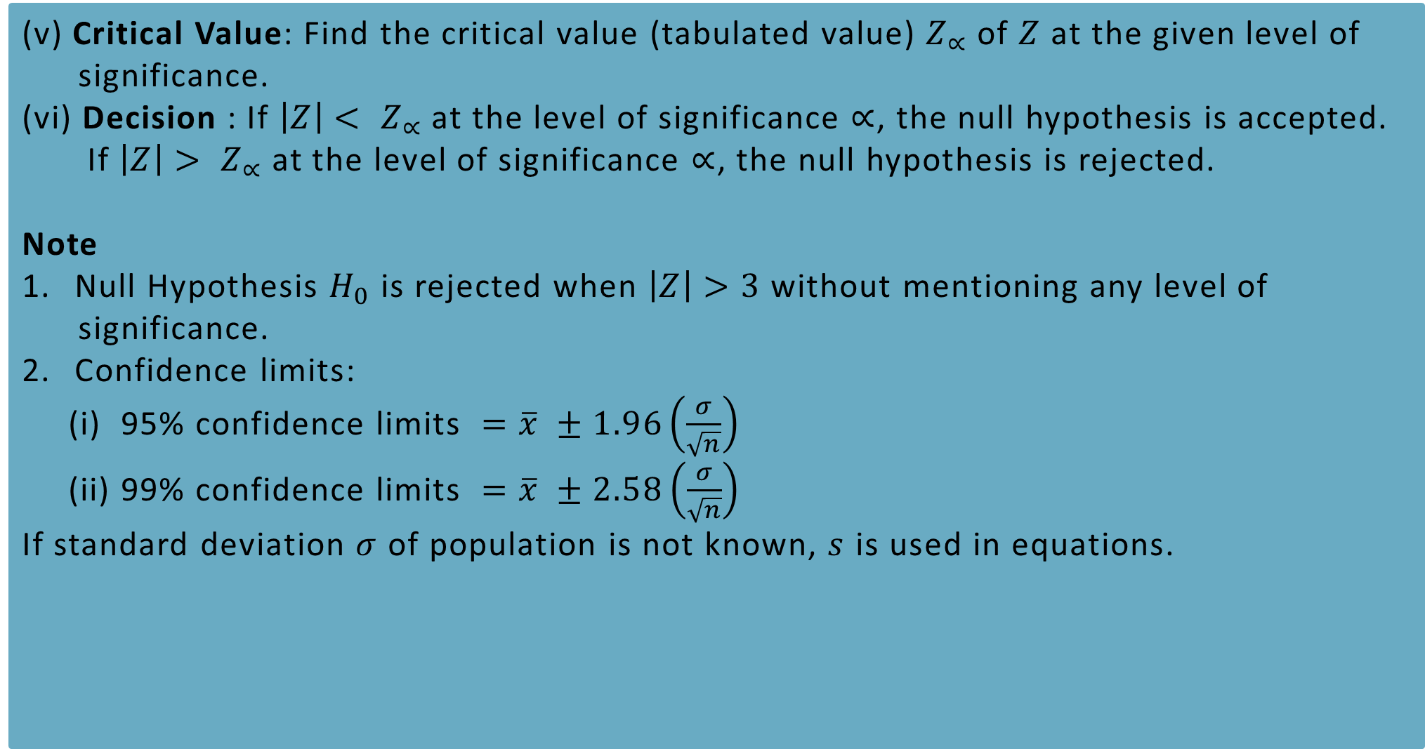
TEST OF SIGNIFICANCE FOR SINGLE MEAN-LARGE SAMPLES
(v) Critical Value: Find the critical value (tabulated value) $Z_{∝}$ of $Z$ at the given level of
significance.
(vi) Decision : If $\left|Z\right|< Z_{∝}$ at the level of significance $∝$, the null hypothesis is accepted.
If $\left|Z\right|> Z_{∝}$ at the level of significance $∝$, the null hypothesis is rejected.
Note
Null Hypothesis $H_{0}$ is rejected when $\left|Z\right|>3$ without mentioning any level of
significance.
Confidence limits:
(i) 95% confidence limits $=\overline{x} ±1.96\left(\frac{σ}{\sqrt{n}}\right)$
(ii) 99% confidence limits $=\overline{x} ±2.58\left(\frac{σ}{\sqrt{n}}\right)$
If standard deviation $σ$ of population is not known, $s$ is used in equations.

Slide 24
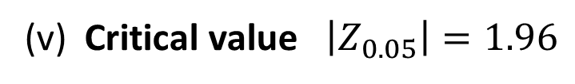



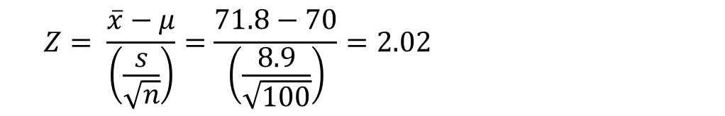
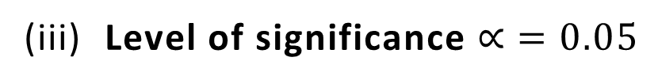
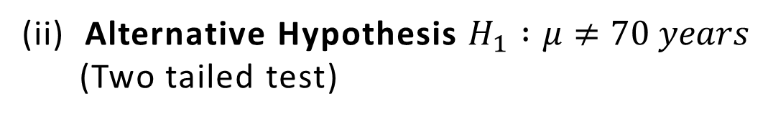
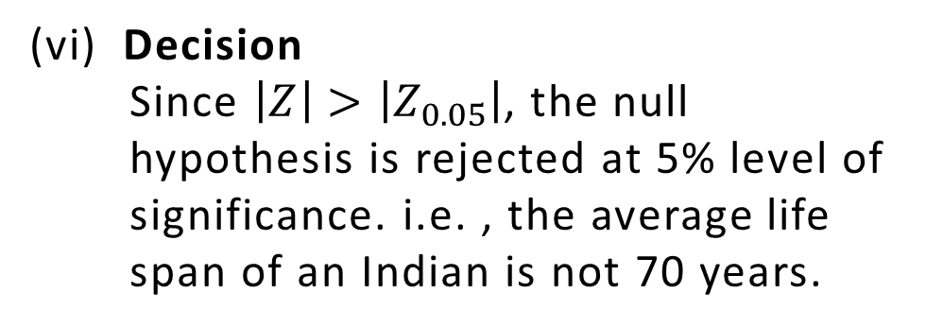
Example 5
A random sample of 100 Indians has an average life span of 71.8 years with standard deviation of 8.9 years. Can it be concluded that the average life span of an Indian is 70 years?
Solution
$$n =100, \overline{x}=71.8 years, μ=70 years, s=8.9 years$$
$$\left|Z\right|=2.02$$
(v) Critical value $\left|Z_{0.05}\right|=1.96$
Null Hypothesis $H_{0} :$ $μ=70 years$, i.e. the average life span of an Indian is 70 years.
(vi) Decision
Since $\left|Z\right|>\left|Z_{0.05}\right|$, the null
hypothesis is rejected at 5% level of
significance. i.e. , the average life
span of an Indian is not 70 years.
(ii) Alternative Hypothesis $H_{1} :μ≠70 years$
(Two tailed test)
(iii) Level of significance $∝ =0.05$
(iv) Test statistics
$$Z= \frac{\overline{x}−μ}{\left(\frac{s}{\sqrt{n}}\right)}=\frac{71.8−70}{\left(\frac{8.9}{\sqrt{100}}\right)}=2.02$$

Slide 25
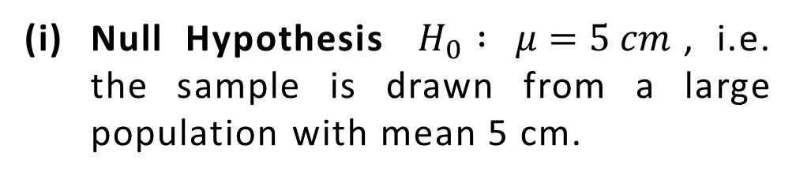


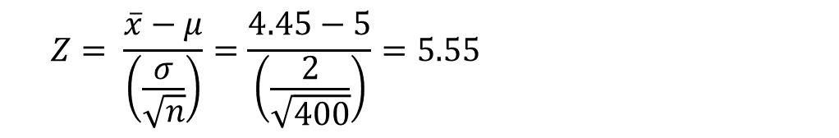
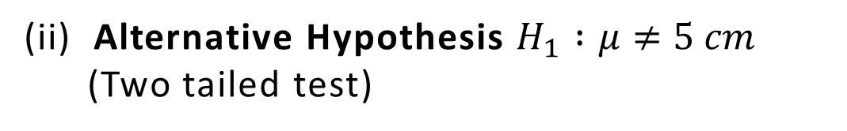
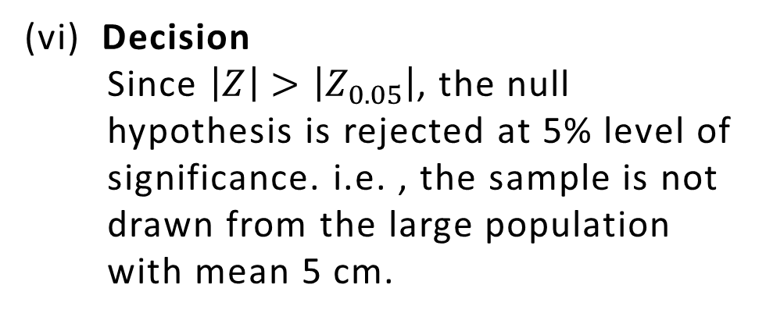
Example 10
A random sample of 400 members is found to have a mean of 4.45 cm. Can it be reasonably regarded as a sample from a large population whose mean is 5 cm and variance is 4 cm?
Solution
$$n =400, \overline{x}=4.45 cm, μ=5 cm, σ=\sqrt{4}=2$$
$$\left|Z\right|=5.55$$
(v) Critical value $\left|Z_{0.05}\right|=1.96$
Null Hypothesis $H_{0} :$ $μ=5 cm$, i.e. the sample is drawn from a large population with mean 5 cm.
(vi) Decision
Since $\left|Z\right|>\left|Z_{0.05}\right|$, the null
hypothesis is rejected at 5% level of
significance. i.e. , the sample is not
drawn from the large population
with mean 5 cm.
(ii) Alternative Hypothesis $H_{1} :μ≠5 cm$
(Two tailed test)
(iii) Level of significance $∝ =0.05$
(iv) Test statistics
$$Z= \frac{\overline{x}−μ}{\left(\frac{σ}{\sqrt{n}}\right)}=\frac{4.45−5}{\left(\frac{2}{\sqrt{400}}\right)}=5.55$$

Slide 26
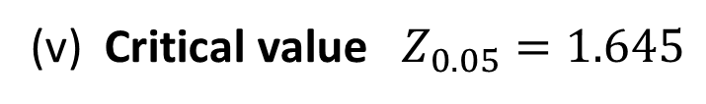
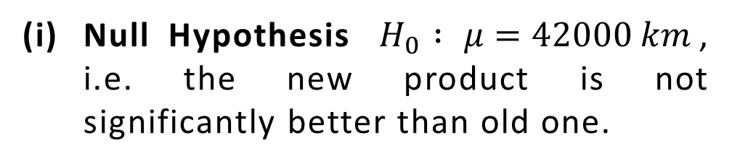

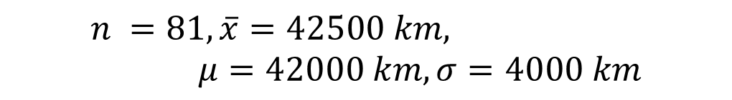
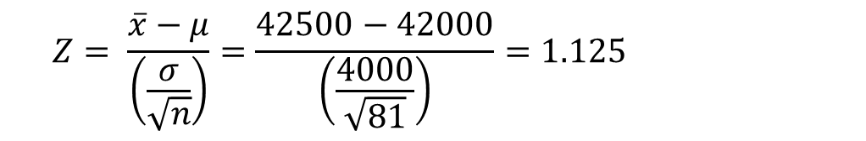
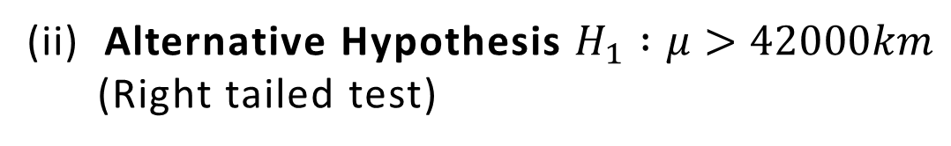
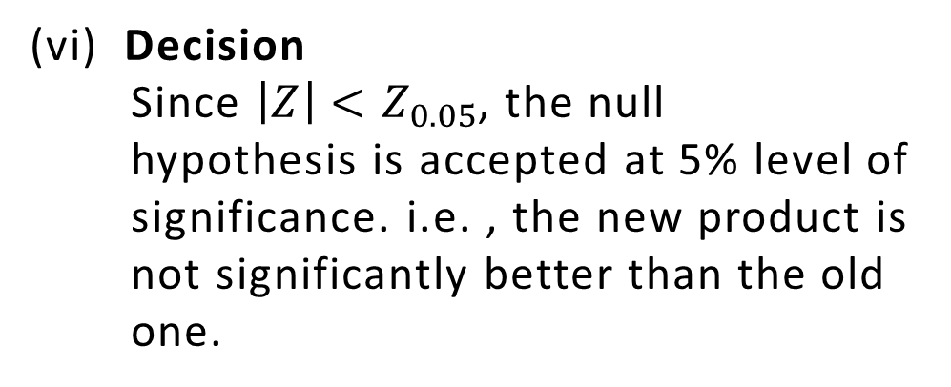
Example 11
A tyre company claims that the lives of tyres have mean 42000 km with s.d. of 4000 km. A change in the production process is believed to result in better product. A test sample of 81 tyres has a mean life of 42500 km. Test at 5% level of significance that the new product is significantly better that the old one
Solution
$$n =81, \overline{x}=42500 km, μ=42000 km, σ=4000 km$$
$$\left|Z\right|=1.125$$
(v) Critical value $Z_{0.05}=1.645$
Null Hypothesis $H_{0} :$ $μ=42000 km$, i.e. the new product is not significantly better than old one.
(vi) Decision
Since $\left|Z\right|<Z_{0.05}$, the null
hypothesis is accepted at 5% level of
significance. i.e. , the new product is
not significantly better than the old
one.
(ii) Alternative Hypothesis $H_{1} :μ>42000km$
(Right tailed test)
(iii) Level of significance $∝ =0.05$
(iv) Test statistics
$$Z= \frac{\overline{x}−μ}{\left(\frac{σ}{\sqrt{n}}\right)}=\frac{42500−42000}{\left(\frac{4000}{\sqrt{81}}\right)}=1.125$$

Slide 27
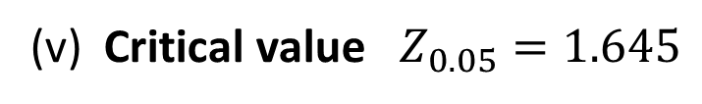
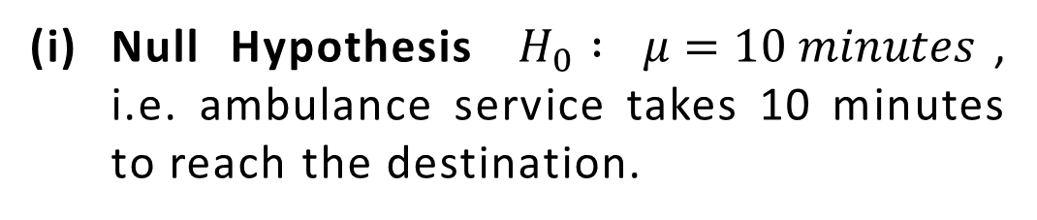


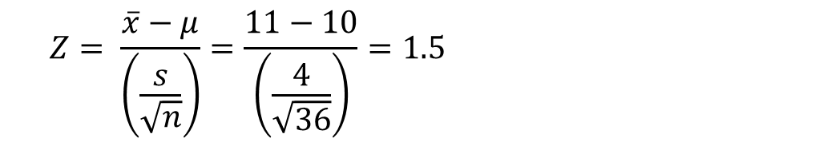
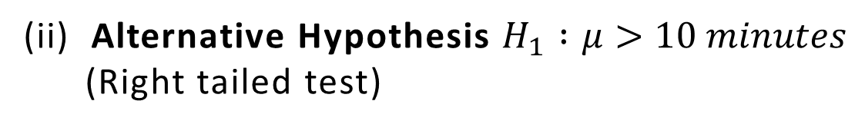
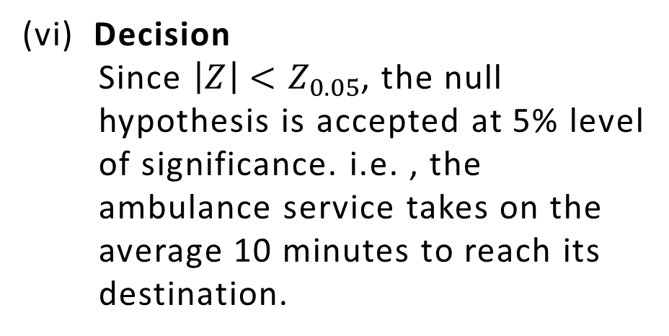
Example 12
An ambulance service claims that it takes on the average 10 minutes to reach its destination in emergency calls. A sample of 36 calls has a mean of 11 minutes and the variance of 16 minutes. Test the claim at 0.05 level of significance.
Solution
$$n =36, \overline{x}=11 minutes, μ=10 minutes, s=\sqrt{16}=4$$
$$\left|Z\right|=1.5$$
(v) Critical value $Z_{0.05}=1.645$
Null Hypothesis $H_{0} :$ $μ=10 minutes$, i.e. ambulance service takes 10 minutes to reach the destination.
(vi) Decision
Since $\left|Z\right|<Z_{0.05}$, the null
hypothesis is accepted at 5% level
of significance. i.e. , the
ambulance service takes on the
average 10 minutes to reach its
destination.
(ii) Alternative Hypothesis $H_{1} :μ>10 minutes$
(Right tailed test)
(iii) Level of significance $∝ =0.05$
(iv) Test statistics
$$Z= \frac{\overline{x}−μ}{\left(\frac{s}{\sqrt{n}}\right)}=\frac{11−10}{\left(\frac{4}{\sqrt{36}}\right)}=1.5$$

Slide 28
Small sample t-Test
Single mean
F-Test
Ratio of Variances
χ² – Test
Goodness of Fit
Test of hypothesis
OR
Test of significance

Slide 29
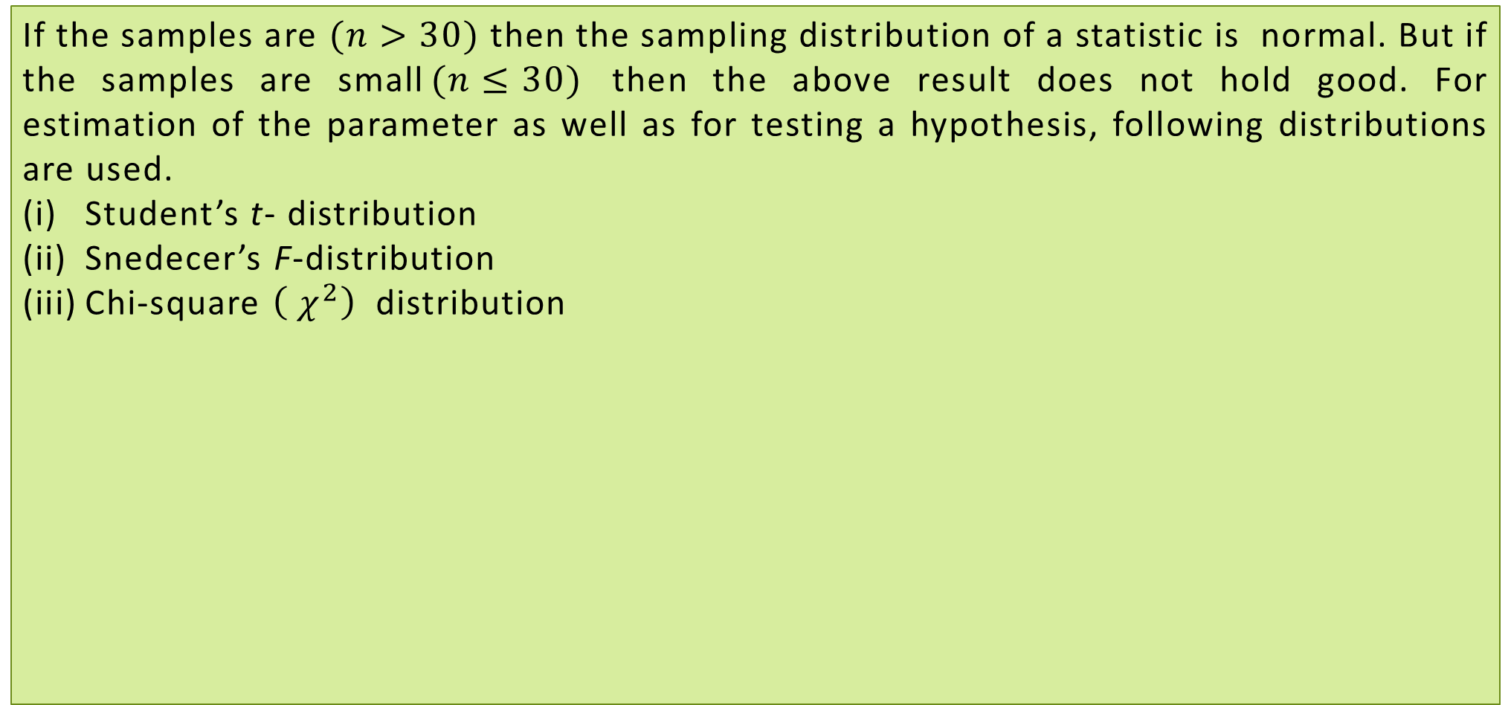
SMALL SAMPLE TESTS
If the samples are $(n>30)$ then the sampling distribution of a statistic is normal. But if the samples are small$(n≤30)$ then the above result does not hold good. For estimation of the parameter as well as for testing a hypothesis, following distributions are used.
Student’s t- distribution
Snedecer’s F-distribution
Chi-square $\left({ χ}^{2}\right)$ distribution

Slide 30
t-TEST: TEST OF SIGNIFICANCE FOR SINGLE MEAN
Let $x_{1},x_{2},….,$ $x_{n}$ be a random sample of size n $\left(n≤30\right)$ drawn from a normal population with mean $μ$ and SD $σ$ and if the sample mean $\overline{x}$ differs significantly from the population mean $μ t$hen the t statistics is given by
$t=\frac{\overline{x}−μ}{\left(\frac{s}{\sqrt{n−1}}\right)}$ , Where $s=\sqrt{\frac{\sum{{\left(x−\overline{x}\right)}^{2}}}{n}}$ with $v=n−1$
Note: Confidence Limit
95% confidence limits $=\overline{x}±t_{0.05}\left(\frac{s}{\sqrt{n−1}}\right)$
where $t_{0.05}$ is the 5% critical value of t for $v=n−1$ degree of freedom for a two
tailed test.
(ii) 99% confidence limits $=\overline{x}±t_{0.01}\left(\frac{s}{\sqrt{n−1}}\right)$
where $t_{0.01}$ is the 1% critical value of t for $v=n−1$ degree of freedom for a two
tailed test.

Slide 31
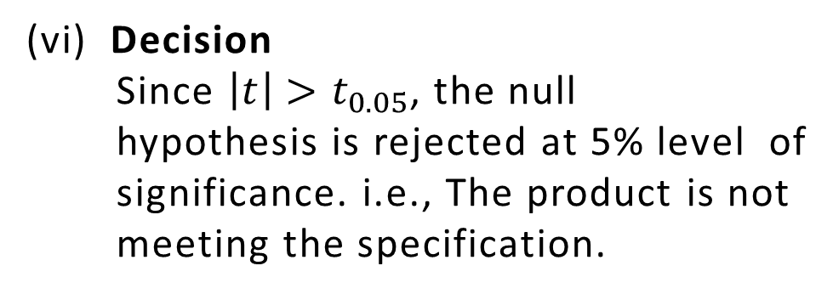


Example
A machinist is making engine parts with axle diameter of 0.7 cm. A random sample of 10 parts shows a mean diameter of 0.742 cm with a standard deviation of 0.04 cm. Compute the statistic you would use to test whether work is meeting the specification at 0.05% level of significance.
Solution
$$\left|t\right|=3.15$$
$$n =10,\overline{x}=0.742 cm$$
$$s =0.04 cm, μ=0.7 cm$$
(v) Critical value $v=n−1=10−1=9$
Null Hypothesis $H_{0} :μ =0.7 cm$, i.e. the
product is meeting the specification.
$$t_{0.05}\left(v=9\right)=2.262$$
(ii) Alternative Hypothesis $H_{1} :μ≠0.7 cm$
(Two tailed test)
(vi) Decision
Since $\left|t\right|>t_{0.05}$, the null
hypothesis is rejected at 5% level of
significance. i.e., The product is not
meeting the specification.
(iii) Level of significance $∝ =0.05$
(iv) Test statistics
$$t= \frac{\overline{x}−μ}{\left(\frac{s}{\sqrt{n−1}}\right)}=\frac{0.742−0.7}{\left(\frac{0.04}{\sqrt{10−1}}\right)}=3.15$$

Slide 32




Example
The mean lifetime of a sample of 25 bulbs is found as 1550 hours with a SD of 120 hours. The company manufacturing the bulbs claims that the average life of their bulbs is 1600 hours. Can you consider average is less than 1600 hours ? Is the claim acceptance at 5% level of significance?
Solution
$$n =25,\overline{x}=1550 hours$$
$$\left|t\right|=2.04$$
$$s=120 hours, μ=1600 hours$$
(v) Critical value $v=n−1=25−1=24$
Null Hypothesis $H_{0} :μ =1600 hours$, i.e. the average life of bulbs is 1600 hours.
$$t_{0.05}\left(v=24\right)=1.711$$
Alternative Hypothesis
$H_{1} :μ<1600 hours$ (One tailed test)
(vi) Decision
Since $\left|t\right|>t_{0.05}$, the null
hypothesis is rejected at 5% level of
significance. i.e., the average life of
bulbs is less than 1600 hours and
the claim is unacceptable.
(iii) Level of significance $∝ =0.05$
(iv) Test statistics
$$t= \frac{\overline{x}−μ}{\left(\frac{s}{\sqrt{n−1}}\right)}=\frac{1550−1600}{\left(\frac{120}{\sqrt{25−1}}\right)}=−2.04$$

Slide 33




Example
A soap manufacturing company was distributing a particular brand of soap through a large number of retail shops. Before a heavy advertisement campaign, the mean sales per week per shop was 140 dozens. After the campaign, a sample of 26 shops was taken and the mean sales was found to be 147 dozens with standard deviation 16. Can you consider the advertisement effective?
Solution
$$\left|t\right|=2.1875$$
$$n =26,\overline{x}=147 dozens$$
(v) Critical value $v=n−1=26−1=25$
$$s=16 dozens, μ=140 dozens$$
Null Hypothesis $H_{0} :μ =140 dozens$, i.e. the advertisement is not effective.
$$t_{0.05}\left(v=25\right)=1.708$$
(vi) Decision
Since $\left|t\right|>t_{0.05}$, the null
hypothesis is rejected at 5% level of
significance. i.e., the advertisement
is effective.
Alternative Hypothesis
$H_{1} :μ>140 dozens$ (One tailed test)
(iii) Level of significance $∝ =0.05$
(iv) Test statistics
$$t= \frac{\overline{x}−μ}{\left(\frac{s}{\sqrt{n−1}}\right)}=\frac{147−140}{\left(\frac{16}{\sqrt{26−1}}\right)}=2.1875$$

Slide 34
F-TEST OF SIGNIFICANCE FOR RATIO OF VARIANCES
Let $x_{1},x_{2},….,$ $x_{n}$ and $y_{1},y_{2},…,$ $y_{n}$be two independent samples of sizes $n_{1}$ and $n_{2}$ $\left(n_{1}≤30,n_{2}≤30\right)$ with means $\overline{x}$ and $\overline{y}$ and standard deviations $s_{1}$ and $s_{2}$. If $S_{1}$ and $S_{2}$
Standard deviations of population then the process of F-test is as follows.
Working Rule
Null Hypothesis $H_{0}: σ_{1}^{2}=σ_{2}^{2}$
Alternative Hypothesis $H_{1}: σ_{1}^{2}>σ_{2}^{2}$
Level of significance: Select the level of significance
Test statistics : $F=\frac{S_{1}^{2}}{S_{2}^{2}}$ where $S_{1}^{2}{>S}_{2}^{2}$, $S_{1}=\frac{n_{1}s_{1}^{2}}{n_{1}−1}$ and $S_{2}=\frac{n_{2}s_{2}^{2}}{n_{2}−1}$
Critical value: Find the critical value(tabulated value) $F_{∝}$ at the given level of significance at degree of freedoms $v_{1}=n_{1}−1$ and $v_{2}=n_{2}−1$.
Decision: If $F<F_{∝}$ at the level of significance $∝$, the null hypothesis is accepted.
If $F>F_{∝}$ at the level of significance $∝$, the null hypothesis is rejected.

Slide 35




Example
In two independent samples of sizes 8 and 10, the sum of squares of deviations of the sample values from the respective means were 84.4 and 102.6. Test whether the difference of variances of the population is significant or not. Use a 0.05 level of significance.
Solution
(iii) Level of significance $∝ =0.05$
$n_{1} =8,$ $n_{2} =10$
$$\sum{{\left(x−\overline{x}\right)}^{2}}=84.4, \sum{{\left(y−\overline{y}\right)}^{2}}=102.6$$
(iv) Test statistics
$$F=\frac{S_{1}^{2}}{S_{2}^{2}}=\frac{12.057}{11.4}=1.057$$
$S_{1}^{2}=\frac{n_{1}s_{1}^{2}}{n_{1}−1}=\frac{n_{1}\frac{\sum{{\left(x−\overline{x}\right)}^{2}}}{n_{1}}}{n_{1}−1}=\frac{84.4}{8−1}=12.057$,
$S_{2}^{2}=\frac{n_{2}s_{2}^{2}}{n_{2}−1}=\frac{n_{2}\frac{\sum{{\left(y−\overline{y}\right)}^{2}}}{n_{2}}}{n_{2}−1}=\frac{102.6}{10−1}=11.4$
(v) Critical value $v_{1}=n_{1}−1=8−1=7$
$$v_{2}=n_{2}−1=10−1=9$$
$$F_{0.05}\left(v_{1}=7,v_{2}=9\right)=3.29$$
(vi) Decision
Since $F<F_{0.05}$ , the null hypothesis is accepted at 5% level of significance. i. e. , there is no significant difference in variances of the population.
Null Hypothesis $H_{0} :σ_{1}^{2}=σ_{2}^{2}$, i.e., the variances of two populations are equal.
Alternative Hypothesis
$H_{1} :σ_{1}^{2}>σ_{2}^{2}$

Slide 36









Example
The standard deviations calculated from two random samples of sizes 9 and 13 are 2.1 and 1.8 respectively. Can the samples be regarded as drawn from normal populations with the same SD?
Solution
(iv) Test statistics
$n_{1} =9,$ $n_{2} =13,s_{1}=2.1,s_{2}=1.8$
$$F=\frac{S_{1}^{2}}{S_{2}^{2}}=\frac{4.96}{3.51}=1.41$$
$$S_{1}^{2}=\frac{n_{1}s_{1}^{2}}{n_{1}−1}=\frac{9{\left(2.1\right)}^{2}}{9−1}=4.96$$
$$S_{2}^{2}=\frac{n_{2}s_{2}^{2}}{n_{2}−1} =\frac{13{\left(1.8\right)}^{2}}{13−1}=3.51$$
(v) Critical value $v_{1}=n_{1}−1=9−1=8$
$$v_{2}=n_{2}−1=13−1=12$$
$$F_{0.05}\left(v_{1}=8,v_{2}=12\right)=2.85$$
Null Hypothesis $H_{0} :σ_{1}^{2}=σ_{2}^{2}$, i.e., the variances of two populations are equal.
(vi) Decision
Since $F<F_{0.05}$ , the null
hypothesis is accepted at 5% level
of significance. i. e. , the samples can
be regarded as drawn from normal
population with same SD.
Alternative Hypothesis
$H_{1} :σ_{1}^{2}>σ_{2}^{2}$
(iii) Level of significance $∝ =0.05$

Slide 37










Example
In a test given to two groups of students drawn from two normal populations, the marks obtained were as follows:
Examine at 5% level, whether the two populations have the same variances.
Solution
Group I | 18 | 20 | 36 | 50 | 49 | 36 | 34 | 49 | 41
Group II | 29 | 28 | 26 | 35 | 30 | 44 | 46
$n_{1} =9,$ $n_{2} =7,\overline{x}=37,\overline{y}=34,$
$$s_{1}=11.225,s_{2}=7.426$$
$$F=\frac{S_{1}^{2}}{S_{2}^{2}}=\frac{141.75}{64.33}=2.203$$
(iv) Test statistics
$$S_{1}^{2}=\frac{n_{1}s_{1}^{2}}{n_{1}−1}=\frac{9{\left(11.2225\right)}^{2}}{9−1}=141.75$$
$$S_{2}^{2}=\frac{n_{2}s_{2}^{2}}{n_{2}−1} =\frac{7{\left(7.426\right)}^{2}}{7−1}=64.3$$
(v) Critical value $v_{1}=n_{1}−1=9−1=8$
$$v_{2}=n_{2}−1=7−1=6$$
$$F_{0.05}\left(v_{1}=8,v_{2}=6\right)=4.15$$
Null Hypothesis $H_{0} :σ_{1}^{2}=σ_{2}^{2}$, i.e., the two populations have same variances.
(vi) Decision
Since $F<F_{0.05}$ , the null
hypothesis is accepted at 5% level
of significance. i. e., the two
populations have same variances.
Alternative Hypothesis
$H_{1} :σ_{1}^{2}>σ_{2}^{2}$
(iii) Level of significance $∝ =0.05$

Slide 38










Example 36
Two nicotine contents in two random samples of tobacco are given below:
Can we say that two samples came from the same population?.
Solution
Sample I | 21 | 24 | 25 | 26 | 27
Sample II | 22 | 27 | 28 | 30 | 31 | 36
F-test :
(iii) Level of significance $∝ =0.05$
$n_{1} =5,$ $n_{2} =6,\overline{x}=24.6,\overline{y}=29,$
$$s_{1}=2.06,s_{2}=4.24$$
$$F=\frac{S_{1}^{2}}{S_{2}^{2}}=\frac{21.57}{5.30}=4.07$$
(iv) Test statistics
$$S_{1}^{2}=\frac{n_{1}s_{1}^{2}}{n_{1}−1}=\frac{5{\left(2.06\right)}^{2}}{5−1}=5.30$$
$$S_{2}^{2}=\frac{n_{2}s_{2}^{2}}{n_{2}−1} =\frac{6{\left(4.24\right)}^{2}}{6−1}=21.57$$
(v) Critical value $v_{1}=n_{1}−1=5−1=4$
$$v_{2}=n_{2}−1=6−1=5$$
$$F_{0.05}\left(v_{1}=5,v_{2}=4\right)=6.26$$
(vi) Decision
Since $F<F_{0.05}$ , the null
hypothesis is accepted at 5% level
of significance. i. e., the two
populations have same variances.
Null Hypothesis $H_{0} :σ_{1}^{2}=σ_{2}^{2}$, i.e., the two populations have same variances.
Alternative Hypothesis
$H_{1} :σ_{1}^{2}>σ_{2}^{2}$

Slide 39

CHI-SQUARE $\left( χ^{2}\right)$ TEST : GOODNESS OF FIT
The values of $χ^{2}$ is used to test whether the deviations of the observed frequencies from the expected frequencies are significant or not. It is also used to fit a set of observations to a given distribution. Hence, chi-square test provides a test of goodness of fit and may be used to examine the validity of some hypothesis about an observed frequency distribution.
Test of significance
Let $f_{o_{1}},f_{o_{2}},…,f_{o_{n}}$ be a set of observed frequencies and $f_{e_{1}},f_{e_{2}},…,f_{e_{n}}$ be the corresponding set of expected (or theoretical ) frequencies then $χ^{2}$ is given by
$χ^{2}=\sum{\frac{{\left(f_{o}−f_{e}\right)}^{2}}{f_{e}}}$ with degree of freedom v = n - 1

Slide 40

CHI-SQUARE $\left( χ^{2}\right)$ TEST : GOODNESS OF FIT
Working Rule
Set up a null hypothesis.
Set up an alternative hypothesis.
Set a level of significance $∝$.
Calculate $χ^{2}$.
Find the degree of freedom and find the corresponding value of $χ^{2}$ at given level of
significance $∝$.
If the calculated values of $χ^{2}$ is less than tabulated value of $χ^{2}$ at given level of significance $∝$, the null hypothesis is accepted. If the calculated values of $χ^{2}$ is more than tabulated value of $χ^{2}$ at given level of significance $∝$, the null hypothesis is rejected.

Slide 41






Example
A dice was thrown 132 times and the following frequencies were observed:
Test the hypothesis that the dice is unbiased.
Solution
No. obtained | 1 | 2 | 3 | 4 | 5 | 6 | Total
Frequency | 15 | 20 | 25 | 15 | 29 | 28 | 132
$$n=6$$
No. obtained | Observed frequency $f_{o}$ | Expected frequency $f_{e}$ | $$\frac{{\left(f_{o}−f_{e}\right)}^{2}}{f_{e}}$$
1 | 15 | 22 | 2.23
2 | 20 | 22 | 0.18
3 | 25 | 22 | 0.41
4 | 15 | 22 | 2.23
5 | 29 | 22 | 2.23
6 | 28 | 22 | 1.64
$χ^{2}=\sum{\frac{{\left(f_{o}−f_{e}\right)}^{2}}{f_{e}}=8.92}$
Null Hypothesis $H_{0} :$ The dice is unbiased.
Alternative Hypothesis
$H_{1} :$ The dice is biased.
(iii) Level of significance $∝ =0.05$
(iv) Test statistics
Expected frequency of each
number $f_{e}=\frac{132}{6}=22$

Slide 42


(v) Critical value$v=n−1=6−1=5$
$$χ_{0.05}^{2} \left(v=5 \right)=11.07$$
(vi) Decision
Since , $χ^{2}<χ_{0.05}^{2}$, the null hypothesis is accepted at 5% level of significance.
i. e., the dice is unbiased.

Slide 43






Example
The number of car accidents in a metropolitan city was found to be 20,17,12, 6,7,15,8,5,16 and 14 per month respectively. Use $χ^{2}$ test to check whether these frequencies are in agreement with the belief that the occurrence of accidents was the same during 10 months period. Test at 5% level of significance.
Solution
$$n=10$$
Observed frequency $f_{o}$ | Expected frequency $f_{e}$ | $$\frac{{\left(f_{o}−f_{e}\right)}^{2}}{f_{e}}$$
20 | 12 | 5.53
17 | 12 | 2.08
12 | 12 | 0
6 | 12 | 3
7 | 12 | 2.08
15 | 12 | 0.75
8 | 12 | 1.33
Null Hypothesis $H_{0} :$ Occurrence of accident was same during 10 months period.
Alternative Hypothesis
$H_{1} :$ Occurrence of accident was
not same during 10 months period.
(iii) Level of significance $∝ =0.05$
(iv) Test statistics
Expected frequency of the accidents
per month number $f_{e}=\frac{120}{10}=12$

Slide 44


$$χ_{0.05}^{2} \left(v=9\right)=16.92$$
Observed frequency $f_{o}$ | Expected frequency $f_{e}$ | $$\frac{{\left(f_{o}−f_{e}\right)}^{2}}{f_{e}}$$
5 | 12 | 4.08
16 | 12 | 1.33
14 | 12 | 0.33
$χ^{2}=\sum{\frac{{\left(f_{o}−f_{e}\right)}^{2}}{f_{e}}=20.31}$
(vi) Decision
Since , $χ^{2}>χ_{0.05}^{2}$, the null
hypothesis is rejected at 5% level
of significance. i.e., occurrence of
accidents was not same during 10
months period.
(v) Critical value$v=n−1=10−1=9$

Slide 45




Example
Theory predicts that the proportion of beans in the four groups A,B,C,D should be 9:3:3:1. In an experiment among 1600 beans, the numbers in the four groups were 882,313,287 and 118. Does the experimental results support the theory?
Solution
$$n=4$$
Group | Observed frequency $f_{o}$ | Expected frequency $f_{e}$ | $$\frac{{\left(f_{o}−f_{e}\right)}^{2}}{f_{e}}$$
A | 882 | $$\frac{9}{16}×1600=900$$ | 0.36
B | 313 | $$\frac{3}{16}×1600=300$$ | 0.56
C | 287 | $$\frac{3}{16}×1600=300$$ | 0.56
D | 118 | $$\frac{1}{16}×1600=100$$ | 3.24
$χ^{2}=\sum{\frac{{\left(f_{o}−f_{e}\right)}^{2}}{f_{e}}=4.72}$
Null Hypothesis $H_{0} :$ The proportion of the beans in the four groups A,B,C,D is 9:3:3:1.
Alternative Hypothesis
$H_{1} :$ The proportion of the beans
in the four groups A,B,C,D is not
9:3:3:1.
(iii) Level of significance $∝ =0.05$
(iv) Test statistics

Slide 46



(v) Critical value$v=n−1=4−1=3$
$$χ_{0.05}^{2} \left(v=3\right)=7.81$$
(vi) Decision
Since , $χ^{2}<χ_{0.05}^{2}$, the null hypothesis is accepted at 5% level of significance. i.e.,
experimental results support the theory and the proportion of the beans is 9:3:3:1.

