Slide 1

Department of Computer Engineering
Unit-4 XML
Web Technology-01CE0306
Prof. Kajal Tanchak

Slide 2
Outlines
Introduction to XML,
uses of XML,
simple XML,
XML key
components,
DTD and Schemas,
Transforming XML using XSL and XSLT,
XML AJAX,
XML DOM.

Slide 3
CO Mapping
CO4: Categories various XML components to structurize data. (Analyze)

Slide 4
Introduction to XML
XML is a software- and hardware-independent tool for storing and transporting data.
What is XML?
XML stands for eXtensible Markup Language
XML is a markup language much like HTML
XML was designed to store and transport data
XML was designed to be self-descriptive
XML is a W3C Recommendation
XML Does Not DO Anything
Maybe it is a little hard to understand, but XML does not DO anything.
This note is a note to Tove from Jani, stored as XML:

Slide 5
Introduction to XML
<note>
<to>Tove</to>
<from>Jani</from>
<heading>Reminder</heading>
<body>Don't forget me this weekend!</body>
</note>
The XML above is quite self-descriptive:
It has sender information
It has receiver information
It has a heading
It has a message body
But still, the XML above does not DO anything. XML is just information wrapped in tags.
Someone must write a piece of software to send, receive, store, or display it

Slide 6
The Difference Between XML and HTML
The Difference Between XML and HTML
XML and HTML were designed with different goals:
XML was designed to carry data - with focus on what data is
HTML was designed to display data - with focus on how data looks
XML tags are not predefined like HTML tags are.
XML Does Not Use Predefined Tags
The XML language has no predefined tags.
The tags in the example above (like <to> and <from>) are not defined in any XML standard. These tags are "invented" by the author of the XML document.
HTML works with predefined tags like <p>, <h1>, <table>, etc.
With XML, the author must define both the tags and the document structure.

Slide 7
XML is Extensible
XML is Extensible
Most XML applications will work as expected even if new data is added (or removed).
Imagine an application designed to display the original version of note.xml (<to> <from> <heading> <body>).
Then imagine a newer version of note.xml with added <date> and <hour> elements, and a removed <heading>.
The way XML is constructed, older version of the application can still work
XML Simplifies Things
XML simplifies data sharing
XML simplifies data transport
XML simplifies platform changes
XML simplifies data availability

Slide 8
XML Simplifies Things
Many computer systems contain data in incompatible formats. Exchanging data between incompatible systems (or upgraded systems) is a time-consuming task for web developers. Large amounts of data must be converted, and incompatible data is often lost.
XML stores data in plain text format. This provides a software- and hardware-independent way of storing, transporting, and sharing data.
XML also makes it easier to expand or upgrade to new operating systems, new applications, or new browsers, without losing data.
With XML, data can be available to all kinds of "reading machines" like people, computers, voice machines, news feeds, etc.

Slide 9
How Can XML be Used?
XML is used in many aspects of web development.
XML is often used to separate data from presentation.
XML Separates Data from Presentation
XML does not carry any information about how to be displayed.
The same XML data can be used in many different presentation scenarios.
Because of this, with XML, there is a full separation between data and presentation.
XML is Often a Complement to HTML
In many HTML applications, XML is used to store or transport data, while HTML is used to format and display the same data.

Slide 10
How Can XML be Used?
XML Separates Data from HTML
When displaying data in HTML, you should not have to edit the HTML file when the data changes.
With XML, the data can be stored in separate XML files.
With a few lines of JavaScript code, you can read an XML file and update the data content of any HTML page.
Transaction Data
Thousands of XML formats exist, in many different industries, to describe day-to-day data transactions:
Stocks and Shares
Financial transactions
Medical data
Mathematical data
Scientific measurements
News information
Weather services

Slide 11
XML Syntax Rules
The syntax rules of XML are very simple and logical. The rules are easy to learn, and easy to use.
XML Documents Must Have a Root Element
XML documents must contain one root element that is the parent of all other elements
<root>
<child>
<subchild>.....</subchild>
</child>
</root>
In this example <note> is the root element

Slide 12
XML Syntax Rules
<?xml version="1.0" encoding="UTF-8"?>
<note>
<to>Tove</to>
<from>Jani</from>
<heading>Reminder</heading>
<body>Don't forget me this weekend!</body>
</note>
The XML Prolog
This line is called the XML prolog
<?xml version="1.0" encoding="UTF-8"?>
The XML prolog is optional. If it exists, it must come first in the document.
XML documents can contain international characters, like Norwegian øæå or French êèé.
To avoid errors, you should specify the encoding used, or save your XML files as UTF-8.
UTF-8 is the default character encoding for XML documents.

Slide 13
XML Syntax Rules
All XML Elements Must Have a Closing Tag
In XML, it is illegal to omit the closing tag. All elements must have a closing tag:
<p>This is a paragraph.</p>
<br />
Note: The XML prolog does not have a closing tag! This is not an error. The prolog is not a part of the XML document.
XML Tags are Case Sensitive
XML tags are case sensitive. The tag <Letter> is different from the tag <letter>.
Opening and closing tags must be written with the same case
<message>This is correct</message>
"Opening and closing tags" are often referred to as "Start and end tags". Use whatever you prefer. It is exactly the same thing.

Slide 14
XML Syntax Rules
XML Elements Must be Properly Nested
In HTML, you might see improperly nested elements.
<b><i>This text is bold and italic</b></i>
In XML, all elements must be properly nested within each other.
<b><i>This text is bold and italic</i></b>
In the example above, "Properly nested" simply means that since the <i> element is opened inside the <b> element, it must be closed inside the <b> element.

Slide 15
XML Syntax Rules
XML Attribute Values Must Always be Quoted
XML elements can have attributes in name/value pairs just like in HTML.
In XML, the attribute values must always be quoted
<note date="12/11/2007">
<to>Tove</to>
<from>Jani</from>
</note>
Entity References
Some characters have a special meaning in XML.
If you place a character like "<" inside an XML element, it will generate an error because the parser interprets it as the start of a new element.
This will generate an XML error

Slide 16
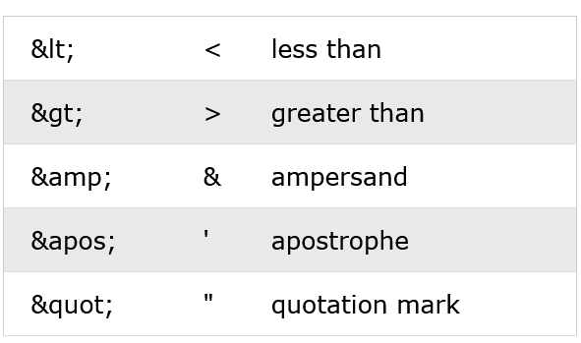
XML Syntax Rules
<message>salary < 1000</message>
To avoid this error, replace the "<" character with an entity reference.
<message>salary &lt; 1000</message>
Only < and & are strictly illegal in XML, but it is a good habit to replace > with &gt; as well.
There are 5 pre-defined entity references in XML

Slide 17
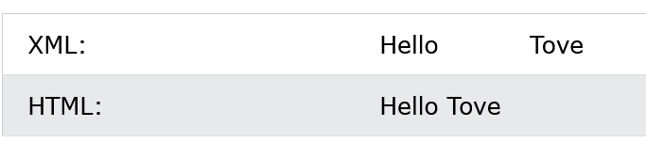
XML Syntax Rules
Comments in XML
The syntax for writing comments in XML is similar to that of HTML:
<!-- This is a comment -->
Two dashes in the middle of a comment are not allowed:
<!-- This is an invalid -- comment -->
White-space is Preserved in XML
XML does not truncate multiple white-spaces (HTML truncates multiple white-spaces to one single white-space):

Slide 18
XML Syntax Rules
XML Stores New Line as LF
Windows applications store a new line as: carriage return and line feed (CR+LF).
Unix and Mac OSX use LF.
Old Mac systems use CR.
XML stores a new line as LF.
Well Formed XML
XML documents that conform to the syntax rules above are said to be "Well Formed" XML documents.

Slide 19
XML Elements
An XML document contains XML Elements.
What is an XML Element?
An XML element is everything from (including) the element's start tag to (including) the element's end tag.
<price>29.99</price>
An element can contain:
text
attributes
other elements
or a mix of the above

Slide 20
XML Elements
<bookstore>
<book category="children">
<title>Harry Potter</title>
<author>J K. Rowling</author>
<year>2005</year>
<price>29.99</price>
</book>
<book category="web">
<title>Learning XML</title>
<author>Erik T. Ray</author>
<year>2003</year>
<price>39.95</price>
</book>
</bookstore>

Slide 21
XML Elements
In the example in previous slide:
<title>, <author>, <year>, and <price> have text content because they contain text (like 29.99).
<bookstore> and <book> have element contents, because they contain elements.
<book> has an attribute (category="children").
Empty XML Elements
An element with no content is said to be empty.
In XML, you can indicate an empty element like this
<element></element>
You can also use a so called self-closing tag
<element />
Empty elements can have attributes.

Slide 22
XML Elements
XML Naming Rules
XML elements must follow these naming rules:
Element names are case-sensitive
Element names must start with a letter or underscore
Element names cannot start with the letters xml (or XML, or Xml, etc)
Element names can contain letters, digits, hyphens, underscores, and periods
Element names cannot contain spaces
Any name can be used, no words are reserved (except xml).

Slide 23
XML Elements
Best Naming Practices
Create descriptive names, like this: <person>, <firstname>, <lastname>.
Create short and simple names, like this: <book_title> not like this: <the_title_of_the_book>.
Avoid "-". If you name something "first-name", some software may think you want to subtract "name" from "first".
Avoid ".". If you name something "first.name", some software may think that "name" is a property of the object "first".
Avoid ":". Colons are reserved for namespaces (more later).
Non-English letters like éòá are perfectly legal in XML, but watch out for problems if your software doesn't support them!

Slide 24
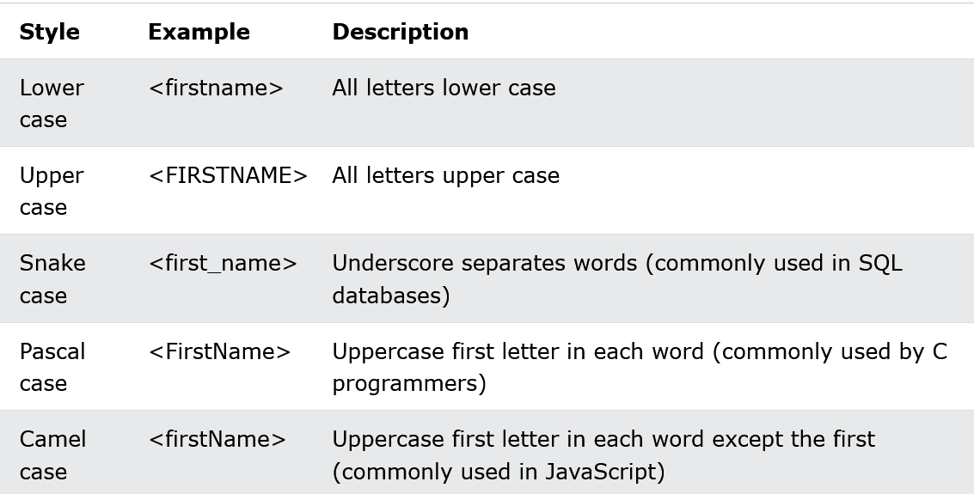
XML Elements
Naming Conventions

Slide 25
XML Elements
Tip! Choose your naming style, and be consistent about it!
XML documents often have a corresponding database. A common practice is to use the naming rules of the database for the XML elements.
XML Elements are Extensible
XML elements can be extended to carry more information.
Look at the following XML example:
<note>
<to>Tove</to>
<from>Jani</from>
<body>Don't forget me this weekend!</body>
</note>

Slide 26
XML Elements
Imagine that the author of the XML document added some extra information to it
<note>
<date>2008-01-10</date>
<to>Tove</to>
<from>Jani</from>
<heading>Reminder</heading>
<body>Don't forget me this weekend!</body>
</note>
Should the application break or crash?
No. The application should still be able to find the <to>, <from>, and <body> elements in the XML document and produce the same output.
This is one of the beauties of XML. It can be extended without breaking applications.

Slide 27
XML Attributes
XML elements can have attributes, just like HTML.
Attributes are designed to contain data related to a specific element.
XML Attributes Must be Quoted
Attribute values must always be quoted. Either single or double quotes can be used.
For a person's gender, the <person> element can be written like this
<person gender="female">
or like this:
<person gender='female'>

Slide 28
XML Attributes
If the attribute value itself contains double quotes you can use single quotes, like in this example:
<gangster name='George "Shotgun" Ziegler'>
or you can use character entities:
<gangster name="George &quot;Shotgun&quot; Ziegler">
XML Elements vs. Attributes
Take a look at these two examples:
<person gender="female">
<firstname>Anna</firstname>
<lastname>Smith</lastname>
</person>

Slide 29
XML Attributes
<person>
<gender>female</gender>
<firstname>Anna</firstname>
<lastname>Smith</lastname>
</person>
In the first example, gender is an attribute. In the last example, gender is an element. Both examples provide the same information.
There are no rules about when to use attributes or when to use elements in XML.

Slide 30
XML Attributes
Standard Way:
The following three XML documents contain exactly the same information:
A date attribute is used in the first example:
<note date="2008-01-10">
<to>Tove</to>
<from>Jani</from>
</note>
A <date> element is used in the second example.
<note>
<date>2008-01-10</date>
<to>Tove</to>
<from>Jani</from>
</note>

Slide 31
XML Attributes
An expanded <date> element is used in the third example.
<note>
<date>
<year>2008</year>
<month>01</month>
<day>10</day>
</date>
<to>Tove</to>
<from>Jani</from>
</note>

Slide 32
Avoid XML Attributes?
Some things to consider when using attributes are:
attributes cannot contain multiple values (elements can)
attributes cannot contain tree structures (elements can)
attributes are not easily expandable (for future changes)
Don't end up like this
<note day="10" month="01" year="2008"
to="Tove" from="Jani" heading="Reminder"
body="Don't forget me this weekend!">
</note>

Slide 33
XML Attributes for Metadata
Sometimes ID references are assigned to elements. These IDs can be used to identify XML elements in much the same way as the id attribute in HTML. This example demonstrates this.
<messages>
<note id="501">
<to>Tove</to>
<from>Jani</from>
<heading>Reminder</heading>
<body>Don't forget me this weekend!</body>
</note>
<note id="502">
<to>Jani</to>
<from>Tove</from>
<heading>Re: Reminder</heading>
<body>I will not</body>
</note>
</messages>
The id attributes above are for identifying the different notes. It is not a part of the note itself.

Slide 34
XML Namespaces
XML Namespaces provide a method to avoid element name conflicts.
Name Conflicts
In XML, element names are defined by the developer. This often results in a conflict when trying to mix XML documents from different XML applications.
This XML carries HTML table information
<table>
<tr>
<td>Apples</td>
<td>Bananas</td>
</tr>
</table>

Slide 35
XML Namespaces
This XML carries information about a table (a piece of furniture)
<table>
<name>African Coffee Table</name>
<width>80</width>
<length>120</length>
</table>
If these XML fragments were added together, there would be a name conflict. Both contain a <table> element, but the elements have different content and meaning.
A user or an XML application will not know how to handle these differences.

Slide 36
Solving the Name Conflict Using a Prefix
Name conflicts in XML can easily be avoided using a name prefix.
This XML carries information about an HTML table, and a piece of furnitur
<h:table>
<h:tr>
<h:td>Apples</h:td>
<h:td>Bananas</h:td>
</h:tr>
</h:table>
<f:table>
<f:name>African Coffee Table</f:name>
<f:width>80</f:width>
<f:length>120</f:length>
</f:table>

Slide 37
XML Namespaces - The xmlns Attribute
XML Namespaces - The xmlns Attribute
When using prefixes in XML, a namespace for the prefix must be defined.
The namespace can be defined by an xmlns attribute in the start tag of an element.
The namespace declaration has the following syntax. xmlns:prefix="URI".
<root>
<h:table xmlns:h="http://www.w3.org/TR/html4/">
<h:tr>
<h:td>Apples</h:td>
<h:td>Bananas</h:td>
</h:tr>
</h:table>

Slide 38
XML Namespaces - The xmlns Attribute
<f:table xmlns:f="https://www.w3schools.com/furniture">
<f:name>African Coffee Table</f:name>
<f:width>80</f:width>
<f:length>120</f:length>
</f:table>
</root>
In the example above:
The xmlns attribute in the first <table> element gives the h: prefix a qualified namespace.
The xmlns attribute in the second <table> element gives the f: prefix a qualified namespace.
When a namespace is defined for an element, all child elements with the same prefix are associated with the same namespace.

Slide 39
XML Namespaces - The xmlns Attribute
Namespaces can also be declared in the XML root element.
<root xmlns:h="http://www.w3.org/TR/html4/"
xmlns:f="https://www.w3schools.com/furniture">
<h:table>
<h:tr>
<h:td>Apples</h:td>
<h:td>Bananas</h:td>
</h:tr>
</h:table>

Slide 40
Uniform Resource Identifier
Note: The namespace URI is not used by the parser to look up information.
The purpose of using an URI is to give the namespace a unique name.
However, companies often use the namespace as a pointer to a web page containing namespace information.
Uniform Resource Identifier (URI)
A Uniform Resource Identifier (URI) is a string of characters which identifies an Internet Resource.
The most common URI is the Uniform Resource Locator (URL) which identifies an Internet domain address. Another, not so common type of URI is the Uniform Resource Name (URN).

Slide 41
Default Namespaces
Default Namespaces
Defining a default namespace for an element saves us from using prefixes in all the child elements. It has the following syntax
xmlns="namespaceURI"
This XML carries HTML table information.
<table xmlns="http://www.w3.org/TR/html4/">
<tr>
<td>Apples</td>
<td>Bananas</td>
</tr>
</table>

Slide 42
Namespaces in Real Use
XSLT is a language that can be used to transform XML documents into other formats.
The XML document below, is a document used to transform XML into HTML.
The namespace "http://www.w3.org/1999/XSL/Transform" identifies XSLT elements inside an HTML document:

Slide 43
XML DTD
An XML document with correct syntax is called "Well Formed".
An XML document validated against a DTD is both "Well Formed" and "Valid".
What is a DTD?
DTD stands for Document Type Definition.
A DTD defines the structure and the legal elements and attributes of an XML document.
Valid XML Documents
A "Valid" XML document is "Well Formed", as well as it conforms to the rules of a DTD

Slide 44
XML DTD
<?xml version="1.0" encoding="UTF-8"?>
<!DOCTYPE note SYSTEM "Note.dtd">
<note>
<to>Tove</to>
<from>Jani</from>
<heading>Reminder</heading>
<body>Don't forget me this weekend!</body>
</note>
The DOCTYPE declaration above contains a reference to a DTD file. The content of the DTD file is shown and explained below

Slide 45
XML DTD
The purpose of a DTD is to define the structure and the legal elements and attributes of an XML document
<!DOCTYPE note
[
<!ELEMENT note (to,from,heading,body)>
<!ELEMENT to (#PCDATA)>
<!ELEMENT from (#PCDATA)>
<!ELEMENT heading (#PCDATA)>
<!ELEMENT body (#PCDATA)>
]>

Slide 46
XML DTD
The DTD above is interpreted like this:
!DOCTYPE note - Defines that the root element of the document is note
!ELEMENT note - Defines that the note element must contain the elements: "to, from, heading, body"
!ELEMENT to - Defines the to element to be of type "#PCDATA"
!ELEMENT from - Defines the from element to be of type "#PCDATA"
!ELEMENT heading - Defines the heading element to be of type "#PCDATA"
!ELEMENT body - Defines the body element to be of type "#PCDATA"
Tip: #PCDATA means parseable character data.

Slide 47
XML DTD
Using DTD for Entity Declaration
A DOCTYPE declaration can also be used to define special characters or strings, used in the document
<?xml version="1.0" encoding="UTF-8"?>
<!DOCTYPE note [
<!ENTITY nbsp "&#xA0;">
<!ENTITY writer "Writer: Donald Duck.">
<!ENTITY copyright "Copyright: W3Schools.">
]>
Tip: An entity has three parts: it starts with an ampersand (&), then comes the entity name, and it ends with a semicolon (;).

Slide 48
Usages of DTD
When to Use a DTD?
With a DTD, independent groups of people can agree to use a standard DTD for interchanging data.
With a DTD, you can verify that the data you receive from the outside world is valid.
You can also use a DTD to verify your own data.
When NOT to Use a DTD?
XML does not require a DTD.
When you are experimenting with XML, or when you are working with small XML files, creating DTDs may be a waste of time.
If you develop applications, wait until the specification is stable before you add a DTD. Otherwise, your software might stop working because of validation errors.

Slide 49
XML Schema
An XML Schema describes the structure of an XML document, just like a DTD.
An XML document with correct syntax is called "Well Formed".
An XML document validated against an XML Schema is both "Well Formed" and "Valid".
XML Schema is an XML-based alternative to DTD

Slide 50
XML Schema
<xs:element name="note">
<xs:complexType>
<xs:sequence>
<xs:element name="to" type="xs:string"/>
<xs:element name="from" type="xs:string"/>
<xs:element name="heading" type="xs:string"/>
<xs:element name="body" type="xs:string"/>
</xs:sequence>
</xs:complexType>
</xs:element>

Slide 51
XML Schema
The Schema above is interpreted like this:
<xs:element name="note"> defines the element called "note"
<xs:complexType> the "note" element is a complex type
<xs:sequence> the complex type is a sequence of elements
<xs:element name="to" type="xs:string"> the element "to" is of type string (text)
<xs:element name="from" type="xs:string"> the element "from" is of type string
<xs:element name="heading" type="xs:string"> the element "heading" is of type string
<xs:element name="body" type="xs:string"> the element "body" is of type string

Slide 52
XML Schemas are More Powerful than DTD
XML Schemas are written in XML
XML Schemas are extensible to additions
XML Schemas support data types
XML Schemas support namespaces
Why Use an XML Schema?
With XML Schema, your XML files can carry a description of its own format.
With XML Schema, independent groups of people can agree on a standard for interchanging data.
With XML Schema, you can verify data.

Slide 53
XML Schema
XML Schemas Support Data Types:
One of the greatest strengths of XML Schemas is the support for data types:
It is easier to describe document content
It is easier to define restrictions on data
It is easier to validate the correctness of data
It is easier to convert data between different data types
XML Schemas use XML Syntax
Another great strength about XML Schemas is that they are written in XML:
You don't have to learn a new language
You can use your XML editor to edit your Schema files
You can use your XML parser to parse your Schema files
You can manipulate your Schemas with the XML DOM
You can transform your Schemas with XSLT

Slide 54
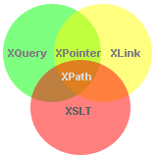
XML and XPath
What is XPath?
XPath is a major element in the XSLT standard.
XPath can be used to navigate through elements and attributes in an XML document.
XPath is a syntax for defining parts of an XML document
XPath uses path expressions to navigate in XML documents
XPath contains a library of standard functions
XPath is a major element in XSLT and in XQuery
XPath is a W3C recommendation

Slide 55
XPath Path Expressions
XPath uses path expressions to select nodes or node-sets in an XML document. These path expressions look very much like the expressions you see when you work with a traditional computer file system.
XPath expressions can be used in JavaScript, Java, XML Schema, PHP, Python, C and C++, and lots of other languages.
XPath is Used in XSLT
XPath is a major element in the XSLT standard.
With XPath knowledge you will be able to take great advantage of XSL.

Slide 56
XPath Example
We will use the following XML document
<?xml version="1.0" encoding="UTF-8"?>
<bookstore>
<book category="cooking">
<title lang="en">Everyday Italian</title>
<author>Giada De Laurentiis</author>
<year>2005</year>
<price>30.00</price>
</book>
<book category="children">
<title lang="en">Harry Potter</title>
<author>J K. Rowling</author>
<year>2005</year>
<price>29.99</price>
</book>

Slide 57
<book category="web">
<title lang="en">XQuery Kick Start</title>
<author>James McGovern</author>
<author>Per Bothner</author>
<author>Kurt Cagle</author>
<author>James Linn</author>
<author>Vaidyanathan Nagarajan</author>
<year>2003</year>
<price>49.99</price>
</book>
<book category="web">
<title lang="en">Learning XML</title>
<author>Erik T. Ray</author>
<year>2003</year>
<price>39.95</price>
</book>
</bookstore>

Slide 58
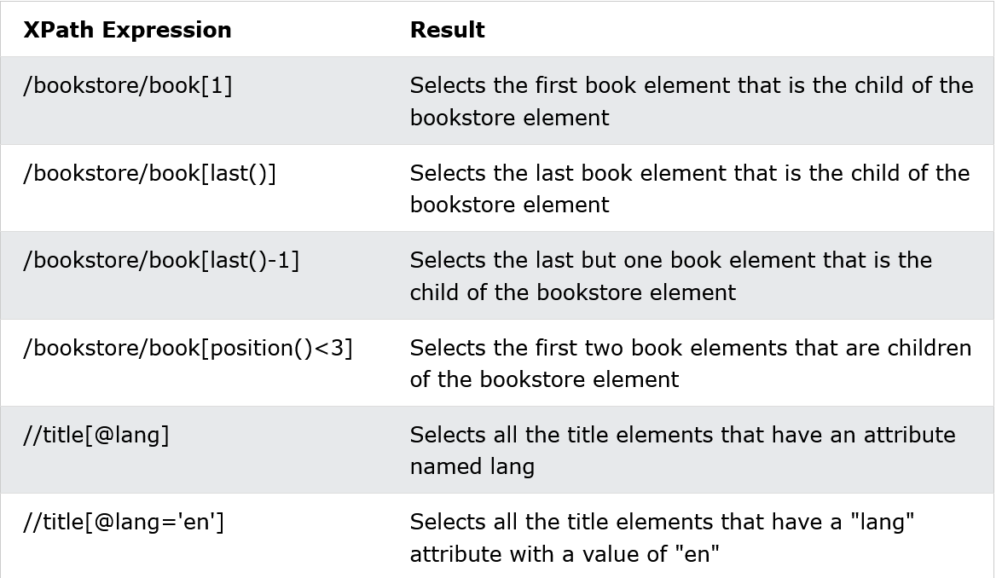

Slide 59
XSLT Introduction
XSL (eXtensible Stylesheet Language) is a styling language for XML.
XSLT stands for XSL Transformations.
XSL(T) Languages
XSLT is a language for transforming XML documents.
XPath is a language for navigating in XML documents.
XQuery is a language for querying XML documents.
It Started with XSL
XSL stands for EXtensible Stylesheet Language.
The World Wide Web Consortium (W3C) started to develop XSL because there was a need for an XML-based Stylesheet Language.

Slide 60
CSS = Style Sheets for HTML
HTML uses predefined tags. The meaning of, and how to display each tag is well understood.
CSS is used to add styles to HTML elements.
XSL = Style Sheets for XML
XML does not use predefined tags, and therefore the meaning of each tag is not well understood.
A <table> element could indicate an HTML table, a piece of furniture, or something else - and browsers do not know how to display it!
So, XSL describes how the XML elements should be displayed.

Slide 61
XSL - More Than a Style Sheet Language
XSL consists of four parts:
XSLT - a language for transforming XML documents
XPath - a language for navigating in XML documents
XSL-FO - a language for formatting XML documents (discontinued in 2013)
XQuery - a language for querying XML documents
What is XSLT?
XSLT stands for XSL Transformations
XSLT is the most important part of XSL
XSLT transforms an XML document into another XML document
XSLT uses XPath to navigate in XML documents
XSLT is a W3C Recommendation

Slide 62
XSLT = XSL Transformations
XSLT is the most important part of XSL.
XSLT is used to transform an XML document into another XML document, or another type of document that is recognized by a browser, like HTML and XHTML. Normally XSLT does this by transforming each XML element into an (X)HTML element.
With XSLT you can add/remove elements and attributes to or from the output file. You can also rearrange and sort elements, perform tests and make decisions about which elements to hide and display, and a lot more.
A common way to describe the transformation process is to say that XSLT transforms an XML source-tree into an XML result-tree.

Slide 63
XSLT Uses XPath
XSLT uses XPath to find information in an XML document. XPath is used to navigate through elements and attributes in XML documents.
How Does it Work?
In the transformation process, XSLT uses XPath to define parts of the source document that should match one or more predefined templates. When a match is found, XSLT will transform the matching part of the source document into the result document.

Slide 64
XSLT - Transformation
How to transform XML into XHTML using XSLT?
Correct Style Sheet Declaration
The root element that declares the document to be an XSL style sheet is <xsl:stylesheet> or <xsl:transform>.
Note: <xsl:stylesheet> and <xsl:transform> are completely synonymous and either can be used!
<xsl:stylesheet version="1.0" xmlns:xsl="http://www.w3.org/1999/XSL/Transform">
Or
<xsl:transform version="1.0" xmlns:xsl="http://www.w3.org/1999/XSL/Transform">

Slide 65
To get access to the XSLT elements, attributes and features we must declare the XSLT namespace at the top of the document.
The xmlns:xsl="http://www.w3.org/1999/XSL/Transform" points to the official W3C XSLT namespace. If you use this namespace, you must also include the attribute version="1.0".
Start with a Raw XML Document
We want to transform the following XML document ("cdcatalog.xml") into XHTML

Slide 66
cdcatalog.xml
<?xml version="1.0" encoding="UTF-8"?>
<catalog>
<cd>
<title>Empire Burlesque</title>
<artist>Bob Dylan</artist>
<country>USA</country>
<company>Columbia</company>
<price>10.90</price>
<year>1985</year>
</cd>
.
.
</catalog>
Note: Refer this for example.
https://www.w3schools.com/xml/xsl_transformation.asp

Slide 67
cdcatalog.xsl
Viewing XML Files in browsers: Open the XML file (click on the link below) - The XML document will be displayed with color-coded root and child elements. Often, there is an arrow or plus/minus sign to the left of the elements that can be clicked to expand or collapse the element structure. Tip: To view the raw XML source, right-click in XML file and select "View Page Source"!
Create an XSL Style Sheet
Then you create an XSL Style Sheet ("cdcatalog.xsl") with a transformation template

Slide 68
<?xml version="1.0" encoding="UTF-8"?> <xsl:stylesheet version="1.0“ xmlns:xsl="http://www.w3.org/1999/XSL/Transform"> <xsl:template match="/"> <html> <body> <h2>My CD Collection</h2> <table border="1"> <tr bgcolor="#9acd32"> <th>Title</th> <th>Artist</th> </tr> <xsl:for-each select="catalog/cd"> <tr> <td><xsl:value-of select="title"/></td> <td><xsl:value-of select="artist"/></td> </tr> </xsl:for-each> </table> </body> </html> </xsl:template> </xsl:stylesheet>

Slide 69
Link the XSL Style Sheet to the XML Document
Add the XSL style sheet reference to your XML document ("cdcatalog.xml")
<?xml version="1.0" encoding="UTF-8"?>
<?xml-stylesheet type="text/xsl" href="cdcatalog.xsl"?>
<catalog>
<cd>
<title>Empire Burlesque</title>
<artist>Bob Dylan</artist>
<country>USA</country>
<company>Columbia</company>
<price>10.90</price>
<year>1985</year>
</cd>
.
.
</catalog>

Slide 70
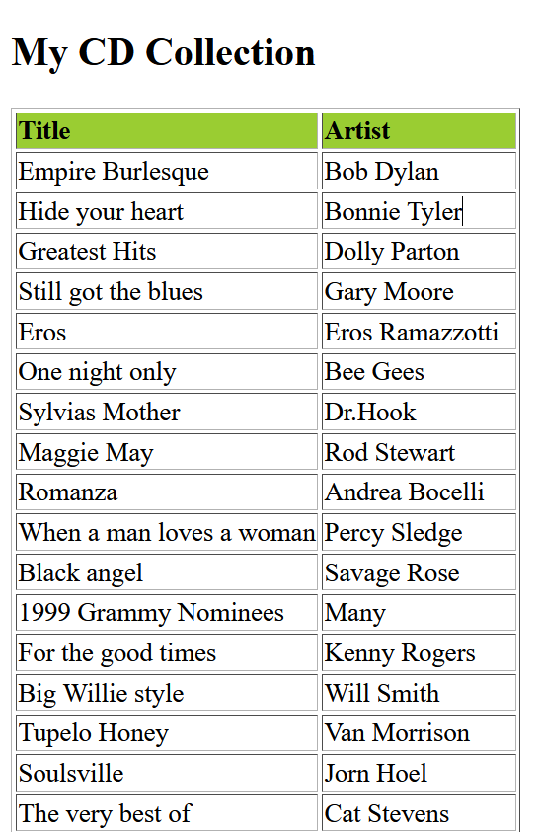

Slide 71
XSLT <xsl:template> Element
An XSL style sheet consists of one or more set of rules that are called templates.
A template contains rules to apply when a specified node is matched.
The <xsl:template> Element
The <xsl:template> element is used to build templates.
The match attribute is used to associate a template with an XML element. The match attribute can also be used to define a template for the entire XML document. The value of the match attribute is an XPath expression (i.e. match="/" defines the whole document).

Slide 72
<xsl:template> Element
Since an XSL style sheet is an XML document, it always begins with the XML declaration: <?xml version="1.0" encoding="UTF-8"?>.
The next element, <xsl:stylesheet>, defines that this document is an XSLT style sheet document (along with the version number and XSLT namespace attributes).
The <xsl:template> element defines a template. The match="/" attribute associates the template with the root of the XML source document.
The content inside the <xsl:template> element defines some HTML to write to the output.
The last two lines define the end of the template and the end of the style sheet.
The result from this example was a little disappointing, because no data was copied from the XML document to the output. In the next chapter you will learn how to use the <xsl:value-of> element to select values from the XML elements.

Slide 73
XSLT <xsl:value-of> Element
The <xsl:value-of> element is used to extract the value of a selected node.
The <xsl:value-of> element can be used to extract the value of an XML element and add it to the output stream of the transformation.
<tr>
<td><xsl:value-of select="catalog/cd/title"/></td>
<td><xsl:value-of select="catalog/cd/artist"/></td>
</tr>
Note: The select attribute, in the example above, contains an XPath expression. An XPath expression works like navigating a file system; a forward slash (/) selects subdirectories.
The result from the example above was a little disappointing; only one line of data was copied from the XML document to the output. In the next chapter you will learn how to use the <xsl:for-each> element to loop through the XML elements, and display all of the records.

Slide 74
XSLT <xsl:for-each> Element
The <xsl:for-each> element allows you to do looping in XSLT.
The XSL <xsl:for-each> element can be used to select every XML element of a specified node-set:
<table border="1">
<tr bgcolor="#9acd32">
<th>Title</th>
<th>Artist</th>
</tr>
<xsl:for-each select="catalog/cd">
<tr>
<td><xsl:value-of select="title"/></td>
<td><xsl:value-of select="artist"/></td>
</tr>
</xsl:for-each>
</table>

Slide 75
Note: The value of the select attribute is an XPath expression. An XPath expression works like navigating a file system; where a forward slash (/) selects subdirectories.
Filtering the Output
We can also filter the output from the XML file by adding a criterion to the select attribute in the <xsl:for-each> element.
<xsl:for-each select="catalog/cd[artist='Bob Dylan']">
Legal filter operators are:
= (equal)
!= (not equal)
&lt; less than
&gt; greater than
Take a look at the adjusted XSL style sheet

Slide 76
<xsl:for-each select="catalog/cd[artist='Bob Dylan']">

Slide 77
XSLT <xsl:sort> Element
The <xsl:sort> element is used to sort the output.
Where to put the Sort Information
To sort the output, simply add an <xsl:sort> element inside the <xsl:for-each> element in the XSL file
<xsl:for-each select="catalog/cd">
<xsl:sort select="artist"/>
<tr>
<td><xsl:value-of select="title"/></td>
<td><xsl:value-of select="artist"/></td>
</tr>
</xsl:for-each>
Note: The select attribute indicates what XML element to sort on.

Slide 78
XSLT <xsl:if> Element
The <xsl:if> element is used to put a conditional test against the content of the XML file.
To put a conditional if test against the content of the XML file, add an <xsl:if> element to the XSL document.
<xsl:if test="expression">
...some output if the expression is true...
</xsl:if>
Where to Put the <xsl:if> Element
To add a conditional test, add the <xsl:if> element inside the <xsl:for-each> element in the XSL file

Slide 79
<xsl:for-each select="catalog/cd">
<xsl:if test="price &gt; 10">
<tr>
<td><xsl:value-of select="title"/></td>
<td><xsl:value-of select="artist"/></td>
<td><xsl:value-of select="price"/></td>
</tr>
</xsl:if>
</xsl:for-each>
Note: The value of the required test attribute contains the expression to be evaluated.
The code above will only output the title and artist elements of the CDs that has a price that is higher than 10.

Slide 80
XML AJAX
AJAX Introduction
AJAX is a developer's dream, because you can:
Update a web page without reloading the page
Request data from a server - after the page has loaded
Receive data from a server - after the page has loaded
Send data to a server - in the background
What is AJAX?
AJAX = Asynchronous JavaScript And XML.
AJAX is not a programming language.
AJAX just uses a combination of:
A browser built-in XMLHttpRequest object (to request data from a web server)
JavaScript and HTML DOM (to display or use the data)

Slide 81
AJAX is a misleading name. AJAX applications might use XML to transport data, but it is equally common to transport data as plain text or JSON text.
AJAX allows web pages to be updated asynchronously by exchanging data with a web server behind the scenes. This means that it is possible to update parts of a web page, without reloading the whole page.

Slide 82
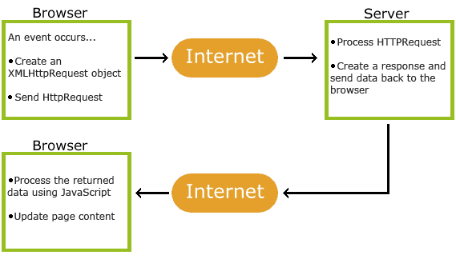
How AJAX Works

Slide 83
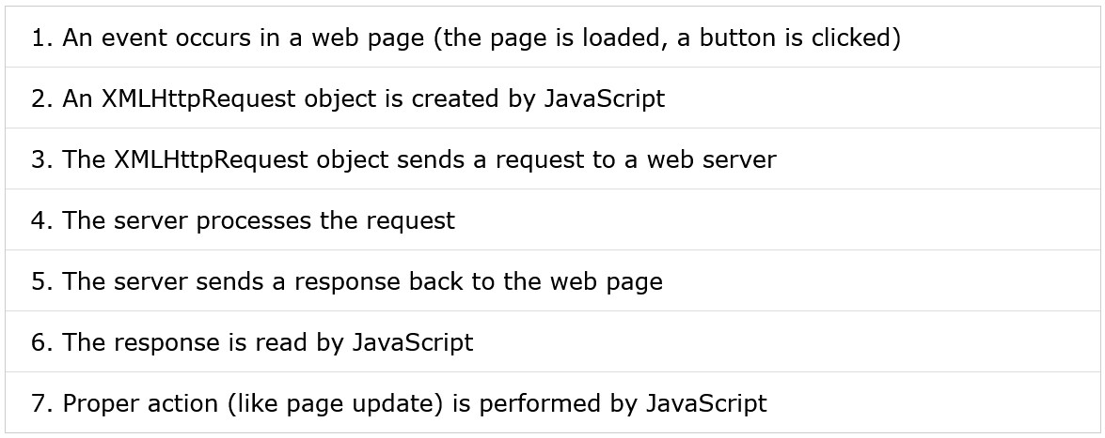
How AJAX Works

Slide 84
AJAX Example Explained
HTML Page
<!DOCTYPE html>
<html>
<body>
<div id="demo">
<h2>Let AJAX change this text</h2>
<button type="button" onclick="loadDoc()">Change Content</button>
</div>
function loadDoc() {
var xhttp = new XMLHttpRequest();
xhttp.onreadystatechange = function() {
if (this.readyState == 4 && this.status == 200) {
document.getElementById("demo").innerHTML = this.responseText;
}
};

Slide 85
xhttp.open("GET", "ajax_info.txt", true);
xhttp.send();
}
</body>
</html>
The "ajax_info.txt" file used in the example above, is a simple text file and looks like this
<h1>AJAX</h1>
<p>AJAX is not a programming language.</p>
<p>AJAX is a technique for accessing web servers from a web page.</p>
<p>AJAX stands for Asynchronous JavaScript And XML.</p>

Slide 86
Explanation:
The HTML page contains a <div> section and a <button>.
The <div> section is used to display information from a server.
The <button> calls a function (if it is clicked).
The function requests data from a web server and displays it

Slide 87
AJAX - The XMLHttpRequest Object
The XMLHttpRequest object can be used to exchange data with a server behind the scenes. This means that it is possible to update parts of a web page, without reloading the whole page.
Create an XMLHttpRequest Object
All modern browsers (Chrome, Firefox, Edge (and IE7+), Safari, Opera) have a built-in XMLHttpRequest object.
Syntax for creating an XMLHttpRequest object
variable = new XMLHttpRequest();

Slide 88
Access Across Domains
For security reasons, modern browsers do not allow access across domains.
This means that both the web page and the XML file it tries to load, must be located on the same server.
The examples on W3Schools all open XML files located on the W3Schools domain.
If you want to use the example above on one of your own web pages, the XML files you load must be located on your own server.

Slide 89
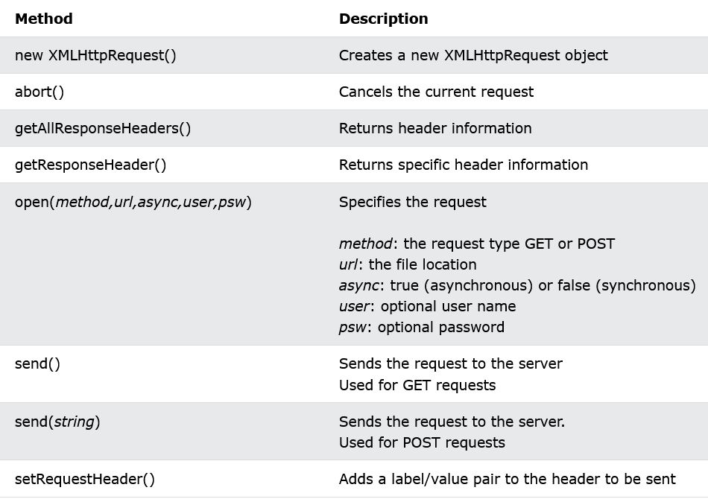
XMLHttpRequest Object Methods

Slide 90
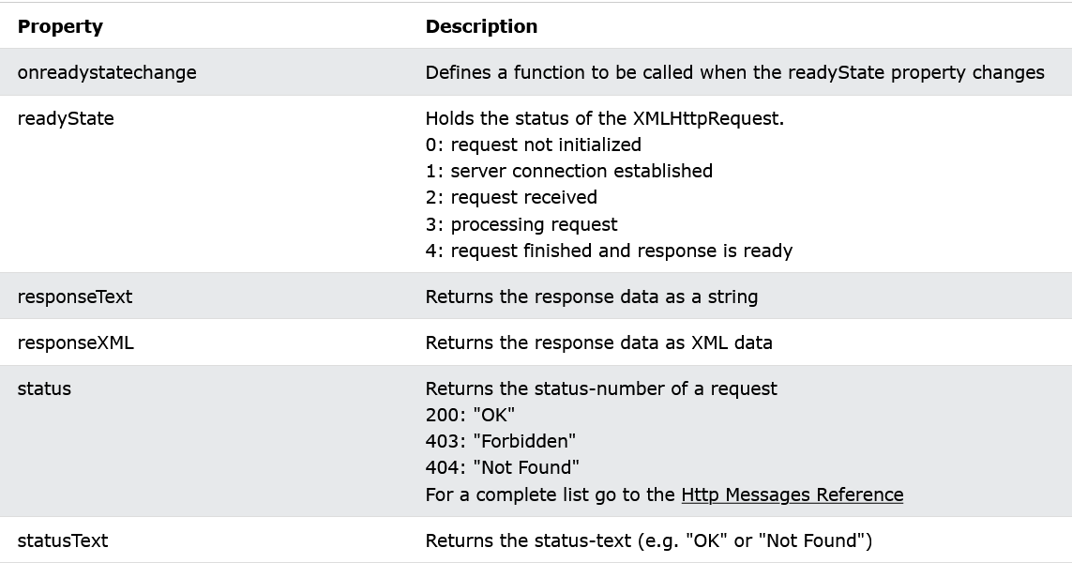
XMLHttpRequest Object Properties

Slide 91
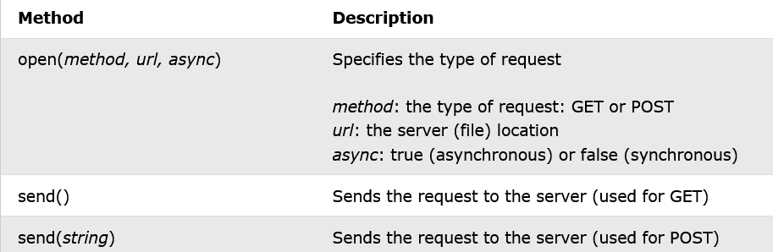
AJAX - Send a Request To a Server
The XMLHttpRequest object is used to exchange data with a server.
Send a Request To a Server
To send a request to a server, we use the open() and send() methods of the XMLHttpRequest object
xhttp.open("GET", "ajax_info.txt", true);
xhttp.send();

Slide 92
GET or POST?
GET is simpler and faster than POST, and can be used in most cases.
However, always use POST requests when:
A cached file is not an option (update a file or database on the server).
Sending a large amount of data to the server (POST has no size limitations).
Sending user input (which can contain unknown characters), POST is more robust and secure than GET.
GET Requests
xhttp.open("GET", "demo_get.asp", true);
xhttp.send();

Slide 93
POST Requests
xhttp.open("POST", "demo_post.asp", true);
xhttp.send();
To POST data like an HTML form, add an HTTP header with setRequestHeader(). Specify the data you want to send in the send() method:
xhttp.open("POST", "demo_post2.asp", true);
xhttp.setRequestHeader("Content-type", "application/x-www-form-urlencoded");
xhttp.send("fname=Henry&lname=Ford");

Slide 94
Asynchronous - True or False?
Server requests should be sent asynchronously.
The async parameter of the open() method should be set to true
xhttp.open("GET", "ajax_test.asp", true);
By sending asynchronously, the JavaScript does not have to wait for the server response, but can instead:
execute other scripts while waiting for server response
deal with the response after the response is ready

Slide 95
Synchronous Request
To execute a synchronous request, change the third parameter in the open() method to false:
xhttp.open("GET", "ajax_info.txt", false);
Sometimes async = false are used for quick testing. You will also find synchronous requests in older JavaScript code.
Since the code will wait for server completion, there is no need for an onreadystatechange function.
Note:
https://www.w3schools.com/xml/ajax_xmlhttprequest_send.asp

Slide 96
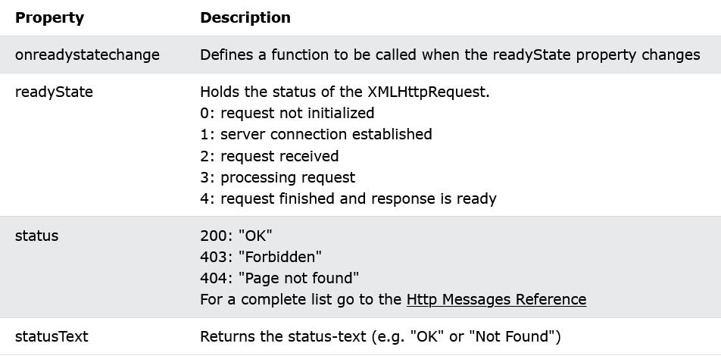
AJAX - Server Response
The onreadystatechange Property
The readyState property holds the status of the XMLHttpRequest.
The onreadystatechange property defines a function to be executed when the readyState changes.
The status property and the statusText property holds the status of the XMLHttpRequest object.

Slide 97
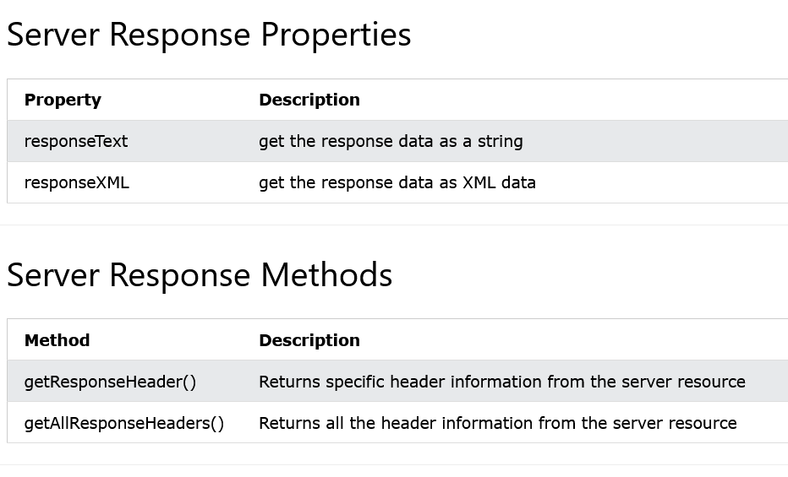
The onreadystatechange function is called every time the readyState changes.
When readyState is 4 and status is 200, the response is ready

Slide 98
The responseText Property
The responseText property returns the server response as a JavaScript string, and you can use it accordingly
document.getElementById("demo").innerHTML = xhttp.responseText;
The responseXML Property
The XML HttpRequest object has an in-built XML parser.
The responseXML property returns the server response as an XML DOM object.
Using this property you can parse the response as an XML DOM object:

Slide 99
xmlDoc = xhttp.responseXML;
txt = "";
x = xmlDoc.getElementsByTagName("ARTIST");
for (i = 0; i < x.length; i++) {
txt += x[i].childNodes[0].nodeValue + "<br>";
}
document.getElementById("demo").innerHTML = txt;
xhttp.open("GET", "cd_catalog.xml", true);
xhttp.send();

Slide 100
The getAllResponseHeaders() Method
The getAllResponseHeaders() method returns all header information from the server response.
var xhttp = new XMLHttpRequest();
xhttp.onreadystatechange = function() {
if (this.readyState == 4 && this.status == 200) {
document.getElementById("demo").innerHTML =
this.getAllResponseHeaders();
}
};

Slide 101
The getResponseHeader() Method
The getResponseHeader() method returns specific header information from the server response.
var xhttp = new XMLHttpRequest();
xhttp.onreadystatechange = function() {
if (this.readyState == 4 && this.status == 200) {
document.getElementById("demo").innerHTML =
this.getResponseHeader("Last-Modified");
}
};
xhttp.open("GET", "ajax_info.txt", true);
xhttp.send();

Slide 102
XML DOM
What is the DOM?
The DOM defines a standard for accessing and manipulating documents:
"The W3C Document Object Model (DOM) is a platform and language-neutral interface that allows programs and scripts to dynamically access and update the content, structure, and style of a document."
The HTML DOM defines a standard way for accessing and manipulating HTML documents. It presents an HTML document as a tree-structure.
The XML DOM defines a standard way for accessing and manipulating XML documents. It presents an XML document as a tree-structure.

Slide 103
The HTML DOM
All HTML elements can be accessed through the HTML DOM.
This example changes the value of an HTML element with id="demo"
<h1>This is a Heading</h1>
<h1>This is a Heading</h1>
<script>
document.getElementsByTagName("h1")[0].innerHTML = "Hello World!";
</script>
Note: Even if the HTML document contains only ONE <h1> element you still have to specify the array index [0], because the getElementsByTagName() method always returns an array.

Slide 104
The XML DOM
All XML elements can be accessed through the XML DOM.
The XML DOM is:
A standard object model for XML
A standard programming interface for XML
Platform- and language-independent
A W3C standard
In other words: The XML DOM is a standard for how to get, change, add, or delete XML elements.
Get the Value of an XML Element
This code retrieves the text value of the first <title> element in an XML document
txt=xmlDoc.getElementsByTagName("title")[0].childNodes[0].nodeValue;

Slide 105
xmlDoc - the XML DOM object created by the parser.
getElementsByTagName("title")[0] - get the first <title> element
childNodes[0] - the first child of the <title> element (the text node)
nodeValue - the value of the node (the text itself)

Slide 106
Programming Interface
The DOM models XML as a set of node objects. The nodes can be accessed with JavaScript or other programming languages. In this tutorial we use JavaScript.
The programming interface to the DOM is defined by a set standard properties and methods.
Properties are often referred to as something that is (i.e. nodename is "book").
Methods are often referred to as something that is done (i.e. delete "book").

Slide 107
XML DOM Properties
These are some typical DOM properties:
x.nodeName - the name of x
x.nodeValue - the value of x
x.parentNode - the parent node of x
x.childNodes - the child nodes of x
x.attributes - the attributes nodes of x
Note: In the list above, x is a node object.
XML DOM Methods
x.getElementsByTagName(name) - get all elements with a specified tag name
x.appendChild(node) - insert a child node to x
x.removeChild(node) - remove a child node from x
Note: In the list above, x is a node object.

Slide 108
THANK YOU..!
Happy Learning…

