Slide 1

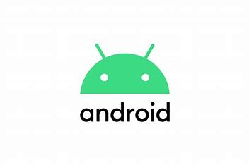
Android Application Development
Unit – 1
Mobile Programming
Prof. Hardik Chavda
FOCA,MU

Slide 2
Unit – 1
Introduction of Android
History of Android
OHA
Android Development Tools
Android SDK
Building Blocks of Android
Android Architecture
Activity Life-Cycle
AndroidManifest.xml file
Anatomy of Android Application
Building a Sample Android App

Slide 3
Introduction to Android
Android is an operating system for mobile devices.
It’s an integrated open source software stack for mobile device:
Operating system
Middleware
Key mobile applications
Android SDK (software development kit) provides the tools and APIs necessary to begin developing applications on the Android platform using the Java programming language / Kotlin.
Android, as a system is a Java-based operating system that runs on the Linux 2.6 kernel.
The system is very lightweight and full featured

Slide 4
Android has large community of developers writing applications (“apps”) that extend the functionality of the devices.
Presently 3Million + apps are available in Android’s Play Store.
Around 3,000+ apps are published to the Play Store every single day.
Android Play Store is the online app store run by Google, though apps can also be downloaded from third-party sites.
Google is constantly working on new versions of the Android OS.
Versions usually come with a numerical code and a name that’s so far been themed after sweets and deserts, running in alphabetical order.

Slide 5
History of Android
The early intentions of the company were to develop an advanced operating system for digital cameras, and this was the basis of its pitch to investors in April 2004.
The company then decided that the market for cameras was not large enough for its goals, and five months later it had diverted its efforts and was pitching Android as a handset operating system that would rival Symbian and Microsoft Windows Mobile.
Initially Andy Rubin founded android int. at Palo Alto, California, in October 2003.
The Key founders of Android Inc. are Andy Rubin, Rich Miner, Nick Sears, and Chris White.

Slide 6





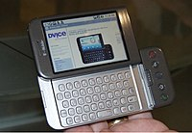
Android began in 2003 as a project of the American technology company Android Inc., to develop an operating system for digital cameras.
In 2004 the project changed to become an operating system for smartphones.
Android Inc., was bought by the American search engine company Google Inc., in 2005. At Google, the Android team decided to base their project on Linux, an open source operating system for personal computers.

Slide 7
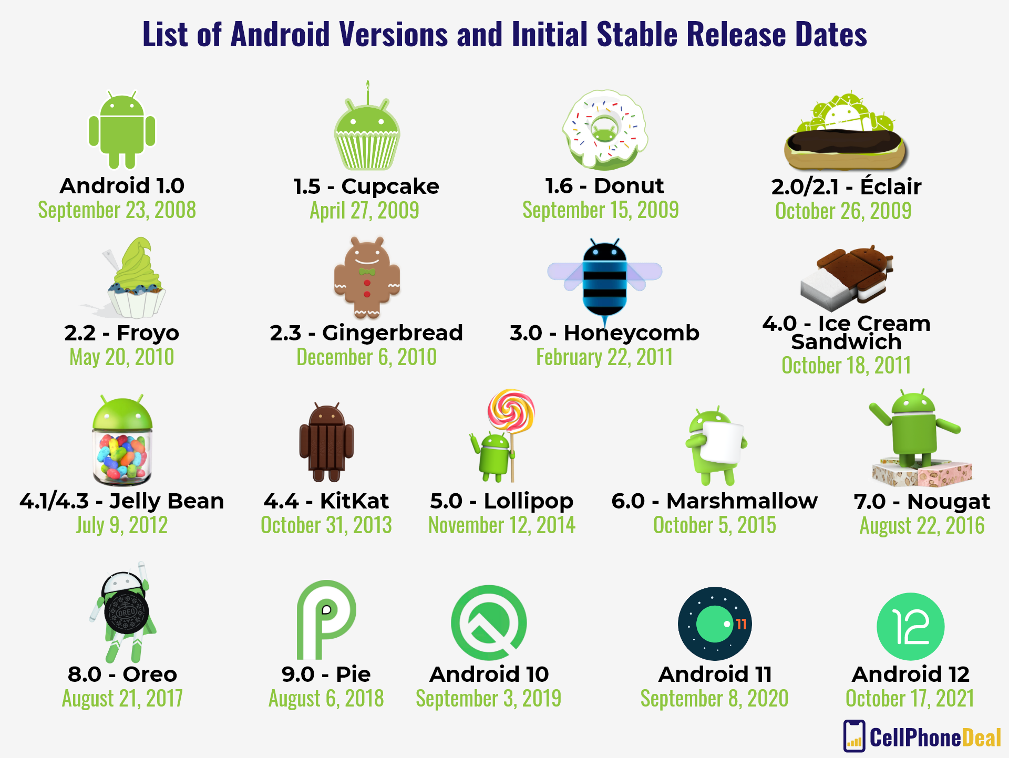

Slide 8
OHA (Open Handset Alliance)
Open Handset Alliance was announced in Nov 2007.
At the time Alliance consisted of 34 members led by Google.
OHA is a business Alliance of technologies who come together to accelerate innovation in mobile and offer consumers a richer, less expensive, and better mobile experience.
Open Handset Alliance OHA together developed Android, the first complete, open and free mobile platform.

Slide 9
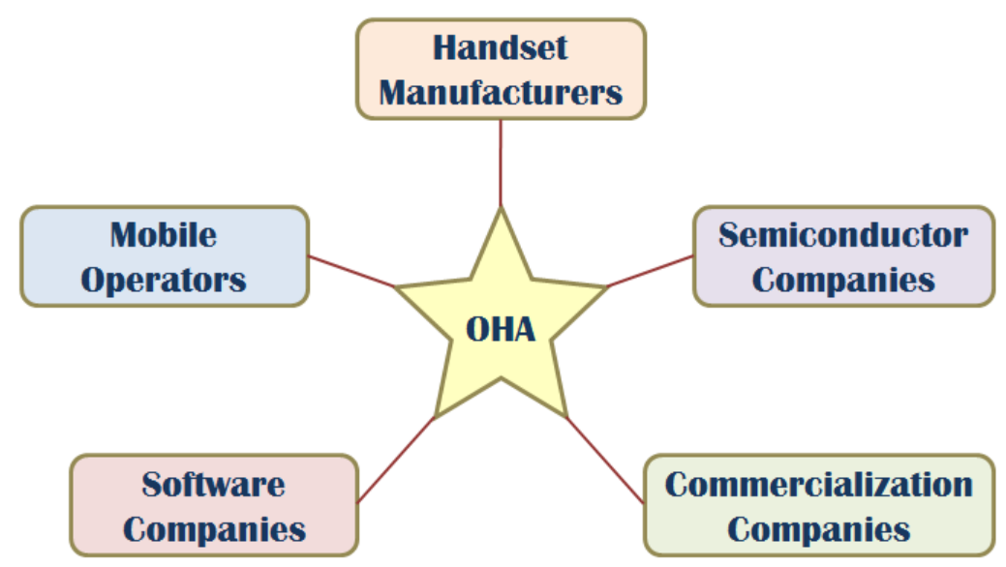
All parts of mobile ecosystem are represented in Alliance.
Members firms include Google, HTC, Sony, Dell, Intel, Motorola, LG, T-Mobile, Nvidia etc.
Handset manufacturers and mobile operators are working to develop handsets based on platform.
Commercialization partners are working with the industry to support the platform via professional service model.

Slide 10
Need of OHA
Open Handset Alliance is needed because of following reasons.
Building a Better Phone for Consumers:
OHA is a group of mobile and technology leaders who share this vision for changing the mobile experience for consumers.
Today there are 1.5 billion+ television sets, 1 billion+ internet users and nearly 3 billion+ people have a mobile phone.
Making it one of the world’s most successful consumer product.
Building a better mobile phone makes life of people enrich across the globe.

Slide 11
Innovating in the Open:
Each member of the OHA is committed to greater openness in the mobile ecosystem.
Increase openness will enable everyone in our industry to innovate more rapidly and respond better to consumer’s demand.
Android was built from the ground up with the explicit goal to be the first open, complete, and free platform created specifically for mobile devices.
Making the Vision a Reality:
Android is a complete platform that will give mobile operators, handset manufacturers, and developers everything they need to built innovative devices, software and services.

Slide 12

Members of OHA
Members of OHA includes
Handset manufacturers,
Mobile operators and
Content providers.
Manufacturers:
The main functions of android manufacturers are to design the android handsets.
More than half members of OHA are handset manufacturers such as Samsung, Motorola, HTC, and LG.
Semiconductor companies such as Intel, Texas Instruments, NVIDIA, and Qualcomm.

Slide 13
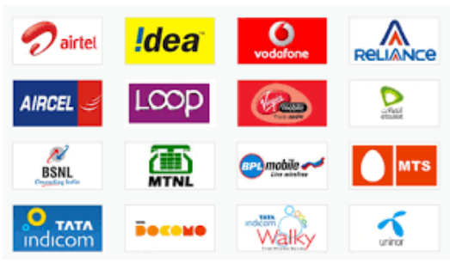
Mobile Operators:
The main functions of mobile operators are to delivering the Android experience.
Mobile operators from North, South, and Central America, Europe, Asia, India, Australia, Africa and the Middle East have joined the OHA ensuring a Worldwide market for the Android movement

Slide 14
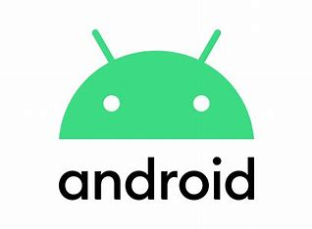
Unit – 2
OHA
Android Development Tools
Android SDK
Building Blocks of Android
Android Architecture
Activity Life-Cycle
AndroidManifest.xml file
Anatomy of Android Application
Building a Sample Android App

Slide 15
Android Development Tools
The Android SDK includes several tools and utilities to help you create, test, and debug your projects.
The Android SDK and Virtual Device Manager :
It Used to create and manage Android Virtual Devices (AVD) and SDK packages.
The AVD hosts an emulator running a particular build of Android, letting you specify the supported SDK version, screen resolution, amount of SD card storage available, and available hardware capabilities (such as touch screens and GPS).
The Android Emulator :
An implementation of the Android virtual machine designed to run within a virtual device on your development computer. Use the emulator to test and debug your Android applications.
Dalvik Debug Monitoring Service (DDMS) :
Use the DDMS perspective to monitor and control the Dalvik virtual machines on which you’re debugging your applications.
Android Asset Packaging Tool (AAPT) :
Constructs the distributable Android package files (.apk).

Slide 16
Android Debug Bridge (ADB) :
A client-server application that provides a link to a running emulator.
It lets you copy files, install compiled application packages (.apk), and run shell commands.
The following additional tools are also available:
SQLite3 : A database tool that you can use to access the SQLite database files created and used by Android.
Traceview : A graphical analysis tool for viewing the trace logs from your Android application.
MkSDCard : Creates an SD card disk image that can be used by the emulator to simulate an external storage card.
Dx : Converts Java .class bytecode into Android .dex bytecode.

Slide 17
Unit – 2
OHA
Android Development Tools
Android SDK
Building Blocks of Android
Android Architecture
Activity Life-Cycle
AndroidManifest.xml file
Anatomy of Android Application
Building a Sample Android App

Slide 18
Android SDK
The Android software development kit (SDK) includes everything you need to start developing, testing, and debugging Android applications.
The android SDK includes sample project with source code, development tools an emulator, and required libraries to build android applications.
SDK Include :
The Android APIs : The core of the SDK is the Android API libraries that provide developer access to the Android stack.
These are the same libraries used at Google to create native Android applications
Development tools :
It includes several development tools that let you compile and debug your applications.

Slide 19
The Android Virtual Device Manager and Emulator
The Android Emulator is a fully interactive Android device emulator featuring several alternative skins.
The emulator runs within an Android Virtual Device that simulates the device hardware configuration.
Using the emulator you can see how your applications will look and behave on a real Android device.
All Android applications run within the Dalvik VM.
Full documentation :
The SDK includes extensive code-level reference information detailing exactly what’s included in each package and class and how to use them.
Sample code :
The Android SDK includes a selection of sample applications that demonstrate some of the possibilities available with Android, as well as simple programs that highlight how to use individual API features.

Slide 20
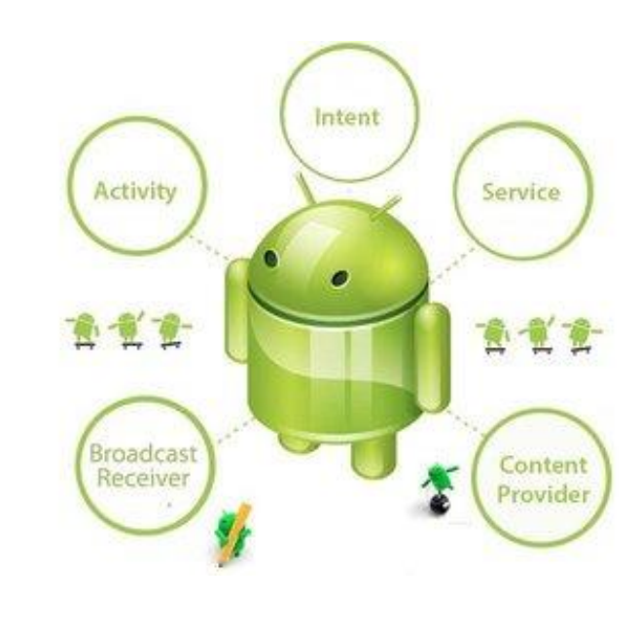
Building Blocks of Android
The core building blocks or fundamental components of android are activities, views, intents, services, content providers, fragments and AndroidManifest.xml.
Activity
Intent
Service
Content Provider
Broadcast/ Receiver
Application Context

Slide 21
Activity
Activity is a screen. Activity is the main Screen which contains the User Interface (UI) and Logic. It contains XML and java code. The activity file contains two files Activity.xml which is used for User Interface (UI) and the second file contains java file (Activity.java) used for writing Logic.
Intent:
Activity is a screen. Activity is the main Screen which contains the User Interface (UI) and Logic. It contains XML and java code. The activity file contains two files Activity.xml which is used for User Interface (UI) and the second file contains java file (Activity.java) used for writing Logic.
Uses of intent
Start Activity.
Start Service.
Delivering broadcast.
Opening a webpage.
There are two types of intent
Implicit Intent
Explicit Intent

Slide 22
Service:
Service is a background process that can run for a long time. There are two types of services local and remote. Local service is accessed from within the application whereas remote service is accessed remotely from other applications running on the same device.
Fragments:
Like parts of activity. An activity can display one or more fragments on the screen at the same time.
BroadCast Receiver:
A broadcast Receiver (short receiver) is an Android component which allows you to register for system or application events. All registered receivers for an event are notified by the Android run time once this event happens.
Content Provider
Used to share data between the applications
Context
The Context is the central command centre for and android application.
App application specific functionality can be accessed through the context.

Slide 23
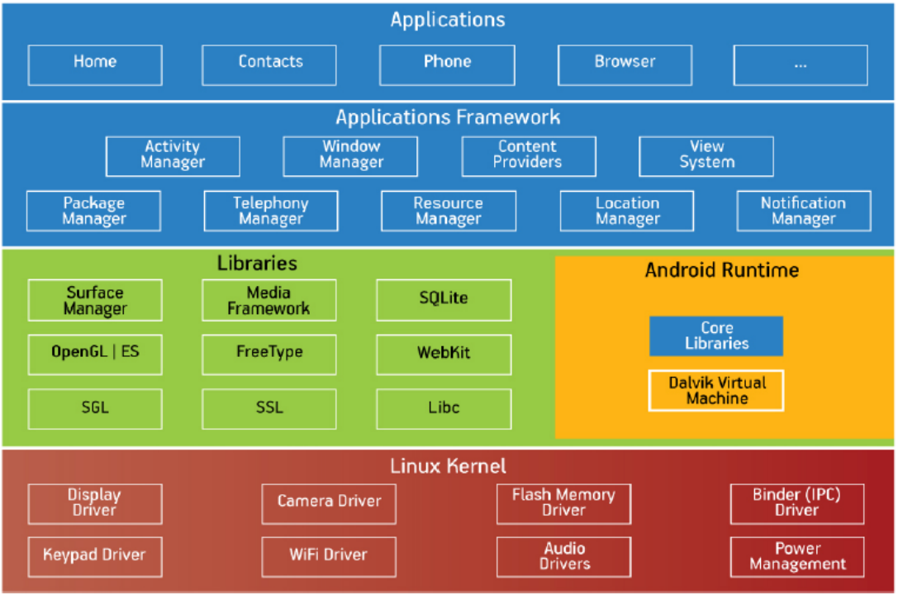

Slide 24
Applications
Applications is the top layer of android architecture. The pre-installed applications like home, contacts, camera, gallery etc and third party applications downloaded from the play store like chat applications, games etc. will be installed on this layer only.
It runs within the Android run time with the help of the classes and services provided by the application framework.
Application framework –
Application Framework provides several important classes which are used to create an Android application. It provides a generic abstraction for hardware access and also helps in managing the user interface with application resources. Generally, it provides the services with the help of which we can create a particular class and make that class helpful for the Applications creation.
It includes different types of services activity manager, notification manager, view system, package manager etc. which are helpful for the development of our application according to the prerequisite.

Slide 25
Application framework –
Application Framework provides several important classes which are used to create an Android application. It provides a generic abstraction for hardware access and also helps in managing the user interface with application resources. Generally, it provides the services with the help of which we can create a particular class and make that class helpful for the Applications creation.
It includes different types of services activity manager, notification manager, view system, package manager etc. which are helpful for the development of our application according to the prerequisite.
Platform libraries –
The Platform Libraries includes various C/C++ core libraries and Java based libraries such as Media, Graphics, Surface Manager, OpenGL etc. to provide a support for android development.
Media library provides support to play and record an audio and video formats.
Surface manager responsible for managing access to the display subsystem.
SGL and OpenGL both cross-language, cross-platform application program interface (API) are used for 2D and 3D computer graphics.
SQLite provides database support and FreeType provides font support.
Web-Kit This open source web browser engine provides all the functionality to display web content and to simplify page loading.
SSL (Secure Sockets Layer) is security technology to establish an encrypted link between a web server and a web browser.

Slide 26
Linux Kernel –
Linux Kernel is heart of the android architecture. It manages all the available drivers such as display drivers, camera drivers, Bluetooth drivers, audio drivers, memory drivers, etc. which are required during the runtime.
The Linux Kernel will provide an abstraction layer between the device hardware and the other components of android architecture. It is responsible for management of memory, power, devices etc.
The features of Linux kernel are:
Security: The Linux kernel handles the security between the application and the system.
Memory Management: It efficiently handles the memory management thereby providing the freedom to develop our apps.
Process Management: It manages the process well, allocates resources to processes whenever they need them.
Network Stack: It effectively handles the network communication.
Driver Model: It ensures that the application works properly on the device and hardware manufacturers responsible for building their drivers into the Linux build.

Slide 27
Activity Life Cycle
Android applications can be multi-process, and the Android operating system allows multiple applications to run concurrently, provided memory and processing power is available.
Applications can have background processes, and applications can be interrupted and paused when events such as phone calls occur.
There can be only one active application visible to the user at a time—specifically, a single application Activity is in the foreground at any given time.
The Android operating system keeps track of all Activity objects running by placing them on an Activity stack.
When a new Activity starts, the Activity on the top of the stack (the current foreground Activity) pauses, and the new Activity pushes onto the top of the stack.
When that Activity finishes, that Activity is removed from the activity stack, and the previous Activity in the stack resumes.

Slide 28
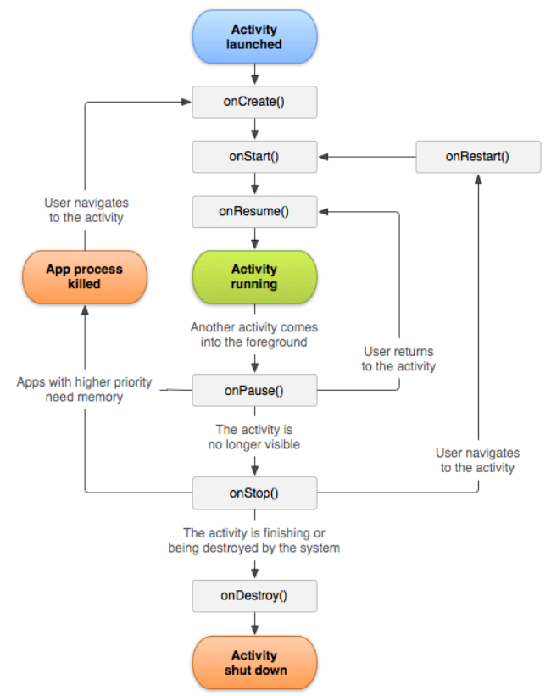
Methods
protected void onCreate();
protected void onStart();
protected void onRestart();
protected void onResume();
protected void onPause();
protected void onStop();
protected void onDestroy();

Slide 29
onCreate() :
which fires when the system first creates the activity.
On activity creation, the activity enters the Created state.
In the onCreate() method, you perform basic application startup logic that should happen only once for the entire life of the activity
onStart() :
When the activity enters the Started state, the system invokes this callback.
The onStart() call makes the activity visible to the user, as the app prepares for the activity to enter the foreground and become interactive.
For example, this method is where the app initializes the code that maintains the UI.
onResume() :
When the activity enters the Resumed state, it comes to the foreground, and then the system invokes the onResume() callback.
This is the state in which the app interacts with the user.
The app stays in this state until something happens to take focus away from the app.

Slide 30
onPause() :
The system calls this method as the first indication that the user is leaving your activity (though it does not always mean the activity is being destroyed);
it indicates that the activity is no longer in the foreground (though it may still be visible if the user is in multi-window mode)
onStop() :
When your activity is no longer visible to the user, it has entered the Stopped state, and the system invokes the onStop() callback.
This may occur, for example, when a newly launched activity covers the entire screen.
The system may also call onStop() when the activity has finished running, and is about to be terminated.
onDestroy() :
It is called before the activity is destroyed.
The system invokes this callback either the activity is finishing or terminated.

Slide 31
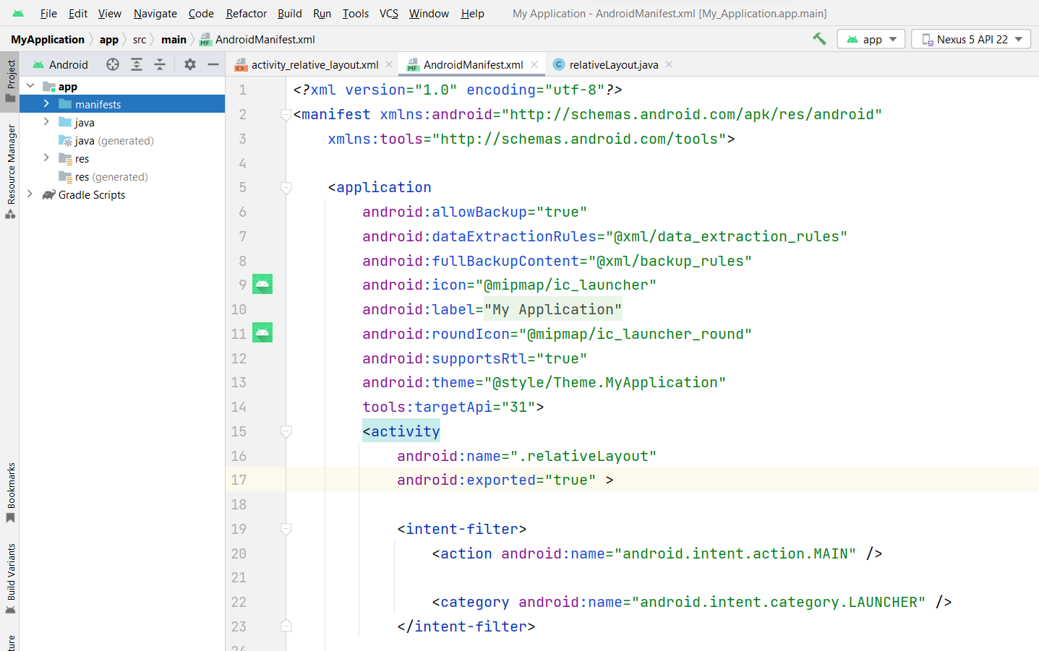
Android Manifest File in Android

Slide 32
It’s special configuration file which determine applications settings.
Such as application name, version, permissions, components etc.
Specially formatted XML file contains important information about the application’s identity.
Named AndroidManifest.xml & must be included at the top level of your android project.
Information in AndoirdManifest.xml is used for
Launch application activities.
Manage Application permissions.
Configure other advance application configuration detail Service
Broadcast Receiver
Content Provider
Enable application settings for debugging.

Slide 33
Elements of the AndroidManifest.xml file
<manifest>
manifest is the root element of the AndroidManifest.xml file.
It has package attribute that describes the package name of the activity class.
<application>
application is the subelement of the manifest.
It includes the namespace declaration.
This element contains several subelements that declares the application component such as activity etc.
The commonly used attributes are of this element are icon, label, theme etc.
android:icon
It represents the icon for all the android application components.
android:label
It works as the default label for all the application components.
android:theme
It represents a common theme for all the android activities.

Slide 34
<activity>
activity is the subelement of application and represents an activity that must be defined in the AndroidManifest.xml file.
It has many attributes such as label, name, theme, launchMode etc.
<intent-filter>
intent-filter is the sub-element of activity that describes the type of intent to which activity, service or broadcast receiver can respond to.
<action>
It adds an action for the intent-filter.
The intent-filter must have at least one action element.
<category>
It adds a category name to an intent-filter.

Slide 35
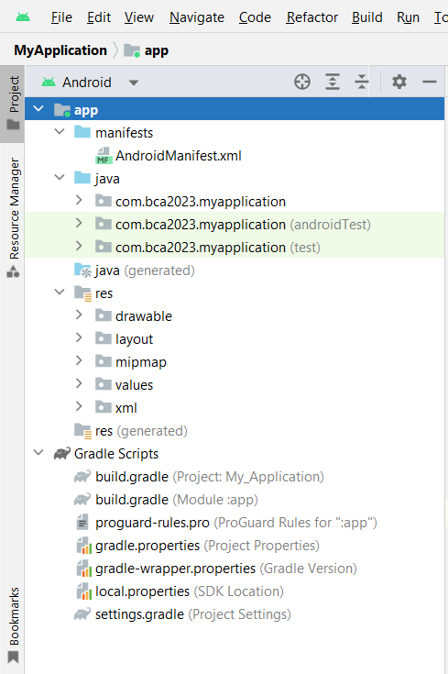
Anatomy of Android Application
AndroidManifest.xml
The AndroidManifest.xml file contains a bunch of properties that you’ll need to set when you eventually deploy your app to the Play Store or on other phones. This is where stuff like the name of your app and its permissions gets set.
Source Code
Android apps are written in Java (technically it’s not quite Java, but let’s not worry too much about that), so the source code of Android apps is stored in .java files, just like you’re already used to.
The .java files are stored in whatever package you chose when you created your app project. The entry point of an Android app is the main activity class: by default it’s MainActivity.java. We’ll talk more about activities in a minute, but for now just know that your code will go in a bunch of .java files inside your project.

Slide 36
Resources
The res directory contains non-code files that are needed to run your app. Stuff like images and property files go here.
There are a few subdirectories under the res folder:
drawable - contains image files that you use in your code.
layout - contains layout files. See the Layouts section below for more info.
mipmap - contains image files to use as your app’s icon. We’ll talk more about this when we deploy our app.
values - contains files that define various properties. For example, the strings.xml file can be used to list the various user-facing messages used in your app, which lets you translate your app into multiple languages.
Gradle
Gradle is an open-source build automation tool that focuses on flexibility and performance. So, to put it simply, it is an automation tool that creates the application build. Gradle is Android’s official build tool.
When we start a new Android project, we see two different build.gradle files.
One is at the project level, while the other is at the app level.

Slide 37
When we start a new Android project, we see two different build.gradle files. One is at the project level, while the other is at the app level.
In some simpler terms:
Compilers transform your source code into DEX (Dalvik Executable) files, which contain the bytecode that runs on Android devices, and everything else into compiled resources.
The DEX files and compiled resources are combined into a single APK by the APK Packager. The APK must be signed before it can be installed and deployed on an Android device.
The APK Packager uses either the debug or release Keystore to sign your APK.
If you are creating a debug version of your app, that is, an app that will only be used for testing and profiling, the packager will sign it with the debug Keystore. Android Studio creates a debug Keystore for new projects by default.
If you are creating a release version of your app for external distribution, the packager signs it with the release Keystore.
Read about signing your app in Android Studio to create a release Keystore.
Before generating your final APK, the packager optimizes your app to use less memory when running on a device with the zipalign tool.
You will have either a debug APK or a release APK of your app at the end of the build process, which you can use to deploy, test, or release to external users.

Slide 38
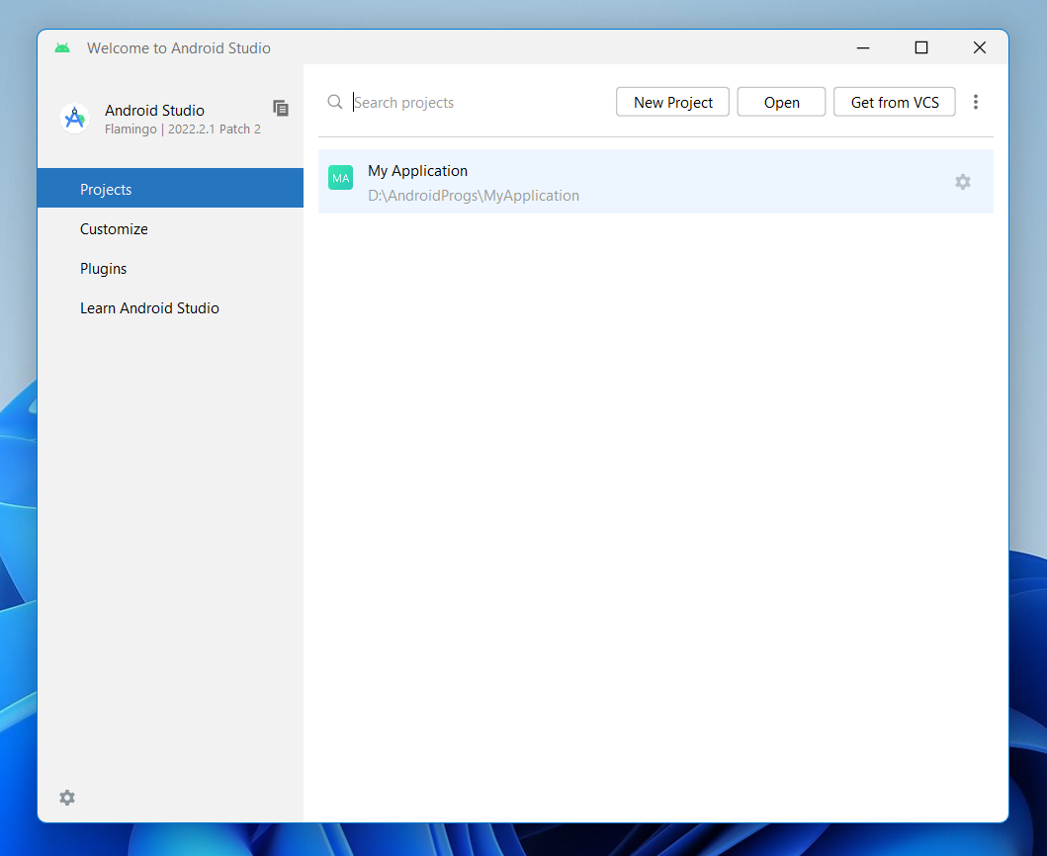
Build an Sample Android App

Slide 39
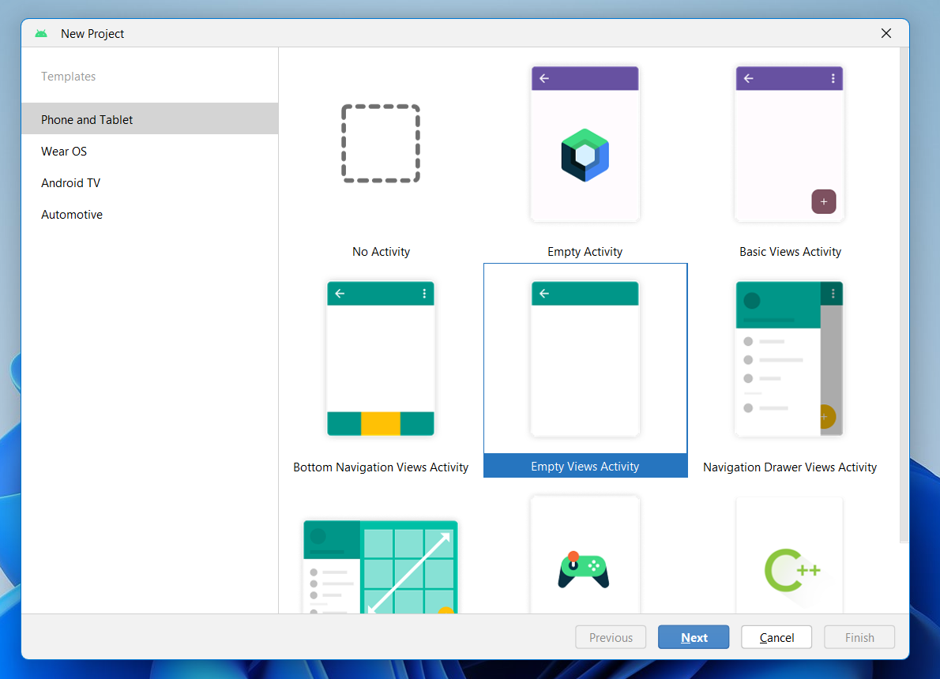
Select Empty Views Activity

Slide 40
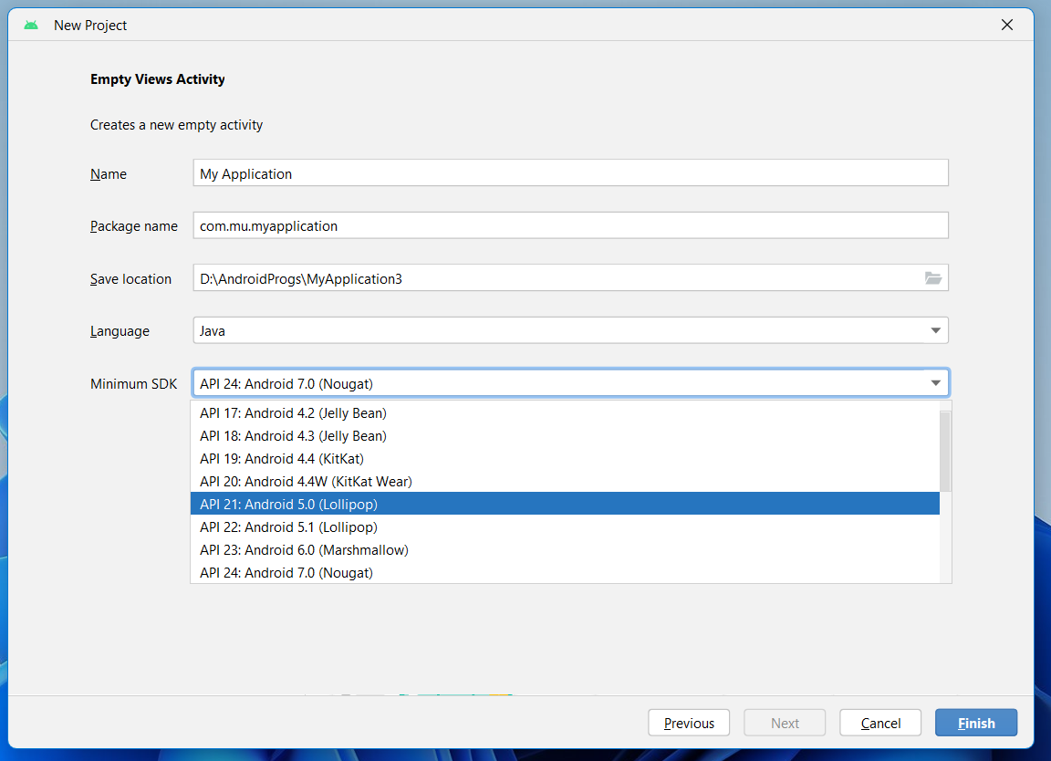
Name
Your Application Name
Package Name
An unique Package name is require for every project
Save Location
Select a location for your application
Language
Select Programming language where you want to work
Java
Kotlin
Select Java in our case
Minimum SDk
Select API for Application Development
Select API 21 (Lolipop) or API 22 (Lolipop) in our case.

Slide 41
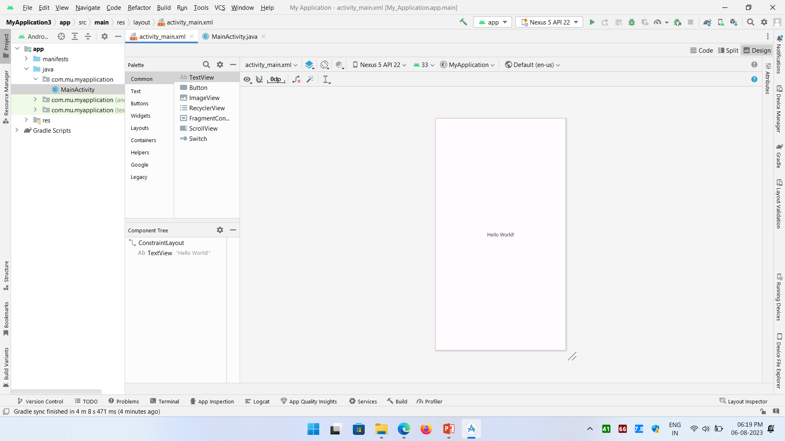
Your application will be ready for development.

Slide 42
Thank You
Prof. Hardik Chavda

