Slide 1


Android Application Development
Unit – 2
Basics of UI
Prof. Hardik Chavda
FOCA,MU

Slide 2

Unit – 2
Working with Intents
Types of Intents
Fundamentals of android UI design
Layouts (Linear, Relative, Table, Frame, Absolute)
Introduction to adapters
Widgets in android like
TextView, EditText,
RadioButton, RadioGroup, ImageView,
Spinner, ListView,
Button, ImageButton,
ToggleButton, CheckBox
AutoCompleteTextView, MultiAutoCompleteTextView,
RatingBar, DatePicker, TimePicker, ProgressBar,
AnalogClock, DigitalClock, ScrollView, RecyclerView,
Working with WebView
Introduction to Fragment
Fragment Life-Cycle

Slide 3
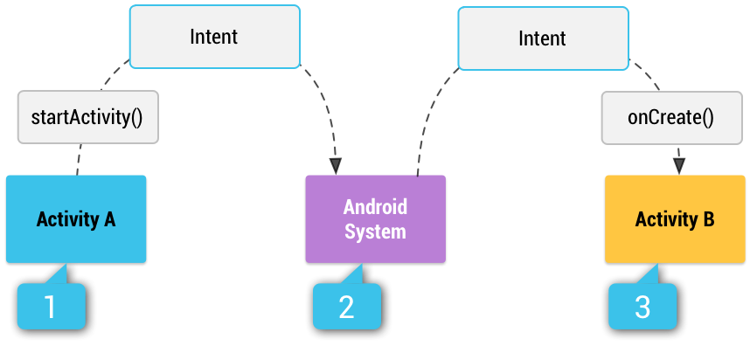
Intents in Android
What is Intent?
Type of Intent
Calling Activity Using Intent
Passing additional information using Intent
Intent Examples

Slide 4
What are Intent?
Intents are used to send asynchronous message within your application or between application.
Intents are powerful concepts as they allow to create loosely coupled application.
Intent object can contains information for receiving component
Type of intent
Implicit
It ask system to perform some task without specifying Java class, which should be called.
E.g. Open webpage
Intent Filter is used when we have more option.
Explicit
It ask system to perform some task with specified java class.

Slide 5
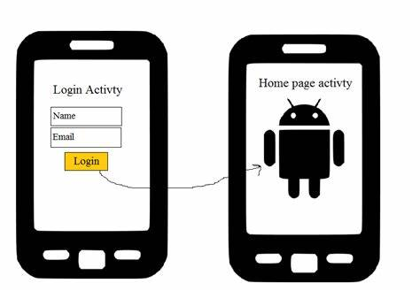
Explicit Intent
Calling Activity using Intent
To call other activity we will use startActivity()
Above method takes Intent as parameter.
Intent constructor is overloaded, for calling activity within application, you are suppose to pass
ApplicationContext
Java Class which you want to call
Passing Additional information to Intent
Intent can have information for receiving component
You can put extra information if you want to put.
Using putExtra() method of intent
To get Extra information which was passed you can use
getExtra() or related methods.

Slide 6
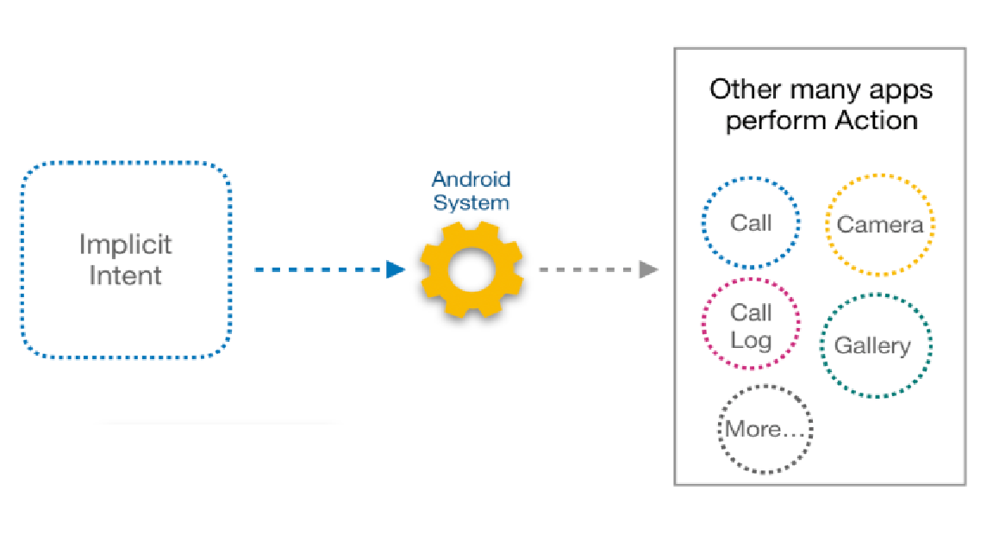
Implicit Intent
To open website using implicit intent
To dial the number passed in InputTypes (EditText)
To pass the location to Google map
To share the text with other applications.
Intent intent=new Intent(Intent.ACTION_VIEW); intent.setData(Uri.parse("http://www.tutlane.com")); startActivity(intent);

Slide 7

Fundamentals of UI Design
A layout defines the structure for a user interface in your app, such as in an activity. All elements in the layout are built using a hierarchy of View and ViewGroup objects.
A View usually draws something the user can see and interact with. Whereas a ViewGroup is an invisible container that defines the layout structure for View and other ViewGroup objects
There is a number of layout classes in the Android SDK. They can be used, modified or can create your own to make the UI for your Views, Fragments and Activities. You can display your contents effectively by using the right combination of layouts.
The View objects are usually called "widgets" and can be one of many subclasses, such as Button or TextView. The ViewGroup objects are usually called "layouts" and can be one of many types that provide a different layout structure, such as LinearLayout or RelativeLayout.

Slide 8
UI Declaration
You can declare a layout in two ways:
Declare UI elements in XML. Android provides a straightforward XML vocabulary that corresponds to the View classes and subclasses, such as those for widgets and layouts.
You can also use Android Studio's Layout Editor to build your XML layout using a drag-and-drop interface.
Instantiate layout elements at runtime. Your app can create View and ViewGroup objects (and manipulate their properties) programmatically.
Declaring your UI in XML allows you to separate the presentation of your app from the code that controls its behaviour. Using XML files also makes it easy to provide different layouts for different screen sizes and orientations.

Slide 9
Write the XML
<?xml version="1.0" encoding="utf-8"?>
<LinearLayout xmlns:android="http://schemas.android.com/apk/res/android"
android:layout_width="match_parent"
android:layout_height="match_parent"
android:orientation="vertical" >
<TextView android:id="@+id/text"
android:layout_width="wrap_content"
android:layout_height="wrap_content"
android:text="Hello, I am a TextView" />
<Button android:id="@+id/button"
android:layout_width="wrap_content"
android:layout_height="wrap_content"
android:text="Hello, I am a Button" />
</LinearLayout>
Using Android's XML vocabulary, you can quickly design UI layouts and the screen elements they contain, in the same way you create web pages in HTML — with a series of nested elements.
Each layout file must contain exactly one root element, which must be a View or ViewGroup object. Once you've defined the root element, you can add additional layout objects or widgets as child elements to gradually build a View hierarchy that defines your layout.
For example, here's an XML layout that uses a vertical LinearLayout to hold a TextView and a Button:

Slide 10
Load the XML Resource
When you compile your app, each XML layout file is compiled into a View resource. You should load the layout resource from your app code, in your Activity.onCreate() callback implementation.
Do so by calling setContentView(), passing it the reference to your layout resource in the form of: R.layout.layout_file_name.
For example, if your XML layout is saved as main_layout.xml, you would load it for your Activity like so:
public void onCreate(Bundle savedInstanceState) {
super.onCreate(savedInstanceState);
setContentView(R.layout.main_layout);
}
The onCreate() callback method in your Activity is called by the Android framework when your Activity is launched (see the discussion about lifecycles, in the Activities document).

Slide 11
Attributes
Every View and ViewGroup object supports their own variety of XML attributes.
Some attributes are specific to a View object (for example, TextView supports the textSize attribute), but these attributes are also inherited by any View objects that may extend this class.
Some are common to all View objects, because they are inherited from the root View class (like the id attribute). And, other attributes are considered "layout parameters," which are attributes that describe certain layout orientations of the View object, as defined by that object's parent ViewGroup object.

Slide 12
ID
Any View object may have an integer ID associated with it, to uniquely identify the View within the tree.
When the app is compiled, this ID is referenced as an integer, but the ID is typically assigned in the layout XML file as a string, in the id attribute.
This is an XML attribute common to all View objects (defined by the View class) and you will use it very often. The syntax for an ID, inside an XML tag is:
android:id="@+id/my_button"
The at-symbol (@) at the beginning of the string indicates that the XML parser should parse and expand the rest of the ID string and identify it as an ID resource.
The plus-symbol (+) means that this is a new resource name that must be created and added to our resources (in the R.java file).

Slide 13
Layout Parameters
XML layout attributes named layout_something define layout parameters for the View that are appropriate for the ViewGroup in which it resides.
Every ViewGroup class implements a nested class that extends ViewGroup.LayoutParams.
All view groups include a width and height (layout_width and layout_height), and each view is required to define them. Many LayoutParams also include optional margins and borders.
wrap_content tells your view to size itself to the dimensions required by its content.
match_parent tells your view to become as big as its parent view group will allow.

Slide 14
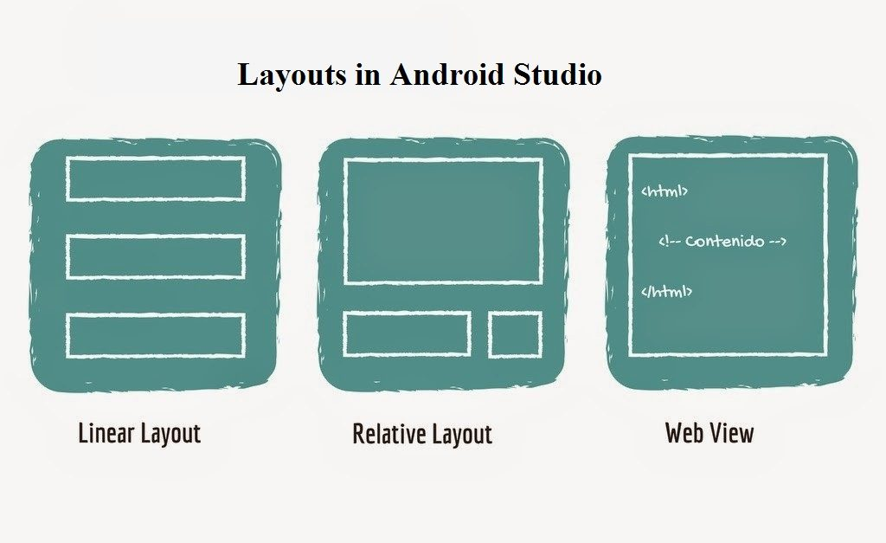
Types of UI Layouts
LinearLayout
RelativeLayout
FrameLayout
TableLayout
ConstraintLayout

Slide 15
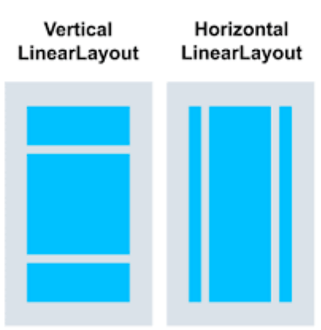
Linear Layout
It is one of the simplest and most common layout. It simply lay out its children next to each other. Either horizontally or vertically.
The order of the children matters. As linear layout ask its children how much space they need, it allocates the desired space to each child in the order they are added.
One important property for Linear Layout is layout orientation. Its valid options are vertical and horizontal.

Slide 16
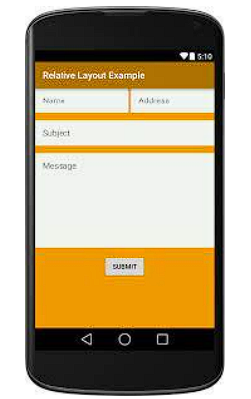
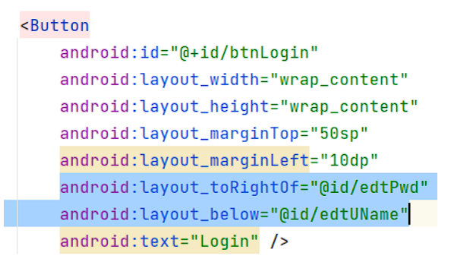
Relative Layout
It lays-out its childeren relative to each other. Its very powerful because it does not require you to nest unnecessary layouts to achieve a certain look.
At the same time, using RealtiveLayout can minimize the total number of widgets that need to be drawn, thus improving the overall performance of your application.
RelativeLayout requires each of its child views to have ID set so that they can set it to relative position with other children.

Slide 17
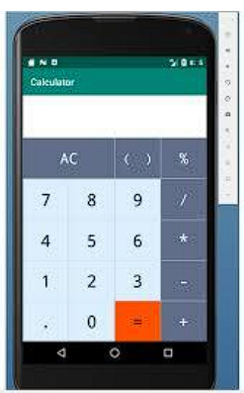
Table Layout
Its lay-out its children in a table and cconsist of only other TableRow widget. TableRow presents a row in a table and can contain other UI widgets.
TableRow widget are laid out next to each other horizontally, sort of like LinearLayout with Horizontal orientation.
An important property for TableLayout is strech_columns, indicating which column of the table to stretch. One can also use to stretch all columns.

Slide 18
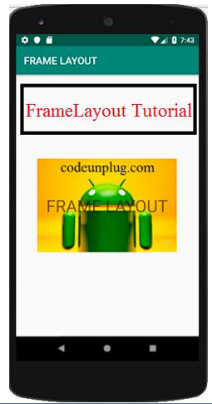
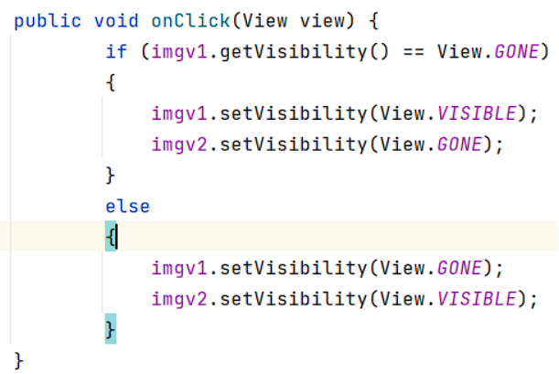
Frame Layout
It place its children on the top of each other so that the latest child is covering the previous, like a deck of cards.
For example, this layout policy is useful for tabs;
FrameLayout is also used as a placeholder for other widget that will be added programmatically at some later point in time.

Slide 19
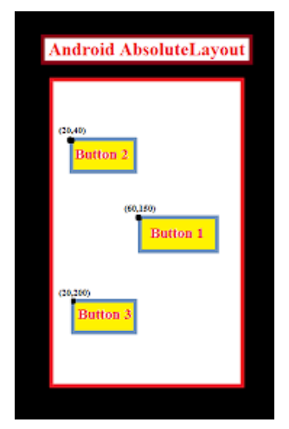
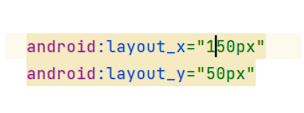
Absolute layout
It position Its childeren at the absolute coordinates on the screen. It is the favourite layout for WYSIWYG tool and although it is very simple. It is not very Flexible.
User Interface would look like good on one particular screen but as soon as the screen size, orientation, or density changed, AbsoulteLayout would not be able to adjust.

Slide 20
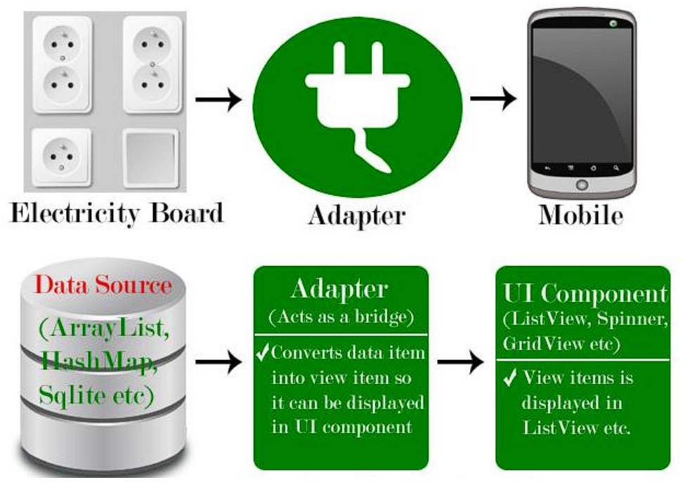
Adapters

Slide 21
Introduction to Adapters
In Android, Adapter is a bridge between UI component and data source that helps us to fill data in UI component.
It holds the data and send the data to an Adapter view then view can takes the data from the adapter view and shows the data on different views like as ListView, GridView, Spinner etc.
To fill data in a list or a grid we need to implement Adapter.
Generally there are few types available:
ArrayAdapter (List & Spinners)
BaseAdapter (GridViews)
CustomAdapter (Combining Multiple Requirements)

Slide 22
Array Adapter
An ArrayAdapter is an adapter backed by an array of objects. It links the array to the Adapter View.
The defaultArrayAdapter converts an array item into a String object putting it into a
TextView. The text view is then displayed in the AdapterView (a ListView for example).
Whenever you have a list of single type of items which is backed by an array, you can use ArrayAdapter. For instance, list of phone contacts, countries or names.
By default, ArrayAdapter expects a Layout with a single TextView, If you want to use more complex views means more customization in grid items or list items, please avoid ArrayAdapter and use custom adapters.
Syntax:
ArrayAdapter(Context context, int resource, int textViewResourceId, T[] objects)
ArrayAdapter(Context context, int resource, T[] objects)

Slide 23
BaseAdapter
BaseAdapter is a common base class of a general implementation of an Adapter that can be used in ListView, GridView, Spinner etc.
Whenever you need a customized list in a ListView or customized grids in a GridView you create your own adapter and extend base adapter in that.
Base Adapter can be extended to create a custom Adapter for displaying a custom list item.
public class MyAdapter extends BaseAdapter {
@Override
public int getCount() {
return 0;
}
@Override
public Object get Item(int i) {
return null;
}
@Override
public long get ItemId(int i) {
return 0;
}
@Override
public View getView(int i, View view,
ViewGroupview Group) {
return null;
}

Slide 24
Widgets in Android
TextView
A TextView displays text to the user and optionally allows them to edit it. A TextView is a complete text editor, however the basic class is configured to not allow editing.
Attributes :
Id : This is the ID which uniquely identifies the control.
fontFamily : Font family (named by string) for the text.
gravity : Specifies how to align the text by the view's x-and/or y-axis when the text is smaller than the view.
Text : Text to display.
textAllCaps : Present the text in ALL CAPS. Possible value either "true" or "false".
textSize : Size of the text. Recommended dimension type for text is "sp" for scaled-pixels (example: 15sp).
textStyle : Style (bold, italic, bolditalic) for the text.
Methods :
getText ( ) : Retrieve text from control
setText ( ) : Set a text in the control.

Slide 25
EditText
EditText is a user interface control which is used to allow the user to enter or modify the text.
Attribute :
id : This supplies an identifier name for this view.
text : This is the Text to display.
hint : Acts like placeholder in HTML.
background : This is a drawable to use as the background.
Most of the common attributes of the TextView controls.
Methods :
setText ()
getText()

Slide 26
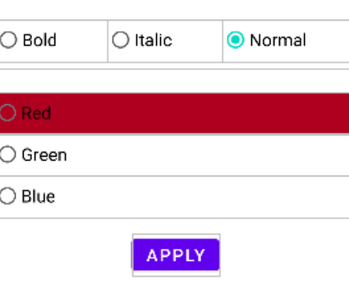
RadioGroup
Radio group represents the group of various Radio buttons and every group allows to select one option from the set.
Important Attribute : Orientation ( Horizontal /Vertical)
Example :
In this example, two Radio Buttons groups are there.
Font Style group (Bold, Italic, Normal) with Horizontal Orientation
Font Color (Red , Green , Blue) with Vertical Orientation
Radio buttons allow the user to select one option from a set of options.
RadioButon is a two state button that can be checked or unchecked

Slide 27
Attributes of Radio Button
id : It is an attribute used to uniquely identify a radio button.
checked:
checked attribute in radio button is used to set the current state of a radio button.
We can set it either true or false where true shows the checked state and false shows unchecked state of a radio button. As usual default value of checked attribute is false.
text: text attribute is used to set the text in a radio button.
gravity: The gravity attribute is an optional attribute which is used to control the alignment of text like left, right, center, top, bottom, center_vertical, center_horizontal etc.
textColor: textColor attribute is used to set the text color of a radio button.
textSize: textSize attribute is used to set the size of the text of a radio button.
textStyle: textStyle attribute is used to set the text style of the text of a radio button. The possible text styles are bold, italic and normal.
Method of Radio Button:
isChecked( ) : This method returns True / False as per selection of Radio Button

Slide 28
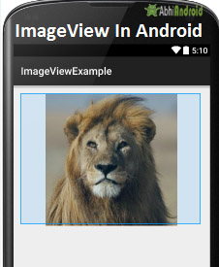
ImageView
In Android, ImageView class is used to display an image file in application. Image file is easy to use but hard to master in Android, because of the various screen sizes in Android devices.
An android is enriched with some of the best UI design widgets that allows us to build good looking and attractive UI based application.
ImageView comes with different configuration options to support different scale types.
Scale type options are used for scaling the bounds of an image to the bounds of the imageview.
Some of them scaleTypes configuration properties are center, center_crop, fit_xy, fitStart etc.
<ImageView
android:id="@+id/simpleImageView"
android:layout_width=“match_parent"
android:layout_height="wrap_content"
android:src="@drawable/lion" />

Slide 29
Spinner
Spinner is a view similar to the dropdown list which is used to select one option from the list of options.
It provides an easy way to select one item from the list of items and it shows a dropdown list of all values when we click on it.
Attributes:
android:id = Used to specify the id of the view.
android:textAlignment = Used to the text alignment in the dropdown list.
android:background = Used to set the background of the view.
android:padding = Used to set the padding of the view.
android:visibility = Used to set the visibility of the view.
android:gravity = Used to specify the gravity of the view like center, top,bottom, etc

Slide 30
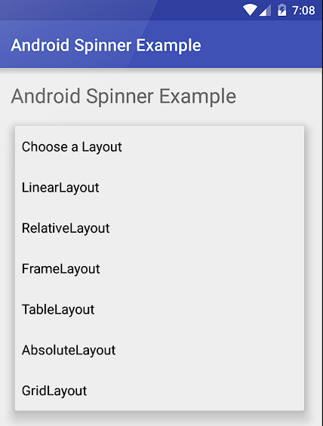
Methods :
setAdapter ( ) : To assign adapter for data source.
For example :
String[] courses = { “LinearLayout", “RelativeLayout", “FrameLayout", “TableLayout“,”AbsoluteLayout”, ”GridLayout”};
ArrayAdapter ad = new ArrayAdapter( this, android.R.layout.simple_spinner_item, courses);
spinner.setAdapter(ad);

Slide 31
ListView
List of scrollable items can be displayed in Android using ListView.
It helps you to displaying the data in the form of a scrollable list. Users can then select any list item by clicking on it.
ListView is default scrollable so we do not need to use scroll View or anything else with ListView.
Adapter: To fill the data in a ListView we simply use adapters.
List items are automatically inserted to a list using an Adapter that pulls the content from a source such as an arraylist, array or database.

Slide 32
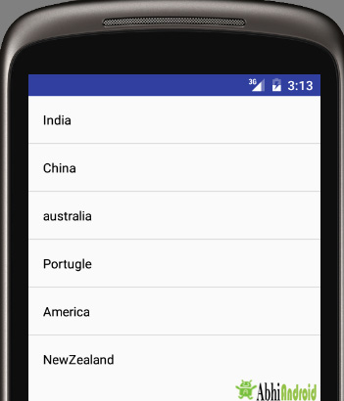
<ListView
android:id="@+id/simpleListView"
android:layout_width="match_parent"
android:layout_height=“match_content“/>
simpleList = (ListView)findViewById(R.id.simpleListView);
ArrayAdapter<String> arrayAdapter = new ArrayAdapter<>(
this,
R.layout.activity_listview, R.id.textView, countryList);
simpleList.setAdapter(arrayAdapter);
String countryList[] = {
"India", "China", "australia", "Portugle", "America", "NewZealand“
};

Slide 33
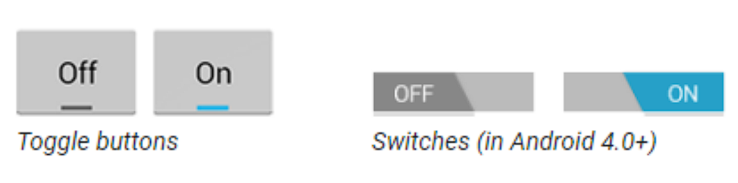
Toggle Button
Android Toggle Button can be used to display checked/unchecked (On/Off) state on the button.
It is beneficial if user have to change the setting between two states. It can be used to On/Off Sound, Wi-Fi, Bluetooth, etc.
Attributes :
Id : It is an attribute used to uniquely identify a button.
textOff : This is the text for the button when it is not checked.
textOn : This is the text for the button when it is checked.
Visibility : This controls the initial visibility of the view.
Text : This is the Text to display.
Methods :
isChecked ( ) : It is verified whether button is checked or not.
setChecked(boolean checked) : To enable in checked or unchecked mode.
Event : setOnCheckedChangeListener()

Slide 34
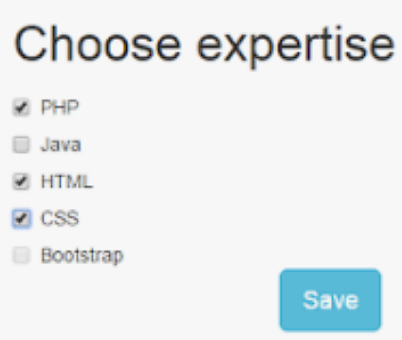
CheckBox
Checkboxes allow the user to select one or more options from a set.
Attributes : Almost similar as Radio Button (Take ref. from Radio button)
Method :
isCheck () : It will check whether checkbox is checked or not. If yes then return True otherwise False.
Event : setOnCheckedChangeListener()

Slide 35
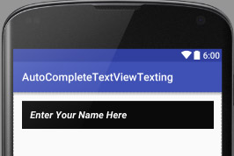
AutoCompleteTextView
In Android, AutoCompleteTextView is a view i.e similar to EditText, except that it displays a list of completion suggestions automatically while the user is typing.
A list of suggestions is displayed in drop down menu from which user can choose an item which actually replace the content of EditText with that.

Slide 36
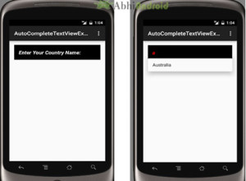
<AutoCompleteTextView
android:id="@+id/simpleAutoCompleteTextView"
android:layout_width=“match_parent"
android:layout_height="wrap_content"
android:hint="Country"/>
String[] countryNameList = {"India", "China", "Australia", "New Zealand", "England"};
/initiate an auto complete text view
AutoCompleteTextView smtxt = findViewById(R.id.simpleAutoCompleteTextView);
ArrayAdapter adapter = new ArrayAdapter(this, android.R.layout.simple_list_item_1, countryNameList);
smtxt.setAdapter(adapter);

Slide 37
MultiAutoCompleteTextView
In Android, MultiAutoCompleteTextView is an editable TextView extends AutoCompleteTextView that can show the complete suggestion for the sub-string of a text allowing user to quickly select instead of typing whole.
An AutoCompleteTextView only offers suggestion about the whole sentence and a MultiAutoCompleteTextView offers suggestion for every token in the sentence. We can specify what is the delimiter between tokens.

Slide 38
<MultiAutoCompleteTextView
android:id="@+id/simpleMultiAutoCompleteTextView"
android:layout_width=“match_parent"
android:layout_height="wrap_content"
android:hint=“Select"/>
String[] androidVersionNames = {"Aestro", "Blender", "CupCake", "Donut", "Eclair", "Froyo", "Gingerbread", "HoneyComb", "IceCream Sandwich", "Jellibean", "Kitkat", "Lollipop", "MarshMallow"};
MultiAutoCompleteTextView smt = (MultiAutoCompleteTextView) findViewById(R.id.simpleMultiAutoCompleteTextView);
ArrayAdapter<String> versionNames = new ArrayAdapter<String>(this, android.R.layout.simple_list_item_1, androidVersionNames);
smt.setAdapter(versionNames);
smt.setTokenizer(new MultiAutoCompleteTextView.CommaTokenizer());
}

Slide 39
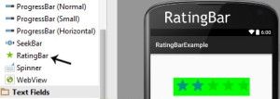
RatingBar
RatingBar is used to get the rating from the app user. A user can simply touch, drag or click on the stars to set the rating value.
The value of rating always returns a floating point number which may be 1.0, 2.5, 4.5 etc.
<RatingBar
android:id="@+id/simpleRatingBar"
android:layout_width="wrap_content"
android:layout_height="wrap_content"
android:rating="3.5" />

Slide 40
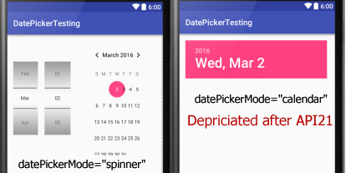
DatePicker
In Android, DatePicker is a widget used to select a date. It allows to select date by day, month and year in your custom UI (user interface).
If we need to show this view as a dialog then we have to use a DatePickerDialog class.
<DatePicker
android:id="@+id/simpleDatePicker"
android:layout_width="wrap_content"
android:layout_height="wrap_content"
android:datePickerMode="spinner"
/>

Slide 41
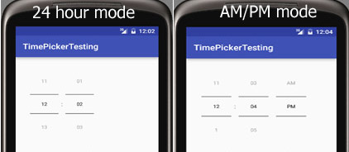
TimePicker
In Android, TimePicker is a widget used for selecting the time of the day in either AM/PM mode or 24 hours mode.
The displayed time consist of hours, minutes and clock format. If we need to show this view as a Dialog then we have to use a TimePickerDialog class.
<TimePicker
android:id="@+id/simpleTimePicker"
android:layout_width="wrap_content"
android:layout_height="wrap_content"
android:timePickerMode="spinner"/>

Slide 42
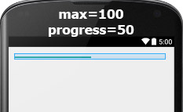
ProgressBar
In Android, ProgressBar is used to display the status of work being done like analyzing status of work or downloading a file etc.
In Android, by default a progress bar will be displayed as a spinning wheel but If we want it to be displayed as a horizontal bar then we need to use style attribute as horizontal.
It mainly use the “android.widget.ProgressBar” class.
<ProgressBar
android:id="@+id/simpleProgressBar"
android:layout_width="wrap_content"
android:layout_height="wrap_content"
android:max="100"
android:progress="50"
/>

Slide 43
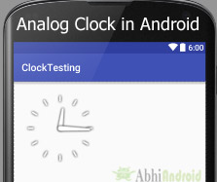
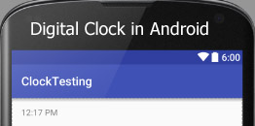
AnalogClock / DigitalClock
In Android, AnalogClock is a two handed clock one for hour indicator and the other for minute indicator and DigitalClock & TextClock both looks like your normal digital watch on hand which displays the hours minutes and seconds in digital format.
You can simply use these two widgets in your application but these components cannot be used to change the time so for that you may use TimePicker component.
<AnalogClock
android:id="@+id/simpleAnalogClock"
android:layout_width="wrap_content"
android:layout_height="wrap_content" />
<DigitalClock
android:id="@+id/simpleDigitalClock"
android:layout_width="wrap_content"
android:layout_height="wrap_content" />

Slide 44
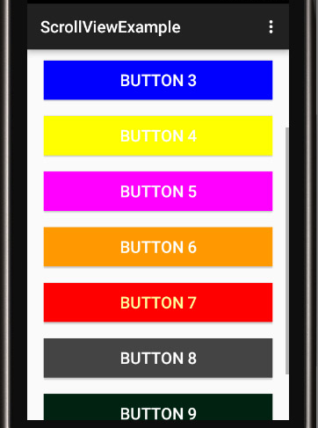
ScrollView
In android ScrollView can hold only one direct child. This means that, if you have complex layout with more views(Buttons, TextViews or any other view) then you must enclose them inside another standard layout like Table Layout, Relative Layout or Linear Layout.
You can specify layout_width and layout_height to adjust width and height of screen. You can specify height and width in dp(density pixel) or px(pixel). Then after enclosing them in a standard layout, enclose the whole layout in ScrollView to make all the element or views scrollable.
<ScrollView
android:id="@+id/scrollView"
android:layout_width=“match_parent"
android:layout_height=“match_parent">
<!-- add child view’s here -->
</ScrollView>

Slide 45
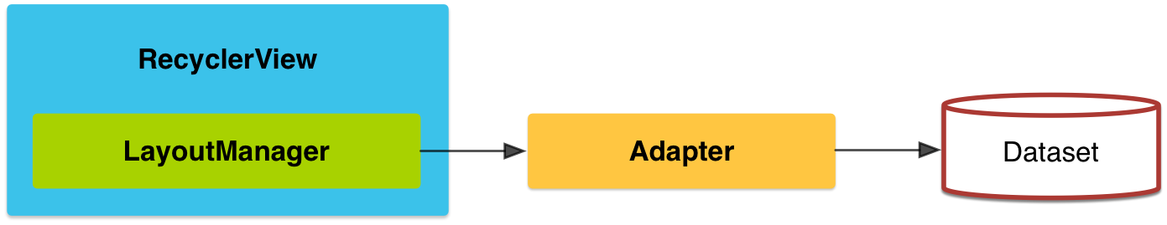
RecyclerView
The RecyclerView is a ViewGroup that renders any adapter-based view in a similar way. It is supposed to be the successor of ListView and GridView.
One of the reasons is that RecyclerView has a more extensible framework, especially since it provides the ability to implement both horizontal and vertical layouts.
Use the RecyclerView widget when you have data collections whose elements change at runtime based on user action or network events.
If you want to use a RecyclerView, you will need to work with the following:
RecyclerView.Adapter - To handle the data collection and bind it to the view
LayoutManager - Helps in positioning the items
ItemAnimator - Helps with animating the items for common operations such as Addition or Removal of item

Slide 46
Compared to ListView
Required ViewHolder in Adapters - ListView adapters do not require the use of the ViewHolder pattern to improve performance. In contrast, implementing an adapter for RecyclerView requires the use of the ViewHolder pattern for which it uses RecyclerView.Viewholder.
Customizable Item Layouts - ListView can only layout items in a vertical linear arrangement and this cannot be customized. In contrast, the RecyclerView has a RecyclerView.LayoutManager that allows any item layouts including horizontal lists or staggered grids.
Easy Item Animations - ListView contains no special provisions through which one can animate the addition or deletion of items. In contrast, the RecyclerView has the RecyclerView.ItemAnimator class for handling item animations.
Manual Data Source - ListView had adapters for different sources such as ArrayAdapter and CursorAdapter for arrays and database results respectively. In contrast, the RecyclerView.Adapter requires a custom implementation to supply the data to the adapter.
Manual Item Decoration - ListView has the android:divider property for easy dividers between items in the list. In contrast, RecyclerView requires the use of a RecyclerView.ItemDecoration object to setup much more manual divider decorations.
Manual Click Detection - ListView has a AdapterView.OnItemClickListener interface for binding to the click events for individual items in the list. In contrast, RecyclerView only has support for RecyclerView.OnItemTouchListener which manages individual touch events but has no built-in click handling.

Slide 47
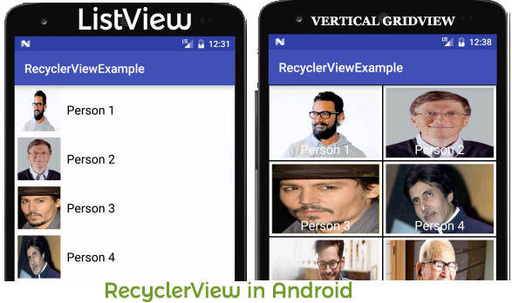
Components of a RecyclerView
LayoutManagers
A RecyclerView needs to have a layout manager and an adapter to be instantiated. A layout manager positions item views inside a RecyclerView and determines when to reuse item views that are no longer visible to the user.
RecyclerView provides these built-in layout managers:
LinearLayoutManager shows items in a vertical or horizontal scrolling list.
GridLayoutManager shows items in a grid.
StaggeredGridLayoutManager shows items in a staggered grid.
RecyclerView.Adapter
RecyclerView includes a new kind of adapter. It’s a similar approach to the ones you already used, but with some peculiarities, such as a required ViewHolder.
ItemAnimator
RecyclerView.ItemAnimator will animate ViewGroup modifications such as add/delete/select that are notified to the adapter. DefaultItemAnimator can be used for basic default animations and works quite well. See the section of this guide for more information.

Slide 48
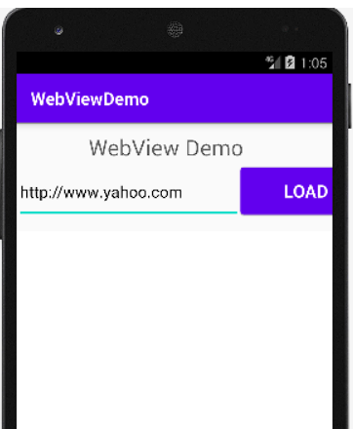
WebView
There are two ways to view web content on an Android device.
Traditional web browser
Android application that includes WebView in the layout.
Android WebView is used to display web page in android. The web page can be loaded from same application or URL.
It is used to display online content in android activity.
Android WebView uses webkit engine to display web page.
Here, in order for your activity to access the Internet and load web pages in a WebView, you must add the INTERNET permissions to your Android Manifest file:
<uses-permission android:name="android.permission.INTERNET"/>

Slide 49
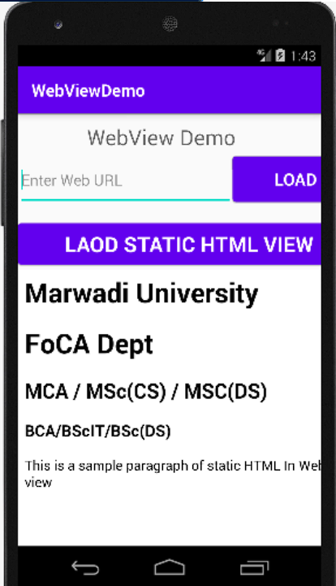
The loadUrl() and loadData() methods of Android WebView class are used to load and display web page.
loadUrl() – Load a web page in our WebView
loadUrl(String url);
Example :
btnLoad.setOnClickListener(newView.OnClickListener(){
@Override
public void onClick(View view) {
wvDisp.loadUrl(edtURL.getText().toString());
}
})
loadData() – Load Static Html Data on WebView
This method is used to load the static HTML string in a web view. loadData() function takes html string data, mime-type and encoding param as three parameters.
Syntaxt :
loadData(String data, String mimeType, String encoding)

Slide 50
Fragments
Fragment is a piece of an activity that enables a more modular activity design.
A fragment encapsulates functionality so that it is easier to reuse within activities and layouts. Android devices exist in a variety of screen sizes and densities.
Fragments simplify the reuse of components in different layouts and their logic.
You can build single-pane layouts for handsets (phones) and multi-pane layouts for tablets. You can also use fragments also to support different layouts for landscape and portrait orientation on a smartphone.
Types of Android Fragments
Single Fragment: Display only one single view on the device screen. This type of fragment is mostly used for mobile phones.
List Fragment: This Fragment is used to display a list-view from which the user can select the desired sub-activity. The menu drawer of apps like Gmail is the best example of this kind of fragment.
Fragment Transaction: This kind of fragments supports the transition from one fragment to another at run time. Users can switch between multiple fragments like switching tabs.

Slide 51
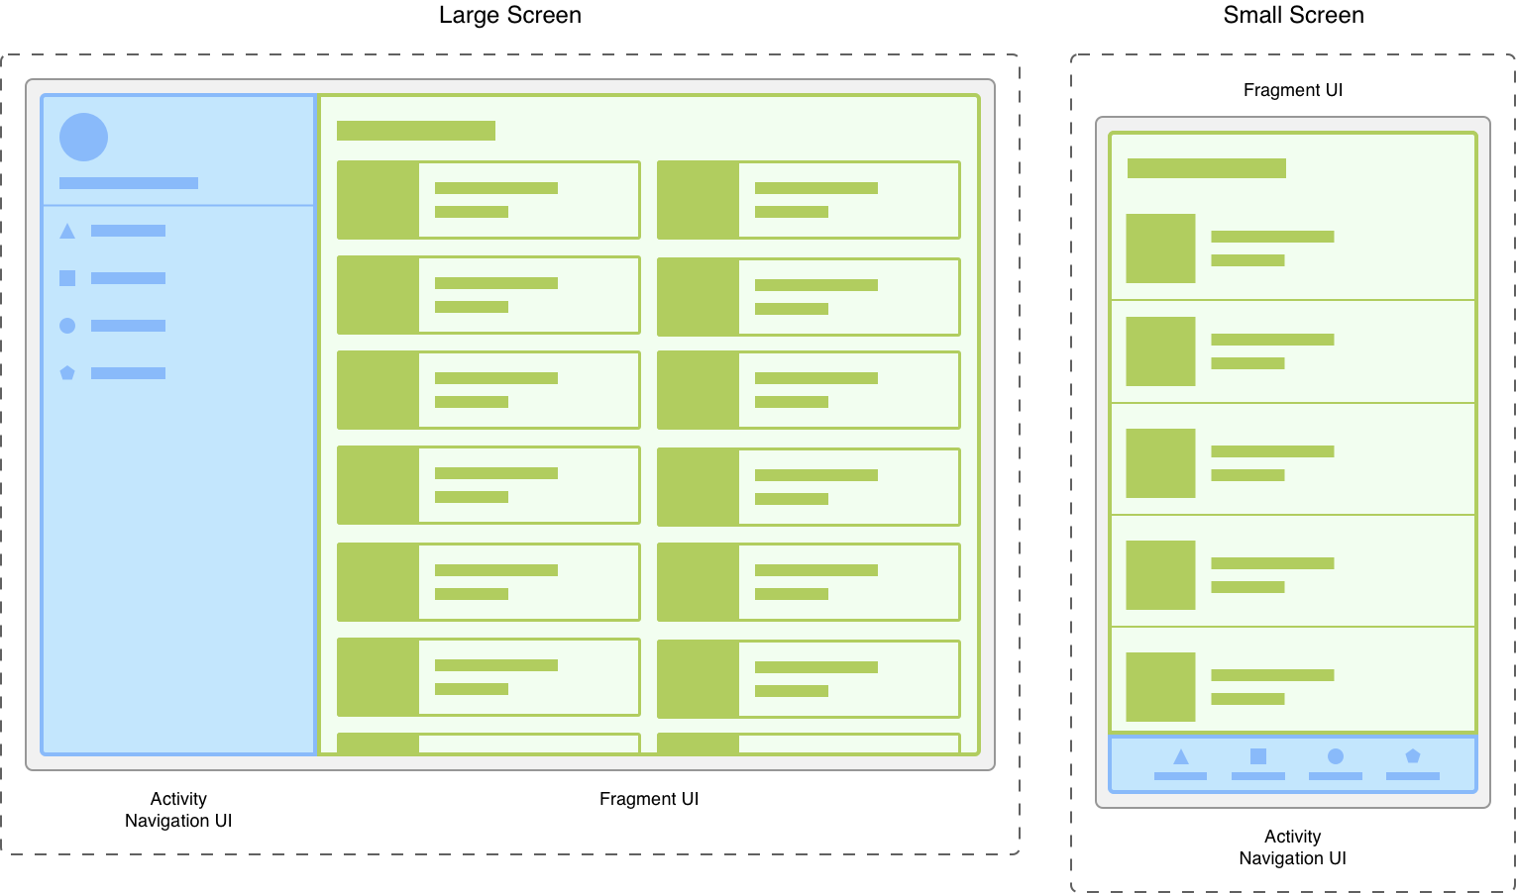

Slide 52
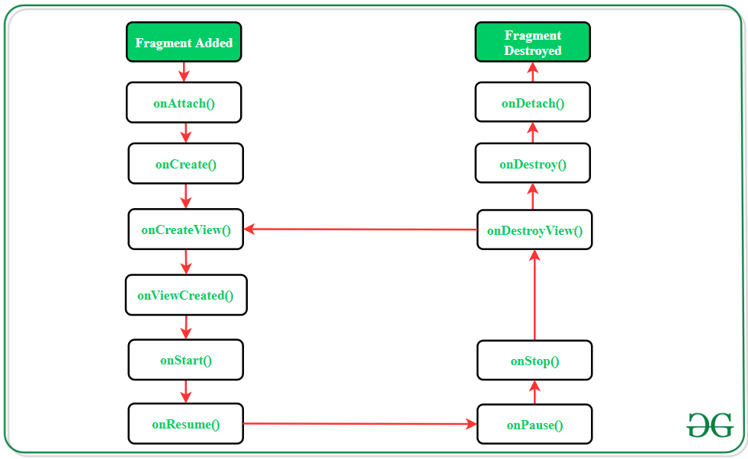
Fragments Lifecycle
Consider Fragment-1 is A and Fragment-2 is B and A is attached to the Main Activity 1. If you can replace B with A. A’s call back: onDestroyView() onDestroy() onDetach()
B’s call back: onAttach() onCreate() onCreateView() onViewCreated()
2. If you can replace B with A without Losing resources. A’s call back: onDestroy() onDetach()
B’s call back: onAttach() onCreate() onCreateView() onViewCreated()

Slide 53
XML Fragment
<fragment
android:id="@+id/fragments"
android:layout_width="match_parent"
android:layout_height="match_parent" />
Fragments were added in in Honeycomb version of Android i.e API version 11. There are some primary classes related to Fragment’s are:
1. FragmentActivity: The base class for all activities using compatibility based Fragment (and loader) features.
2. Fragment: The base class for all Fragment definitions
3. FragmentManager: The class for interacting with Fragment objects inside an activity
4. FragmentTransaction: The class for performing an atomic set of Fragment operations such as Replace or Add a Fragment.

