Slide 1


DATA SCIENCE ESSENTIALS
Program: Bachelor of Technology
Branch: Computer Engineering
Course Code: 01CE0517
Course Credit: 3
Prepared by:
Dr. Deepak Kumar Verma
Associate Professor,
Department of Computer Engineering
Marwadi University, Rajkot, India

Slide 2


Objective:
To provide a strong foundation for data science and application areas related to it and understand the underlying core concepts and emerging technologies in data science.

Slide 3
Course Outcomes:
Explore the fundamental concepts of data science.
Analyze data processing techniques for applications handling large data.
Understand concept of statistical and exploratory data analysis.
Understand various machine learning algorithms used in data science process.
Apply ethical frameworks to help them analyze ethical challenges.

Slide 4
Unit – 1
Introduction to data science

Slide 5
Topics to be cover
Introduction to data science
Overview of data science and its applications
Emergence of data science
Outlining the core competencies of a data scientist and data science
Linking data science with big data and AI,
Data science workflow and process
Role of python in data science
Tool for Data Science.

Slide 6
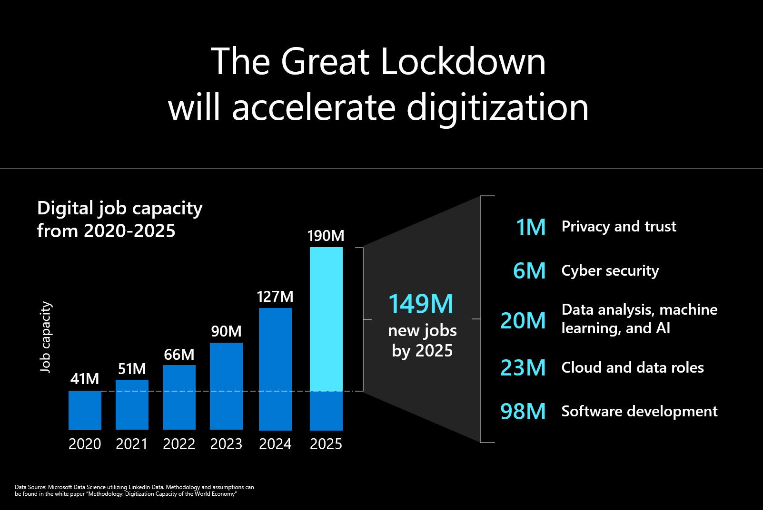
Introduction to data science

Slide 7
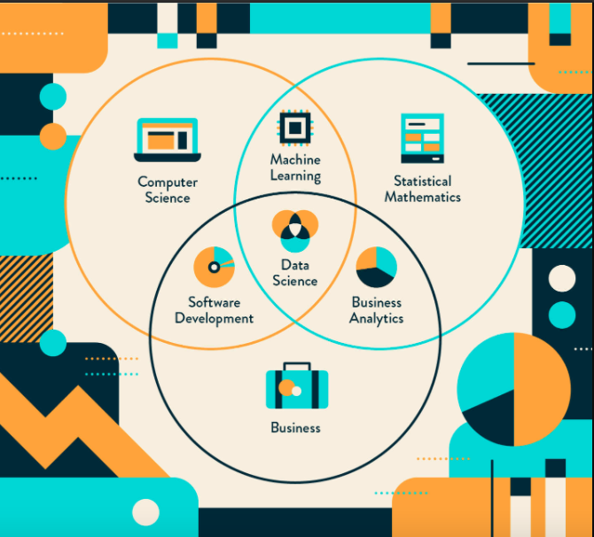
Introduction to data science

Slide 8

What is Data Science?
Introduction to data science

Slide 9
What is Data Science ?
Introduction to data science
Data science is the domain of study that deals with vast volumes of data using modern tools and techniques to find unseen patterns, derive meaningful information, and make business decisions.
Data science uses complex machine learning algorithms to build predictive models.

Slide 10
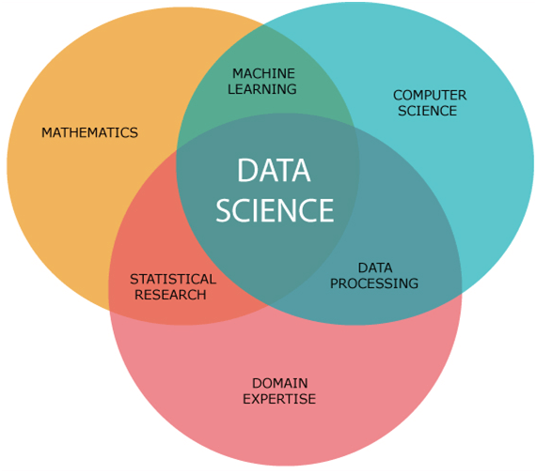
Prerequisites for Data Science
Introduction to data science

Slide 11
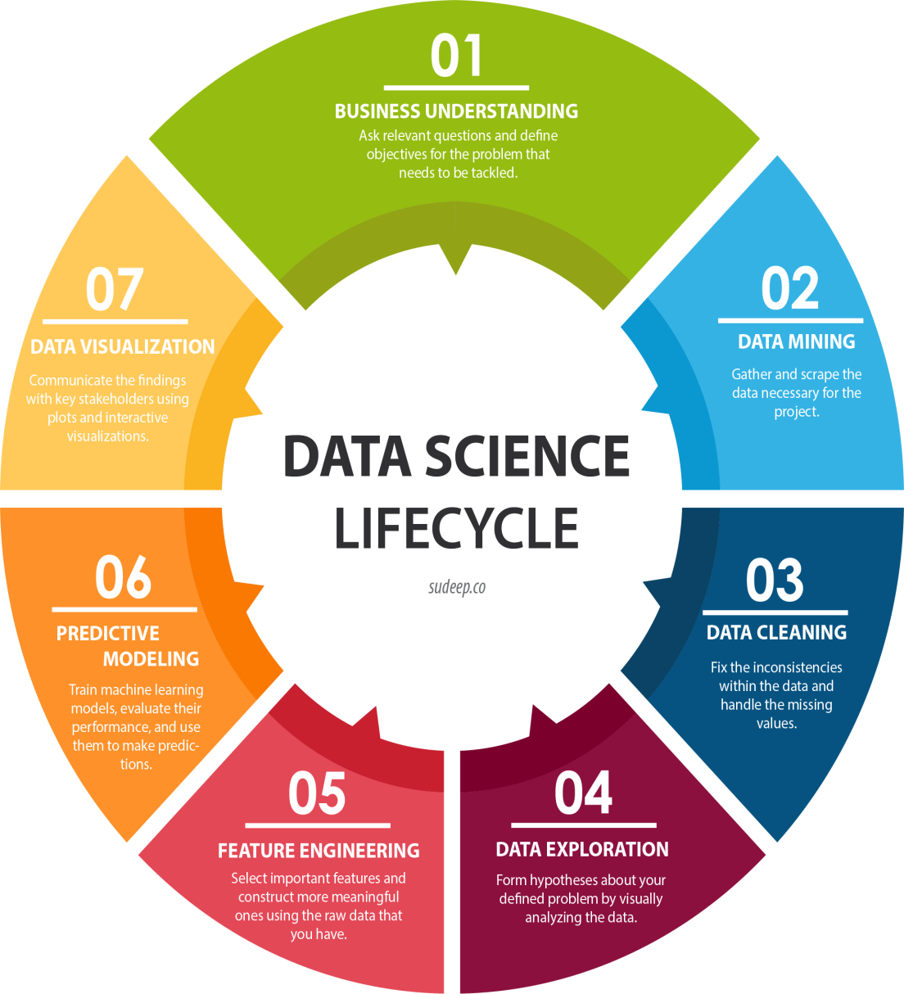
Data Science Lifecycle
Introduction to data science

Slide 12
What Does a Data Scientist Do?
Introduction to data science
A data scientist solves business problems through a series of steps, including:
Before tackling the data collection and analysis, the data scientist determines the problem by asking the right questions and gaining understanding.
The data scientist then determines the correct set of variables and data sets.
The data scientist gathers structured and unstructured data from many disparate sources.
Once the data is collected, the data scientist processes the raw data and converts it into a format suitable for analysis.
After the data has been rendered into a usable form, it’s fed into the analytic system—ML algorithm or a statistical model.

Slide 13
What Does a Data Scientist Do?
Introduction to data science
When the data has been completely rendered, the data scientist interprets the data to find opportunities and solutions.
The data scientists finish the task by preparing the results and insights to share with the appropriate stakeholders and communicating the results.

Slide 14
Why Become a Data Scientist?
Introduction to data science
According to Glassdoor and Forbes, demand for data scientists will increase by 28 percent by 2026, which speaks of the profession’s durability and longevity, so if you want a secure career, data science offers you that chance.
Furthermore, the profession of data scientist came in second place in the Best Jobs in America for the 2021 survey, with an average base salary of USD 127,500.
So, if you’re looking for an exciting career that offers stability and generous compensation, then look no further!

Slide 15
Where Do You Fit in Data Science?
Introduction to data science
Data science offers you the opportunity to focus on and specialize in one aspect of the field.
Data Scientist
Job role:
Determine what the problem is.
what questions need answers.
where to find the data.
Skills needed:
Programming skills (SAS, R, Python).
statistical and mathematical skills.
knowledge of Hadoop, and SQL.
Machine Learning.

Slide 16
Where Do You Fit in Data Science?
Introduction to data science
Data Analyst
Job role:
Data engineers focus on developing, deploying, managing, and optimizing the organization’s data infrastructure and data pipelines.
Skills needed:
NoSQL databases (e.g., MongoDB, Cassandra DB)
programming languages such as Java and Scala
frameworks (Apache Hadoop).

Slide 17
Where Do You Fit in Data Science?
Introduction to data science
Data Engineer
Job role:
Analysts bridge the gap between the data scientists and the business analysts
organizing and analyzing data to answer the questions the organization poses
Skills needed:
Statistical and mathematical skills
programming skills (SAS, R, Python)
experience in data wrangling and data visualization.

Slide 18
Data Science Tools
Introduction to data science
The data science profession is challenging, but fortunately, there are plenty of tools available to help the data scientist succeed at their job.
Data Analysis: SAS, Jupyter, R Studio, MATLAB, Excel, RapidMiner
Data Warehousing: Informatica/ Talend, AWS Redshift
Data Visualization: Jupyter, Tableau, Cognos, RAW
Machine Learning: Spark MLib, Mahout, Azure ML studio

Slide 19
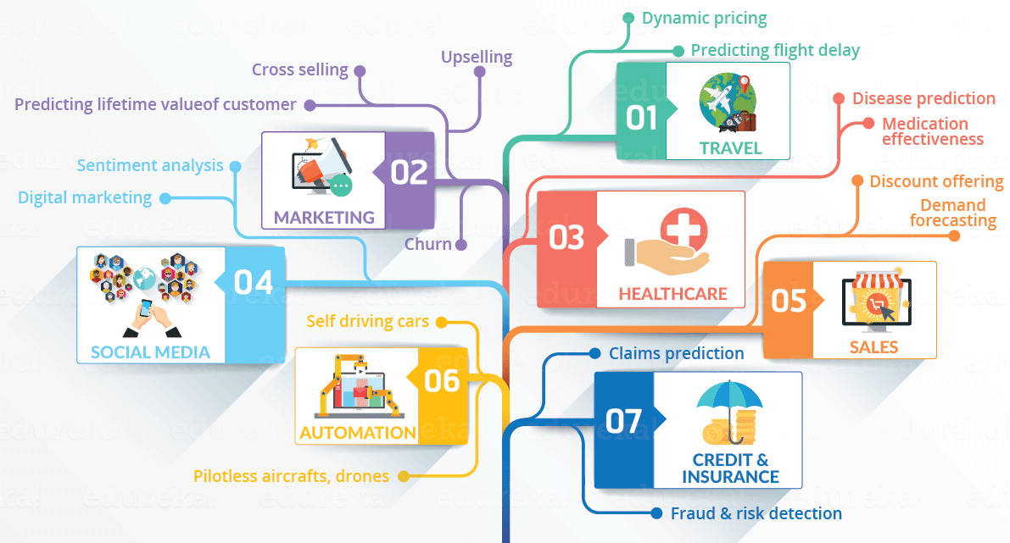
Data Science Area
Introduction to data science

Slide 20
Top Data Science Applications
Introduction to data science
Fraud and Risk Detection
Healthcare
Image Recognition and Speech Recognition
Airline Route Planning
Gaming
Banking
E-commerce
Manufacturing
Transport
Education

Slide 21
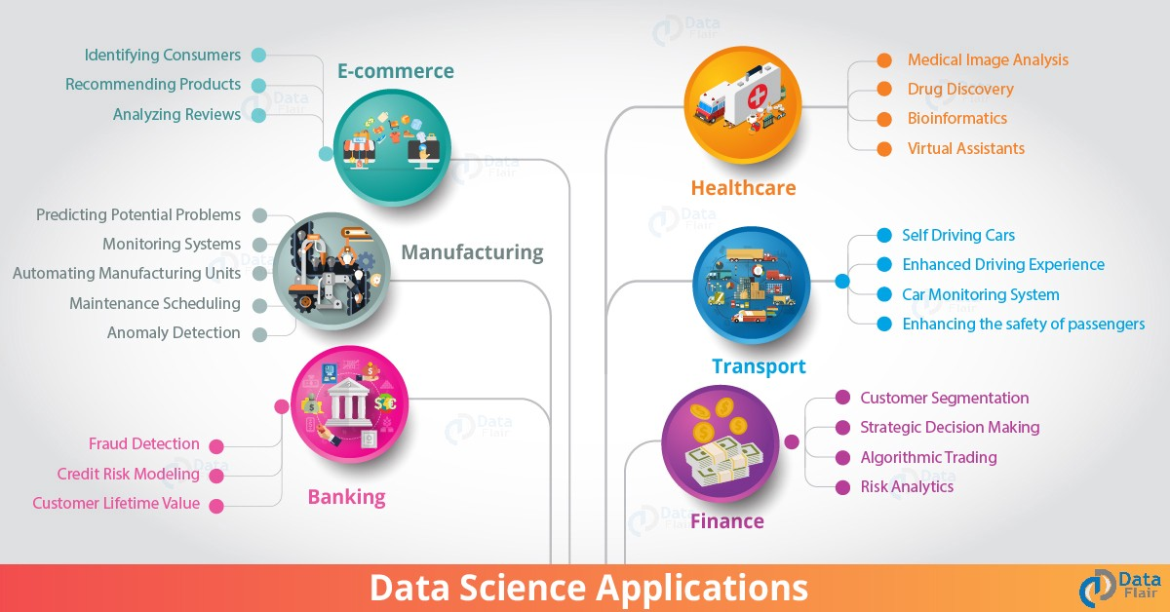
Top Data Science Applications
Introduction to data science

Slide 22
Top Data Science Applications
Introduction to data science
Fraud and Risk Detection
To analyze risk probabilities, they learned to separate the data by customer profiling, past expenditures, and other necessary variables.
It also helps to push their banking products based on customers’ purchasing power.
Making the customer experiences better for the users as through extensive analysis of client experience and modification of preferences, financial institutions can create a personalized relationship with their customers.

Slide 23
Top Data Science Applications
Introduction to data science
Healthcare
2.1. Image Analysis and Diagnosis
Traditionally medical images were studied by doctors themselves, looking for clues to detect an abnormality, if any, in the patient's reports.
Eventually, MRIs, X-rays, and CT scan created an influence on analyzing medical images.
With further development in computing technologies and the surge in data, machines and image recognition tools have been created to automatically detect flaws in the image.

Slide 24
Top Data Science Applications
Introduction to data science
Healthcare
2.2. Genetics and Genomics Research
Genetics and genomics research has taken a new turn and is inclined towards an advanced level of treatment with data science integration for better data analysis.
Data science helps bioinformaticians and geneticists to analyze the reaction of genes to various medications.
It aims to understand and study the impact of DNA on an individual's health trying to find biological connections between diseases, genes, and drug responses.
Big data technologies like MapReduce are known to reduce the processing time for genome sequencing significantly.

Slide 25
Top Data Science Applications
Introduction to data science
Healthcare
2.3. Drug Discovery and Development
The procedure also involves a massive expenditure in terms of time and money. Data science has a significant impact on drug manufacturing by simplifying and shortening the process significantly.
It offers specific algorithms that provide us with timely insight into the success rate of the newly discovered drug.

Slide 26
Top Data Science Applications
Introduction to data science
Image Recognition and Speech Recognition
Data science algorithms rule the speech and image recognition fields
Ever found yourself and taking assistance from virtual voice assistants like Google Assistant, Alexa, or Siri?
Image recognition can also be all over your social media sites like Facebook, Instagram, and Twitter.

Slide 27
Top Data Science Applications
Introduction to data science
Airline Route Planning
Companies like Southwest Airlines and Alaska Airlines have started to incur data science in their processing of flights to bring in the new change in their working style.
Earlier airline companies suffered a massive loss with rising fuel prices as it became difficult for them to maintain occupancy ratio and operating profits.
With data science, airline companies can think of strategic improvements like predicting flight delays, deciding on the aircraft to purchase, planning routes and layovers, and marketing strategies like a customer loyalty program.

Slide 28
Top Data Science Applications
Introduction to data science
Gaming
They're also machine and data science algorithms that upgrade themselves to a new level as the gamer moves up the higher level in the game.
The algorithm is designed and developed to analyze the previous performance of the gamer and shape up the game accordingly.
Top-notch gaming studios like Zynga, EA Sports have upgraded to a new experience altogether with the help of such algorithms.

Slide 29
Top Data Science Applications
Introduction to data science
Banking
Data science has enabled banks across the globe to be more secure and manage their resources efficiently.
It also enables them to make smarter and more strategic decisions and be saved from fraud.
It also helps manage customer data, risk analysis and modeling, predictive analysis, and much more.
Data science allows bankers to assess the customer lifetime value allowing them to monitor and thus derive several predictions and analyze investment patterns of customers for their business.

Slide 30
Top Data Science Applications
Introduction to data science
E-commerce
Data science algorithms and machine learning concepts like NLP and recommendation systems are hugely benefitting the e-commerce market.
The e-commerce platforms can study customer purchases and feedback using such techniques to get powerful insights into their business development.
They make use of NLP to analyze texts and online surveys. It is used in collaborative and content-based filtering to analyze the data and provide better services to its customers.

Slide 31
Top Data Science Applications
Introduction to data science
Manufacturing
Data scientists are the new factory labor in the manufacturing industry and thus acquired a crucial position in manufacturing and retail.
It has shrunk away redundant jobs by introducing powerful machinery using machine learning techniques such as reinforcement learning.
Optimize energy costs and productive hours.
Improving decisions and improving the quality of the products based on customer reviews.
Build an autonomous system using historical and real-time data to boost up the manufacturing line.

Slide 32
Top Data Science Applications
Introduction to data science
Transport
The most significant advancement or the evolution that data science has given us in transportation is introducing self-driving cars.
Data science has created a stronghold in transport through extensive analysis of fuel consumption patterns, driver behavior, and vehicle monitoring.
It is making its name by providing safer driving environments for drivers, optimizing vehicle performance, adding autonomy to the driver, and much more.
Popular cab services like Uber use data science to use various variables such as customer profiles, location, economic indicators, and logistics vendors to optimize price and delivery routes and proper allocation of resources.

Slide 33
Top Data Science Applications
Introduction to data science
Education
Data science plays a vital role in nurturing a person's academic, non-academic, and social-emotional skills.
It provides tools for measuring instructor performance and monitoring student requirements.
It plays a diverse role in education, and universities are using them to innovate the curriculum.

Slide 34
Introduction to data science
DATA SCIENCE APPLICATIONS AND EXAMPLES
Identifying and predicting disease
Personalized healthcare recommendations
Optimizing shipping routes in real-time
Getting the most value out of soccer rosters
Finding the next slew of world-class athletes
Stamping out tax fraud
Automating digital ad placement
Algorithms that help you find love
Predicting incarceration rates

Slide 35
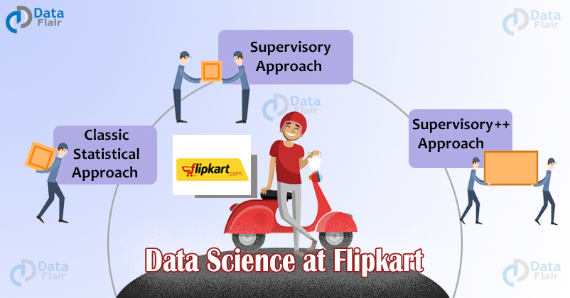
Introduction to data science
How Data Science became the Trump Card for Flipkart?
Flipkart is India’s largest e-commerce marketplace. It has a registered customer base of over 100 million. It was started 12 years ago and it offers over 80 million products across 80+ categories.
The company has a very flat structure within the Data Science team, which enables it to focus on excellence and create a deep sense of ownership. Also being a young team they are able to democratize the process of problem selection.

Slide 36
Introduction to data science
Recommendation System
Flipkart is nothing without Data Science, the recommendation system helps in providing the highest conversion rates. It is also a significant contributor to the company’s units and revenue.
The Flipkart has a set of Filters like Categories, Price, Brand, Customer ratings, Offers, Discount, Color, and Availability. The Problems that Flipkart faces are:
Product discovery along with personalization and intent modeling
Demand shaping and planning
Heterogeneous networks for consumer, product & seller interactions
Customer insights
Catalog enhancement and product insights
Customer emotion detection and right response matching

Slide 37
Introduction to data science
Data Science Vs Data Analytics
Data science shouldn’t be confused with data analytics.
Both fields are ways of understanding big data, and both often involve analyzing massive databases using R and Python.
These points of overlap mean the fields are often treated as one field, but they differ in important ways.
For one, they have different relationships with time.
Data analysts synthesize big data to answer concrete questions grounded in the past, e.g., “How has our subscriber base grown from 2016 to 2021?”
In other words, they mine big data for insights into what’s already happened.
Meanwhile, data scientists build on big data, creating models that can predict or analyze whatever comes next.

Slide 38
Introduction to data science
Conclusion
To conclude, data science has made its mark on every industry like education, banking, finance, manufacturing, and more to make their products and services better for customers.
Due to such diverse data science applications, industries need to stay updated and move forward with the technology in the competitive world.

Slide 39
Introduction to data science
Linking data science with big data and AI
Data science, big data, and artificial intelligence (AI) are interrelated fields that often converge to create powerful solutions for real-world problems.
Data Science
Data science involves using statistical and computational methods to extract insights and knowledge from data. It encompasses data collection, cleaning, analysis, visualization, and interpretation.
Big Data
Big data refers to datasets that are too large or complex for traditional data-processing software. Big data is characterized by its volume, variety, velocity, and veracity.
Artificial Intelligence
AI involves creating systems that can perform tasks typically requiring human intelligence. This includes machine learning (ML), natural language processing (NLP), computer vision, and more.

Slide 40
Introduction to data science
Integration of Data Science, Big Data, and AI
Healthcare
Big Data: Hospitals generate massive amounts of data from patient records, medical imaging, and sensor data.
Data Science: Data scientists analyze this data to identify patterns and correlations that can lead to better diagnosis and treatment plans.
AI: AI algorithms, such as ML models, can predict disease outbreaks, personalize treatment plans, and even assist in early diagnosis through image recognition (e.g., detecting tumors in MRI scans).
Finance
Big Data: Financial institutions gather data from transactions, market feeds, customer interactions, and social media.
Data Science: Analyzing this data helps in understanding market trends, customer behavior, and risk management.
AI: AI-driven trading algorithms can make real-time trading decisions. AI can also enhance fraud detection by identifying unusual patterns and flagging potentially fraudulent activities.

Slide 41
Introduction to data science
Integration of Data Science, Big Data, and AI
Transportation
Big Data: Transportation systems generate data from GPS devices, traffic sensors, and user interactions.
Data Science: Data analysis helps in understanding traffic patterns, optimizing routes, and predicting maintenance needs.
AI: Autonomous vehicles use AI to process data in real-time for navigation and safety. AI also powers traffic management systems to reduce congestion and improve safety.
Marketing
Big Data: Marketers collect data from web analytics, social media, email campaigns, and customer interactions.
Data Science: Analyzing this data helps in segmenting customers, understanding campaign performance, and optimizing marketing strategies.
AI: AI can create personalized marketing messages, optimize ad placements, and predict customer behavior to improve engagement and conversion rates.

Slide 42
Introduction to data science
Integration of Data Science, Big Data, and AI
Example: Smart Cities
Smart cities integrate big data, data science, and AI to improve urban living.
Big Data: Sensors and IoT devices across the city collect data on traffic, air quality, energy usage, and public safety.
Data Science: This data is analyzed to identify trends and inefficiencies.
AI: AI systems optimize traffic flow, manage energy distribution, and enhance public safety through predictive analytics.
Conclusion
The integration of data science, big data, and AI creates powerful tools and applications that transform industries and improve daily life. By harnessing vast amounts of data and applying advanced analytics and intelligent algorithms, organizations can make informed decisions, automate processes, and innovate solutions to complex problems.

Slide 43
Introduction to data science
Data science workflow and process
Data science is an interdisciplinary field that uses scientific methods, processes, algorithms, and systems to extract knowledge and insights from structured and unstructured data. The data science workflow generally follows a systematic process that includes several stages:
Problem Definition
Data Collection
Data Cleaning
Exploratory Data Analysis (EDA)
Feature Engineering
Model Selection
Model Training
Model Evaluation
Model Deployment
Monitoring and Maintenance

Slide 44
Introduction to data science
A real-life example: predicting house prices
1. Problem Definition
Example: A real estate company wants to develop a model to predict house prices based on various factors like location, size, number of bedrooms, etc.
Objective: Predict the sale price of a house.
2. Data Collection
Example: Collect data from multiple sources such as public records, real estate listings, and demographic data.
Sources:
Public property records
Online real estate platforms (e.g., Zillow, Realtor)
Census data
3. Data Cleaning
Example: Cleaning the dataset to handle missing values, remove duplicates, and correct inaccuracies.
Steps:
Handle missing values: Replace missing values with mean/median or use algorithms to impute.
Remove duplicates: Ensure each house is represented once.
Correct inaccuracies: Ensure data like the number of bedrooms or square footage is realistic.

Slide 45
Introduction to data science
A real-life example: predicting house prices
4. Exploratory Data Analysis (EDA)
Example: Analyze the data to understand distributions, correlations, and potential patterns.
Steps:
Visualize data distributions using histograms and box plots.
Identify correlations using heatmaps.
Detect outliers that might skew the analysis.
5. Feature Engineering
Example: Create new features that might help the model better predict house prices.
Steps:
Create features like price per square foot.
Encode categorical variables like neighborhood using one-hot encoding.
Scale numerical features to standardize the data range.
6. Model Selection
Example: Choose the appropriate model for predicting house prices.
Options:
Linear Regression: For simple linear relationships.
Decision Trees: For capturing non-linear relationships.
Random Forest: For better accuracy by combining multiple decision trees.

Slide 46
Introduction to data science
A real-life example: predicting house prices
7. Model Training
Example: Train the selected model using the cleaned and prepared dataset.
Steps:
Split data into training and testing sets (e.g., 80% train, 20% test).
Train the model on the training set.
Tune hyperparameters for optimal performance.
8. Model Evaluation
Example: Evaluate the model's performance using the testing dataset.
Metrics:
Mean Absolute Error (MAE)
Mean Squared Error (MSE)
R-squared (R²)
9. Model Deployment
Example: Deploy the trained model to a production environment where it can make real-time predictions.
Steps:
Integrate the model into a web application or API.
Ensure the system can handle new data and provide predictions efficiently.

Slide 47
Introduction to data science
A real-life example: predicting house prices
10. Monitoring and Maintenance
Example: Monitor the model's performance over time and update it as necessary.
Steps:
Track performance metrics to detect any degradation in accuracy.
Regularly update the model with new data to improve accuracy.
Ensure the model adapts to any changes in the data patterns or market conditions.
Real-life Example: Zillow's Zestimate
Zillow, a real estate marketplace, uses a similar data science workflow to develop its Zestimate algorithm, which provides estimated home values. Here's how Zillow might use the workflow:
Problem Definition: Predict home values for millions of properties.
Data Collection: Gather data from property records, user-submitted data, and market trends.
Data Cleaning: Ensure the data is accurate and consistent.
EDA: Analyze trends and patterns in housing data.
Feature Engineering: Develop features like location score, property condition, etc.
Model Selection: Use advanced algorithms like gradient boosting.
Model Training: Train on a massive dataset with millions of entries.
Model Evaluation: Continuously evaluate the model against actual sale prices.
Model Deployment: Deploy the model to provide real-time Zestimates on their website.
Monitoring and Maintenance: Regularly update the model with new data and monitor its performance.

Slide 48
Introduction to data science
Role of python in data science
1. Data Manipulation and Cleaning
Python provides powerful libraries like Pandas and NumPy for data manipulation and cleaning. These libraries help in handling missing values, merging datasets, and performing various data transformations.
Example: A healthcare company might use Python to clean and organize patient data from multiple sources. By using Pandas, they can merge patient records, handle missing values, and prepare the data for further analysis.
2. Data Visualization
Python's visualization libraries, such as Matplotlib, Seaborn, and Plotly, are used to create a wide range of static, animated, and interactive visualizations.
Example: A marketing team can use Python to visualize customer demographics and purchase patterns. Using Seaborn, they can create heatmaps, bar charts, and scatter plots to identify trends and inform marketing strategies.
3. Statistical Analysis and Hypothesis Testing
Python libraries like SciPy and Statsmodels offer tools for performing statistical tests, regression analysis, and other statistical operations.
Example: In the field of social sciences, researchers can use Python to perform hypothesis testing on survey data to determine if there are significant differences between groups or if observed patterns are statistically significant.

Slide 49
Introduction to data science
Role of python in data science
4. Machine Learning
Python is widely used in machine learning, thanks to libraries such as Scikit-learn, TensorFlow, and Keras. These libraries provide tools for building, training, and deploying machine learning models.
Example: An e-commerce platform can use machine learning models built in Python to recommend products to customers based on their browsing and purchase history. Scikit-learn can be used to develop recommendation systems and predict customer behavior.
5. Natural Language Processing (NLP)
Libraries like NLTK, SpaCy, and Transformers allow for the processing and analysis of textual data. These tools are used for tasks like sentiment analysis, language translation, and text summarization.
Example: A news agency might use NLP techniques in Python to automatically summarize articles, translate content into multiple languages, and analyze reader sentiment from social media comments.
6. Big Data and Distributed Computing
Python integrates with big data tools such as Apache Spark and Dask to handle large-scale data processing and analysis.
Example: A financial institution might use Spark with Python to process and analyze large volumes of transaction data in real-time to detect fraudulent activities and ensure compliance with regulatory standards.

Slide 50
Introduction to data science
Tools for data science
1. Programming Languages
Python: Widely used for its simplicity and extensive libraries.
Example: A retail company uses Python to analyze customer purchase data, identifying buying patterns and personalizing marketing strategies.
2. Data Visualization Tools
Tableau: Helps create interactive and shareable dashboards.
Example: A financial analyst uses Tableau to visualize stock market trends, aiding investors in making informed decisions.
Power BI: Integrates with Microsoft products for robust business analytics.
Example: A sales team uses Power BI to track sales performance across different regions, identifying areas needing improvement.
3. Database Management Systems
SQL: Essential for querying and managing data in relational databases.
Example: An e-commerce website uses SQL to manage user information, transaction records, and inventory levels.
NoSQL (e.g., MongoDB): Handles unstructured data and scalability.
Example: A social media platform uses MongoDB to store and retrieve user posts, comments, and interactions.

Slide 51
Introduction to data science
Tools for data science
4. Big Data Tools
Apache Hadoop: Processes large data sets across clusters of computers.
Example: An online streaming service uses Hadoop to analyze user viewing habits, recommending personalized content.
Apache Spark: Provides fast data processing and analytics.
Example: A logistics company uses Spark to optimize delivery routes and improve supply chain efficiency.
5. Machine Learning and AI Libraries
Scikit-learn: Simple and efficient tools for data mining and data analysis.
Example: A credit card company uses Scikit-learn to build models predicting fraudulent transactions.
TensorFlow: Open-source platform for machine learning.
Example: A tech company uses TensorFlow to develop image recognition systems for identifying objects in photos.
6. Data Cleaning and Preprocessing Tools
Pandas: Offers data structures and operations for manipulating numerical tables and time series.
Example: A marketing firm uses Pandas to clean and analyze survey data, extracting actionable insights.
OpenRefine: Helps clean messy data and transform it from one format to another.
Example: A researcher uses OpenRefine to clean large datasets from multiple sources, ensuring consistency and accuracy.

Slide 52
Introduction to data science
Tools for data science
7. Cloud Platforms
AWS (Amazon Web Services): Provides scalable computing power and storage.
Example: A startup uses AWS to store large volumes of data and perform complex analyses without investing in physical infrastructure.
Google Cloud Platform (GCP): Offers various data analytics and machine learning tools.
Example: A healthcare provider uses GCP to securely store patient data and apply machine learning to predict patient outcomes.
8. Version Control Systems
Git: Tracks changes in code and collaborates on projects.
Example: A data science team uses Git to manage versions of their analysis scripts and models, ensuring collaboration and reproducibility.
9. Integrated Development Environments (IDEs)
Jupyter Notebook: Supports interactive data science and scientific computing.
Example: A data scientist uses Jupyter Notebook to document and share their analysis process, combining code, visualizations, and narrative text.
Google Colab: short for Google Colaboratory, is a cloud-based platform that allows users to write and execute Python code in a Jupyter notebook environment. It's particularly popular in the data science community due to its accessibility and integration with Google Drive.

Slide 53


