Slide 1
Introduction to Programming with Python

Slide 2
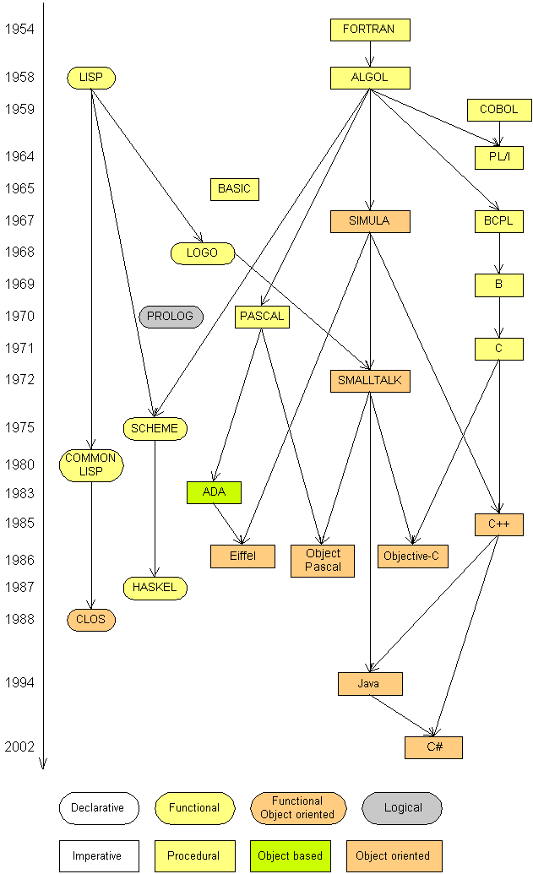
Languages
Some influential ones:
  FORTRAN
    science / engineering
  COBOL
    business data
  LISP
    logic and AI
  BASIC
    a simple language

Slide 3
4 Major Versions of Python
“Python” or “CPython” is written in C/C++
- Version 2.7 came out in mid-2010
- Version 3.1.2 came out in early 2010
“Jython” is written in Java for the JVM
“IronPython” is written in C# for the .Net environment

Slide 4
Development Environments what IDE to use? http://stackoverflow.com/questions/81584
1.PyDev with Eclipse
2. Komodo
3. Emacs
4. Vim
5. TextMate
6. Gedit
7. Idle
8. PIDA (Linux)(VIM Based)
9. NotePad++ (Windows)
10.BlueFish (Linux)

Slide 5

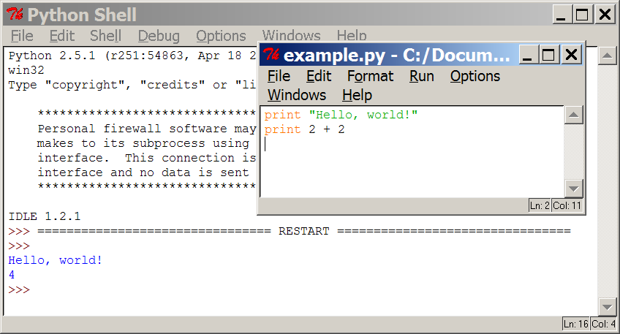
Programming basics
code or source code: The sequence of instructions in a program.
syntax: The set of legal structures and commands that can be used in a particular programming language.
output: The messages printed to the user by a program.
console: The text box onto which output is printed.
  Some source code editors pop up the console as an external window, and others contain their own console window.

Slide 6



Compiling and interpreting
Many languages require you to compile (translate) your program into a form that the machine understands.
Python is instead directly interpreted into machine instructions.
compile
execute
source code
Hello.java
byte code
Hello.class
output
interpret
source code
Hello.py
output

Slide 7
Operators
Anything after a # symbol is treated as a comment
Multi line comment
‘’’multiline
comment’’’ # triple quotes
+ addition
- subtraction
/ division
** exponentiation
% modulus (remainder after division)‏
Python has incorporated operators like +=, but ++ (or --) do not work in Python
Number1 +=number2 ie a+=7

Slide 8
Arithmetic Operators
Operator | Description | Example
= | Assignment | num = 7
+ | Addition | num = 2 + 2
- | Subtraction | num = 6 - 4
* | Multiplication | num = 5 * 4
/ // | Division Division returns whole no. | num = 25 / 5 Num = 7// 2= 3
% | Modulo | num = 8 % 3 =2
** | Exponent | num = 9 ** 2 =81

Slide 9
Order Of Operation
First level of precedence: top to bottom
Second level of precedence
  If there are multiple operations that are on the same level then precedence goes from left to right.
() | Brackets (inner before outer)
** | Exponent
*, /, % | Multiplication, division, modulo
+, - | Addition, subtraction

Slide 10

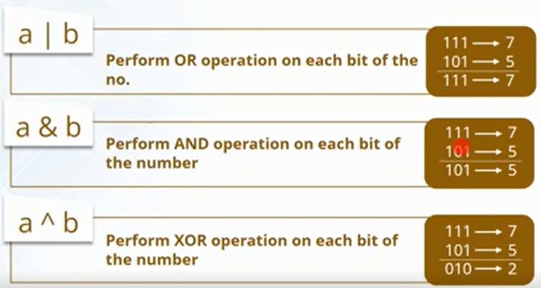
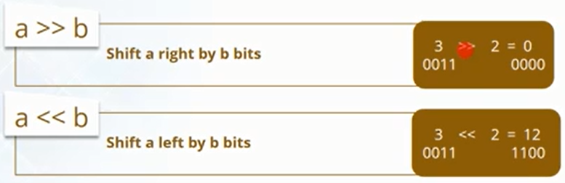
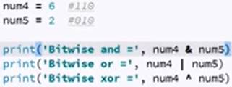
Bit wise operator

Slide 11
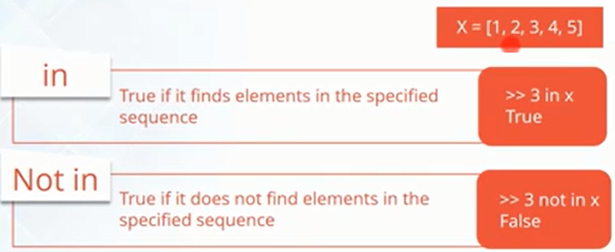
Membership operator

Slide 12
Order Of Operation And Style
Even for languages where there are clear rules of precedence (e.g., Java, Python) it is regarded as good style to explicitly bracket your operations.
  x = (a * b) + (c / d)
It not only makes it easier to read complex formulas but also a good habit for languages where precedence is not always clear (e.g., C++, C).

Slide 13
Expressions
Example operators.py
print (2*2)
print (2**3)
print (10%3)
print (1.0/2.0)
print (1/2)
Output:
4
8
1
0.5
0
Note the difference between floating point division and integer division in the last two lines

Slide 14
Type conversion
int(), float(), str(), and bool() convert to integer, floating point, string, and boolean (True or False) types, respectively
Example typeconv.py:
print 1.0/2.0
print 1/2
print float(1)/float(2)
print int(3.1415926)
print str(3.1415926)
print bool(1)
print bool(0)‏
Output:
0.5
0
0.5
3
3.1415926
True
False

Slide 15
Operators acting on strings
>>> "Ni!"*3 Output: 'Ni!Ni!Ni!'
>>> "hello " + "world!“ Output: 'hello world!‘
and, or, not
>>> 2+2==5 or 1+1==2 Output: True
>>> 2+2==5 and 1+1==2 Output: False
>>> not(2+2==5) and 1+1==2 Output: True
Note: We do NOT use &&, ||, !, as in C!

Slide 16
Expressions
expression: A data value or set of operations to compute a value.
  Examples: 1 + 4 * 3
  42
Arithmetic operators we will use:
  + - * / addition, subtraction/negation, multiplication, division
  % modulus, a.k.a. remainder
  ** exponentiation
precedence: Order in which operations are computed.
  * / % ** have a higher precedence than + -
  1 + 3 * 4 is 13
  Parentheses can be used to force a certain order of evaluation.
  (1 + 3) * 4 is 16

Slide 17
Format
print('The area of the triangle is %0.2f' %area)
This will the value of area upto 2 places of decimam
print('The sum of {0} and {1} is {2}'.format(num1, num2, sum))
Enter first number: 21
Enter second number: 13
The sum of 21 and 13 is 34.0

Slide 18
Booleans: True and False
>>> type (True)
<type 'bool'>
>>> type (true)
Traceback (most recent call last):
File "<stdin>", line 1, in <module>
NameError: name 'true' is not defined
>>> 2+2==5
False
Note: True and False are of type bool. The capitalization is required for the booleans!
A boolean expression can be evaluated as True or False. An expression evaluates to False if it is...
the constant False, the object None, an empty sequence or collection, or a numerical item of value 0
Everything else is considered True

Slide 19
Expressions
expression: A data value or set of operations to compute a value.
  Examples: 1 + 4 * 3
  42
Arithmetic operators we will use:
  + - * / addition, subtraction/negation, multiplication, division
  % modulus, a.k.a. remainder
  ** exponentiation
precedence: Order in which operations are computed.
  * / % ** have a higher precedence than + -
  1 + 3 * 4 is 13
  Parentheses can be used to force a certain order of evaluation.
  (1 + 3) * 4 is 16

Slide 20
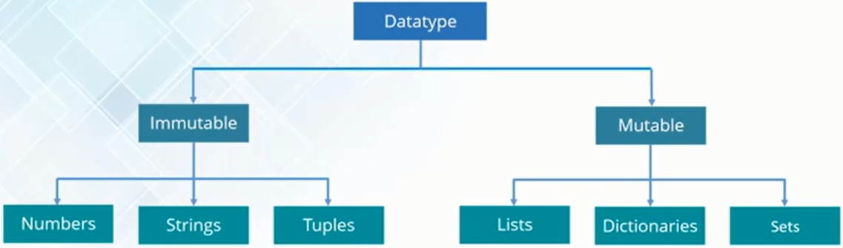
Data types
Python is a loosely typed language. Therefore, no need to define the data type of variables
No need to declare variable before using them

Slide 21
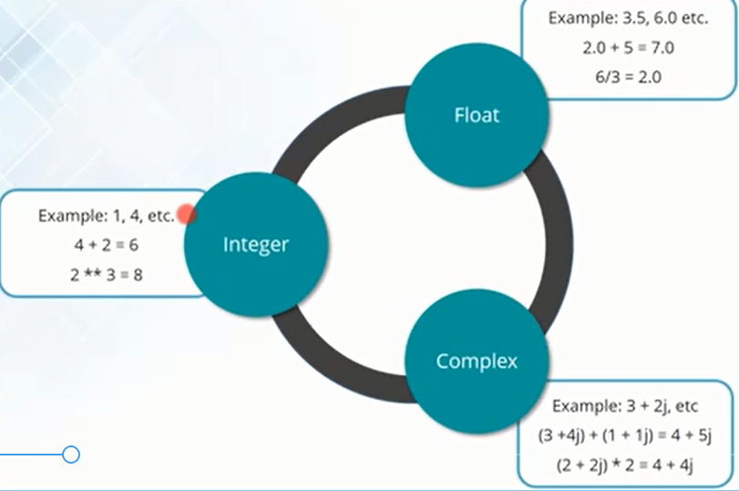
Data types: Number

Slide 22
Array
One of the most fundamental data structures in any language is the array.
A matrix is a two-dimensional data structure. In real-world tasks you often have to store rectangular data table. The table below shows the marks of three students in different subjects.
Python doesn't have a native array data structure, but it has the list which is much more general and can be used as a multidimensional array quite easily.
List basics
A list in Python is just an ordered collection of items which can be of any type.
By comparison an array is an ordered collection of items of a single type - so in principle a list is more flexible than an array but it is this flexibility that makes things slightly harder when you want to work with a regular structure.
A list is also a dynamic mutable type and this means you can add and delete elements from the list at any time.

Slide 23
Array
For example:
A = [['Roy',80,75,85,90,95],['John',75,80,75,85,100],['Dave',80,80,80,90,95]]
In the above example A represents a 3*6 matrix where 3 is number of rows and 6 is number of columns.
# a is 2-D matrix with integers
a = [['Roy',80,75,85,90,95], ['John',75,80,75,85,100], ['Dave',80,80,80,90,95]]
#b is a nested list but not a matrix
b= [['Roy',80,75,85,90,95], ['John',75,80,75], ['Dave',80,80,80,90,95]]
In the above examples a is a matrix as well as nested list where as b is a nested list but not a matrix.(elements are not equal

Slide 24
Array(Negative index)
a = [['Roy',80,75,85,90,95], ['John',75,80,75,85,100], ['Dave',80,80,80,90,95]]
print(a[-1]) Output: ['Dave', 80, 80, 80, 90, 95]
print(a[-1][-2]) Output: 90
print(a[-2][-3]) Output: 75

Slide 25
Array(index) value modification
a = [['Roy',80,75,85,90,95], ['John',75,80,75,85,100], ['Dave',80,80,80,90,95]]
b=a[0]
print(b) Output: b=['Roy',80,75,85,90,95]
b[1]=75
print(b) Output: b=['Roy',75,75,85,90,95]
a[2]=['Sam',82,79,88,97,99]
print(a) [['Roy',75,75,85,90,95], ['John',75,80,75,85,100], ['Sam',82,79,88,97,99]]
a[0][4]=95
print(a) [['Roy',75,75,85,95,95], ['John',75,80,75,85,100], ['Sam',82,79,88,97,99]]

Slide 26
Array(Negative index)
a = [['Roy',80,75,85,90,95], ['John',75,80,75,85,100], ['Dave',80,80,80,90,95]]
print(a[-1]) Output: ['Dave', 80, 80, 80, 90, 95]
print(a[-1][-2]) Output: 90
print(a[-2][-3]) Output: 75

Slide 27
Expressions
expression: A data value or set of operations to compute a value.
  Examples: 1 + 4 * 3
  42
Arithmetic operators we will use:
  + - * / addition, subtraction/negation, multiplication, division
  % modulus, a.k.a. remainder
  ** exponentiation
precedence: Order in which operations are computed.
  * / % ** have a higher precedence than + -
  1 + 3 * 4 is 13
  Parentheses can be used to force a certain order of evaluation.
  (1 + 3) * 4 is 16

Slide 28
Integer division
When we divide integers with / , the quotient is also an integer.
3 52
4 ) 14 27 ) 1425
12 135
2 75
54
21
  More examples:
    35 / 5 is 7
    84 / 10 is 8
    156 / 100 is 1
The % operator computes the remainder from a division of integers.
3 43
4 ) 14 5 ) 218
12 20
2 18
15
3
Notes:
Dividing by 0 crashes the program.

Slide 29
Real numbers
Python can also manipulate real numbers.
  Examples: 6.022 -15.9997 42.0 2.143e17
The operators + - * / % ** ( ) all work for real numbers.
  The / produces an exact answer: 15.0 / 2.0 is 7.5
  The same rules of precedence also apply to real numbers:
  Evaluate ( ) before * / % before + -
When integers and reals are mixed, the result is a real number.
  Example: 1 / 2.0 is 0.5
  The conversion occurs on a per-operator basis.
  7 / 3 * 1.2 + 3 / 2
  2 * 1.2 + 3 / 2
  2.4 + 3 / 2
  2.4 + 1
  3.4

Slide 30
Math commands
Python has useful commands for performing calculations.
To use many of these commands, you must write the following at the top of your Python program:
  from math import *
Command name | Description
abs(value) | absolute value
ceil(value) | rounds up
cos(value) | cosine, in radians
floor(value) | rounds down
log(value) | logarithm, base e
log10(value) | logarithm, base 10
max(value1, value2) | larger of two values
min(value1, value2) | smaller of two values
round(value) | nearest whole number
sin(value) | sine, in radians
sqrt(value) | square root
Constant | Description
e | 2.7182818...
pi | 3.1415926...

Slide 31
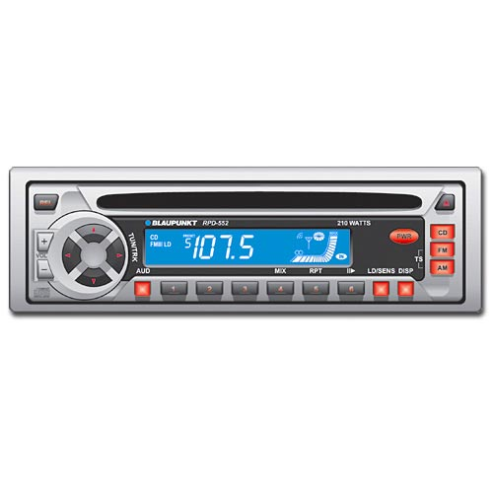
Variables
variable: A named piece of memory that can store a value.
  Usage:
    Compute an expression's result,
    store that result into a variable,
    and use that variable later in the program.
assignment statement: Stores a value into a variable.
  Syntax:
  name = value
  Examples: x = 5
  gpa = 3.14
  x 5 gpa 3.14
  A variable that has been given a value can be used in expressions.
  x + 4 is 9
Exercise: Evaluate the quadratic equation for a given a, b, and c.

Slide 32
Variables
No need to declare
Need to assign (initialize)
    use of uninitialized variable raises exception
Not typed
    if friendly: greeting = "hello world"
    else: greeting = 12**2
    print greeting
Everything is a "variable":
    Even functions, classes, modules

Slide 33
Reference Semantics
Assignment manipulates references
    x = y does not make a copy of y
    x = y makes x reference the object y references
Very useful; but beware!
Example:
    >>> a = [1, 2, 3]
    >>> b = a
    >>> a.append(4)
    >>> print b
    [1, 2, 3, 4]

Slide 34
Changing a Shared List
a
1
2
3
a = [1, 2, 3]
a
1
2
3
b = a
b
a
1
2
3
a.append(4)
4

Slide 35
Changing an Integer
a
1
a = 1
a
1
b = a
b
new int object created
by add operator (1+1)
a
2
a = a+1
old reference deleted
by assignment (a=...)
b

Slide 36
print
print : Produces text output on the console.
Syntax:
  print ("Message“)
  print (Expression)
  Prints the given text message or expression value on the console, and moves the cursor down to the next line.
  print (Item1, Item2, ..., ItemN)
  Prints several messages and/or expressions on the same line.
Examples:
  print ("Hello, world!“)
  age = 45
  print ("You have", 65 - age, "years until retirement“)
  Output:
  Hello, world!
  You have 20 years until retirement

Slide 37
input
The computer program getting string information from the user.
Strings cannot be used for calculations (information getting numeric input will provided shortly).
Format:
  <variable name> = input()
  OR
  <variable name> = input("<Prompting message>")
Example:
  Program name: input1.py
  print ("What is your name: ")
  name = input ()
OR
  name = input ("What is your name: ")

Slide 38
input
input : Reads a number from user input.
  You can assign (store) the result of input into a variable.
  Example:
  age = input("How old are you? ")
  print "Your age is", age
  print "You have", 65 - age, "years until retirement"
  Output:
  How old are you? 53
  Your age is 53
  You have 12 years until retirement
Exercise: Write a Python program that prompts the user for his/her amount of money, then reports how many Nintendo Wiis the person can afford, and how much more money he/she will need to afford an additional Wii.

Slide 39
input
input : Reads a number from user input.
  You can assign (store) the result of input into a variable.
  Example:
  age = input("How old are you? ")
  print "Your age is", age
  print "You have", 65 - age, "years until retirement"
  Output:
  How old are you? 53
  Your age is 53
  You have 12 years until retirement
Exercise: Write a Python program that prompts the user for his/her amount of money, then reports how many Nintendo Wiis the person can afford, and how much more money he/she will need to afford an additional Wii.

Slide 40
Repetition (loops) and Selection (if/else)

Slide 41
Control Flow
Things that are False
The boolean value False
The numbers 0 (integer), 0.0 (float) and 0j (complex).
The empty string "".
The empty list [], empty dictionary {} and empty set set().
Things that are True
The boolean value True
All non-zero numbers.
Any string containing at least one character.
A non-empty data structure.

Slide 42
The for loop
for loop: Repeats a set of statements over a group of values.
  Syntax:
  for variableName in groupOfValues:
  statements
    We indent the statements to be repeated with tabs or spaces.
    variableName gives a name to each value, so you can refer to it in the statements.
    groupOfValues can be a range of integers, specified with the range function.
  Example:
  for x in range(1, 6):
  print x, "squared is", x * x
  Output:
  1 squared is 1
  2 squared is 4
  3 squared is 9
  4 squared is 16
  5 squared is 25

Slide 43
The for loop
>>> for value in [3, 1, 4, 1, 5, 9, 2]:
... print "Checking", value
... if value > 8:
... print "Exiting for loop"
... break
... elif value < 3:
... print "Ignoring"
... continue
... print "The square is", value**2
...
Checking 3
The square is 9
Checking 1
Ignoring
Checking 4
The square is 16
Checking 1
Ignoring
Checking 5
The square is 25
Checking 9
Exiting for loop
>>>
Use “break” to stop
the for loop
Use “continue” to stop
processing the current item

Slide 44
The for loop
for loop: Repeats a set of statements over a group of values.
  Syntax:
  for variableName in groupOfValues:
  statements
    We indent the statements to be repeated with tabs or spaces.
    variableName gives a name to each value, so you can refer to it in the statements.
    groupOfValues can be a range of integers, specified with the range function.
  Example:
  for x in range(1, 6):
  print x, "squared is", x * x
  Output:
  1 squared is 1
  2 squared is 4
  3 squared is 9
  4 squared is 16
  5 squared is 25

Slide 45
range
The range function specifies a range of integers:
    range(start, stop) - the integers between start (inclusive)
    and stop (exclusive)
  It can also accept a third value specifying the change between values.
    range(start, stop, step) - the integers between start (inclusive)
    and stop (exclusive) by step
  Example:
  for x in range(5, 0, -1):
  print x
  print "Blastoff!"
  Output:
  5
  4
  3
  2
  1
  Blastoff!
  Exercise: How would we print the "99 Bottles of Beer" song?

Slide 46
Cumulative loops
Some loops incrementally compute a value that is initialized outside the loop. This is sometimes called a cumulative sum.
  sum = 0
  for i in range(1, 11):
  sum = sum + (i * i)
  print "sum of first 10 squares is", sum
  Output:
  sum of first 10 squares is 385
Exercise: Write a Python program that computes the factorial of an integer.

Slide 47

if
if statement: Executes a group of statements only if a certain condition is true. Otherwise, the statements are skipped.
  Syntax:
  if condition:
  statements
Example:
  gpa = 3.4
  if gpa > 2.0:
  print "Your application is accepted.“
  Range Test
if (3 <= Time <= 5):
print “Office Hour"

Slide 48
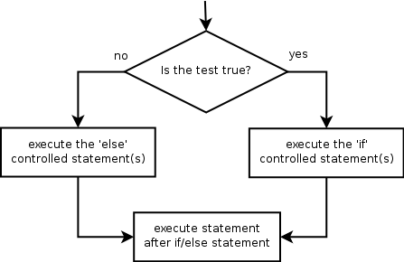

if/else
if/else statement: Executes one block of statements if a certain condition is True, and a second block of statements if it is False.
  Syntax:
  if condition:
  statements
  else:
  statements
Example:
  gpa = 1.4
  if gpa > 2.0:
  print "Welcome to Mars University!"
  else:
  print "Your application is denied."
Multiple conditions can be chained with elif ("else if"):
  if condition:
  statements
  elif condition:
  statements
  else:
  statements

Slide 49
Grouping Indentation
0
Bingo!
---
---
---
3
---
---
---
6
---
---
---
9
---
---
---
12
---
---
---
15
Bingo!
---
---
---
18
---
---
In Python:
for i in range(20):
if i%3 == 0:
print i
if i%5 == 0:
print "Bingo!"
print "---"
In C:
for (i = 0; i < 20; i++)
{
if (i%3 == 0) {
printf("%d\n", i);
if (i%5 == 0) {
printf("Bingo!\n"); }
}
printf("---\n");
}

Slide 50
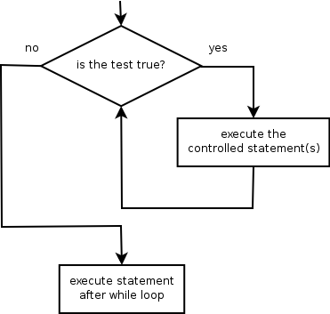
while
while loop: Executes a group of statements as long as a condition is True.
  good for indefinite loops (repeat an unknown number of times)
Syntax:
  while condition:
  statements
Example:
  number = 1
  while number < 200:
  print number,
  number = number * 2
  Output:
  1 2 4 8 16 32 64 128

Slide 51
Logic
Many logical expressions use relational operators:
Logical expressions can be combined with logical operators:
Exercise: Write code to display and count the factors of a number.
Operator | Meaning | Example | Result
== | equals | 1 + 1 == 2 | True
!= | does not equal | 3.2 != 2.5 | True
< | less than | 10 < 5 | False
> | greater than | 10 > 5 | True
<= | less than or equal to | 126 <= 100 | False
>= | greater than or equal to | 5.0 >= 5.0 | True
Operator | Example | Result
and | 9 != 6 and 2 < 3 | True
or | 2 == 3 or -1 < 5 | True
not | not 7 > 0 | False

Slide 52
Boolean Logic
Python expressions can have “and”s and “or”s:
if (ben <= 5 and chen >= 10 or
chen == 500 and ben != 5):
print “Ben and Chen“

Slide 53
Text and File Processing

Slide 54
Strings
string: A sequence of text characters in a program.
  Strings start and end with quotation mark " or apostrophe ' characters.
  Examples:
  "hello"
  "This is a string"
  "This, too, is a string. It can be very long!"
A string may not span across multiple lines or contain a " character.
"This is not
a legal String."
"This is not a "legal" String either."
A string can represent characters by preceding them with a backslash.
  \t tab character
  \n new line character
  \" quotation mark character
  \\ backslash character
  Example: "Hello\tthere\nHow are you?"

Slide 55
Strings
    "hello"+"world" "helloworld" # concatenation
    "hello"*3 "hellohellohello" # repetition
    "hello"[0] "h" # indexing
    "hello"[-1] "o" # (from end)
    "hello"[1:4] "ell" # slicing
    len("hello") 5 # size
    "hello" < "jello" 1 # comparison
    "e" in "hello" 1 # search
    "escapes: \n etc, \033 etc, \if etc"
    'single quotes' """triple quotes""" r"raw strings"

Slide 56
List
In Python programming, a list is created by placing all the items (elements) inside a square bracket [ ], separated by commas.
A Lists in Python language can be compared to arrays in Java but they are different in many other aspects.
1. Create a Python List
>>> myList = ["The", "earth", "revolves", "around", "sun"]
>>> myList Output: ['The', 'earth', 'revolves', 'around', 'sun']
Lists in python are zero indexed. This means, you can access individual elements in a list just as you would do in an array. Here is an example :
>>> myList[0] Output: 'The'
>>> myList[4] Output: 'sun‘
>>> myList[-1] Output: 'sun‘
print ("lmyist[1:5]: ", mylist[1:5])

Slide 57
List
2. Add Elements to a List
One can use the method insert, append and extend to add elements to a List.
The insert method expects an index and the value to be inserted. Here is an example of insert :
>>> myList.insert(0,"Yes")
>>> myList Output: ['Yes', 'The', 'earth', 'revolves', 'around', 'sun']
value ‘yes’ was inserted at the index 0 in the list and all the other elements were shifted accordingly.
The append method can take one or more elements as input and appends them into the list. Here is an example :
>>> myList.append(["a", "true"])
>>> myList Output:['Yes', 'The', 'earth', 'revolves', 'around', 'sun', ['a', 'true']]
two values were appended towards the end of the list
The extend method. Like append, it also expects one or more values as input. But, unlike append, all the elements are added as individual elements. Here is an example :
>>> myList.extend(["statement", "for", "sure"])
>>> myList
['Yes', 'The', 'earth', 'revolves', 'around', 'sun', ['a', 'true'], 'statement', 'for', 'sure']
>>> len(myList) Output: 10

Slide 58
Slice Elements from a List
You can access a part of complete list by using index range.
If it is required to access a sub-list from index 1 to index 3 then it can be done in following way:
>>> myList[1:4] Output: ['The', 'earth', 'revolves']
>>> myList[:4] Output: ['Yes', 'The', 'earth', 'revolves']
>>> myList[4:] ['around', 'sun', ['a', 'true'], 'statement', 'for', 'sure']
>>> myList[:]
['Yes', 'The', 'earth', 'revolves', 'around', 'sun', ['a', 'true'], 'statement', 'for', 'sure']

Slide 59
4. Search the Lists and find Elements
myList :['Yes', 'The', 'earth', 'revolves', 'around', 'sun', ['a', 'true']]
Lists can easily be searched for values using the index method that expects a value that is to be searched. The output is the index at which the value is kept.
Here we try to search the list for value ‘revolves’.
>>> myList.index("revolves") Output: 3
search a sub list :
>>> myList.index(["a", "true"]) Output: 6
If it is desired to just whether an element is present in a list, it can be done in following way :
>>> "sun" in myList Output: True

Slide 60
5. Delete Elements from the List
>>> myList
['Yes', 'The', 'earth', 'revolves', 'around', 'sun', ['a', 'true'], 'statement', 'for', 'sure']
>>> myList.remove("Yes")
>>> myList
['The', 'earth', 'revolves', 'around', 'sun', ['a', 'true'], 'statement', 'for', ‘Sure’]
>>> myList.remove("statement")
>>> myList
['The', 'earth', 'revolves', 'around', 'sun', ['a', 'true'], 'for', 'sure']
Here is how a sub list can be deleted :
>>> myList.remove(["a", "true"])
>>> myList ['The', 'earth', 'revolves', 'around', 'sun', 'for', 'sure']

Slide 61
5. Delete Elements from the List
If it is required to access the last element and then to delete it, this can be done through pop method.
>>> myList.pop() 'sure‘
>>> myList
['The', 'earth', 'revolves', 'around', 'sun', 'for']

Slide 62
6. Python List Operators
Python allows to use mathematical operators like +, * etc to be used with lists.
>>> myList ['The', 'earth', 'revolves', 'around', 'sun', 'for']
>>> myList = myList + ["sure"]
>>> myList ['The', 'earth', 'revolves', 'around', 'sun', 'for', 'sure']
>>> myList += ["."]
>>> myList ['The', 'earth', 'revolves', 'around', 'sun', 'for', 'sure', '.']
>>> myList *= 2
>>> myList
['The', 'earth', 'revolves', 'around', 'sun', 'for', 'sure', '.', 'The', 'earth', 'revolves', 'around', 'sun', 'for', 'sure', '.']

Slide 63
List
A compound data type:
[0]
[2.3, 4.5]
[5, "Hello", "there", 9.8]
[]
Use len() to get the length of a list
>>> names = [“Ben", “Chen", “Yaqin"]
>>> len(names)
3
Flexible arrays, not Lisp-like linked lists
    a = [99, "bottles of beer", ["on", "the", "wall"]]
Same operators as for strings
    a+b, a*3, a[0], a[-1], a[1:], len(a)
Item and slice assignment
    a[0] = 98
    a[1:2] = ["bottles", "of", "beer"]
      -> [98, "bottles", "of", "beer", ["on", "the", "wall"]]
    del a[-1] # -> [98, "bottles", "of", "beer"]

Slide 64
More List operation
mylist1= []
for i in range(10):
i=input("enter values")
mylist1=mylist1 +[i]
print(mylist1)
>>> a = range(5) # [0,1,2,3,4]
>>> a.append(5) # [0,1,2,3,4,5]
>>> a.pop() # [0,1,2,3,4]
5
>>> a.insert(0, 42) # [42,0,1,2,3,4]
>>> a.pop(0) # [0,1,2,3,4]
5.5
>>> a.reverse() # [4,3,2,1,0]
>>> a.sort() # [0,1,2,3,4]

Slide 65
Use [ ] to index items in the list
>>> names[0]
‘Ben'
>>> names[1]
‘Chen'
>>> names[2]
‘Yaqin'
>>> names[3]
Traceback (most recent call last):
File "<stdin>", line 1, in <module>
IndexError: list index out of range
>>> names[-1]
‘Yaqin'
>>> names[-2]
‘Chen'
>>> names[-3]
‘Ben'
[0] is the first item.
[1] is the second item
...
Out of range values
raise an exception
Negative values
go backwards from
the last element.

Slide 66
zipping lists together
>>> names
['ben', 'chen', 'yaqin']
>>> gender = [0, 0, 1]
>>> zip(names, gender)
[('ben', 0), ('chen', 0), ('yaqin', 1)]

Slide 67
Multi Dimension Array
Example 10: Create a two-dimensional array using lists
multd = [[1,2], [3,4], [5,6], [7,8]]
print(multd[0]) Output: [1, 2]
print(multd[3]) Output: [7, 8]
print(multd[2][1]) 6
print(multd[3][0]) 7
all()Return True if all elements of the list are true (or if the list is empty).
any()Return True if any element of the list is true. If the list is empty, return False.
enumerate()Return an enumerate object. It contains the index and value of all the items of list as a tuple.

Slide 68
Functions of list
Methods | Functions
append() | to add element to the end of the list a.append(5)
extend() | to extend all elements of a list to the another list
insert() | to insert an element at the another index
remove() | to remove an element from the list
pop() | to remove elements return element at the given index
clear() | to remove all elements from the list
index() | to return the index of the first matched element
count() | to count of number of elements passed as an argument
sort() | to sort the elements in ascending order by default
reverse() | to reverse order element in a list
copy() | to return a copy of elements in a list

Slide 69
# Count the occurrences of the number 4
print([1, 2, 9, 4, 5, 4, 1].count(4))
# Count the occurrences of the letter "a“
list = ["d", "a", "t", "a", "c", "a", "m", "p"]
list.count("a")

Slide 70
Dictionaries
Python programs or scripts without lists and dictionaries are nearly inconceivable.
Like lists dictionaries can easily be changed, can be shrunk and grown ad libitum at run time. They shrink and grow without the necessity of making copies.
Dictionaries can be contained in lists and vice versa
Lists are ordered sets of objects, whereas dictionaries are unordered sets
main difference is that items in dictionaries are accessed via keys and not via their position
A dictionary is an associative array (also known as hashes). Any key of the dictionary is associated (or mapped) to a value. The values of a dictionary can be any Python data type. So dictionaries are unordered key-value-pairs.

Slide 71
Dictionaries
Dictionaries are lookup tables.
>>> empty = {}
>>> empty Output : {}
They map from a “key” to a “value”.
symbol_to_name = {"H": "hydrogen“, "He": "helium", "Li": "lithium“, "C": "carbon“, "O": "oxygen", "N": "nitrogen“ }
To add one element in a dictionaries
>>> symbol_to_name [“P"] = “phosphorus“
Example:s
ymbol_to_name = {'H': 'hydrogen', 'He': 'helium', 'Li': 'lithium','C': 'carbon', 'O': 'oxygen', 'N': 'nitrogen'}
print(symbol_to_name)
symbol_to_name['P']="Phosphorus"
print(symbol_to_name)
print(symbol_to_name["H"]) output: hydrogen
print(symbol_to_name[0]) output: error
Duplicate keys are not allowed
Duplicate values are just fine

Slide 72
Operators on Dictionaries
Operator Explanation
len(d) returns the number of stored entries, i.e. the number of (key,value) pairs.
del d[k] deletes the key k together with his value
k in d True, if a key k exists in the dictionary d
k not in d True, if a key k doesn't exist in the dictionary d
my_dict = {'name':‘Suraj, 'age': 26}
# update value
my_dict['age'] = 27 #Output: {'age': 27, 'name': ‘Sural'} print(my_dict)
# add item
my_dict['address'] = ‘Delhi'
# Output: {'address': ‘Delhi', 'age': 27, 'name': ‘suraj'}print(my_dict)

Slide 73
Update: Merging Dictionaries
What about concatenating dictionaries, like we did with lists?
There is something similar for dictionaries: the update method
update() merges the keys and values of one dictionary into another, overwriting values of the same key:
>>> w={"house":"Haus","cat":"Katze","red":"rot"}
>>> w1 = {"red":"rouge","blau":"bleu"}
>>> w.update(w1)
>>> print w
{'house': 'Haus', 'blau': 'bleu', 'red': 'rouge', 'cat': 'Katze'}

Slide 74
Keys can be any immutable value numbers, strings, tuples, frozenset, not list, dictionary, set, ...
atomic_number_to_name = {
1: "hydrogen",
6: "carbon",
7: "nitrogen",
8: "oxygen",
}
print(atomic_number_to_name)
nobel_prize_winners = {
(1979, "physics"): ["Glashow", "Salam", "Weinberg"],
(1962, "chemistry"): ["Hodgkin"],
(1984, "biology"): ["McClintock"],
}
print(nobel_prize_winners)
A set is an unordered collection
with no duplicate elements.

Slide 75
Dictionary
>>> symbol_to_name["C"]
'carbon'
>>> "O" in symbol_to_name, "U" in symbol_to_name
(True, False)
>>> "oxygen" in symbol_to_name
False
>>> symbol_to_name["P"]
Traceback (most recent call last):
File "<stdin>", line 1, in <module>
KeyError: 'P'
>>> symbol_to_name.get("P", "unknown")
'unknown'
>>> symbol_to_name.get("C", "unknown")
'carbon'
Get the value for a given key
Test if the key exists
(“in” only checks the keys,
not the values.)
[] lookup failures raise an exception.
Use “.get()” if you want
to return a default value.

Slide 76
Some useful dictionary methods
>>> symbol_to_name.keys() ['C', 'H', 'O', 'N', 'Li', 'He']
>>> symbol_to_name.values()
['carbon', 'hydrogen', 'oxygen', 'nitrogen', 'lithium', 'helium']
>>> symbol_to_name.update( {"P": "phosphorous", "S": "sulfur"} )
>>> symbol_to_name.items()
[('C', 'carbon'), ('H', 'hydrogen'), ('O', 'oxygen'), ('N', 'nitrogen'), ('P', 'phosphorous'), ('S', 'sulfur'), ('Li', 'lithium'), ('He', 'helium')]
>>> del symbol_to_name['C']
>>> symbol_to_name {'H': 'hydrogen', 'O': 'oxygen', 'N': 'nitrogen', 'Li': 'lithium', 'He': 'helium'}
    For loop
    squares = {1: 1, 3: 9, 5: 25, 7: 49, 9: 81}
    for i in squares:
    print(squares[i])
    squares = {1: 1, 3: 9, 5: 25, 7: 49, 9: 81}
    print(squares[0]) This gives an error

Slide 77
Dictionary
In Dictionary we store data in key value pair. No position value like a list.
We can store any data types.
A={} # this is a empty dictionary
A={“amit”, “sumit”, “suman”} # Not a valid dictionary
A={“k1”: “amit”, “k2” : “India”, “k3” :“22} # Dictionary
To print “amit” print(a[“k1”]) output : amit
To add element A[“branch”]=“CSE”
To delete element del A[“branch”]
To print keys print(A.keys())
To print values print(A.values())

Slide 78
Dictionary
A={“k1”: “amit”, “k2” : “India”, “k3” :“22}
For loop
for I in A.keys():
print(i) prints k1, k2, k3
for I in A.values():
print(i) prints amit, India, 22
To print the complete list we use items method
print(A.items()) prints key:value combination
For i,j in items(): # I is for key and j is for value
print(“key is”+str(i)+ (“and its value is” + str(j)))

Slide 79
Set
Python offers a datatype called set whose elements must be unique.
It can be used to perform different set operations like union, intersection, difference and symmetric difference.
A Set is an unordered collection data type that is iterable, mutable, and has no duplicate elements.
Python’s set class represents the mathematical notion of a set. The major advantage of using a set, as opposed to a list, is that it has a highly optimized method for checking whether a specific element is contained in the set.
This is based on a data structure known as a hash table.

Slide 80
Set
# Program to perform different set operations like in mathematics
# define three sets
E = {0, 2, 4, 6, 8};
N = {1, 2, 3, 4, 5};
# set union
print("Union of E and N is",E | N)
# set intersection
print("Intersection of E and N is",E & N)
# set difference
print("Difference of E and N is",E - N)
# set symmetric difference
print("Symmetric difference of E and N is",E ^ N)
Union of E and N is {0, 1, 2, 3, 4, 5, 6, 8}
Intersection of E and N is {2, 4}
Difference of E and N is {0, 8, 6}
Symmetric difference of E and N is {0, 1, 3, 5, 6, 8}

Slide 81
Directories
Hash tables, "associative arrays"
    d = {"duck": "eend", "water": "water"}
Lookup:
    d["duck"] -> "eend"
    d["back"] # raises KeyError exception
Delete, insert, overwrite:
    del d["water"] # {"duck": "eend", "back": "rug"}
    d["back"] = "rug" # {"duck": "eend", "back": "rug"}
    d["duck"] = "duik" # {"duck": "duik", "back": "rug"}

Slide 82
Directories
Hash tables, "associative arrays"
    d = {"duck": "eend", "water": "water"}
Lookup:
    d["duck"] -> "eend"
    d["back"] # raises KeyError exception
Delete, insert, overwrite:
    del d["water"] # {"duck": "eend", "back": "rug"}
    d["back"] = "rug" # {"duck": "eend", "back": "rug"}
    d["duck"] = "duik" # {"duck": "duik", "back": "rug"}

Slide 83
More Dictionary Ops
Keys, values, items:
    d.keys() -> ["duck", "back"]
    d.values() -> ["duik", "rug"]
    d.items() -> [("duck","duik"), ("back","rug")]
Presence check:
    d.has_key("duck") -> 1; d.has_key("spam") -> 0
Values of any type; keys almost any
    {"name":"Guido", "age":43, ("hello","world"):1,
    42:"yes", "flag": ["red","white","blue"]}

Slide 84
Tuples
print "list2[1:5]: ", list2[1:5]
A tuple is a sequence of immutable Python objects.
Tuples are sequences, just like lists.
The differences between tuples and lists are, the tuples cannot be changed
tuples use parentheses(small and culry), whereas lists use square brackets.
Creating a tuple is as simple as putting different comma-separated values.
Optionally you can put these comma-separated values between parentheses also. For example −
tup1 = ('physics', 'chemistry', 1997, 2000);
tup2 = (1, 2, 3, 4, 5 );
tup3 = "a", "b", "c", "d";
print(tup1) Output:('physics', 'chemistry', 1997, 2000)
print(tup2) Output:(1, 2, 3, 4, 5)
print(tup3) Output:('a', 'b', 'c', 'd')

Slide 85
Tuples
print "list2[1:5]: ", list2[1:5]
tup2 = (1, 2, 3, 4, 5 );
print(tup2[1]) Output: 2
The empty tuple is written as two parentheses containing nothing −
tup1 = ();
To write a tuple containing a single value you have to include a comma, even though there is only one value −
tup1 = (50,);
Like string indices, tuple indices start at 0, and they can be sliced, concatenated, and so on.
>>> x, y = 1, 2
>>> x Output: 1
>>> y Output: 2

Slide 86
Accessing Values in Tuples
print "list2[1:5]: ", list2[1:5]
To access values in tuple, use the square brackets for slicing along with the index or indices to obtain value available at that index.
For example −
tup1 = ('physics', 'chemistry', 1997, 2000)
tup2 = (1, 2, 3, 4, 5, 6, 7 )
print ("tup1[0]: ", tup1[0])
print ("tup2[1:5]: ", tup2[1:5])
Output
tup1[0]: physics
tup2[1:5]: (2, 3, 4, 5)

Slide 87
Updating Tuples
print "list2[1:5]: ", list2[1:5]
Tuples are immutable which means you cannot update or change the values of tuple elements.
You are able to take portions of existing tuples to create new tuples as the following example demonstrates −
tup1 = (12, 34.56)
tup2 = ('abc', 'xyz‘)
# Following action is not valid for tuples
# tup1[0] = 100
# So let's create a new tuple as follows
tup3 = tup1 + tup2
print (tup3)
When the above code is executed, it produces the following result −
(12, 34.56, 'abc', 'xyz')

Slide 88
Delete Tuple Elements
print "list2[1:5]: ", list2[1:5]
Removing individual tuple elements is not possible.
There is, of course, nothing wrong with putting together another tuple with the undesired elements discarded.
To explicitly remove an entire tuple, just use the del statement.
For example
tup = ('physics', 'chemistry', 1997, 2000)
print (tup)
del tup
print ("After deleting tup : “)
print (tup) Error message

Slide 89
Basic Tuples Operations
print "list2[1:5]: ", list2[1:5]
Python Expression | Results | Description
len((1, 2, 3)) | 3 | Length
(1, 2, 3) + (4, 5, 6) | (1, 2, 3, 4, 5, 6) | Concatenation
('Hi!',) * 4 | ('Hi!', 'Hi!', 'Hi!', 'Hi!') | Repetition
3 in (1, 2, 3) | True | Membership
for x in (1, 2, 3): print (x) | 1 2 3 | Iteration

Slide 90
Indexing, Slicing, and Matrixes
print "list2[1:5]: ", list2[1:5]
Because tuples are sequences, indexing and slicing work the same way for tuples as they do for strings.
Assuming following input −
L = ('spam', 'Spam', 'SPAM!')
Python Expression | Results | Description
L[2] | 'SPAM!' | Offsets start at zero
L[-2] | 'Spam' | Negative: count from the right
L[1:] | ['Spam', 'SPAM!'] | Slicing fetches sections

Slide 91
Built-in Tuple Functions
print "list2[1:5]: ", list2[1:5]
Sr.No. | Function with Description
1 | cmp(tuple1, tuple2)Compares elements of both tuples.
2 | len(tuple)Gives the total length of the tuple.
3 | max(tuple)Returns item from the tuple with max value.
4 | min(tuple)Returns item from the tuple with min value.
5 | tuple(seq)Converts a list into tuple.

Slide 92
No Enclosing Delimiters
print "list2[1:5]: ", list2[1:5]
Any set of multiple objects, comma-separated, written without identifying symbols, i.e., brackets for lists, parentheses for tuples, etc., default to tuples, as indicated in these short examples −
print ('abc', -4.24e93, 18+6.6j, 'xyz‘)
x, y = 1, 2
print ("Value of x , y : ", x,y)
;When the above code is executed, it produces the following result −
abc -4.24e+93 (18+6.6j) xyz
Value of x , y : 1 2

Slide 93
Tuples
print "list2[1:5]: ", list2[1:5]
key = (lastname, firstname)
point = x, y, z # parentheses optional
x, y, z = point # unpack
lastname = key[0]
singleton = (1,) # trailing comma!!!
empty = () # parentheses!
tuples vs. lists; tuples immutable
>>> names
['ben', 'chen', 'yaqin']
>>> gender = [0, 0, 1]
>>> zip(names, gender)
[('ben', 0), ('chen', 0), ('yaqin', 1)]

Slide 94
Tuples assignment in For loop
data = [ ("C20H20O3", 308.371),
("C22H20O2", 316.393),
("C24H40N4O2", 416.6),
("C14H25N5O3", 311.38),
("C15H20O2", 232.3181)]
for (formula, mw) in data:
print "The molecular weight of %s is %s" % (formula, mw)
The molecular weight of C20H20O3 is 308.371
The molecular weight of C22H20O2 is 316.393
The molecular weight of C24H40N4O2 is 416.6
The molecular weight of C14H25N5O3 is 311.38
The molecular weight of C15H20O2 is 232.3181

Slide 95
Tuples: sort of an immutable list
>>> yellow = (255, 255, 0) # r, g, b
>>> one = (1,)
>>> yellow[0]
>>> yellow[1:]
(255, 0)
>>> yellow[0] = 0
Traceback (most recent call last):
File "<stdin>", line 1, in <module>
TypeError: 'tuple' object does not support item assignment
Very common in string interpolation:
>>> "%s lives in %s at latitude %.1f" % ("Andrew", "Sweden", 57.7056)
'Andrew lives in Sweden at latitude 57.7'

Slide 96
Directories
Hash tables, "associative arrays"
    d = {"duck": "eend", "water": "water"}
Lookup:
    d["duck"] -> "eend"
    d["back"] # raises KeyError exception
Delete, insert, overwrite:
    del d["water"] # {"duck": "eend", "back": "rug"}
    d["back"] = "rug" # {"duck": "eend", "back": "rug"}
    d["duck"] = "duik" # {"duck": "duik", "back": "rug"}
Dictionaries are lookup tables.
They map from a “key” to a “value”.
symbol_to_name = {
"H": "hydrogen",
"He": "helium",
"Li": "lithium",
"C": "carbon",
"O": "oxygen",
"N": "nitrogen"
}
Duplicate keys are not allowed
Duplicate values are just fine

Slide 97
Indexes
Characters in a string are numbered with indexes starting at 0:
  Example:
  name = "P. Diddy"
Accessing an individual character of a string:
  variableName [ index ]
  Example:
  print name, "starts with", name[0]
  Output:
  P. Diddy starts with P
index | 0 | 1 | 2 | 3 | 4 | 5 | 6 | 7
character | P | . |  | D | i | d | d | y

Slide 98
String properties
len(string) - number of characters in a string
(including spaces)
str.lower(string) - lowercase version of a string
str.upper(string) - uppercase version of a string
Example:
name = "Martin Douglas Stepp"
length = len(name)
big_name = str.upper(name)
print big_name, "has", length, "characters"
Output:
MARTIN DOUGLAS STEPP has 20 characters

Slide 99
String operators: in, not in
if "Br" in “Brother”:
print "contains brother“
email_address = “clin”
if "@" not in email_address:
email_address += "@brandeis.edu“
>>> line = " # This is a comment line \n"
>>> line.strip()
'# This is a comment line'
>>> line.rstrip()
' # This is a comment line'
>>> line.rstrip("\n")
' # This is a comment line '
>>>

Slide 100
String operators: in, not in
if "Br" in “Brother”:
print "contains brother“
email_address = “clin”
if "@" not in email_address:
email_address += "@brandeis.edu“
>>> line = " # This is a comment line \n"
>>> line.strip()
'# This is a comment line'
>>> line.rstrip()
' # This is a comment line'
>>> line.rstrip("\n")
' # This is a comment line '
>>>

Slide 101
More String methods
email.startswith(“c") endswith(“u”)
True/False
>>> "%s@brandeis.edu" % "clin"
'clin@brandeis.edu'
>>> names = [“Ben", “Chen", “Yaqin"]
>>> ", ".join(names)
‘Ben, Chen, Yaqin‘
>>> “chen".upper()
‘CHEN'

Slide 102
Unexpected things about strings
>>> s = "andrew"
>>> s[0] = "A"
Traceback (most recent call last):
File "<stdin>", line 1, in <module>
TypeError: 'str' object does not support item assignment
>>> s = "A" + s[1:]
>>> s
'Andrew‘

Slide 103
“\” is for special characters
\n -> newline
\t -> tab
\\ -> backslash
...
But Windows uses backslash for directories!
filename = "M:\nickel_project\reactive.smi" # DANGER!
filename = "M:\\nickel_project\\reactive.smi" # Better!
filename = "M:/nickel_project/reactive.smi" # Usually works

Slide 104
More String methods
email.startswith(“c") endswith(“u”)
True/False
>>> "%s@brandeis.edu" % "clin"
'clin@brandeis.edu'
>>> names = [“Ben", “Chen", “Yaqin"]
>>> ", ".join(names)
‘Ben, Chen, Yaqin‘
>>> “chen".upper()
‘CHEN'

Slide 105
Lists are mutable - some useful methods
>>> ids = ["9pti", "2plv", "1crn"]
>>> ids.append("1alm")
>>> ids
['9pti', '2plv', '1crn', '1alm']
>>>ids.extend(L)
Extend the list by appending all the items in the given list; equivalent to a[len(a):] = L.
>>> del ids[0]
>>> ids
['2plv', '1crn', '1alm']
>>> ids.sort()
>>> ids
['1alm', '1crn', '2plv']
>>> ids.reverse()
>>> ids
['2plv', '1crn', '1alm']
>>> ids.insert(0, "9pti")
>>> ids
['9pti', '2plv', '1crn', '1alm']
append an element
remove an element
sort by default order
reverse the elements in a list
insert an element at some
specified position.
(Slower than .append())

Slide 107
More String methods
email.startswith(“c") endswith(“u”)
True/False
>>> "%s@brandeis.edu" % "clin"
'clin@brandeis.edu'
>>> names = [“Ben", “Chen", “Yaqin"]
>>> ", ".join(names)
‘Ben, Chen, Yaqin‘
>>> “chen".upper()
‘CHEN'

Slide 108
String properties
len(string) - number of characters in a string
(including spaces)
str.lower(string) - lowercase version of a string
str.upper(string) - uppercase version of a string
Example:
name = "Martin Douglas Stepp"
length = len(name)
big_name = str.upper(name)
print big_name, "has", length, "characters"
Output:
MARTIN DOUGLAS STEPP has 20 characters

Slide 109
raw_input
raw_input : Reads a string of text from user input.
  Example:
  name = raw_input("Howdy, pardner. What's yer name? ")
  print name, "... what a silly name!"
  Output:
  Howdy, pardner. What's yer name? Paris Hilton
  Paris Hilton ... what a silly name!

Slide 110
Text processing
text processing: Examining, editing, formatting text.
  often uses loops that examine the characters of a string one by one
A for loop can examine each character in a string in sequence.
  Example:
  for c in "booyah":
  print c
  Output:
  b
  o
  o
  y
  a
  h

Slide 111
Strings and numbers
ord(text) - converts a string into a number.
  Example: ord("a") is 97, ord("b") is 98, ...
  Characters map to numbers using standardized mappings such as ASCII and Unicode.
chr(number) - converts a number into a string.
  Example: chr(99) is "c"
Exercise: Write a program that performs a rotation cypher.
  e.g. "Attack" when rotated by 1 becomes "buubdl"

Slide 112
Functions, Procedures
def name(arg1, arg2, ...):
"""documentation""" # optional doc string
statements
return # from procedure
return expression # from function

Slide 113
Example Function
def gcd(a, b):
"greatest common divisor"
while a != 0:
a, b = b%a, a # parallel assignment
return b
>>> gcd.__doc__
'greatest common divisor'
>>> gcd(12, 20)
4

Slide 114
Classes
class name:
"documentation"
statements
-or-
class name(base1, base2, ...):
...
Most, statements are method definitions:
def name(self, arg1, arg2, ...):
...
May also be class variable assignments

Slide 115
Example class
class Stack:
"A well-known data structure…"
def __init__(self): # constructor
self.items = []
def push(self, x):
self.items.append(x) # the sky is the limit
def pop(self):
x = self.items[-1] # what happens if it’s empty?
del self.items[-1]
return x
def empty(self):
return len(self.items) == 0 # Boolean result

Slide 116
Using Classes
To create an instance, simply call the class object:
    x = Stack() # no 'new' operator!
To use methods of the instance, call using dot notation:
    x.empty() # -> 1
    x.push(1) # [1]
    x.empty() # -> 0
    x.push("hello") # [1, "hello"]
    x.pop() # -> "hello" # [1]
To inspect instance variables, use dot notation:
    x.items # -> [1]

Slide 117
Sub classing
class FancyStack(Stack):
"stack with added ability to inspect inferior stack items"
def peek(self, n):
"peek(0) returns top; peek(-1) returns item below that; etc."
size = len(self.items)
assert 0 <= n < size # test precondition
return self.items[size-1-n]

Slide 118
Sub classing 2
class LimitedStack(FancyStack):
"fancy stack with limit on stack size"
def __init__(self, limit):
self.limit = limit
FancyStack.__init__(self) # base class constructor
def push(self, x):
assert len(self.items) < self.limit
FancyStack.push(self, x) # "super" method call

Slide 119
Class / Instance Variables
class Connection:
verbose = 0 # class variable
def __init__(self, host):
self.host = host # instance variable
def debug(self, v):
self.verbose = v # make instance variable!
def connect(self):
if self.verbose: # class or instance variable?
print "connecting to", self.host

Slide 120
Instance Variable Rules
On use via instance (self.x), search order:
  (1) instance, (2) class, (3) base classes
  this also works for method lookup
On assignment via instance (self.x = ...):
  always makes an instance variable
Class variables "default" for instance variables
But...!
  mutable class variable: one copy shared by all
  mutable instance variable: each instance its own

Slide 121
Modules
Collection of stuff in foo.py file
  functions, classes, variables
Importing modules:
  import re; print re.match("[a-z]+", s)
  from re import match; print match("[a-z]+", s)
Import with rename:
  import re as regex
  from re import match as m
  Before Python 2.0:
    import re; regex = re; del re

Slide 122
Packages
Collection of modules in directory
Must have __init__.py file
May contain subpackages
Import syntax:
  from P.Q.M import foo; print foo()
  from P.Q import M; print M.foo()
  import P.Q.M; print P.Q.M.foo()
  import P.Q.M as M; print M.foo() # new

Slide 123
Basic Exception Handling
An “exception” is a (recognized type of) error, and “handling” is what you do when that error occurs
General syntax:
try:
code-you-want-to-run
except exception1 [as variable1]:
exception1 block
...
except exceptionN [as variableN]:
exceptionN block
If an error occurs, if it's of exception type 1, then variable1 becomes an alias to the exception object, and then exception1 block executes. Otherwise, Python tries exception types 2 ... N until the exception is caught, or else the program stops with an unhandled exception (a traceback will be printed along with the exception's text)‏
The optional [as variable] will not work with older Python

Slide 124
Exception example
value-error.pl
try:
i = int("snakes")
print "the integer is", i
except ValueError:
print "oops! invalid value"

Slide 125
Other exceptions
EOFError is raised at the end of a file
IndexError happens if we use an invalid index for a string/collection, e.g., if we try to get argv[1] if there is only one command-line argument (counting starts from zero)‏
TypeError happens when, e.g., comparing two incomparable types

Slide 126
Catching Exceptions
  def foo(x):
  return 1/x
  def bar(x):
  try:
  print foo(x)
  except ZeroDivisionError, message:
  print "Can’t divide by zero:", message
  bar(0)

Slide 127
Try-finally: Cleanup
  f = open(file)
  try:
  process_file(f)
  finally:
  f.close() # always executed
  print "OK" # executed on success only

Slide 128
Raising Exceptions
raise IndexError
raise IndexError("k out of range")
raise IndexError, "k out of range"
try:
something
except: # catch everything
print "Oops"
raise # reraise

Slide 129
Raising Exceptions
>>> mode = "absolute"
>>> if mode == "canonical":
... smiles = "canonical"
... elif mode == "isomeric":
... smiles = "isomeric”
... elif mode == "absolute":
... smiles = "absolute"
... else:
... raise TypeError("unknown mode")
...
>>> smiles
' absolute '
>>>
“raise” is the Python way to raise exceptions

Slide 130
More on Exceptions
User-defined exceptions
  subclass Exception or any other standard exception
Old Python: exceptions can be strings
  WATCH OUT: compared by object identity, not ==
Last caught exception info:
  sys.exc_info() == (exc_type, exc_value, exc_traceback)
Last uncaught exception (traceback printed):
  sys.last_type, sys.last_value, sys.last_traceback
Printing exceptions: traceback module

Slide 131
File Objects
f = open(filename[, mode[, buffersize])
  mode can be "r", "w", "a" (like C stdio); default "r"
  append "b" for text translation mode
  append "+" for read/write open
  buffersize: 0=unbuffered; 1=line-buffered; buffered
methods:
  read([nbytes]), readline(), readlines()
  write(string), writelines(list)
  seek(pos[, how]), tell()
  flush(), close()
  fileno()

Slide 132
Standard Library
Core:
  os, sys, string, getopt, StringIO, struct, pickle, ...
Regular expressions:
  re module; Perl-5 style patterns and matching rules
Internet:
  socket, rfc822, httplib, htmllib, ftplib, smtplib, ...
Miscellaneous:
  pdb (debugger), profile+pstats
  Tkinter (Tcl/Tk interface), audio, *dbm, ...

Slide 133
Python 2.0: What's New
Augmented assignment: x += y
List comprehensions:
[s.strip() for s in f.readlines()]
Extended print: print >>sys.stderr, "Hello!"
Extended import: import foo as bar
Unicode strings: u"\u1234"
New re implementation (faster, Unicode)
Collection of cyclic garbage
XML, distutils

Slide 134
Python 2.1: What's New
From __future__ import nested_scopes
  def make_adder(n):
  def adder(x): return x+n
  return adder
  add2 = make_adder(2)
  add2(10) == 12
Rich comparisons
  Overload <, <=, ==, !=, >=, > separately
Warnings framework
  Prepare for the future

Slide 135
Python 2.2: What's New
Iterators and Generators
    from __future__ import generators
    def inorder(tree):
    if tree:
    for x in inorder(tree.left): yield x
    yield tree.label
    for x in inorder(tree.right): yield x
Type/class unification
  class mydict(dict): …
Fix division operator so 1/2 == 0.5; 1//2 == 0
  Requires __future__ statement in Python 2.x
  Change will be permanent in Python 3.0

Slide 136
URLs
http://www.python.org
  official site
http://starship.python.net
  Community
http://www.python.org/psa/bookstore/
  (alias for http://www.amk.ca/bookstore/)
  Python Bookstore

Slide 137
Further Reading
Learning Python: Lutz, Ascher (O'Reilly '98)
Python Essential Reference: Beazley (New Riders '99)
Programming Python, 2nd Ed.: Lutz (O'Reilly '01)
Core Python Programming: Chun (Prentice-Hall '00)
The Quick Python Book: Harms, McDonald (Manning '99)
The Standard Python Library: Lundh (O'Reilly '01)
Python and Tkinter Programming: Grayson (Manning '00)
Python Programming on Win32:
Hammond, Robinson (O'Reilly '00)
Learn to Program Using Python: Gauld (Addison-W. '00)
And many more titles...

Slide 138
File processing
Many programs handle data, which often comes from files.
Reading the entire contents of a file:
  variableName = open("filename").read()
  Example:
  file_text = open("bankaccount.txt").read()

Slide 139
Line-by-line processing
Reading a file line-by-line:
  for line in open("filename").readlines():
  statements
  Example:
  count = 0
  for line in open("bankaccount.txt").readlines():
  count = count + 1
  print "The file contains", count, "lines."
Exercise: Write a program to process a file of DNA text, such as:
  ATGCAATTGCTCGATTAG
  Count the percent of C+G present in the DNA.

Slide 140
“import” and “from ... import ...”
>>> import math
math.cos
>>> from math import cos, pi
cos
>>> from math import *

Slide 141
Line-by-line processing
Reading a file line-by-line:
  for line in open("filename").readlines():
  statements
  Example:
  count = 0
  for line in open("bankaccount.txt").readlines():
  count = count + 1
  print "The file contains", count, "lines."
Exercise: Write a program to process a file of DNA text, such as:
  ATGCAATTGCTCGATTAG
  Count the percent of C+G present in the DNA.

Slide 142
Graphics

Slide 143
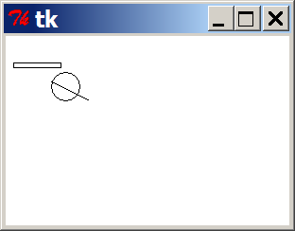
DrawingPanel
To create a window, create a drawingpanel and its graphical pen, which we'll call g :
  from drawingpanel import *
  panel = drawingpanel(width, height)
  g = panel.get_graphics()
  ... (draw shapes here) ...
  panel.mainloop()
The window has nothing on it, but we can draw shapes and
lines on it by sending commands to g .
  Example:
  g.create_rectangle(10, 30, 60, 35)
  g.create_oval(80, 40, 50, 70)
  g.create_line(50, 50, 90, 70)

Slide 144
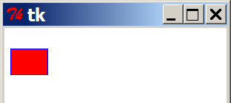
Graphical commands
Command | Description
g.create_line(x1, y1, x2, y2) | a line between (x1, y1), (x2, y2)
g.create_oval(x1, y1, x2, y2) | the largest oval that fits in a box with top-left corner at (x1, y1) and bottom-left corner at (x2, y2)
g.create_rectangle(x1, y1, x2, y2) | the rectangle with top-left corner at (x1, y1), bottom-left at (x2, y2)
g.create_text(x, y, text="text") | the given text at (x, y)
The above commands can accept optional outline and fill colors.
  g.create_rectangle(10, 40, 22, 65, fill="red", outline="blue")
The coordinate system is y-inverted:
  (0, 0)
  (200, 100)

Slide 145
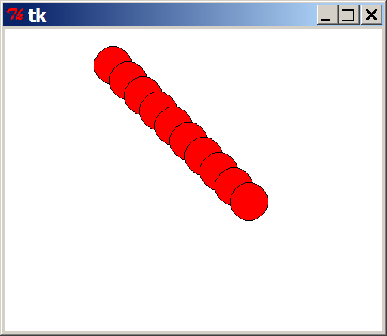
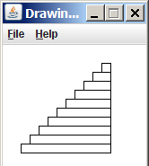
Drawing with loops
We can draw many repetitions of the same item at different x/y positions with for loops.
  The x or y assignment expression contains the loop counter, i, so that in each pass of the loop, when i changes, so does x or y.
  from drawingpanel import *
  window = drawingpanel(500, 400)
  g = window.get_graphics()
  for i in range(1, 11):
  x = 100 + 20 * i
  y = 5 + 20 * i
  g.create_oval(x, y, x + 50, y + 50, fill="red")
  window.mainloop()
Exercise: Draw the figure at right.

Slide 146
What's Next?

Slide 147
Further programming
Lab exercises
  Let's go downstairs to the basement computer labs!
  All resources are available at the following URL:
    http://faculty.washington.edu/stepp/cs4hs/
What next?
  Arrays, data structures
  Algorithms: searching, sorting, recursion, etc.
  Objects and object-oriented programming
  Graphical user interfaces, event-driven programming

