Slide 1
Unit-4: String Matching

Slide 2

Outline
Introduction
The Naive String Matching Algorithm
The Rabin-Karp Algorithm
The Knuth-Morris-Pratt Algorithm
Looping

Slide 3
Introduction
Text-editing programs frequently need to find all occurrences of a pattern in the text.
Efficient algorithms for this problem is called String-Matching Algorithms.
Among its many applications, “String-Matching” is highly used in Searching for patterns in DNA and Internet search engines.
Assume that the text is represented in the form of an array 𝑻[𝟏…𝒏] and the pattern is an array 𝑷[𝟏…𝒎].
Text T[1..13]
a
b
c
a
b
a
a
b
c
a
b
a
c
Pattern P[1..4]
a
b
a
a

Slide 4
Naive String Matching Algorithm

Slide 5
Naive String Matching - Example
The naive algorithm finds all valid shifts using a loop that checks the condition P[1..m] = T[s+1..s+m]
a
c
a
a
b
c
a
c
a
a
b
c
a
c
a
a
b
c
a
a
b
a
a
b
a
a
b
s = 0
s = 1
s = 2
a
c
a
a
b
c
Pattern matched with shift 2
P[1..m] = T[s+1..s+m]
a
a
b
s = 3

Slide 6
Naive String Matching - Algorithm
NAIVE-STRING MATCHER (T,P)
n = T.length
m = P.length
for s = 0 to n-m
if p[1..m] == T[s+1..s+m]
print “Pattern occurs with shift” s
T[1..6]
a
c
a
a
b
c
P[1..3]
a
a
a
a
a
b
a
a
b
b
a
b
2
s = 0
1
3
Pattern occurs with shift 2
Naive String Matcher takes time O((n-m+1)m)

Slide 7
Rabin-Karp Algorithm
Who created the Rabin Karp Algorithm?
Michael Rabin and Richard Karp

Slide 8
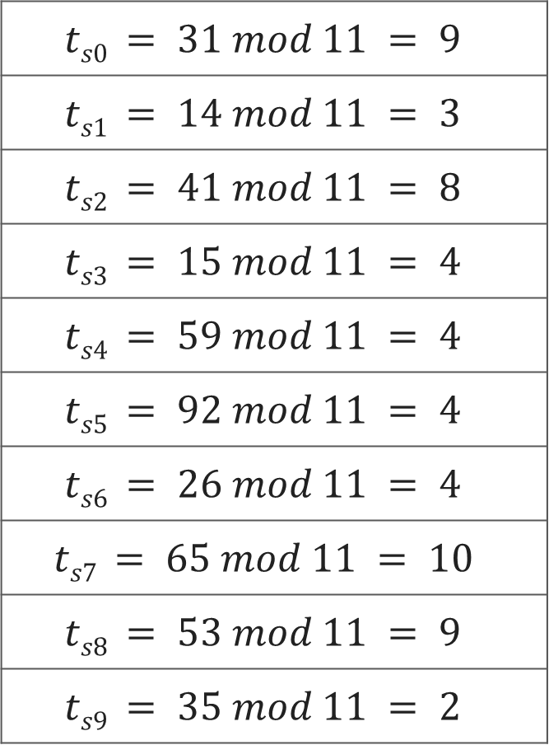
Text T
3 | 1 | 4 | 1 | 5 | 9 | 2 | 6 | 5 | 3 | 5
$$ts0 = 31 mod 11 = 9$$
$$ts1 = 14 mod 11 = 3$$
$$ts2 = 41 mod 11 = 8$$
$$ts3 = 15 mod 11 = 4$$
$$ts4 = 59 mod 11 = 4$$
$$ts5 = 92 mod 11 = 4$$
$$ts6 = 26 mod 11 = 4$$
$$ts7 = 65 mod 11 = 10$$
$$ts8 = 53 mod 11 = 9$$
$$ts9 = 35 mod 11 = 2$$
Pattern P
2 | 6
Choose a random prime number q = 11
Let, p = P mod q
= 26 mod 11 = 4
Let t_{s} denotes modulo q for text of length m
3 | 1 | 4 | 1 | 5 | 9 | 2 | 6 | 5 | 3 | 5
9 | 3 | 8 | 4 | 4 | 4 | 4 | 10 | 9 | 2

Slide 9
Pattern P
2 | 6
p = P mod q = 26 mod 11 = 4
2 | 6
Text T
3 | 1 | 4 | 1 | 5 | 9 | 2 | 6 | 5 | 3 | 5
t_{s}
9 | 3 | 8 | 4 | 4 | 4 | 4 | 10 | 9 | 2
Spurious Hit
Valid match
if t_{s} == p
if P[1..m] == T[s+1..s+m]
print “pattern occurs with shift” s

Slide 10

Rabin-Karp Algorithm
We can compute $t_{s}$ using following formula
t_{s+1} = 10(t_{s} - 10^{m-1}T[s+1]) + T[s + m + 1]
3 | 1 | 4 | 1 | 5 | 9 | 2 | 6 | 5 | 3 | 5
For m=2 and s=0 t_{s} = 31
We wish to remove higher order digit T[s+1]=3 and bring the new lower order digit T[s+m+1]=4
t_{s+1} = 10(31-10·3) + 4
= 10(1) + 4 = 14
t_{s+2} = 10(14-10·1) + 1
= 10(4) + 1 = 41

Slide 11
Rabin-Karp-Matcher
RABIN-KARP-MATCHER(T, P, d, q)
n ← length[T];
m ← length[P];
h ← d^{m-1} mod q;
p ← 0;
t₀ ← 0;
for i ← 1 to m do
p ← (d_{p} + P[i]) mod q
t₀ ← (dt₀ + T[i]) mod q
for s ← 0 to n – m do
if p == t_{s} then
if P[1..m] == T[s+1..s+m] then
print “pattern occurs with shift” s
if s < n-m then
t_{s+1} ← (d(t_{s} – T[s+1]h) + T[s+m+1]) mod q
T | 3 | 1 | 4 | 1 | 5 | 9 | 2 | 6 | 5 | 3 | 5
P | 2 | 6
d | 10
q | 11
n | 11
m | 2
h | 10
t₀ | 9
p | 4
t₀ | 0
p | 0

Slide 12
Time Complexity:
The average and best-case running time of the Rabin-Karp algorithm is O(n+m), but its worst-case time is O(nm).
The worst case of the Rabin-Karp algorithm occurs when all characters of pattern and text are the same as the hash values of all the substrings of T[] match with the hash value of P[].

Slide 13
String Matching with Knuth-Morris-Pratt Algorithm

Slide 14
Introduction
The KMP algorithm relies on prefix function (π).
Proper prefix: All the characters in a string, with one or more cut off the end. “S”, “Sn”, “Sna”, and “Snap” are all the proper prefixes of “Snape”.
Proper suffix: All the characters in a string, with one or more cut off the beginning. “agrid”, “grid”, “rid”, “id”, and “d” are all proper suffixes of “Hagrid”.
KMP algorithm works as follows:
Step-1: Calculate Prefix Function
Step-2: Match Pattern with Text

Slide 15
Longest Common Prefix and Suffix
 | 1 | 2 | 3 | 4 | 5 | 6 | 7
Pattern | a | b | a | b | a | c | a
Prefix(π) | 0 | 0 | 1 | 2 | 3 | 0 | 1
abab
ababa
aba
ab
a
We have no possible prefixes
Possible prefix = a
Possible prefix = a, ab, aba, abab
Possible prefix = a, ab
Possible prefix = a, ab, aba
We have no possible suffixes
Possible suffix = b
Possible suffix = a, ba, aba, baba
Possible suffix = a, ba
Possible suffix = b, ab, bab

Slide 16
Calculate Prefix Function - Example
k+1
q
q
k+1
 | 1 | 2 | 3 | 4 | 5 | 6 | 7
P | a | c | a | c | a | g | t
π | 0 | 0 | 1 | 2 | 3 | 0 | 0
false
P[k+1]==P[q]
true
k =
0
1
2
3
1
0
q =
2
3
4
5
6
7
false
k>0
true
Initially set π[1] = 0
k is the longest prefix found
q is the current index of pattern
k=π[k]
k=k+1
π[q]=k

Slide 17
KMP- Compute Prefix Function
COMPUTE-PREFIX-FUNCTION(P)
m ← length[P]
π[1] ← 0
k ← 0
for q ← 2 to m
while k > 0 and P[k + 1] ≠ P[q]
k ← π[k]
end while
if P[k + 1] == P[q] then
k ← k + 1
end if
π[q] ← k
return π

Slide 18
KMP String Matching
 | 1 | 2 | 3 | 4 | 5 | 6 | 7
Pattern | a | c | a | c | a | g | t
Prefix(π) | 0 | 0 | 1 | 2 | 3 | 0 | 0
T | a | c | a | t | a | c | g | a | c | a | c | a | g | t
Mismatch ?
Check value in prefix table
a
c
a
c
a
g
t
a
c
a
c
a
g
t
We can skip 2 shifts
(Skip unnecessary shifts)
T | a | c | a | t | a | c | g | a | c | a | c | a | g | t
a
c
a
c
a
g
t
Mismatch ?
Check value in prefix table
T | a | c | a | t | a | c | g | a | c | a | c | a | g | t
a
c
a
c
a
g
t
Mismatch ?
Check value in prefix table

Slide 19
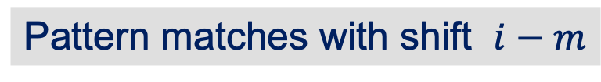
KMP String Matching
 | 1 | 2 | 3 | 4 | 5 | 6 | 7
Pattern | a | c | a | c | a | g | t
Prefix(π) | 0 | 0 | 1 | 2 | 3 | 0 | 0
T | a | c | a | t | a | c | g | a | c | a | c | a | g | t
Mismatch ?
Check value in prefix table
a
c
a
c
a
g
t
We can skip 2 shifts
(Skip unnecessary shifts)
T | a | c | a | t | a | c | g | a | c | a | c | a | g | t
a
c
a
c
a
g
t
T | a | c | a | t | a | c | g | a | c | a | c | a | g | t
a
c
a
c
a
g
t
Pattern matches with shift $i−m$

Slide 20
KMP-MATCHER
KMP-MATCHER(T, P)
n ← length[T]
m ← length[P]
π ← COMPUTE-PREFIX-FUNCTION(P)
q ← 0 //Number of characters matched.
for i ← 1 to n //Scan the text from left to right.
while q > 0 and P[q + 1] ≠ T[i]
q ← π[q] //Next character does not match.
if P[q + 1] == T[i] then
then q ← q + 1 //Next character matches.
if q == m then //Is all of P matched?
print "Pattern occurs with shift" i - m
q ← π[q] //Look for the next match.

Slide 21
The worst case time complexity of KMP algorithm for pattern searching (m = length of text, n = length of pattern)
O(m+n)

Slide 22
Thank You!

