Slide 1
Unit - 3 Greedy Algorithm
01CE1503 - Design and Analysis of Algorithm
Prof. Megha Mudholkar
Department of Computer Engineering

Slide 2
OUTLINE
Introduction
General Characteristics of greedy algorithms
Elements of greedy strategy
Activity selection problem
Fractional Knapsack Problem
Job Scheduling Problem

Slide 3
INTRODUCTION
What is Greedy Algorithm?
Greedy Algorithm is optimization method. When the problem has many feasible solutions with different cost or benefit, finding the best solution is known as an optimization problem and the best solution is known as the optimal solution.
There are numerous optimization problems in the real world, such as make a change, knapsack, shortest path, job scheduling ( or job sequencing), and so on.
Greedy algorithms, like dynamic programming and many other techniques, are used to tackle optimization problems.

Slide 4
INTRODUCTION
The greedy algorithm derives the solution step by step, by looking at the information available at the current moment. It does not look at future prospects.
Decisions are completely locally optimal.
This method constructs the solution simply by looking at current benefit without exploring future possibilities and hence they are known as greedy.
The choice made under greedy solution procedure are irrevocable, means once we have selected the local best solution, it cannot be backtracked.
Thus, a choice made at each step in the greedy method should be:

Slide 5
INTRODUCTION
Feasible : choice should satisfy problem constraints.
Locally optimal : Best solution from all feasible solution at the current stage should be selected.
Irrevocable : Once the choice is made, it cannot be altered, i.e. if a feasible solution is selected (rejected) in step i, it cannot be rejected (selected) in subsequent stages.

Slide 6
CHARACTERISTICS OF GREEDY ALGORITHMS
Problems which can be solved using the greedy method generally possess the following two interesting properties:
1. Greedy choice property:
The global optimal solution is found by selecting locally optimal choices, or the ones that appear to be the best at the time. If the choice is feasible, include it in the solution set and reduce the problem by the same amount. The current decision may be influenced by prior decisions, but it is independent by future decisions.
2. Optimal substructure:
We say given problem exhibits optimal substructure if the optimal solution to the given problem contains the optimal solution to its sub problems too. In the problem which possesses the optimal substructure, best next choice always leads to an optimal solution.

Slide 7
ACTIVITY SELECTION PROBLEM
Activity Selection Problem : “Schedule maximum number of compatible activities that need exclusive access to resources likes processor, class room, event venue etc.”
Span of activity is defined by its start time and finishing time. Suppose we have such n activities.
Aim of algorithm is to find optimal schedule with maximum number of activities to be carried out with limited resources. Suppose S = {a1, a2, a3, .. an} is the set of activities that we want to schedule.

Slide 8
ACTIVITY SELECTION PROBLEM
Scheduled activities must be compatible with each other. Start time of activities is let’s say si and finishing time is fi, then activities i and j are called compatible if and only if fi < sj or fj < si. In other words, two activities are compatible if their time durations do not overlap.
Consider the below time line. Activities {A1, A3} and {A2, A3} are compatible set of activities.
For given n activities, there may exist multiple such schedules. Aim of activity selection algorithm is to find out the longest schedule without overlap.

Slide 9
ACTIVITY SELECTION PROBLEM
Greedy approach sort activities by their finishing time in increasing order, so that f1 ≤ f2 ≤ f3 ≤ . . . ≤ fn. By default it schedules the first activity in sorted list.
Subsequent next activities are scheduled whose start time is larger than finish time of previous activity. Run through all possible activities and do the same.

Slide 10
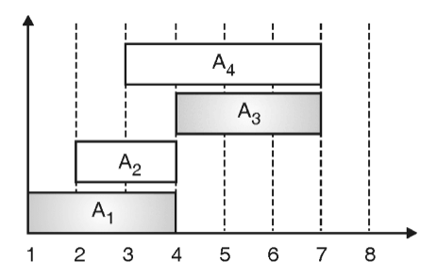
ACTIVITY SELECTION PROBLEM

Slide 11
ACTIVITY SELECTION PROBLEM
Consider the activity set A = {A1, A2, A3, A4, A5, A6, A7, A8, A9}, their start time S = {1, 4, 5, 2, 6, 3, 10, 12, 11} and finish time F = {4, 5, 7, 9, 10, 14, 15, 16, 17}. If we first select activity A4 for scheduling, we will end up with two activities {A4, A7}.
If we select A1 followed by A6, we end up with {A1, A6} only.
Whereas, greedy algorithm schedules {A1, A2, A3, A7}, which is the largest possible set.

Slide 12
ACTIVITY SELECTION PROBLEM
Algorithm for Activity Selection Problem
Algorithm ACTIVITY_SELECTION(A, S)
// A is Set of n activities sorted by finishing time.
// S = { A[1] }, solution set, initially which contains first activity
j ← 2
while j ≤ n do
if fi ≤ si then
S ← S union A[ j ]
i ← j
end
j ← j + 1
i ← i – 1
end

Slide 13
ACTIVITY SELECTION PROBLEM
Example: Given following data, determine the optimal schedule using greedy approach. A = <A1, A2, A3, A4, A5, A6>, S = <1, 2, 3, 4, 5, 6>, F = <3, 6, 4, 5, 7, 9>
Solution:
First of all, sort all activities by their finishing time.
Activity | A₁ | A₃ | A₄ | A₂ | A₅ | A₆
f_{i} | 3 | 4 | 5 | 6 | 7 | 9
s_{i} | 1 | 3 | 4 | 2 | 5 | 6

Slide 14
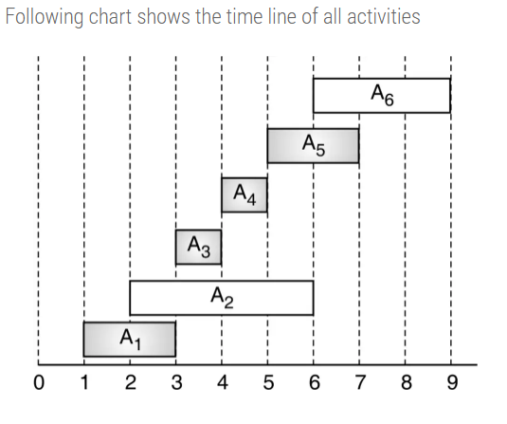
ACTIVITY SELECTION PROBLEM

Slide 15
ACTIVITY SELECTION PROBLEM
Let us now check the feasible set of activities.
A1 is already selected, so S = < A1>
f1 > s2, so A1 and A2 are not compatible. Do check for next activity
f1 ≤ s3, so A1 and A3 are compatible. Schedule A3, S = <A1, A3>
f3 ≤ s4, so A3 and A4 are compatible. Schedule A4, S = <A1, A3, A4>
f4 ≤ s5, so A4 and A5 are compatible. Schedule A5, S = <A1, A3, A4, A5>
f5 > s6, so A5 and A6 are not compatible. And there is no more activity left to check. Hence final schedule is, S = <A1, A3, A4, A5>

Slide 16
ACTIVITY SELECTION PROBLEM
Example: Given following data, determine the optimal schedule for activity selection using greedy algorithm. A = <A1, A2, A3, A4, A5, A6, A7, A8>, S = <1, 2, 3, 4, 5, 6, 7, 8>, F = <4, 3, 7, 5, 6, 8, 10, 9>
Solution:
First of all sort all activities by their finishing time.
Activity | A₂ | A₁ | A₄ | A₅ | A₃ | A₆ | A₈ | A₇
f_{i} | 3 | 4 | 5 | 6 | 7 | 8 | 9 | 10
s_{i} | 2 | 1 | 4 | 5 | 3 | 6 | 8 | 7

Slide 17
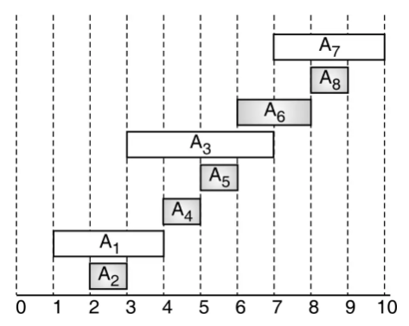
ACTIVITY SELECTION PROBLEM

Slide 18
ACTIVITY SELECTION PROBLEM
A2 is already selected, so S = < A2>
f2 > s1, so A1 and A2 are not compatible. Do check for next activity
f2 ≤ s4, so A2 and A4 are compatible. Schedule A3, S = <A2, A4>
f4 ≤ s5, so A4 and A5 are compatible. Schedule A5, S = <A2, A4, A5>
f5 > s3, so A3 and A5 are not compatible. Do check for next activity
f5 ≤ s6, so A5 and A6 are compatible. Schedule A6, S = <A2, A4, A5, A6>
f6 ≤ s8, so A6 and A6 are compatible. Schedule A8, S = <A2, A4, A5, A6, A8>
f8 > s7, so A8 and A7 are not compatible. And there is no more activity left to check.
So final schedule is, S = <A2, A4, A5, A6, A8>

Slide 19
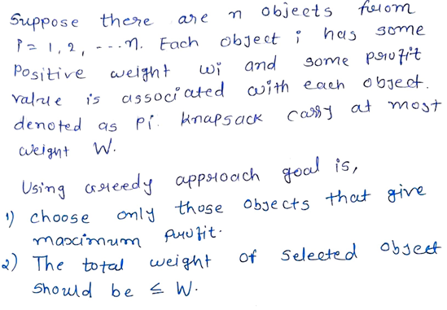
FRACTIONAL KNAPSACK PROBLEM

Slide 20
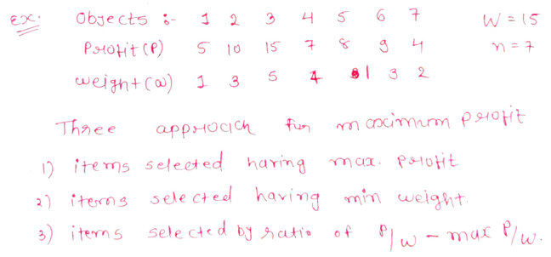
FRACTIONAL KNAPSACK PROBLEM

Slide 21
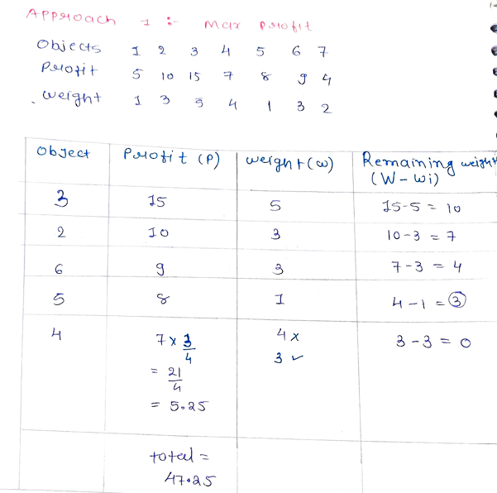
FRACTIONAL KNAPSACK PROBLEM

Slide 22
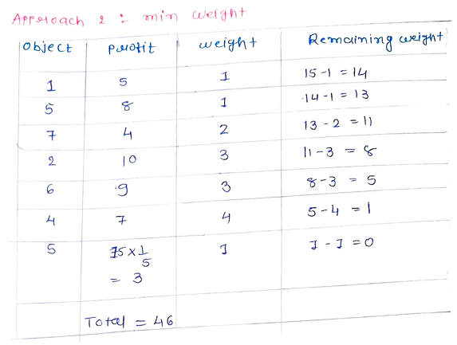
FRACTIONAL KNAPSACK PROBLEM

Slide 23
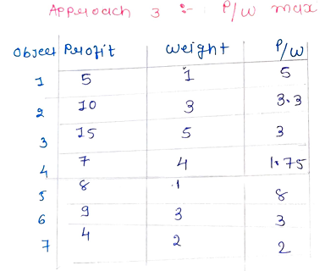
FRACTIONAL KNAPSACK PROBLEM

Slide 24
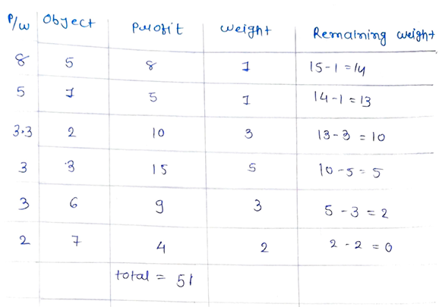
FRACTIONAL KNAPSACK PROBLEM
Note: By using approach 3 i.e. P/W ratio we are getting maximum profit which is 51.
For solving fractional knapsack problem always use APPROACH 3 only until and unless
mentioned in question.

Slide 25
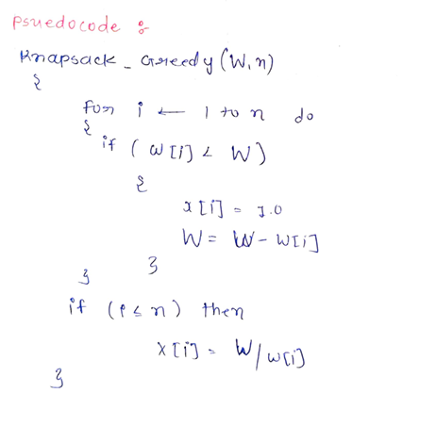
FRACTIONAL KNAPSACK PROBLEM

Slide 26
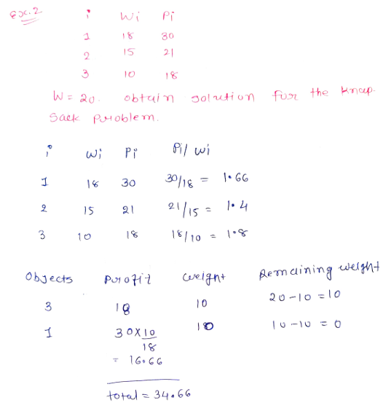
FRACTIONAL KNAPSACK PROBLEM

Slide 27
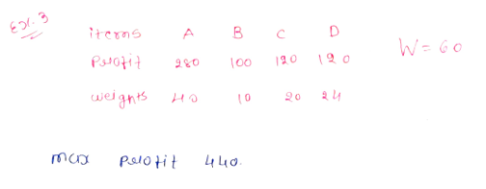
FRACTIONAL KNAPSACK PROBLEM

Slide 28
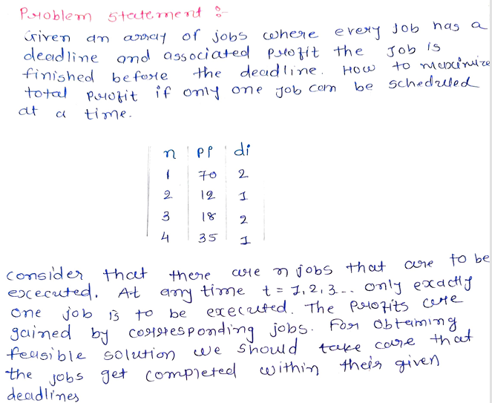
JOB SCHEDULING PROBLEM OR
JOB SEQUENCING WITH DEADLINE

Slide 29
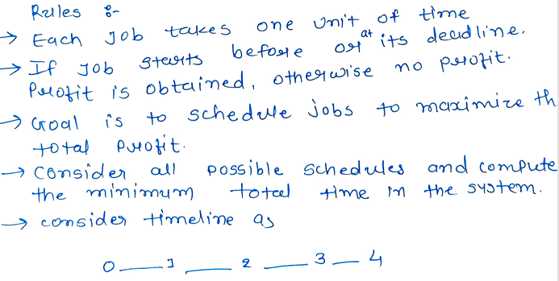
JOB SCHEDULING PROBLEM OR
JOB SEQUENCING WITH DEADLINE

Slide 30
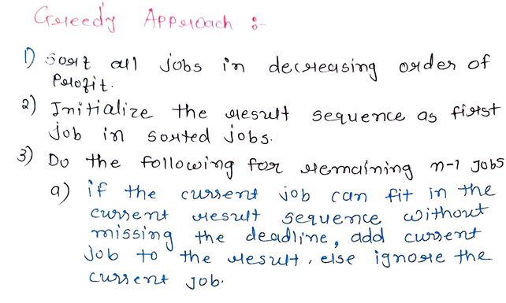
JOB SCHEDULING PROBLEM OR
JOB SEQUENCING WITH DEADLINE

Slide 31
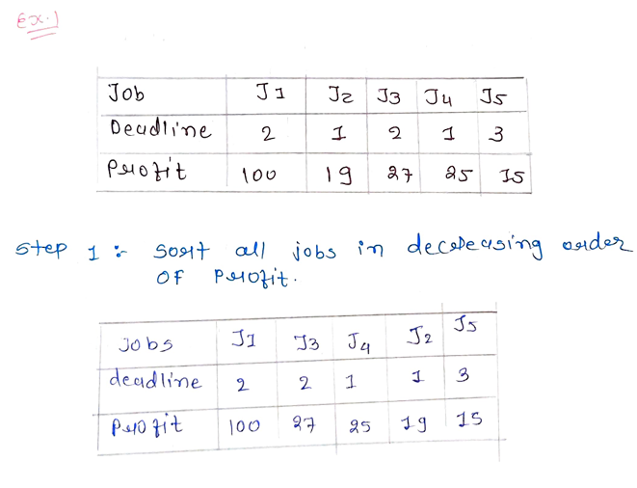
JOB SCHEDULING PROBLEM OR
JOB SEQUENCING WITH DEADLINE

Slide 32
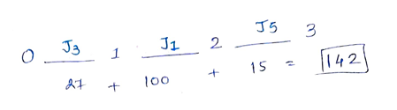
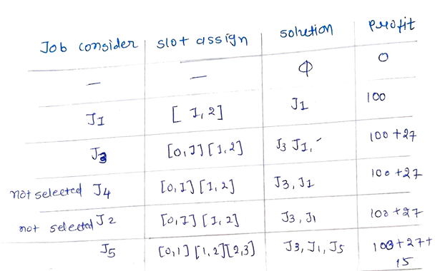
JOB SCHEDULING PROBLEM OR
JOB SEQUENCING WITH DEADLINE

Slide 33
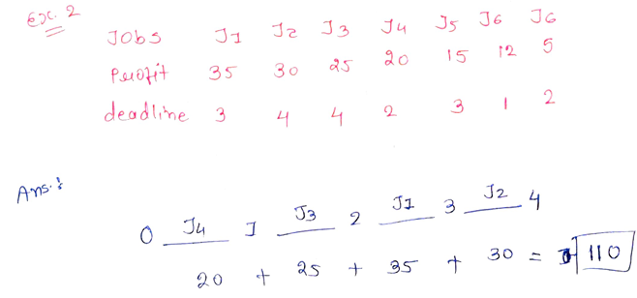
JOB SCHEDULING PROBLEM OR
JOB SEQUENCING WITH DEADLINE

Slide 34
Thank You

