Slide 1
Heap Sort

Slide 2
Heap sort is one of the sorting algorithms used to arrange a list of elements in order.
Heap sort algorithm uses one of the tree concepts called Heap Tree.
Let us first define a Complete Binary Tree. A complete binary tree is a binary tree in which every level, except possibly the last, is completely filled, and all nodes are as far left as possible.
A Binary Heap is a Complete Binary Tree where items are stored in a special order such that the value in a parent node is greater(or smaller) than the values in its two children nodes.
The former is called max heap and the latter is called min-heap.
The heap can be represented by a binary tree or array.

Slide 3
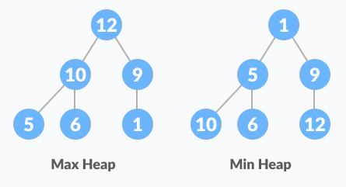
HEAP SORT

Slide 4
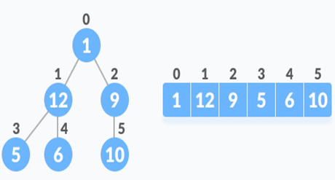
HEAP SORT
Relationship between Array Indexes and Tree Elements
A complete binary tree has an interesting property that we can use to find the children and parents of any node.
If the index of any element in the array is i,
the element in the index 2i+1 will become the left child and element in 2i+2 index will become the right child.
Also, the parent of any element at index i is given by the lower bound of (i-1)/2.

Slide 5
HEAP SORT
Algorithm
The Heap sort algorithm to arrange a list of elements in ascending order is performed using following steps...
Step 1 - Construct a Binary Tree with given list of Elements.
Step 2 - Transform the Binary Tree into Max Heap.
Step 3 - Delete the root element from Max Heap using Heapify method.
Step 4 - Put the deleted element into the Sorted list.
Step 5 - Repeat the same until Max Heap becomes empty.
Step 6 - Display the sorted list.

Slide 6
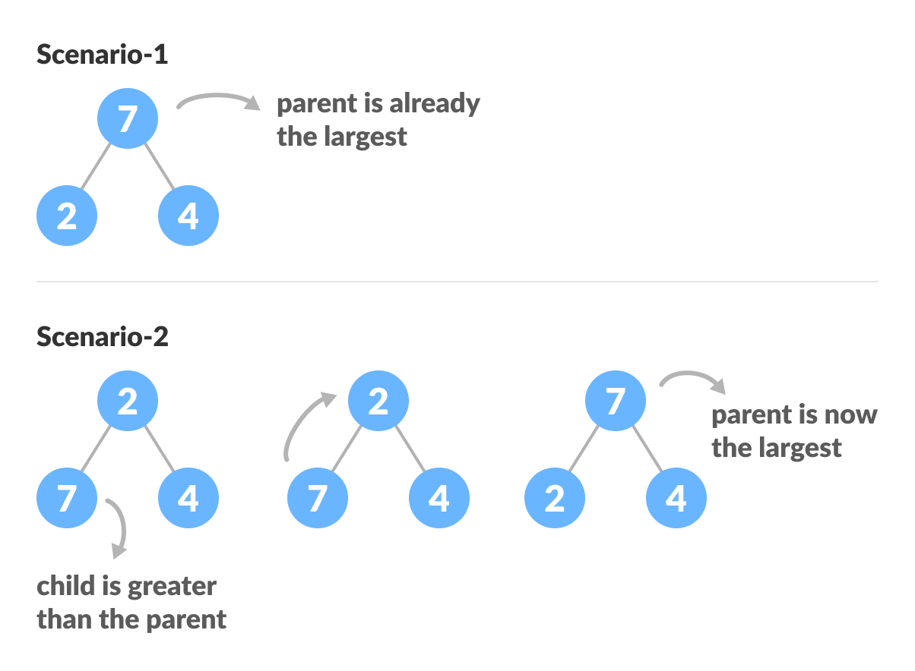
How to "heapify" a tree
Starting from a complete binary tree, we can modify it to become a Max-Heap by running a function called heapify on all the non-leaf elements of the heap.
heapify(array)
Root = array[0]
Largest = largest( array[0] , array [2*0 + 1], array[2*0+2])
if(Root != Largest)
Swap(Root, Largest)

Slide 7
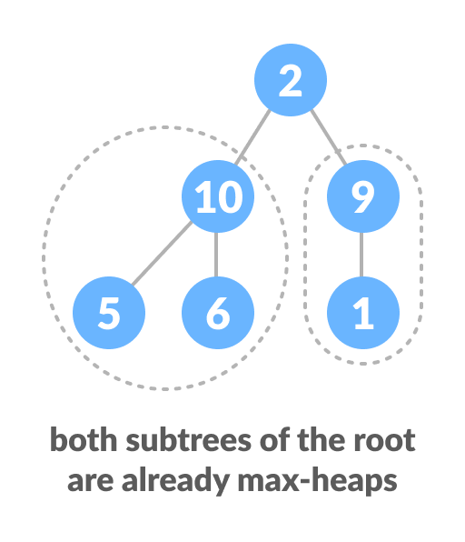
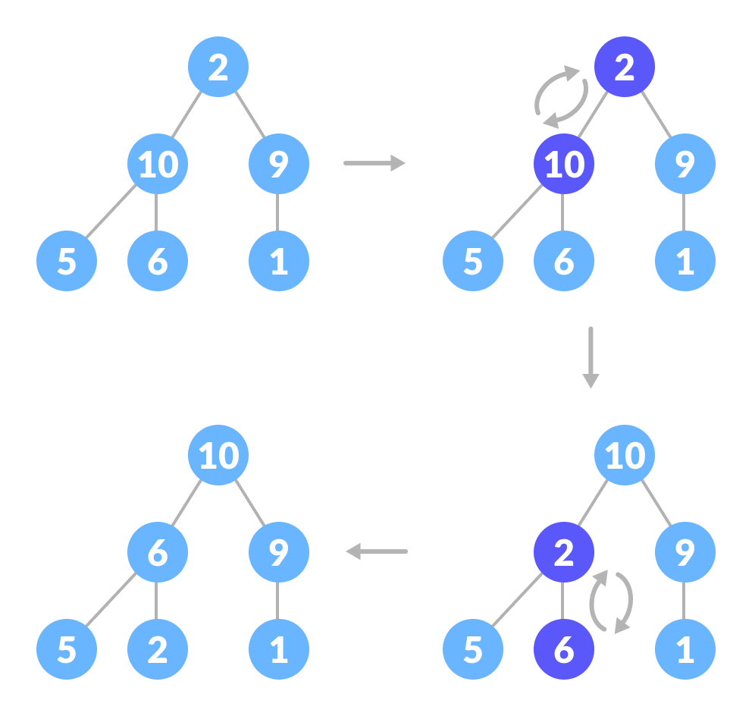
How to "heapify" a tree

Slide 8
Algorithm for Heapify
void heapify(int arr[], int n, int i) {
// Find largest among root, left child and right child
int largest = i;
int left = 2 * i + 1;
int right = 2 * i + 2;
if (left < n && arr[left] > arr[largest])
largest = left;
if (right < n && arr[right] > arr[largest])
largest = right;
// Swap and continue heapifying if root is not largest
if (largest != i) {
swap(&arr[i], &arr[largest]);
heapify(arr, n, largest);
}

Slide 9
Build max-heapify
To build a max-heap from any tree, we can thus start heapifying each sub-tree from the bottom up and end up with a max-heap after the function is applied to all the elements including the root element.
In the case of a complete tree, the first index of a non-leaf node is given by n/2 - 1. All other nodes after that are leaf-nodes and thus don't need to be heapified.
// Build heap (rearrange array)
for (int i = n / 2 - 1; i >= 0; i--)
heapify(arr, n, i);

Slide 10
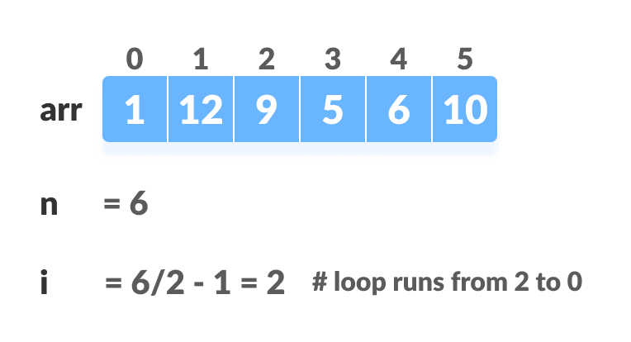
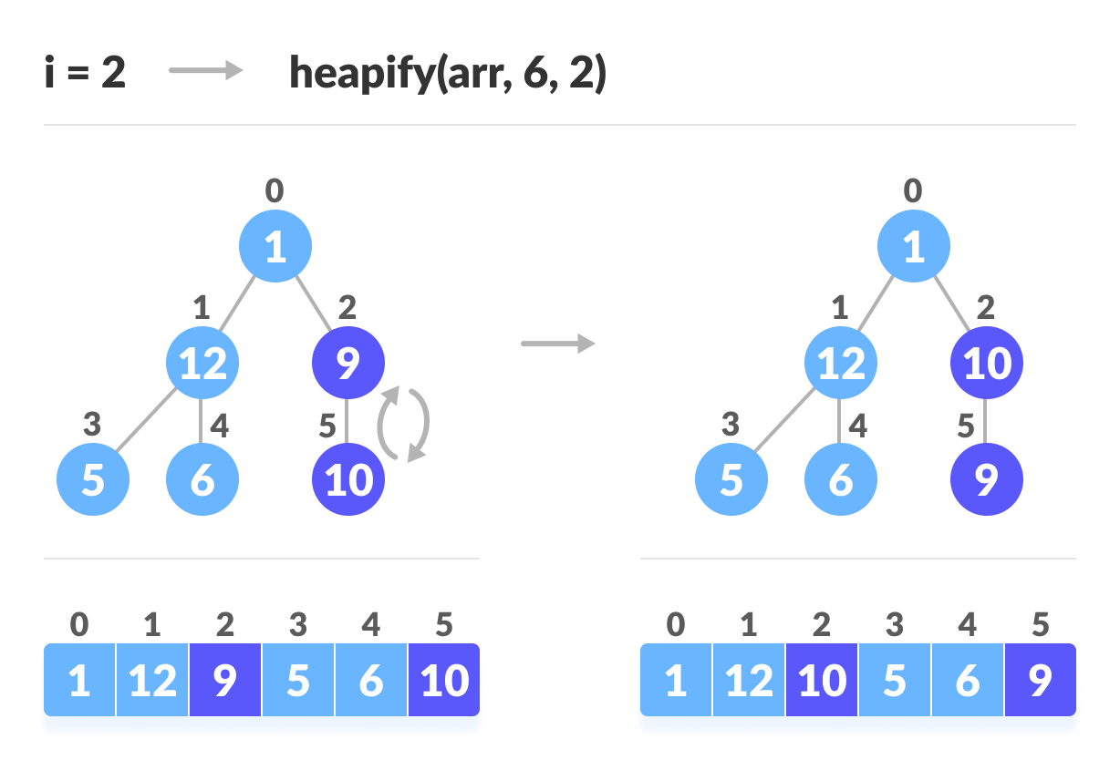
Build max-heapify

Slide 11
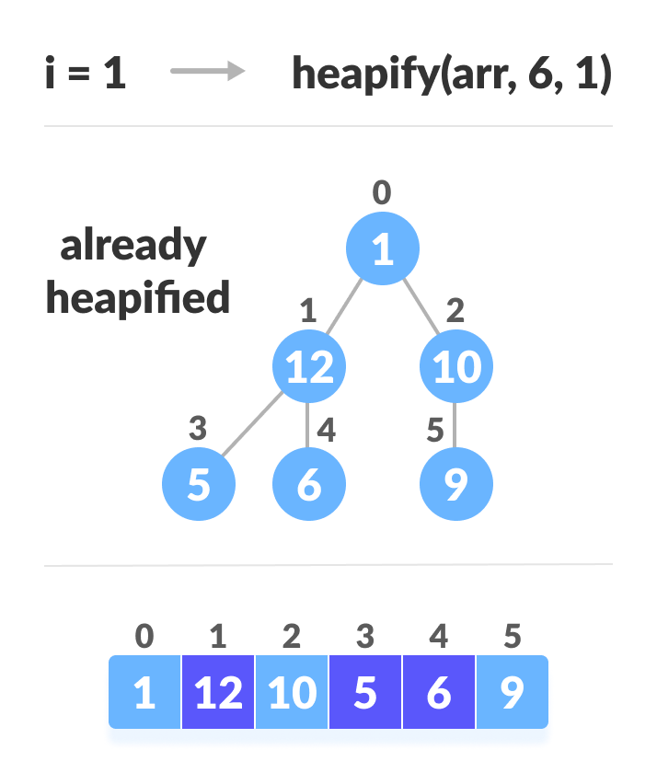
Build max-heapify

Slide 12
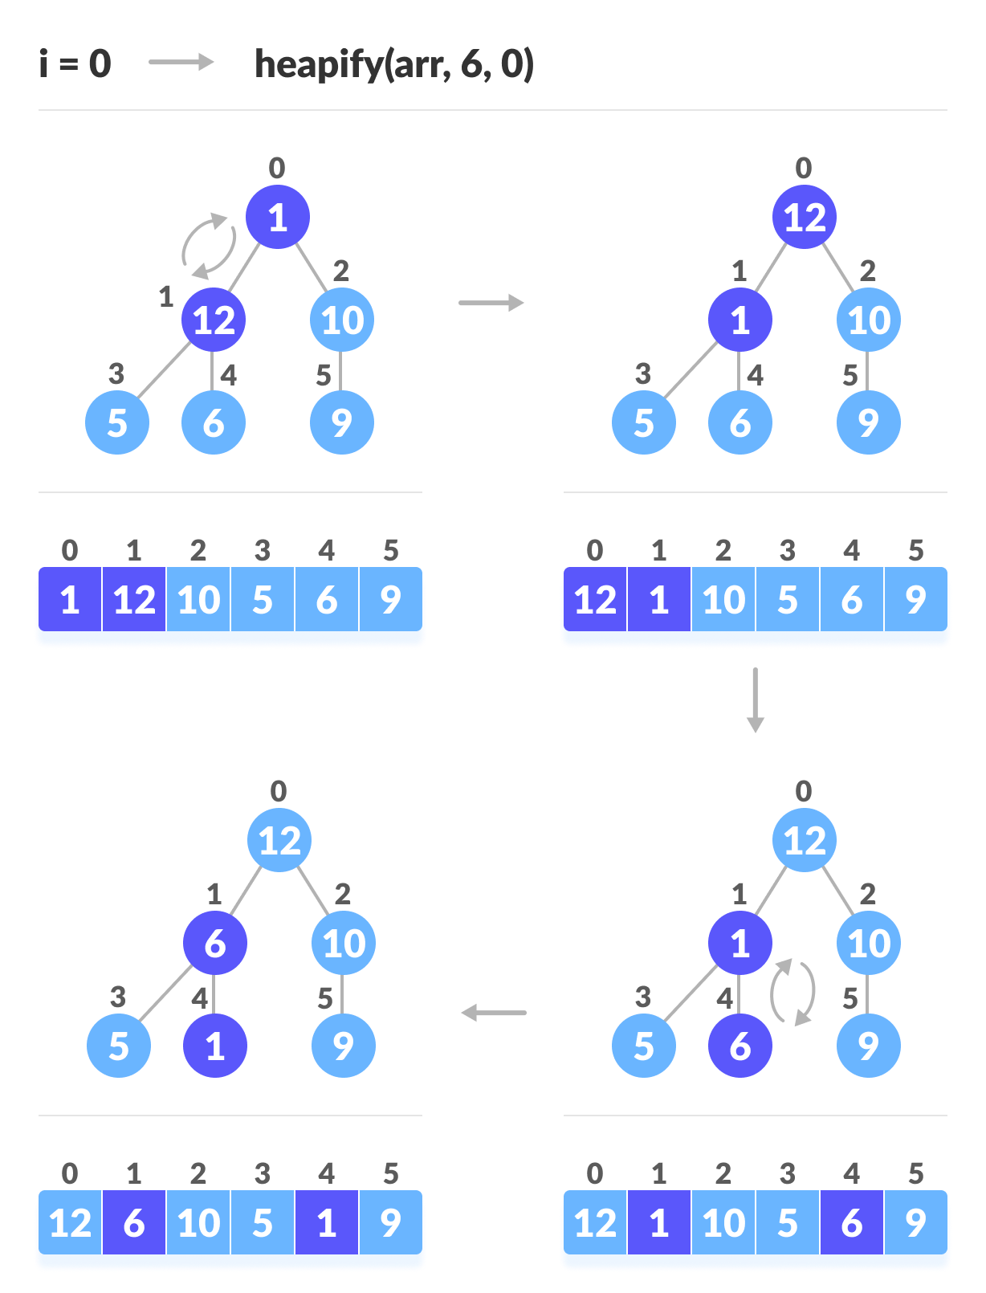
Build max-heapify

Slide 13
How Heap Sort Works?
Since the tree satisfies Max-Heap property, then the largest item is stored at the root node.
Swap: Remove the root element and put at the end of the array (nth position) Put the last item of the tree (heap) at the vacant place.
Remove: Reduce the size of the heap by 1.
Heapify: Heapify the root element again so that we have the highest element at root.
The process is repeated until all the items of the list are sorted.

Slide 14
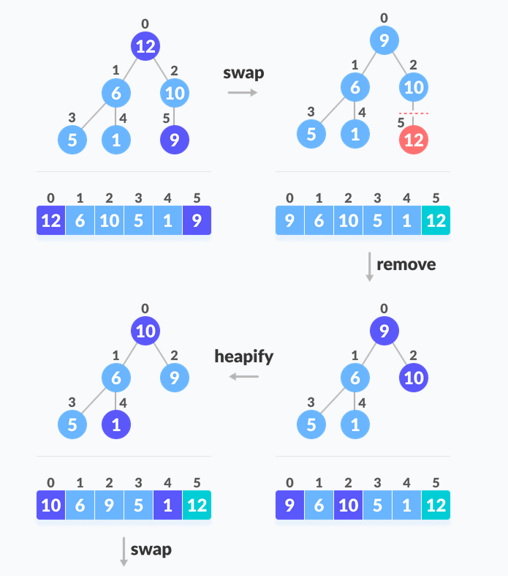

Slide 15
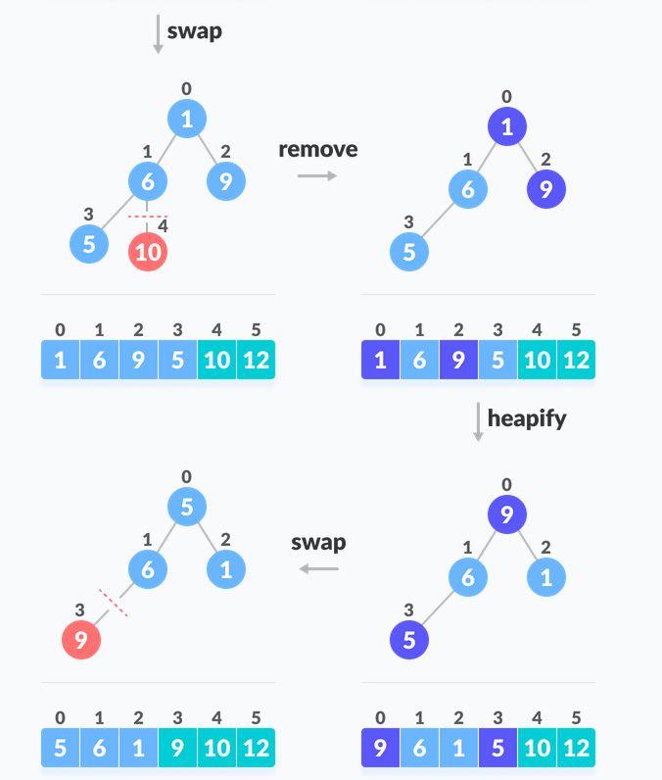

Slide 16
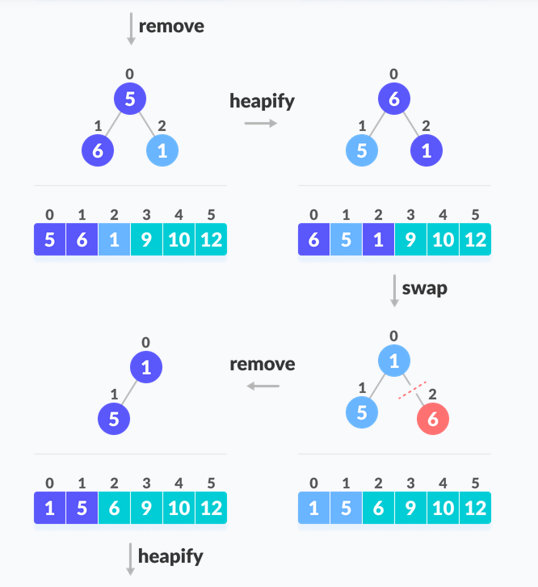

Slide 17
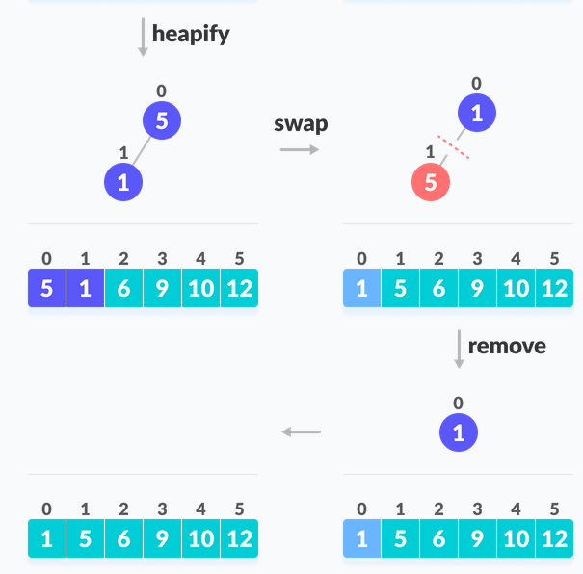

Slide 18
Heapsort and Time Complexity
void heapSort(int arr[], int n) {
// Build heap (rearrange array)
int i;
for (i = n / 2 - 1; i >= 0; i--)
heapify(arr, n, i);
// One by one extract an element from heap
for (i = n - 1; i > 0; i--) {
// Move current root to end
swap(&arr[0], &arr[i]);
// Call max heapify on the reduced heap
heapify(arr, i, 0);
}
}

Slide 19
Time Complexity
Best Case Complexity - It occurs when there is no sorting required, i.e. the array is already sorted. The best-case time complexity of heap sort is O(n log n).
Average Case Complexity - It occurs when the array elements are in jumbled order that is not properly ascending and not properly descending. The average case time complexity of heap sort is O(n log n).
Worst Case Complexity - It occurs when the array elements are required to be sorted in reverse order. That means suppose you have to sort the array elements in ascending order, but its elements are in descending order. The worst-case time complexity of heap sort is O(n log n).
Case | Time Complexity
Best Case | O(n logn)
Average Case | O(n log n)
Worst Case | O(n log n)

