Slide 1
Unit-1: Analysis of Algorithm
Prof. Mitul N. Takodara

Slide 2

Outline
Analysis of Algorithm
The efficient algorithm
Average, Best and Worst-case analysis
Asymptotic Notations
Analyzing control statement
Sorting Algorithms and analysis: Bubble sort, Selection sort, Insertion sort, Shell sort and Heap sort
Sorting in linear time : Bucket sort, Radix sort and Counting sort.

Slide 3
Analysis of Algorithm

Slide 4


Introduction
What is Analysis of an Algorithm?
Analyzing an algorithm means calculating/predicting the resources that the algorithm requires.
Analysis provides theoretical estimation for the required resources of an algorithm to solve a specific computational problem.
Two most important resources are computing time (time complexity) and storage space (space complexity).
Why Analysis is required?
By analyzing some of the candidate algorithms for a problem, the most efficient one can be easily identified.

Slide 5
Efficiency of Algorithm
The efficiency of an algorithm is a measure of the amount of resources consumed in solving a problem of size 𝑛.
An algorithm must be analyzed to determine its resource usage.
Two major computational resources are execution time and memory space.
Memory Space requirement can not be compared directly, so the important resource is computational time required by an algorithm.
To measure the efficiency of an algorithm requires to measure its execution time using any of the following approaches:
Empirical Approach: To run it and measure how much processor time is needed.
Theoretical Approach: Mathematically computing how much time is needed as a function of input size.

Slide 6
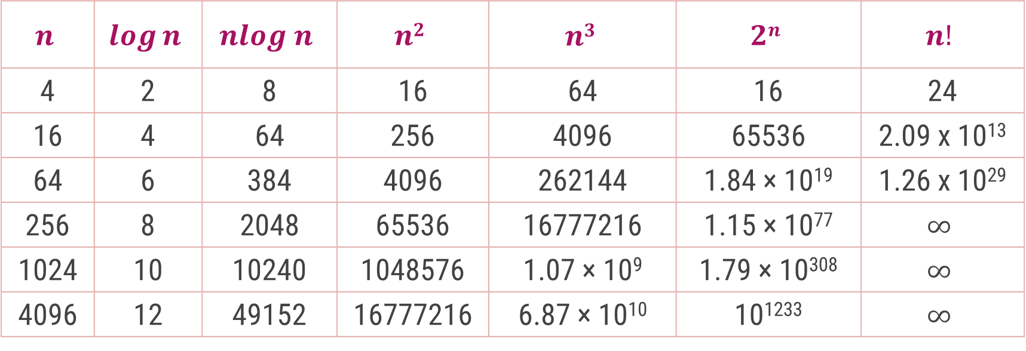
Common Orders of Magnitude
$$n$$ | $$\log{n}$$ | $$nlog n$$ | $$n2$$ | $$n3$$ | $$2n$$ | $$n!$$
4 | 2 | 8 | 16 | 64 | 16 | 24
16 | 4 | 64 | 256 | 4096 | 65536 | 2.09 x 10¹³
64 | 6 | 384 | 4096 | 262144 | 1.84 × 10¹⁹ | 1.26 x 10²⁹
256 | 8 | 2048 | 65536 | 16777216 | 1.15 × 10⁷⁷ | $$∞$$
1024 | 10 | 10240 | 1048576 | 1.07 × 10⁹ | 1.79 × 10³⁰⁸ | $$∞$$
4096 | 12 | 49152 | 16777216 | 6.87 × 10¹⁰ | 10¹²³³ | $$∞$$

Slide 7

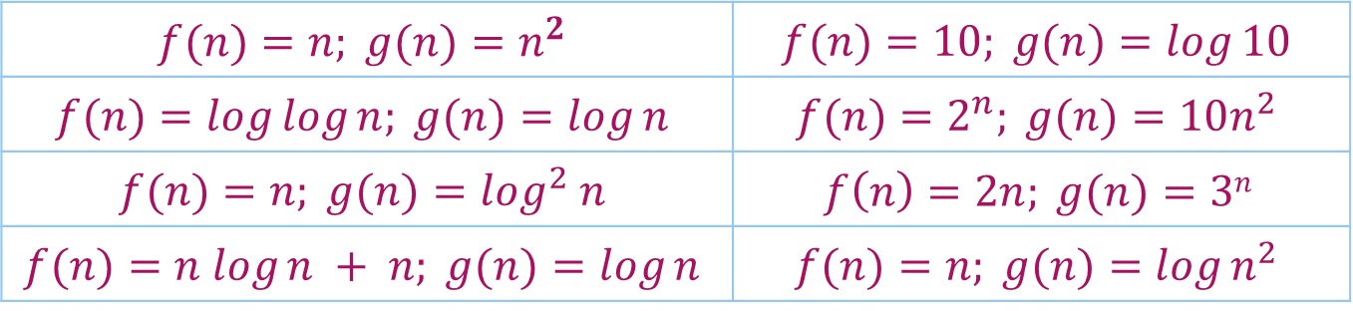
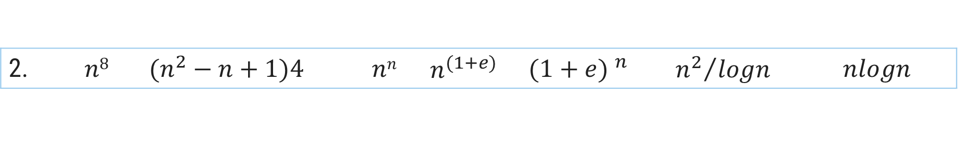
Growth of Function
$$n!$$ | $$en$$ | $$2n$$ | $$n3$$ | $$n2$$ | $$nlogn$$ | $$n$$ | $$\sqrt{n}$$ | $$logn$$ | $$1$$
Arrange the given notations in the increasing order of their values.
For each of the following pairs of functions, either $f(n)$ is $O(g(n))$, $f(n)$ is $Ω(g(n))$, or $f(n) =θ(g(n))$. Determine which relationship is correct.
1. | $$n$$ | $$nlogn$$ | $$2n$$ | $$logn$$ | $$\sqrt{n}$$ | $$en$$ | $$n2+logn$$ | $$n2$$ | $$loglogn$$ | $$n3$$ | $$(logn)2$$ | $$n!$$
2. | $$n8$$ | $$(n^{2}−n+1)4{}^{}$$ | $$nn$$ | $$n^{(1+e)}$$ | $${(1+e) }^{n}$$ | $${n^{2}}/{logn}$$ | $$nlogn$$
$$f(n)=n; g(n)=n^{2}$$ | $$f(n)=10; g(n)=log⁡10$$
$$f(n)=log⁡log⁡n; g(n)=log⁡n$$ | $$f(n)=2^{n}; g(n)=10n^{2}$$
$$f(n)=n; g(n)=\log^{2} n$$ | $$f\left(n\right)=2n; g(n)=3n$$
$$f(n)=n log⁡n + n; g(n)=log⁡n$$ | $$f(n)=n; g(n)=log⁡n^{2}$$

Slide 8
Heap & Heap Sort Algorithm

Slide 9
Introduction
A heap data structure is a binary tree with the following two properties.
It is a complete binary tree: Each level of the tree is completely filled, except possibly the bottom level. At this level it is filled from left to right.
It satisfies the heap order property: the data item stored in each node is greater than or equal to the data item stored in its children node.
a
a
9
9
b
c
b
c
6
7
6
7
d
e
f
d
e
f
2
4
8
2
4
1
Binary Tree but not a Heap
Complete Binary Tree - Heap
Not a Heap
Heap

Slide 10
Array Representation of Heap
Heap can be implemented using an Array.
An array 𝐴 that represents a heap is an object with two attributes:
𝑙𝑒𝑛𝑔𝑡ℎ[𝐴], which is the number of elements in the array, and
ℎ𝑒𝑎𝑝−𝑠𝑖𝑧𝑒[𝐴], the number of elements in the heap stored within array 𝐴
16
14
10
8
7
9
3
Array representation of heap
2
4
1
16
14
10
8
7
9
3
2
4
1
Heap

Slide 11

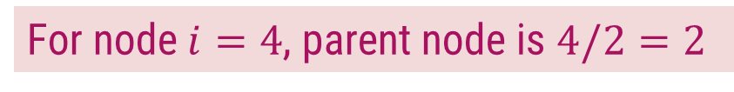









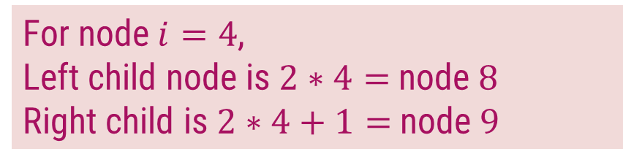
Array Representation of Heap
In the array 𝐴, that represents a heap
length[𝐴] = heap-size[𝐴]
For any node 𝒊 the parent node is 𝒊/𝟐
For any node 𝒋, its left child is 𝟐𝒋 and right child is 𝟐𝒋+𝟏
For node $i=4$, parent node is $4/2=2$
$$1$$
16
For node $i=4$,
Left child node is $2∗4=$node $8$
Right child is $2∗4+1=$node $9$
$$2$$
$$3$$
14
10
$$4$$
$$5$$
$$6$$
$$7$$
8
7
9
3
$$1$$ | $$2$$ | $$3$$ | $$4$$ | $$5$$ | $$6$$ | $$7$$ | $$8$$ | $$9$$ | $$10$$
$$8$$
$$9$$
$$10$$
14
8
2
4
2
4
1
16
14
10
8
7
9
3
2
4
1
Heap

Slide 12
Types of Heap
Max-Heap − Where the value of the root node is greater than or equal to either of its children.
9
6
7
2
4
1
1
Min-Heap − Where the value of the root node is less than or equal to either of its children.
2
4
6
7
9

Slide 13
Introduction to Heap Sort
Build the complete binary tree using given elements.
Create Max-heap to sort in ascending order.
Once the heap is created, swap the last node with the root node and delete the last node from the heap.
Repeat step 2 and 3 until the heap is empty.

Slide 14

Heap Sort – Example 1
Sort the following elements in Ascending order
4 | 10 | 3 | 5 | 1
Step 1 : Create Complete Binary Tree
4
$$1$$ | $$2$$ | $$3$$ | $$4$$ | $$5$$
4 | 10 | 3 | 5 | 1
10
3
Now, a binary tree is created and we have to convert it into a Heap.
5
1

Slide 15
Heap Sort – Example 1
Sort the following elements in Ascending order
4 | 10 | 3 | 5 | 1
Step 2 : Create Max Heap
4
10
10 is greater than 4
So, swap 10 & 4
$$1$$ | $$2$$ | $$3$$ | $$4$$ | $$5$$
4 | 10 | 3 | 5 | 1
10
4
10
3
4
Swap
In a Max Heap, parent node is always greater than or equal to the child nodes.
5
1

Slide 16
Heap Sort – Example 1
Sort the following elements in Ascending order
4 | 10 | 3 | 5 | 1
Step 2 : Create Max Heap
10
5 is greater than 4
So, swap 5 & 4
$$1$$ | $$2$$ | $$3$$ | $$4$$ | $$5$$
10 | 4 | 3 | 5 | 1
5
4
4
3
5
Swap
In a Max Heap, parent node is always greater than or equal to the child nodes.
5
1
4
Max Heap is created

Slide 17
Heap Sort – Example 1
Sort the following elements in Ascending order
4 | 10 | 3 | 5 | 1
Step 3 : Apply Heap Sort
10
1
$$1$$ | $$2$$ | $$3$$ | $$4$$ | $$5$$
10 | 5 | 3 | 4 | 1
1
10
5
3
Swap
Swap the first and the last nodes and
Delete the last node.
4
1
10

Slide 18
Heap Sort – Example 1
Sort the following elements in Ascending order
4 | 10 | 3 | 5 | 1
Step 3 : Apply Heap Sort
1
5
Max Heap Property is violated so, create a Max Heap again.
$$1$$ | $$2$$ | $$3$$ | $$4$$ | $$5$$
1 | 5 | 3 | 4 | 10
5
1
1
4
5
3
1
4
Swap
4
1

Slide 19
Heap Sort – Example 1
Sort the following elements in Ascending order
4 | 10 | 3 | 5 | 1
Step 3 : Apply Heap Sort
5
1
Max Heap is created
$$1$$ | $$2$$ | $$3$$ | $$4$$ | $$5$$
5 | 4 | 3 | 1 | 10
1
5
4
3
Swap
Swap the first and the last nodes and
Delete the last node.
1
5

Slide 20
Heap Sort – Example 1
Sort the following elements in Ascending order
4 | 10 | 3 | 5 | 1
Step 3 : Apply Heap Sort
1
Create Max Heap again
3
4
$$1$$ | $$2$$ | $$3$$ | $$4$$ | $$5$$
1 | 4 | 3 | 5 | 10
4
1
4
3
Max Heap is created
4
3
1
4
Swap
Swap the first and the last nodes and
Delete the last node.

Slide 21
Heap Sort – Example 1
Sort the following elements in Ascending order
4 | 10 | 3 | 5 | 1
Step 3 : Apply Heap Sort
3
Already a Max Heap
1
$$1$$ | $$2$$ | $$3$$ | $$4$$ | $$5$$
3 | 1 | 4 | 5 | 10
1
3
1
3
Swap
Swap the first and the last nodes and
Delete the last node.

Slide 22
Heap Sort – Example 1
Sort the following elements in Ascending order
4 | 10 | 3 | 5 | 1
Step 3 : Apply Heap Sort
1
Already a Max Heap
$$1$$ | $$2$$ | $$3$$ | $$4$$ | $$5$$
1 | 3 | 4 | 5 | 10
1
Remove the last element from heap and the sorting is over.

Slide 23
Heap Sort – Example 2
Sort given element in ascending order using heap sort. 19, 7, 16, 1, 14, 17
19 | 7 | 16 | 1 | 14 | 17
14
17
7
16
Step 1: Create binary tree
Step 2: Create Max-heap
19
19
7
16
7
16
14
17
1
14
17
1
14
17
7
16

Slide 24
Heap Sort – Example 2
Step 3
Step 4
19 | 14 | 17 | 1 | 7 | 16
16 | 14 | 17 | 1 | 7 | 19
16
19
17
16
19
16
Create Max-heap
16
17
Swap & remove the last element
14
17
14
17
16
1
7
16
1
7
19

Slide 25
Heap Sort – Example 2
Step 5
Step 6
17 | 14 | 16 | 1 | 7 | 19
7 | 14 | 16 | 1 | 17 | 19
7
17
16
7
17
7
Create Max-heap
7
16
Swap & remove the last element
14
16
14
16
7
1
7
1
17

Slide 26
Heap Sort – Example 2
Step 7
Step 8
16 | 14 | 7 | 1 | 17 | 19
1 | 14 | 7 | 16 | 17 | 19
1
16
14
1
16
1
Create Max-heap
1
14
Swap & remove the last element
14
7
14
7
1
1
16

Slide 27
Heap Sort – Example 2
Step 9
Step 10
14 | 1 | 7 | 16 | 17 | 19
7 | 1 | 14 | 16 | 17 | 19
7
14
1
7
14
7
Already a Max-heap
7
Swap & remove the last element
1
Swap & remove the last element
1
7
1
14
7
Step 11
1 | 7 | 14 | 16 | 17 | 19
1 | 7 | 14 | 16 | 17 | 19
1
Remove the last element
The entire array is sorted now.

Slide 28
Exercises
Sort the following elements using Heap Sort Method.
34, 18, 65, 32, 51, 21
20, 50, 30, 75, 90, 65, 25, 10, 40
Sort the following elements in Descending order using Hear Sort Algorithm.
65, 77, 5, 23, 32, 45, 99, 83, 69, 81

Slide 29
Sorting Algorithms
Shell Sort, Radix Sort, Bucket Sort, Counting Sort

Slide 30
Shell Sort - Example
Sort the following elements in ascending order using shell sort.
This algorithm avoids large shifts as in case of insertion sort, if the smaller value is to the far right and has to be moved to the far left.
80
93
60
12
42
30
68
85
10
Step 1: Divide input array into segments, where Initial Segmenting Gap = 4 (n/2)
$$1$$ | $$2$$ | $$3$$ | $$4$$ | $$5$$ | $$6$$ | $$7$$ | $$8$$ | $$9$$
80
93
60
12
42
30
68
85
10
Each segment is sorted within itself using insertion sort
$$1$$ | $$2$$ | $$3$$ | $$4$$ | $$5$$ | $$6$$ | $$7$$ | $$8$$ | $$9$$
10
93
60
12
42
30
68
85
80

Slide 31
Shell Sort - Example
Sort the following elements in ascending order using shell sort.
80
93
60
12
42
30
68
85
10
Step 1: Divide input array into segments, where Initial Segmenting Gap = 4 (n/2)
$$1$$ | $$2$$ | $$3$$ | $$4$$ | $$5$$ | $$6$$ | $$7$$ | $$8$$ | $$9$$
10
30
60
12
42
93
68
85
80
$$1$$ | $$2$$ | $$3$$ | $$4$$ | $$5$$ | $$6$$ | $$7$$ | $$8$$ | $$9$$
Each segment is sorted within itself using insertion sort
10
30
60
12
42
93
68
85
80
$$1$$ | $$2$$ | $$3$$ | $$4$$ | $$5$$ | $$6$$ | $$7$$ | $$8$$ | $$9$$
10
30
60
12
42
93
68
85
80

Slide 32
Shell Sort - Example
Sort the following elements in ascending order using shell sort.
80
93
60
12
42
30
68
85
10
Step 2: Now, the Segmenting Gap = 2 (4/2)
$$1$$ | $$2$$ | $$3$$ | $$4$$ | $$5$$ | $$6$$ | $$7$$ | $$8$$ | $$9$$
10
30
60
12
42
93
68
85
80
$$1$$ | $$2$$ | $$3$$ | $$4$$ | $$5$$ | $$6$$ | $$7$$ | $$8$$ | $$9$$
Each segment is sorted within itself using insertion sort
10
30
42
12
60
93
68
85
80
$$1$$ | $$2$$ | $$3$$ | $$4$$ | $$5$$ | $$6$$ | $$7$$ | $$8$$ | $$9$$
10
12
42
30
60
85
68
93
80

Slide 33
Shell Sort - Example
Sort the following elements in ascending order using shell sort.
80
93
60
12
42
30
68
85
10
Step 3: Now, the Segmenting Gap = 1 (2/2)
$$1$$ | $$2$$ | $$3$$ | $$4$$ | $$5$$ | $$6$$ | $$7$$ | $$8$$ | $$9$$
10
12
42
30
60
85
68
93
80
Each segment is sorted within itself using insertion sort
$$1$$ | $$2$$ | $$3$$ | $$4$$ | $$5$$ | $$6$$ | $$7$$ | $$8$$ | $$9$$
10
12
30
42
60
68
80
85
93
The entire array is sorted now.

Slide 34
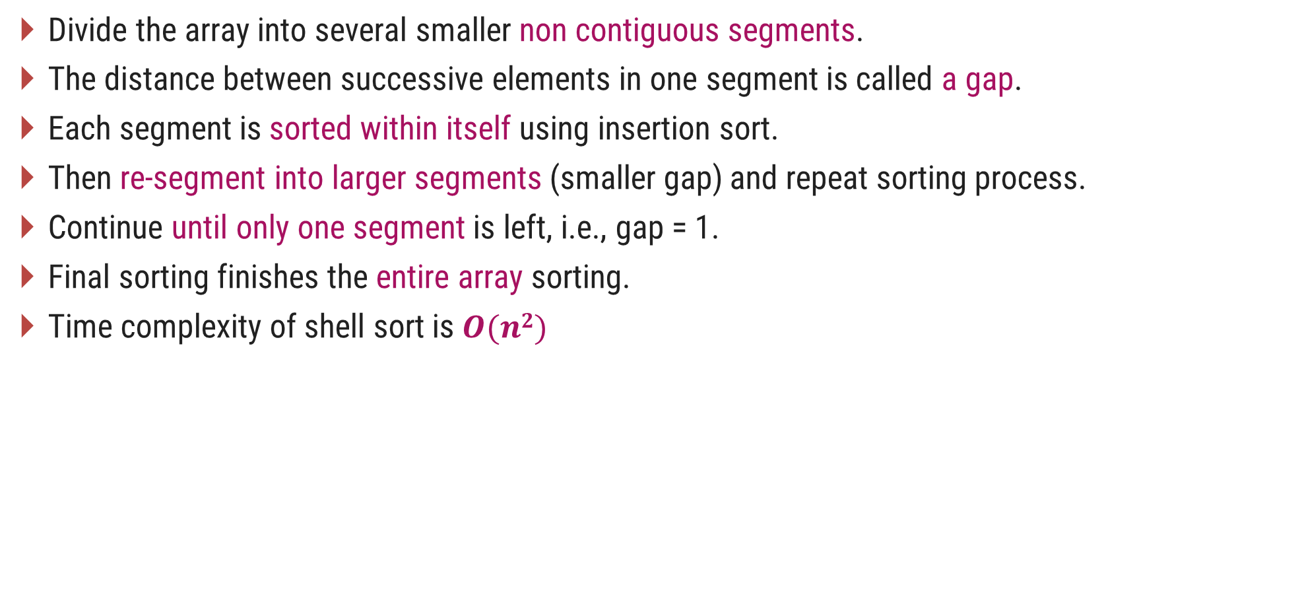
Shell Sort - Procedure
Divide the array into several smaller non contiguous segments.
The distance between successive elements in one segment is called a gap.
Each segment is sorted within itself using insertion sort.
Then re-segment into larger segments (smaller gap) and repeat sorting process.
Continue until only one segment is left, i.e., gap = 1.
Final sorting finishes the entire array sorting.
Time complexity of shell sort is $O(n2)$

Slide 35
Radix Sort
Radix Sort puts the elements in order by comparing the digits of the numbers.
Each element in the 𝒏-element array 𝑨 has 𝒅 digits, where digit 1 is the lowest-order digit and digit 𝑑 is the highest order digit.
Sort following elements in Ascending order using radix sort.
363, 729, 329, 873, 691, 521, 435, 297
Algorithm: RADIX-SORT(A, d)
for i ← 1 to d
do use a stable sort to sort array A on digit i

Slide 36
Radix Sort - Example
3 6 3
6 9 1
5 2 1
7 2 9
5 2 1
7 2 9
3 2 9
3 6 3
3 2 9
8 7 3
8 7 3
4 3 5
6 9 1
4 3 5
3 6 3
5 2 1
2 9 7
8 7 3
4 3 5
7 2 9
6 9 1
2 9 7
3 2 9
2 9 7
Sort on column 1
Sort on column 2
The entire array is sorted now.
Sort on column 3

Slide 37
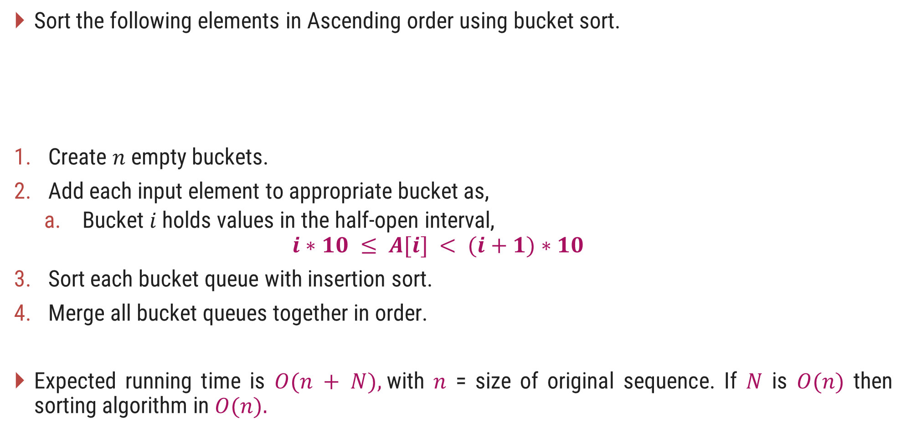
Bucket Sort – Introduction
Sort the following elements in Ascending order using bucket sort.
Create $n$ empty buckets.
Add each input element to appropriate bucket as,
Bucket $i$holds values in the half-open interval,
$$i∗10 ≤ A[i] < (i+1)∗10$$
Sort each bucket queue with insertion sort.
Merge all bucket queues together in order.
Expected running time is $O(n + N),$with $n$ = size of original sequence. If $N$ is $O(n)$ then sorting algorithm in $O(n).$
45 | 96 | 29 | 30 | 27 | 12 | 39 | 61 | 91

Slide 38
Bucket Sort – Example
45 | 96 | 29 | 30 | 27 | 12 | 39 | 61 | 91
45
96
29
30
27
12
39
61
91
29
96
27
39
91
12
27
30
29
45
61
91
96
0
1
2
3
4
5
6
7
8
9
Sort each bucket queue with insertion sort
Merge all bucket queues together in order
12 | 27 | 29 | 30 | 39 | 45 | 61 | 91 | 96

Slide 39
Bucket Sort - Algorithm
# Input: Array A
# Output: Sorted array A
Algorithm: Bucket-Sort(A[1,…,n])
n ← length[A]
for i ← 1 to n do
insert A[i] into bucket B[⌊A[i] ÷ n ⌋]
for i ← 0 to n – 1 do
sort bucket B[i] with insertion sort
concatenate the buckets B[0], B[1], . . ., B[n - 1] together in order.

Slide 40
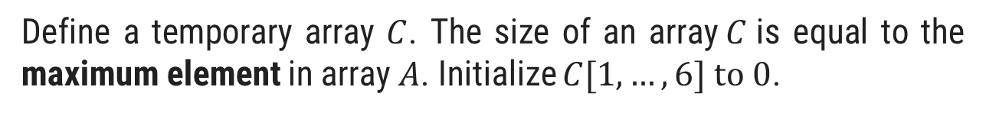
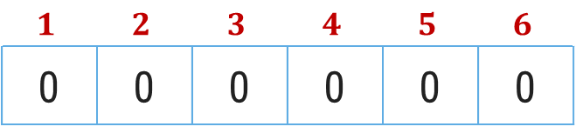
Counting Sort – Example
Sort the following elements in Ascending order using counting sort.
3 | 6 | 4 | 1 | 3 | 4 | 1 | 4 | 2
Step 1
Given elements are stored in an input array $A[1,…,9]$
Index
$$1$$ | $$2$$ | $$3$$ | $$4$$ | $$5$$ | $$6$$ | $$7$$ | $$8$$ | $$9$$
Elements
3 | 6 | 4 | 1 | 3 | 4 | 1 | 4 | 2
Step 2
Define a temporary array $C$. The size of an array$C$is equal to the maximum element in array $A$. Initialize $C[1,…,6] to 0$.
Index
$$1$$ | $$2$$ | $$3$$ | $$4$$ | $$5$$ | $$6$$
0 | 0 | 0 | 0 | 0 | 0
Elements

Slide 41

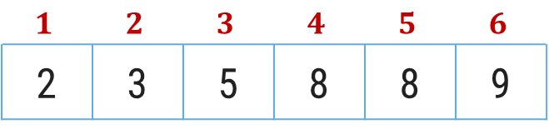
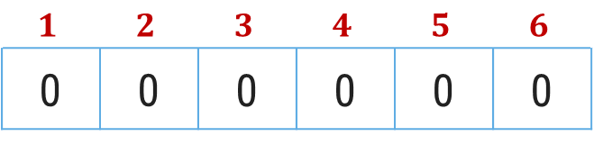
Counting Sort – Example
Sort the following elements in Ascending order using counting sort.
Input array$A$
3 | 6 | 4 | 1 | 3 | 4 | 1 | 4 | 2
Step 3
Update an array C with the occurrences of each value of array 𝐴
Index
$$1$$ | $$2$$ | $$3$$ | $$4$$ | $$5$$ | $$6$$
0 | 0 | 0 | 0 | 0 | 0
Elements
2
1
2
3
0
1
+
+
Step 4
In array 𝐶, from index 2 to 𝑛 add the value with previous element
Index
$$1$$ | $$2$$ | $$3$$ | $$4$$ | $$5$$ | $$6$$
2 | 3 | 5 | 8 | 8 | 9
Elements

Slide 42
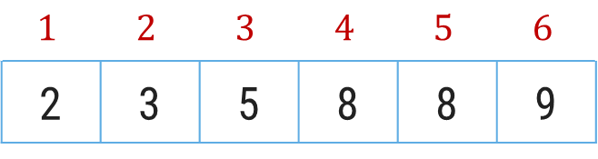
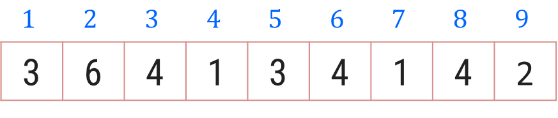

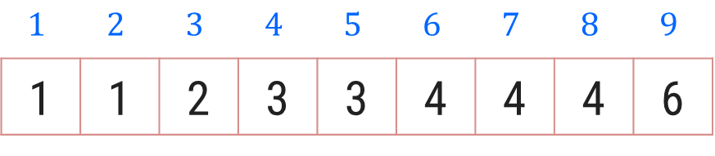
Counting Sort – Example
Create an output array 𝐵[1…9]. Start positioning elements of Array 𝐴 𝑡𝑜 𝐵 as shown below.
$$1$$ | $$2$$ | $$3$$ | $$4$$ | $$5$$ | $$6$$ | $$7$$ | $$8$$ | $$9$$
3 | 6 | 4 | 1 | 3 | 4 | 1 | 4 | 2
Input array$A$
$$1$$ | $$2$$ | $$3$$ | $$4$$ | $$5$$ | $$6$$
2 | 3 | 5 | 8 | 8 | 9
Temporary Array C
1
2
4
6
7
0
3
5
8
$$1$$ | $$2$$ | $$3$$ | $$4$$ | $$5$$ | $$6$$ | $$7$$ | $$8$$ | $$9$$
1 | 1 | 2 | 3 | 3 | 4 | 4 | 4 | 6
Output Array B

Slide 43
Counting Sort - Procedure
Counting sort assumes that each of the 𝑛 input elements is an integer in the range 0 to 𝑘, for some integer 𝑘.
When 𝒌=𝑶(𝒏), the counting sort runs in 𝜽(𝒏) time.
The basic idea of counting sort is to determine, for each input element 𝑥, the number of elements less than 𝑥.
This information can be used to place element 𝑥 directly into its position in the output array.

Slide 44
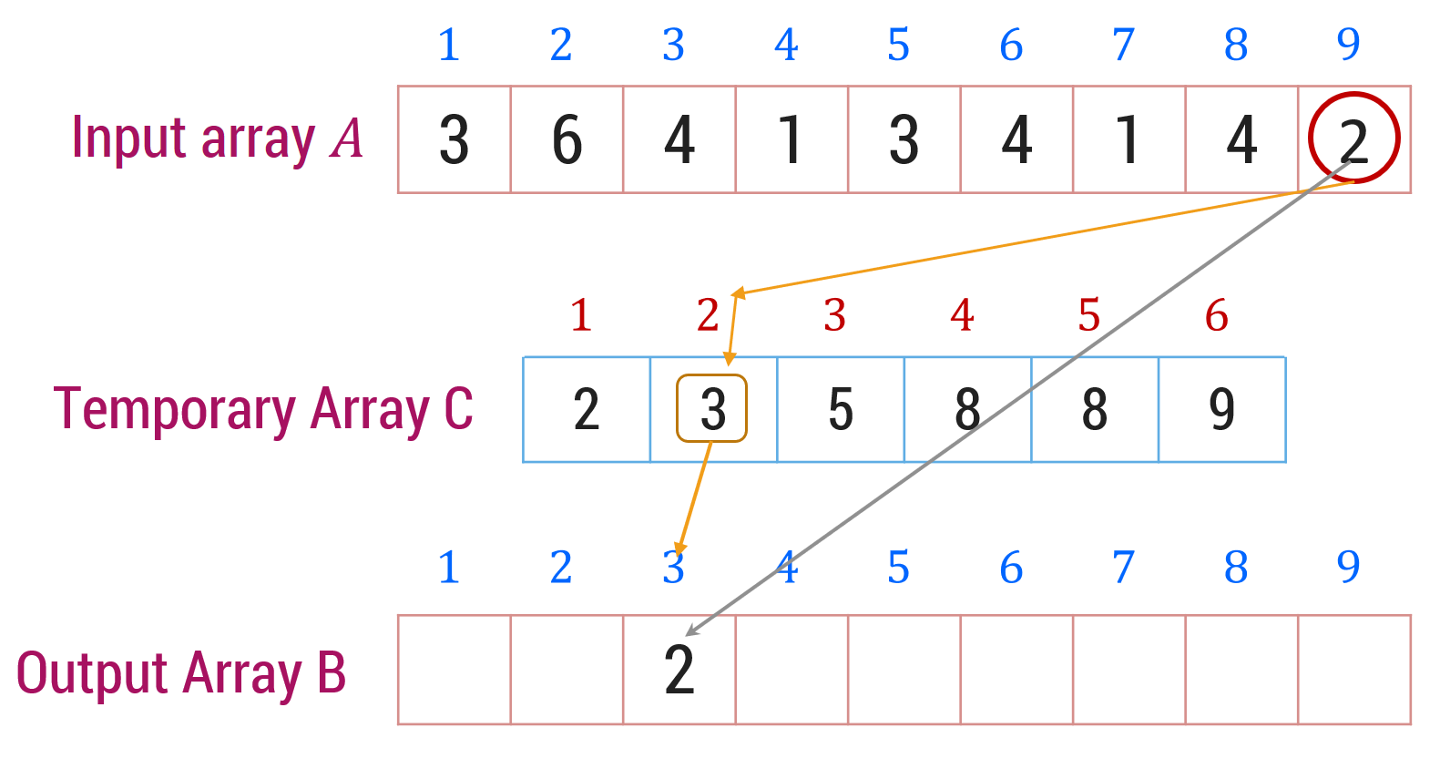
Counting Sort - Algorithm
# Input: Array A
# Output: Sorted array A
Algorithm: Counting-Sort(A[1,…,n], B[1,…,n], k)
for i ← 1 to k do
c[i] ← 0
for j ← 1 to n do
c[A[j]] ← c[A[j]] + 1
for i ← 2 to k do
c[i] ← c[i] + c[i-1]
for j ← n downto 1 do
B[c[A[j]]] ← A[j]
c[A[j]] ← c[A[j]] - 1

Slide 45
Strassen’s Algorithm for Matrix Multiplication

Slide 46
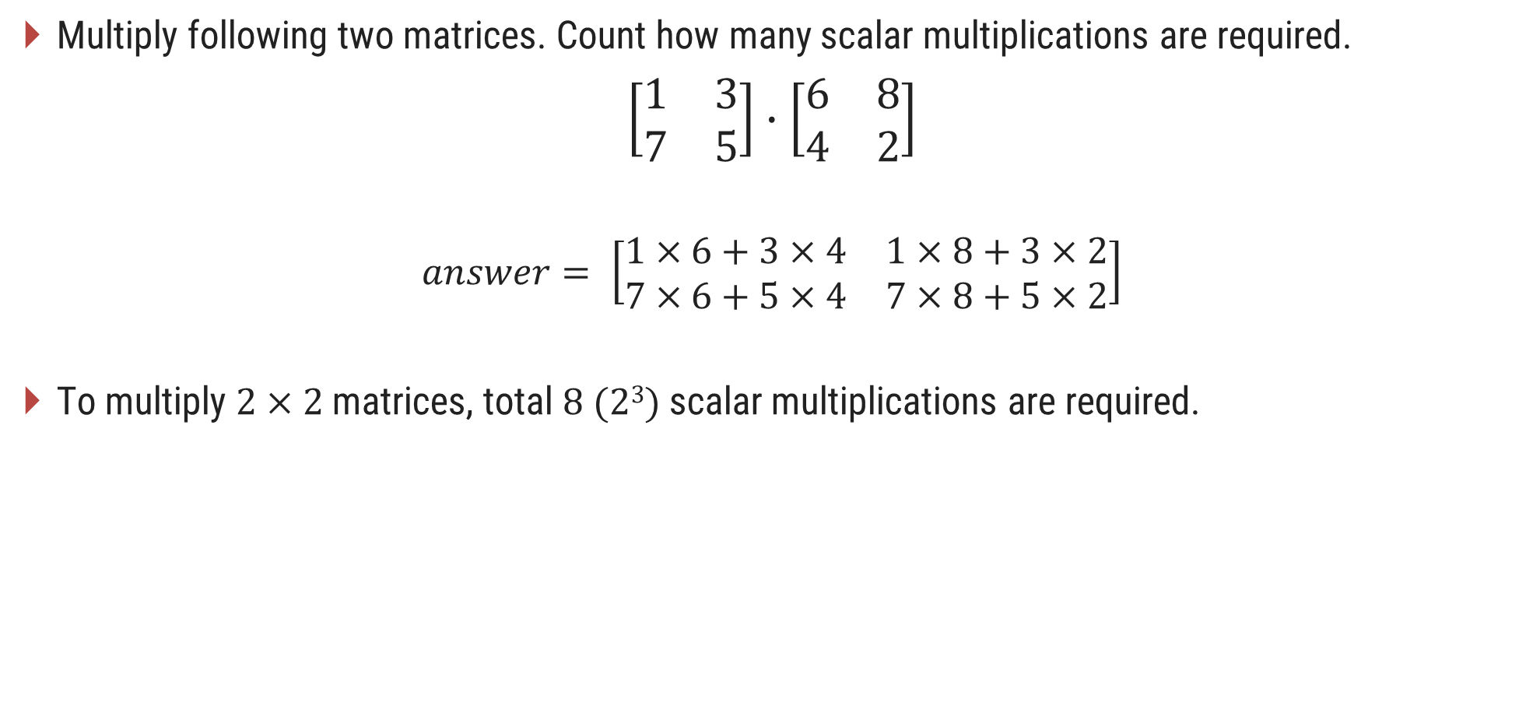
Matrix Multiplication
Multiply following two matrices. Count how many scalar multiplications are required.
$$\left[\begin{matrix}1 & 3 \\ 7 & 5\end{matrix}\right]∙\left[\begin{matrix}6 & 8 \\ 4 & 2\end{matrix}\right]$$
$$answer= \left[\begin{matrix}1×6+3×4 & 1×8+3×2 \\ 7×6+5×4 & 7×8+5×2\end{matrix}\right]$$
To multiply $2×2$matrices, total $8 (23)$scalar multiplications are required.

Slide 47
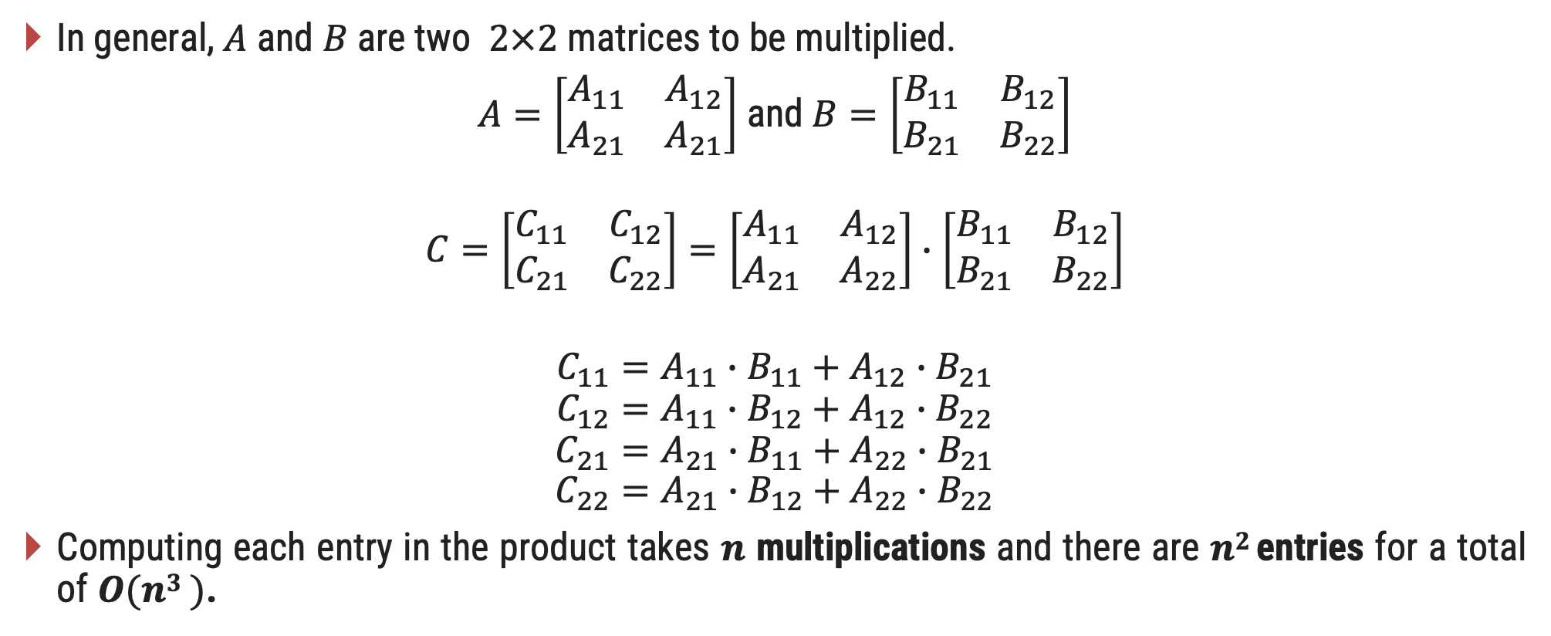
Matrix Multiplication
In general, $A$ and $B$ are two $2×2$ matrices to be multiplied.
$A=\left[\begin{matrix}A_{11} & A_{12} \\ A_{21} & A_{21}\end{matrix}\right]$ and $B=\left[\begin{matrix}B_{11} & B_{12} \\ B_{21} & B_{22}\end{matrix}\right]$
$$C=\left[\begin{matrix}C_{11} & C_{12} \\ C_{21} & C_{22}\end{matrix}\right]=\left[\begin{matrix}A_{11} & A_{12} \\ A_{21} & A_{22}\end{matrix}\right]∙\left[\begin{matrix}B_{11} & B_{12} \\ B_{21} & B_{22}\end{matrix}\right]$$
$$C_{11}=A_{11}∙B_{11}+A_{12}∙B_{21}$$
$$C_{12}=A_{11}∙B_{12}+A_{12}∙B_{22}$$
$$C_{21}=A_{21}∙B_{11}+A_{22}∙B_{21}$$
$$C_{22}=A_{21}∙B_{12}+A_{22}∙B_{22}$$
Computing each entry in the product takes $n$ multiplications and there are $n2$ entries for a total of $O(n3 )$.

Slide 48

Strassen’s Algorithm for Matrix Multiplication
Consider the problem of multiplying two $n × n$matrices.
Strassen’s devised a better method which has the same basic method as the multiplication of long integers.
The main idea is to save one multiplication on a small problem and then use recursion.

Slide 49
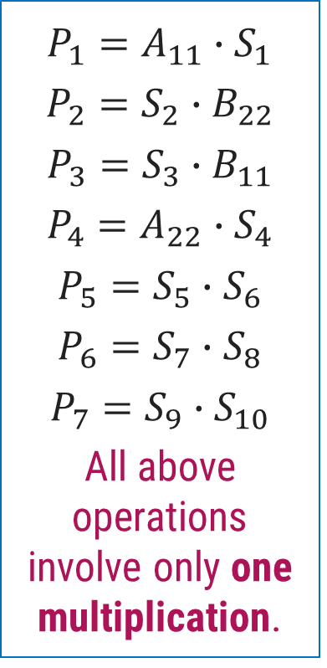
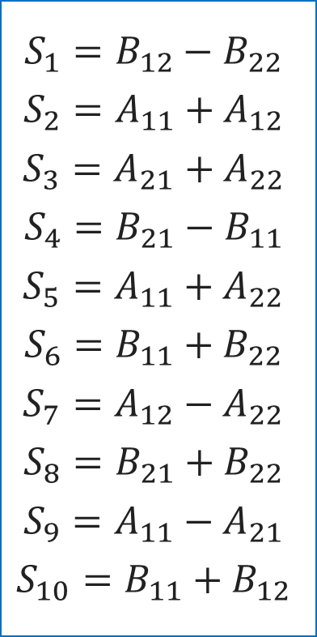
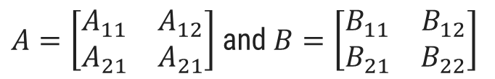
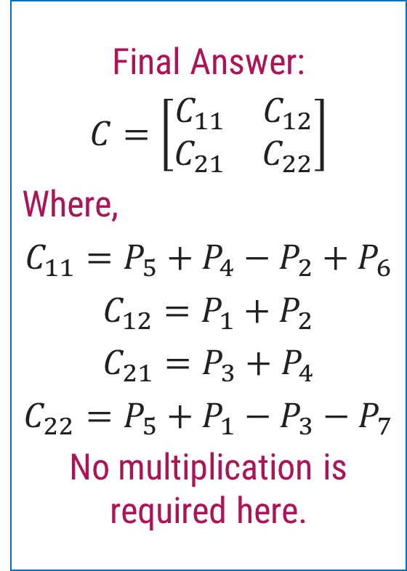
Strassen’s Algorithm for Matrix Multiplication
$A=\left[\begin{matrix}A_{11} & A_{12} \\ A_{21} & A_{21}\end{matrix}\right]$ and $B=\left[\begin{matrix}B_{11} & B_{12} \\ B_{21} & B_{22}\end{matrix}\right]$
Step 1
Step 2
Step 3
$$S_{1}=B_{12}−B_{22}$$
$$S_{2}=A_{11}+A_{12}$$
$$S_{3}=A_{21}+A_{22}$$
$$S_{4}=B_{21}−B_{11}$$
$$S_{5}=A_{11}+A_{22}$$
$$S_{6}=B_{11}+B_{22}$$
$$S_{7}=A_{12}−A_{22}$$
$$S_{8}=B_{21}+B_{22}$$
$$S_{9}=A_{11}−A_{21}$$
$$S_{10}=B_{11}+B_{12}$$
$$P_{1}=A_{11}∙S_{1}$$
$$P_{2}=S_{2}∙B_{22}$$
$$P_{3}=S_{3}∙B_{11}$$
$$P_{4}=A_{22}∙S_{4}$$
$$P_{5}=S_{5}∙S_{6}$$
$$P_{6}=S_{7}∙S_{8}$$
$$P_{7}=S_{9}∙S_{10}$$
All above operations involve only one multiplication.
Final Answer:
$$C=\left[\begin{matrix}C_{11} & C_{12} \\ C_{21} & C_{22}\end{matrix}\right]$$
Where,
$$C_{11}=P_{5}+P_{4}−P_{2}+P_{6}$$
$C_{12}=P_{1}+P_{2}$
$$C_{21}=P_{3}+P_{4}$$
$$C_{22}=P_{5}+P_{1}−P_{3}−P_{7}$$
No multiplication is required here.

Slide 50

Strassen’s Algorithm - Analysis
It is therefore possible to multiply two $2 × 2$matrices using only seven scalar multiplications.
Let $t(n)$ be the time needed to multiply two $n × n$matrices by recursive use of equations.
$$t(n)= 7t(n/2) + g(n)$$
Where $g(n) ∈ O(n2).$

Slide 51
Thank You!

