Slide 1


Slide 2
Unit 4: Graph Representation and String Matching

Slide 3
Outline
Graph Traversal algorithms
Breadth First Search, Depth First Search,
Minimum Spanning Tree
Prim’s and Kruskal’s Algorithm,
Shortest Path Algorithm
Dijkstra’s Algorithm,
All Pair Shortest Path,
Introduction to String Matching
The naive string matching algorithm, The Rabin-Karp algorithm
The Knuth-Morris-Pratt algorithm.

Slide 4
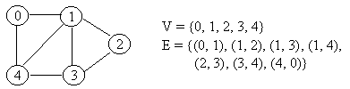
Graphs
Graph G = (V, E) where V is a set of vertices (nodes) and E is a set of edges (arcs, in case of digraphs).

Slide 5
Graph Terminology
Vertex
A individual data element of a graph is called as Vertex.
Vertex is also known as node.
Edge
An edge is a connecting link between two vertices.
Edge is also known as Arc.
An edge is represented as (startingVertex, endingVertex).

Slide 6
Terminology
Edges are three types.
Undirected Edge - An undirected edge is a bidirectional edge. If there is a undirected edge between vertices A and B then edge (A , B) is equal to edge (B , A).
Directed Edge - A directed edge is a unidirectional edge. If there is a directed edge between vertices A and B then edge (A , B) is not equal to edge (B , A).
Weighted Edge - A weighted edge is an edge with cost on it.

Slide 7
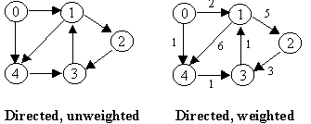
Directed graph
A graph with only directed edges is said to be directed graph.
Each edge has a sense of direction from u to v and is written as an ordered pair <u,v> or u->v.
Undirected graph
A graph with only undirected edges is said to be undirected graph.
Each edge has no sense of direction and is written as an unordered pair {u,v} or u<->v.
Weighted graph/ network
Each edge is weighted.

Slide 8
Degree - the number of edges with respect to a node.
Undirected Graphs - number of edges incident to node.
Directed Graphs
Indegree - number of edges coming into the node.
Outdegree - number of edges going out of node.
Parallel edges
If there are two undirected edges to have the same end vertices, and for two directed edges to have the same origin and the same destination. Such edges are called parallel edges or multiple edges.
h and i are parallel edges
Self-loop – single edge begins and ends at same vertex.
An edge (undirected or directed) is a self-loop if its two endpoints coincide.
j is a self-loop

Slide 9
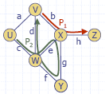
Path
A path is a sequence of alternating vertices and edges that starts at a vertex and ends at a vertex such that each edge is incident to its predecessor and successor vertex.
Length of a path
number of edges in the path
Simple path
path in which no vertex is repeated
P1=(V,b,X,h,Z) is a simple path
P2=(U,c,W,e,X,g,Y,f,W,d,V) is a not a simple path

Slide 10
Cycle
A cycle is a path consisting of at least three vertices that starts and ends with the same vertex.
A graph with no cycles is called a tree
Simple cycle
Cycle in which no vertex is visited more than once along the cycle’s path.
C1=(V,b,X,g,Y,f,W,c,U,a,V) is a simple cycle
C2=(U,c,W,e,X,g,Y,f,W,d,V,a,U) is not a simple cycle

Slide 11
Connected Vertices–
2 vertices are said to be connected if there is a path between them.
A graph is connected if there is a path from any vertex to any other vertex.
Strongly Connected Graph–
A directed graph is strongly connected there is a path from each vertex to every other vertex in the digraph.
Weakly Connected –
A directed graph is weakly connected if at least two vertices are not connected.
A connected undirected graph would always be Strongly Connected.
Disjoint graph – not connected

Slide 12
A
A
B
E
B
E
G
G
F
F
C
D
H
I
C
D
H
I
Weakly Connected
Strongly Connected
A
B
E
G
F
Disjoint Graph
C
D
H
I

Slide 13
Graph Representation
Adjacency matrix
Adjacency List

Slide 14
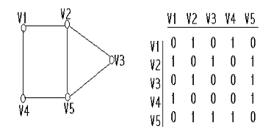
Adjacency matrix
n by n matrix, where n is number of vertices
A(m,n) = 1 iff (m,n) Є E ,
0 otherwise
If V_{i} is adjacent to V_{j}, then place 1 at the i^{th} row and j^{th} column and 1 at j^{th} row and i^{th} column; place 0 otherwise.
The adjacency matrix is symmetric for a simple graph.

Slide 15
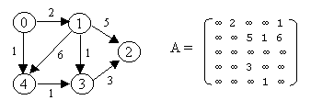

Digraph - for each directed edge (V_{i}, V_{j}), we place 1 at i^{th} row and j^{th} column
Adjacency matrix, in general, is not symmetric for a digraph.
Weighted graph:
A(m,n) = w (weight of edge), or positive infinity (or 0) otherwise

Slide 16
Advantage of matrix representation of graph
Simple
Disadvantages of matrix representation of graph
Additional information about graph can not be stored.
Insertion/ Deletion of node requires changing dimension of matrix.
Wastage of space. Even if no edge is present in graph (null graph) of n nodes, a n x n matrix will be allocated which will be containing all 0’s (null matrix).

Slide 17
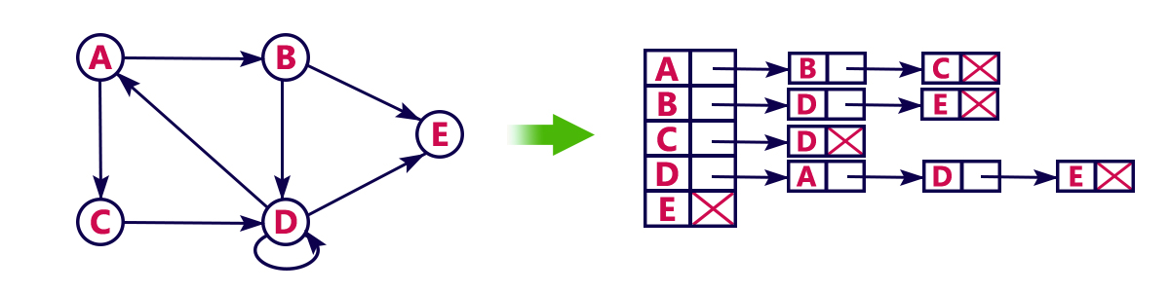
Adjacency list
In this representation, every vertex of graph contains list of its adjacent vertices.
For a graph G = (V,E) a list is formed for each element x of V, containing all nodes y such that (x,y) Є E.

Slide 18
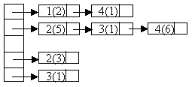
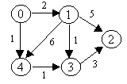
Advantages
Insertion/ Deletion simpler.
Possible to store additional information of nodes and edges.
Better when adjacency matrix is sparse

Slide 19
Traversal
Graph traversal is technique used for searching a vertex in a graph.
The graph traversal is also used to decide the order of vertices to be visit in the search process.
A graph traversal finds the edges to be used in the search process without creating loops that means using graph traversal we visit all vertices of graph without getting into looping path.

Slide 20
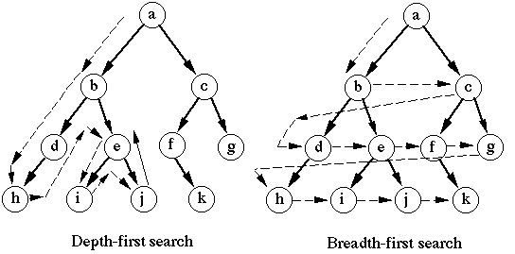
Traversal
Depth First Traversal
Breadth First Traversal

Slide 21
Depth First Traversal
DFS traversal of a graph, produces a spanning tree as final result.
Spanning Tree is a graph without any loops.
We use Stack data structure with maximum size of total number of vertices in the graph to implement DFS traversal of a graph.

Slide 22
Steps to implement DFS traversal
Step 1: Define a Stack of size total number of vertices in the graph.
Step 2: Select any vertex as starting point for traversal. Visit that vertex and push it on to the Stack.
Step 3: Visit any one of the adjacent vertex of the vertex which is at top of the stack which is not visited and push it on to the stack.
Step 4: Repeat step 3 until there are no new vertex to be visit from the vertex on top of the stack.
Step 5: When there is no new vertex to be visit then use back tracking and pop one vertex from the stack.
Step 6: Repeat steps 3, 4 and 5 until stack becomes Empty.
Step 7: When stack becomes Empty, then produce final spanning tree by removing unused edges from the graph

Slide 23
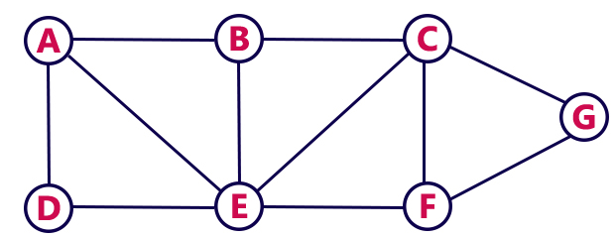
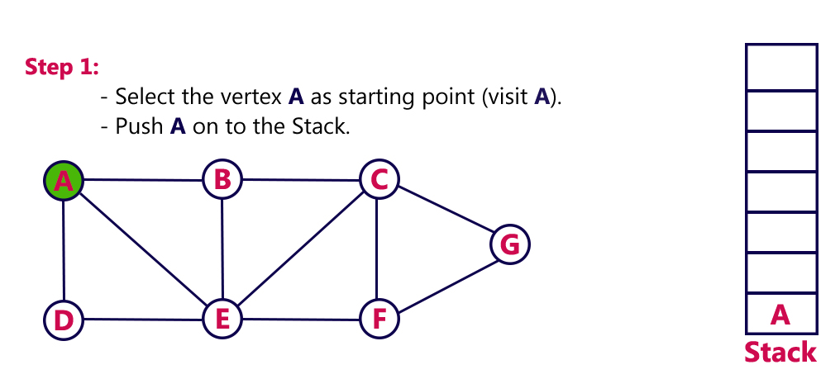
Example:

Slide 24
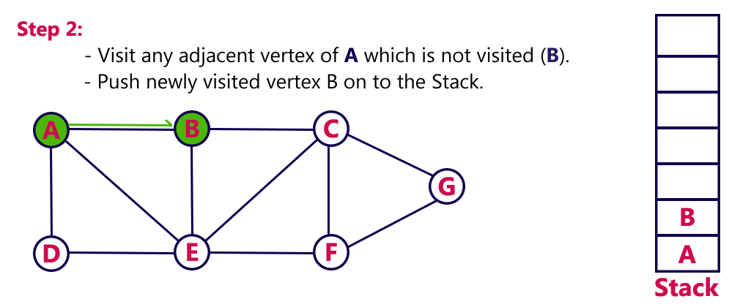
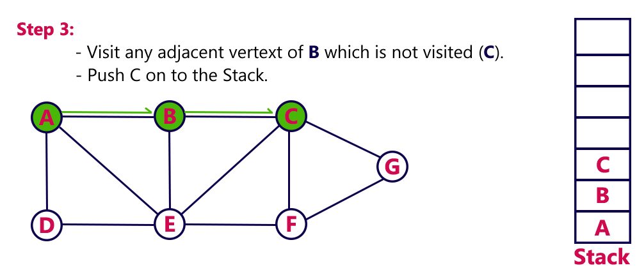

Slide 25
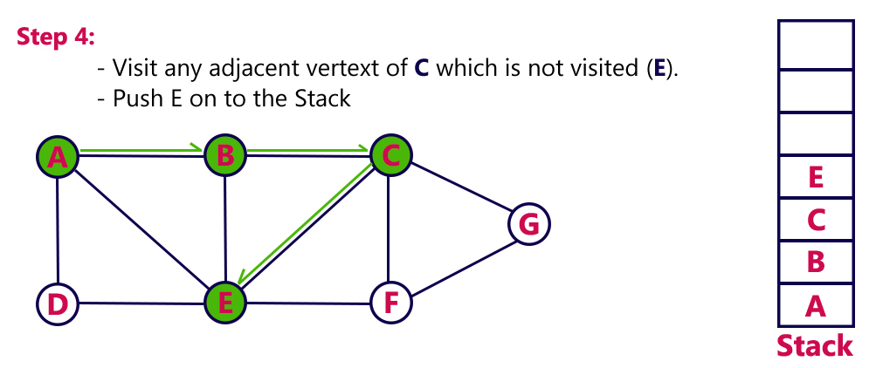
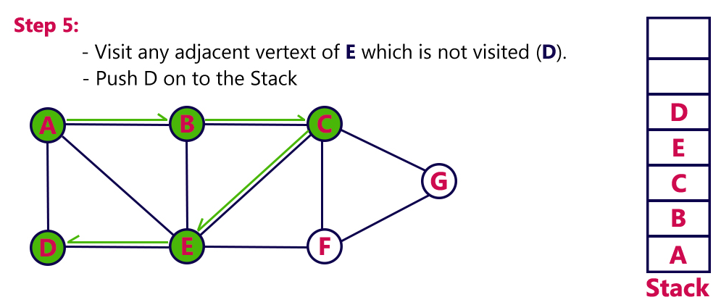

Slide 26
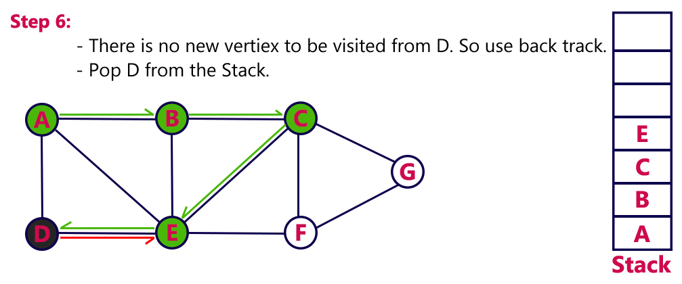
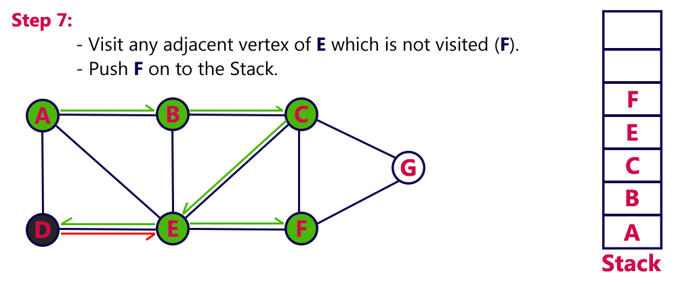

Slide 27
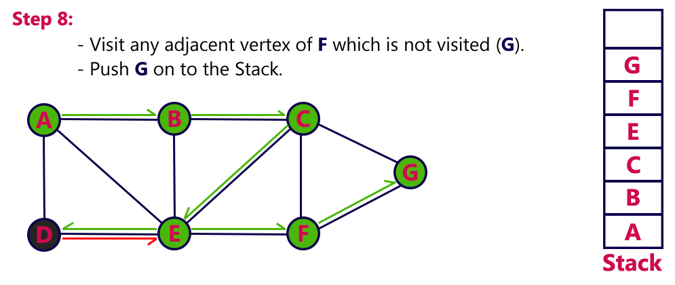

Slide 28
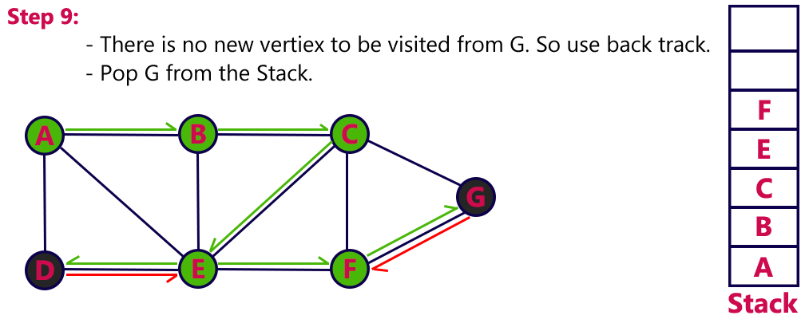
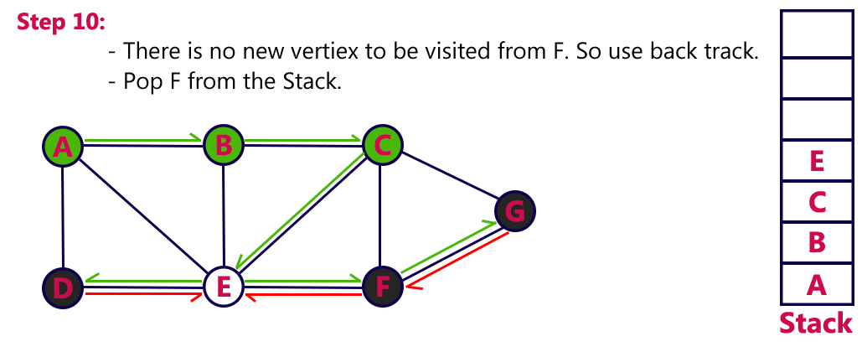

Slide 29
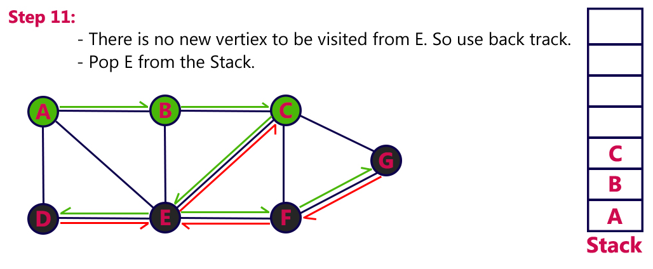
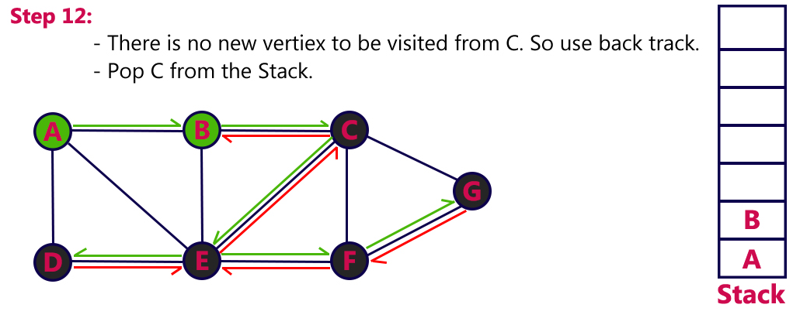

Slide 30
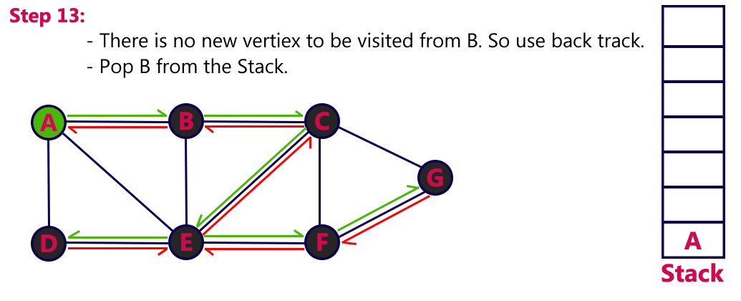

Slide 31
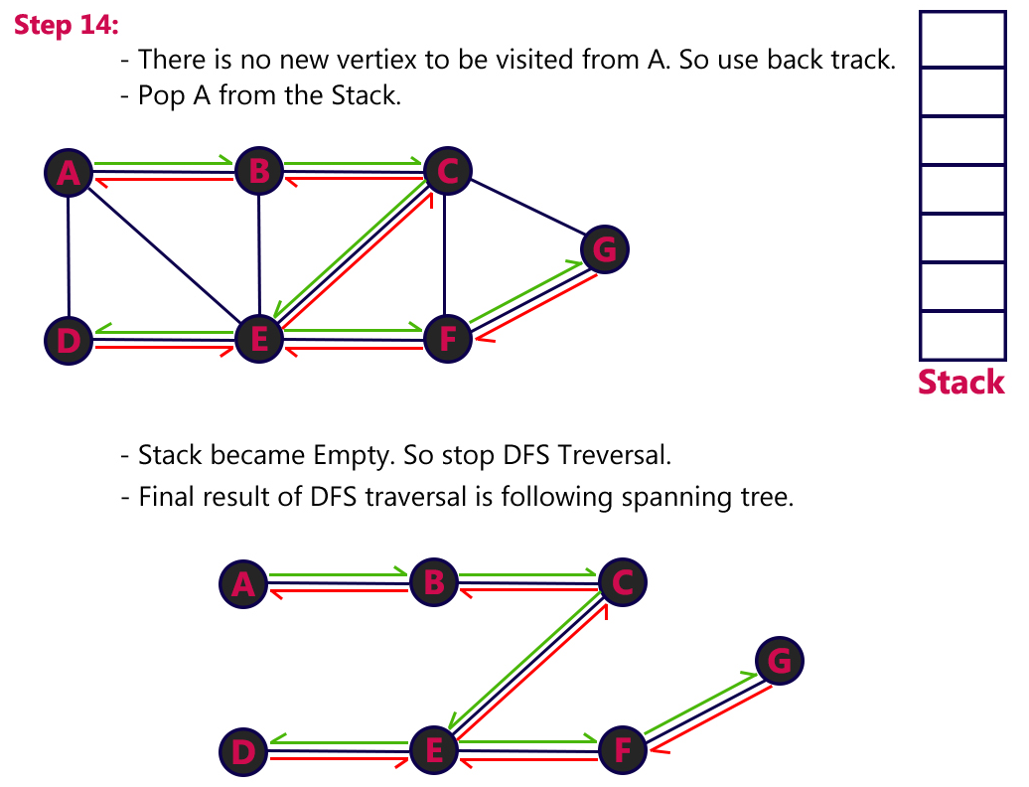

Slide 32
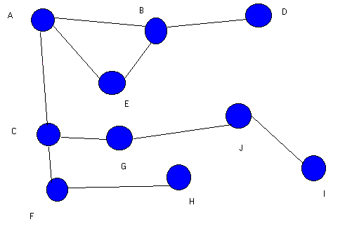
Ques: DFT for the above graph

Slide 33
Algorithm DFT (G <graph>)
Pre: G is graph structure;Post: Graph traversed in Depth First
for (all v in G)
visited[v] = false
for (all v in G)
if (not visited[v])
traverse(v)
Algo traverse(v <vertex of graph>)
visited[v] = true
process v
for (all w adjacent to v )
if (not visited[w])
traverse(w)
Time Complexity: O(n+E)

Slide 34
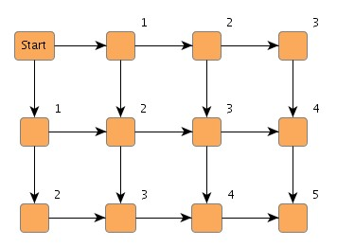
Breadth First Traversal
Beginning at a starting node breadth-first search visits all of its direct neighbors (having distance 1) before it in turn uses these already visited nodes as new starting nodes to continue with their direct neighbors. That way, it visits all reachable nodes at distance k to the original starting node before those at distance k+1.

Slide 35
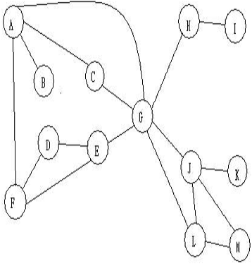

Slide 37
Algorithm BFS (G <graph>)
Pre: G is graph structure;Post: Graph traversed in Breadth First
for (all v in G)
visited[v] = false
for (all v in G)
if (not visited[v])
add(v, queue)
while (queue not empty)
v = delete (queue)
if (not visited[v])
visited[v]=true
process v
for (all w adjacent to v)
if (not visited[w])
1. add(w, queue)

Slide 38
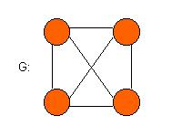
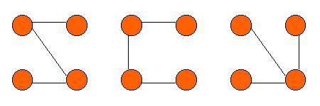
Spanning Trees
A spanning tree of a connected graph is the smallest set of edges such that all nodes of the graph are connected. Addition of one more edge will result into a cycle.
Graph
Three (of the many possible) spanning trees from graph

Slide 39
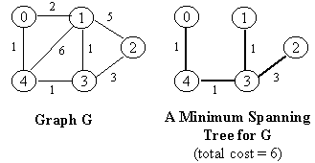
Minimum Spanning Trees (MST)
A minimum spanning tree T of an graph G is a subgraph of G that connects all the vertices in G at the lowest total cost.

Slide 40
If weights of edges in a network are unique, then there will be a unique MST. If there are duplicate weights, there can be more than one MST’s.
MST is used as one of the most important tools to analyze computer networks (e.g. cabling, network load capacity, optimal flow).
Two algorithms:
Prim's algorithm
Kruskal's algorithm.

Slide 41
Prim's Algorithm
Include an edge of minimum cost in your Spanning Tree
Repeatedly include the next edge (u, v)
u should be in the tree , v should not be.
Cost of (u, v) is minimum among all alternative edges (i.e., all edges connected from any vertex/node in the tree built so far).
The algorithm stops when all the nodes have been reached

Slide 42
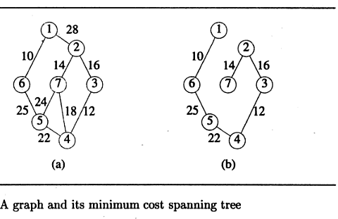
Prims algorithm

Slide 43
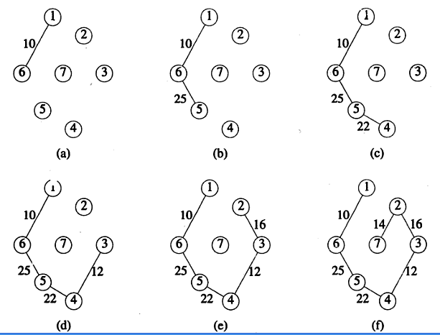

Slide 44
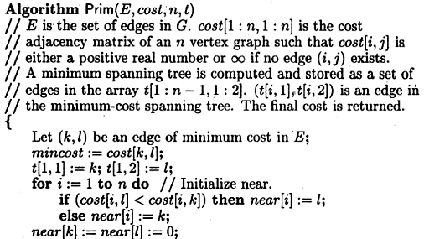

Slide 45
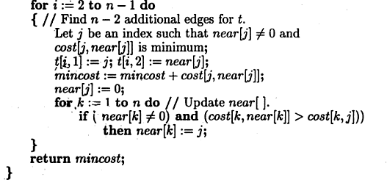
Time Complexity: O(n^2)
N- No. of nodes

Slide 46
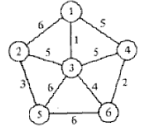
 | 1 | 2 | 3 | 4 | 5 | 6
1 | ∞ | 6 | 1 | 5 | ∞ | ∞
2 | 6 | ∞ | 5 | ∞ | 3 | ∞
3 | 1 | 5 | ∞ | 5 | 6 | 4
4 | 5 | ∞ | 5 | ∞ | ∞ | 2
5 | ∞ | 3 | 6 | ∞ | ∞ | 6
6 | ∞ | ∞ | 4 | 2 | 6 | ∞
 | 1 | 2 | 3 | 4 | 5 | 6
near | -1 | 1 | 1 | 1 | 1 | 1

Slide 47
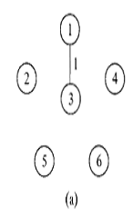
 | 1 | 2 | 3 | 4 | 5 | 6
near | -1 | 3 | -1 | 1 | 3 | 3
Cost |  | 5 |  | 5 | 6 | 4
t
1 | 3
 | 1 | 2 | 3 | 4 | 5 | 6
near | -1 | 3 | -1 | 6 | 3 | -1
Cost |  | 5 |  | 2 | 6
t
1 | 3
3 | 6

Slide 48
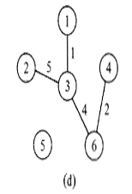
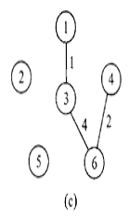
 | 1 | 2 | 3 | 4 | 5 | 6
near | -1 | 3 | -1 | -1 | 3 | -1
t
1 | 3
3 | 6
6 | 4
Cost |  | 5 |  |  | 6
 | 1 | 2 | 3 | 4 | 5 | 6
near | -1 | -1 | -1 | -1 | 2 | -1
Cost |  |  |  |  | 6
t
1 | 3
3 | 6
6 | 4
3 | 2

Slide 49
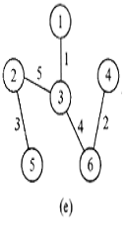
 | 1 | 2 | 3 | 4 | 5 | 6
near | -1 | -1 | -1 | -1 | -1 | -1
Cost
t
1 | 3
3 | 6
6 | 4
3 | 2
2 | 5

Slide 50
Kruskal's Algorithm
The main idea is to
start with a set (called forest) of singleton trees, and
merge two trees at a time, unless it creates a cycle in the merged tree, until the forest becomes one tree.

Slide 51
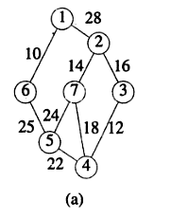
Find minimum spanning tree using kruskal’s algorithm

Slide 52
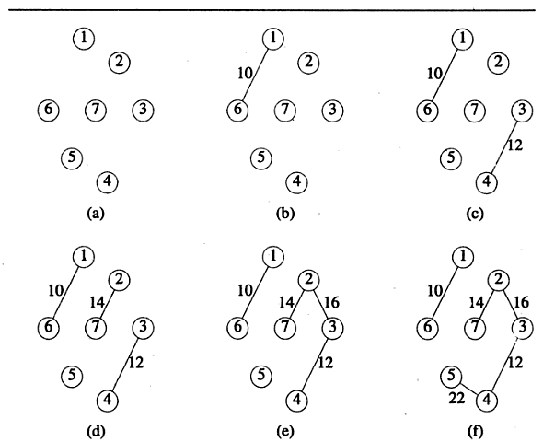

Slide 53
Algorithm union (i, j)
Pre: i vertex, j vertex
Post: j made parent of i.
p[i] = j
Algorithm find(i)
Pre: i vertex whose parent is to be found
Post: return parent of i
while (p[i] >= 0)
i = p[i]
return i

Slide 54
Algorithm Kruskal (E, cost, n, t)
Pre: E - set of edges in graph G, cost - n x n cost matrix, n – no. of vertices, t – (n-1) x 2 array storing edge list of MST
Post: MST is stored in array t
construct a heap out of edge costs using heapify
for i = 1 to n
parent[i] = -1
i = 0
mincost = 0

Slide 55
while (i < n-1 and heap not empty)
Delete minimum cost edge (u, v) from heap and reheapify
j = find (u)
k = find(v)
If ( j <> k)
i = i + 1
t[i,1] = u
t[I,2] = v
mincost = mincost + cost(u, v)
union(j, k)
return mincost
Time Complexity: O(n*e) i.e O(n^2) if no. of edges are same as no. of nodes(without min Heap)
By using minheap time complexity is O(nlogn)

Slide 56
 | 1 | 2 | 3 | 4 | 5 | 6
1 | ∞ | 6 | 1 | 5 | ∞ | ∞
2 | 6 | ∞ | 5 | ∞ | 3 | ∞
3 | 1 | 5 | ∞ | 5 | 6 | 4
4 | 5 | ∞ | 5 | ∞ | ∞ | 2
5 | ∞ | 3 | 6 | ∞ | ∞ | 6
6 | ∞ | ∞ | 4 | 2 | 6 | ∞
 | 1 | 2 | 3 | 4 | 5 | 6
parent | -1 | -1 | -1 | -1 | -1 | -1
1
3
1
4
6
2
2
5
3
3
6
4
1
4
5
2
3
5
3
4
5
3
5
6
1
2
6
5
6
6
Start
End vertex
Cost

Slide 57
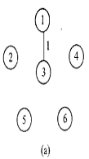
t
1 | 3
 | 1 | 2 | 3 | 4 | 5 | 6
parent | 3 | -1 | -1 | -1 | -1 | -1
1
3
1
4
6
2
2
5
3
3
6
4
1
4
5
2
3
5
3
4
5
3
5
6
1
2
6
5
6
6
Start
End vertex
Cost

Slide 58
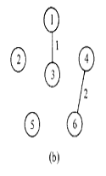
t
1 | 3
4 | 6
 | 1 | 2 | 3 | 4 | 5 | 6
parent | 3 | -1 | -1 | 6 | -1 | -1
1
3
1
4
6
2
2
5
3
3
6
4
1
4
5
2
3
5
3
4
5
3
5
6
1
2
6
5
6
6
Start
End vertex
Cost

Slide 59
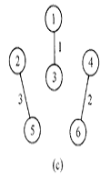
t
1 | 3
4 | 6
2 | 5
 | 1 | 2 | 3 | 4 | 5 | 6
parent | 3 | 5 | -1 | 6 | -1 | -1
1
3
1
4
6
2
2
5
3
3
6
4
1
4
5
2
3
5
3
4
5
3
5
6
1
2
6
5
6
6
Start
End vertex
Cost

Slide 60
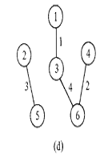
t
1 | 3
4 | 6
2 | 5
3 | 6
 | 1 | 2 | 3 | 4 | 5 | 6
parent | 3 | 5 | 6 | 6 | -1 | -1
1
3
1
4
6
2
2
5
3
3
6
4
1
4
5
2
3
5
3
4
5
3
5
6
1
2
6
5
6
6
Start
End vertex
Cost

Slide 61
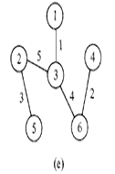
t
1 | 3
4 | 6
2 | 5
3 | 6
2 | 3
 | 1 | 2 | 3 | 4 | 5 | 6
parent | 3 | 5 | 6 | 6 | 6 | -1
Consider edge (1,4). But is rejected as both belong to same set ( have same parent). Then consider (2,3). We get n-1 edges, so we stop here.

Slide 62
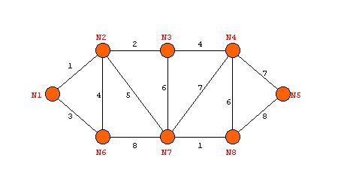
Example 1:

Slide 63
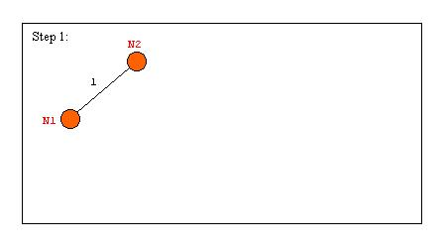
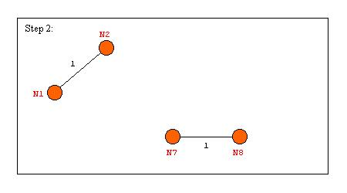

Slide 64
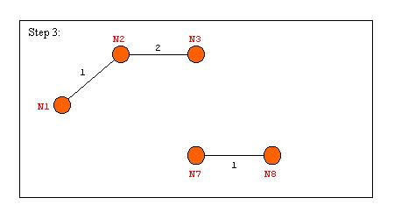


Slide 65



Slide 66


Slide 67
N1 to N2 - cost is 1 - add to tree
N7 to N8 - cost is 1 - add to tree
N2 to N3 - cost is 2 - add to tree
N1 to N6 - cost is 3 - add to tree
N2 to N6 - cost is 4 - reject because it forms a circuit
N3 to N4 - cost is 4 - add to tree
N2 to N7 - cost is 5 - add to tree
N3 to N7 - cost is 6 - reject because it forms a circuit
N4 to N8 - cost is 6 - reject because it forms a circuit
N4 to N7 - cost is 7 - reject because it forms a circuit
N4 to N5 - cost is 7 - add to tree
We stop here, because n -1 edges have been added. We are left with the minimum spanning tree, with a total weight of 23.

Slide 68

Example 2:
Edge | Weight | Action
(1,4) | 1 | Accepted
(6,7) | 1 | Accepted
(1,2) | 2 | Accepted
(3,4) | 2 | Accepted
(2,4) | 3 | Rejected
(1,3) | 4 | Rejected
(4,7) | 4 | Accepted
(3,6) | 5 | Rejected
(5,7) | 6 | Accepted

Slide 69


Example 3:

Slide 70


Example 4:

Slide 71
All pair shortest path
Let G(V,E) be the graph with n vertices.
The all pair shortest path problem is to determine a matrix A such that A(i,j) is the length of the shortest path from i to j.

Slide 72


Slide 73

Warshall’s Algorithm:

Slide 74


Slide 75
Single Source, All Destinations, Shortest Path

Slide 76
Dijkstra’s Algorithm
Single Source Shortest Path - shortest path from a given vertex ‘v’ to every other vertex.
Greedy Algorithm with following steps -
Start at source vertex and grow tree in steps.
At each step identify edges going out from tree to non-tree vertices.
Pick "best" (with lowest cumulative cost from start vertex) such vertex and add it to tree (along with connecting edge).
Consider edges leading out

Slide 77


Start at point A: Point A has 3 choices, either to go to B(3) or H(1) or C(6)
H is chosen since it only takes 1 units to reach point H.

Slide 78


Next alternatives are G(10-H), B(2-H, 3-A) and C (6-A). Choose edge (H, B)
Next alternatives are G(10-H) and C (6-A, 2-B). Choose edge (B, C)

Slide 79


Next alternatives are G(10-H) and D (1-C). Choose edge (C, D)
Next alternatives are G(10-H, 4-D), F(3-D), and E (6-D). Choose edge (F,D)

Slide 80


Next alternatives are G(10-H, 4-D, 2-F) and E (6-D, 3-F). Choose edge (F, G)
Next alternatives are E (6-D, 3-F). Choose edge (F, E)

Slide 81

Cost of MST = 1 + 2 + 2 + 1 + 3 + 2 + 3 = 14

Slide 82
Algorithm Dijkstra (v, cost, n)
Pre: v – starting vertex, cost - n x n cost matrix, n – no. of vertices
Post: Shortest path for all nodes found from v
for i = 1 to n
foundpath[i] = false
dist[i] = cost[v, i]
foundpath[v] = true
dist[v] = 0

Slide 83
4. for i = 2 to n-1
let u be a vertex such that (foundpath[u] = false) & dist[u] is minimum
foundpath[u] = true
for (each w adjacent to u s.t. foundpath[w] = 0)
if (dist[w] > dist[u] + cost[u, w])
dist[w] = dist[u] + cost[u, w]

Slide 84


Slide 85


Slide 86


Slide 87


Slide 88


Slide 89


Slide 91




Depth First Traversal

Slide 92


Slide 93
Thank You…

