Slide 1


Slide 2
Course Objective & Outcomes
Objective:
Net Technologies are blend of technologies supported by Microsoft .Net Framework that allows user to create various applications. Students will be able to work with various technologies provided by Microsoft .NET platform.
Outcomes:
After completion of this course, student will be able to:
To Review the components of .Net Framework
To practice Web based application
To create web applications using MVC framework
To practice basic database application using ADO.net
To designing, developing, and deploying APIs

Slide 3
Unit - 3
ASP.NET MVC

Slide 4
Contents
Introduction to ASP.NET MVC
MVC Architecture Overview
Controllers
Razor Views
LayoutView
PartialView
Models
HTML helpers
Action Filters
Model Validation
URLs and Routing

Slide 5
Introduction to ASP.NET MVC
Model-View-Controller (MVC) is a framework for developing applications which have become so popular these days.
Gone are the days when developers would go for ASP.NET to create applications from scratch.
MVC is a Model Controller View Pattern and using it in ASP.NET is ASP.NET MVC.
The basic need of introducing MVC was to make complex application development easy.
This design pattern is a lightweight framework which is integrated with various features such as master pages and membership based authentication. It is defined in the System.Web.Mvc assembly.
MVC focusses on Separation of Concerns.

Slide 6
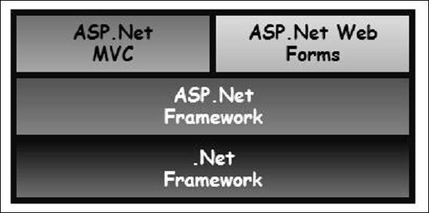
Introduction to ASP.NET MVC

Slide 7
Introduction to ASP.NET MVC
The purpose of MVC is to separate the content from the presentation and data processing from content.
One thing that MVC has done is to separate the view from the code i.e., unlike Web Forms where “*.aspx” is attached to “*.aspx.cs” here in MVC View is a separate entity entirely.
ASP.NET MVC is stateless. In this we do not pass requests to the page like Web Forms. But we talk to the controller.
The Controller handles the request and fetches the desired data from the model and transfers the data to the view.
The View is used to display the data to the end user.

Slide 8
Introduction to ASP.NET MVC
There are three basic components in ASP.NET MVC:
Model
View
Controller
Model
This is the business layer. It helps retrieve data from the database. These are simple class files that contain the properties.
View
This component is responsible for displaying data on the screen. In MVC we use Razor Syntax. The extension of the view has “*.cshtml” instead of “.aspx” which we have used in ASP.NET in the past.
Controller
It handles input control. All the user interaction is done through Controller. A Controller is nothing but a class file that contains the methods.

Slide 9
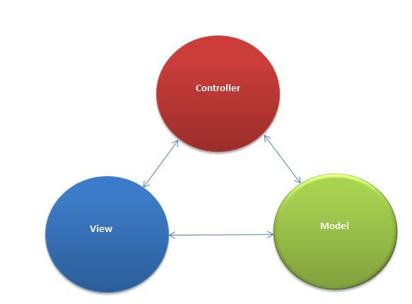
Introduction to ASP.NET MVC

Slide 10
ASP.NET MVC URL Structure
MVC helps to maintain a pretty good URL that is readable to the user.
In MVC the URL has specific meaning which we will understand now.
The following is the structure that explains how?
http://www.sitename.com/ControllerName/ActionName/Id
URL is in MVC.
Controller Name is passed after the site name followed by the Action Name present in the controller.
And if there is an Id we have to specify the Id as well, though it is optional.

Slide 11
ASP.NET MVC URL Structure
Find this, http://www.dummywebsite.com/Products/View/1
In the preceding URL “Products” is the controller and View is the name of the ActionResult method that accepts an ID that has a value “1” passed in the URL.
Comparing, http://www.dummysite.com/Products.aspx?id=1 URL to the traditional Web Forms had it been made in the older version would be something like it.
ASP.NET MVC URLs are much more user friendly. Microsoft has released many versions of ASP.NET MVC of which MVC 6 is the latest one.

Slide 12
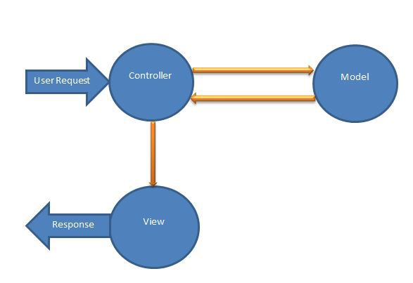
How MVC Works?
The request goes to controller.
Controller fetches the data from the model and passes this data to the View.
The view displays the data to the end user.

Slide 13
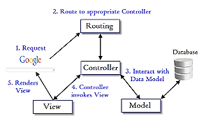
MVC Architecture Overview

Slide 14
Advantages of ASP.NET MVC Pattern
It manages application complexity by dividing an application into the model, view and controller.
It does not use view state or server-based forms. This makes the MVC framework ideal for developers who want full control over the behavior of an application.
It provides better support for test-driven development.
It is suitable for large scale developer team and web applications.
It provides high degree of control to the developer over the application behavior.

Slide 15
Controller
Controller is a class that handles user requests. It retrieves data from the Model and renders view as response.
The ASP.NET MVC framework maps requested URLs to the classes that are referred to as controllers. Controller processes incoming requests, handle user input and interactions and executes appropriate business logic.
The file format will be .cs file
Inherited from Controller class (go to definitions)
It Resides in controller folder
It has controller convention in name
Controllers Handle incoming request and get data from model and provide data to view.

Slide 16
Controller
The ControllerBase class is a base class for all controller classes. It provides general MVC handling. A controller mainly performs the following tasks.
It locates for the appropriate action method to call and validate.
It gets the values to use as the action method's arguments.
It handles all errors that might occur during execution of the action.
It uses the WebFormViewEngine class for rendering ASP.NET page.

Slide 17
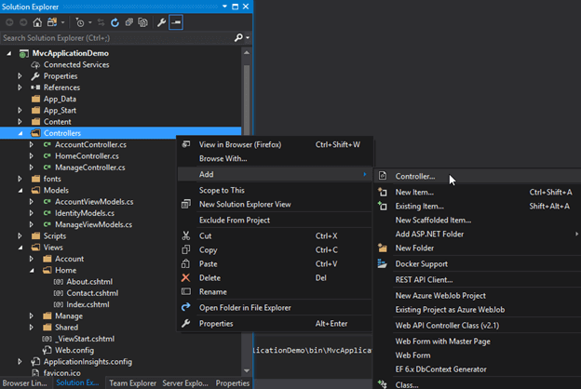
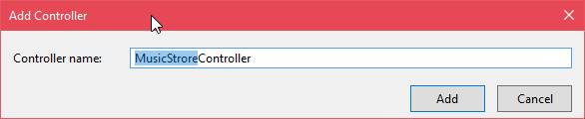
Controller
We can create controller for the application by adding a new item into the controller folder. Just right click on the controller folder and click add -> controller as given below.

Slide 18
Controller
// MusicStoreController.cs
using System;
using System.Collections.Generic;
using System.Linq;
using System.Web;
using System.Web.Mvc;
namespace MvcApplicationDemo.Controllers
{
public class MusicStoreController : Controller
{
// GET: MusicStrore
public ActionResult Index()
{
return View();
} } }

Slide 19
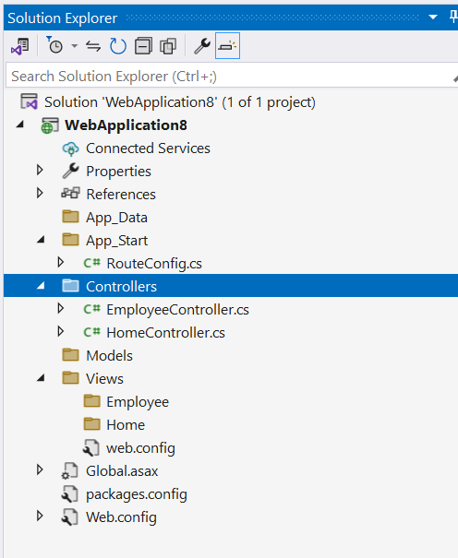
Controller Demo
Create ASP.NET Web Application (.NET Framework) -> select Empty -> MVC check box and create project.

Slide 20
Controller Demo
HomeController.cs
using System.Web.Mvc;
namespace WebApplication8.Controllers
{
public class HomeController : Controller
{
public string Index()
{
return "Hello";
}
public string Name()
{
return "Ravi";
}
}
}

Slide 21
Controller Demo
HomeController.cs
using System.Web.Mvc;
namespace WebApplication8.Controllers
{
public class HomeController : Controller
{
public string Index()
{
return "Hello";
}
public string Name()
{
return “RK KEYNOTES";
}
}
}

Slide 22
Controller Demo
Action Methods?
A method inside controller is called as Action Method.
Default return type of Action method is ActionResult
Only public method can be accessed from http request
By default all action methods are GET
Action methods can return View, File, Partial View, JSON, etc.

Slide 23
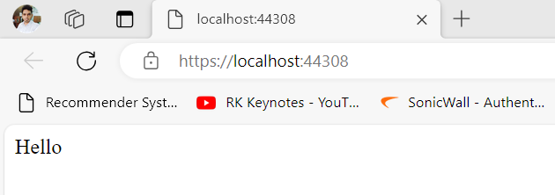
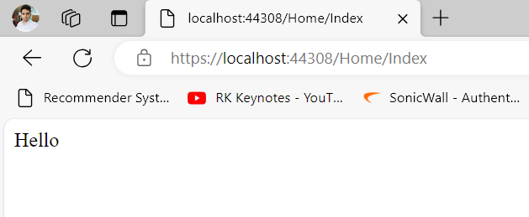
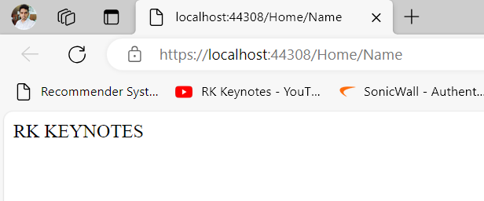
Output

Slide 24
Controller Demo
RouteConfig Demo

Slide 25
Controller Demo
EmployeeController
using System.Web.Mvc;
namespace WebApplication8.Controllers
{
public class EmployeeController : Controller
{
//public string EmployeeProfile(int id)
//{
// return "profile";
//}
public string EmployeeProfile(int id)
{
string profile = string.Empty;
if (id == 1)
{
profile = "EMP 1";
}
else if (id == 2)
{
profile = "EMP 2";
}
else
{
profile = "No profile";
}
return profile;
}
public string Address(int id, string division) {
return "id= " + id + "division= " + division;
}
}
}

Slide 26
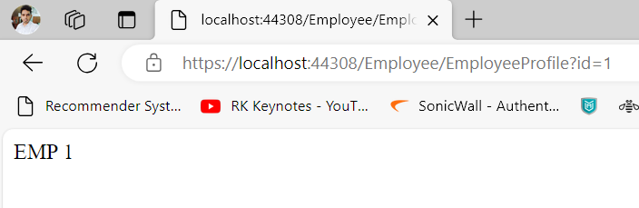
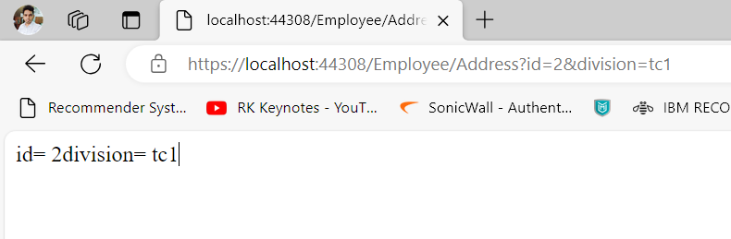
Controller Demo
EmployeeController
Parameters in action method

Slide 27
View in MVC
The MVC View is a standard HTML page that may contain script. It is used to create web pages for the application. Unlike ASP.NET Web Pages, MVC Views are mapped to the action and then controller renders the view to the browser.
MVC has certain conventions for project structure. The view file should be located in the subdirectory of View folder.
MVC uses Razor view engine so that we can write server side code in HTML as well. Let's create a view and execute it to the browser.
File extension is .cshtml (c sharp + html)
View is UI of application and it supports HTML

Slide 28
View in MVC
Razor View Engine is a markup syntax which helps us to write HTML and server-side code in web pages using C# or VB.Net.
It is server-side markup language however it is not at all a programming language.

Slide 29
View in MVC
WHY VIEW IS REQUIRED?
To make application interactive
Easy to use
To use html and other client side framework

Slide 30
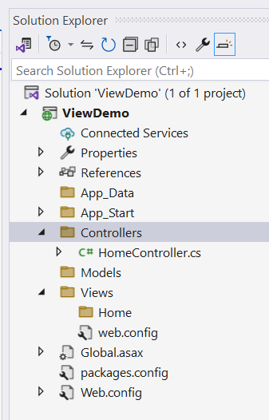
View Demo
Step 1
Create MVC project
Step 2
Add HomeController and
EmployeeController

Slide 31
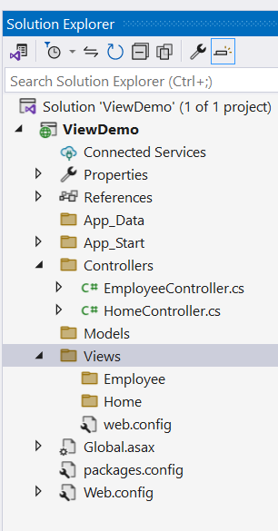
View Demo
Step 3
Check the view folder,
You can see two folders in the
Name of controllers.

Slide 32
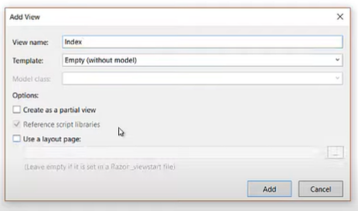
View Demo
Step 4
Right click on Home in views folder
Add -> view

Slide 33
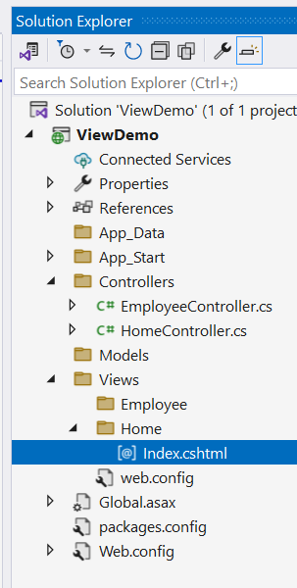
View Demo
Step 5
Open Index.cshtml
<!DOCTYPE html>
<html>
<head>
<meta name="viewport" content="width=device-width" />
<title>Index</title>
</head>
<body>
<div> <h1>Hi, Home Controller and Index method </h1>
</div>
</body>
</html>

Slide 34
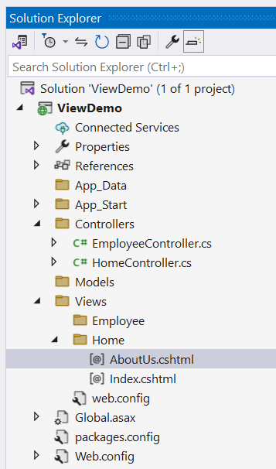
View Demo
Step 6
In HomeController.cs
using System.Web.Mvc;
namespace ViewDemo.Controllers
{
public class HomeController : Controller
{
// GET: Home
public ActionResult Index()
{
return View();
}
public ViewResult AboutUs()
{
return View();
}
}
}

Slide 35
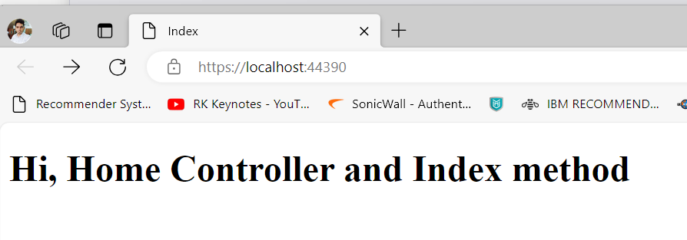
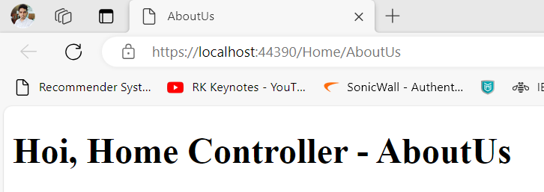
View Demo
Step 6
Do same in EmployeeController.cs and run

Slide 36
View Demo
Points
In MVC, browser cannot call view directly.
Controller will perform it.
Browser doesn’t know one is calling view or something else. Because it is a job of Action Method.
Browser will display the content via view.

Slide 37
View Demo
Step 7
Index.cshtml – Create Hyperlink
<!DOCTYPE html>
<html>
<head>
<meta name="viewport" content="width=device-width" />
<title>Index</title>
</head>
<body>
<div> <h1>Hi, Home Controller and Index method </h1>
</div>
<div>
<a href="/Home/AboutUs">Home - AboutUs</a>
<a href="/Employee/Index">Employee - Index</a>
<a href="/Employee/AboutUs">Employee - AboutUs</a>
</div>
</body>
</html>

Slide 38
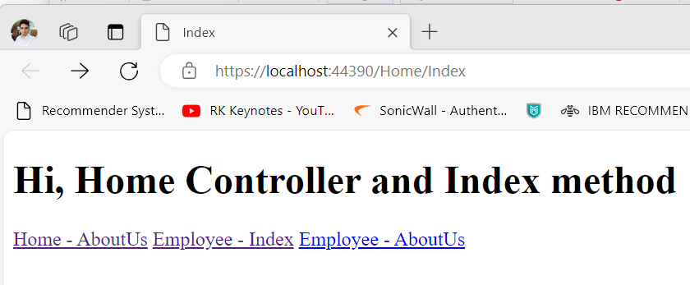
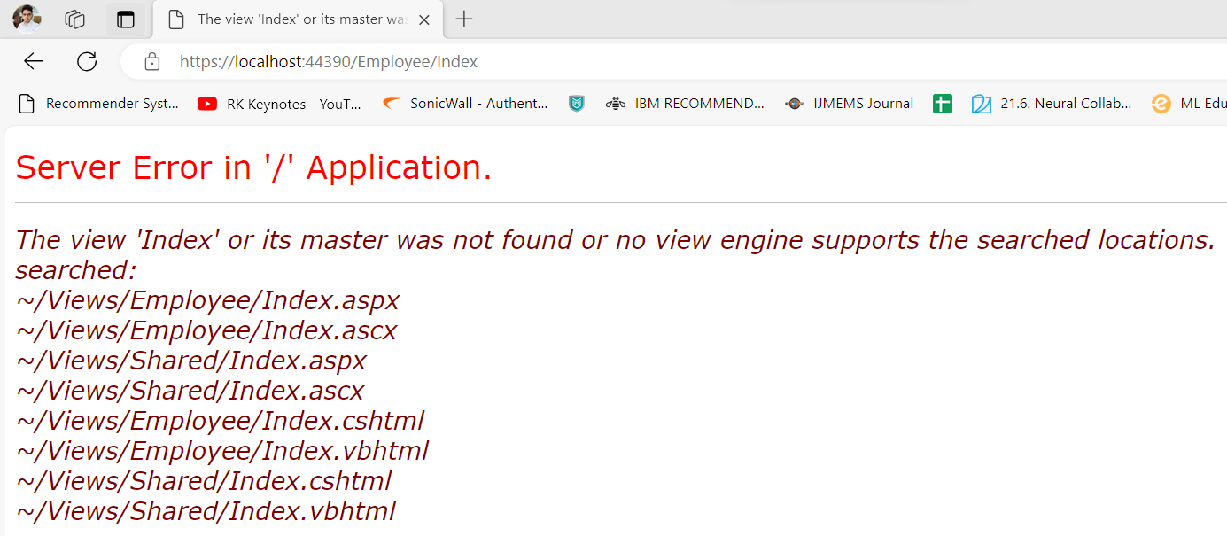
View Demo
If the view file is not available, the controller will try to check all the possibilities and throw this error.

Slide 39
Model in MVC
A model is a class that contains the business logic of the application. It also used for accessing data from the database.
The model class does not handle directly input from the browser. It does not contain any HTML code as well.
Models are also refers as objects that are used to implement conceptual logic for the application.
A controller interacts with the model, access the data, perform the logic and pass that data to the view.

Slide 40
Model in MVC
To add the model, just right click on the Model folder of the project and then follow this sequence Model->Add->New Item->Visual C#->Code->Class.
// Student.cs
using System;
using System.Collections.Generic;
using System.Linq;
using System.Web;
public class Student {
public int StudentId { get; set; }
public string StudentName { get; set; }
public int Age { get; set; }
}

Slide 41
Model in MVC
To add the model, just right click on the Model folder of the project and then follow this sequence Model->Add->New Item->Visual C#->Code->Class.
// Student.cs
using System;
using System.Collections.Generic;
using System.Linq;
using System.Web;
public class Student {
public int StudentId { get; set; }
public string StudentName { get; set; }
public int Age { get; set; }
}
The model class can be used in the view to populate the data, as well as sending data to the controller.

Slide 42
Model in MVC
To add the model, just right click on the Model folder of the project and then follow this sequence Model->Add->New Item->Visual C#->Code->Class.
// Student.cs
using System;
using System.Collections.Generic;
using System.Linq;
using System.Web;
public class Student {
public int StudentId { get; set; }
public string StudentName { get; set; }
public int Age { get; set; }
}
The model class can be used in the view to populate the data, as well as sending data to the controller.

Slide 43
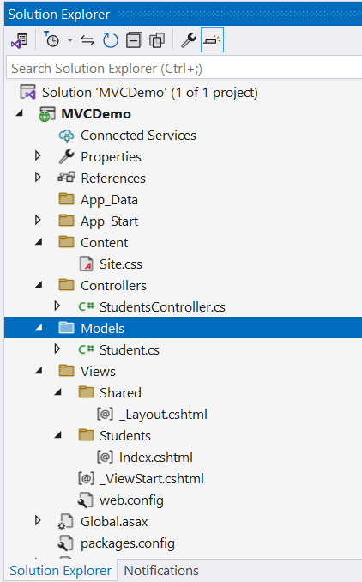
Integrate/Bind Model, View and Controller

Slide 44
Model
//Student.cs
using System;
using System.Collections.Generic;
using System.Linq;
using System.Web;
namespace MVCDemo.Models
{
public class Student
{
public int ID { get; set; }
public string Name { get; set; }
public string LastName { get; set; }
}
}

Slide 45
Controller
//StudentController.cs
using System.Web.Mvc;
namespace MVCDemo.Controllers
{
public class StudentsController : Controller
{
// GET: Students
public ActionResult Index()
{
return View();
}
}
}

Slide 46
View
@model MVCDemo.Models.Student
@{
ViewBag.Title = "Index";
}
<h2>Index</h2>
@using (Html.BeginForm())
{
@Html.AntiForgeryToken()
<div class="form-horizontal">
<h4>Student</h4>
<hr />
@Html.ValidationSummary(true, "", new { @class = "text-danger" })
<div class="form-group">
@Html.LabelFor(model => model.Name, htmlAttributes: new { @class = "control-label col-md-2" })
<div class="col-md-10">
@Html.EditorFor(model => model.Name, new { htmlAttributes = new { @class = "form-control" } })
@Html.ValidationMessageFor(model => model.Name, "", new { @class = "text-danger" })
</div>
</div>
<div class="form-group">
@Html.LabelFor(model => model.LastName, htmlAttributes: new { @class = "control-label col-md-2" })
<div class="col-md-10">
@Html.EditorFor(model => model.LastName, new { htmlAttributes = new { @class = "form-control" } })
@Html.ValidationMessageFor(model => model.LastName, "", new { @class = "text-danger" })
</div>
</div>
<div class="form-group">
<div class="col-md-offset-2 col-md-10">
<input type="submit" value="Create" class="btn btn-default" />
</div>
</div>
</div>
}
<div>
@Html.ActionLink("Back to List", "Index")
</div>

Slide 47
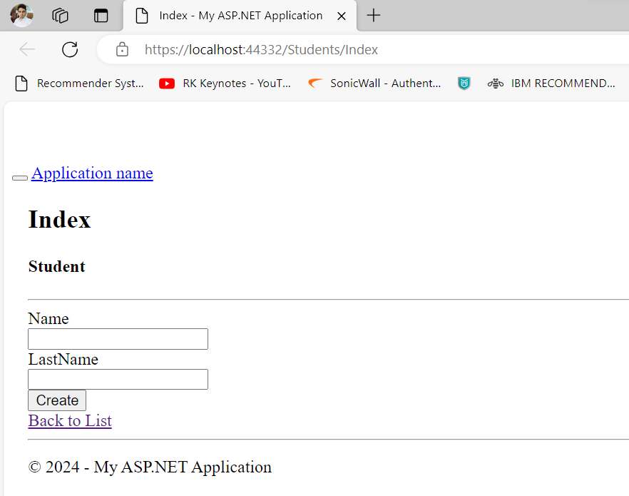
Output

Slide 48
ASP.NET Razor View
Razor is a standard markup syntax that allows us to embed server code into the web pages.
It uses its own syntax and keywords to generate view.
If there is server code in the web page, server executes that code first then send response to the browser. It allows us to perform logical tasks in the view page.
We can create expressions, loops and variables in the view page.
It has simplified syntax which is easy to learn and code. This file extension is .cshtml.
Notes:
ASPX files have a dependency on the ASP.NET runtime to be available to parse and execute those ASPX files. Razor has no such dependencies.

Slide 49
Razor Syntax Rules
Razor code blocks are enclosed in @{ ... }
Inline expressions (variables and functions) start with @
Code statements end with semicolon
Variables are declared with the var keyword
Strings are enclosed with quotation marks
C# code is case sensitive
C# files have the extension .cshtml
@{var price=60;}
<html>
<body>
@if (price>50)
{
<p>The price is greater than 50.</p>
}
</body>

Slide 50
Razor Characteristics
Compact: Razor syntax is compact, enabling you to minimize the number of characters and keystrokes required to write code.
Easy to Learn: Razor syntax is easy to learn where you can use your familiar language C# or Visual Basic.
Intellisense: Razor syntax supports statement completion within Visual Studio.

Slide 51
Razor View Demo
<h2>Index</h2>
<h2>@DateTime.Now.ToShortDateString()</h2>
@{
var d = DateTime.Now.ToShortDateString();
var m = "Hello";
}
<h2> Date is: @d </h2>
<h3> @m</h3>
Notes:
ViewBag only transfers data from controller to view, not visa-versa. ViewBag values will be null if redirection occurs.

Slide 52
Razor View Demo
@if(DateTime.IsLeapYear(DateTime.Now.Year) )
{
@DateTime.Now.Year @:is a leap year.
}
else {
@DateTime.Now.Year @:is not a leap year.
}
//
@for (int i = 0; i < 5; i++) {
@i.ToString() <br />
}
//
<ul> @foreach (var x in Request.ServerVariables) {
<li>@x</li>} </ul>

Slide 53
Accept User Input
@{
var totalMessage = "";
var num1 = Request["text1"];
var num2 = Request["text2"];
var total = num1.AsInt() + num2.AsInt();
totalMessage = "Total = " + total;
}

Slide 54
Accept User Input
<html>
<body style="background-color: beige; font-family: Verdana, Arial;">
<form action="" method="post">
<p>
<label for="text1">First Number:</label><br>
<input type="text" name="text1" />
</p>
<p>
<label for="text2">Second Number:</label><br>
<input type="text" name="text2" />
</p>
<p><input type="submit" value=" Add " /></p>
</form>
<p>@totalMessage</p>
</body>
</html>

Slide 55
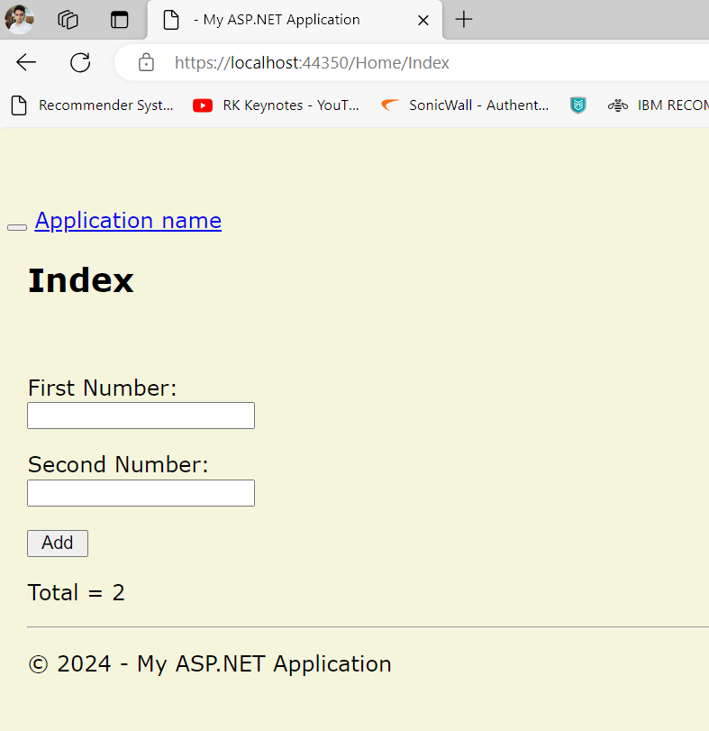
Output

Slide 56
Points
Razor is one of the view engines supported in ASP.NET MVC.
Razor allows you to write a mix of HTML and server-side code using C# or Visual Basic.
Razor code will be executed before HTML.
It is server-side markup language however it is not at all a programming language.
Razor view is similar to APSX. ASPX files have a dependency on the ASP.NET runtime to be available to parse and execute those ASPX files. Razor has no such dependencies.

Slide 57
What is View Bag?
The ViewBag in ASP.NET MVC is used to transfer temporary data (which is not included in the model) from the controller to the view.
ViewBag only transfers data from controller to view, not visa-versa.
ViewBag values will be null if redirection occurs.

Slide 58
Layout View
An application may contain a specific UI portion that remains the same throughout the application, such as header, left navigation bar, right bar, or footer section.
ASP.NET MVC introduced a Layout view which contains these common UI portions so that we don't have to write the same code in every page.
The layout view is the same as the master page of the ASP.NET webform application.

Slide 59
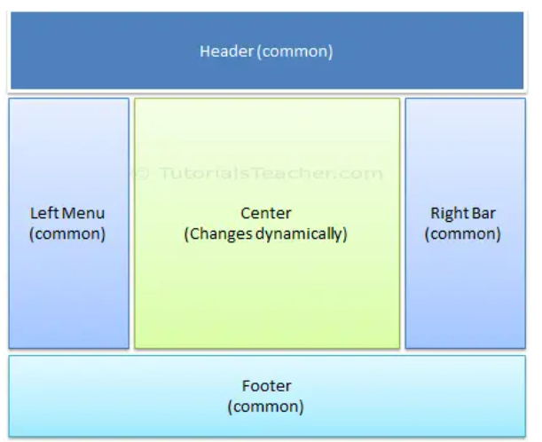
Layout View
An application may contain a specific UI portion that remains the same throughout the application, such as header, left navigation bar, right bar, or footer section.
ASP.NET MVC introduced a Layout view which contains these common UI portions so that we don't have to write the same code in every page.
The layout view is the same as the master page of the ASP.NET webform application.

Slide 60
Create Layout View
You can create a layout view in any folder under the Views folder. However, it is recommended to create all the layout views in the Shared folder for easy maintenance purpose.
To create a new layout view in Visual Studio, right-click on the Shared folder -> select Add -> click on New Item. This will open the Add New Item popup, as shown below.
In the Add New Item dialogue box, select MVC 5 Layout Page (Razor) template, and specify a layout view name as _myLayoutPage.cshtml and click Add to create it as shown below.
Prefixing the underscore _ before layout view name is a common naming convention in ASP.NET MVC.
Notes:
The ViewBag in ASP.NET MVC is used to transfer temporary data (which is not included in the model) from the controller to the view.

Slide 61
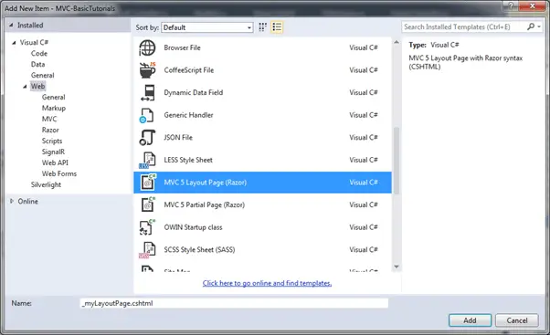
Layout View Demo

Slide 62
Layout View Demo
_myLayoutPage.cshtml
<!DOCTYPE html>
<html>
<head>
<meta name="viewport" content="width=device-width" />
<title>@ViewBag.Title</title>
</head>
<body>
<div>
@RenderBody()
</div>
</body>
</html>

Slide 63
Layout View Demo
_myLayoutPage.cshtml
<!DOCTYPE html>
<html>
<head>
<meta name="viewport" content="width=device-width" />
<title>@ViewBag.Title</title>
@Styles.Render("~/Content/css")
@Scripts.Render("~/bundles/modernizr")
</head>
<body>
<div>
@RenderBody()
</div>
<footer class="panel-footer">
@RenderSection("footer", true)
</footer>
</body>
</html>

Slide 64
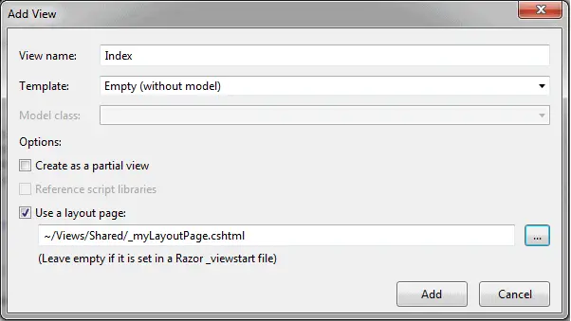
Layout View Demo

Slide 65
Layout View Demo
@{
ViewBag.Title = "Home Page";
Layout = "~/Views/Shared/_myLayoutPage.cshtml";
}
<h2>Index</h2>
<div class="row">
<div class="col-md-4">
<p>This is body.</p>
</div>
@section footer{
<p class="lead">
This is footer section.
</p>
}
</div>
Notes:
The ViewBag in ASP.NET MVC is used to transfer temporary data (which is not included in the model) from the controller to the view.

Slide 66
Partial View
A partial view is a reusable portion of a web page.
It is .cshtml or .vbhtml file that contains HTML code.
It can be used in one or more Views or Layout Views.
You can use the same partial view at multiple places and eliminates the redundant code.
Let's create a partial view for the following menu, so that we can use the same menu in multiple layout views without rewriting the same code everywhere.

Slide 67
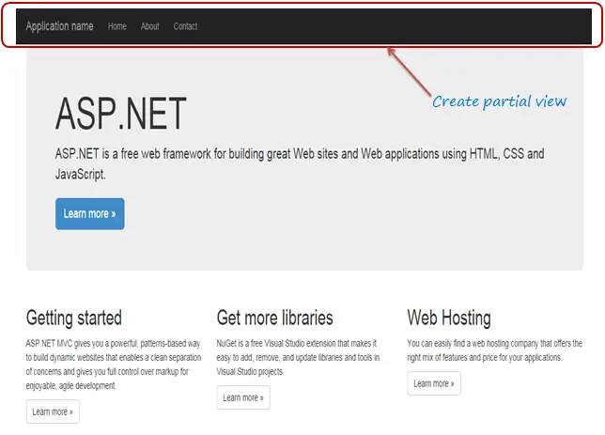
Partial View

Slide 68
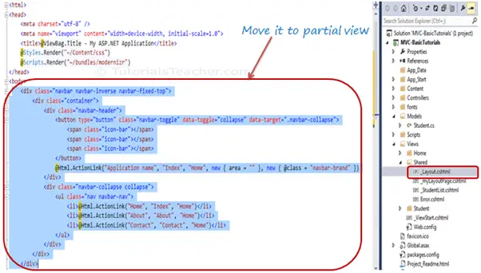
Partial View

Slide 69
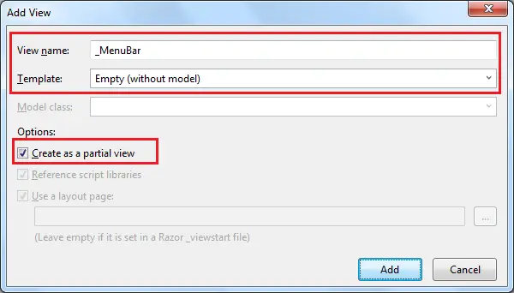
Partial View
Create a New Partial View
To create a partial view, right click on the Shared folder -> click Add -> click View

Slide 70
Partial View
_MenuBar.cshtml
Cut the layout code and paste in _MenuBar
<div class="navbar navbar-inverse navbar-fixed-top">
<div class="container">
<div class="navbar-header">
<button type="button" class="navbar-toggle" data-toggle="collapse" data-target=".navbar-collapse">
<span class="icon-bar"></span>
<span class="icon-bar"></span>
<span class="icon-bar"></span>
</button>
@Html.ActionLink("Application name", "Index", "Home", new { area = "" }, new { @class = "navbar-brand" })
</div>
<div class="navbar-collapse collapse">
<ul class="nav navbar-nav">
<li>@Html.ActionLink("Home", "Index", "Home")</li>
<li>@Html.ActionLink("About", "About", "Home")</li>
<li>@Html.ActionLink("Contact", "Contact", "Home")</li>
</ul>
</div>
</div>
</div>

Slide 71
Rendering Partial View
You can render the partial view in the parent view using the HTML helper methods:
@html.Partial(),
@html.RenderPartial(), and
@html.RenderAction().

Slide 72
Rendering Partial View
@html.Partial()
The @Html.Partial() method renders the specified partial view. It accepts partial view name as a string parameter and returns MvcHtmlString. It returns an HTML string, so you have a chance of modifying the HTML before rendering.
Now, include _MenuBar partial view in _Layout.cshtml using @html.Partial("_MenuBar")

Slide 73
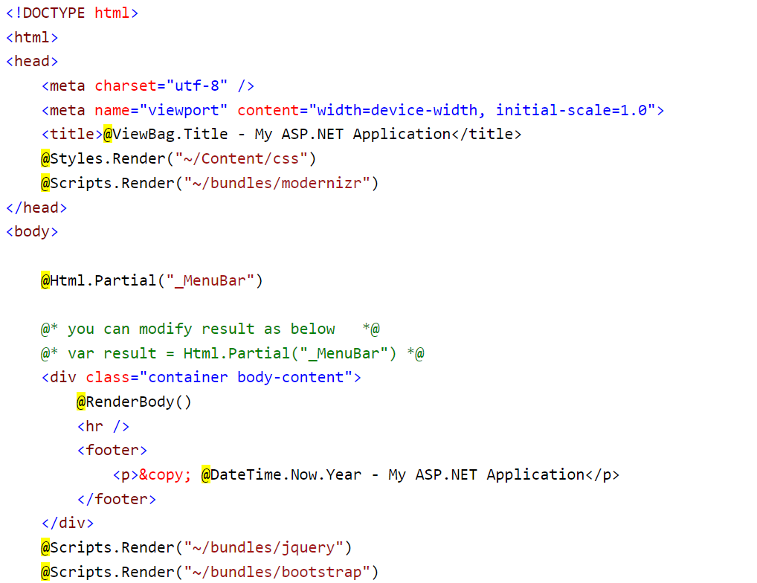
Rendering Partial View
@html.Partial()

Slide 74
Rendering Partial View
@html.RenderPartial()
The @html.RenderPartial() method is the same as the @html.Partial() method except that it writes the resulted HTML of a specified partial view into an HTTP response stream directly. So, you can modify it's HTML before render.
The RenderPartial() method returns void, so a semicolon is required at the end, and so it must be enclosed within the @{ }.
<body>
@{
Html.RenderPartial("_MenuBar");
}

Slide 75
Rendering Partial View
@html.RenderAction()
The @html.RenderAction() method executes the specified action method and renders the result. The specified action method must be marked with the [ChildActionOnly] attribute and return the PartialViewResult using the PartialView() method.
To render a partial view using the RenderAction() method, first create an HttpGet action method and apply the ChildActionOnly attribute.
In Home controller add the below code:
public class HomeController : Controller
{
[ChildActionOnly]
public ActionResult RenderMenu()
{
return PartialView("_MenuBar");
}
}

Slide 76
Rendering Partial View
@html.RenderAction()
In Layout, include below code
<body>
@{
Html.RenderAction("RenderMenu", "Home");
}

Slide 77
HTML Helpers
The HtmlHelper class renders HTML controls in the razor view.
It binds the model object to HTML controls to display the value of model properties into those controls and also assigns the value of the controls to the model properties while submitting a web form.
So always use the HtmlHelper class in razor view instead of writing HTML tags manually.

Slide 78
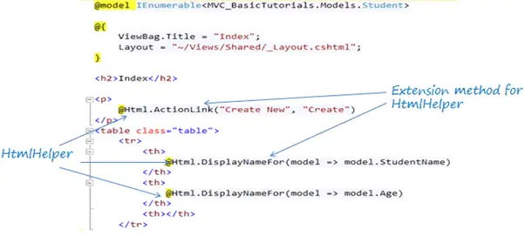
HTML Helpers
@Html is an object of the HtmlHelper class. (@ symbol is used to access server-side object in razor syntax).
Html is a property of the HtmlHelper class included in base class of razor view WebViewPage.
The ActionLink() and DisplayNameFor() are extension methods included in the HtmlHelper class.

Slide 79
HtmlHelper Methods
Extension Method | Strongly Typed Method | Html Control
Html.ActionLink() | NA | <a></a>
Html.TextBox() | Html.TextBoxFor() | <input type="textbox">
Html.TextArea() | Html.TextAreaFor() | <input type="textarea">
Html.CheckBox() | Html.CheckBoxFor() | <input type="checkbox">
Html.RadioButton() | Html.RadioButtonFor() | <input type="radio">
Html.DropDownList() | Html.DropDownListFor() | <select> <option> </select>
Html.ListBox() | Html.ListBoxFor() | multi-select list box: <select>
Html.Hidden() | Html.HiddenFor() | <input type="hidden">
Html.Password() | Html.PasswordFor() | <input type="password">
Html.Display() | Html.DisplayFor() | HTML text: ""
Html.Label() | Html.LabelFor() | <label>
Html.Editor() | Html.EditorFor() | Generates Html controls based on data type of specified model property e.g. textbox for string property, numeric field for int, double or other numeric type.

Slide 80
HTML Helper Demo
<input type="text" name="fname" id="fname" />
@Html.TextBox(“fname”, “RK KEYNOTES”)
@Html.TextBox("fn", "RAVI", new { style = "background-color:Red; color:White; font-weight:bold", title="Enter Name"})
@Html.Label("firstname", "First Name")
@Html.Password("Password")
@Html.TextArea("Comments","",5,20,null)
@Html.Hidden("ID")

Slide 81
HTML Helper Demo
In CSS file:
.greenbox{
background-color:Red;
color:White;
font-weight:bold
}
In VIEW file:
<link href="~/Content/Site.css" rel="stylesheet" />
@Html.TextBox("fname", "RK", new { @class = "greenbox"})

Slide 82
MVC Actions
In ASP.NET MVC application, the controller defines action methods that are used to handle user requests and render view as the response. A controller can have any number of actions.
A user request can be any of like: entering URL into the browser, clicking a link or submitting a form.
The MVC application uses the routing rules that are defined in the Global.asax.cs file. This file is used to parse the URL and determine the path of the controller. Now, controller executes the appropriate action to handle the user request.

Slide 83
MVC Actions
ActionResult Return Type
The ActionResult class is the base class for all action results. Action methods return an instance of this class. There can be different action result types depending on the task that the action is implementing.
Action Result | Helper Method | Description
ViewResult | View | It is used to render a view as a Web page.
PartialViewResult | PartialView | It is used to render a partial view.
RedirectResult | Redirect | It is used to redirect to another action method by using its URL.
RedirectToRouteResult | RedirectToAction RedirectToRoute | It is used to redirect to another action method.
ContentResult | Content | It is used to return a user-defined content type.
JsonResult | Json | It is used to return a serialized JSON object.
JavaScriptResult | JavaScript | It is used to return a script that can be executed on the client.
FileResult | File | It is used to return binary output to write to the response.
EmptyResult | (None) | It represents a return value that is used if the action method must return a null result.

Slide 84
Adding an Action method
using System;
using System.Collections.Generic;
using System.Linq;
using System.Web;
using System.Web.Mvc;
namespace MvcApplicationDemo.Controllers
{
public class MusicStoreController : Controller
{
// GET: MusicStrore
public ActionResult Index()
{
return View();
}
public string Welcome()
{
return "Hello, this is welcome action message";
}
}
}
To access the welcome action method, execute the application then access it by using MusicStore/Welcome URL. It will produce the following output.

Slide 85
Action Method Parameters
Action parameters are the variables that are used to retrieve user requested values from the URL.
using System;
using System.Collections.Generic;
using System.Linq;
using System.Web;
using System.Web.Mvc;
namespace MvcApplicationDemo.Controllers
{
public class MusicStoreController : Controller
{
// GET: MusicStrore
public ActionResult Index()
{
return View();
}
public string ShowMusic(string MusicTitle)
{
return "You selected " + MusicTitle + " Music";
}
}
}
In URL, we have to pass the parameter value. So, we are doing it by this URL localhost:port-no/MusicStore/ShowMusic?MusicTitle=Classic.

Slide 86
ASP.NET MVC Action Selectors
Action selectors are attributes that are applied on action methods of a controller. It is used to select correct action method to call as per the request. MVC provides the following action selector attributes:
ActionName
This attribute allows us to specify a different name for the action method. It is useful when we want to call action by different name.
ActionVerbs
ASP.NET MVC provides action verbs that are applied on the action methods and works for HttpRequest methods.

Slide 87
Action Name
//MusicStoreController.cs
using System;
using System.Collections.Generic;
using System.Linq;
using System.Web;
using System.Web.Mvc;
namespace MvcApplicationDemo.Controllers
{
public class MusicStoreController : Controller
{
[ActionName("store")]
public ActionResult Index()
{
return View();
}
}
}
// store.cshtml
@{
ViewBag.Title = "store";
}
<h2>Hello, This is Music store.</h2>

Slide 88
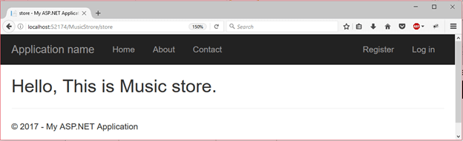
Action Name

Slide 89
Action Verbs
ActionVerbs
ASP.NET MVC provides action verbs that are applied on the action methods and works for HttpRequest methods.
HttpPost
HttpGet
HttpPut
HttpDelete
HttpOptions
HttpPatch

Slide 90
ActionVerbs
// MusicStoreController.cs
using System; using System.Collections.Generic; using System.Linq; using System.Web; using System.Web.Mvc;
namespace MvcApplicationDemo.Controllers
{
public class MusicStoreController : Controller
{
[HttpGet]
public ActionResult Index()
{
return View();
}
[HttpPost]
public ActionResult Welcome()
{
return View();
} } }

Slide 91
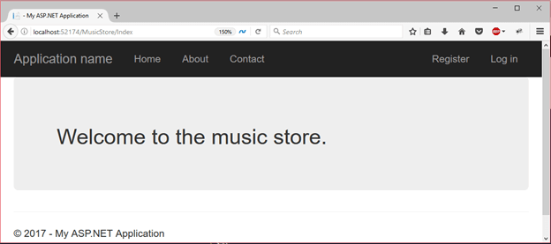
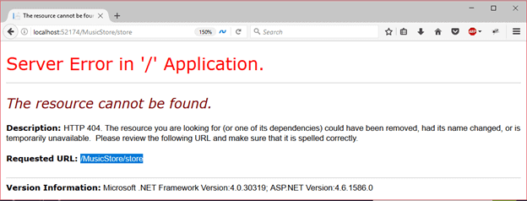
ActionVerbs
// index.cshtml
<div class="jumbotron">
<h2>Welcome to the music store.</h2>
</div>

Slide 92
ASP.NET MVC- Filters
The MVC framework provides the filter attribute so that we can filter the user requests. We can apply it to an individual action or an entire controller.
ASP.NET MVC Filter is a custom class where you can write custom logic to execute before or after an action method executes.
Filters can be applied to an action method or controller in a declarative or programmatic way.
Declarative means by applying a filter attribute to an action method or controller class and programmatic means by implementing a corresponding interface.

Slide 93
ASP.NET MVC- Filters
Filter Type | Description | Built-in Filter | Interface
Authorization filters | Performs authentication and authorizes before executing an action method. | [Authorize], [RequireHttps] | IAuthorizationFilter
Action filters | Performs some operation before and after an action method executes. |  | IActionFilter
Result filters | Performs some operation before or after the execution of the view. | [OutputCache] | IResultFilter
Exception filters | Performs some operation if there is an unhandled exception thrown during the execution of the ASP.NET MVC pipeline. | [HandleError] | IExceptionFilter

Slide 94
OutputCache Example
// MusicStoreController.cs
using System;
using System.Collections.Generic;
using System.Linq;
using System.Web;
using System.Web.Mvc;
namespace MvcApplicationDemo.Controllers
{
public class MusicStoreController : Controller
{
[OutputCache(Duration =10)]
public ActionResult Index()
{
return View();
}
}
}
// index.cshtml
<h4>
@{
Response.Write( DateTime.Now.ToString("T"));
}
</h4>

Slide 95
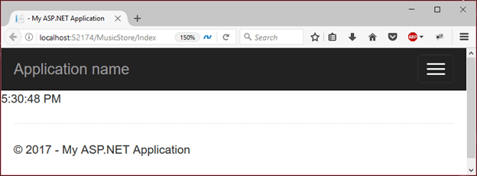
OutputCache Example
It produces the following output and cache that for 10 seconds. It will not change before 10 seconds even we refresh the web page again and again.

Slide 96
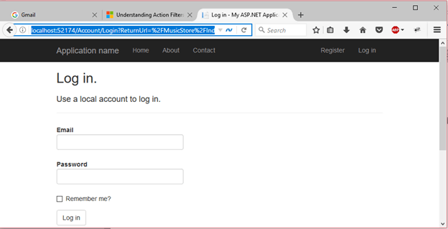
Authorize Example
// MusicStoreController.cs
using System;
using System.Collections.Generic;
using System.Linq;
using System.Web;
using System.Web.Mvc;
namespace MvcApplicationDemo.Controllers
{
public class MusicStoreController : Controller
{
[Authorize]
public ActionResult Index()
{
return View();
}
}
}

Slide 97
MVC Validation
Validation of user input is necessary task for the application programmer. An application should allow only valid user input so that we get only desired information.
ASP.NET MVC framework provides built-in annotations that we can apply on Model properties. It validates input and display appropriate message to the user.

Slide 98
MVC Validation
Attribute | Usage
Required | Specifies that a property value is required.
StringLength | Specifies the minimum and maximum length of characters that are allowed in a string type property.
Range | Specifies the numeric range constraints for the value of a property.
RegularExpression | Specifies that a property value must match the specified regular expression.
CreditCard | Specifies that a property value is a credit card number.
CustomValidation | Specifies a custom validation method that is used to validate a property.
EmailAddress | Validates an email address.
FileExtension | Validates file name extensions.
MaxLength | Specifies the maximum length of array or string data allowed in a property.
MinLength | Specifies the minimum length of array or string data allowed in a property.
Phone | Specifies that a property value is a well-formed phone number.

Slide 99
DataAnnotation Attributes
public class Student {
public int StudentId { get; set; }
[Required]
public string StudentName { get; set; }
[Range(10, 20)]
public int Age { get; set; } }

Slide 100
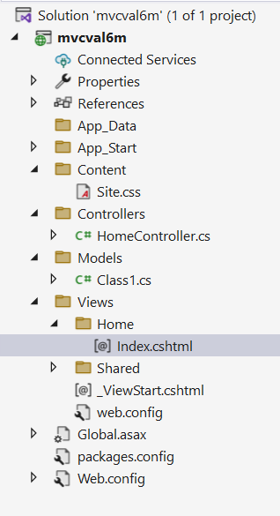
Validation Demo
//model
namespace mvcval6m.Models
{
public class Class1
{
public string username { get; set; }
}
}

Slide 101
Validation Demo
//controller
using System.Web.Mvc;
namespace mvcval6m.Controllers
{
public class HomeController : Controller
{
// GET: Home
public ActionResult Index()
{
return View();
}
}
}

Slide 102
Validation Demo
//view
@model mvcval6m.Models.Class1
@{
ViewBag.Title = "Index";
}
<h2>Index</h2>
<head>
<script>
function validate() {
if (document.getElementById("txtuser").value.length == 0) {
document.getElementById("spuser").innerHTML = "Name required";
return false;
}
}
</script>
</head>

Slide 103
Validation Demo
<body>
<div>
@using (Html.BeginForm())
{
<table>
<tr><td>Enter Name:</td><td>@Html.TextBoxFor(a => a.username, new {id="txtuser" })</td><td><span id="spuser"></span></td></tr>
<tr><td colspan="3"><input type="submit" name="btnsubmit" value="Insert" onclick="return validate()"/></td></tr>
</table>
}
</div>
</body>

Slide 104
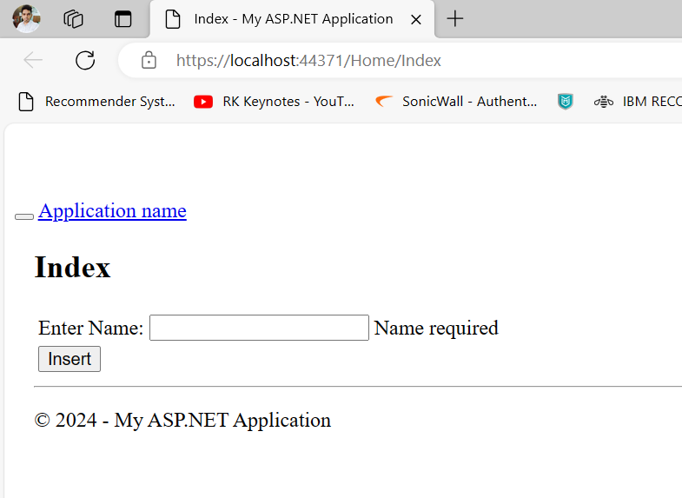
Output

Slide 105
Routing
In MVC, routing is a process of mapping the browser request to the controller action and return response back.
Each MVC application has default routing for the default HomeController. We can set custom routing for newly created controller.
The RouteConfig.cs file is used to set routing for the application.

Slide 106
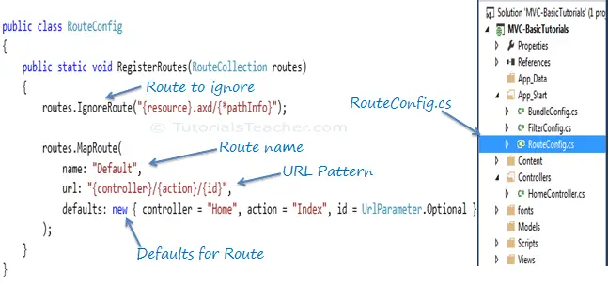
Routing

Slide 107
Routing
//RouteConfig.cs
using System.Web.Mvc;
using System.Web.Routing;
namespace mvcval6m
{
public class RouteConfig
{
public static void RegisterRoutes(RouteCollection routes)
{
routes.IgnoreRoute("{resource}.axd/{*pathInfo}");
routes.MapRoute(
name: "Default",
url: "{controller}/{action}/{id}",
defaults: new { controller = "Home", action = "Index", id = UrlParameter.Optional }
);
} } }

Slide 108
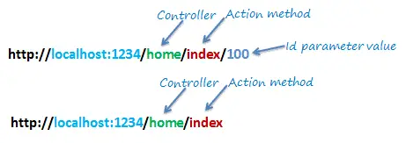
URL Pattern
The URL pattern is considered only after the domain name part in the URL. For example, the URL pattern "{controller}/{action}/{id}" would look like localhost:1234/{controller}/{action}/{id}.
Anything after "localhost:1234/" would be considered as a controller name.
The same way, anything after the controller name would be considered as action name and then the value of id parameter.

Slide 109
URL Pattern
URL | Controller | Action | Id
http://localhost/home | HomeController | Index | null
http://localhost/home/index/123 | HomeController | Index | 123
http://localhost/home/about | HomeController | About | null

Slide 110
Summary
Introduction to ASP.NET MVC
MVC Architecture Overview
Controllers
Razor Views
LayoutView
PartialView
Models
HTML helpers
Action Filters
Model Validation
URLs and Routing

Slide 111
Up Next
Working with ADO.Net:
ADO.Net Architecture
Characteristics of ADO.Net
Data Namespaces
ADO.Net Object Model
DataSet
DataTable
DataRelation
Connection object
Command Object
Data Reader
Object
DataAdapter Object
Data Controls (Repeater, DataList, DataGrid)
Binding data with Crystal Report
Performing CRUD operations

Slide 112


