Slide 1


DATA SCIENCE ESSENTIALS
Program: Bachelor of Technology
Branch: Computer Engineering
Course Code: 01CE0517
Course Credit: 3
_____________________________________
Prepared by:
Dr. Deepak Kumar Verma
Associate Professor,
Department of Computer Engineering
Marwadi University, Rajkot, India

Slide 2


Objective:
To provide a strong foundation for data science and application areas related to it and understand the underlying core concepts and emerging technologies in data science.

Slide 3
Course Outcomes:
Explore the fundamental concepts of data science.
Analyze data processing techniques for applications handling large data.
Understand concept of statistical and exploratory data analysis.
Understand various machine learning algorithms used in data science process.
Apply ethical frameworks to help them analyze ethical challenges.

Slide 4
Unit – 2
Data Acquisition and Management

Slide 5
Topics to be cover
Data Acquisition and Management
Introduction to different data formats
structured, unstructured, semi- structured
overview of data acquisition techniques
surveys, web scraping, APIs
Data cleaning techniques to Handle missing data and outliers
Data preprocessing – Issues in high dimensional data
Dimensionality reduction and feature subset selection.

Slide 6
Variety of Data Types
Data Acquisition and Management
Variety is one of the basic principles of big data.
It is also one of the four characteristics of big data.
The data scientist should be able to manage a variety of data types.
The information from various sources of data from bank transactions to tweets to images to videos should be integrated for analysis and data management.
Based on the business problem, you may come across different facets of data.

Slide 7
Variety of Data Types
Data Acquisition and Management
You would require different data management tools and techniques to analyze and extract results for each flavor of data.
Certain situations such as monitoring traffic data require real-time data management and analysis techniques whereas other situations such as data analysis to determine unsuspected patterns require massive historic data collection.
In certain situations, we need to integrate data from a variety of sources for our analysis.

Slide 8
Different Data Formats
Data Acquisition and Management
Structured Data
Semi-Structured Data
Unstructured Data

Slide 9
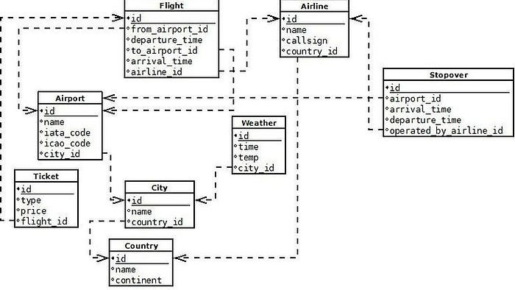
Structured Data
Data Acquisition and Management
Data having a pre-defined structure or schema which can also be categorized as quantitative data and is well-organized defined as Structured Data.
Because of having a pre-defined structure-property, data can be organized into tables — columns, and rows just like in spreadsheets.

Slide 10
Structured Data
Data Acquisition and Management
Tools for working with Structured Data:
PostgreSQL: PostgreSQL is an object-relational database management system (ORDBMS). It supports a large part of the SQL standard and offers many modern features like complex queries, transactional integrity, and multi-version concurrency control.
SQLite: SQLite is an in-process library that implements a self-contained, serverless, zero-configuration, transactional SQL database engine. SQLite reads and writes directly to ordinary disk files.
MySQL: MySQL is a widely used relational database management system (RDBMS). It is free and open-source and ideal for both small and large applications.

Slide 11
Structured Data
Data Acquisition and Management
Tools for working with Structured Data:
Oracle Database: This is an advanced database management system with a multi-model structure. It can be used for data warehousing, online transaction process, and mixed database workloads.
Microsoft SQL Server: Microsoft SQL Server is a relational database management system developed by Microsoft. As a database server, it is a software product with the primary function of storing and retrieving data as requested by other software applications.

Slide 12
Structured Data
Data Acquisition and Management
Structured Data Use Cases
Customer Relationship Management: CRM software runs structured data through analytical tools to create datasets that reveal customer behavior patterns and trends.
Online Booking: Hotel and ticket reservation data (e.g, dates, prices, destinations, etc.) fits the “rows and columns” format indicative of the pre-defined data model.
Accounting: Accounting firms or departments use structured data to process and record financial transactions.

Slide 13
Unstructured Data
Data Acquisition and Management
Unstructured data is typically categorized as qualitative rather than quantitative. It doesn’t have a pre-defined structure or specific format.
Data that lies in this category are audio, video, images, and text files contents which have different properties for making these data available for analysis and can’t be stored in relational databases.
Stored in their raw format and analysis is done by applying Image processing, Natural Language Processing, and Machine Learning.

Slide 14
Unstructured Data
Data Acquisition and Management
Tools for working with Unstructured Data
MongoDB: MongoDB is a non-relational document database that provides support for JSON-like storage.
Hadoop: A distributed storage that can store any file format in a distributed and scalable manner.
Data Lake: A data lake is a centralized repository that allows you to store all your structured and unstructured data at any scale. You can store your data as-is, without having to first structure the data. Amazon S3 service provides a data lake service.

Slide 15
Unstructured Data
Data Acquisition and Management
Unstructured Data Use Cases
Data Mining: Enables businesses to use unstructured data to identify consumer behavior, product sentiment, and purchasing patterns to better accommodate their customer base.
Predictive Data Analytics: Alert businesses of important activity ahead of time so they can properly plan and accordingly adjust to significant market shifts.
Chatbots: Performs text analysis to route customer questions to appropriate answer sources.

Slide 16
Semi-Structured Data
Data Acquisition and Management
Semi-Structured data contains elements of both structured and unstructured, it’s schema is not fixed as structured data and with the help of metadata (which enables users to define some partial structure or hierarchy), it can be organized to some extent so not unorganized as unstructured data.
Metadata includes tags and other markers just like in JSON, XML, or CSV which separates the elements and enforces the hierarchy, but the size of the element varies and order is not important.

Slide 17
Semi-Structured Data
Data Acquisition and Management
Tools for working with Semi-Structured Data
Cassandra: Apache Cassandra is an open-source NoSQL distributed database having scalability and high availability without compromising performance and provides availability (CAP theorem).
MongoDB: MongoDB is a non-relational document database that provides support for JSON-like storage and provides consistency (CAP theorem).

Slide 18
Semi-Structured Data
Data Acquisition and Management
Semi-Structured Data Use Cases
E-commerce: Products with different attributes which have tags as metadata makes it partially organized.
For mobile phones: {“storage”: “64GB”, “network”: “5G”, “color”: “black”}
For books: {“publisher”: “Oxford Press”, “writer”: “John Doe”, “pages”: 250}

Slide 19
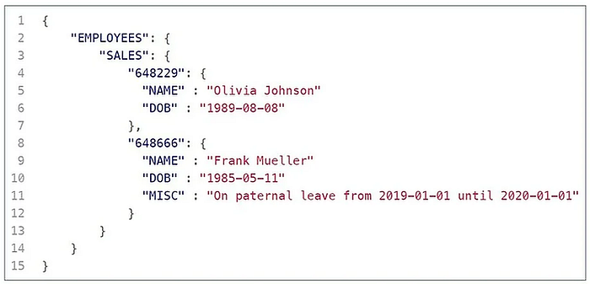
Semi-Structured Data
Data Acquisition and Management

Slide 20
Data Acquisition and Management
overview of data acquisition techniques
Data acquisition involves collecting information from various sources to analyze and make informed decisions.
Here are overviews of three common data acquisition techniques:
Surveys
Web scraping
APIs.

Slide 21
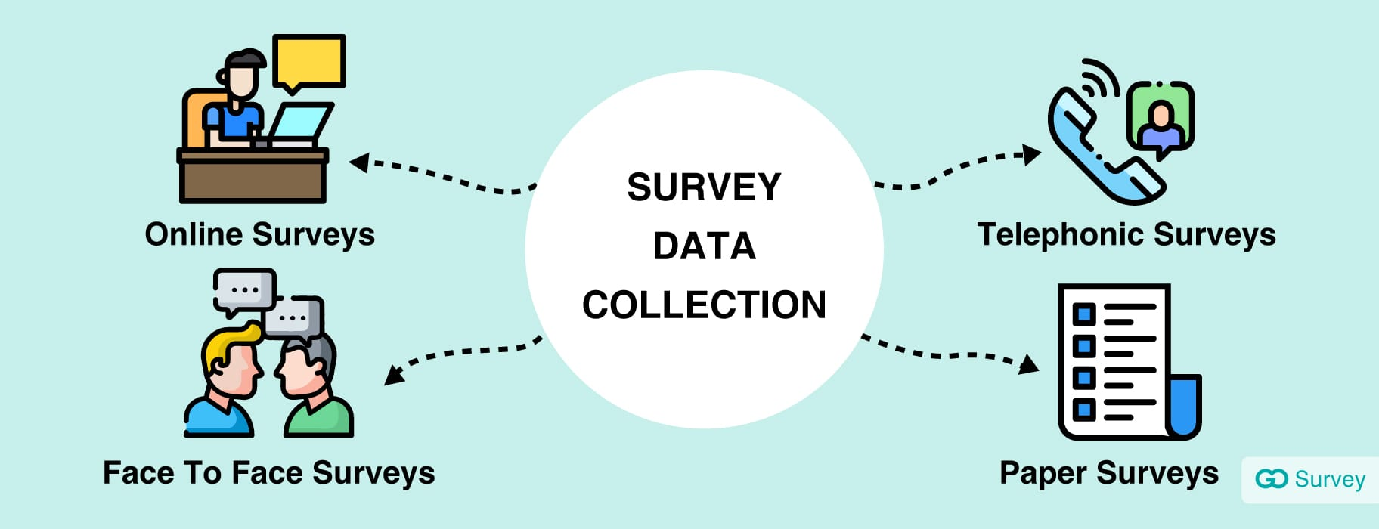
Data Acquisition and Management
Surveys
Surveys involve collecting data directly from respondents through a structured set of questions.
This method is widely used in research, marketing, social sciences, and more.

Slide 22
Data Acquisition and Management
Surveys
Types of Surveys
Online Surveys: Administered via the internet using tools like SurveyMonkey, Google Forms, or Typeform. They can reach a large audience quickly and are cost-effective.
Telephone Surveys: Conducted over the phone, often used for market research or public opinion polling. They provide higher response rates but can be costly.
Face-to-Face Surveys: Involves personal interviews, typically used for in-depth qualitative research. They allow for more detailed responses but are time-consuming and expensive.
Mail Surveys: Sent and returned by postal service. They have a higher cost and longer turnaround time but can reach specific demographics effectively.

Slide 23
Data Acquisition and Management
Surveys
Design Considerations
Question Types: Multiple-choice, Likert scale, open-ended questions.
Sampling Methods: Random sampling, stratified sampling, cluster sampling.
Survey Length: Keeping it concise to maintain respondent engagement.
Pilot Testing: Conducting a test run to identify potential issues.

Slide 24
Data Acquisition and Management
Surveys
Pros:
Direct feedback from participants.
Customizable to specific research needs.
Can target specific demographics or populations.
Cons:
Response bias and social desirability bias.
Low response rates, particularly in online and mail surveys.
Time-consuming and costly, especially for large-scale surveys.

Slide 25
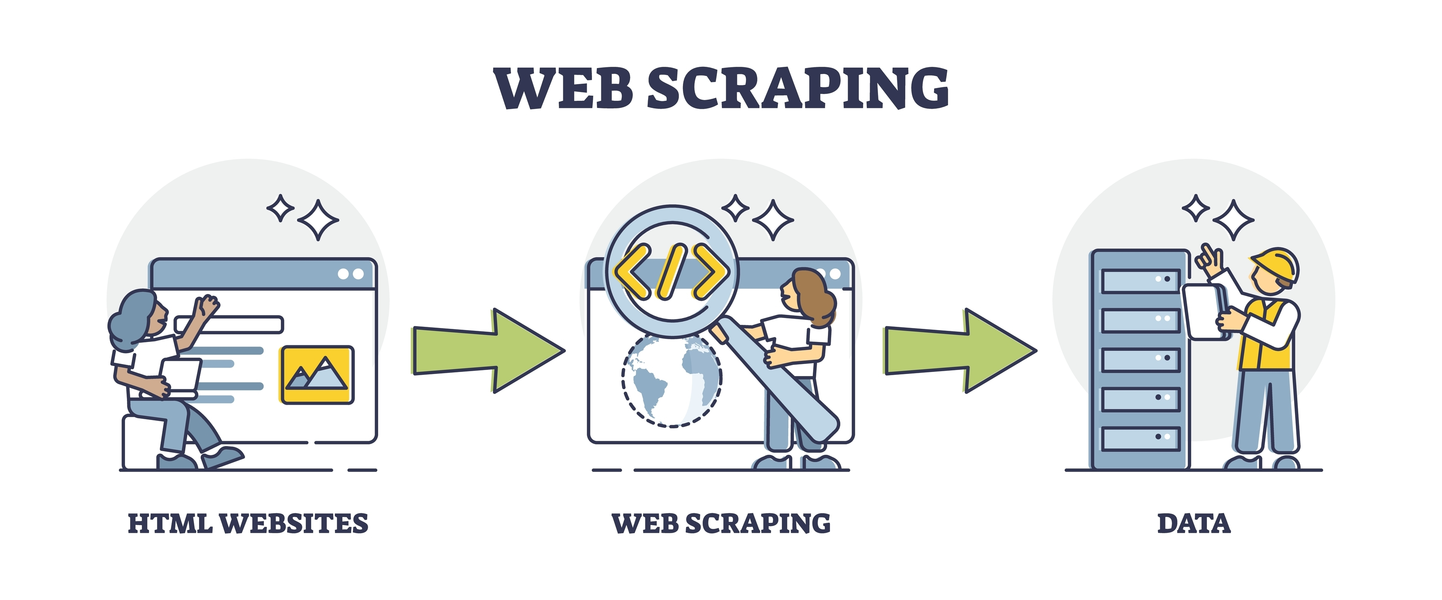
Data Acquisition and Management
Web Scraping
Web scraping is the process of extracting data from websites using automated scripts or software.
It's useful for gathering large volumes of data from publicly available web pages.

Slide 26
Data Acquisition and Management
Web Scraping
Tools and Techniques
BeautifulSoup: A Python library for parsing HTML and XML documents. Ideal for beginners due to its simplicity.
Scrapy: An open-source web-crawling framework for more advanced scraping needs, offering robust features for large-scale projects.
Selenium: A tool for automating web browsers, often used for scraping dynamic content that requires interaction (e.g., clicking buttons, filling forms).

Slide 27
Data Acquisition and Management
Web Scraping
Process
Identify Target Websites: Determine the websites from which to scrape data.
Inspect Page Structure: Use browser developer tools to understand the HTML structure and locate the desired data.
Write Scraping Scripts: Use tools like BeautifulSoup, Scrapy, or Selenium to write scripts that extract data.
Handle Data Storage: Save the scraped data in a structured format like CSV, JSON, or directly into databases.
Data Cleaning and Validation: Ensure the accuracy and consistency of the scraped data.

Slide 28
Data Acquisition and Management
Web Scraping
Pros:
Access to vast amounts of data from various sources.
Automated data collection, scalable to large datasets.
Useful for gathering real-time data.
Cons:
Legal and ethical considerations, such as respecting website terms of service and data privacy regulations.
Websites may implement anti-scraping measures (e.g., CAPTCHAs, IP blocking).Data quality can vary, requiring extensive cleaning and validation.

Slide 29
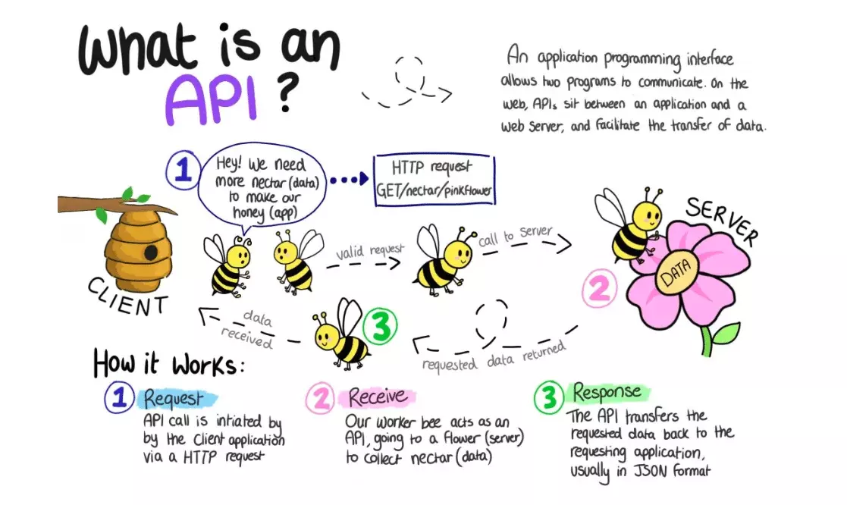
Data Acquisition and Management
APIs (Application Programming Interfaces)
APIs are a set of protocols and tools for building software and applications. They enable different software systems to communicate and exchange data.

Slide 30
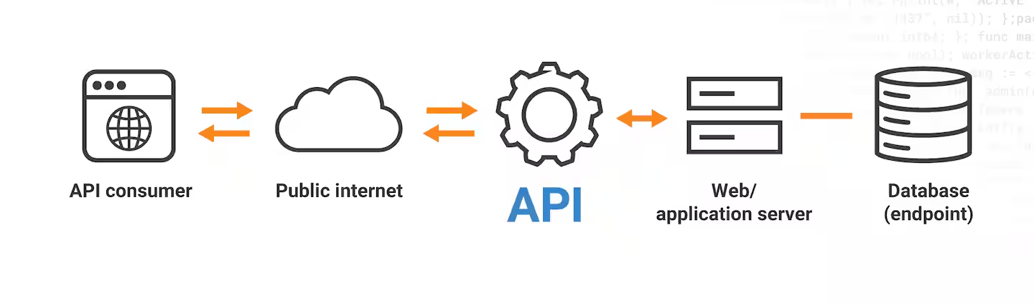
Data Acquisition and Management
APIs (Application Programming Interfaces)
APIs are a set of protocols and tools for building software and applications. They enable different software systems to communicate and exchange data.

Slide 31
Data Acquisition and Management
APIs (Application Programming Interfaces)
Types of APIs
REST APIs: Representational State Transfer, which uses standard HTTP methods (GET, POST, PUT, DELETE) and is stateless. It is widely used due to its simplicity and scalability.
SOAP APIs: Simple Object Access Protocol, which relies on XML-based messaging and is designed for more complex and secure transactions.
GraphQL APIs: A query language for APIs that allows clients to request specific data, reducing the amount of data transferred and improving performance.

Slide 32
Data Acquisition and Management
APIs (Application Programming Interfaces)
Usage
Authentication: Most APIs require authentication, usually through API keys, OAuth, or other token-based methods.
Endpoints: Specific URLs where API requests are sent. Each endpoint corresponds to a specific functionality or data resource.
Rate Limits: Restrictions on the number of API requests that can be made within a certain time frame, imposed to prevent abuse and ensure fair usage.

Slide 33
Data Acquisition and Management
APIs (Application Programming Interfaces)
Pros:
Structured and reliable data access, often with comprehensive documentation.
Real-time data retrieval, ensuring up-to-date information.
Interoperability with various systems and platforms.
Cons:
Rate limits and access restrictions can limit the amount of data that can be retrieved.
Dependency on the API provider's uptime and stability.
Potential costs associated with API usage, especially for higher-tier services or large volumes of data.

Slide 34
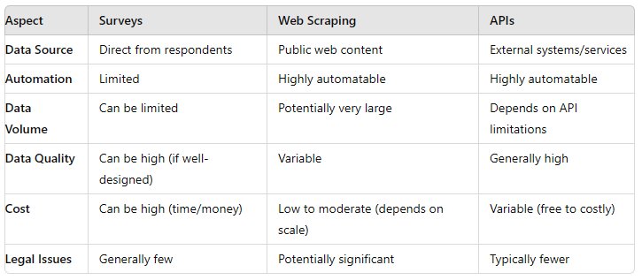
Data Acquisition and Management
Comparison

Slide 35

Data Acquisition and Management

