Slide 1


Module-3
Linear Regression
Department of Computer Engineering

Slide 2
Contents
Representation of Model, Cost Function, Gradient Descent, Gradient Descent For Linear Regression, Shrinkage Methods: Ridge Regression, Lasso, Selecting the tuning parameter, Feature selection: Subset Selection, Step Selection

Slide 3
What is a Regression Problem?
Linear Regression is one of the machine learning algorithms where the result is predicted by the use of known parameters which are correlated with the output.
It is used to predict values within a continuous range rather than trying to classify them into categories.
The known parameters are used to make a continuous and constant slope which is used to predict the unknown or the result.
https://www.knowledgehut.com/blog/data-science/linear-regression-for-machine-learning

Slide 4
What is a Regression Problem?
Majority of the machine learning algorithms fall under the supervised learning category. It is the process where an algorithm is used to predict a result based on the previously entered values and the results generated from them. Suppose we have an input variable ‘x’ and an output variable ‘y’ where y is a function of x (y=f{x}). Supervised learning reads the value of entered variable ‘x’ and the resulting variable ‘y’ so that it can use those results to later predict a highly accurate output data of ‘y’ from the entered value of ‘x’. A regression problem is when the resulting variable contains a real or a continuous value. It tries to draw the line of best fit from the data gathered from a number of points.
https://www.knowledgehut.com/blog/data-science/linear-regression-for-machine-learning

Slide 5

What is a Regression Problem?
For example, which of these is a regression problem?
How much gas will I spend if I drive for 100 miles?
What is the nationality of a person?
What is the age of a person?
Which is the closest planet to the Sun?
https://www.knowledgehut.com/blog/data-science/linear-regression-for-machine-learning

Slide 6
What is a Regression Problem?
For example, which of these is a regression problem?
Predicting the amount of gas to be spent and the age of a person are regression problems. Predicting nationality is categorical and the closest planet to the Sun is discrete.
https://www.knowledgehut.com/blog/data-science/linear-regression-for-machine-learning

Slide 7


What is Linear Regression?
Let’s say we have a dataset which contains information about the relationship between ‘number of hours studied’ and ‘marks obtained’. A number of students have been observed and their hours of study along with their grades are recorded. This will be our training data. Our goal is to design a model that can predict the marks if number of hours studied is provided. Using the training data, a regression line is obtained which will give minimum error. This linear equation is then used to apply for a new data. That is, if we give the number of hours studied by a student as an input, our model should be able to predict their mark with minimum error.

Slide 8
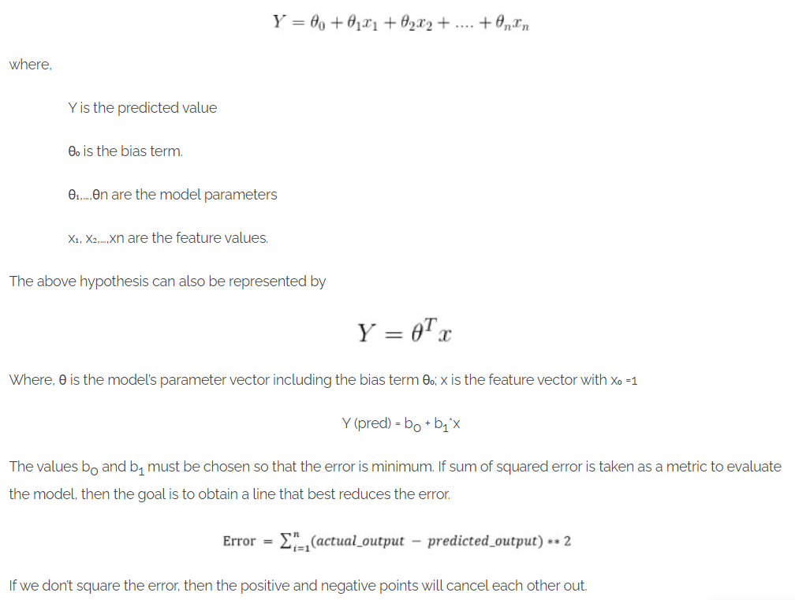
Hypothesis of Linear Regression
The linear regression model can be represented by the following equation:

Slide 9
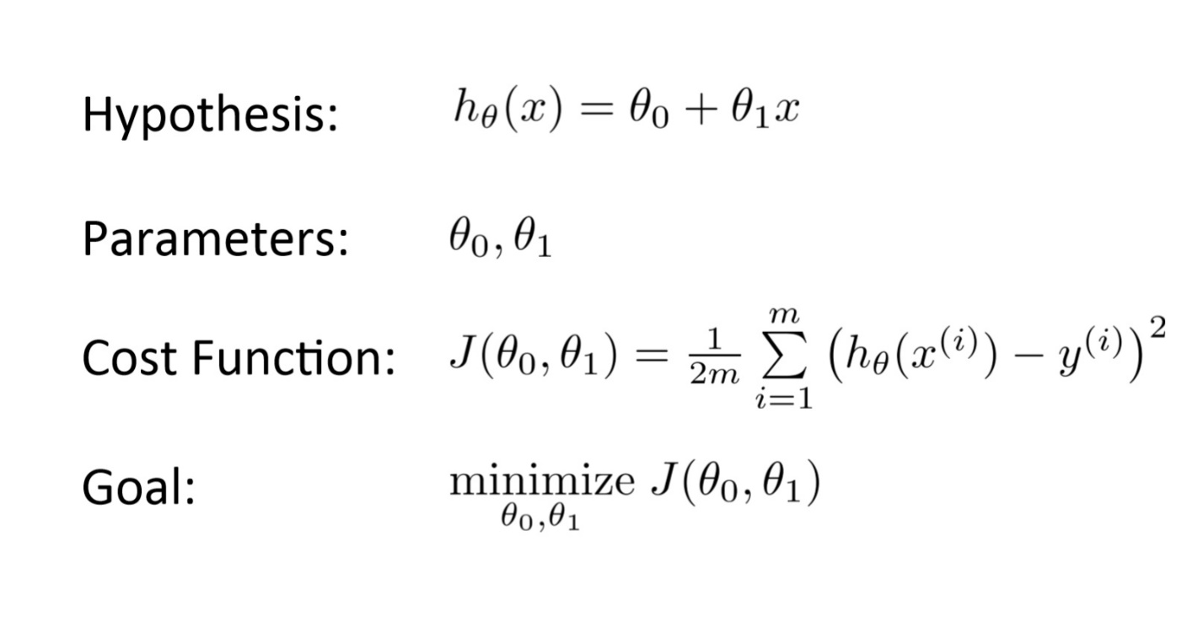
What is a Cost Function?
It is a function that measures the performance of a model for any given data. Cost Function quantifies the error between predicted values and expected values and presents it in the form of a single real number

Slide 10
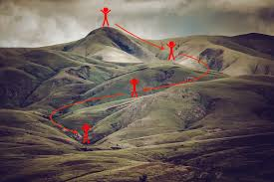
What is Gradient Descent?
Let’s say you are playing a game where the players are at the top of a mountain, and they are asked to reach the lowest point of the mountain. Additionally, they are blindfolded. So, what approach do you think would make you reach the lake?
Take a moment to think about this before you read on.
The best way is to observe the ground and find where the land descends. From that position, take a step in the descending direction and iterate this process until we reach the lowest point.

Slide 11
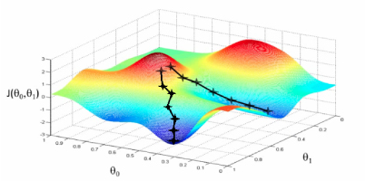
What is Gradient Descent?
Gradient descent is an optimization algorithm which is mainly used to find the minimum of a function. In machine learning, gradient descent is used to update parameters in a model. Parameters can vary according to the algorithms, such as coefficients in Linear Regression and weights in Neural Networks.
Let us relate gradient descent with a real-life analogy for better understanding. Think of a valley you would like to descend when you are blind-folded. Any sane human will take a step and look for the slope of the valley, whether it goes up or down. Once you are sure of the downward slope you will follow that and repeat the step again and again until you have descended completely (or reached the minima).

Slide 12

What is Gradient Descent?
Similarly, let us consider another analogy. Suppose you have a ball and you place it on an inclined plane (at position A). As per laws, it will start rolling until it travels to a gentle plane where it will be stationary (at position B as shown in the figure below).

Slide 13
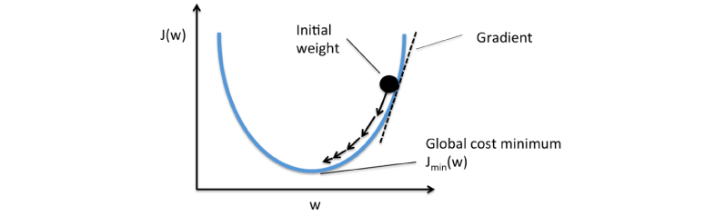
What is Gradient Descent?
This is exactly what happens in gradient descent. The inclined and/or irregular is the cost function when it is plotted and the role of gradient descent is to provide direction and the velocity (learning rate) of the movement in order to attain the minima of the function i.e where the cost is minimum.

Slide 14
How does Gradient Descent work?
The primary goal of machine learning algorithms is always to build a model, which is basically a hypothesis which can be used to find an estimation for Y based on X.
Let us consider an example of a model based on certain housing data which comprises of the sale price of the house, the size of the house etc. Suppose we want to predict the pricing of the house based on its size. It is clearly a regression problem where given some inputs, we would like to predict a continuous output.
The hypothesis is usually presented as
where the theta values are the parameters.
This yields h(x) = 1.5 + 0x. 0x means no slope, and y will always be the constant 1.5.

Slide 15
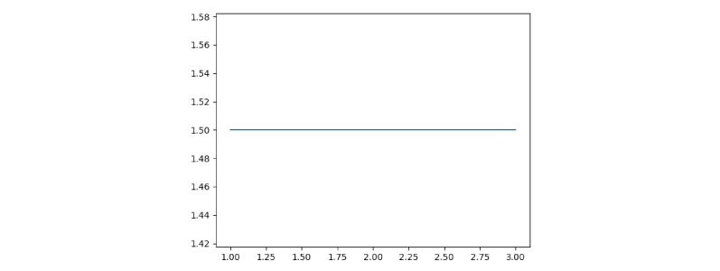
How does Gradient Descent work?
This yields h(x) = 1.5 + 0x. 0x means no slope, and y will always be the constant 1.5.

Slide 16
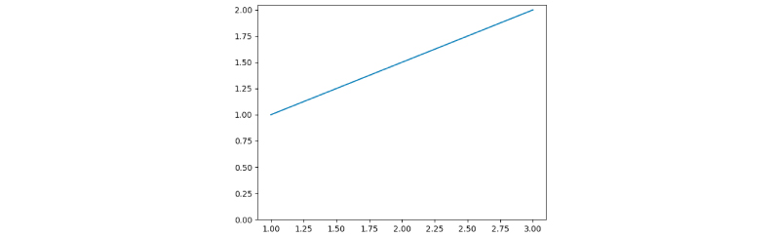
How does Gradient Descent work?
Where, h(x) = 1 + 0.5x
This yields h(x) = 1.5 + 0x. 0x means no slope, and y will always be the constant 1.5.

Slide 17
Cost Function
The objective in the case of gradient descent is to find a line of best fit for some given inputs, or X values, and any number of Y values, or outputs.
A cost function is defined as “a function that maps an event or values of one or more variables onto a real number intuitively representing some “cost” associated with the event.”

Slide 18

Cost Function
With a known set of inputs and their corresponding outputs, a machine learning model attempts to make predictions according to the new set of inputs.
This relates to the idea of a Cost function or Loss function.
A Cost Function/Loss Function tells us “how good” our model is at making predictions for a given set of parameters. The cost function has a curve and a gradient, the slope of this curve helps us to update our parameters and make an accurate model.

Slide 19
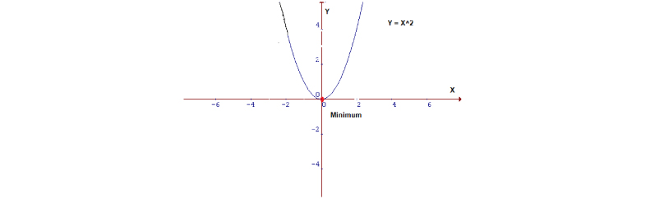
Minimizing the Cost Function
It is always the primary goal of any Machine Learning Algorithm to minimize the Cost Function. Minimizing cost functions will also result in a lower error between the predicted values and the actual values which also denotes that the algorithm has performed well in learning.
Generally, the cost function is in the form of Y = X². In a Cartesian coordinate system, this represents an equation for a parabola which can be graphically represented as :

Slide 20
Minimizing the Cost Function
Now a function is required which will minimize the parameters over a dataset. The most common function which is often used is the mean squared error. It measures the difference between the estimated value (the prediction) and the estimator (the dataset).
It turns out we can adjust the equation a little to make the calculation down the track a little more simple.

Slide 21
Minimizing the Cost Function
Why do we take the squared differences and simply not the absolute differences?
Because the squared differences make it easier to derive a regression line. Indeed, to find that line we need to compute the first derivative of the Cost function, and it is much harder to compute the derivative of absolute values than squared values.
The squared differences increase the error distance, thus, making the bad predictions more pronounced than the good ones. Minimizing the Cost Function

Slide 22
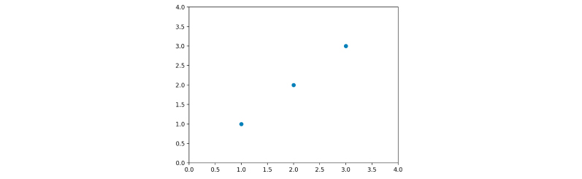
Minimizing the Cost Function: Example
Let us apply this cost function to the following data:
Here we will calculate some of the theta values and then plot the cost function by hand. Since this function passes through (0, 0), we will look only at a single value of theta. Also, let us refer to the cost function as J(ϴ) from now on.

Slide 23
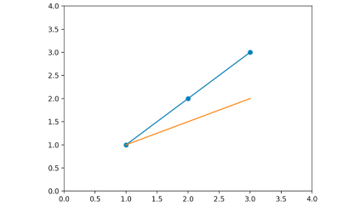
Minimizing the Cost Function: Example
When the value of ϴ is 1, for J(1), we get a 0. You will notice the value of J(1) gives a straight line which fits the data perfectly. Now let us try with ϴ = 0.5
Here we will calculate some of the theta values and then plot the cost function by hand. Since this function passes through (0, 0), we will look only at a single value of theta. Also, let us refer to the cost function as J(ϴ) from now on.

Slide 24
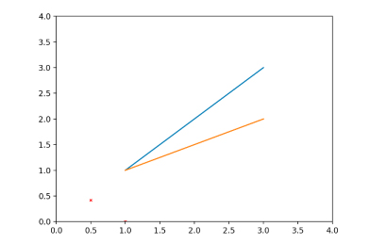
Minimizing the Cost Function: Example
The MSE function gives us a value of 0.58. Let’s plot both our values so far:
J(1) = 0
J(0.5) = 0.58
With J(1) and J(0.5)

Slide 25
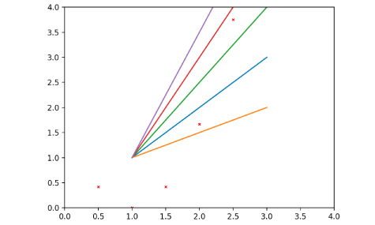
Minimizing the Cost Function: Example
Let us go ahead and calculate some more values of J(ϴ).

Slide 26
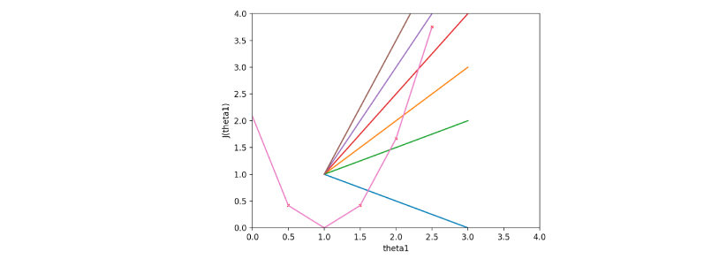
Minimizing the Cost Function: Example
Now if we join the dots carefully, we will get -
As we can see, the cost function is at a minimum when theta = 1, which means the initial data is a straight line with a slope or gradient of 1 as shown by the orange line in the above figure.
Using a trial and error method, we minimized J(ϴ). We did all of these by trying out a lot of values and with the help of visualizations. Gradient Descent does the same thing in a much better way, by changing the theta values or parameters until it descends to the minimum value.

Slide 27
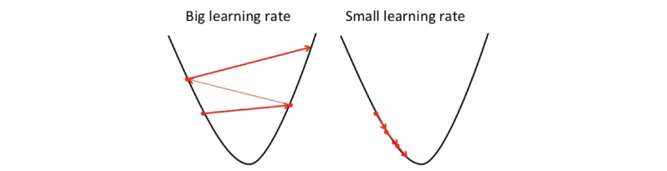
Learning Rate
Let us now start by initializing theta0 and theta1 to any two values, say 0 for both, and go from there. The algorithm is as follows:
where α, alpha, is the learning rate, or how rapidly do we want to move towards the minimum. We can always overshoot if the value of α is too large.

Slide 28


Learning Rate
The derivative which refers to the slope of the function is calculated. Here we calculate the partial derivative of the cost function. It helps us to know the direction (sign) in which the coefficient values should move so that they attain a lower cost on the following iteration.
Once we know the direction from the derivative, we can update the coefficient values. Now you need to specify a learning rate parameter which will control how much the coefficients can change on each update.
coefficient = coefficient – (alpha * delta)

Slide 29


Types of Gradient Descent Algorithms: 1. Batch Gradient Descent
Gradient descent variants’ trajectory towards the minimum
1. Batch Gradient Descent: In this type of gradient descent, all the training examples are processed for each iteration of gradient descent. It gets computationally expensive if the number of training examples is large. This is when batch gradient descent is not preferred, rather a stochastic gradient descent or mini-batch gradient descent is used.

Slide 30
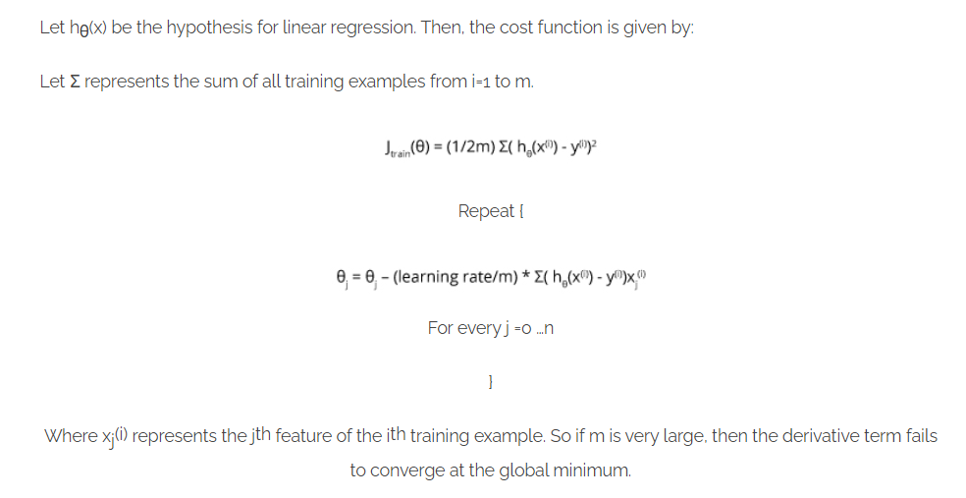
Types of Gradient Descent Algorithms: 1. Batch Gradient Descent
Algorithm for batch gradient descent:

Slide 31
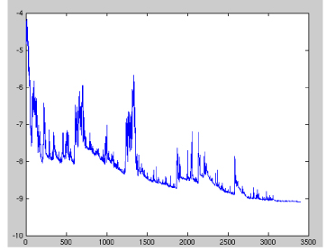
Types of Gradient Descent Algorithms: 2. Stochastic Gradient Descent
2. Stochastic Gradient Descent:
The word stochastic is related to a system or a process that is linked with a random probability. Therefore, in Stochastic Gradient Descent (SGD) samples are selected at random for each iteration instead of selecting the entire data set. When the number of training examples is too large, it becomes computationally expensive to use batch gradient descent, however, Stochastic Gradient Descent uses only a single sample, i.e., a batch size of one, to perform each iteration. The sample is randomly shuffled and selected for performing the iteration. The parameters are updated even after one iteration where only one has been processed. Thus, it gets faster than batch gradient descent.

Slide 32
Types of Gradient Descent Algorithms: 2. Stochastic Gradient Descent
2. Algorithm for stochastic gradient descent:
Firstly shuffle the data set randomly in order to train the parameters evenly for each type of data.
As mentioned above, it takes into consideration one example per iteration.

Slide 33
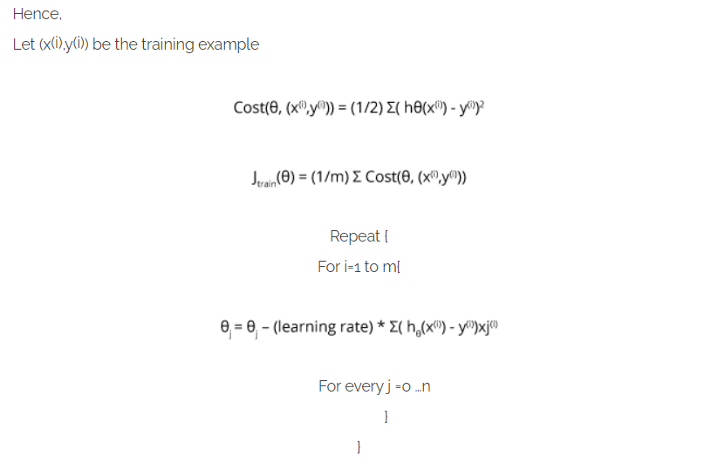
Types of Gradient Descent Algorithms: 2. Stochastic Gradient Descent
2. Algorithm for stochastic gradient descent:
Firstly shuffle the data set randomly in order to train the parameters evenly for each type of data.
As mentioned before, it takes into consideration one example per iteration.

Slide 34

Types of Gradient Descent Algorithms: 3. Mini Batch gradient descent
3. Mini Batch gradient descent:
This type of gradient descent is considered to be faster than both batch gradient descent and stochastic gradient descent. Even if the number of training examples is large, it processes it in batches in one go. Also, the number of iterations are lesser in spite of working with larger training samples.

Slide 35
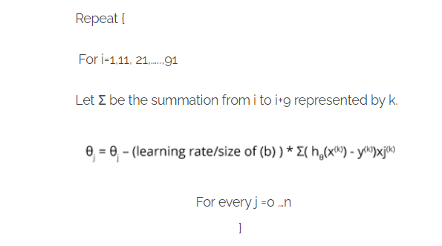
Types of Gradient Descent Algorithms: 3. Mini Batch gradient descent
Let us consider b be the number of examples in one batch, where b The batch size can be adjusted. It is generally kept as a power of 2. The reason behind it is because some hardware such as GPUs achieve better run time with common batch sizes such as a power of 2.

Slide 36
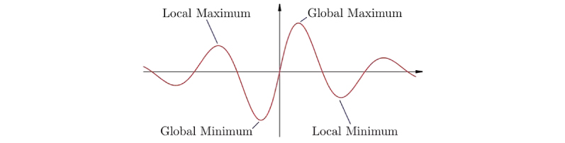
Convergence trends in different variants of Gradient Descent
For Batch Gradient Descent, the algorithm traces a straight line towards the minimum. If the cost function is convex, then it converges to a global minimum and if the cost function is not convex, then it converges to a local minimum. The learning rate is typically held constant over here.
For stochastic gradient descent and mini-batch gradient descent, the algorithm keeps on fluctuating around the global minimum instead of converging. In order to converge, the learning rate needs to be changed slowly.

Slide 37
Challenges in executing Gradient Descent
There are many cases where gradient descent fails to perform well. There are mainly three reasons when this would happen:
Data challenges
Gradient challenges
Implementation challenges

Slide 38
Challenges in executing Gradient Descent
Data challenges
The arrangement of data sometimes leads to challenges. If it is arranged in such a way that it poses a non-convex optimization problem then it becomes difficult to perform optimization using gradient descent. Gradient descent works for problems which are arranged with a well-defined convex optimization problem.
During the optimization of a convex optimization problem, you will come across several minimal points. The lowest among all the points is called the global minimum, and other points are called the local minima. You will have to make sure you go to the global minimum and avoid local minima.
There is also a saddle point problem. This is a situation where the gradient is zero but is not an optimal point. It cannot be avoided and is still an active part of the research.

Slide 39
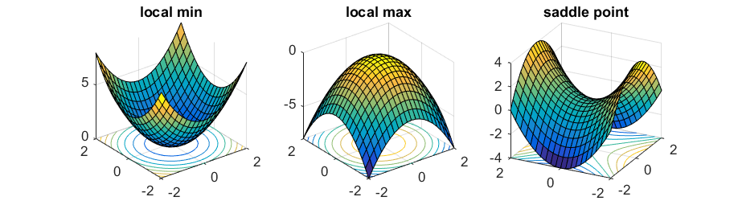
Challenges in executing Gradient Descent
Data challenges

Slide 40
Challenges in executing Gradient Descent
2. Gradient challenges
While using gradient descent, if the execution is not proper, it leads to certain problems like vanishing gradient. This happens when the gradient is either too small or too large which results in no convergence.

Slide 41
Challenges in executing Gradient Descent
3. Implementation challenges
Smaller memory results in the failure of network. A lot of neural network practitioners do not pay attention but it is very important to look at the resource utilization by the network.
Another important thing to look at is to keep track of things like floating point considerations and hardware/software prerequisites.

Slide 42
Variants of Gradient Descent algorithms
Let us look at some of the most commonly used gradient descent algorithms and how they are implemented.

Slide 43
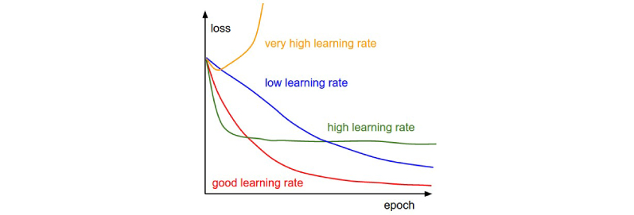
Variants of Gradient Descent algorithms
Vanilla Gradient Descent
One of the simplest forms of gradient descent technique is the Vanilla Gradient Descent. Here, vanilla means pure / without any adulteration. In this algorithm, the main feature is that small steps are taken in the direction of minima by taking the gradient of cost function.

Slide 44
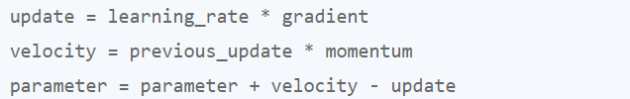
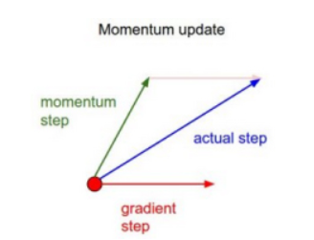
Variants of Gradient Descent algorithms
Gradient Descent with Momentum
In this case, we adjust the algorithm in such a manner that we are aware about the prior step before taking the next step.

Slide 45
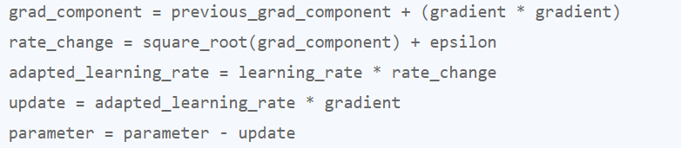
Variants of Gradient Descent algorithms
ADAGRAD
ADAGRAD (Adaptive Gradient Algorithm) mainly uses an adaptive technique to learn rate updation. In this algorithm, we try to change the algorithm on the basis of how the gradient has been changing for all the previous iterations.

Slide 46
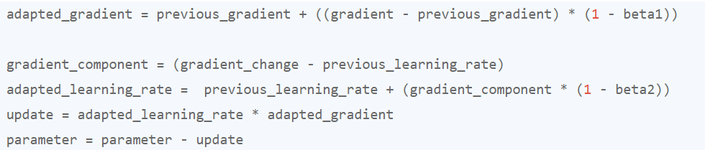
Variants of Gradient Descent algorithms
ADAGRAD
ADAM is another adaptive technique which is built out of ADAGRAD and further reduces its downside. In simple words you can consider it to be ADAGRAD + momentum.

Slide 47
Tips for Gradient Descent
Plot Cost versus Time: It is suggested to collect and plot the cost values calculated by the algorithm for each iteration. It helps you keep track of the descent. For a well-performing gradient descent the cost always decreases in each iteration. If you see there is no decrease, reduce the learning rate.
Learning Rate: The learning rate value is a small real value such as 0.1, 0.001 or 0.0001. Keep trying different values to check which works best for your algorithm.
Rescale Inputs: Try to achieve a range such as [0, 1] or [-1, 1] by rescaling all the input variables. The algorithm reaches the minimum cost faster if the shape of the cost function is not distorted or skewed.
Few Passes: Stochastic gradient descent often does not need more than 1-to-10 passes through the training dataset to converge on good or good enough coefficients.
Plot Mean Cost: The updates for each training dataset instance can result in a noisy plot of cost over time when using stochastic gradient descent. Try to take the average over 10, 100, or 1000 updates. This will give you a better idea of the learning trend for the algorithm.

Slide 48
What is Linear Regression?
Let’s say we have a dataset which contains information about the relationship between ‘number of hours studied’ and ‘marks obtained’. A number of students have been observed and their hours of study along with their grades are recorded. This will be our training data. Our goal is to design a model that can predict the marks if number of hours studied is provided. Using the training data, a regression line is obtained which will give minimum error. This linear equation is then used to apply for a new data. That is, if we give the number of hours studied by a student as an input, our model should be able to predict their mark with minimum error.

Slide 49
Hypothesis of Linear Regression
The linear regression model can be represented by the following equation:
where,
Y is the predicted value
θ₀ is the bias term.
θ₁,…,θn are the model parameters
x₁, x₂,…,xn are the feature values.
The above hypothesis can also be represented by
Where, θ is the model’s parameter vector including the bias term θ₀; x is the feature vector with x₀ =1
Y (pred) = b₀ + b₁*x

Slide 50
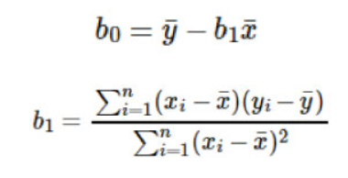
Hypothesis of Linear Regression
The values b₀ and b₁ must be chosen so that the error is minimum. If sum of squared error is taken as a metric to evaluate the model, then the goal is to obtain a line that best reduces the error.
If we don’t square the error, then the positive and negative points will cancel each other out.
For a model with one predictor,

Slide 51
Hypothesis of Linear Regression
Exploring ‘b₁’
If b₁ > 0, then x (predictor) and y(target) have a positive relationship. That is an increase in x will increase y.
If b₁ < 0, then x (predictor) and y(target) have a negative relationship. That is an increase in x will decrease y.
Exploring ‘b₀’
If the model does not include x=0, then the prediction will become meaningless with only b₀. For example, we have a dataset that relates height(x) and weight(y). Taking x=0 (that is height as 0), will make the equation have only b₀ value which is completely meaningless as in real-time height and weight can never be zero. This resulted due to considering the model values beyond its scope.

Slide 52
Hypothesis of Linear Regression
Exploring ‘b₀’
If the model includes value 0, then ‘b₀’ will be the average of all predicted values when x=0. But, setting zero for all the predictor variables is often impossible.
The value of b₀ guarantees that the residual will have mean zero. If there is no ‘b₀’ term, then the regression will be forced to pass over the origin. Both the regression coefficient and prediction will be biased.

Slide 53
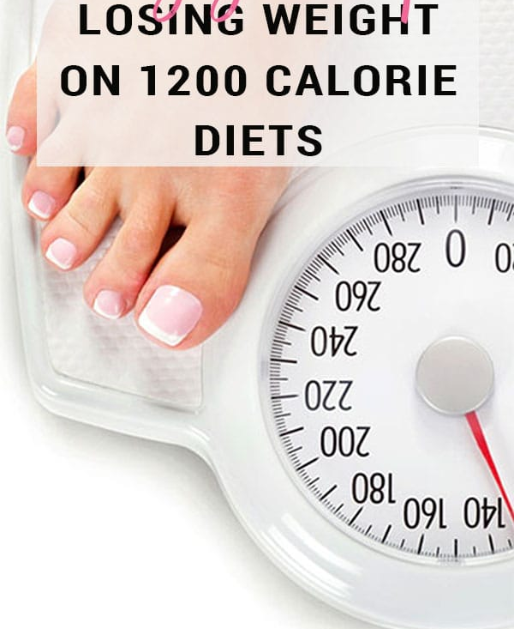
How does Linear Regression work?
Let’s look at a scenario where linear regression might be useful: losing weight. Let us consider that there’s a connection between how many calories you take in and how much you weigh; regression analysis can help you understand that connection.
Regression analysis will provide you with a relation which can be visualized into a graph in order to make predictions about your data.
For example, if you’ve been putting on weight over the last few years, it can predict how much you’ll weigh in the next ten years if you continue to consume the same amount of calories and burn them at the same rate.

Slide 54
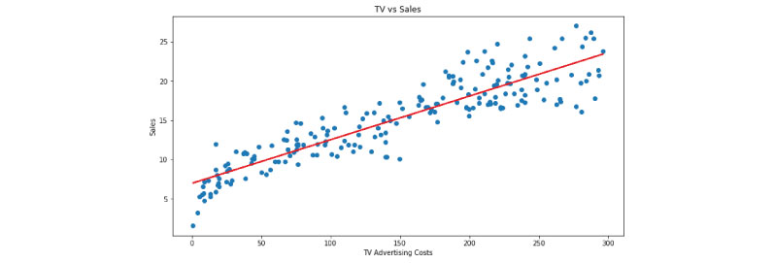
How does Linear Regression work?
The goal of regression analysis is to create a trend line based on the data you have gathered. This then allows you to determine whether other factors apart from the amount of calories consumed affect your weight, such as the number of hours you sleep, work pressure, level of stress, type of exercises you do etc.
Before taking into account, we need to look at these factors and attributes and determine whether there is a correlation between them.
Linear Regression can then be used to draw a trend line which can then be used to confirm or deny the relationship between attributes. If the test is done over a long time duration, extensive data can be collected and the result can be evaluated more accurately.

Slide 55

How do we determine the best fit line?
The best fit line is considered to be the line for which the error between the predicted values and the observed values is minimum. It is also called the regression line and the errors are also known as residuals. The figure shown below shows the residuals. It can be visualized by the vertical lines from the observed data value to the regression line.

Slide 56
Assumptions in linear regression
If you are planning to use linear regression for your problem then there are some assumptions you need to consider:
The relation between the dependent and independent variables should be almost linear.
The data is homoscedastic, meaning the variance between the results should not be too much.
The results obtained from an observation should not be influenced by the results obtained from the previous observation.
The residuals should be normally distributed. This assumption means that the probability density function of the residual values is normally distributed at each independent value.
You can determine whether your data meets these conditions by plotting it and then doing a bit of digging into its structure.

Slide 57
Few properties of Regression Line
Regression passes through the mean of independent variable (x) as well as mean of the dependent variable (y).
Regression line minimizes the sum of “Square of Residuals”. That’s why the method of Linear Regression is known as “Ordinary Least Square (OLS)”. We will discuss more in detail about Ordinary Least Square later on.
B₁ explains the change in Y with a change in x by one unit. In other words, if we increase the value of ‘x’ it will result in a change in value of Y.

Slide 58
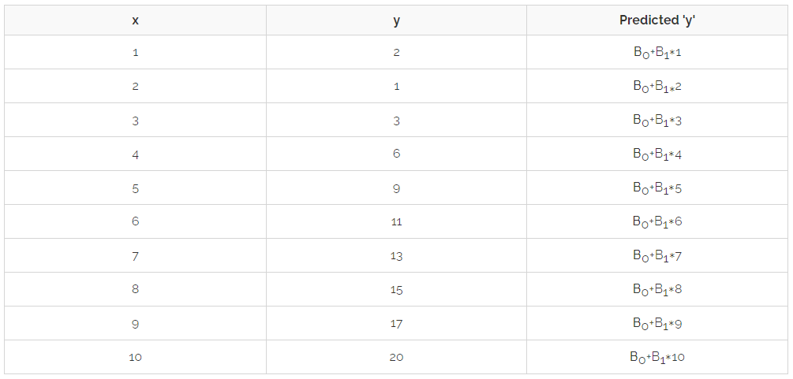
Finding a Linear Regression line
Let’s say we want to predict ‘y’ from ‘x’ given in the following table and assume they are correlated as “y=B0+B1∗x”

Slide 59
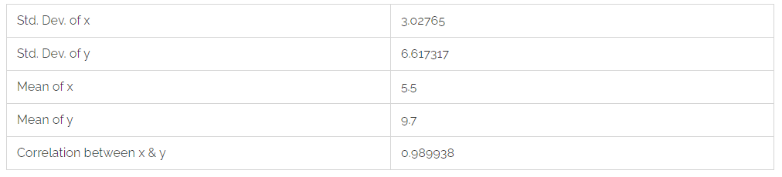
Finding a Linear Regression line
If the Residual Sum of Square (RSS) is differentiated with respect to B0 & B1 and the results equated to zero, we get the following equation:
B₁ = Correlation * (Std. Dev. of y/ Std. Dev. of x)
B₀ = Mean(Y) – B₁ * Mean(X)
Putting values from table 1 into the above equations,
B₁ = 2.64
B₀ = -2.2

Slide 60
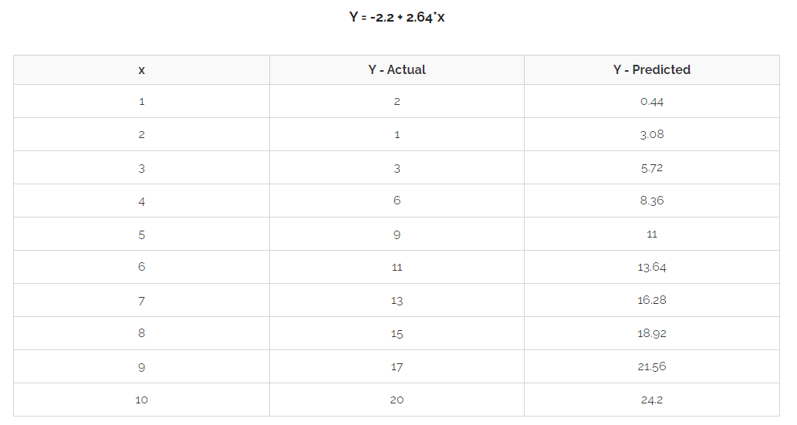
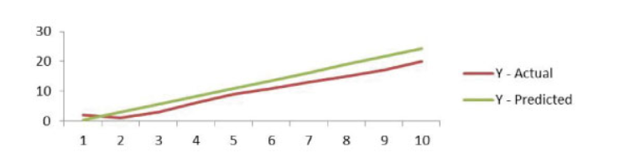
Finding a Linear Regression line

Slide 61
Simple Linear Regression
Optimization is a big part of machine learning and almost every machine learning algorithm has an optimization technique at its core for increased efficiency.
Gradient Descent is such an optimization algorithm used to find values of coefficients of a function that minimizes the cost function.
Gradient Descent is best applied when the solution cannot be obtained by analytical methods (linear algebra) and must be obtained by an optimization technique.

Slide 62
Simple Linear Regression
Residual Analysis:
Simple linear regression models the relationship between the magnitude of one variable and that of a second—for example, as x increases, y also increases. Or as x increases, y decreases.
Correlation is another way to measure how two variables are related. The models done by simple linear regression estimate or try to predict the actual result but most often they deviate from the actual result.
Residual analysis is used to calculate by how much the estimated value has deviated from the actual result.

Slide 63
Simple Linear Regression
Null Hypothesis and p-value:
During feature selection, null hypothesis is used to find which attributes will not affect the result of the model. Hypothesis tests are used to test the validity of a claim that is made about a particular attribute of the model. This claim that’s on trial, in essence, is called the null hypothesis. A p-value helps to determine the significance of the results. p-value is a number between 0 and 1 and is interpreted in the following way:
A small p-value (less than 0.05) indicates a strong evidence against the null hypothesis, so the null hypothesis is to be rejected.
A large p-value (greater than 0.05) indicates weak evidence against the null hypothesis, so the null hypothesis is to be considered.
p-value very close to the cut-off (equal to 0.05) is considered to be marginal (could go either way). In this case, the p-value should be provided to the readers so that they can draw their own conclusions.

Slide 64
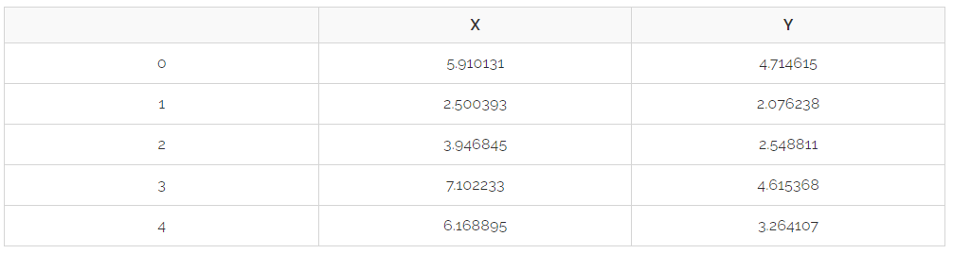
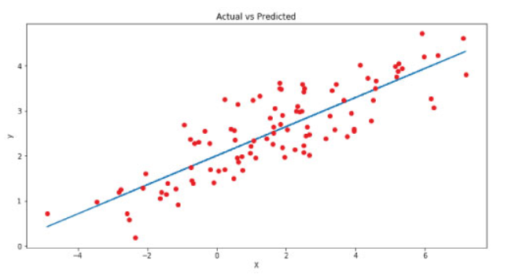
Simple Linear Regression: Example
Yₑ = 2.003 + 0.323 (8) = 4.587

Slide 65
Question#1
“Why is Linear Regression giving me such good accuracy on the training set but a low accuracy on the test set in spite of adding all the available dependent features to the model?”
Ans: The question above seems inexplicable to many people but is answered by a concept called overfitting in which your model, in addition to learning the data, also learns the noise present in it. Hence learning the training points, a bit too perfectly.

Slide 66
Question#2
How do you solve it?
Ans: This is where shrinkage methods (also known as regularization) come in play. These methods apply a penalty term to the Loss function used in the model. Minimizing the loss function is equal to maximizing the accuracy.
Linear Regression uses Least Squares to calculate the minimum error between the actual values and the predicted values. The aim is to minimize the squared difference between the actual and predicted values to draw the best possible regression curve for the best prediction accuracy.

Slide 67
Question#3
Now, what does shrinking do?
Ans: Shrinking the coefficient estimates significantly reduces their variance. When we perform shrinking, we essentially bring the coefficient estimates closer to 0.
The need for shrinkage method arises due to the issues of underfitting or overfitting the data. When we want to minimize the mean error (Mean Squared Error(MSE) in case of Linear Regression), we need to optimize the bias-variance trade-off.
The best known shrinking methods are Ridge Regression and Lasso Regression which are often used in place of Linear Regression.

Slide 68
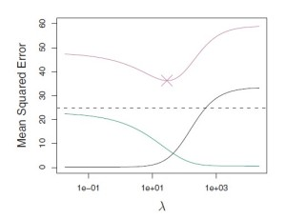
Question#4
What is this bias-variance trade-off?
Ans: The bias-variance trade-off indicates the level of underfitting or overfitting of the data with respect to the Linear Regression model applied to it. A high bias-low variance means the model is underfitted and a low bias-high variance means that the model is overfitted. We need to trade-off between bias and variance to achieve the perfect combination for the minimum Mean Squared Error as shown by the graph below.

Slide 69
Question#4
In this figure, the green curve is variance, the black curve is squared bias and the purple curve is the MSE. Lambda is the regularization parameter

Slide 70


Ridge regression
Ridge regression is very similar to least squares, except that the Ridge coefficients are estimated by minimizing a different quantity. In particular, the Ridge regression coefficients β are the values that minimize the following quantity:
Here, λ is the tuning parameter that decides how much we want to penalize the flexibility of the model. λ controls the relative impact of the two components: RSS and the penalty term.

Slide 71
Ridge regression
If λ = 0, the Ridge regression will produce a result similar to least squares method. If λ → ∞, all estimated coefficients tend to zero. Ridge regression produces different estimates for different values of λ. The optimal choice of λ is crucial and should be done with cross-validation. The coefficient estimates produced by ridge regression method is also known as the L2 norm.

Slide 72

Lasso Regression
Ridge Regression has a major disadvantage that it includes all p predictors in the output model regardless of the value of their coefficients which can be challenging for a model with huge number of features.
This disadvantage is overcome by Lasso Regression which performs variable selection. Lasso Regression uses L-1 penalty as compared to Ridge Regression’s L-2 penalty which instead of squaring the coefficient, takes its absolute value as shown below :
Ridge Regression brings the value of coefficients close to 0 whereas Lasso Regression forces some of the coefficient values to be exactly equal to 0. It is important to optimize the value of λ in Lasso Regression as well to reduce the MSE error.

Slide 73
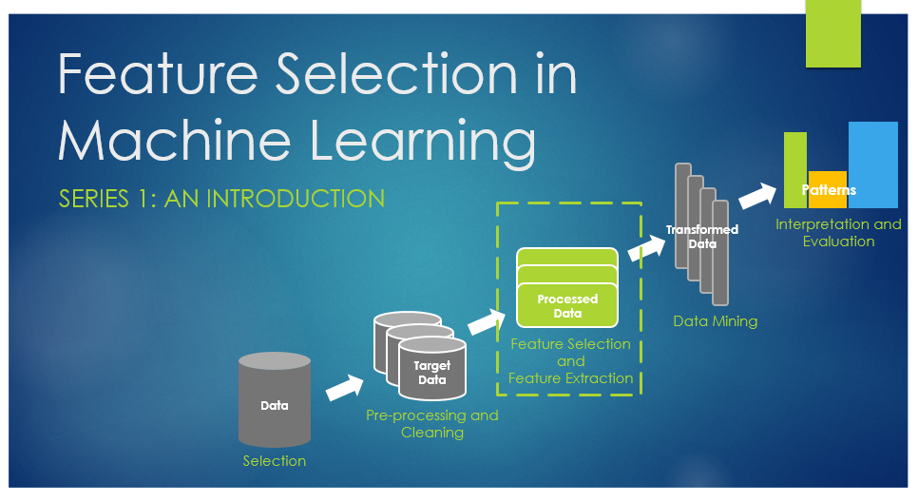
Feature Selection/Extraction
An universal problem of intelligent (learning) agents is where to focus their attention. It is very critical to understand “What are the aspects of the problem at hand are important/necessary to solve it?” i.e. discriminate between the relevant and irrelevant parts of experience.

Slide 74
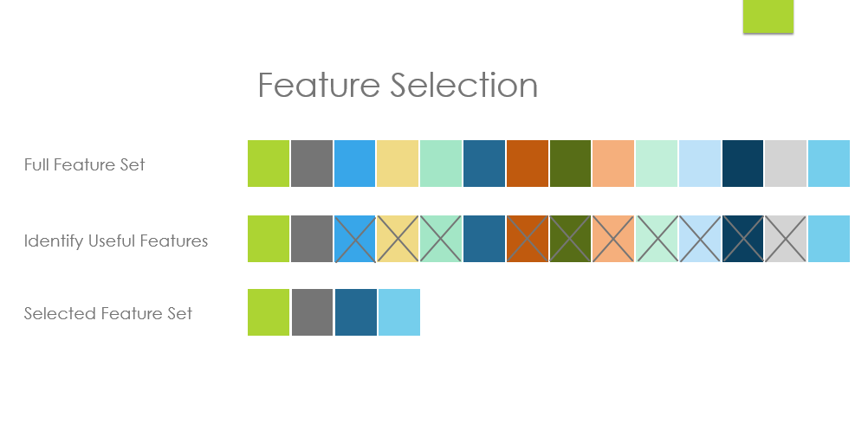
What is Feature selection (or Variable Selection)?
Problem of selecting some subset of a learning algorithm’s input variables upon which it should focus attention, while ignoring the rest. In other words, Dimensionality Reduction.

Slide 75
What is Feature selection (or Variable Selection)?
Mathematically
Given a set of features F = { f1 ,…, fi ,…, fn } the Feature Selection problem is to find a subset that “maximizes the learner’s ability to classify patterns”
Formally F’ should maximize some scoring function
This general definition subsumes feature selection (i.e. a feature selection algorithm also performs a mapping but can only map to subsets of the input variables)

Slide 76
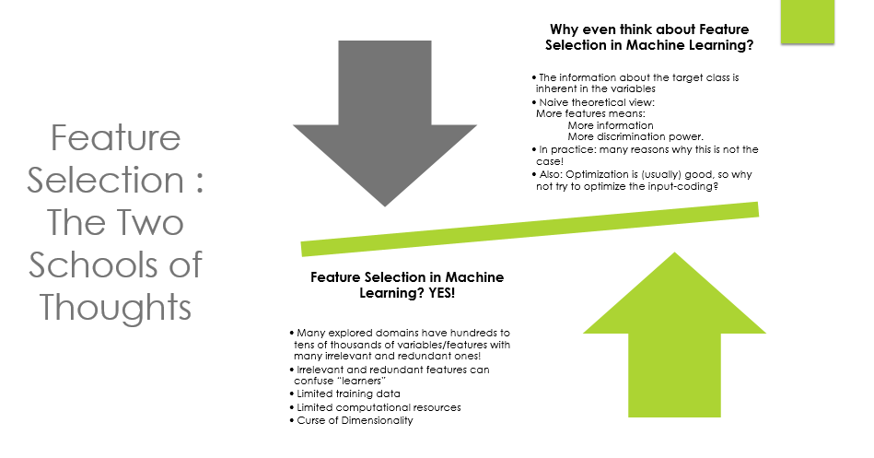

Slide 77
What is Feature selection (or Variable Selection)?
While the these two school of thoughts coexist, we’d focus here on the Motivation for Feature Selection.
Especially when dealing with a large number of variables there is a need for Dimensionality Reduction
Feature Selection can significantly improve a learning algorithm’s performance

Slide 78
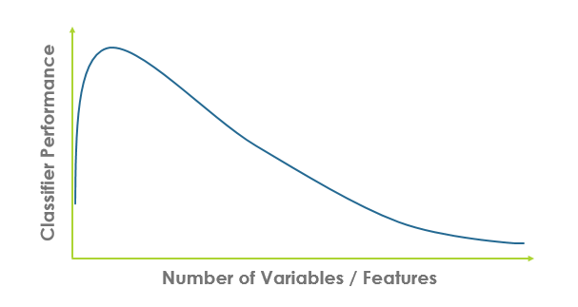
The Curse of Dimensionality
The required number of samples (to achieve the same accuracy) grows exponentially with the number of variables.
The classifier’s performance usually will degrade for a large number of features.
In many cases the information that is lost by discarding variables is made up for by a more accurate mapping/sampling in the lower-dimensional space.

Slide 79
Feature Selection— Optimality?
In theory, the goal is to find an optimal feature-subset
For most problems it is computationally intractable to search the whole space of possible feature subsets
One usually has to settle for approximations of the optimal subset
Most of the research in this area is devoted to finding efficient search-heuristics

Slide 80
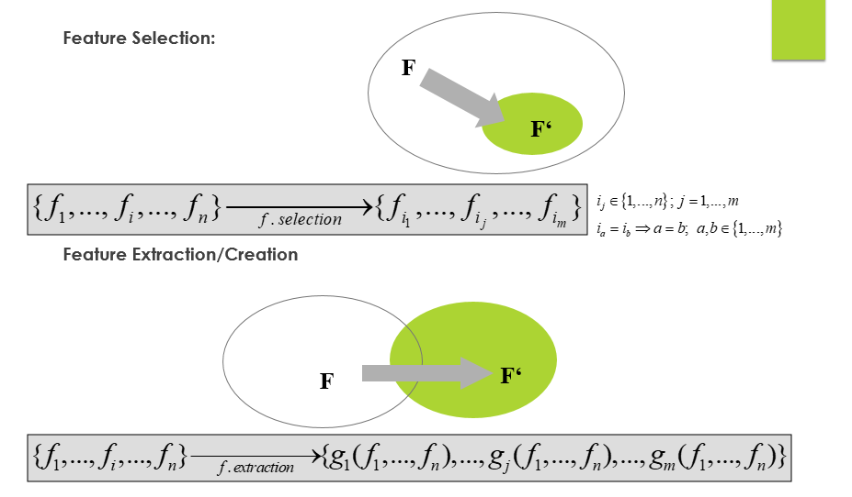
Feature Selection and Feature Extraction

Slide 81
Optimal Feature Subset
Optimal Feature Subset:
Often, the definition of optimal feature subset in terms of classifier’s performance
The best one can hope for theoretically is the Bayes error rate

Slide 82
Relevance of Features
There are several definitions of relevance in literature.
Relevance of 1 variable, Relevance of a variable given other variables, Relevance given a certain learning algorithm ,..
Most definitions are problematic, because there are problems where all features would be declared to be irrelevant
This can be defined through two degrees of relevance: weak and strong relevance.
A feature is relevant iff it is weakly or strongly relevant and irrelevant (redundant) otherwise.

Slide 83
Strong Relevance of a variable/feature
Let Si = {f1, …, fi-1, fi+1, …fn} be the set of all features except fi. Denote by si a value-assignment to all features in Si.
A feature fi is strongly relevant, iff there exists some xi, y and si for which p(fi = xi, Si = si) > 0 such that
p(Y = y | fi = xi; Si = si) ≠ p(Y = y | Si = si)
This means that removal of fi alone will always result in a performance deterioration of an optimal Bayes classifier.

Slide 84
Weak Relevance of a variable/feature
A feature fi is weakly relevant, iff it is not strongly relevant, and there exists a subset of features Si‘ of Si for which there exists some xi, y and si’ with p(fi = xi, Si’ = si’) > 0 such that
p(Y = y | fi = xi; Si’ = si’) ≠ p(Y = y | Si’ = si’)
This means that there exists a subset of features Si’, such that the performance of an optimal Bayes classifier on Si’ is worse than Si’ U { fi }

