Slide 1


Slide 2

01CE1503 - Design and Analysis of Algorithm
Unit - 1
Introduction and Analysis of Algorithms
Prof. Megha Mudholkar
Department of Computer Engineering

Slide 3
OUTLINE
Introduction to algorithm,
Characteristics, Efficiency of algorithm,
Average, Best and Worst case analysis,
Asymptotic notations – Big oh notation, Omega notations, Theta notation ,
Amortized Analysis,
Analysis of algorithms – Using control statements, through recurrence equation- Substitution method, , Master’s method, Tree based method.

Slide 4
Course Outcome
CO1: Analyse the complexity of algorithms and evaluate their performance in terms of time and space requirements.

Slide 5
Introduction to Algorithm
The algorithm is defined as collection of unambiguous instructions occurring in some specific sequence and such algorithm should produce some output for given set of input in finite amount of time.
An algorithm is
a sequence of computational steps that transform the input into the output.
a tool for solving a well-specified computational problem.

Slide 6
An algorithm is
A set of rules for carrying out calculation either by hand or on a machine
Finite step-by-step procedure to achieve a required result
Sequence of computational steps that transform the input into the output
Operations performed on data that have to be organized in data structures

Slide 7
Introduction to Algorithm
An algorithm is a set of steps of operations to solve a problem performing calculation, data processing, and automated reasoning tasks.
An algorithm is an efficient method that can be expressed within finite amount of Time and space.
The important aspects of algorithm design include creating an efficient algorithm to solve a problem in an efficient way using minimum time and space.
To solve a problem, different approaches can be followed. Some of them can be efficient with respect to time consumption, whereas other approaches may be memory efficient.

Slide 8
ALGORITHM (CONTD…)
A well-defined computational procedure that takes some value, or set of values, as input and produces some value, or set of values, as output.
Written in a pseudo code which can be implemented in the language of programmer’s choice.
PSEUDO CODE: A notation resembling a simplified programming language, used in program design.

Slide 9
Properties Of Algorithm
TO EVALUATE AN ALGORITHM WE HAVE TO SATISFY THE FOLLOWING CRITERIA:
INPUT: The Algorithm should be given zero or more input.
OUTPUT: At least one quantity is produced. For each input the algorithm
produced value from specific task.
3.DEFINITENESS: Each instruction is clear and unambiguous.
4.FINITENESS: If we trace out the instructions of an algorithm, then for all cases, the algorithm terminates after a finite number of steps.
5.EFFECTIVENESS: Every instruction must very basic so that it can be carried out, in principle, by a person using only pencil & paper.

Slide 11
Differences
Algorithm Program
1.At design phase 1.At Implementation phase
2.Natural language 2.written in any programming language
3.Person should have 3.Programmer
Domain knowledge
4.Analyze 4.Testing

Slide 12
ALGORITHM SPECIFICATION
Algorithm can be described (Represent) in four ways.
Natural language like English:
When this way is chooses, care should be taken, we should ensure that each & every statement is definite.
(no ambiguity)
2. Graphic representation called flowchart:
This method will work well when the algorithm is small& simple.
3. Pseudo-code Method:
In this method, we should typically describe algorithms as program, which resembles language like Pascal & Algol(Algorithmic Language).
4.Programming Language:
we have to use programming language to write algorithms like
C, C++,JAVA etc.

Slide 13
PSEUDO-CODE CONVENTIONS
Comments begin with // and continue until the end of line.
Blocks are indicated with matching braces { and }.
An identifier begins with a letter. The data types of variables are not explicitly declared.
node= record
{
data type 1 data 1;
data type n data n;
node *link;
}
4. There are two Boolean values TRUE and FALSE.
Logical Operators
AND, OR, NOT
Relational Operators
<, <=,>,>=, =, !=

Slide 14
5. Assignment of values to variables is done using the assignment statement. <Variable>:= <expression>;
6. Compound data types can be formed with records. Here is an example,
Node. Record
{
data type – 1 data-1;
.
.
.
data type – n data – n;
node * link;
}
Here link is a pointer to the record type node. Individual data items of a record can be accessed with → and period.

Slide 15
Contd…
7. The following looping statements are employed.
For, while and repeat-until While Loop:
While < condition > do
{
<statement-1>
..
..
<statement-n>
}
For Loop:
For (initalization;comparasion;incre or decre) do
for variable=value1 to value2 Step step do
{
<statement-1>
.
.
.
<statement-n>
}

Slide 16
repeat-until:
repeat
<statement-1>
.
.
.
<statement-n>
until<condition>
8. A conditional statement has the following forms.
→ If <condition> then <statement>
→ If <condition> then <statement-1>
Else <statement-1>

Slide 17
Case statement:
Case
{
: <condition-1> : <statement-1>
.
.
.
: <condition-n> : <statement-n>
: else : <statement-n+1>
}
9. Input and output are done using the instructions read & write. No format is used to specify the size of input or output quantities

Slide 18
Contd…
10. There is only one type of procedure: Algorithm, the heading takes the form,
Algorithm Name (Parameter lists)
Consider an example, the following algorithm fields & returns the maximum of n given numbers:
algorithm Max(A,n)
// A is an array of size n
{
Result := A[1];
for i:= 2 to n do
if A[i] > Result then
Result :=A[i];
return Result;
}

Slide 19
Issue in the study of algorithm
1. How to create an algorithm.
2. How to validate an algorithm.
3. How to analyses an algorithm
4. How to test a program.
1 .How to create an algorithm: To create an algorithm we have following design technique
a) Divide & Conquer
b) Greedy method
c) Dynamic Programming
d) Branch & Bound
e) Backtracking

Slide 20
2.How to validate an algorithm: Once an algorithm is created it is necessary to show that it computes the correct output for all possible legal input , this process is called algorithm validation.
3.How to analyses an algorithm: Analysis of an algorithm or performance analysis refers to task of determining how much computing Time & storage algorithms required.
Computing time-Time complexity: Frequency or Step count method
Storage space- To calculate space complexity we have to use number
of input used in algorithms.
4.How to test the program: Program is nothing but an expression for the algorithm using any programming language. To test a program we need following
Debugging: It is processes of executing programs on sample data sets
to determine whether faulty results occur & if so correct them.
Profiling or performance measurement is the process of executing a
correct program on data set and measuring the time & space it takes
to compute the result.

Slide 21
Order of growth
Order of growth of an algorithm is a way of saying/predicting how execution time of a program and the space/memory occupied by it changes with the input size.
Name of efficiency class | Order of growth | Description | Example
Constant | 1 | Algorithm takes fixed number of steps, no matter how large input size increases. | Indexing an item in a list
Logarithmic | logn | Problem is divided into smaller parts on each iteration. | Binary Search
Linear | n | Running time is dependent on input size | Sequential search
nlogn | nlogn | Some instance of algorithm considered for list of size n | Merge sort and quick sort
Quadratic | n² | Algorithm has 2 nested loops | Scanning matrix elements.

Slide 22
Order of growth
Name of efficiency class | Order of growth | Description | Example
Cubic | n³ | Algorithm has 3 nested loops | perform matrix multiplication.
Exponential | 2^{n} | Algorithm has faster rate of growth | Generating subset of all n elements
Factorial | n! | Algorithms compute permutation | All permutation
n | logn | nlogn | n^2 | 2^n
1 | 0 | 0 | 1 | 2
2 | 1 | 2 | 4 | 4
4 | 2 | 8 | 16 | 16
8 | 3 | 24 | 64 | 256
16 | 4 | 64 | 256 | 65536
32 | 5 | 160 | 1024 | 4294967296

Slide 23
Arrange from smallest to largest or in increasing order
2^{n}, nlogn, n² ,1, n, logn, n!, n³
nlogn, n+n²+n³, 2^{n}, sqrt(n)
n², 2^{n}, nlogn, logn, n³
n!, 2^{n}, (n+1)!,2^{2n}, n^{n}, n^{logn}

Slide 24
Arrange from smallest to largest or in increasing order
2^{n}, nlogn, n² ,1, n, logn, n!, n³
1, n, logn,nlogn, n² , n³ , 2^{n} ,n!
nlogn, n+n²+n³, 2^{n}, sqrt(n)
Sqrt(n), nlogn, n+n²+n³, 2^{n}
n², 2^{n}, nlogn, logn, n³
logn, nlogn, n², n³,2^{n}
n!, 2^{n}, (n+1)!,2^{2n}, n^{n}, n^{logn}
n^{logn} , 2^{n} , n!, (n+1)!, 2^{2n}, n^{n}

Slide 25
Performance of the program
Performance of the program-amount of computer memory and time needed to run the program
Two Approaches to determine performance:
Analytical
Performance Analysis (machine independent) -Use Analytical Method
space complexity: storage requirement
time complexity: computing time
Experimental
Performance Measurement (machine dependent) - Conduct Experiment

Slide 26
PERFORMANCE ANALYSIS
Performance Analysis: An algorithm is said to be efficient and fast if it take less time to execute and consumes less memory space at run time is called Performance Analysis.
SPACE COMPLEXITY:
The space complexity of an algorithm is the amount of Memory Space required by an algorithm during course of execution is called space complexity .There are three types of space
Instruction space : executable program
Data space: Required to store all the constant and variable data space.
Environment: It is required to store environment information needed to resume the suspended space.
2. TIME COMPLEXITY:
The time complexity of an algorithm is the total amount of time required by an algorithm to complete its execution.

Slide 27
Space complexity
Now there are two types of space complexity
a) Constant space complexity
b) Linear(variable)space complexity

Slide 28
1.Constant space complexity: A fixed amount of space for all the input values.
Example : int square(int a)
{
return a*a;
}
Here algorithm requires fixed amount of space for all the input values.

Slide 29
2.Linear space complexity: The space needed for algorithm is based on size.
Size of the variable ‘n’ = 1 word
Array of a values = n word
Loop variable = 1 word
Sum variable = 1 word
Example:
int sum(int A[],int n)
{ n
int sum=0,i; 1
for (i=0;i<n;i++) 1
Sum=sum+A[i]; 1
Return sum;
} Ans : 1+n+1+1 = n+3 words

Slide 30
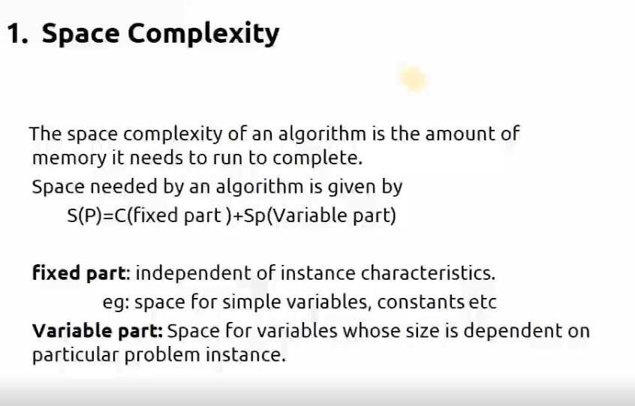

Slide 31
Examples:
1.Algorithm sum(a,b,c)
{
a=10; a-1
b=20; b-1
c=a+b; c-1
}
0(n)=3

Slide 32
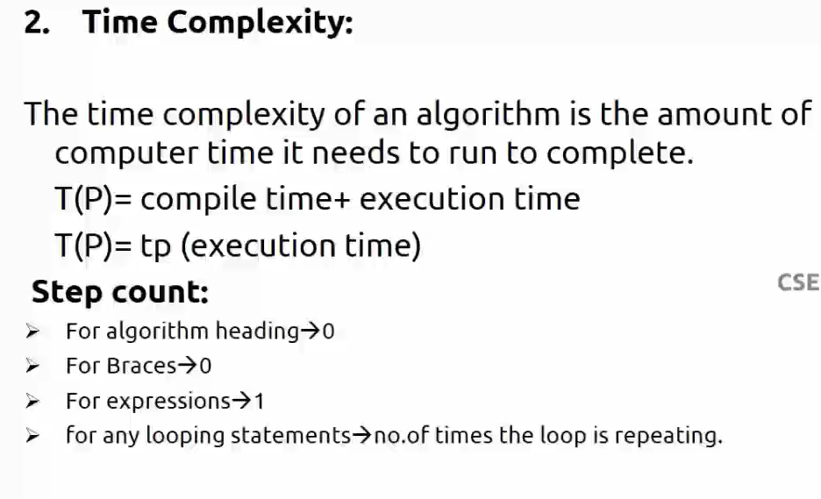

Slide 33
1.Constant time complexity : If a program required fixed amount of time for all input values is called Constant time complexity .
Example : int sum(int a , int b)
{
return a+b;
}

Slide 34
2.Linear time complexity: If the input values are increased then the time complexity will changes.
comments = 0 step
Assignment statement= 1 step
condition statement= 1 step
loop condition for n times = n+1 steps
body of the loop = n steps

Slide 35
TIME COMPLEXITY
The time T(p) taken by a program P is the sum of the compile time and the run time(execution time)
Statement |  | Total
1. Algorithm Sum(a,n) |  | 0
2.{ |  | 0
3. | S=0.0; | 1
4. | for i=1 to n do | n+1
5. | s=s+a[I]; | n
6. | return s; | 1
7. | } | 0
Total |  | 2n+3

Slide 36
A Posteriori analysis | A priori analysis
Posteriori analysis is a relative analysis. | Priori analysis is an absolute analysis.
It is dependent on language of compiler and type of hardware. | It is independent of language of compiler and types of hardware.
It will give exact answer. | It will give approximate answer.
It doesn’t use asymptotic notations to represent the time complexity of an algorithm. | It uses the asymptotic notations to represent how much time the algorithm will take in order to complete its execution.
The time complexity of an algorithm using a posteriori analysis differ from system to system. | The time complexity of an algorithm using a priori analysis is same for every system.
It is done after execution of an algorithm. | It is done before execution of an algorithm.
It is costlier than priori analysis because of requirement of software and hardware for execution. | It is cheaper than Posteriori Analysis.
Time complexity of an algorithm can be calculated by using two methods:
Posteriori Analysis
Priori Analysis

Slide 37
Asymptotic Analysis
Asymptotic analysis of an algorithm refers to defining the mathematical boundation/framing of its run-time performance.
It is used to find the best case, average case, and worst case scenario of an algorithm.
Asymptotic analysis is input bound
Other than the "input" all other factors are considered constant.
Notes:
Asymptotic analysis is input bound i.e., if there's no input to the algorithm, it is concluded to work in a constant time.

Slide 38
Asymptotic analysis refers to computing the running time of any operation in mathematical units of computation.
For example, the running time of one operation is computed as f(n) and may be for another operation it is computed as g(n2).
The time required by an algorithm falls under three types −
Best Case − Minimum time required for program execution.
Average Case − Average time required for program execution.
Worst Case − Maximum time required for program execution.
Notes:
For example, the running time of one operation is computed as f(n) and may be for another operation it is computed as g(n2). This means the first operation
running time will increase linearly with the increase in n and the running time of the second
operation will increase exponentially when n increases. Similarly, the running time of both
operations will be nearly the same if n is significantly small.

Slide 39
Asymptotic Notations
Following are the commonly used asymptotic notations to calculate the running time complexity of an algorithm.
Big – Oh(O) Notation
Big - Omega (Ω) Notation
Big - Theta (Θ) Notation

Slide 40
O-Notation (Upper Bound)
The notation Ο(n) is the formal way to express the upper bound of an algorithm's running time.
It measures the worst case time complexity or the longest amount of time an algorithm can possibly take to complete.

Slide 41
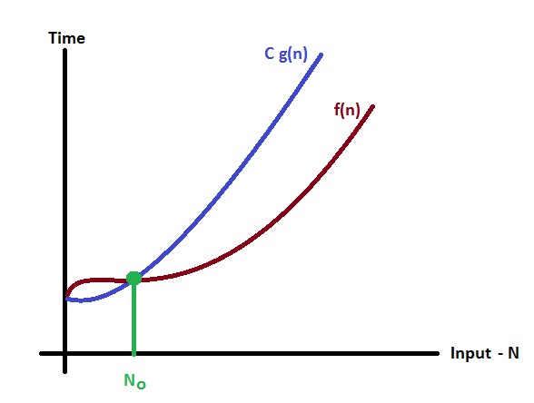
O-Notation (Upper Bound)
Def - Given functions f(n) and g(n), we say that f(n) is O(g(n) ) if and only if there are positive constants c and n₀ such that
f(n)≤ c g(n) for n ≥ n_{0.}
f(n) is your algorithm runtime, and g(n) is an arbitrary time complexity you are trying to relate to your algorithm.
As n increases, f(n) grows no faster than g(n). In other words, g(n) is an asymptotic upper bound on f(n).
f(n) = O(g(n))
Notes:
Big-O, commonly written as O, is an Asymptotic Notation for the worst case, or ceiling of growth for a given function. It provides us with an asymptotic upper bound for the growth rate of runtime of an algorithm. Say f(n) is your algorithm runtime, and g(n) is an arbitrary time complexity you are trying to relate to your algorithm. f(n) is O(g(n)), if for some real constants c (c > 0) and n₀, f(n) <= c g(n) for every input size n (n > n₀).

Slide 42
Big-O Examples
f(n) = 2n+2 , g(n) = n² , Is f(n) O(g(n²))?
2n+2 <= c* n²
C= 1
2n+2 <= n²
For n>2 we can obtain f(n) < g(n).
n | f(n)= 2n+2 | g(n)= n² | f(n)<=c*g(n)
1 | 2 | 1 | f(n)>g(n)
2 | 6 | 4 | f(n)>g(n)
3 | 8 | 9 | f(n)<g(n)

Slide 43
Examples Contd…
Show that 30n+8 is O(n).
f(n) = 30n+8 <= c* g(__)
30n+8<= c* n
Find value of c such that f(n) is always less than g(n).
Put c = 31
30n+8 <= 31*n
8 <= n
n >= 8

Slide 44
Example Contd..
Prove that: 20n² + 2n + 5 = O(n²)
f(n) = 20n² + 2n + 5 < = c* g(__)
20n² + 2n + 5 <= c * n²
C = 21
2n+ 5 <= n²
n > 4, c= 21
n | f(n)= 2n+5 | g(n)= n^2 | f(n)<=c*g(n)
1 | 7 | 1 | f(n)>g(n)
2 | 9 | 4 | f(n)>g(n)
3 | 11 | 9 | f(n)>g(n)
4 | 13 | 16 | f(n)<g(n)

Slide 45
Example
Prove that: 100n + 5 = O(n²)
f(n) = 100n + 5 < = c* g(__)
100n + 5 <= c * n²
C = 105
100n+5 <= 105 n²
n > 1, c= 105
n | f(n)= 100n+5 | g(n)= 105 n^2 | f(n)<=c*g(n)
1 | 105 | 105 | f(n) =g(n)

Slide 46
Examples
Example : f(n)=2n +3 & g(n)= n
Formula : f(n)<=c g(n) n>=n_{0 ,} c>0 ,n₀ >=1
f(n)=2n+3 & g(n)=n
Now 3n+2<=c.n
3n+2<=4.n
Put the value of n =1
5<=4 false
N=2 8<=8 true now n0>2 For all value of n>2 & c=4
now f(n)<= c.g(n)
3n+2<=4n for all value of n>2
Above condition is satisfied this notation takes maximum amount of time to execute .so that it is called worst case complexity.

Slide 47
Ω-Notation (Lower Bound)
The notation Ω(n) is the formal way to express the lower bound of an algorithm's running time.
It measures the best case time complexity or the best amount of time an algorithm can possibly take to complete.

Slide 48
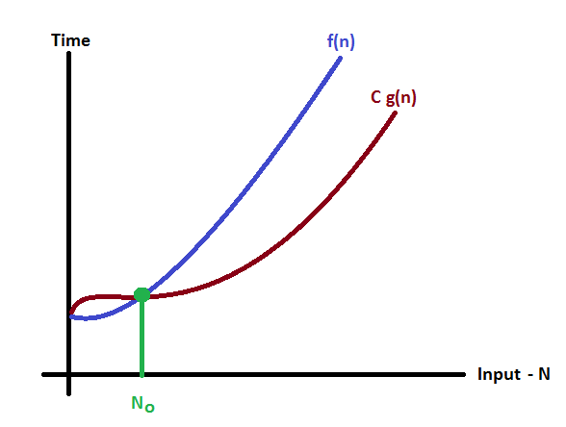
Ω-Notation (Lower Bound)
Def - Given functions f(n) and g(n), we say that f(n) is Ω(g(n) ) if g(n) is O(f(n) ); that is, there exists positive constants c and n₀ such that f(n) ≥ c g(n) for n ≥ n_{0.}
g(n) should be as large as possible. Gives best case running time
f(n) = Ω(g(n))

Slide 49
Big-omega Examples
1) f(n) = 2n²+n , Is f(n) Ω(g(n²))?
2 n² +n >= c* n²
C= 2
2 n² + n >= 2* n²
n >=0
For n>0 we can obtain f(n) > g(n).
2) f(n) = 5n² , Is f(n) Ω(g(n))?
5n² >= c* g(__)
5n² >= c* n
5n² >= 1 * n
n >= 1, c =1
n | f(n)=5n² | g(n)=n | f(n)>=c*g(n)
1 | 5 | 1 | f(n) >g(n)

Slide 50
Θ-Notation
The notation θ(n) is the formal way to express both the lower bound and the upper bound of an algorithm's running time.
Big - Theta notation is used to define the average bound of an algorithm in terms of Time Complexity.
That means Big - Theta notation always indicates the average time required by an algorithm for all input values.
That means Big - Theta notation describes the average case of an algorithm time complexity.

Slide 51
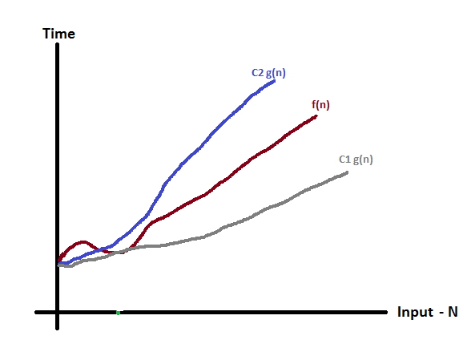
We say f(n) = Θ(g(n)) if there exist positive constants n₀, c₁ and c₂ such that to the right of n₀ the value of f(n) always lies between c₁g(n) and c₂g(n) inclusive i.e. g(n) is both upper and lower bound of f(n).
f(n) = Θ(g(n))

Slide 52
Big-theta
f(n) = 2n²+n , Is f(n) θ(g(n²))?
c1 * n² <= 2 n² +n <= c2 * n²
c1 = 2, c2 = 3
2* n² <= 2 n² + n <= 3* n²

Slide 53
Examples
Example : f(n)=3n+2
Formula : c₁ g(n)<=f(n)<=c₂ g(n)
f(n)=3n+2
1*n<=3n+2<=4*n now put the value of n=1 we get 1<=5<=4 false
n=2 we get 2<=8<=8 true
n=3 we get 3<=11<=12 true
Now all value of n>=2 it is true above condition is satisfied.

Slide 54
Amortized Analysis
Amortized analysis means finding an average running time per operation over a worst case sequence of operations.
Amortized analysis can be used to show that
The average cost of an operation is small, if one averages over a sequence of operations, even though a single operation within the sequence might be expensive.
3 Techniques.
Aggregate analysis: In aggregate analysis, we compute the total cost of a sequence of operations and divide it by the number of operations to get the average cost
Accounting method: Assign costs to each operation so that it is easy to sum them up while still ensuring that result is accurate
Potential method: A more sophisticated version of the accounting method
Notes:
In average case analysis, we are taking average of all inputs but in amortized analysis we take sequence of input.

Slide 55
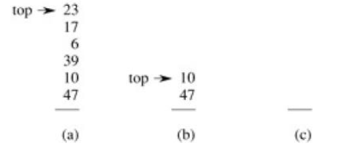
Aggregate method
Show that a sequence of n operations takes T(n) time.
We can then say that the amortized cost per operation is T(n)/n
Makes no distinction between operation types.
Stack operations:
•PUSH(S,x) O(1)
•POP(S) O(1)
•MULTIPOP(S,k) min(S,k)
while(not STACK-EMPTY(S) and k>0)
{
POP(S)
k=k-1
}
Let us consider a sequence of n PUSH, POP, MULTIPOP.
The worst case cost for MULTIPOP in the sequence is O(n), since the stack size is at most n.
Thus the cost of the sequence is O(n^2). Correct, but not tight.
Notes:
Geometric Progression (G.P.) is a geometric sequence where each successive term is the result of multiplying a constant number to its preceding term.

Slide 56
Aggregate method
For any value of n, any sequence of n PUSH, POP, and MULTIPOP operations takes a total of O(n) time.
The average cost of an operation is O(n)/n = O(1).
In aggregate analysis, =(Total cost of n operation/n)
Assign the amortized cost of each operation to be the average cost.
In this example, therefore, all three stack operations have an amortized cost of O(1).

Slide 57
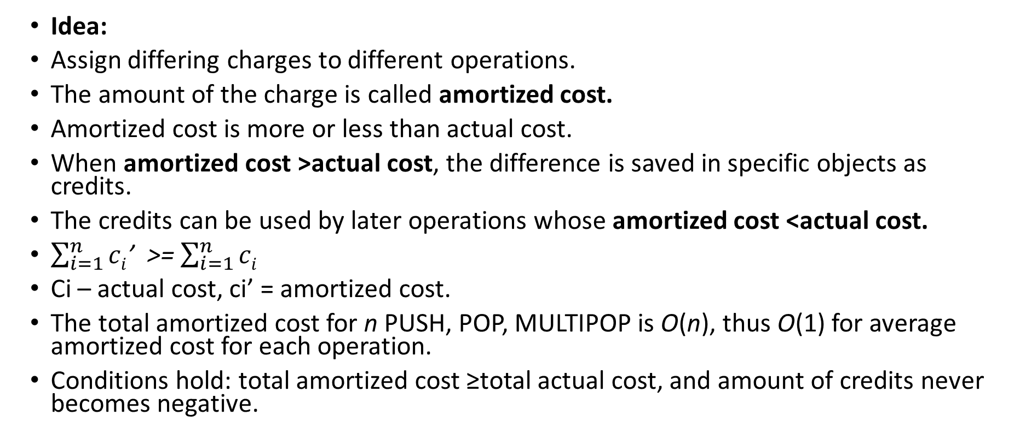
Accounting Method
Idea:
Assign differing charges to different operations.
The amount of the charge is called amortized cost.
Amortized cost is more or less than actual cost.
When amortized cost >actual cost, the difference is saved in specific objects as credits.
The credits can be used by later operations whose amortized cost <actual cost.
$\sum_{i=1}^{n}{ci}$’ >= $\sum_{i=1}^{n}{ci}$
Ci – actual cost, ci’ = amortized cost.
The total amortized cost for n PUSH, POP, MULTIPOP is O(n), thus O(1) for average amortized cost for each operation.
Conditions hold: total amortized cost ≥total actual cost, and amount of credits never becomes negative.

Slide 58
Accounting Method
Actual costs:
PUSH :1, POP :1, MULTIPOP: min(s,k).
Let assign the following amortized costs:
PUSH:2, POP: 0, MULTIPOP: 0.
Similar to a stack of plates in a cafeteria.
Suppose $1 represents a unit cost.
When pushing a plate, use one dollar to pay the actual cost of the push and leave one dollar on the plate as credit.
Whenever POPing a plate, the one dollar on the plate is used to pay the actual cost of the POP. (same for MULTIPOP).
By charging PUSH a little more, do not charge POP or MULTIPOP.

Slide 59
The potential method
Same as accounting method:
something prepaid is used later.
Different from accounting method
The prepaid work not as credit, but as “potential energy”, or “potential”.
The potential is associated with the data structure as a whole rather than with specific objects within the data structure.

Slide 60
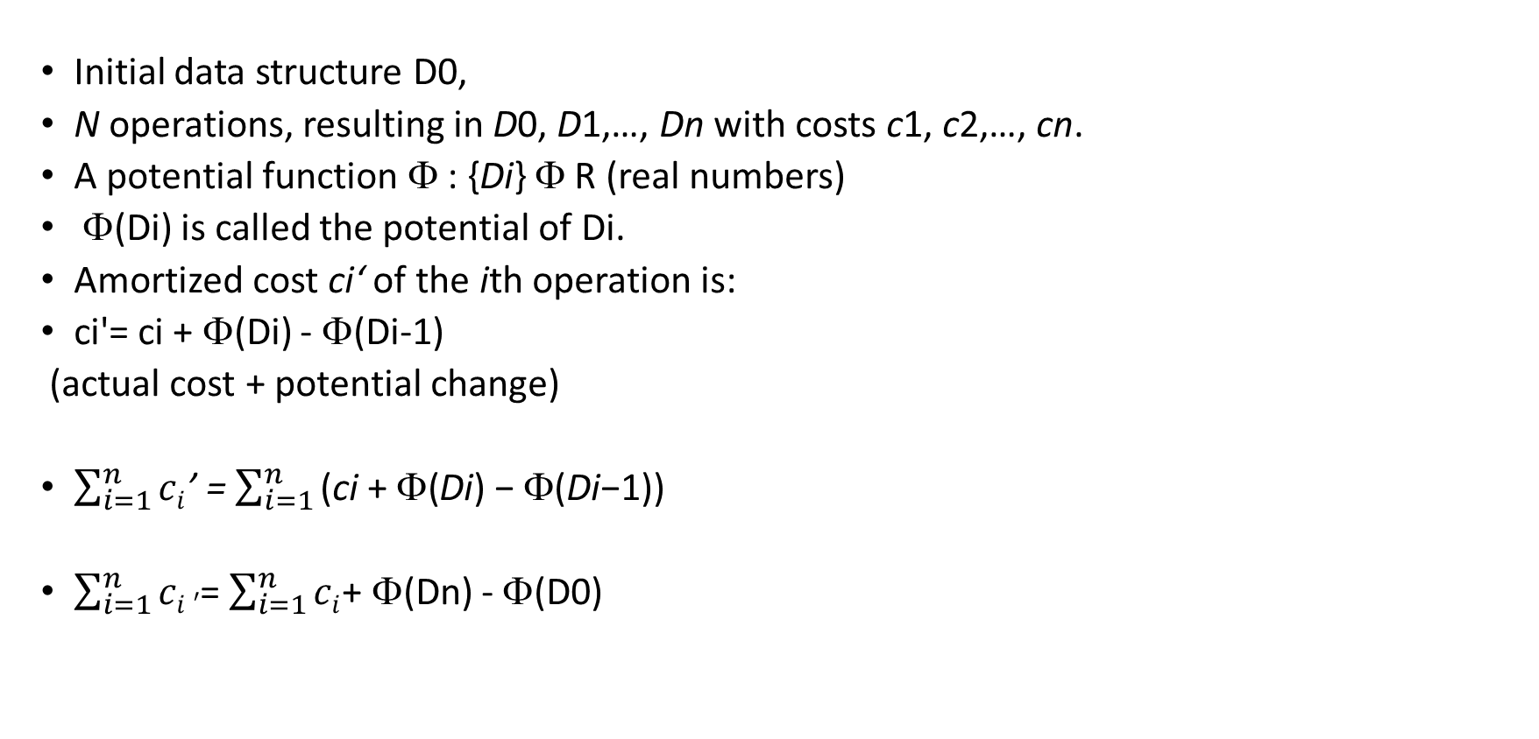
The Potential Method
Initial data structure D0,
N operations, resulting in D0, D1,…, Dn with costs c1, c2,…, cn.
A potential function Φ : {Di} Φ R (real numbers)
Φ(Di) is called the potential of Di.
Amortized cost ci‘ of the ith operation is:
ci'= ci + Φ(Di) - Φ(Di-1)
(actual cost + potential change)
$\sum_{i=1}^{n}{ci}$’ = $\sum_{i=1}^{n}{\text{(}\text{ci} \text{+}\text{ Φ}\text{(}\text{Di}\text{) −}\text{ Φ}\text{(}\text{Di}\text{−1))}}$
$\sum_{i=1}^{n}{ci}′$= $\sum_{i=1}^{n}{ci}$+ Φ(Dn) - Φ(D0)

Slide 61
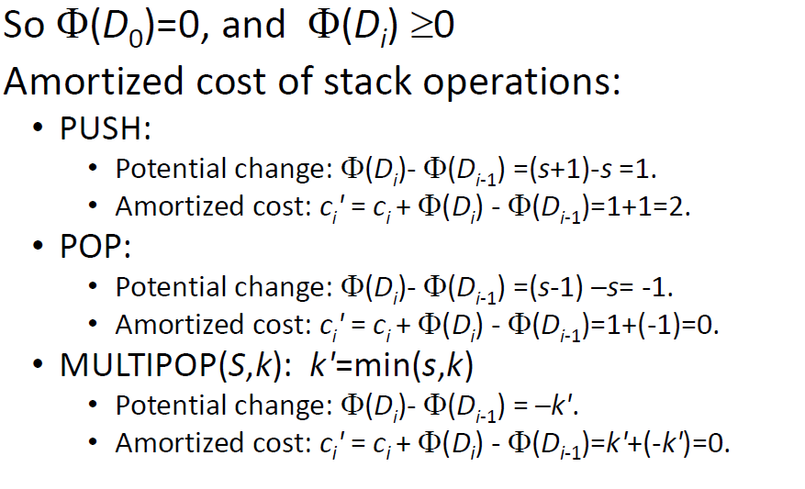
The Potential Method Stack example
Potential for a stack is the number of objects in the stack.

Slide 62
The Potential Method Stack example
So amortized cost of each operation is O(1), and total amortized cost of n operations is O(n).
Since total amortized cost is an upper bound of actual cost, the worse case cost of n operations is O(n).

Slide 63
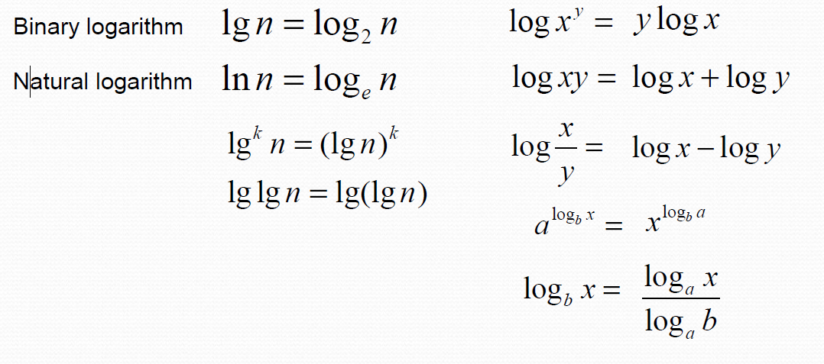
Logarithms and properties
In algorithm analysis we often use the notation “log n”
without specifying the base.

Slide 64
Analyzing Control Statement
Sequencing:
Sequencing means putting one instruction after another.
For ex.
i = 10;
Printf(“%d”, i);
i = 10+5;
Here, each instruction executes only once. So time take by above code is:
1+1+1 = 3
T(n) =3
For loop
While and do while loop
Recursive call

Slide 65
Linear loops
for(i=0;i<1000;i++)
{
code
}
n = Loop factor =1000
Number of iterations are directly proportional to loop factor
f(n) = n

Slide 66
Analyzing control statement
algo sum()
{ s=0 --------- 1
for i= 1 to n --------- n + 1
s=s+a[i] ---------- n
return s ---------- 1
} 2n + 3

Slide 67
Linear loops
for(i=0;i<1000;i=i+2)
{
code
}
n = Loop factor =1000
Number of iterations are directly proportional to half the loop factor
f(n) = n/2

Slide 68
Nested loops
Iterations = outer loop iterations * inner loop iterations
Quadratic loop
for(i=1; i <= n; i++)
{
for(j=1; j <= n; j++)
{
code
}
}
f(n) = n²

Slide 69
Nested loops
Dependent Quadratic loop
for(i=1; i <= n; i++)
{
for(j=1; j <= i; j++)
{
code
}
}
f(n) = n (n+1) / 2

Slide 70
Logarithmic loops
Multiply for( i=1; i<1000; i *= 2) Application code |  | Divide for( i=1000; i>=1; i /= 2) Application code
iteration | Value of i | Iteration | Value of i
1 | 1 | 1 | 1000
2 | 2 | 2 | 500
3 | 4 | 3 | 250
4 | 8 | 4 | 125
5 | 16 | 5 | 62
6 | 32 | 6 | 31
7 | 64 | 7 | 15
8 | 128 | 8 | 7
9 | 256 | 9 | 3
10 | 512 | 10 | 1
exit | 1024 | exit | 0
2^{iteration} < 1000 |  | 1000 / 2^{iteration} >= 1
Generalized formula: f(n) = log n
Notes:
O(log N) basically means time goes up linearly while the n goes up exponentially. So if it takes 1 second to compute 10 elements, it will take 2 seconds to compute 100 elements, 3 seconds to compute 1000 elements, and so on.
​It is O(log n) when we do divide and conquer type of algorithms e.g binary search. Another example is quick sort where each time we divide the array into two parts and each time it takes O(N) time to find a pivot element. Hence it N O(log N)

Slide 71
Analyzing control statement
Recursive call:
Recursion is a process in which one function calls itself.
void Test(int n) ---------Suppose Total Time Required to execute is T(n)
{
if(n>0)
{
printf(“%d”, n); ---------- n
Test(n-1); ---------- n+1
}
}
F(n)=O(n)

Slide 72
Analyzing control statement
While” and “Repeat” Loops
Analyzing the running time of code involving while loops follows the same principle using for loops.

Slide 73
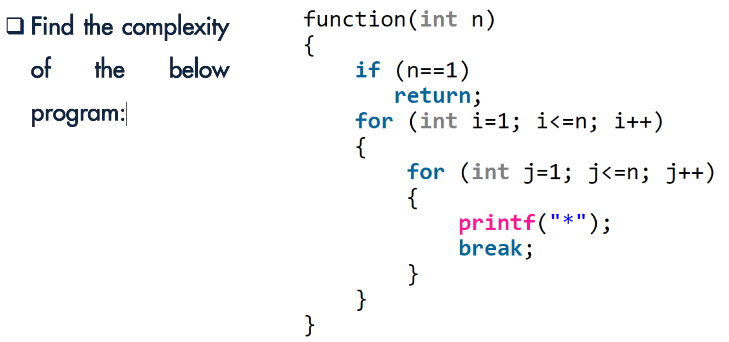
Analyzing control statement

Slide 74
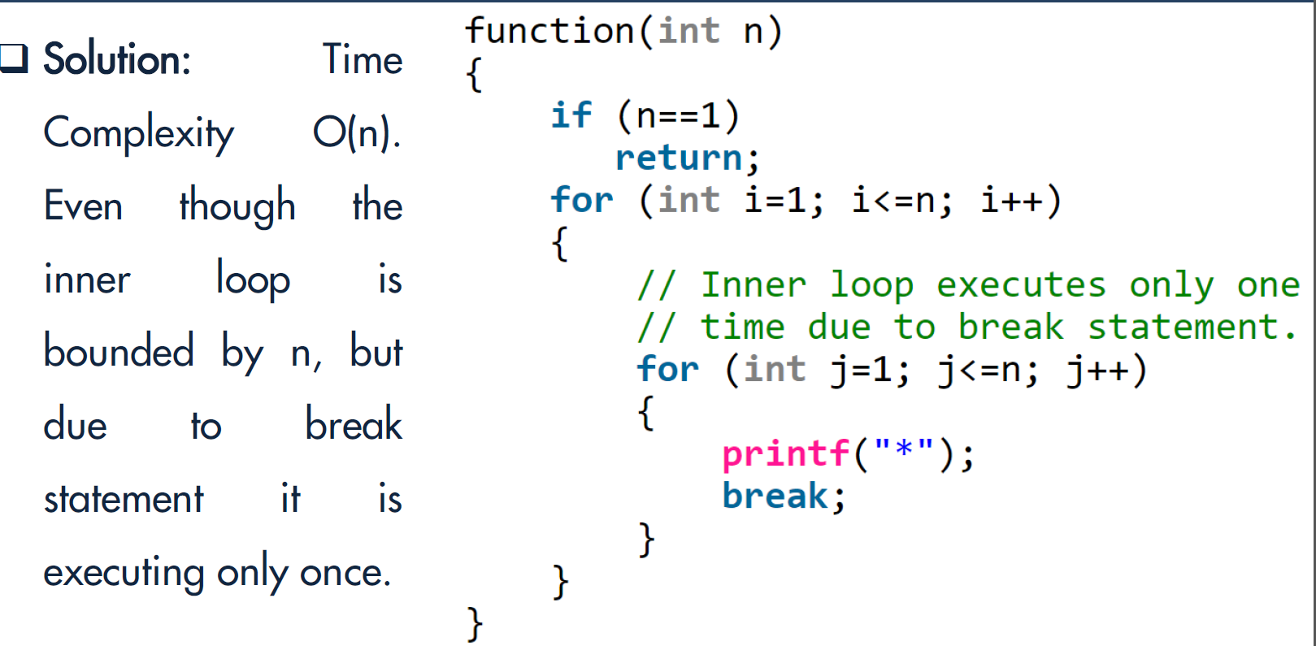
Analyzing control statement

Slide 75
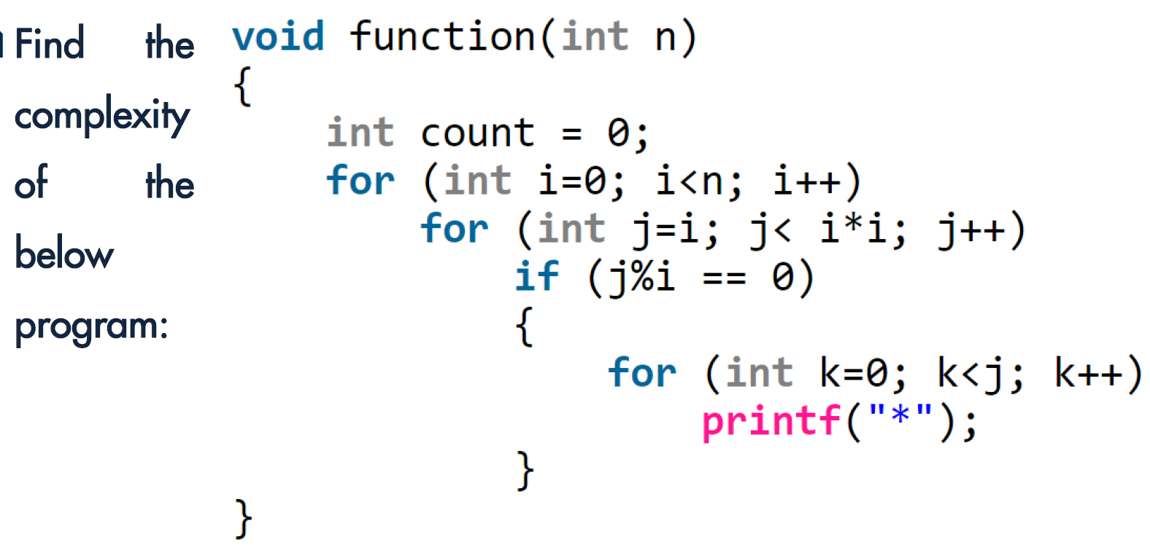
Analyzing control statement

Slide 76
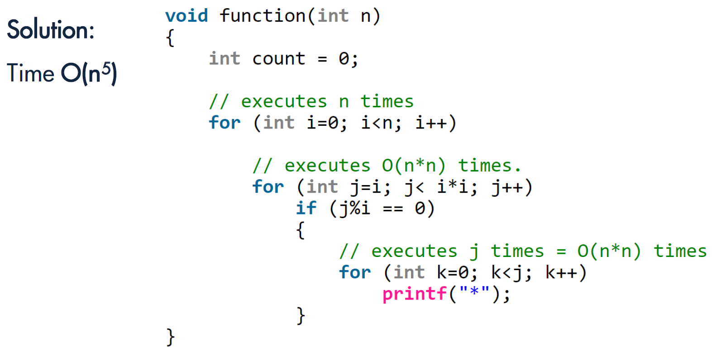
Analyzing control statement

Slide 77
Recurrence and different methods to solve recurrence
Recurrence equation:
Equation that defines a sequence recursively.
T(n) = T(n-1) + n, n>0 -------(1 (recurrence relation))
T(0) = 1 --------(2 (initial condition))
3 methods to solve recurrence equation.

Slide 78
Recurrence equation
Recurrence equation
Substitution method
Forward substitution
Backward substitution
Master’s method
Recurrence tree method

Slide 79
Substitution method
1 . Forward Substitution
Use initial condition in initial term, use this value to find next term.
Recurrence relation
T(n) = T(n-1) + n Initial condition T(0)= 1
Sol.: T(n) = T(n-1) + n -----(1)
If n=1
T(1) = T(0)+1
= 1+1
T(1) = 1+1 ----(2)

Slide 80
Substitution method
If n=2
T(2) = T(1)+2
= 1+1+2
T(2) = 1+1+2 ----(3)
If n=3
T(3) = T(2)+3
= 1+1+2+3
T(3) = 1+1+2+3 ----(4)
T(4)=1+1+2+3+4 -------(5)
T(5)=1+1+2+3+4+5 ------------(6)
By observing,
T(n) = ∑n=1+n(n+1)/2
= 1+(n²+n/2)
= O(n²)
It is difficult to find pattern so generally not used.

Slide 81
Backward substitution method
2. Backward substitution
T(n) = T(n-1) + n -----(1)
If n=n-1
T(n-1) = T(n-1-1)+(n-1)
= T(n-2) + (n-1) ----(2)
Put eq^{n}(2) in eq^{n} (1)
T(n) = T(n-2) + (n-1)+ n ------(3)
let n=n-2
T(n-2) = T(n-1-2)+(n-2)
= T(n-3) + (n-2) ----(4)

Slide 82
Backward substitution method
Put eq^{n}(4) in eq^{n} (3)
T(n) = T(n-3) + (n-2) + (n-1)+ n ------(3)
|
|
T(n) = T(n-k) + (n-k+1) + (n-k+2)+------+ n
Let k=n then,
T(n) = T(n-n) + (n-n+1) + (n-n+2)+------+ n
T(n) = T(0) +1+2+3+------+ n
T(n) = 1 +1+2+3+------+ n
T(n) = n(n+1)/2
= n²+n/2
= O(n²)

Slide 83
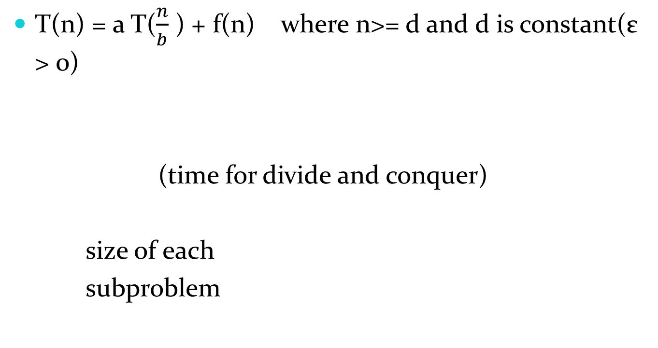
Master’s Method

Slide 84
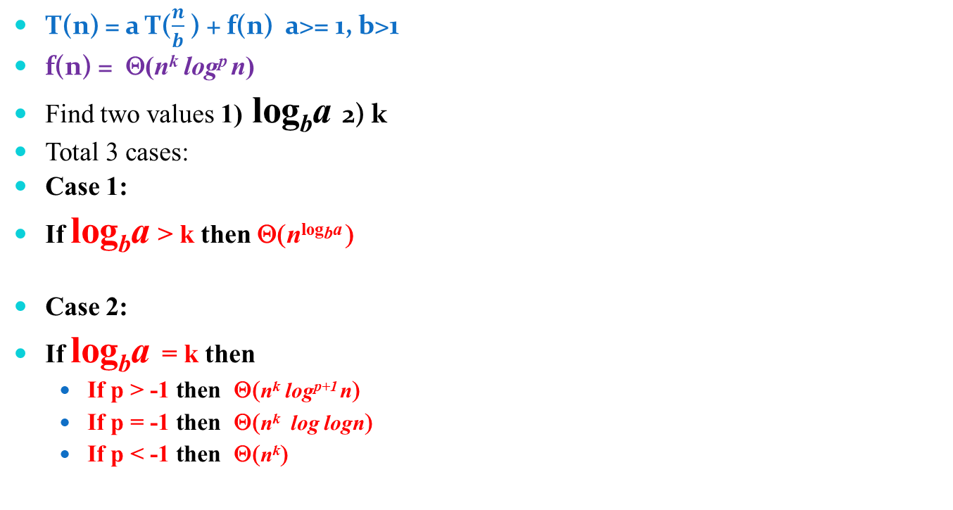
Master’s Method

Slide 85
Master’s Method
Case 3:
If log_{b}a < k then
If p >= 0 then Θ(n^{k} log^{p} n)
If p < 0 then Ο (n^{k})
Ex1 . T(n) = 9T(n/3) + n
a = 9, b = 3, f (n) = θ(n¹log⁰n ), k =1 , p=0
log_{b}a = 2
CASE 1: log_{b}a > k
T(n) = Θ(n²).

Slide 86
Master’s Method
Ex2 . T(n) = 2T(n/3) + 1
a = 2, b = 3 , f (n) = θ( n⁰log⁰n ), k =0 , p=0 and p >-1
log_{b}a = log₃ 2 = n⁰ = 1
CASE 2: log_{b}a = k ,
If p > -1 then Θ(n^{k} log^{p+1} n)
∴ T(n) = Θ(logn).
Ex 3 T(n) = 4T(n/2) + n³
a = 4, b = 2 ,f (n) = θ(n³log⁰n ), k=3, p=0
log_{b}a = 2
CASE 3: log_{b}a < k
If p >= 0 then Θ(n^{k} log^{p} n)
T(n) = Θ(n³).

Slide 87
Recursion tree method
T(n) = 3 T(n/2) + n²
Where n² = root node
T(n/2) = size of sub-problem
3 = number of sub-problem
Step 1: find cost of each level
Step 2: find depth of tree
Step 3: find number of leaves
There are total 3 cases to solve examples. But case 1 and case 2 are solved by above 3 steps.
Case 1: cost of root node is maximum
Case 2: cost of leaf node is maximum.
Case 3: cost of each level is same.

Slide 88
Recursion tree method
Case 3: cost of each level is same.
Step 1: find cost of each level
Step 2: find depth of tree
Step 3: find level of tree
Step 4: total cost = cost of each level * number of level

Slide 89
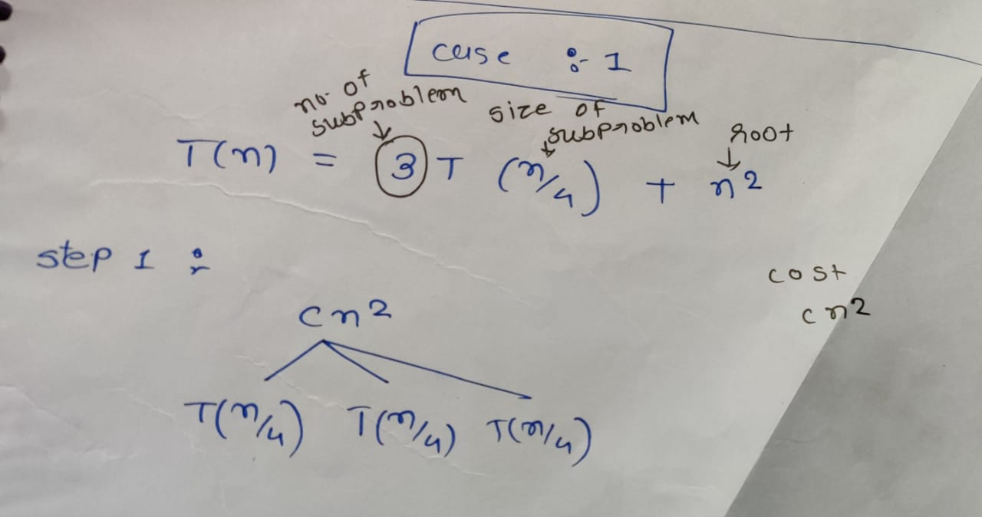
CASE 1: recursion tree

Slide 90
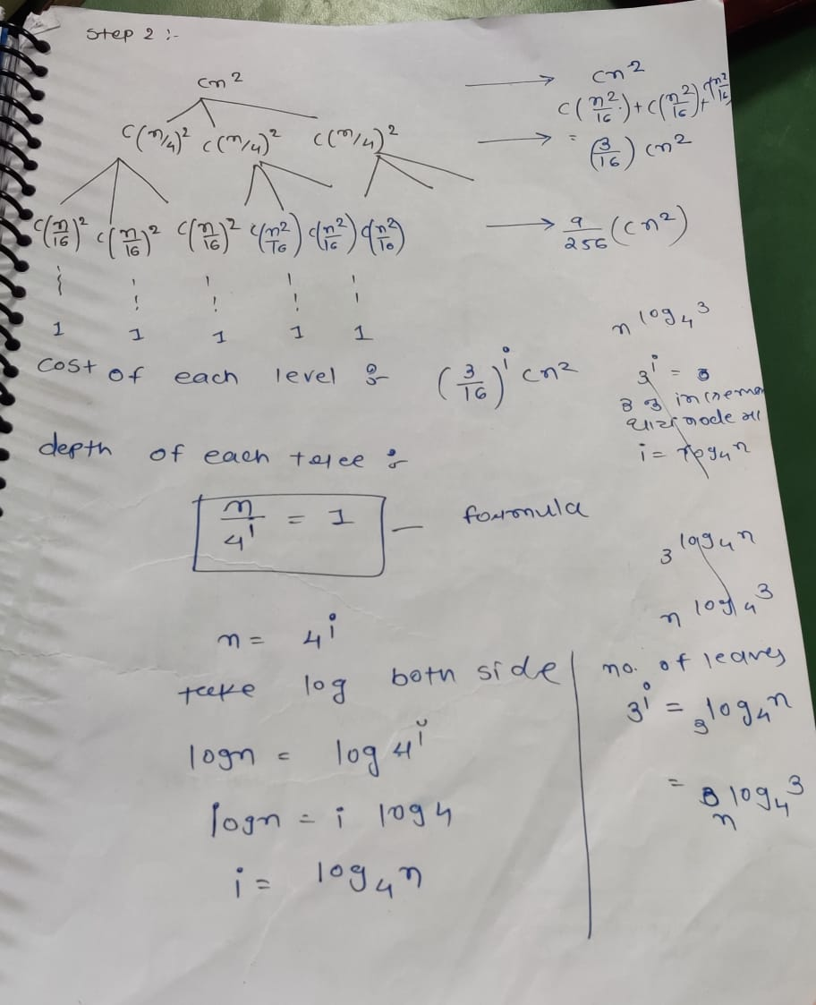
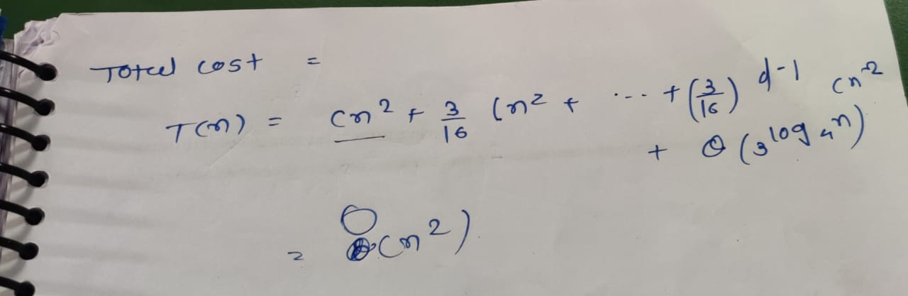

Slide 91
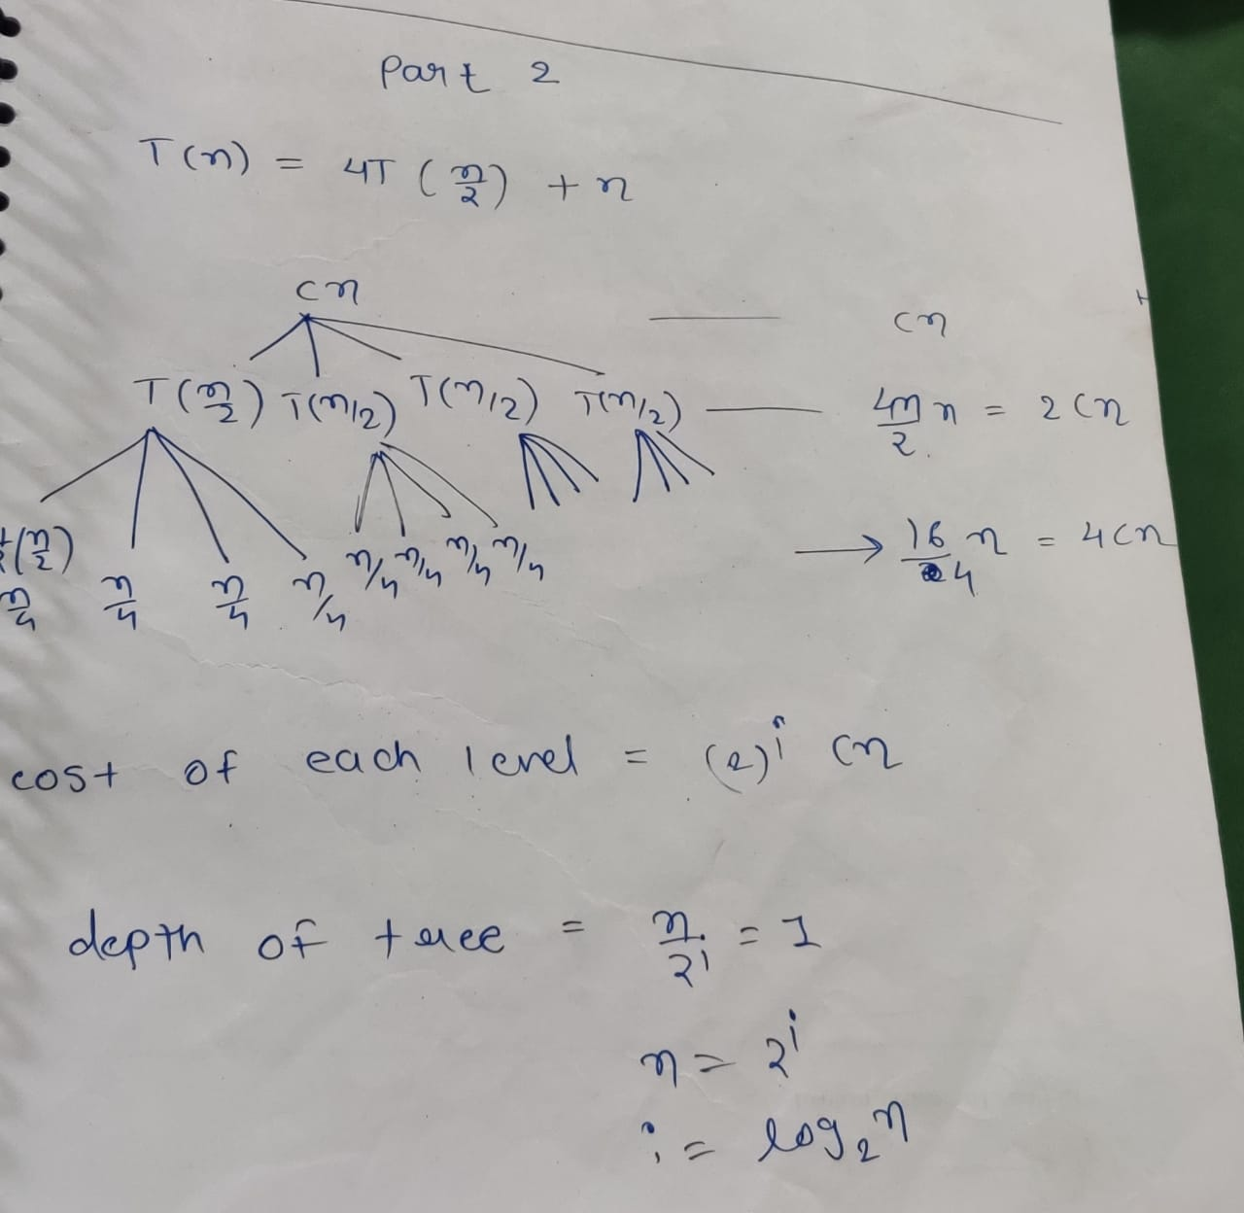
CASE 2: recursion tree

Slide 92
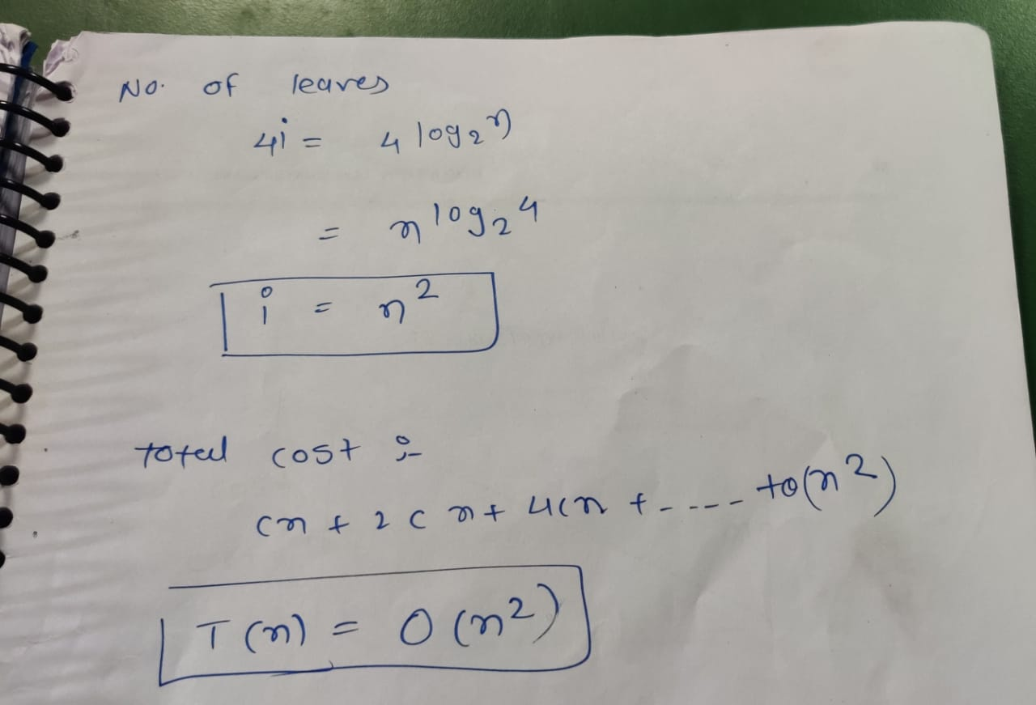

Slide 93
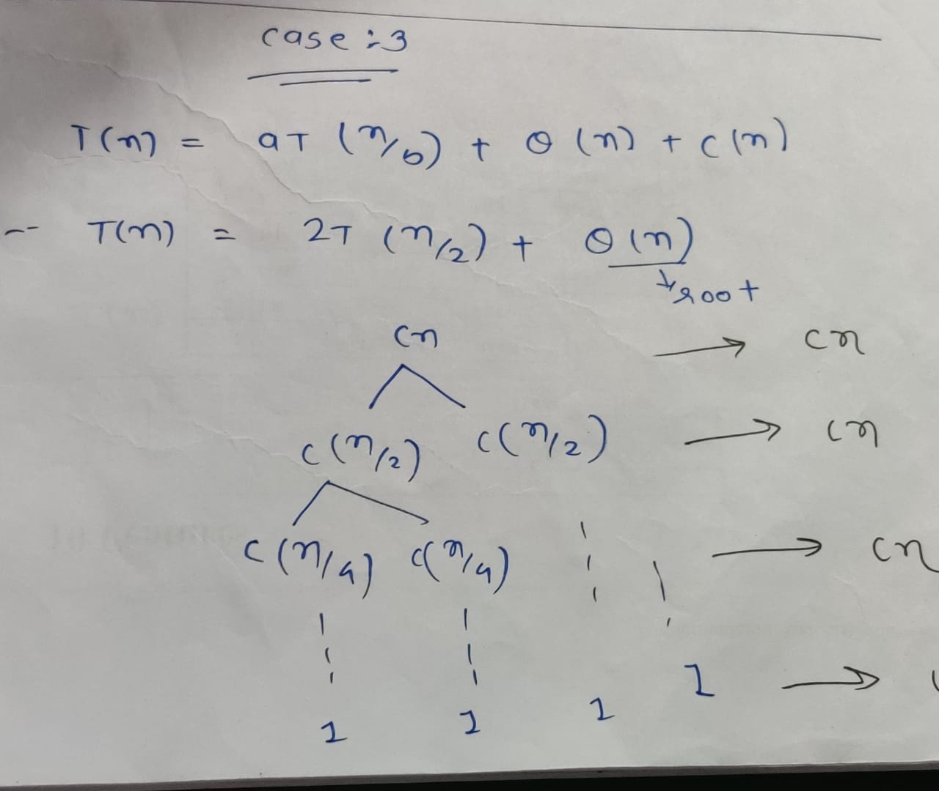
CASE 3: recursion tree

Slide 94
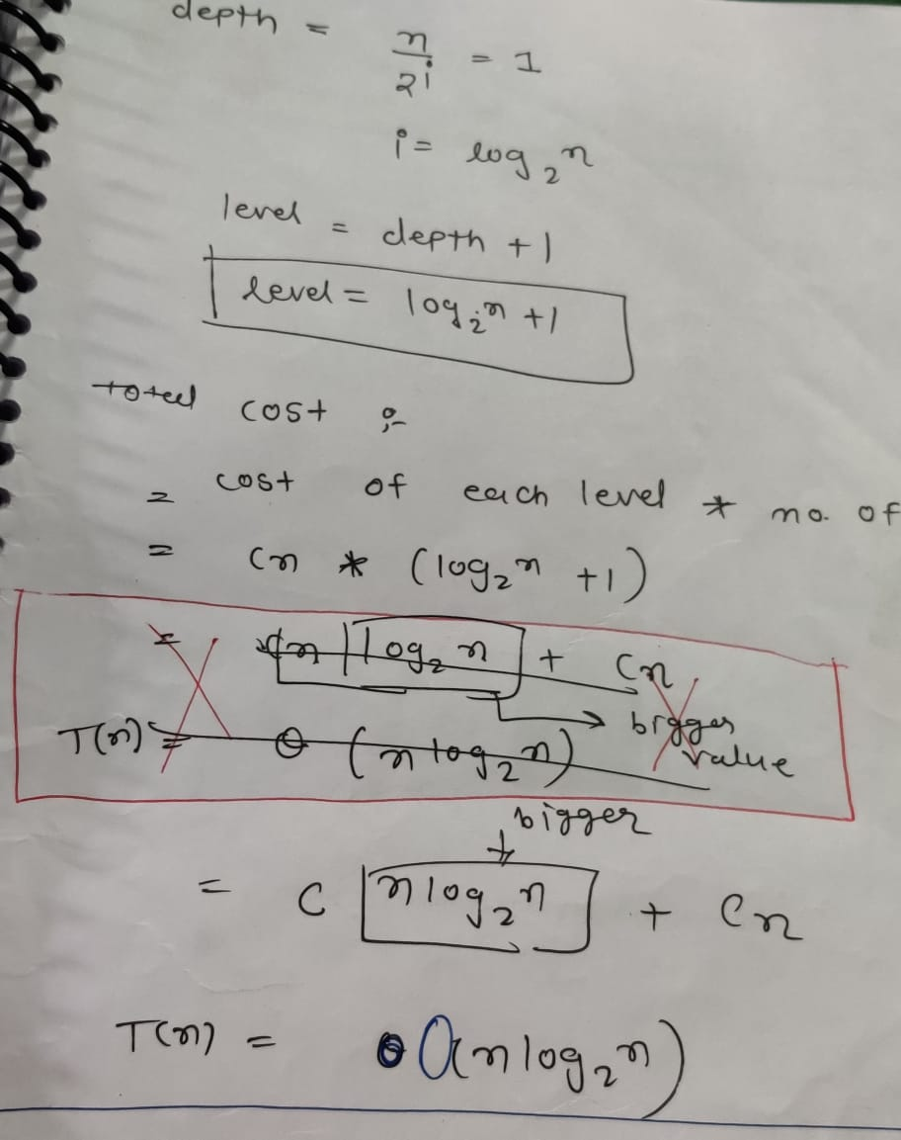

Slide 95
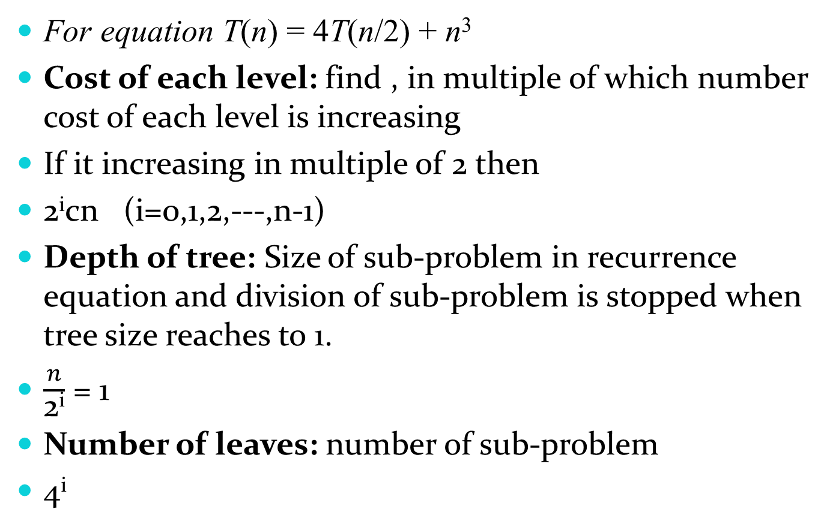
How to find

Slide 96


