Slide 1
Unit 2 - Sorting and Divide and Conquer Approach divide and conquer algorithm-Max-Min problem, , Matrix Multiplication, , Exponential.
01CE1503 - Design and Analysis of Algorithm
Prof. Megha Mudholkar
Department of Computer Engineering

Slide 2
Contents
Comparison based sorting algorithms,
Non Comparison based sorting algorithms,
Problem Solving using divide and conquer algorithm-Max-Min problem,
Matrix Multiplication,
Exponential

Slide 3
Sorting
Sorting refers to arranging data in a particular format.
Sorting algorithm specifies the way to arrange data in a particular order.
The importance of sorting:
data searching can be optimized to a very high level, if data is stored in a sorted manner.
used to represent data in more readable formats.
Examples of sorting in real-life scenarios:
Telephone Directory
Dictionary

Slide 4


Sorting takes an unordered collection and makes it an ordered one.

Slide 5
1 2 3 4 5 6 7
77
42
35
12
101
5
1 2 3 4 5 6 7
5
12
35
42
77
101

Slide 6
SORTING TECHNIQUES
There are various methods for sorting:
Comparison Based Sorting Algorithms
Bubble sort, Insertion sort, Selection sort, Quick sort, Heap sort, Merge sort, Shell Sort
Non-Comparison Based Sorting Algorithms
Radix Sort
Bucket Sort
Counting Sort

Slide 7
Comparison Based Sorting

Slide 8
1. BUBBLE SORT
Introduction:
Bubble sorting is a simple sorting technique in which we arrange the elements of the list by forming pairs of adjacent elements.
That means we form the pair of the ith and (i+1)th element.
If the order is ascending, we interchange the elements of the pair if the first element of the pair is greater than the second element.

Slide 9
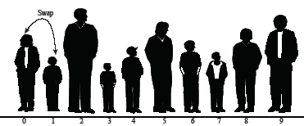

1. BUBBLE SORT
Bubble sort: beginning of first pass

Slide 10


1. BUBBLE SORT

Slide 11

1. BUBBLE SORT
Bubble sort: end of First pass

Slide 12
Pseudo code for Bubble Sort
Algorithm bubble (a, n)
Pre: Unsorted array a of length n.
Post: Sorted array in ascending order of length n
for i = 1 to (n – 1) do // n-1 passes
for j = 1 to (n- i ) do
if ( a[j] > a[j+1] )
temp=a[j] //swapping of numbers
a[j]=a[j+1]
a[j+1]=temp
Sort by comparing each adjacent pair of items in a list in turn, swapping the items if not in order, and repeating the pass through the list until no swaps are done.

Slide 13
Exercise
Sort the following numbers using bubble sort.
25 14 62 35 69 12

Slide 14
Pass 1
25 14 62 35 69 12
14 25 62 35 69 12
14 25 62 35 69 12
14 25 35 62 69 12
14 25 35 62 69 12
14 25 35 62 12 69
Number of comparisons = 5

Slide 15
Pass 2
14 25 35 62 12 69
14 25 35 62 12 69
14 25 35 62 12 69
14 25 35 62 12 69
14 25 35 12 62 69
Number of comparisons = 4

Slide 16
Pass 3
14 25 35 12 62 69
14 25 35 12 62 69
14 25 35 12 62 69
14 25 12 35 62 69
Number of comparisons = 3

Slide 17
Pass 4
14 25 12 35 62 69
14 25 12 35 62 69
14 12 25 35 62 69
Number of comparisons = 2

Slide 18
Pass 5
14 12 25 35 62 69
12 14 25 35 62 69
Number of comparisons = 1

Slide 19
Number of elements = 6
Number of pass = 5
Number of comparison in any pass
= n – pass number

Slide 20
Bubble Sort
Number of elements = n
Number of pass = n – 1
If k is pass number then
Number of comparisons in k^{th} pass = n – k

Slide 21
Exercise
Sort following elements using bubble sort method.
7 8 10 26 44 33

Slide 22
Pass 1
7 8 10 26 44 33
7 8 10 26 44 33
7 8 10 26 44 33
7 8 10 26 44 33
7 8 10 26 44 33
7 8 10 26 33 44
Number of comparisons = 5
Exchange of numbers occurred

Slide 23
Pass 2
7 8 10 26 33 44
7 8 10 26 33 44
7 8 10 26 33 44
7 8 10 26 33 44
7 8 10 26 33 44
Number of comparisons = 4
No exchange of numbers
Hence skip further pass.

Slide 24
Bubble Sort - Optimized
Algorithm bubble (a, n)
Pre: Unsorted array a of length n.
Post: Sorted array in ascending order of length n
for i = 1 to (n – 1) do // n-1 passes
test = 0
for j = 0 to ((n-1) – i ) do
if ( a[j] > a[j+1] )
temp=a[j]
a[j]=a[j+1]
a[j+1]=temp
test = 1 // exchange happened
if (test = 0) //no exchange - list is now sorted
return

Slide 25
Complexity of algorithm
No. of comparisons in 1st pass = n – 1
No. of comparisons in 2nd pass = n – 2
No. of comparisons in 3rd pass = n – 3
*
*
No. of comparisons in (n – 1) pass = 1
f(n) = (n – 1) + (n – 2)+ ….+ 1
= n(n-1)/2 = O(n² )
Therefore Worst case complexity = O(n²)
If list is already sorted then no. of pass = 1 and no. of comparisons = n-1
Best case complexity = O(n)

Slide 26
Exercise
Sort following elements using bubble sort method.
20 3 17 19 25 35 9 42 16 27

Slide 27
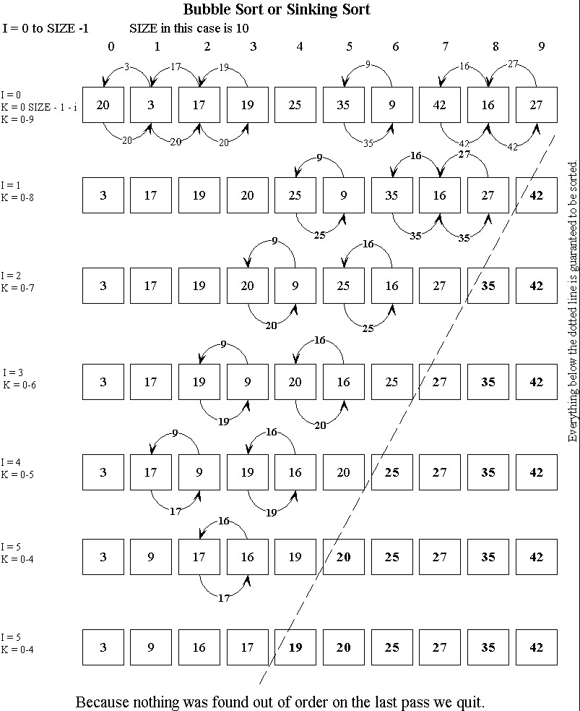

Slide 28
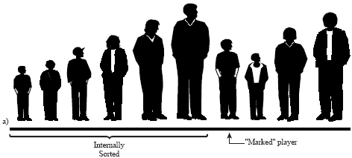
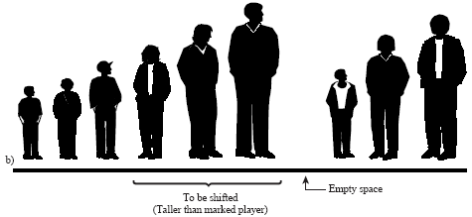
2. INSERTION SORT
Sort by repeatedly taking the next item and inserting it into the final array in its proper order with respect to items already inserted.

Slide 29
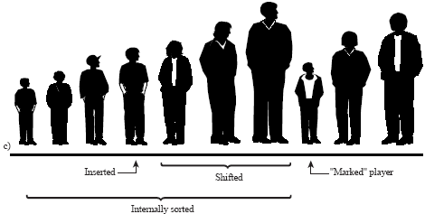
2. INSERTION SORT

Slide 30
Insertion sort
Suppose array A with n elements A[1], A[2], A[3],…..,A[n]
Pass 1: A[1] is already sorted.
Pass 2: A[2] is inserted before or after A[1] such that A[1],A[2] is sorted array.
Pass 3: A[3] is inserted in A[1], A[2] in such a way that A[1],A[2],A[3] is sorted array.
Pass N: A[N] is inserted in A[1],A[2],A[3]…A[n-1] in such a way that A[1],A[2],A[3]…A[n-1], A[n] is sorted array.
This algorithm inserts A[k] into its proper position in the previously sorted sub array A[1], A[2],…,A[k-1]

Slide 31
Example:
24 | 13 | 9 | 64 | 7 | 23 | 34 | 47

Slide 32
24
First value is considered as sorted.
24

Slide 33
Pass 1:
Insert next value 13
13 is less than 24
Swap 24 and 13
24 | 13
13 | 24

Slide 34
Pass 2:
Insert next value 9
9 is less than 24
Swap 24 and 9
9 is less than 13
Swap 13 and 9
13 | 24 | 9
13 | 9 | 24
9 | 13 | 24

Slide 35
Pass 3:
Insert next value 64
Pass 4 :
Insert next value 7
7 is less than 64
Swap 7 with 64 .
9 | 13 | 24 | 64
9 | 13 | 24 | 64 | 7
9 | 13 | 24 | 7 | 64

Slide 36
7 is less than 24
Swap 7 with 24 .
9 | 13 | 24 | 7 | 64
9 | 13 | 7 | 24 | 64
7 is less than 13
Swap 7 with 13
9 | 7 | 13 | 24 | 64

Slide 37
7 is less than 9
Swap 7 with 9
9 | 7 | 13 | 24 | 64
7 | 9 | 13 | 24 | 64
Pass 5 :
Insert next value 23
7 | 9 | 13 | 24 | 64 | 23

Slide 38
23 is less than 64
Swap 23 with 64
7 | 9 | 13 | 24 | 64 | 23
7 | 9 | 13 | 24 | 23 | 64
23 is less than 24
Swap 23 with 24
7 | 9 | 13 | 23 | 24 | 64

Slide 39
Pass 6:
Insert next value 34
34 is less than 64
Swap 34 with 64
7 | 9 | 13 | 23 | 24 | 64 | 34
7 | 9 | 13 | 23 | 24 | 34 | 64

Slide 40
Pass 7:
Insert next value 47
47 is less than 64
Swap 47 with 64
7 | 9 | 13 | 23 | 24 | 34 | 64 | 47
7 | 9 | 13 | 23 | 24 | 34 | 47 | 64

Slide 41
Insertion sort
Number of pass n-1
In each pass proper position is created for element to be inserted by sliding elements which are greater than that element.

Slide 42
Insertion sort - Algorithm
Algorithm insertion (a, n)
Pre: Unsorted list a of length n.
Post: Sorted list a in ascending order of length n
1. for i = 1 to (n -1) do // n-1 passes
temp = a[i] //value to be inserted
ptr = i – 1 //pointer to move downward
while ( temp < a[ptr] and ptr >= 0)
a[ptr + 1] = a[ptr]
ptr = ptr - 1
a[ptr +1] = temp

Slide 43
Insertion sort - Complexity
Best Case: - O (n)
List is already sorted. In each iteration, first element of unsorted list compared with last element of sorted list, thus (n-1) comparisons.
Worst Case: - O(n²)
List sorted in reverse order. First element of unsorted list compared with one element of sorted list, second compared with 2 elements. Last element to be inserted compared with all the n-1 elements.
1 + 2 + 3 + ………………… (n-2) + (n-1)
= (n (n-1))/2
= O (n²)
Average Case: - O(n²)

Slide 44
Exercise
Sort the following array using insertion sort.
25 2 10 5 8 7

Slide 45
Insertion Sort Example
25 2 10 5 8 7
25 First value is considered as sorted.
Pass 1:
2 25
Insert next value 2
2 is less than 25
25 slides over

Slide 46
Insertion Sort Example
Pass 2:
2 10 25
Insert next value 10
10 is less than 25
25 slides over
Pass 3:
2 5 10 25
Insert next value 5
5 is less than 10, 25
10, 25 slide over

Slide 47
Insertion Sort Example
Pass 4:
2 5 8 10 25
Insert next value 8
8 is less than 10, 25
10, 25 slide over
Pass 5:
2 5 7 8 10 25
Insert next value 7
7 is less than 8,10, 25
8,10, 25 slide over

Slide 48
Exercise
Sort following elements using insertion sort algorithm.
78 12 34 98 22 65 11
43 12 56 69 21 105 63 72 36 23 (Nov. 2017)
58 63 78 10 19 81 51 25 37 49(May 2012)
38 10 47 65 19 210 50 70 36(Bridge Course)

Slide 49
Selection Sort

Slide 50
Selection sort
Find the first smallest element in the list and place it at the first position.
Find next smallest number and place it at the second position.
And so on…

Slide 51
Pass 1:
34 | 17 | 23 | 35 | 45 | 9 | 1
exchange
min
1 | 17 | 23 | 35 | 45 | 9 | 34
Pass 2:
1 | 17 | 23 | 35 | 45 | 9 | 34
exchange
min
1 | 9 | 23 | 35 | 45 | 17 | 34

Slide 52
Pass 3:
1 | 9 | 23 | 35 | 45 | 17 | 34
exchange
min
1 | 9 | 17 | 35 | 45 | 23 | 34
Pass 4:
1 | 9 | 17 | 35 | 45 | 23 | 34
exchange
min
1 | 9 | 17 | 23 | 45 | 35 | 34

Slide 53
Pass 5:
1 | 9 | 17 | 23 | 45 | 35 | 34
exchange
min
1 | 9 | 17 | 23 | 34 | 35 | 45
Pass 6:
1 | 9 | 17 | 23 | 34 | 35 | 45
min
No exchange
1 | 9 | 17 | 23 | 34 | 35 | 45

Slide 54
Pass 7:
1 | 9 | 17 | 23 | 34 | 35 | 45
min
No exchange
1 | 9 | 17 | 23 | 34 | 35 | 45
Number of elements = n
Number of pass = n - 1

Slide 55
Selection Sort
Algorithm selection (a, n)
Pre: Unsorted array a of length n.
Post: Sorted list in ascending order of length n
for i = 0 to (n -2) do // n-1 passes
min_index=i
for j = (i+1) to (n -1) do
if ( a[min_index] > a[j] )
min_index = j
if (min_index != i) //place smallest element at i^{th} place
temp= a[i]
a[i]=a[min_index]
a[min_index]=temp

Slide 56
Complexity of algorithm
Worst case and best case complexity:
No. of comparisons in 1st pass = N – 1
No. of comparisons in 2nd pass = N – 2
No. of comparisons in 3rd pass = N – 3
*
No. of comparisons in (N – 1) pass = 1
f(n) = (n – 1) + (n – 2)+ ….+ 1
= n(n-1)/2 = O(n² )

Slide 57
Sort following elements using selection sort method of sorting.
29 83 26 74 95 28

Slide 58
Pass 1
29 83 26 74 95 28
min
exchange
26 83 29 74 95 28

Slide 59
Pass 2
26 83 29 74 95 28
min
exchange
26 28 29 74 95 83

Slide 60
Pass 3
26 28 29 74 95 83
min
No exchange
26 28 29 74 95 83

Slide 61
Pass 4
26 28 29 74 95 83
min
No exchange
26 28 29 74 95 83

Slide 62
Pass 5
26 28 29 74 95 83
min
Exchange
26 28 29 74 83 95
Notes:
http://www.youtube.com/watch?v=P00xJgWzz2c&list=PLyZbsUHhEbO8L1-JVv0S1bycWaxFVcijm

Slide 63
Sort the following numbers using Selection Sort.
59 31 40 90 76 100 21 5 85 14
14 6 4 8 11 12 10 13
25 57 48 37 12 92 86 33

Slide 64
Radix Sort
Radix sort is a sorting algorithm that sorts integers by processing individual digits.
Two classifications of radix sorts
Least significant digit process the integer representations starting from the least significant digit and move towards the most significant digit.
Most significant digit process the integer representations starting from the most significant digit and move towards the least significant digit. This is also known as radix exchange sort

Slide 65
The steps in Least significant digit (LSD) radix sort algorithm are as follows:
Take the least significant digit of each key.
Sort the list of elements based on that digit.
Repeat the sort with the immediate more significant digit.

Slide 66
Also known as digit sorting.
In each pass, list orders the data one digit at a time.
The first pass orders data on the unit’s place.
The second pass orders data on the ten’s digit.
The third pass orders data on hundred’s digit.
This goes on till data on most significant digit is sorted.

Slide 67
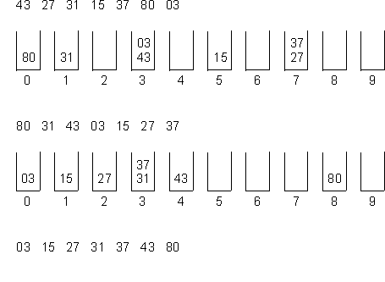
Radix Sort
Example 1:

Slide 68
Radix sort
Unsorted data
4132 | 2176 | 6456 | 2130 | 1466 | 3212 | 1455 | 2119
First pass (Unit’s digit)
2130
4132 | 3212
1455
2176 | 6456 | 1466
2119

Slide 69
Radix sort
2130
4132 | 3212
1455
2176 | 6456 | 1466
2119
Second pass (Ten’s digit)
3212 | 2119
2130 | 4132
1455 | 6456
1466
2176

Slide 70
Radix sort
3212 | 2119
2130 | 4132
1455 | 6456
1466
2176
Third pass (Hundred’s digit)
2119 | 2130 | 4132 | 2176
3212
1455 | 6456 | 1466

Slide 71
Radix sort
2119 | 2130 | 4132 | 2176
3212
1455 | 6456 | 1466
Fourth pass (Thousand’s digit)
1455 | 1466
2119 | 2130 | 2176
3212
4132
6456
Sorted data
1455 | 1466 | 2119 | 2130 | 2176 | 3212 | 4132 | 6456

Slide 72
Radix Sort
Algorithm radix (a, length)
// a is array to be sorted, length is number of elements in array
Pre: Unsorted list of length n.
Post: Sorted list in ascending order of length n
for k = lsd to msd do // k = no. of digits in data
for i = 0 to (n-1) do
y = a[i]
j = k^{th} digit of y
place y at rear of queue[j]
for q = 0 to 9 do
place elements of queue[q] in next sequential position of a
Reference: Tenenbaum , Forouzan (old)

Slide 73
Complexity
Complexity
O (m * n) m is no. of digits, n no. of elements

Slide 74
Quick sort

Slide 75
Quick sort
44 33 11 55 77 90 40 60 99 22 88 66
After partitioning
40 33 11 22 44 90 77 60 99 55 88 66
Less than 44 greater than 44
pivot

Slide 76
Quick sort
Quicksort sorts by employing a divide and conquer strategy to divide a list into two sub-lists.
The steps are:
Pick an element, called a pivot, from the list.
Reorder the list so that all elements which are less than the pivot come before the pivot and all elements greater than the pivot come after it (equal values can go either way). After this partitioning, the pivot is in its final position. This is called the partition operation.
Recursively sort the sub-list of lesser elements and the sub-list of greater elements.

Slide 77
Quick sort - partitioning
Sort following elements using quick sort.
44 33 11 55 77 90 40 60 99 22 88 66
down
up
pivot

Slide 78
Quick sort – partition algorithm
Step 1: Repeatedly increase the pointer down by one position until a[down] > pivot
Step 2: Repeatedly decrease the pointer up by one position until a[up] <= pivot.
Step 3: if down < up, interchange a[down] and a[up]
Steps 1,2 ,3 are repeated until step 3 fails.
i.e. if up <= down, interchange pivot and a[up]

Slide 79
int partition (a, beg, end)
// Places pivot element piv at its proper position; elements
before it are less than it & after it are greater than it
piv = a[beg]
up = end
down = beg
while (down < up)
while( (a[down] <= piv) && (down<end) )
down=down + 1
while(a[up]>piv)
up=up-1
if (down<up)
swap ( a[down], a[up])
swap(a[beg], a[up])
return up

Slide 80
Algorithm sort (a, beg, end)
// a - array to be sorted, beg - starting index of array to be sorted, end - ending index of array to be sorted
Pre: Unsorted list a of length n.
Post: Sorted list in ascending order of length n
if (beg < end)
j = partition(a, beg, end)
sort(a, beg, j-1)
sort (a, j+1, end)
else
return

Slide 81
Complexity of quick sort algorithm
Assume that array size n is power of 2
Let n = 2^{m} , so that m = log₂n
Assume that proper position for the pivot always turn out to be middle of array.
During first pass there will be n comparisons.
Array is split into two subarrays.
For each of the subarrays n/2 comparisons are required.
In next pass total 4 files are created each of size n/4

Slide 82
Complexity of quick sort algorithm
Each file require n/4 comparisons yielding n/8 files.
After m pass, there will be n files each of size 1.
Total number of comparisons =
= n + 2(n/2) + 4 (n/4) + 8 (n/8)+……
= n + n + n + n+….+n (m times)
= n.m
= n log₂ n
Complexity of quicksort algorithm = O(n log₂ n)

Slide 83
If array is already sorted
X[lb] is in its correct position.
The original file is split into subfiles of sizes 0 and n-1.
If this process continues ,total n-1 subfiles are sorted,the first of size n,the second of size n-1,the third of size n-3 and so on.
So,
Total no. of comaparisions are:
f(n) =n+(n-1)+(n-3)+……..+2+1
= = n(n-1)/2
So, The time complexity is O(n² ).

Slide 84
Sort array using quick sort.
65, 21, 14, 97, 87, 78, 74, 76, 45, 84, 22

Slide 85
Merge Sort

Slide 86
Merge Sort
Divide and conquer strategy
The steps are –
Divide the unsorted list into two sub lists of about half the size.
Sort each sub list recursively by re-applying merge sort, till you reach a single element array
Merge the sub lists back into one sorted list.

Slide 87
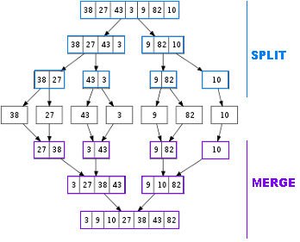

Slide 88
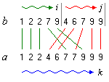
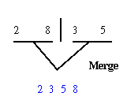
Merging 2 sorted arrays

Slide 89
Merge Sort
Algorithm mergesort (a, low, high)
// a is array to be sorted, low is starting index of array to be
sorted, high is ending index of array to be sorted
Pre: Unsorted list of length n.
Post: Sorted list in ascending order of length n
if (low < high)
mid = (low + high)/2
mergesort(x, low, mid)
mergesort(x, (mid+1), high)
merge(x, low, mid, high)

Slide 90
merge (a, low1, high1, high2)
i = low1; j = high1 + 1; k = 0
while (i<= high1) and (j<=high2) //Merge arrays
if (x[i] <=x[j])
aux[k] = x[i]
k=k+1; i=i+1
else
aux[k] = x[j]
k=k+1; j=j+1
while (i<= high1) // If jth list over, copy ith as it is
aux[k] = x[i]
k=k+1; i=i+1
while (j<= high2) // If ith list over, copy jth as it is
aux[k] = x[j]
k=k+1; j=j+1
k=0
for j = low1 to high2
a[j] = aux[k]
k = k+1

Slide 94
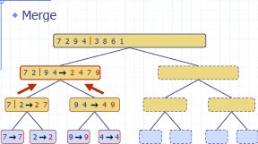

Slide 96
Complexity
Best Case, Average Case, Worst case: O (n log n)
Assume n = 2^{m}, m = log₂n.
In first pass array split in two parts each of size n/2, 2nd pass
4 parts of size n/4, then 8 parts of size n/8…..thus, file split m
(log n) times before getting single element array. So there are
(log n) passes.
At every level there are n elements that have to be merged so
there can not be more than n comparisons in every pass.
Thus, complexity is O (n log n)

Slide 97
Heap Sort

Slide 98
Heap sort is one of the sorting algorithms used to arrange a list of elements in order.
Heap sort algorithm uses one of the tree concepts called Heap Tree.
Let us first define a Complete Binary Tree. A complete binary tree is a binary tree in which every level, except possibly the last, is completely filled, and all nodes are as far left as possible.
A Binary Heap is a Complete Binary Tree where items are stored in a special order such that the value in a parent node is greater(or smaller) than the values in its two children nodes.
The former is called max heap and the latter is called min-heap.
The heap can be represented by a binary tree or array.

Slide 99
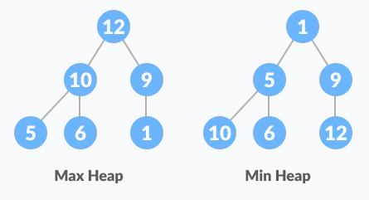
HEAP SORT

Slide 100
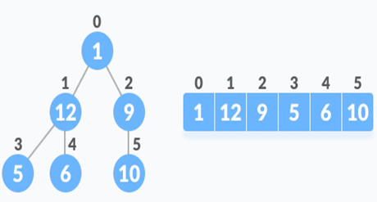
HEAP SORT
Relationship between Array Indexes and Tree Elements
A complete binary tree has an interesting property that we can use to find the children and parents of any node.
If the index of any element in the array is i,
the element in the index 2i+1 will become the left child and element in 2i+2 index will become the right child.
Also, the parent of any element at index i is given by the lower bound of (i-1)/2.

Slide 101
HEAP SORT
Algorithm
The Heap sort algorithm to arrange a list of elements in ascending order is performed using following steps...
Step 1 - Construct a Binary Tree with given list of Elements.
Step 2 - Transform the Binary Tree into Max Heap.
Step 3 - Delete the root element from Max Heap using Heapify method.
Step 4 - Put the deleted element into the Sorted list.
Step 5 - Repeat the same until Max Heap becomes empty.
Step 6 - Display the sorted list.

Slide 102
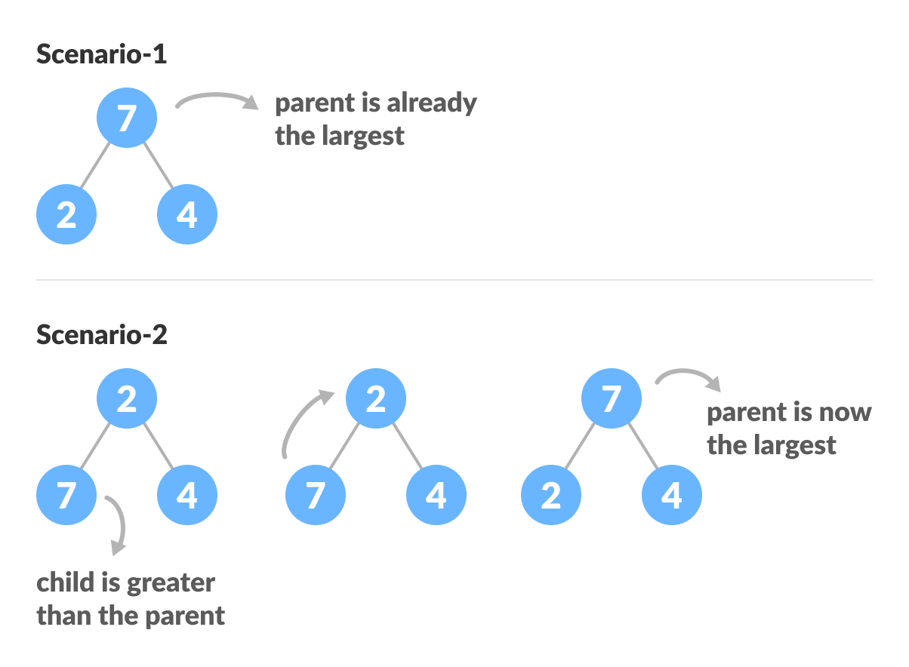
How to "heapify" a tree
Starting from a complete binary tree, we can modify it to become a Max-Heap by running a function called heapify on all the non-leaf elements of the heap.
heapify(array)
Root = array[0]
Largest = largest( array[0] , array [2*0 + 1], array[2*0+2])
if(Root != Largest)
Swap(Root, Largest)

Slide 103
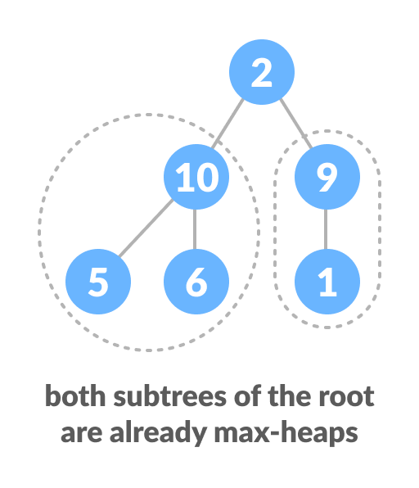
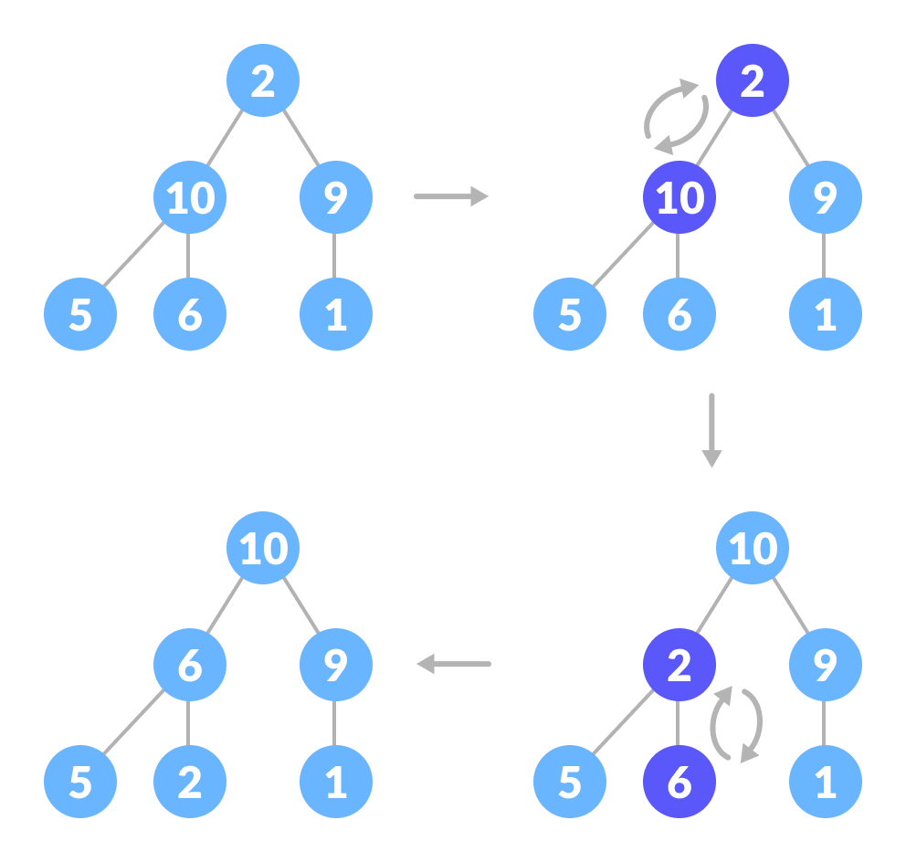
How to "heapify" a tree

Slide 104
Algorithm for Heapify
void heapify(int arr[], int n, int i) {
// Find largest among root, left child and right child
int largest = i;
int left = 2 * i + 1;
int right = 2 * i + 2;
if (left < n && arr[left] > arr[largest])
largest = left;
if (right < n && arr[right] > arr[largest])
largest = right;
// Swap and continue heapifying if root is not largest
if (largest != i) {
swap(&arr[i], &arr[largest]);
heapify(arr, n, largest);
}

Slide 105
Build max-heapify
To build a max-heap from any tree, we can thus start heapifying each sub-tree from the bottom up and end up with a max-heap after the function is applied to all the elements including the root element.
In the case of a complete tree, the first index of a non-leaf node is given by n/2 - 1. All other nodes after that are leaf-nodes and thus don't need to be heapified.
// Build heap (rearrange array)
for (int i = n / 2 - 1; i >= 0; i--)
heapify(arr, n, i);

Slide 106
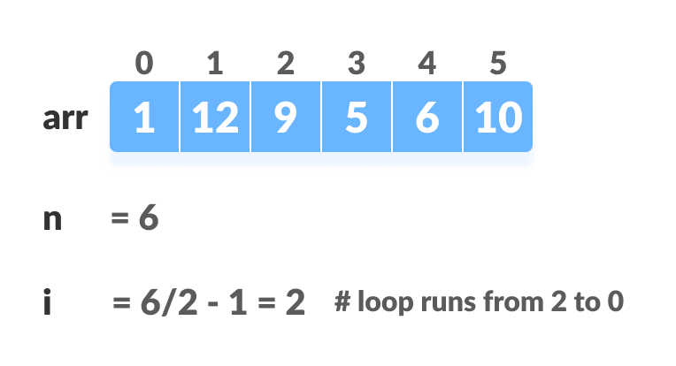
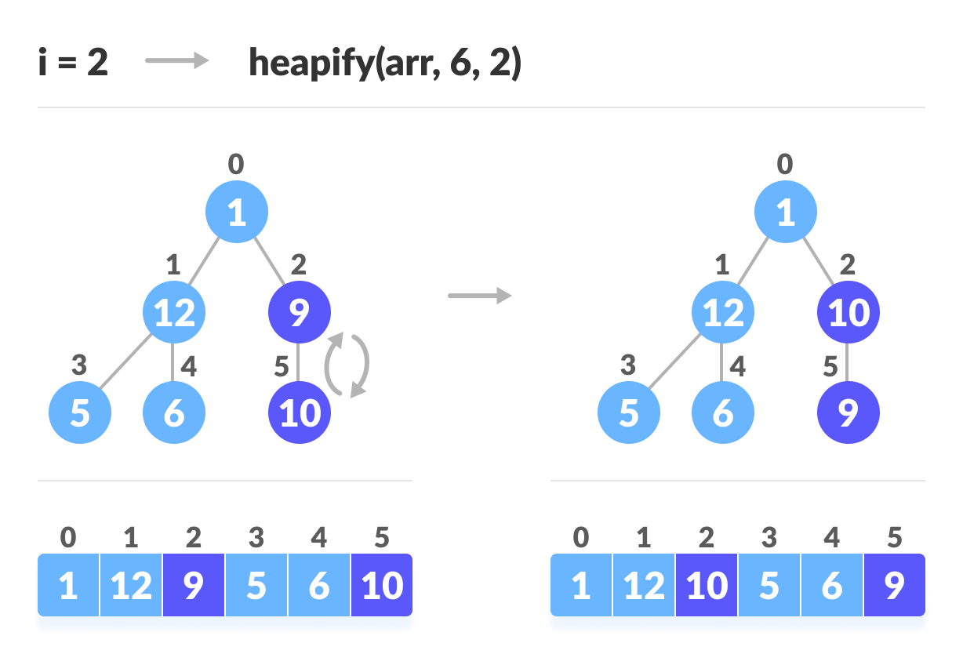
Build max-heapify

Slide 108
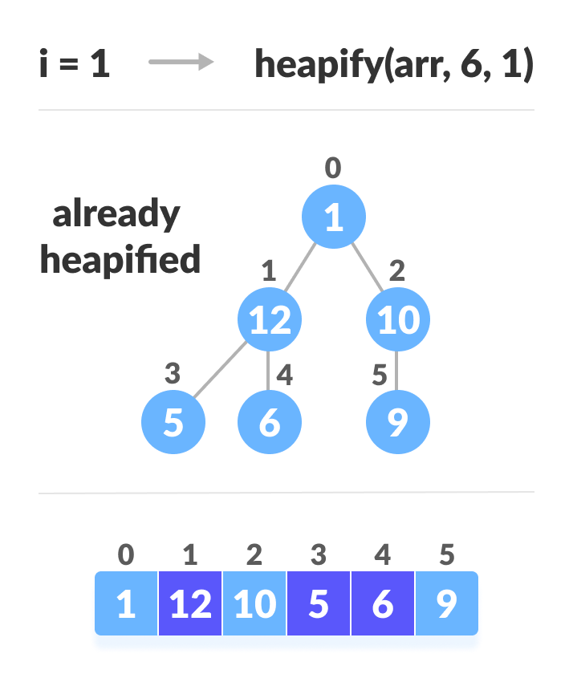
Build max-heapify

Slide 109
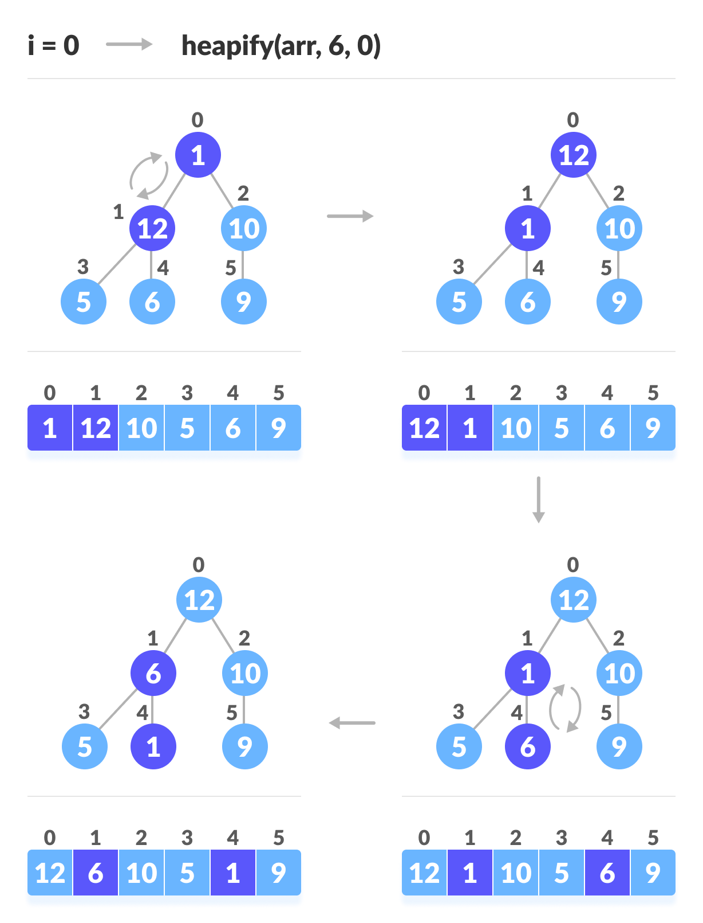
Build max-heapify

Slide 110
How Heap Sort Works?
Since the tree satisfies Max-Heap property, then the largest item is stored at the root node.
Swap: Remove the root element and put at the end of the array (nth position) Put the last item of the tree (heap) at the vacant place.
Remove: Reduce the size of the heap by 1.
Heapify: Heapify the root element again so that we have the highest element at root.
The process is repeated until all the items of the list are sorted.

Slide 111
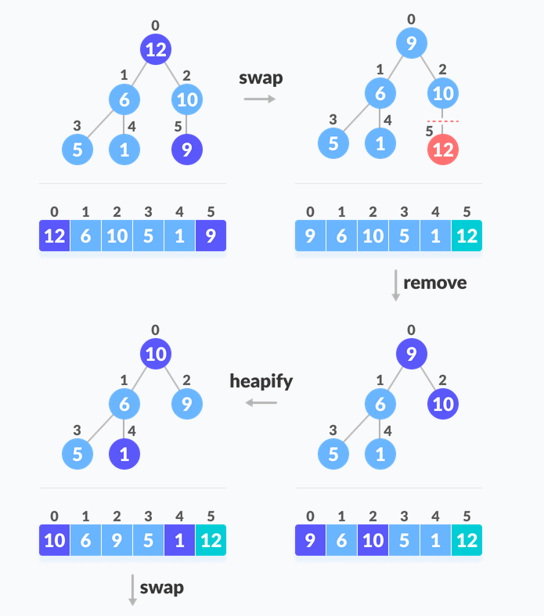

Slide 112
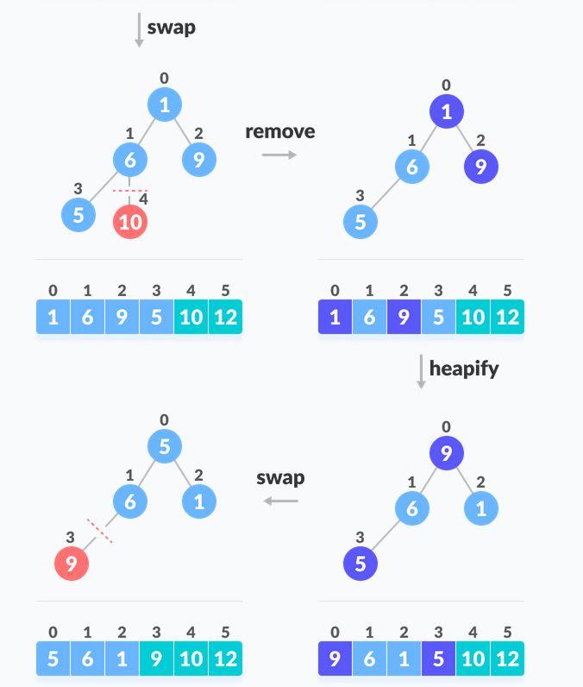

Slide 113
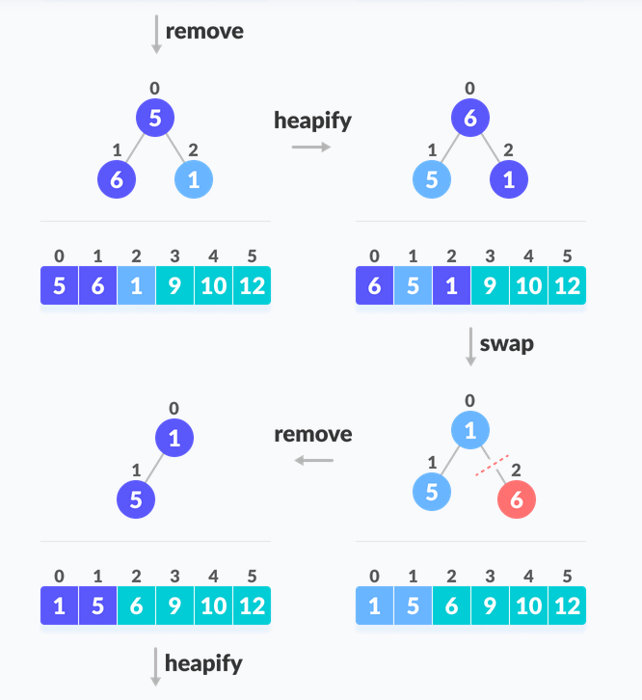

Slide 114
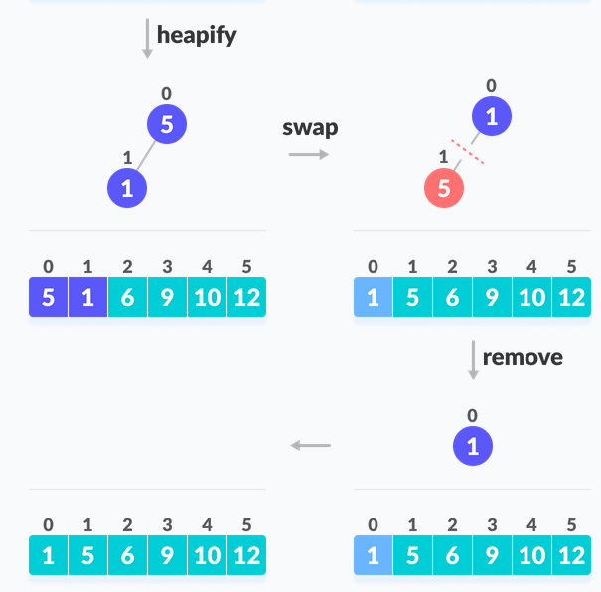

Slide 115
Heapsort and Time Complexity
void heapSort(int arr[], int n) {
// Build heap (rearrange array)
int i;
for (i = n / 2 - 1; i >= 0; i--)
heapify(arr, n, i);
// One by one extract an element from heap
for (i = n - 1; i > 0; i--) {
// Move current root to end
swap(&arr[0], &arr[i]);
// Call max heapify on the reduced heap
heapify(arr, i, 0);
}
}

Slide 116
Time Complexity
Best Case Complexity - It occurs when there is no sorting required, i.e. the array is already sorted. The best-case time complexity of heap sort is O(n log n).
Average Case Complexity - It occurs when the array elements are in jumbled order that is not properly ascending and not properly descending. The average case time complexity of heap sort is O(n log n).
Worst Case Complexity - It occurs when the array elements are required to be sorted in reverse order. That means suppose you have to sort the array elements in ascending order, but its elements are in descending order. The worst-case time complexity of heap sort is O(n log n).
Case | Time Complexity
Best Case | O(n logn)
Average Case | O(n log n)
Worst Case | O(n log n)

Slide 117
Shell Sorting

Slide 118
Shell Sort
Shell sort is an algorithm that first sorts the elements far apart from each other and successively reduces the interval between the elements to be sorted. It is a generalized version of insertion sort.
Efficiency depends on the gap.
Shell's original sequence: N/2 , N/4 , …, 1

Slide 119

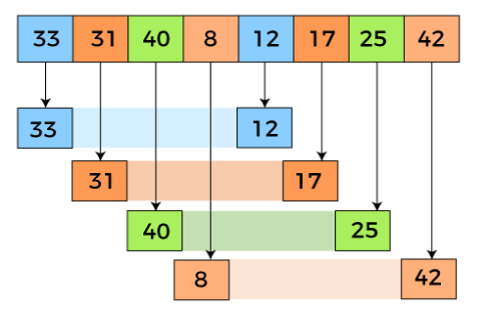
In the first loop, n is equal to 8 (size of the array), so the elements are lying at the interval of 4 (n/2 = 4). Elements will be compared and swapped if they are not in order.
Here, in the first loop, the element at the 0th position will be compared with the element at 4th position. If the 0th element is greater, it will be swapped with the element at 4th position. Otherwise, it remains the same. This process will continue for the remaining elements.
At the interval of 4, the sublists are {33, 12}, {31, 17}, {40, 25}, {8, 42}.

Slide 120

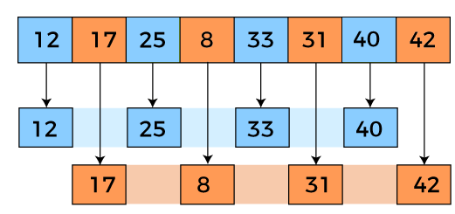
Now, we have to compare the values in every sub-list. After comparing, we have to swap them if required in the original array. After comparing and swapping, the updated array will look as follows -
In the second loop, elements are lying at the interval of 2 (n/4 = 2), where n = 8.
Now, we are taking the interval of 2 to sort the rest of the array. With an interval of 2, two sublists will be generated - {12, 25, 33, 40}, and {17, 8, 31, 42}.

Slide 121

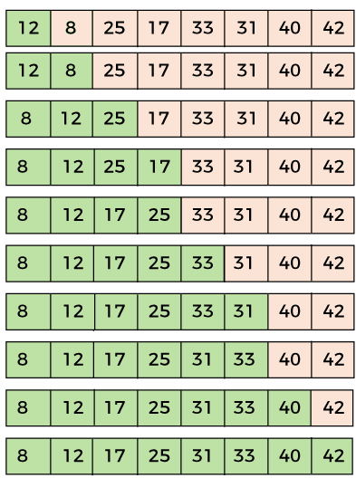
Now, we again have to compare the values in every sub-list. After comparing, we have to swap them if required in the original array. After comparing and swapping, the updated array will look as follows -
In the third loop, elements are lying at the interval of 1 (n/8 = 1), where n = 8. At last, we use the interval of value 1 to sort the rest of the array elements. In this step, shell sort uses insertion sort to sort the array elements.
Now, the array is sorted in ascending order.

Slide 122
Algorithm and Time complexity
shellSort(array, size)
for interval i <- size/2n down to 1
for each interval "i" in array
sort all the elements at interval "i"
end shellSort
Worst case: O(n^2)
Best Case: O(nlogn)
Average case:O(nlogn)

Slide 123
Non-Comparison Based Sorting

Slide 124
Radix Sort
Radix sort is a sorting algorithm that sorts integers by processing individual digits.
Two classifications of radix sorts
Least significant digit process the integer representations starting from the least significant digit and move towards the most significant digit.
Most significant digit process the integer representations starting from the most significant digit and move towards the least significant digit. This is also known as radix exchange sort

Slide 125
The steps in Least significant digit (LSD) radix sort algorithm are as follows:
Take the least significant digit of each key.
Sort the list of elements based on that digit.
Repeat the sort with the immediate more significant digit.

Slide 126
Also known as digit sorting.
In each pass, list orders the data one digit at a time.
The first pass orders data on the unit’s place.
The second pass orders data on the ten’s digit.
The third pass orders data on hundred’s digit.
This goes on till data on most significant digit is sorted.

Slide 127
Radix Sort
Example 1:

Slide 128
Radix sort
Unsorted data
4132 | 2176 | 6456 | 2130 | 1466 | 3212 | 1455 | 2119
First pass (Unit’s digit)
2130
4132 | 3212
1455
2176 | 6456 | 1466
2119

Slide 129
Radix sort
2130
4132 | 3212
1455
2176 | 6456 | 1466
2119
Second pass (Ten’s digit)
3212 | 2119
2130 | 4132
1455 | 6456
1466
2176

Slide 130
Radix sort
3212 | 2119
2130 | 4132
1455 | 6456
1466
2176
Third pass (Hundred’s digit)
2119 | 2130 | 4132 | 2176
3212
1455 | 6456 | 1466

Slide 131
Radix sort
2119 | 2130 | 4132 | 2176
3212
1455 | 6456 | 1466
Fourth pass (Thousand’s digit)
1455 | 1466
2119 | 2130 | 2176
3212
4132
6456
Sorted data
1455 | 1466 | 2119 | 2130 | 2176 | 3212 | 4132 | 6456

Slide 132
Radix Sort
Algorithm radix (a, length)
// a is array to be sorted, length is number of elements in array
Pre: Unsorted list of length n.
Post: Sorted list in ascending order of length n
for k = lsd to msd do // k = no. of digits in data
for i = 0 to (n-1) do
y = a[i]
j = k^{th} digit of y
place y at rear of queue[j]
for q = 0 to 9 do
place elements of queue[q] in next sequential position of a

Slide 133
Complexity
Complexity
O (m * n) m is no. of digits, n no. of elements

Slide 134
Bucket Sort
Bucket Sort is a sorting technique that sorts the elements by first dividing the elements into several groups called buckets.
The elements inside each bucket are sorted using any of the suitable sorting algorithms or recursively calling the same algorithm.
The process of bucket sort can be understood as a scatter-gather approach. The elements are first scattered into buckets then the elements of buckets are sorted. Finally, the elements are gathered in order.

Slide 135
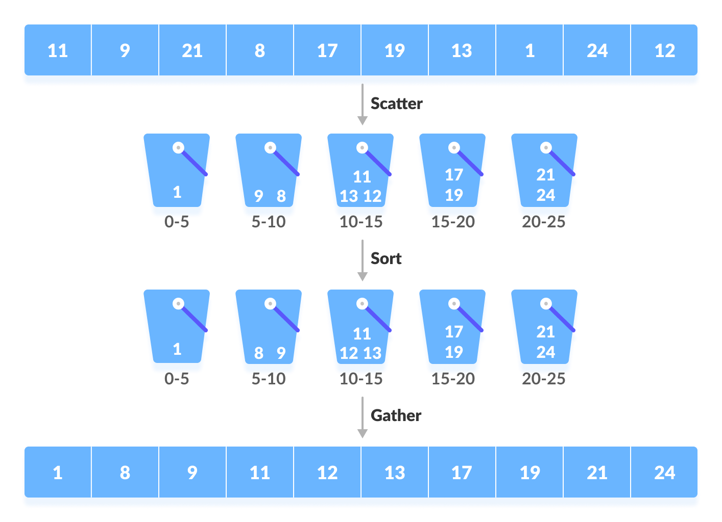
Bucket Sort

Slide 136
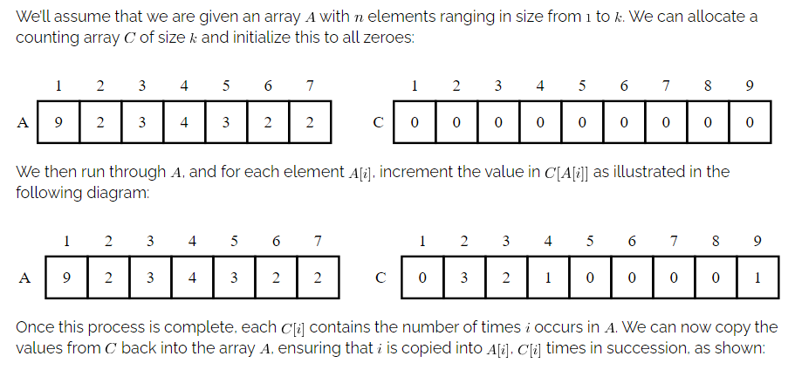
Counting sort

Slide 137
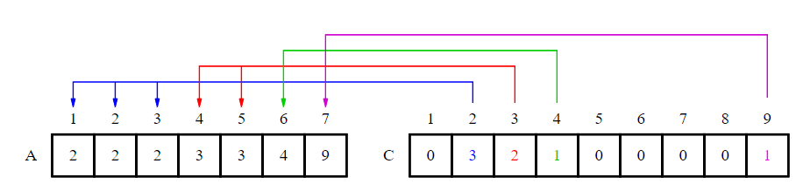

Slide 138
Thank You

