Slide 1

.NET Technologies (01CE0523) 5th Semester 4 Credits
Dept. of Computer Engineering

Slide 2
Objective
Net Technologies are blend of technologies supported by Microsoft .Net Framework that allows user to create various applications.
Students will be able to work with various technologies provided by Microsoft .NET platform.

Slide 3
Course Outcomes
To Review the components of .Net Framework
To practice Web based application
To create web applications using MVC framework
To practice basic database application using ADO.net
To designing, developing, and deploying APIs

Slide 4
Unit 1 Introduction to .NET Framework and C#

Slide 5
Contents
Introduction to .NET Framework Architecture
CLR
Assemblies
Basics of C#
Class
Object
Method
Access Modifiers
Constructors
Abstract Class
Inheritance
Interface
Polymorphism
Exception Handling

Slide 6
History of .NET
The .Net framework was meant to create applications, which would run on the Windows Platform. The first version of the .Net framework was released in the year 2002. The version was called .Net framework 1.0.
The Microsoft .Net framework has come a long way since then, and the current version is .Net Framework 6.0.
The Microsoft .Net framework can be used to create both – Form-based and Web-based applications. Web services can also be developed using the .Net framework.

Slide 7
What is .NET Framework?
.NET Framework is a software development framework for building and running applications on Windows.
.NET Framework is part of the .NET platform, a collection of technologies for building apps for Linux, macOS, Windows, iOS, Android, and more.
.NET apps can run on many operating systems, using different implementations of .NET (.NET Framework, .NET Core or .NET, and Xamarin/Mono).
The framework includes a variety of programming languages, such as C#, F#, and Visual Basic, and supports a range of application types, including desktop, web, mobile, and gaming applications.
. NET Framework supports more than 60 programming languages of which 11 programming languages are designed and developed by Microsoft.

Slide 8
Eleven Programming Languages developed by Microsoft
C#.NET
VB.NET
C++.NET
J#.NET
F#.NET
JSCRIPT.NET
WINDOWS POWERSHELL
IRON RUBY
IRON PYTHON
C OMEGA
ASML(Abstract State Machine Language)

Slide 9
What is the difference between .NET and .NET Framework?
.NET is Cross-Platform and runs on Linux, macOS, and Windows OS. .NET Framework only runs on Windows OS.
.NET is Open-Source and accepts contributions from the community. The .NET Framework source code is available but does not take direct contributions.
.NET Framework is included in Windows and automatically updated machine-wide by Windows Update. .NET is shipped independently.

Slide 10
Applications Developed using .NET Framework
WinForms: This is used for developing Forms-based applications, which would run on an end-user machine. Notepad is an example of a client-based application.
ASP.NET (Active Server Pages): This is used for developing web-based applications, which are made to run on any browser such as Edge, Chrome or Firefox. ASP.NET is a web framework designed and developed by Microsoft.
ADO.NET (ActiveX Data Object): This technology is used to develop applications to interact with databases such as Oracle or Microsoft SQL Server.
WCF (Windows Communication Foundation): It is a framework for building service-oriented applications. Using WCF, you can send data as asynchronous messages from one service endpoint to another.

Slide 11
Applications Developed using .NET Framework
LINQ (Language Integrated Query): It is a query language, introduced in .NET 3.5 framework. It is used to make the query for data sources with C# or Visual Basics programming languages.
Entity Framework: It is an ORM (Object Relational Mapping)-based open-source framework that is used to work with a database using .NET objects. It eliminates a lot of developers’ effort to handle the database. (We learned Hibernate Framework in AJT).
Parallel LINQ: Parallel LINQ or PLINQ is a parallel implementation of LINQ to objects. It combines the simplicity and readability of LINQ and provides the power of parallel programming. Fast speed execution of LINQ queries.

Slide 12
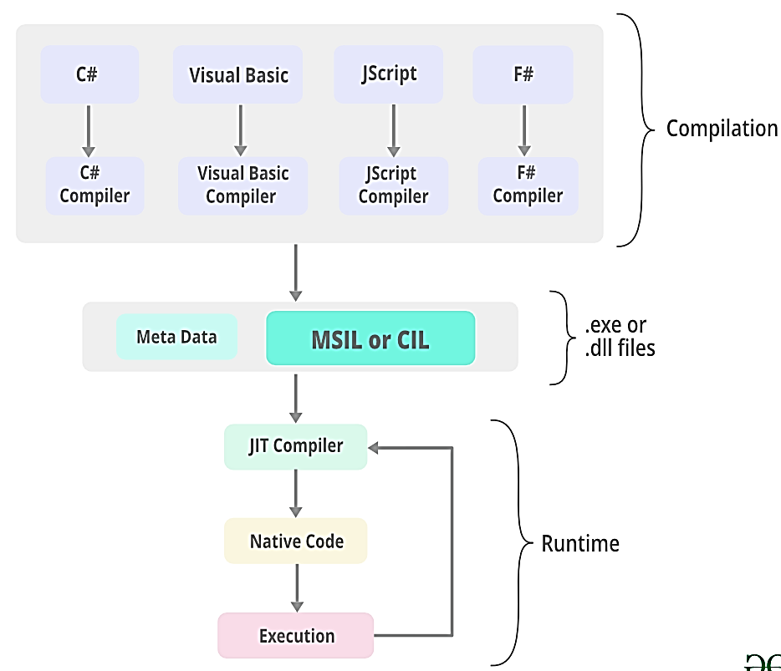
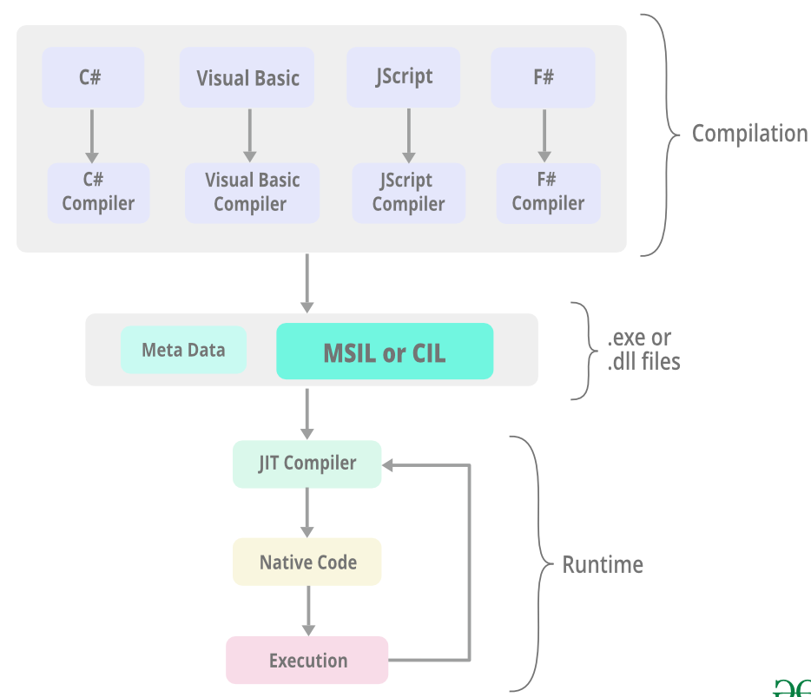
Architecture of .NET Framework

Slide 13
Architecture of .NET Framework
.NET applications are written in the C#, F#, or Visual Basic programming language.
Code is compiled into a language-independent Common Intermediate Language (CIL). Compiled code is stored in assemblies—files with a .dll or .exe file extension. It is called as MSIL (assembly code).
When an app runs, the CLR takes the assembly and uses a just-in-time compiler (JIT) to turn it into machine code that can execute on the specific architecture of the computer it is running on.
The Common Language Runtime (CLR) is the execution engine that handles running applications. It provides services like thread management, garbage collection, type-safety, exception handling, and more.

Slide 14
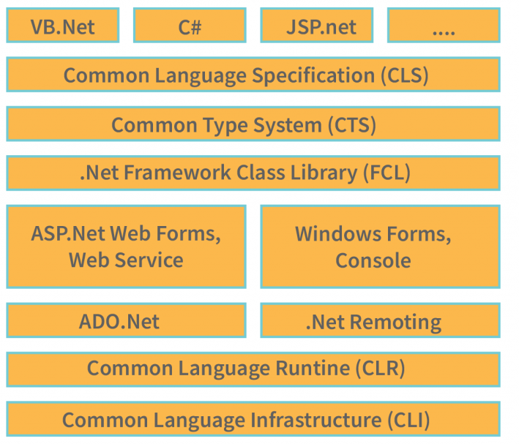
Components of .NET Architecture

Slide 15
Components of .NET Architecture
Common Language Specification (CLS) helps in easy creation of the apps and software. Common Language Specification also helps in reduction of cost. It helps in reducing the development time and cost.
The Common Language Infrastructure (CLI) is an app development framework that is language-independent. Therefore, developers don’t have to worry about changing the language or syntax of their source code when switching from one platform to another.
Common Type Specification (CTS) is a language supporting multiple data types is known as a common type system.
CLR
Framework Class Library (FCL) The FCL is part of the Common Language Runtime. It is loaded when the program starts and unloaded when the program ends. This loading and unloading process is also known as “Dependency Injection”.

Slide 16
Advantages of .NET
Interoperability – Migrating lower version application to higher version is easy.
Portability – works on any windows platforms.
Security - inbuilt security mechanism helps in both validation and verification of applications.
Memory management – CLR will take care.
Simplified deployment - The .Net framework also have tools, which can be used to package applications built on the .Net framework. These packages can then be distributed to client machines.

Slide 17
A Demo on Language Interoperability
Step 1: File > New Project > C# Class Library
using System;
namespace ClassLibrary1
{
public class Class1
{
public string DisplayString(string GetString)
{
string str = "Hi!! I am from C#.NET " + GetString;
return str;
}
}
}

Slide 18
A Demo on Language Interoperability
Step 2: Right click on solution Class Library > Add > New Project > Visual Basic > Windows Form App
Step 3: Add Reference
Right click on WinFormsApp1 > Add > Project Reference > Select the ClassLibrary dll file
Step 4: Open Form1.vb and double click
Public Class Form1
Private Sub Form1_Load(sender As Object, e As EventArgs) Handles MyBase.Load
Dim obj As New ClassLibrary1.Class1
MessageBox.Show(obj.DisplayString("Hello I am from VB.NET"), “MU")
Me.Close()
End Sub
End Class

Slide 19
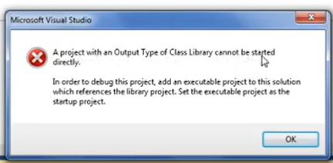
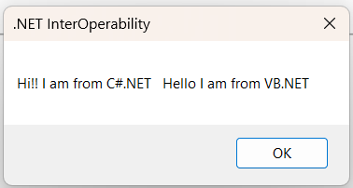
A Demo on Language Interoperability
Step 5: Right click on VB WinFormApp project and build > You will get error
Step 6: Right click on VB WinFormApp > select “set as startup project” > build and run

Slide 20
Basics of C#
C# (C-Sharp) is a simple, modern, general-purpose, object-oriented programming language developed by Microsoft within its .NET initiative led by Anders Hejlsberg.
C# is used to develop web apps, desktop apps, mobile apps, games and much more.
C# enables developers to build many types of secure and robust applications that run in .NET. C# has its roots in the C family of languages and will be immediately familiar to C, C++, Java, and JavaScript programmers.

Slide 21
Features of C#
Simple - C# is a user-friendly language that offers a structured approach to problem-solving. it provides a wide range of library functions and data types to work.
Modern Programming Language - C# programming is a popular and powerful language that is for creating scalable, interoperable, and robust applications.
Object Oriented - C# is an object-oriented programming language, which makes development and maintenance easier.
Type Safe - The code is type safe can only access memory locations that it has permission to execute. This feature significantly enhances program security.

Slide 22
Features of C#
Interoperability - The interoperability process allows C# programs to perform all the tasks that a native C++ application.
Scalable and Updateable - C# is a programming language that is scalable and can be updated automatically.
Component Oriented - It is widely used as a software development methodology to create applications that are more strong and can easily scale.
Structured Programming Language - divide programs into parts using functions, making it easy to understand and modify.
Fast Speed - The compilation and execution time of C# language is fast.

Slide 23
Hello World Program using C#
using System;
namespace HelloWorld
{
class Program
{
static void Main(string[] args)
{
Console.WriteLine("Hello World!");
}
}
}
The using System line means that you are using the System library in your project. Which gives you some useful classes like Console or functions/methods like WriteLine .
The namespace HelloWorld is something that identifies and encapsulates your code within that namespace. It's like packages in Java.

Slide 24
C# Classes and Objects
Everything in C# is associated with classes and objects, along with its attributes and methods. For example: in real life, a car is an object. The car has attributes, such as weight and color, and methods, such as drive and brake.
A class is a data structure that may contain data members (constants and fields), function members (methods, properties, events, indexers, operators, instance constructors, finalizers, and static constructors), and nested types.
A Class is like an object constructor, or a "blueprint" for creating objects.
In C#, classes support polymorphism, inheritance and also provide the concept of derived classes and base classes.
A class can be public or internal etc. By default modifier of the class is internal.
To create a class, use the class keyword:
class Car {
string color = "red";
}

Slide 25
C# Classes and Objects
Objects are also known as instances and are created at runtime.
Object is a basic unit of Object-Oriented Programming and represents real-life entities. A typical C# program creates many objects, which as you know, interact by invoking methods. An object consists of :
State: It is represented by attributes of an object. It also reflects the properties of an object.
Behavior: It is represented by the methods of an object. It also reflects the response of an object with other objects.
Identity: It gives a unique name to an object and enables one object to interact with other objects.

Slide 26
C# Classes and Objects
class Car {
string color = "red";
static void Main(string[] args) {
Car myObj = new Car();
Console.WriteLine(myObj.color);
}
}

Slide 27
C# Methods
A method is a block of code which only runs when it is called.
You can pass data, known as parameters, into a method.
Methods are used to perform certain actions, and they are also known as functions.
Why use methods? To reuse code: define the code once, and use it many times.
class Program {
static void MyMethod() {
// code to be executed
}
}

Slide 28
C# Methods Parameters and Arguments
static void MyMethod(string fname) { Console.WriteLine(fname + " Welcome to MU");
}
static void Main(string[] args) { MyMethod("Ram");
MyMethod("Sofi");
MyMethod("Aarav");
}
When a parameter is passed to the method, it is called an argument. So, from the example above: fname is a parameter, while Ram, Sofi and Aarav are arguments.

Slide 29
Access Modifiers
Access modifiers are accessibility levels of types and type members and set rules how a type and its members can be used within the type, current assembly, and other assemblies.
Access Modifier | Scope
public | The code is accessible for all classes.
private | The code is only accessible within the same class.
protected | The code is accessible within the same class, or in a class that is inherited from that class.
internal | The code is only accessible within its own assembly, but not from another assembly.
protected internal | The type or member can be accessed by any code in the assembly in which it is declared, or from within a derived class in another assembly.
private protected | The type of member can be accessed within the same class or the classes derived within the same assembly.

Slide 30
What is Assembly?
In C#, an assembly is a collection of resources and types that work together to form a functional unit. It can refer to a dynamic link library (DLL) or an executable file (.exe).

Slide 31
Public Access Modifier
using System;
namespace MyApplication
{
class Student
{
public string name = "MU";
public void print()
{
Console.WriteLine("Hello from Student class");
}
}
class Public
{
static void Main(string[] args)
{
Student student1 = new Student();
Console.WriteLine("Name: " + student1.name);
student1.print();
Console.ReadLine();
}
} }
Name: MU
Hello from Student class

Slide 32
Private
using System;
namespace MyApplication1
{
class Student
{
private string name = "MU";
private void print()
{
Console.WriteLine("Hello from Student class");
}
}
class Program
{
static void Main(string[] args)
{
Student student1 = new Student();
Console.WriteLine("Name: " + student1.name);
student1.print();
Console.ReadLine();
}
}
}
Error CS0122 'Student.name' is inaccessible due to its protection level
Error CS0122 'Student.print()' is inaccessible due to its protection level

Slide 33
Protected
using System;
namespace MyApplication11
{
class Student
{
protected string name = “MU";
}
// derived class
class Program : Student
{
static void Main(string[] args)
{
// creating object of derived class
Program program = new Program();
// accessing name field and printing it
Console.WriteLine("Name: " + program.name);
Console.ReadLine();
}
}
}
Name: MU

Slide 34
Internal
using System;
namespace Assembly
{
class Student
{
internal string name = "MU";
}
class Program
{
static void Main(string[] args)
{
// creating object of Student class
Student theStudent = new Student();
// accessing name field and printing it
Console.WriteLine("Name: " + theStudent.name);
Console.ReadLine();
}
}
}
Note: It will not allow access from another assembly.
Name: MU

Slide 35
Internal from another Assembly
// Code on Assembly2
using System;
// access Assembly1
using Assembly1;
namespace Assembly2 {
class Program {
static void Main(string[] args) {
StudentName student = new StudentName();
// accessing name field from Assembly1
Console.Write(student.name);
Console.ReadLine();
}
}
}
// Code on Assembly1
using System;
namespace Assembly1 {
public class StudentName {
internal string name = “MU";
}
class Program {
static void Main(string[] args) {
}
}
}
Error CS0122 'StudentName.name' is inaccessible due to its protection level

Slide 36
Protected Internal
// Code on Assembly1
using System;
namespace Assembly1
{
public class Greet
{
protected internal string msg = "Hello";
}
class Program
{
static void Main(string[] args)
{
Greet greet = new Greet();
Console.WriteLine(greet.msg);
Console.ReadLine();
}
}
}
// Code on Assembly2
using System;
// access Assembly1
using Assembly1;
namespace Assembly2
{
// derived class of Greet
class Program : Greet
{
static void Main(string[] args)
{
Program greet = new Program();
Console.Write(greet.msg);
Console.ReadLine();
}
}
}
Output:
Hello
Output:
Hello

Slide 37
Private Protected
using System;
namespace Assembly1
{
public class StudentName
{
private protected string name = "MU";
}
class Program1 : StudentName
{
static void Main(string[] args)
{
Program1 student = new Program1();
// accessing name field from base class
Console.Write(student.name);
Console.ReadLine();
}
}
}
Output:
MU

Slide 38
Access Modifiers Summary
Caller's location | public | protected internal | protected | internal | private protected | private
Within the class | ✔️ | ✔️ | ✔️ | ✔️ | ✔️ | ✔️
Derived class (same assembly) | ✔️ | ✔️ | ✔️ | ✔️ | ✔️ | ❌
Non-derived class (same assembly) | ✔️ | ✔️ | ❌ | ✔️ | ❌ | ❌
Derived class (different assembly) | ✔️ | ✔️ | ✔️ | ❌ | ❌ | ❌
Non-derived class (different assembly) | ✔️ | ❌ | ❌ | ❌ | ❌ | ❌

Slide 39
C# Constructors
In C#, a constructor is similar to a method that is invoked when an object of the class is created.
However, unlike methods, a constructor:
has the same name as that of the class
does not have any return type
class Car
{
// constructor
Car()
{
//code
}
}
Car car1 = new Car();

Slide 40
C# Constructors
Types of Constructors
Parameterless Constructor
When we create a constructor without parameters, it is known as a parameterless constructor.
Parameterized Constructor
In C#, a constructor can also accept parameters. It is called a parameterized constructor
Default Constructor
If we have not defined a constructor in our class, then the C# will automatically create a default constructor with an empty code and no parameters

Slide 41
Parameterless Constructor
using System;
namespace Constructor
{
class Car
{
// parameterless constructor
Car()
{
Console.WriteLine("Parameterless Constructor");
}
static void Main(string[] args)
{
// call constructor
new Car();
Console.ReadLine();
}
}
}
Output: Parameterless Constructor

Slide 42
Parameterized Constructor
namespace Constructor
{
class Car
{
string brand;
int price;
// parameterized constructor
Car(string theBrand, int thePrice)
{
brand = theBrand;
price = thePrice;
}
static void Main(string[] args)
{
// call parameterized constructor
Car car1 = new Car("MU", 50000);
Console.WriteLine("Brand: " + car1.brand);
Console.WriteLine("Price: " + car1.price);
Console.ReadLine();
}
}
}
Brand: MU
Price: 50000

Slide 43
Default Constructor
namespace Constructor
{
class Program
{
int a;
static void Main(string[] args)
{
// call default constructor
Program p1 = new Program();
Console.WriteLine("Default value of a: " + p1.a);
Console.ReadLine();
}
}
}
Default value of a: 0

Slide 44
Copy Constructor
A copy constructor is used to create an object by copying data from another object
namespace Constructor
{
class Car
{
string brand;
Car(string theBrand)
{
brand = theBrand;
}
// copy constructor
Car(Car c1)
{
brand = c1.brand;
}
static void Main(string[] args)
{
// call constructor
Car car1 = new Car("BMW");
Console.WriteLine("Brand of car1: " + car1.brand);
// call the copy constructor
Car car2 = new Car(car1);
Console.WriteLine("Brand of car2: " + car2.brand);
Console.ReadLine();
} } }
Brand of car1: BMW
Brand of car2: BMW

Slide 45
Private Constructor
A private constructor can be created using the private access specifier. This is known as a private constructor in C#.
Once the constructor is declared private, we cannot create objects of the class in other classes.

Slide 46
Static Constructor
The static constructor is called only once during the execution of the program.
We can have only one static constructor in a class.
It cannot have any parameters or access modifiers.
namespace Constructor
{
class Car
{ // static constructor
static Car()
{
Console.WriteLine("Static Constructor");
}
// parameterless constructor
Car()
{
Console.WriteLine("Default Constructor");
}
static void Main(string[] args)
{
// call parameterless constructor
Car car1 = new Car();
// call parameterless constructor again
Car car2 = new Car();
Console.ReadLine(); } } }
Static Constructor
Default Constructor
Default Constructor

Slide 47
Abstract Class
Data abstraction is the process of hiding certain details and showing only essential information to the user.
Abstraction can be achieved with either abstract classes or interfaces
The abstract keyword is used for classes and methods:
Abstract class: is a restricted class that cannot be used to create objects (to access it, it must be inherited from another class).
Abstract method: can only be used in an abstract class, and it does not have a body. The body is provided by the derived class (Inherited from).
An abstract class can have both abstract and regular methods:
abstract class Animal
{
public abstract void animalSound();
public void sleep()
{
Console.WriteLine("Zzz");
}
}

Slide 48
Abstract Class
From the example above, it is not possible to create an object of the Animal class:
Animal myObj = new Animal(); // Will generate an error (Cannot create an instance of the abstract class or interface 'Animal')

Slide 49
Abstract Class
// Abstract class
abstract class Animal
{
// Abstract method (does not have a body)
public abstract void animalSound();
// Regular method
public void sleep()
{
Console.WriteLine("Zzz");
}
}
// Derived class (inherit from Animal)
class Pig : Animal
{
public override void animalSound()
{
// The body of animalSound() is provided here
Console.WriteLine("The pig says: wee wee");
}
}
class Program
{
static void Main(string[] args)
{
Pig myPig = new Pig(); // Create a Pig object
myPig.animalSound(); // Call the abstract method
myPig.sleep(); // Call the regular method
}
}

Slide 50
inheritance
Inheritance is a fundamental concept in object-oriented programming that allows us to define a new class based on an existing class.
The new class inherits the properties and methods of the existing class and can also add new properties and methods of its own.
Inheritance promotes code reuse, simplifies code maintenance, and improves code organization.
In C#, there are 4 types of inheritance:
Single inheritance: A derived class that inherits from only one base class.
Multi-level inheritance: A derived class that inherits from a base class and the derived class itself becomes the base class for another derived class.
Hierarchical inheritance: A base class that serves as a parent class for two or more derived classes.
Multiple inheritance: A derived class that inherits from two or more base classes.

Slide 51
inheritance
using System;
// single inheritance
class Animal
{
public void Eat()
{
Console.WriteLine("Animal is eating.");
}
}
class Dog : Animal
{
public void Bark()
{
Console.WriteLine("Dog is barking.");
}
}

Slide 52
inheritance
// multi-level inheritance
class Mammal : Animal
{
public void Run()
{
Console.WriteLine("Mammal is running.");
}
}
class Horse : Mammal
{
public void Gallop()
{
Console.WriteLine("Horse is galloping.");
}
}

Slide 53
inheritance
// hierarchical inheritance
class Bird : Animal
{
public void Fly()
{
Console.WriteLine("Bird is flying.");
}
}
class Eagle : Bird
{
public void Hunt()
{
Console.WriteLine("Eagle is hunting.");
}
}
class Penguin : Bird
{
public void Swim()
{
Console.WriteLine("Penguin is swimming.");
}
}

Slide 54
inheritance
// main program
class Program
{
static void Main(string[] args)
{
// single inheritance
Dog dog = new Dog();
dog.Eat();
dog.Bark();
// multi-level inheritance
Horse horse = new Horse();
horse.Eat();
horse.Run();
horse.Gallop();
// hierarchical inheritance
Eagle eagle = new Eagle();
Penguin penguin = new Penguin();
eagle.Fly();
eagle.Hunt();
penguin.Fly();
penguin.Swim();
Console.ReadLine();
}
}

Slide 55
Interface
An interface is a completely "abstract class", which can only contain abstract methods and properties (with empty bodies):
// interface
interface Animal
{
void animalSound(); // interface method (does not have a body)
void run(); // interface method (does not have a body)
}

Slide 56
Interface
// Interface
interface IAnimal
{
void animalSound(); // interface method (does not have a body)
}
// Pig "implements" the IAnimal interface
class Pig : IAnimal
{
public void animalSound()
{
// The body of animalSound() is provided here
Console.WriteLine("The pig says: wee wee");
}
}
class Program
{
static void Main(string[] args)
{
Pig myPig = new Pig(); // Create a Pig object
myPig.animalSound();
}
}

Slide 57
Polymorphism
The term "Polymorphism" is the combination of "poly" + "morphs" which means many forms.
There are two types of polymorphism in C#:
compile time polymorphism
runtime polymorphism.
Compile time polymorphism is achieved by method overloading and operator overloading in C#. It is also known as static binding or early binding.
Runtime polymorphism in achieved by method overriding which is also known as dynamic binding or late binding.

Slide 58
Polymorphism (Runtime)
using System;
public class Animal
{
public virtual void eat()
{
Console.WriteLine("eating...");
}
}
public class Dog : Animal
{
public override void eat()
{
Console.WriteLine("eating bread...");
}
}
public class TestPolymorphism
{
public static void Main()
{
Animal a = new Dog();
a.eat();
}
}
eating bread...

Slide 59
Polymorphism (Runtime)
using System;
public class Shape
{
public virtual void draw()
{
Console.WriteLine("drawing...");
}
}
public class Rectangle : Shape
{
public override void draw()
{
Console.WriteLine("drawing rectangle...");
}
}
public class Circle : Shape
{
public override void draw()
{
Console.WriteLine("drawing circle...");
}
}
public class TestPolymorphism
{
public static void Main()
{
Shape s;
s = new Shape();
s.draw();
s = new Rectangle();
s.draw();
s = new Circle();
s.draw();
} }
drawing...
drawing rectangle...
drawing circle...

Slide 60
Exception Handling
An exception is defined as an event that occurs during the execution of a program that is unexpected by the program code.
The actions to be performed in case of occurrence of an exception is not known to the program.
In such a case, we create an exception object and call the exception handler code.
The execution of an exception handler so that the program code does not crash is called exception handling.
Keyword | Definition
try | Used to define a try block. This block holds the code that may throw an exception.
catch | Used to define a catch block. This block catches the exception thrown by the try block.
finally | Used to define the finally block. This block holds the default code.
throw | Used to throw an exception manually.

Slide 61
Exception Handling
// C# program to show how
// Exceptions occur in a program
using System;
class MU
{
static void Main(string[] args)
{
// Declare an array of max index 4
int[] arr = { 1, 2, 3, 4, 5 };
// Display values of array elements
for (int i = 0; i < arr.Length; i++)
{
Console.WriteLine(arr[i]);
}
// Try to access invalid index of array
Console.WriteLine(arr[7]);
// An exception is thrown upon executing
// the above line
}
}

Slide 62
Exception Handling
// Exception handling of above code
// using try catch blocks
using System;
class Program : System.Exception
{
static void Main(string[] args)
{
// Declare an array of max index 4
int[] arr = { 1, 2, 3, 4, 5 };
// Display values of array elements
for (int i = 0; i < arr.Length; i++)
{
Console.WriteLine(arr[i]);
}
try
{
// Try to access invalid index of array
Console.WriteLine(arr[7]);
// An exception is thrown upon executing
// the above line
}
catch (IndexOutOfRangeException e)
{
// The Message property of the object
// of type IndexOutOfRangeException
// is used to display the type of exception
// that has occurred to the user.
Console.WriteLine("An Exception has occurred : {0}", e.Message);
} } }

Slide 63
Exception Handling
// C# Program to show use of multiple try catch blocks
using System;
class Program
{
static void Main(string[] args)
{
int[] arr = { 19, 0, 75, 52 };
try
{
// Try to generate an exception
for (int i = 0; i < arr.Length; i++)
{
Console.WriteLine(arr[i] / arr[i + 1]);
} }
// Catch block for invalid array access
catch (IndexOutOfRangeException e)
{
Console.WriteLine("An Exception has occurred : {0}", e.Message); }
// Catch block for attempt to divide by zero
catch (DivideByZeroException e)
{
Console.WriteLine("An Exception has occurred : {0}", e.Message); }
// Catch block for value being out of range
catch (ArgumentOutOfRangeException e)
{
Console.WriteLine("An Exception has occurred : {0}", e.Message); }
// Finally block Will execute irrespective of the above catch blocks
finally
{
for (int i = 0; i < arr.Length; i++)
{
Console.Write(" {0}", arr[i]);
}
} } }

