Slide 1

.NET Technologies (01CE0523) 5th Semester 4 Credits

Slide 2
Objectives
Net Technologies are blend of technologies supported by Microsoft .Net Framework that allows user to create various applications.
Students will be able to work with various technologies provided by Microsoft .NET platform.

Slide 3
Course Outcomes
To Review the components of .Net Framework
To practice Web based application
To create web applications using MVC framework
To practice basic database application using ADO.net
To designing, developing, and deploying APIs

Slide 4
Unit 2 ASP.NET Web Application

Slide 5
Contents
ASP.Net Web Application
Page life cycle of ASP.NET Application
Web Controls (Button, TextBox, CheckBox, Image etc.)
Rich Controls (Calendar, AdRotator)
Validation Controls
State management
Cookie
Session

Slide 6
ASP.NET
ASP stands for Active Server Pages.
ASP is a development framework for building dynamic web pages.
ASP and ASP.NET are server side technologies.
Both technologies enable computer code to be executed by an Internet server.
When a browser requests an ASP or ASP.NET file, the ASP engine reads the file, executes any code in the file, and returns the result to the browser.
ASP.NET was released in 2002 as a successor to Classic ASP.
ASP.NET pages have the extension .aspx and are normally written in C# aka (C sharp).
Latest version 4.8
Notes:
Aka – As known as

Slide 7
ASP.NET
ASP.NET Web Pages is an SPA application model (Single Page Application).
A Single-Page Application is an app that doesn't need to reload the page during its use and works within a browser.
Think of the apps you use daily: Facebook, Google Maps, GitHub etc.
The SPA model is quite similar to PHP and Classic ASP.

Slide 8
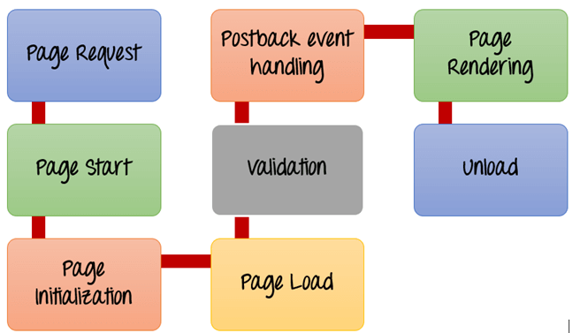
ASP.Net Page Lifecycle
When an ASP.Net page is called, it goes through a particular lifecycle. This is done before the response is sent to the user.

Slide 9
ASP.Net Page Lifecycle
Page Request– This is when the page is first requested from the server. When the page is requested, the server checks if it is requested for the first time. If so, then it needs to compile the page, parse the response and send it across to the user. If it is not the first time the page is requested, the cache is checked to see if the page output exists. If so, that response is sent to the user.
Page Start – During this time, 2 objects, known as the Request and Response object are created. The Request object is used to hold all the information which was sent when the page was requested. The Response object is used to hold the information which is sent back to the user.
Page Initialization – During this time, all the controls on a web page is initialized. So if you have any label, textbox or any other controls on the web form, they are all initialized.
Page Load – This is when the page is actually loaded with all the default values. So if a textbox is supposed to have a default value, that value is loaded during the page load time.

Slide 10
ASP.Net Page Lifecycle
Validation – Sometimes there can be some validation set on the form. For example, there can be a validation which says that a list box should have a certain set of values. If the condition is false, then there should be an error in loading the page.
Postback event handling – This event is triggered if the same page is being loaded again. This happens in response to an earlier event. Sometimes there can be a situation that a user clicks on a submit button on the page. In this case, the same page is displayed again. In such a case, the Postback event handler is called.
Page Rendering – This happens just before all the response information is sent to the user. All the information on the form is saved, and the result is sent to the user as a complete web page (mirror).
Unload – Once the page output is sent to the user, there is no need to keep the ASP.net web form objects in memory. So the unloading process involves removing all unwanted objects from memory.

Slide 11
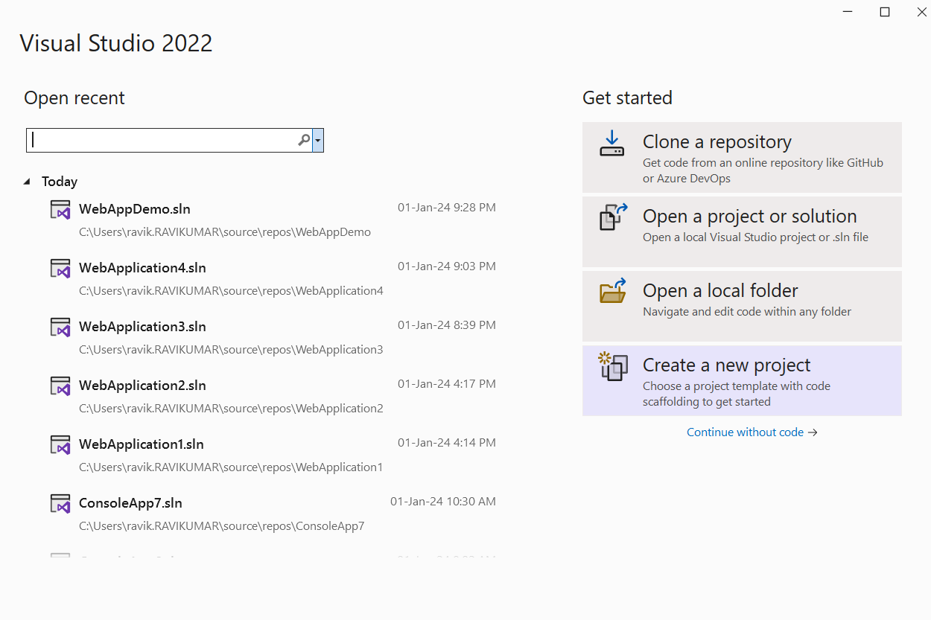
First Web Application

Slide 12
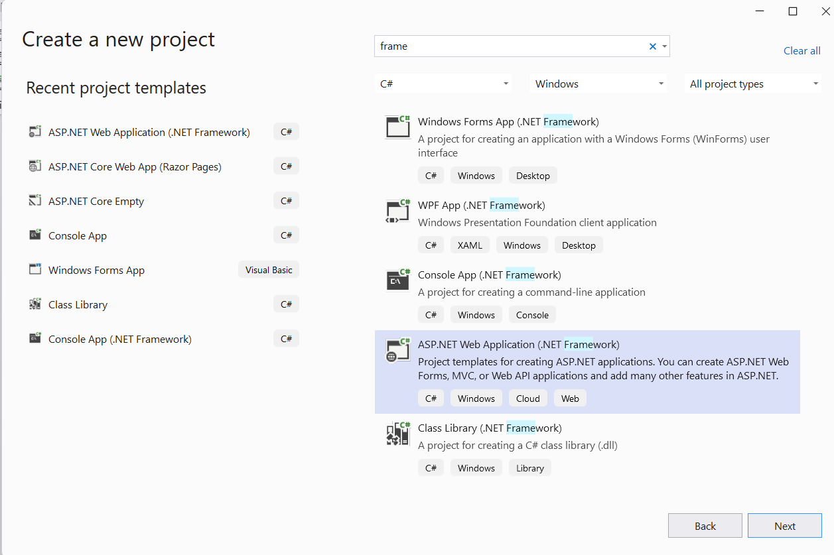
First Web Application

Slide 13
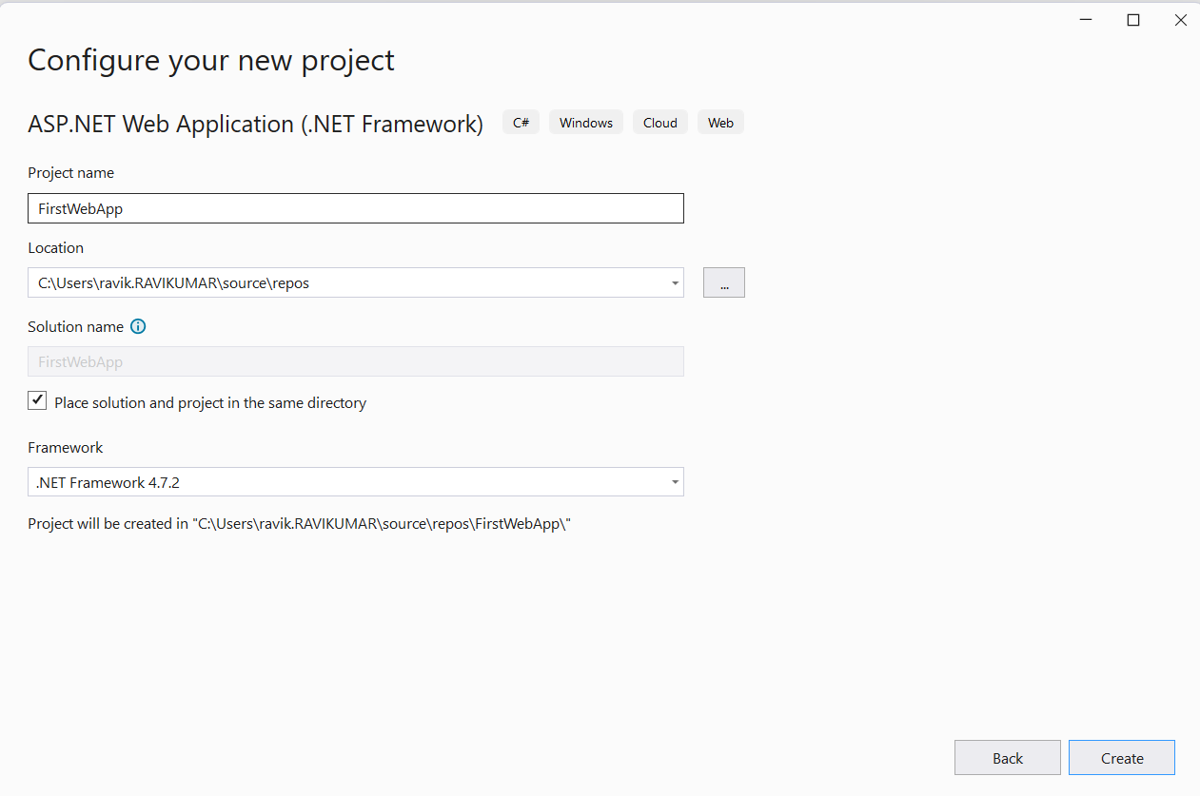
First Web Application

Slide 14
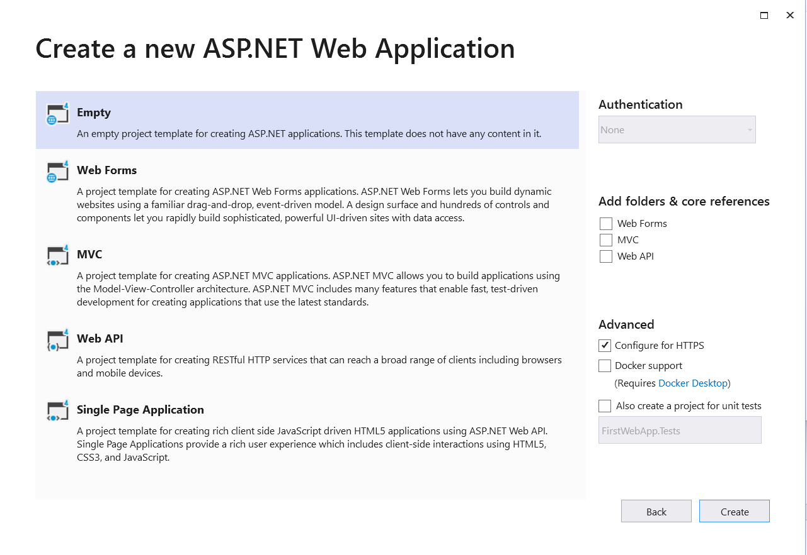
First Web Application

Slide 15
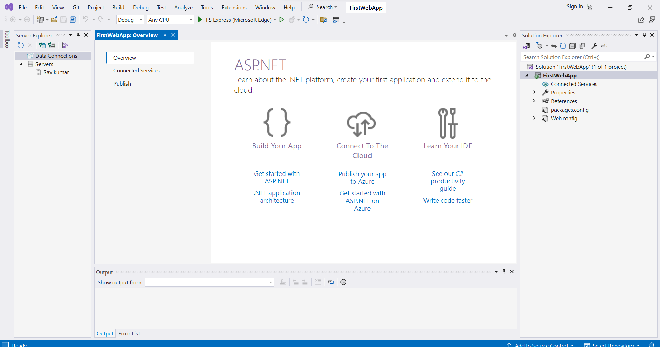
First Web Application

Slide 16
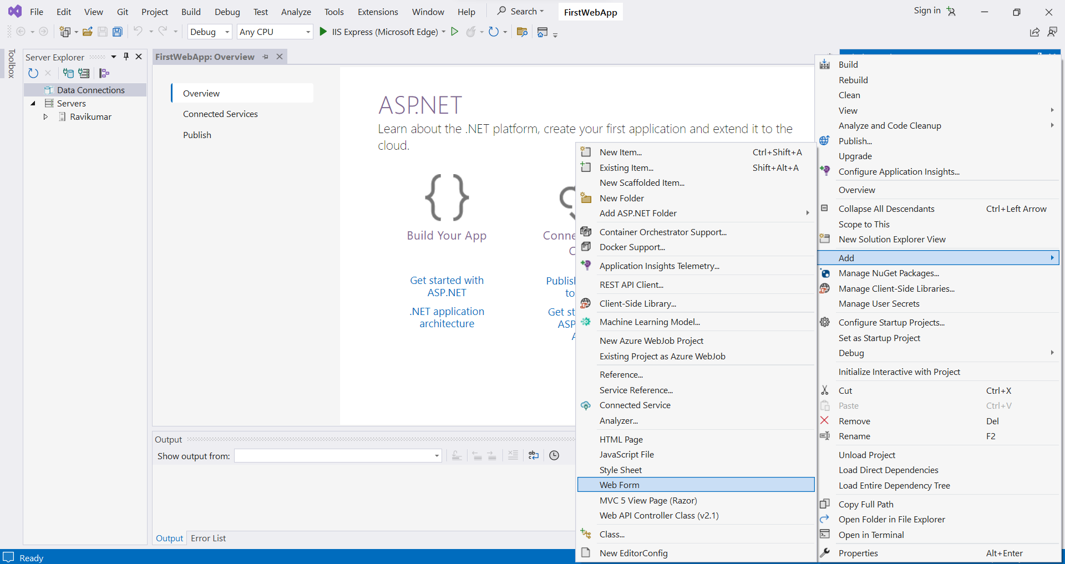
First Web Application

Slide 17
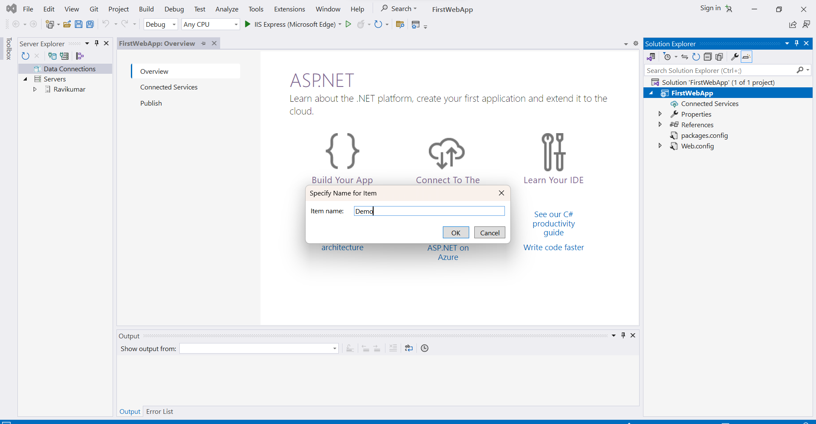
First Web Application

Slide 18
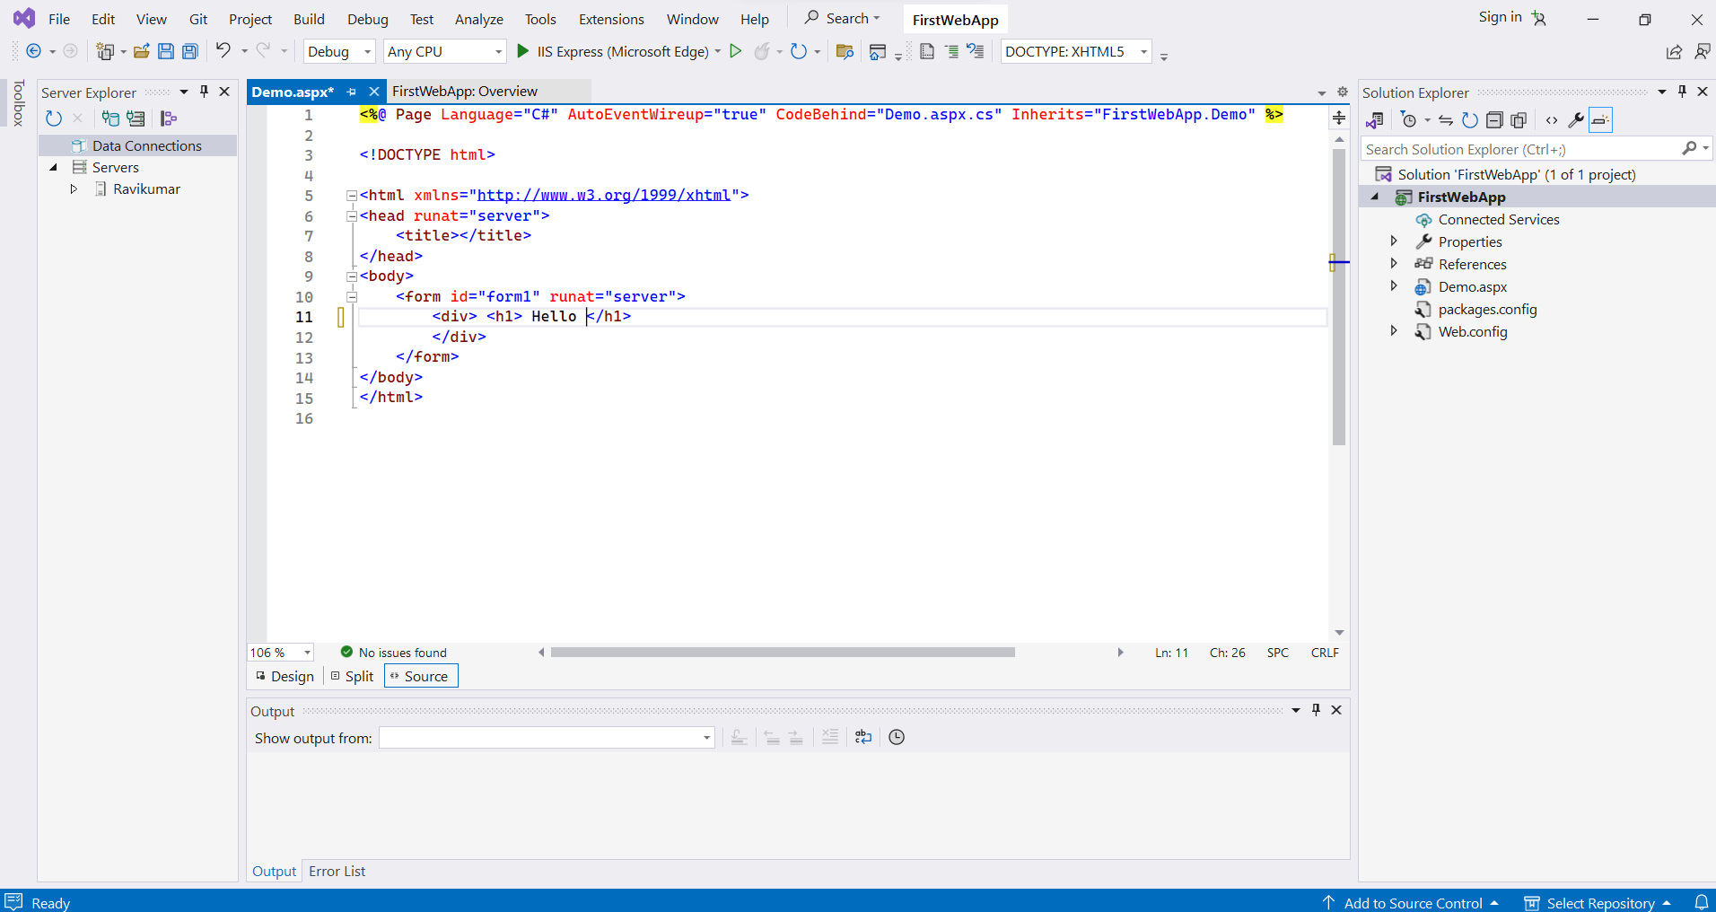
First Web Application

Slide 19
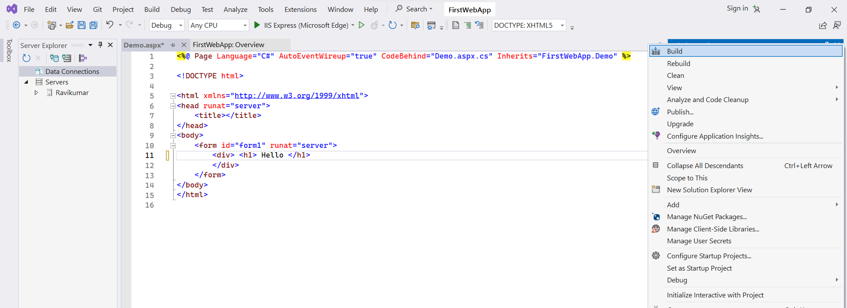
First Web Application

Slide 20
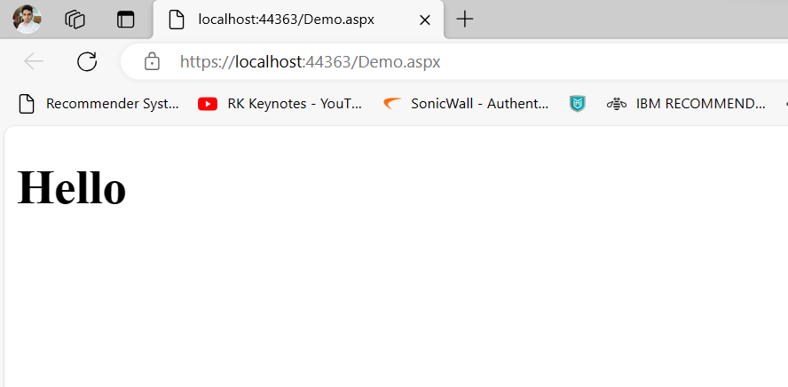
First Web Application
Set as start page
Build and Run

Slide 21
What is IIS?
Internet Information Services (IIS) is a flexible, general-purpose web server from Microsoft that runs on Windows systems to serve requested HTML pages or files. Latest version 10.0 released in 2018.
An IIS web server accepts requests from remote client computers and returns the appropriate response.
It enables web servers to deliver, transfer information across an array of Local Area Networks (LANs) including corporate intranets.
It has the ability to share information with the user in numerous forms such as text documents, HTML webpages, and images.
Notes:
IIS 10 includes support for HTTP/2 and Windows PowerShell 5.0.

Slide 22
Web Controls
Server Controls
Label
TextBox
Button
LinkButton
ImageButton
Hyperlink
DropDownList
ListBox
DataGrid
DataList
CheckBox
CheckBoxList
RadioButton
RadioButtonList
Image
Panel
PlaceHolder
Calendar
AdRotator
Table
XML
Literal

Slide 23
Label
This control is used to display textual information on the web forms. It is mainly used to create caption for the other controls like: textbox.
To create label either we can write code or use the drag and drop facility of visual studio.
<asp:Label ID="Label1" runat="server"
Text="Label" > </asp:Label>

Slide 24
TextBox
This is an input control which is used to take user input.
<asp:TextBox ID="TextBox1" runat="server"> </asp:TextBox>

Slide 25
Label, TextBox and Button
<body>
<form id="form1" runat="server">
<div>
<asp:Label ID="labelId" runat="server">User Name</asp:Label>
<asp:TextBox ID="UserName" runat="server" ToolTip="Enter User Name"></asp:TextBox>
</div>
<p>
<asp:Button ID="SubmitButton" runat="server" Text="Submit" OnClick="SubmitButton_Click" />
</p>
<br />
</form>
<asp:Label ID="userInput" runat="server"></asp:Label>
</body>

Slide 26
Code Behind C#
using System;
using System.Collections.Generic;
using System.Linq;
using System.Web;
using System.Web.UI;
using System.Web.UI.WebControls;
namespace WebApplication6
{
public partial class WebForm1 : System.Web.UI.Page
{
protected void Page_Load(object sender, EventArgs e)
{
}
protected void SubmitButton_Click(object sender, EventArgs e)
{
userInput.Text = UserName.Text;
}
}
}

Slide 27
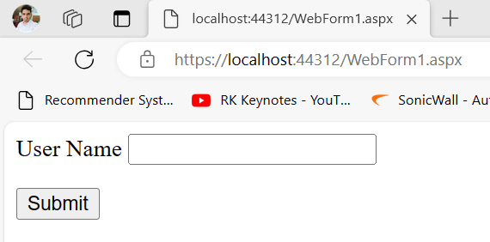
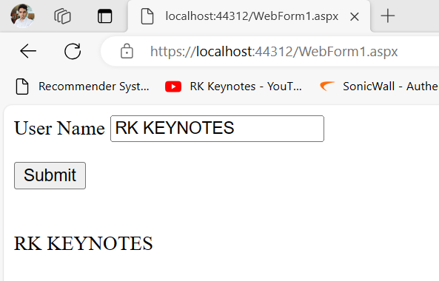
Output

Slide 28
DataGrid
DataGrid is used to display data in scrollable grid. It requires data source to populate data in the grid.
It is a server side control and can be dragged from the toolbox to the web form.
<body>
<form id="form1" runat="server">
<div>
<asp:GridView ID="GridView1" runat="server"></asp:GridView>
</div>
</form>
</body>

Slide 29
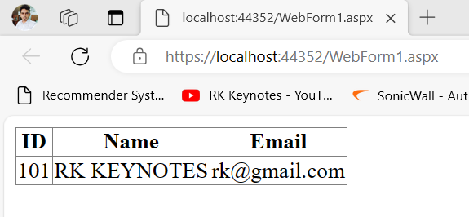
DataGrid
protected void Page_Load(object sender, EventArgs e)
{
DataTable table = new DataTable();
table.Columns.Add("ID");
table.Columns.Add("Name");
table.Columns.Add("Email");
table.Rows.Add("101", "RK KEYNOTES", "rk@gmail.com");
GridView1.DataSource = table;
GridView1.DataBind();
}
Notes:
The IsPostBack property in ASP.NET is a Boolean property that determines if a page is being loaded in response to a postback or for the first time.

Slide 30
GridView with Pagination
protected void Page_Load(object sender, EventArgs e){
if (!IsPostBack)
LoadGridData();
}
private void LoadGridData() {
DataTable table = new DataTable();
table.Columns.Add("ID");
table.Columns.Add("Name");
table.Columns.Add("Email");
table.Rows.Add("101", "RK KEYNOTES", "rk@gmail.com"); //add 10 records
GridView1.DataSource = table;
GridView1.DataBind();
}
protected void GridView1_PageIndexChanging(object sender, GridViewPageEventArgs e) {
GridView1.PageIndex = e.NewPageIndex;
LoadGridData();
}

Slide 31
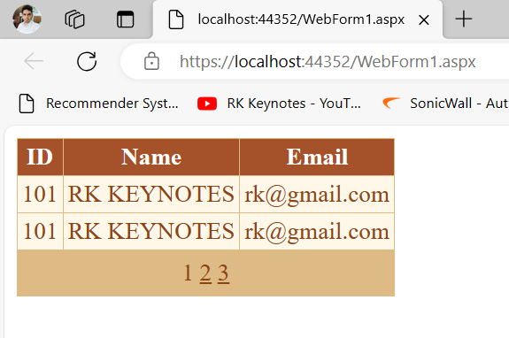
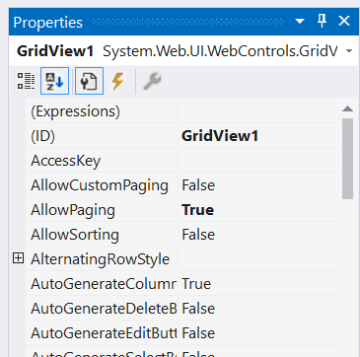
GridView with Pagination

Slide 32
Calendar
It is used to display selectable date in a calendar. It also shows data associated with specific date. This control displays a calendar through which users can move to any day in any year.
We can also set Selected Date property that shows specified date in the calendar.
<asp:Calendar ID="Calendar1" runat="server" OnSelectionChanged="Calendar1_SelectionChanged"></asp:Calendar>

Slide 33
Calendar
<body>
<form id="form1" runat="server">
<h2>Select Date from the Calender</h2>
<div>
<asp:Calendar ID="Calendar1" runat="server"
OnSelectionChanged="Calendar1_SelectionChanged"> </asp:Calendar>
</div>
</form>
<p>
<asp:Label runat="server" ID="ShowDate" ></asp:Label>
</p>
</body>

Slide 34
Calendar
using System;
using System.Collections.Generic;
using System.Linq;
using System.Web;
using System.Web.UI;
using System.Web.UI.WebControls;
namespace WebFormsControlls
{
public partial class WebControls : System.Web.UI.Page
{
public void Calendar1_SelectionChanged(object sender, EventArgs e)
{
ShowDate.Text = "You Selected: "+Calendar1.SelectedDate.ToString();
}
}
}

Slide 35
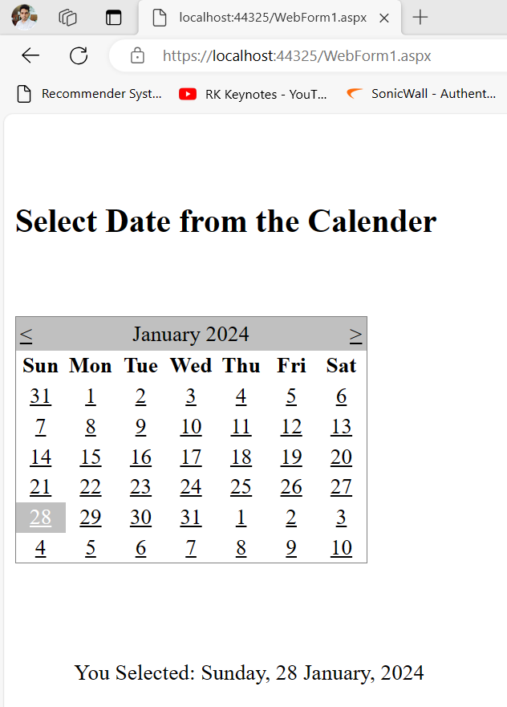
Calendar

Slide 36
File Upload
It is an input controller which is used to upload file to the server. It creates a browse button on the form that pop up a window to select the file from the local machine.
<input name="FileUpload1" id="FileUpload1" type="file">

Slide 37
File Upload
<body>
<form id="form1" runat="server">
<div>
<p>Browse to Upload File</p>
<asp:FileUpload ID="FileUpload1" runat="server" />
</div>
<p>
<asp:Button ID="Button1" runat="server" Text="Upload File"
OnClick="Button1_Click" />
</p>
</form>
<p>
<asp:Label runat="server" ID="FileUploadStatus"></asp:Label>
</p>
</body>

Slide 38
File Upload
using System;
using System.Collections.Generic;
using System.Linq;
using System.Web;
using System.Web.UI;
using System.Web.UI.WebControls;
namespace WebFormsControlls {
public partial class WebControls : System.Web.UI.Page {
protected System.Web.UI.HtmlControls.HtmlInputFile File1;
protected System.Web.UI.HtmlControls.HtmlInputButton Submit1;
protected void Page_Load(object sender, EventArgs e) { }
protected void Button1_Click(object sender, EventArgs e)
{
if ((FileUpload1.PostedFile != null) && (FileUpload1.PostedFile.ContentLength > 0)) {
string fn = System.IO.Path.GetFileName(FileUpload1.PostedFile.FileName);
string SaveLocation = Server.MapPath("upload") + "\\" + fn;
try
{
FileUpload1.PostedFile.SaveAs(SaveLocation);
FileUploadStatus.Text = "The file has been uploaded.";
}
catch (Exception ex)
{ FileUploadStatus.Text = "Error: " + ex.Message; } }
else { FileUploadStatus.Text = "Please select a file to upload."; } } } }

Slide 39
Demo

Slide 40
Download File
ASP.NET provides implicit object Response and its methods to download file from the server. We can use these methods in our application to add a feature of downloading file from the server to the local machine.
<body>
<form id="form1" runat="server">
<div><p>Click the button to download a file</p>
<asp:Button ID="Button1" runat="server" Text="Download" OnClick="Button_click" />
<asp:Label ID="Label1" runat="server" Text="Label"></asp:Label>
</div>
</form>
</body>

Slide 41
Download File
protected void Button_click(object sender, EventArgs e)
{
string filePath = "C:\\Users\\ravik.RAVIKUMAR\\OneDrive\\Desktop\\OpenAI API.txt";
FileInfo file = new FileInfo(filePath);
if (file.Exists)
{
Response.Clear();
Response.AddHeader("Content-Disposition", "attachment; filename=" + file.Name);
Response.AddHeader("Content-Length", file.Length.ToString());
Response.ContentType = "text/plain";
Response.Flush();
Response.TransmitFile(file.FullName);
Response.End();
}
else Label1.Text = "Requested file is not available to download";
}
Notes:
The Content-Disposition header tells the browser how to handle the response body.

Slide 42
Demo

Slide 43
Image and ImageButton
The image button is used to display a clickable image,and a control that displays an image and responds to mouse clicks on the image.
<asp:ImageButton ID="ImageButton1"
runat="server"
Height="268px"
ImageUrl="~/WhatsApp Image 2024-01-06 at 8.53.06 PM (1).jpeg"
PostBackUrl="~/WebForm2.aspx"
Width="357px" />

Slide 44
Image and ImageButton
<asp:Image ID="Image1" runat="server" Height="162px" ImageUrl="~/WhatsApp Image 2024-01-06 at 8.53.06 PM (1).jpeg" Width="226px" />
DEMO

Slide 45
RadioButton
It is an input control which is used to takes input from the user. It allows user to select a choice from the group of choices.
<asp:RadioButton ID="RadioButton1" runat="server" Text="Male" />

Slide 46
RadioButton
<form id="form1" runat="server">
<div>
<asp:RadioButton ID="RadioButton1" runat="server" Text="Male" GroupName="gender" />
<asp:RadioButton ID="RadioButton2" runat="server" Text="Female" GroupName="gender" />
</div>
<asp:Button ID="Button1" runat="server" Text="Button" OnClick="Button1_Click" />
<asp:Label ID="Label1" runat="server" Text="Label"></asp:Label>
</form>

Slide 47
RadioButton
protected void Button1_Click(object sender, EventArgs e)
{
Label1.Text = "";
if (RadioButton1.Checked)
{
Label1.Text = "Your gender is " + RadioButton1.Text;
}
else
Label1.Text = "Your gender is " + RadioButton2.Text;
}

Slide 48
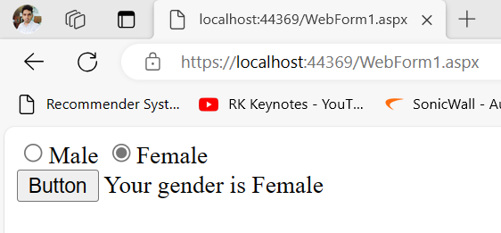
RadioButton

Slide 49
CheckBox
It is used to get multiple inputs from the user. It allows user to select choices from the set of choices.
It takes user input in yes or no format. It is useful when we want multiple choices from the user.
< asp:CheckBox ID="CheckBox2" runat="server" Text="J2EE"/>

Slide 50
CheckBox
<form id="form1" runat="server">
<div>
<asp:CheckBox ID="CheckBox1" runat="server" Text="Python"/>
<asp:CheckBox ID="CheckBox2" runat="server" Text="Java"/>
<asp:CheckBox ID="CheckBox3" runat="server" Text=".NET"/>
</div>
<asp:Button ID="Button1" runat="server" Text="Button" OnClick="Button1_Click" />
You Selected: <asp:Label ID="Label1" runat="server" Text="Label"></asp:Label>
</form>

Slide 51
CheckBox
protected void Page_Load(object sender, EventArgs e)
{ Label1.Text = "";
}
protected void Button1_Click(object sender, EventArgs e) {
var message = "";
if (CheckBox1.Checked)
{ message = CheckBox1.Text + " ";
}
if (CheckBox2.Checked)
{ message += CheckBox2.Text + " ";
}
if (CheckBox3.Checked)
{ message += CheckBox3.Text;
}
Label1.Text = message;
} }
Notes:
The var keyword in C# is used to declare implicit type variables. This means that the compiler will determine the variable type at compilation time.

Slide 52
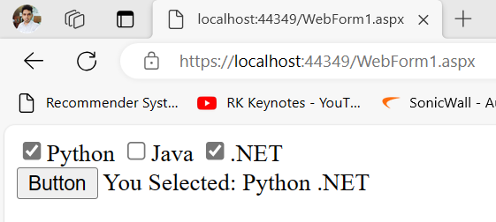
CheckBox

Slide 53
AdRotator
The AdRotator is one of the rich web server control of asp.net. AdRotator control is used to display a sequence of advertisement images as per given priority of image.
AdRotator control displays the sequence of images, which is specified in the external XML file. In a xml file we indicate the images to display with some other attributes, like image impressions, NavigateUrl, ImageUrl, AlternateText.
In a Adrotator control images will be changed each time while refreshing the web page.
<asp:AdRotator ID=“AdRotator1“ runat=“server“ />

Slide 54
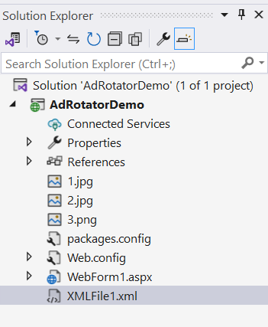
AdRotator
<form id="form1" runat="server">
<div>
<asp:AdRotator ID="AdRotator1" runat="server" AdvertisementFile="~/XMLFile1.xml" />
</div>
</form>

Slide 55
AdRotator
<?xml version="1.0" encoding="utf-8" ?>
<Advertisements>
<Ad>
<ImageUrl>1.jpg</ImageUrl>
<NavigateUrl>https://rkkeynotes.blogspot.com</NavigateUrl>
<AlternateText>RK</AlternateText>
<Impressions>50</Impressions>
<Keyword>RK</Keyword>
</Ad>
</Advertisements>

Slide 56
Validation Controls
Validation controls are an essential part of ASP.NET web development because they help ensure the integrity of user input.
When users enter information into web forms, there is always the potential for intentional or unintentional errors.
Validation controls provide a way to check the accuracy and validity of user input before the web application processes it.
Why validation controls are important in ASP.NET?
Preventing invalid data from being submitted.
Improving user experience
Enhancing security
Business requirements

Slide 57
Validation Controls
ASP.NET supports two types of validation controls:
Client-side validation controls
Server-side validation controls
Client-side validation is good, but we must depend on browser and scripting language support. The client-side validation is done in the user's browser using JavaScript and another scripting. You can use client-side validation libraries such as WebUIValidation.js in .NET.
Server-side validation in ASP.NET is done in the C# code-behind, where the value of the user input is read and validated on the server. This process is time-consuming but provides better security and is easier to implement in ASP.NET.

Slide 58
Validation Controls
ASP.NET provides several types of validation controls that can be used to validate user input in web forms. Some of the common validation controls are:
RequiredFieldValidation Control
CompareValidator Control
RangeValidator Control
RegularExpressionValidator Control
CustomValidator Control
ValidationSummary

Slide 59
Validation Controls
Validation Control | Description
RequiredField Validation | This control ensures that a field is not left empty or blank. It can be used for textboxes, dropdown lists, checkboxes, and other input controls.
Compare Validator | This control compares the value of one input control to another. It can validate passwords, confirm email addresses, and other scenarios where two values must match.
RangeValidator | This control checks if a value falls within a specific range. For example, it can be used to validate a user's age, income, or date of birth.
Regular Expression Validator | This control checks if a value matches a specified regular expression pattern. For example, it can validate email addresses, phone numbers, zip codes, and other input types.
Custom Validator | This control allows developers to define their validation logic. It usually depends on the business rules.
Validation Summary | This control displays a report of all validation errors that occurred on a Web page.

Slide 60
Error
<appSettings>
<add key="ValidationSettings:UnobtrusiveValidationMode" value="None" />
</appSettings>
Unobtrusive Validation means without writing a lot of validation code, you can perform simple client-side validation.

Slide 61
Demo

Slide 62
State Management
State management is a process by which you maintain the state of an object or variable throughout the lifetime of a page.
In ASP.NET, there are two types of state management: client-side state management and server-side state management.
Client-side state management refers to the technique of storing data on the client's browser in the form of either cookies or hidden fields.
Server-side state management, on the other hand, stores data on the server in the form of either application state or session state.
Application state is a global storage mechanism that is used to store data that needs to be available to all users of an ASP.NET application.
Session state, on the other hand, is a per-user storage mechanism that is used to store data that is specific to a user's session.

Slide 63
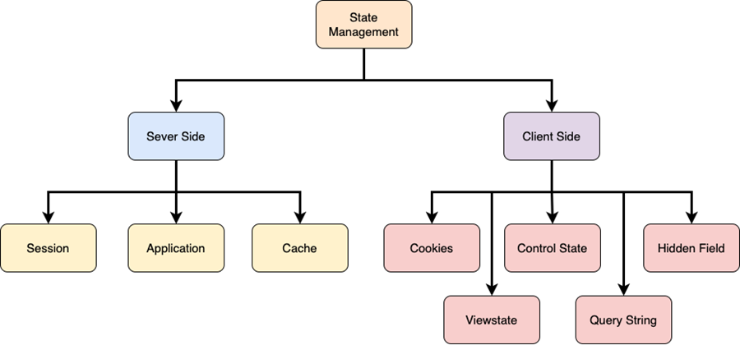
Types of State Management

Slide 64
Sessions
In ASP.NET session is a state that is used to store and retrieve values of a user.
It helps to identify requests from the same browser during a time period (session).
It is used to store value for the particular time session. By default, ASP.NET session state is enabled for all ASP.NET applications.
Each created session is stored in SessionStateItemCollection object.
We can get current session value by using Session property of Page object.

Slide 65
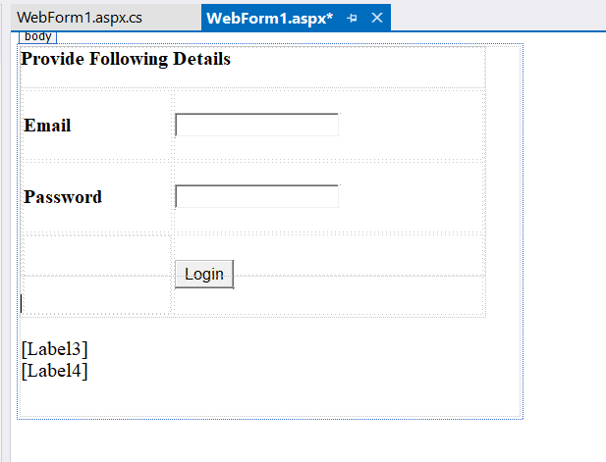
Form Design

Slide 66
Code Behind
protected void login_Click(object sender, EventArgs e) {
if (password.Text == "123"){
// Storing email to Session variable
Session["email"] = email.Text; }
else {
Label3.Text = "Wrong Password";
Label4.Text = "";
}
// Checking Session variable is not empty
if ((Session["email"] != null) && (password.Text=="123")){
// Displaying stored email
Label3.Text = "This email is stored to the session.";
Label4.Text = Session["email"].ToString();
}
else {
Label3.Text = "Wrong Password";
Label4.Text = ""; }}

Slide 67
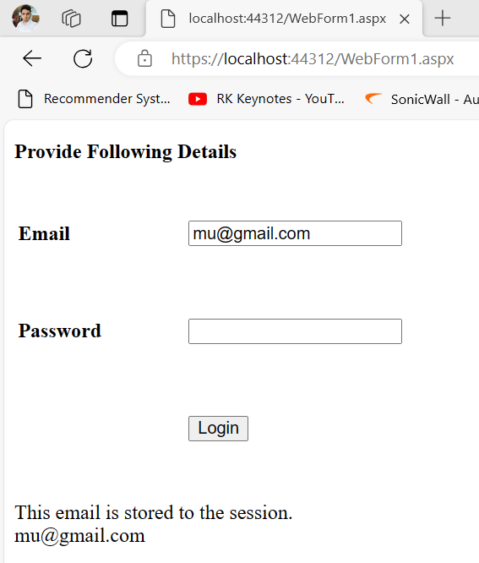
Output

Slide 68
Cookie
ASP.NET Cookie is a small bit of text that is used to store user-specific information. This information can be read by the web application whenever user visits the site.
When a user requests for a web page, web server sends not just a page, but also a cookie containing the date and time. This cookie stores in a folder on the user's hard disk.
When the user requests for the web page again, browser looks on the hard drive for the cookie associated with the web page. Browser stores separate cookie for each different sites user visited.
Note: The Cookie is limited to small size and can be used to store only 4 KB (4096 Bytes) text.

Slide 69
Type of Cookies
Persist Cookie - A cookie that doesn't have expired time is called a Persist Cookie
Non-Persist Cookie - A cookie which has expired time is called a Non-Persist Cookie
How to create a cookie?
HttpCookie userInfo = new HttpCookie("userInfo");
userInfo["UserName"] = "Annathurai"; userInfo["UserColor"] = "Black";
Response.Cookies.Add(userInfo);

Slide 70
How to retrieve from cookie?
string User_Name = string.Empty;
string User_Color = string.Empty;
User_Name = Request.Cookies["userName"].Value; User_Color = Request.Cookies["userColor"].Value;
How to clear the cookie information?
userInfo.Expires = DateTime.Now.AddHours(1);

Slide 71
Advantages and Disadvantages
Advantages of Cookie
It has clear text so the user can read it.
We can store user preference information on the client machine.
It is an easy way to maintain.
Fast accessing.
Disadvantages of Cookie
If the user clears the cookie information, we can't get it back.
No security.
Each request will have cookie information with page.

Slide 72
Form
<form id="form1" runat="server">
<div>
<asp:Label ID="Label1" runat="server" Text="Label"></asp:Label>
</div>
</form>

Slide 73
Code Behind
protected void Page_Load(object sender, EventArgs e)
{
//-- Creating Cookie --//
HttpCookie cookie = new HttpCookie("student");
// Assigning value to the created cookie
cookie.Value = "Kumar";
// Adding Cookie to the response instance
Response.Cookies.Add(cookie);
//-- Fetching Cookie --//
var cookievalue = Response.Cookies["student"].Value;
Label1.Text = cookievalue;
}

Slide 74
Demo

Slide 75
Programming Activity

Slide 76
Summary
ASP.Net Web Application
Page life cycle of ASP.NET Application
Web Controls (Button, TextBox, CheckBox, Image etc.)
Rich Controls (Calendar, AdRotator)
Validation Controls
State management
Cookie
Session

Slide 77
Up Next
ASP.Net MVC:
Introduction to ASP.NET MVC
MVC Architecture Overview
Controllers
Razor Views
LayoutView
PartialView
Models
HTML helpers
Action Filters
Model Validation
URLs and
Routing

