Slide 1

.NET Technologies (01CE0523) 5th Semester 4 Credits

Slide 2
Objective
Net Technologies are blend of technologies supported by Microsoft .Net Framework that allows user to create various applications.
Students will be able to work with various technologies provided by Microsoft .NET platform.

Slide 3
Course Outcomes
To Review the components of .Net Framework
To practice Web based application
To create web applications using MVC framework
To practice basic database application using ADO.net
To designing, developing, and deploying APIs

Slide 4
Unit 5 ASP.Net Web API and Security

Slide 5
Contents
Introduction
Understanding HTTP methods
Creating API controller
API configuration
Routing
Parameter binding, Request and response
API filters
Form Based Security
Windows based security

Slide 6
Introduction
In the modern world, where information flows freely on the internet, safeguarding its security is imperative.
Web API security plays a vital role in safeguarding data and ensuring that only authorized users and systems can access and manipulate resources.
Web APIs (Application Programming Interfaces) enable the communication and interaction between various software components, applications, and services. They expose endpoints through which clients can request and exchange data or perform actions. However, without proper security measures, these APIs are vulnerable to a range of threats, including:
Unauthorized Access: Malicious users may attempt to access sensitive data or perform actions they are not authorized for.
Data Breaches: Unauthorized access to data can lead to data breaches, resulting in the exposure of confidential information.
Denial of Service (DoS) Attacks: Attackers can overwhelm an API by sending a large number of requests, causing it to become slow or unresponsive.
Data Tampering: Data transmitted between the client and the API can be intercepted and modified.

Slide 7
Use of Web API
ASP.NET Web API is a framework that enables the creation of HTTP web services that can be accessed by a range of clients, such as mobile applications, browsers, desktop applications, and IOTs.
Web APIs can be used to:
Provide an interface: For websites and client applications to access data
Access and save data: From a database
Develop RESTful web services: Using the .NET framework
Develop services: That support all features of HTTP services, such as caching, request/response headers, and versioning

Slide 8
RESTful web services are client-server applications that use REpresentational State Transfer (REST) architecture to access data over a network.
RESTful web services can use HTTP GET and POST methods to invoke methods, and XML, JSON, or text for request and response types.

Slide 9
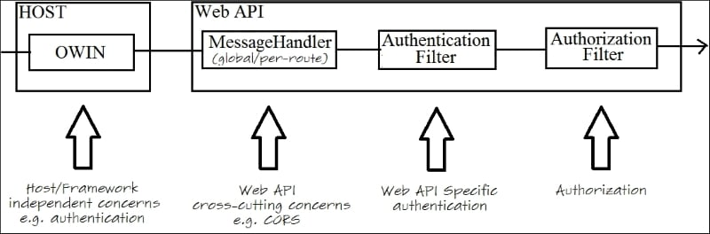
ASP.NET Web API security architecture Components involved in securing the Web API
Open Web Interface for .NET (OWIN) is the new open standard hosting infrastructure. Microsoft has built its own framework called Katana on top of OWIN and all Web API security techniques such as authentication methods (for example, token-based authentication) and support for social login providers (for example, Google and Facebook) will be happening on the OWIN layer.
Message Handler is a class that receives an HTTP request and returns an HTTP response. Implementing authentication at message handler level is not recommended. Message handlers are used for Cross-Origin Resource Sharing (CORS).
Authentication Filters are guaranteed to run before the authorization filter. If you are not interested in operating your authentication logic at the OWIN layer, you can straightaway move to controllers or actions. Authentication filters are really useful to invoke OWIN-based authentication logic.
Authorization Filters are the places in the pipeline where you can recheck the request before the actual expensive business logic stuff runs in the model binding and validation, and the controller action is invoked.

Slide 10
Create and Consume Web API Demo
Steps:
Create ASP.NET Web App with .NET Framework
Select Empty and Web API and create project
Create a controller, select “web API 2 controller – empty”
using System.Collections.Generic;
using System.Web.Http;
namespace WebAPIdemo.Controllers{
public class DefaultController : ApiController{
public string Get()
{
return "Welcome To Web API";
}
public List<string> Get(int Id)
{
return new List<string> {
"Data1",
"Data2"
};
}
}
}

Slide 11
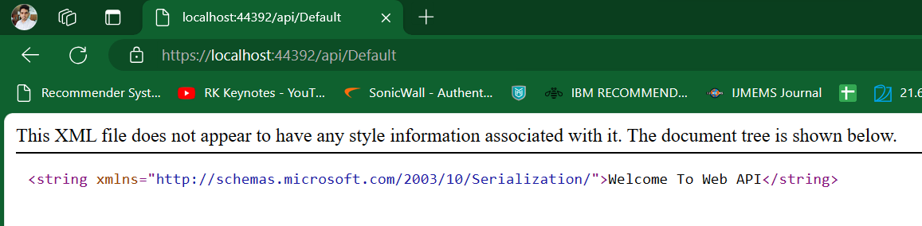
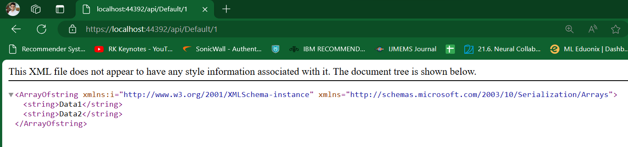
Consume Web API
http://localhost:53027/api/Default
http://localhost:53027/api/Default/1

Slide 12
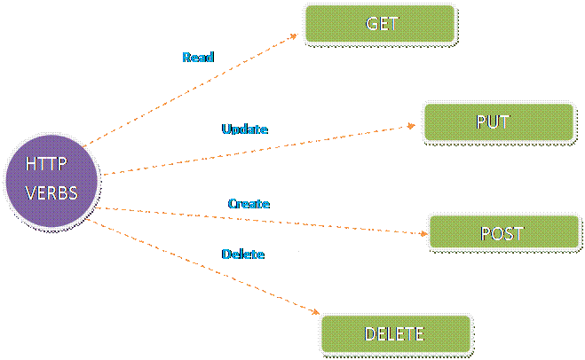
Understanding HTTP Methods
Four verbs in ASP.NET Web API
Get method returns what are the strings assigned in the languages variable.
If need to Add or Save data in the list arises, we can use Post method.
We can update and delete the data in the list using Put and Delete.

Slide 13
Understanding HTTP Methods
Steps:
Create ASP.NET Web App with .NET Framework
Select Empty and Web API and create project
Create a controller, select “web API 2 controller – empty”
using System.Collections.Generic; using System.Web.Http;
namespace HttpVerbsDemo.Controllers{
public class DefaultController : ApiController{
static List<string> languages = new List<string>() {
"C#","ASP.NET","MVC"
};
public IEnumerable<string> Get()
{
return languages;
}
public string Get(int id)
{ return languages[id]; }
public void Post([FromBody]string value) {
languages.Add(value);
}
public void Put(int id, [FromBody]string value) {
languages[id] = value;
}
public void Delete(int id) {
languages.RemoveAt(id);
} } }
Notes:
In C#, IEnumerable is an interface that allows you to iterate over a collection of classes or lists. It's synonymous with iterators

Slide 14
Configure Web API
Web API supports code based configuration. It cannot be configured in web.config file.
We can configure Web API to customize the behaviour of Web API hosting infrastructure and components such as routes, formatters, filters, DependencyResolver, MessageHandlers, ParamterBindingRules, properties, services etc.
We created a simple Web API project in the Create Web API Project section. Web API project includes default WebApiConfig class in the App_Start folder and also includes Global.asax as shown below.

Slide 15
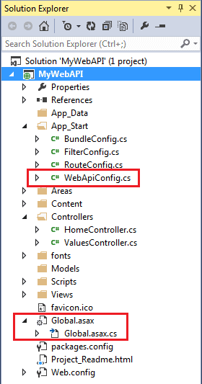
Configure Web API

Slide 16
Configure Web API
//Global.asax
public class WebAPIApplication : System.Web.HttpApplication
{
protected void Application_Start()
{
GlobalConfiguration.Configure(WebApiConfig.Register);
//other configuration
}
}

Slide 17
Configure Web API
//WebApiConfig
public static class WebApiConfig
{
public static void Register(HttpConfiguration config)
{
config.MapHttpAttributeRoutes();
config.Routes.MapHttpRoute(
name: "DefaultApi",
routeTemplate: "api/{controller}/{id}",
defaults: new { id = RouteParameter.Optional }
);
// configure additional webapi settings here..
}
}

Slide 18
Configure Web API
Web API configuration process starts when the application starts. It calls
GlobalConfiguration.Configure(WebApiConfig.Register) in the Application_Start method. The Configure() method requires the callback method where Web API has been configured in code. By default this is the static WebApiConfig.Register() method.
As you can see above, WebApiConfig.Register() method includes a parameter of HttpConfiguration type which is then used to configure the Web API. The HttpConfiguration is the main class which includes following properties using which you can override the default behaviour of Web API.

Slide 19
Configure Web API
Property | Description
DependencyResolver | Gets or sets the dependency resolver for dependency injection.
Filters | Gets or sets the filters.
Formatters | Gets or sets the media-type formatters.
IncludeErrorDetailPolicy | Gets or sets a value indicating whether error details should be included in error messages.
MessageHandlers | Gets or sets the message handlers.
ParameterBindingRules | Gets the collection of rules for how parameters should be bound.
Properties | Gets the properties associated with this Web API instance.
Routes | Gets the collection of routes configured for the Web API.
Services | Gets the Web API services.

Slide 20
Web API Routing
Web API routing is similar to ASP.NET MVC Routing. It routes an incoming HTTP request to a particular action method on a Web API controller.
Web API supports two types of routing:
Convention-based Routing
In the convention-based routing, Web API uses route templates to determine which controller and action method to execute. At least one route template must be added into route table in order to handle various HTTP requests.
Attribute Routing
Attribute routing is supported in Web API 2. As the name implies, attribute routing uses [Route()] attribute to define routes. The Route attribute can be applied on any controller or action method.
In order to use attribute routing with Web API, it must be enabled in WebApiConfig by calling config.MapHttpAttributeRoutes() method.

Slide 21
Web API Routing
Attribute Routing
public class StudentController : ApiController
{
[Route("api/student/names")]
public IEnumerable<string> Get()
{
return new string[] { "student1", "student2" };
}
}
Thus, an HTTP GET request http://localhost:1234/api/student/names will return list of student names.

Slide 22
Parameter Binding
The Parameter Binding in ASP.NET Web API means how the Web API Framework binds the incoming HTTP request data (query string or request body) to the parameters of an action method of a Web API controller.
Action methods in Web API controllers can have one or more parameters of different types.
It can be either primitive type or complex type. Web API binds action method parameters with the URL's query string or with the request body depending on the parameter type.
By default, if the parameter type is of .NET primitive types such as int, bool, double, string, Globally Unique Identifier (GUID), DateTime, decimal, or any other type that can be converted from string type, then it sets the value of a parameter from the query string. And if the parameter type is the complex type, then Web API tries to get the value from the request body by default.
Notes:
Parameter Binding in Web API with Examples - Dot Net Tutorials - A request body is data sent by the client to your API.

Slide 23
Query String
A query string is one of the techniques in Web applications to send data from one webform to another through the URL. A query string consists of two parts, field and value, and each of pair separated by ampersand (&).

Slide 24
Parameter Binding
HTTP Method | Query String | Request Body
GET | Primitive Type, Complex Type | NA
POST | Primitive Type | Complex Type
PUT | Primitive Type | Complex Type
PATCH | Primitive Type | Complex Type
DELETE | Primitive Type, Complex Type | NA

Slide 25
Parameter Binding
Get Action Method with Primitive Parameter
public class StudentController : ApiController
{
public Student Get(int id)
{
}
}
http://localhost/api/student?id=1
http://localhost/api/student?ID=1

Slide 26
Parameter Binding
Multiple Primitive Parameters
public class StudentController : ApiController
{
public Student Get(int id, string name)
{
}
}
http://localhost/api/student?id=1&name=steve
http://localhost/api/student?ID=1&NAME=steve
http://localhost/api/student?name=steve&id=1

Slide 27
Web API filters
Web API includes filters to add extra logic before or after action method executes.
Filters can be used to provide cross-cutting features such as logging, exception handling, performance measurement, authentication and authorization.
Filters are actually attributes that can be applied on the Web API controller or one or more action methods. Every filter attribute class must implement IFilter interface included in System.Web.Http.Filters namespace.
However, System.Web.Http.Filters includes other interfaces and classes that can be used to create filter for specific purpose.

Slide 28
Web API Filters
Filter Type | Interface | Class | Description
Simple Filter | IFilter | - | Defines the methods that are used in a filter
Action Filter | IActionFilter | ActionFilterAttribute | Used to add extra logic before or after action methods execute.
Authentication Filter | IAuthenticationFilter | - | Used to force users or clients to be authenticated before action methods execute.
Authorization Filter | IAuthorizationFilter | AuthorizationFilterAttribute | Used to restrict access to action methods to specific users or groups.
Exception Filter | IExceptionFilter | ExceptionFilterAttribute | Used to handle all unhandled exception in Web API.
Override Filter | IOverrideFilter | - | Used to customize the behaviour of other filter for individual action method.

Slide 29
Web API Filter Class
public class LogAttribute : ActionFilterAttribute
{
public LogAttribute()
{
}
public override void OnActionExecuting(HttpActionContext actionContext)
{
Trace.WriteLine(string.Format("Action Method {0} executing at {1}", actionContext.ActionDescriptor.ActionName, DateTime.Now.ToShortDateString()), "Web API Logs");
}
public override void OnActionExecuted(HttpActionExecutedContext actionExecutedContext)
{
Trace.WriteLine(string.Format("Action Method {0} executed at {1}", actionExecutedContext.ActionContext.ActionDescriptor.ActionName, DateTime.Now.ToShortDateString()), "Web API Logs");
}
}

Slide 30
Form Based Security
The user credentials will be submitted to the server using HTML forms in Forms authentication. This can be used in ASP.NET Web API only if it is consumed from web application.
Form Authentication is used to send the references of the clients to the server in the HTML form.
It is applicable for the Web API only that are calling from the Web Application. By which the client interact with the HTML form.
Advantages
It is easy to implement in the ASP. NET.
It provides the ASP. NET Membership that makes it easy to manage the user accounts.
Disadvantages
It has the requirements of the browser client.
The references are sent to the server as plaintext.
The client references are sent as the request.

Slide 31
Form Based Security
Let's list the step-by-step process of Forms authentication, as follows:
Browser tries to access a restricted action that requires an authenticated request.
If the browser sends an unauthenticated request, then the server will respond with HTTP status 302 Found and triggers the URL redirection to login page.
To send the authenticated request, a user enters the username and password, and submits the form.
If the credentials are valid, the server responds with HTTP 302 status code that initiates the browser

Slide 32
Form Based Security
<system.web>
<authentication mode="Forms">
<forms loginUrl="~/Account...

Slide 33
Window Based Security
Integrated Windows Authentication is an authentication mechanism that is based on SPNEGO, Kerberos, and NTLMSSP protocols. It deals with automatically authenticating the connection between IIS, IE, and active directory.
Notes:
SPNEGO (Simple and Protected GSS-API Negotiation Mechanism)
NTLMSSP (NT LAN Manager Security Support Provider)

Slide 34
Window Based Security
Advantages of the integrated windows Authentication
This application is built in the IIS.
It does not send the client references in the request.
There is no need to enter the references if the user computer belongs to the domain.
Disadvantages of the integrated windows Authentication
It is not approved for the internet application.
It is necessary that the client exist in the Active directory domain.

Slide 35
Window Authentication in Web.config
<system.web>
<authentication mode="Windows" />
</system.web>

Slide 36
Summary
Introduction
Understanding HTTP methods
Creating API controller
API configuration
Routing
Parameter binding
request and response
API filters
Form Based Security
Windows based security

Slide 37
End of Unit 5

