Slide 1

8086 Based Systems
Marwadi University
Subject Code:01CE0509
Subject Name: Fundamental of Processors
B.Tech. Year–III
Unit- 3

Slide 2

Outline
Introduction
Addressing modes of 8086
Data Addressing mode
Address addressing mode
INSTRUCTION FORMAT
INSTRUCTION TEMPLATE
INSRUCTION SET OF 8086
ASSEMBLY LANGUAGE
ASSEMBLY LANGUAGE PROGRAM DEVELOPMENT TOOLS
ASSEMBLER DIRECTIVES
Looping

Slide 3
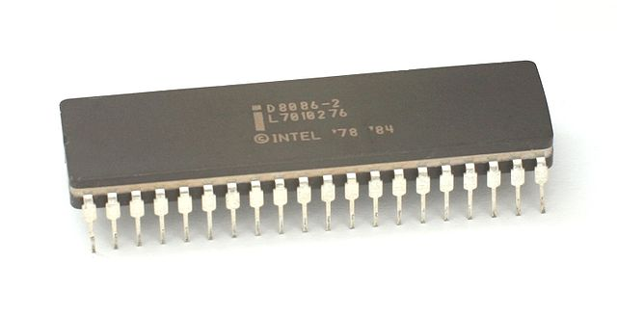
Syllabus
Unit-3
Addressing modes of 8086, Instruction formats, Instruction templates, Instruction set of 8086, Assembly language, Assembly language Program development tools, TASM assembler, MASM assembler, Assembler directives.

Slide 4
INTRODUCTION
Program is set of Instructions written to solve problems.
Programs can be written in Computer languages which is broadly divided into Two main parts:
Computer Languages
High level Language
Low level Language
Machine Language
Assembly Language

Slide 5
INTRODUCTION
Machine language is only language that machine can understand.
Instruction in this language are written in specific bit pattern.
But this language is machine friendly but not user friendly.
To overcome this problems, Programmer develop another way to which instructions are written in English alphabets.
This new language is known as Assembly Language
and the instruction are termed
mnemonics.

Slide 6
INTRODUCTION
Mnemonics are translated in machine language either manually or by a program known as Assembler.
Efficient software development for the microprocessor require
ADDRESSING MODES
INSTRUCTION SET
INSTRUCTION FORMAT

Slide 7
ADDRESSING MODES OF 8086
The addressing modes are the ways of specifying an operand in instruction.
Addressing modes are categorized in two types:
Data Addressing modes
Address Addressing modes

Slide 8
ADDRESSING MODES OF 8086
Data Addressing Modes:
The 8086 microprocessor introduces many new techniques to access the memory by introduction of many more types of addressing modes.
These addressing modes provide flexibility to the processor to access memory.
8086 has all the data addressing modes available in 8085. Implied, Register, Immediate, Direct and Register indirect.
Apart from these data addressing modes 8086 has five more addressing modes.
Base Addressing Mode
Index Addressing Mode
Based Indexed Addressing Mode
Based Indexed with displacement Addressing Mode
String Addressing Mode

Slide 9
ADDRESSING MODES OF 8086
Immediate Addressing Mode:
MOV AX, 2500H
Here the immediate data is 2500H.
Register Addressing Mode:
Most 8086 instructions can operate on the general purpose registers set.
MOV AX, BX
MOV DL, AL
MOV SI, DX
Direct Addressing Mode:
In this mode memory address is always written inside the square bracket.
For Example MOV BL, [2000H], transfers the content of the memory location 2000H in the BL register.

Slide 10
ADDRESSING MODES OF 8086
Direct Addressing Mode:
By Default, All the data addressing mode point in the Data segment.
The Segment prefix is to be used before the address if we have to point any other memory segment
For example: MOV AX, ES:[4321H]
Register Indirect Addressing Mode:
In this addressing mode, the memory address is specified by some pointer, index or base register. This registers are written inside the square bracket.
There are four forms of this addressing mode in 8086:
MOV DX, [BX]
MOV DX, [BP]
MOV DX, [SI]
MOV DX, [DI]

Slide 11
ADDRESSING MODES OF 8086
Register Indirect Addressing Mode:
The [BX], [SI] and [DI] modes use the DS segment by default, [BP] uses stack segment.
To access data from other than the default segments, the segment override prefix symbols are to be used:
MOV AX, CS:[BX]
MOV AX, DS:[BP]
MOV AX, SS:[SI]
MOV AX, ES:[DI]
Base Addressing Mode:
In this mode 8-bit or 16-bit displacement is added to the contents of base register (BX or BP).
Memory Location = BX 8-bit Displacement
±
BP 16-bit Displacement

Slide 12
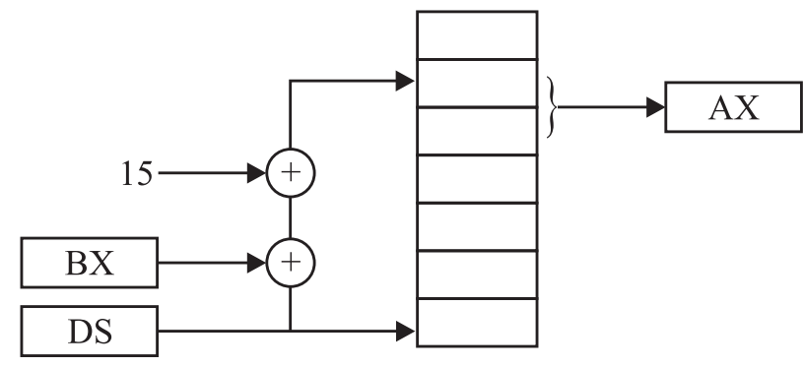
ADDRESSING MODES OF 8086
Base Addressing Mode:
For example if BX = 2000H, the instruction is : MOV AL,[BX + 15]
In this example, the contents of the memory location 200FH is transferred to AL register.
The Maximum 8-bit displacement can be ±127 and maximum 16-bit displacement can be ±32767.
Memory Location = BX ± 8-BIT Displacement
BX ± 16-BIT Displacement
BP ± 8-bit Displacement
BP ± 16-bit Displacement
The displacement can be written as : MOV AL, DISP[BX].
BX uses the Data segment and BP uses the Stack segment by Default. But for different segments: MOV AL, SS:DISP[BX]
MOV AL, ES:DISP[BP]

Slide 13
ADDRESSING MODES OF 8086
Index Addressing Mode:
In this mode 8-bit or 16-bit displacement is added to the contents of index register (SI or DI).
Memory Location = SI 8-bit Displacement
±
DI 16-bit Displacement
The Maximum 8-bit displacement can be ±127 and maximum 16-bit displacement can be ±32767.
There are four combination of the index addressing mode:
Memory Location = SI ± 8-BIT Displacement
SI ± 16-BIT Displacement
DI ± 8-bit Displacement
DI ± 16-bit Displacement

Slide 14
ADDRESSING MODES OF 8086
Index Addressing Mode:
Data segment is the default segment of this addressing mode.
For different segment, the segment override prefixes can be used
MOV AL, CS:DISP[SI]
MOV AL, SS:DISP[DI]
Base indexed addressing mode:
In base indexed addressing mode, the content of base register (BX or BP) are added to the contents of the indexed register (SI or DI).
Memory Location = SI BX
+
DI BP

Slide 15
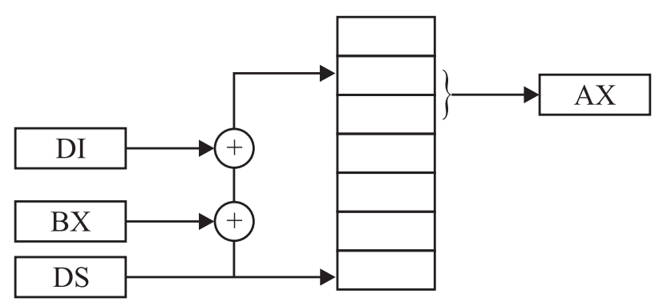
ADDRESSING MODES OF 8086
Base indexed addressing mode:
The allowable forms of these addressing modes are:
MOV AL, [BX][SI]
MOV AL, [BX][DI]
MOV AL, [BP][SI]
MOV AL, [BP][DI]
For Example, BX = 2000H and SI = 5400H, The instruction is MOV AL, [BX + SI]
In this example current memory location is 2000H + 5400H = 7400H.
The addressing modes that do not involve BP use data segment by default otherwise stack segment. Memory Locations = SI + BP
SI + BX
DI + BP
DI + BX

Slide 16
ADDRESSING MODES OF 8086
Base indexed with displacement addressing mode:
In this addressing mode, offset address is generated by the sum of Base registers and Index registers along with 8-bit or 16-bit displacement.
Memory Location = SI BX 8-bit Displacement
+ ±
DI BP 16-bit Displacement
For Example, BX = 2000H and SI = 5400H, The instruction is MOV AL, [BX + SI + 15]
In this example current memory location is 2000H + 5400H + 15H = 740FH
Some Examples of this addressing mode: MOV AL, DISP [BX][SI]
MOV AL, DISP [BX + DI]
MOV AL, [BP + SI + DISP]
MOV AL, [BP][DI][DISP]

Slide 17
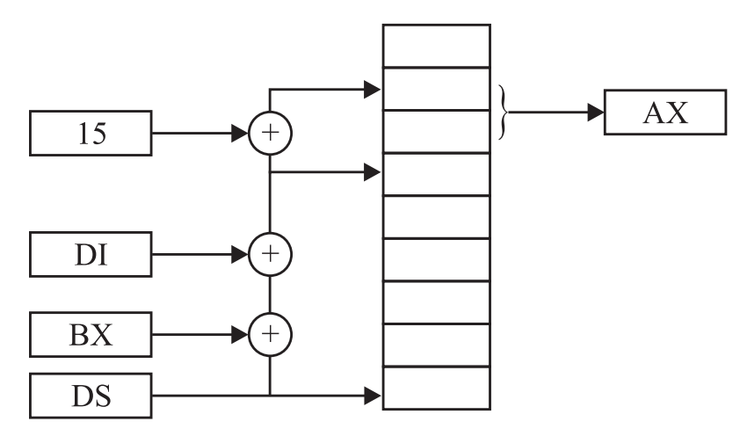
ADDRESSING MODES OF 8086
Base indexed with displacement addressing mode:
Memory Location: SI + BP ± 8-bit Displacement
SI + BX ± 8-bit Displacement
DI + BP ± 8-bit Displacement
DI + BX ± 8-bit Displacement
SI + BP ± 16-bit Displacement
SI + BX ± 16-bit Displacement
DI + BP ± 16-bit Displacement
DI + BX ± 16-bit Displacement

Slide 18
ADDRESSING MODES OF 8086
String Addressing Mode:
This mode uses index registers, SI point to first byte of source and DI point to first byte of destination.
Segment register for the source is Data segment and for destination Extra segment.
The SI and DI are automatically incremented by clearing Direction Flag.
Address Addressing Mode:
These addressing modes indicates branch addresses in the call and jump instructions.
In 8086 there four types of address addressing modes:
Intra segment direct
Intra segment indirect
Inter segment direct
Inter segment Indirect

Slide 19
ADDRESSING MODES OF 8086
Address Addressing Mode:
In Intrasegment the branching is within the segment and in intersegment the branching is outside the segment.
Intersegmet is synonym for far, Intrasegment is synonym for near.
Intra segment direct addressing mode:
In this addressing mode the effective branch address will be the sum of the signed 8 pr 16-bit displacement and the content of IP.
When the displacement is of 8-bit, then this is referred to as short jump or short call, otherwise long jump or long call.
For example, Consider the following two jump instructions
JMP 8-bit displacement; direct intrasegment, 8-bit displacement
JMP 16-bit displacement; direct intrasegment, 16-bit displacement

Slide 20
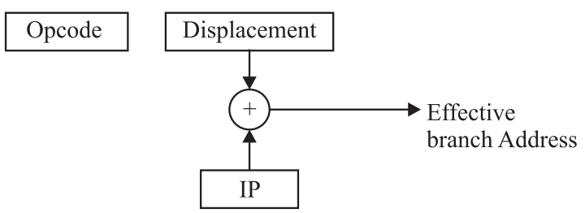
ADDRESSING MODES OF 8086
Intra segment direct addressing mode:
We can say that with the 8-bit displacement the control can be transferred within memory location space of -128 to +127 locations.
The 8-bit displacement is a two byte instruction. First byte for opcode and second for displacement.
With the 16- bit displacement the control can be transferred within location space of -32768 to +32767 locations.
It is 3 byte long with the first byte as the opcode and next two byte as the displacement.
8-bit can be conditional or unconditional jump or call instructions but 16-bit can be unconditional instructions only.

Slide 21
ADDRESSING MODES OF 8086
Intra segment direct addressing mode:
We can say that with the 8-bit displacement the control can be transferred within memory location space of -128 to +127 locations.
The 8-bit displacement is a two byte instruction. First byte for opcode and second for displacement.
With the 16- bit displacement the control can be transferred within location space of -32768 to +32767 locations.
It is 3 byte long with the first byte as the opcode and next two byte as the displacement.
8-bit can be conditional or unconditional jump or call instructions but 16-bit can be unconditional instructions only.

Slide 22
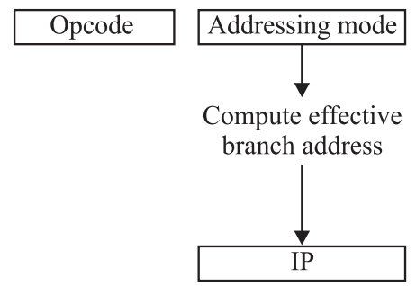
ADDRESSING MODES OF 8086
Intra segment indirect addressing mode:
In this addressing mode effective address is specified by any of the register or memory content.
the memory location can be specified by any of the memory related addressing modes.
In this addressing mode the content of the IP is replaced by the effective branch address.
This is used only for unconditional branch instructions.
JMP Disp [BX]; Disp is an array of words
This addressing mode fetches the word from the location Disp + BX and copies to IP.

Slide 23
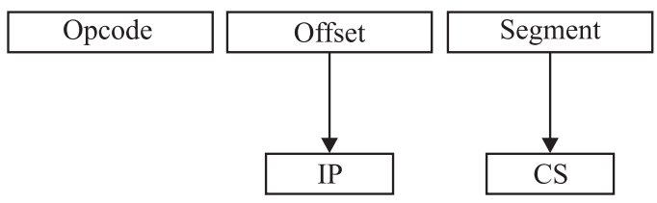
ADDRESSING MODES OF 8086
Inter segment direct addressing mode:
In this mode, the address to which the control is to be transferred is in a different segment.
Here, the CS and IP of the destination address are specified directly in the instruction.
Example: JMP 5000H, 2000H; jump to effective address 2000H in segment 5000H.
32 bit operand to be loaded into the IP and CS register and it is 5 byte long.
First byte for opcode, second and third for IP value, fourth and fifth for CS value.

Slide 24
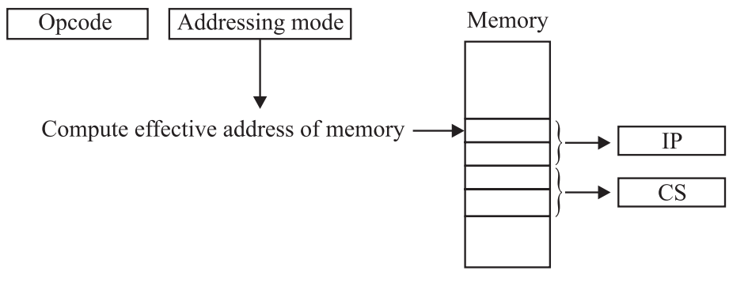
ADDRESSING MODES OF 8086
Inter segment indirect addressing mode:
In this mode, the content of the IP and CS register are replaced by the contents of four consecutive memory locations.
These locations are pointed by any memory-related data addressing modes. Except immediate and register addressing mode.

Slide 25
ADDRESSING MODES OF 8086
Example: Given that BX = 2500H, SI= 5000H, Displacement= 1000H IP = 2000H
Determine the effective address of following addressing mode.
Immediate
Effective address is content of IP = 2500H
Register using SI
SI = 5000H
Direct (if direct address = Displacement)
EA = 1000H
Register indirect addressing mode using BX.
EA = BX = 2500H
Base addressing mode.
EA = BX + Displacement = 2500H + 1000H = 3500H

Slide 26
ADDRESSING MODES OF 8086
Example: Given that BX = 2500H, SI= 5000H, Displacement= 1000H IP = 2000H
Determine the effective address of following addressing mode.
Index addressing mode
EA = SI + Displacement = 5000H + 1000H = 6000H
Base index addressing mode
EA = BX + SI = 2500H + 5000H = 7500H
Base Index with Displacement addressing mode
EA = BX +SI +Displacement = 2500H + 5000H + 1000H = 8500H

Slide 27
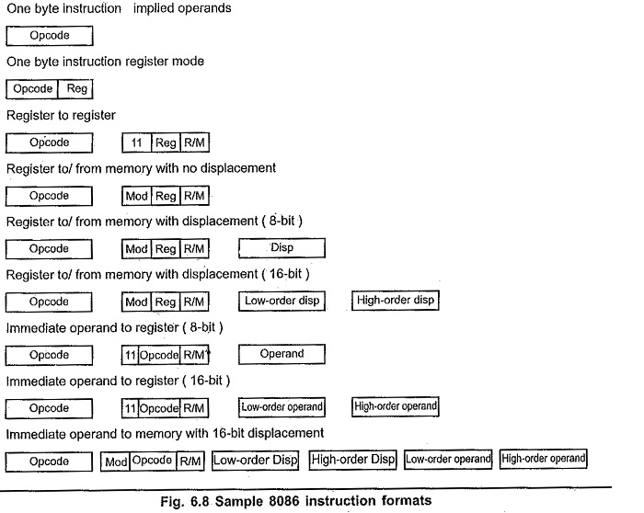
INSTRUCTION FORMAT
The instructions of 8086 is one to six byte long. These instructions have different formats.

Slide 28
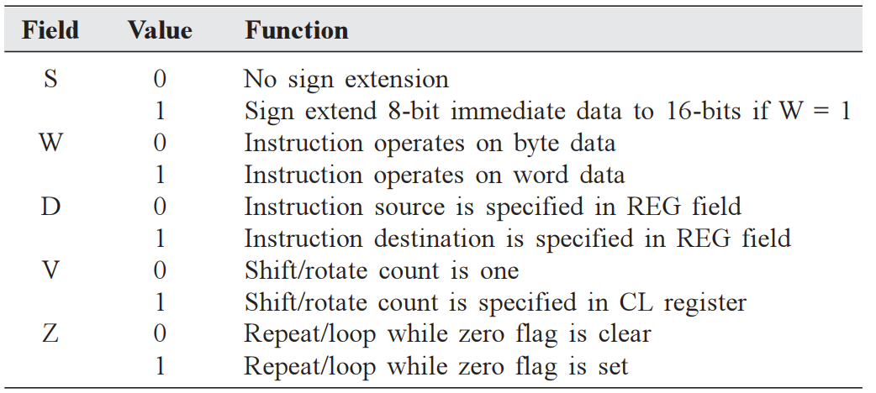
INSTRUCTION FORMAT
The first byte is always consists of opcode.
The opcode may be of 8 bit or may occupy MSB six bits of the first byte.
The remaining two bits are any of the following bits.

Slide 29
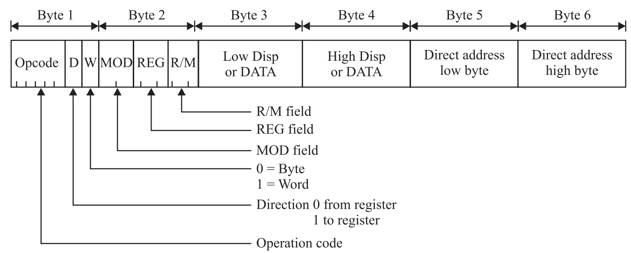
INSTRUCTION TEMPLATE
Microprocessor 8085 has 246 opcodes when Microprocessor 8086 has 13000 opcodes.
It becomes very tedious to find out opcodes for 8086 instructions.
So, Instruction template are used for each instruction to generate the opcode.
Figure given below shows Instruction format of MOV instruction.

Slide 30
INSTRUCTION TEMPLATE
In MOV instruction template the MSB six bit of first byte is opcode and LSB two bits are D and W bits.
Second byte contains 3 fields.
Mode Field (MOD), Register Field (REG), and Register/Memory field (R/M)

Slide 31
INSTRUCTION TEMPLATE
MOD Field:
In the second field MSB two bits D7 and D6 are defined as MOD field.
MOD = 00 : R/M for memory with no displacement
MOD = 01 : R/M for memory with 8-bit displacement
MOD = 10 : R/M for memory with 16-bit displacement
MOD = 11 : R/M for a register.

Slide 32
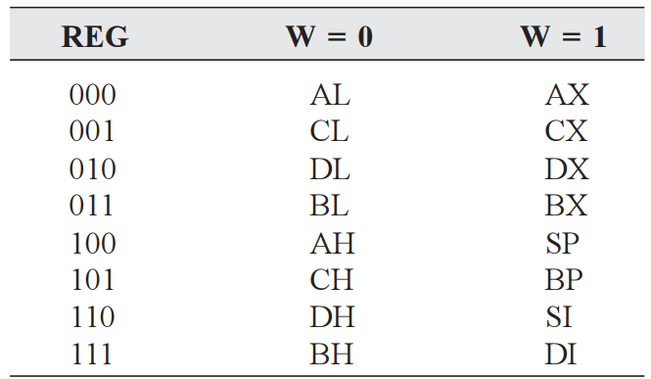
INSTRUCTION TEMPLATE
REG Field:
REG Field occupies 3 bits D5, D4, D3. which are encoded as per table given below.

Slide 33
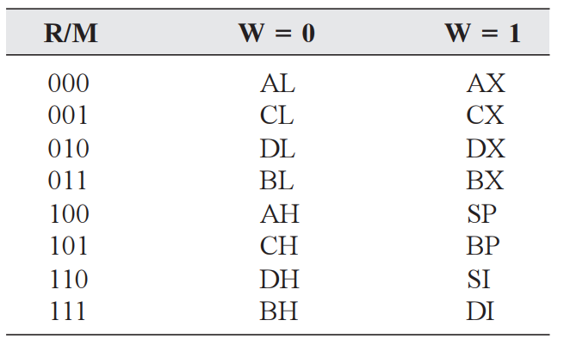
INSTRUCTION TEMPLATE
R/M Field:
R/M Field occupies LSB-3 bits D2, D1, D0. which are encoded as per table given below.
R/M field with MOD field defines second operand.
R/M field with MOD=11 encoded as per table given below.

Slide 34
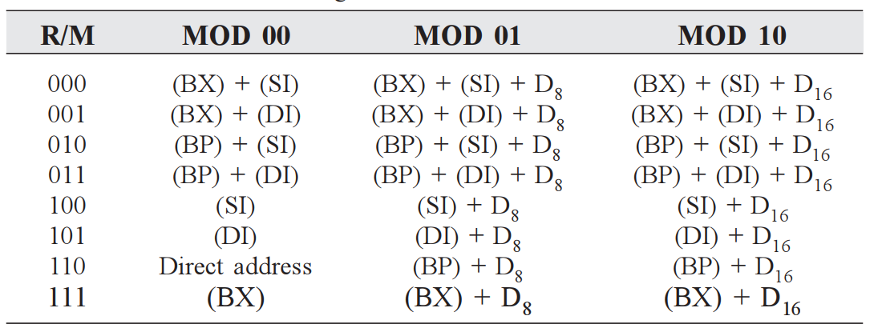
INSTRUCTION TEMPLATE
R/M Field:
R/M field with MOD=00, 01, 10 encoded as per table given below.

Slide 35
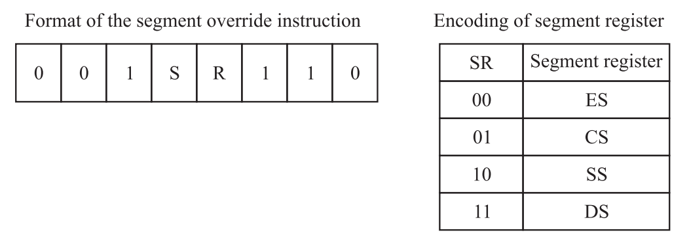
INSTRUCTION TEMPLATE
Segment override prefix:
Segment override prefix(SOP) is used when a default offset register is not used with its default base register, but with different base register.
In Instruction format one byte added before opcode byte. The format is as given below.

Slide 36
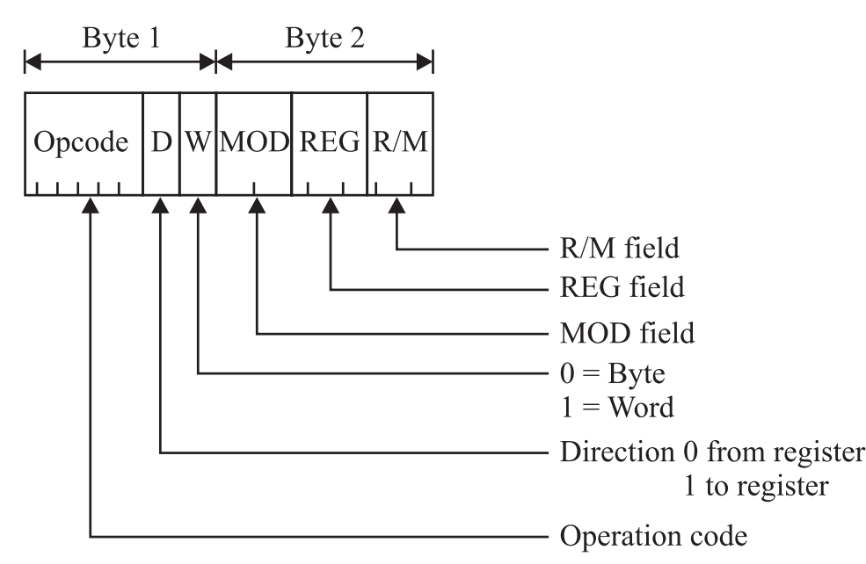
INSTRUCTION TEMPLATE
Example: Construct the machine code for MOV BL, CH
This instruction copies 8 bit data from CH to BL.
This is 2 byte instruction.

Slide 37
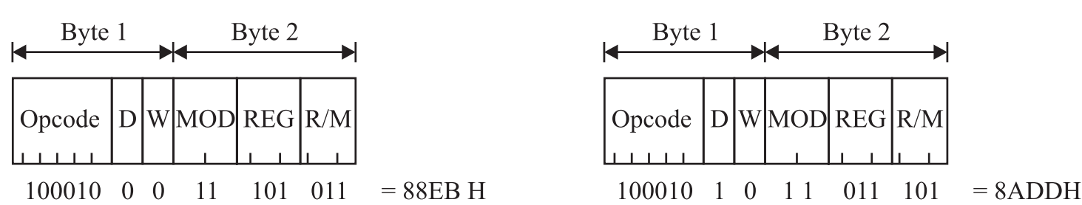
INSTRUCTION TEMPLATE
The bit opcode for this instruction is 100010.
W=0 shows a byte operation.
D = 0 indicates CH is source operand.
In second byte MOD field is 11 for register to register transfer.
The R/M field = 011 (BL) and Register REG field = 101 (CH)
Hence the machine code for MOV BH,CL is 88EBH.
If we represent REG field as destination so D=1 and BL is Destination register.
So, machine code for MOV BL, CH is 8ADDH

Slide 38
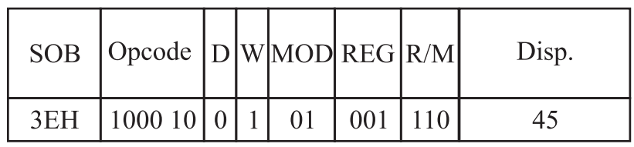
INSTRUCTION TEMPLATE
Construct the machine code for the instruction MOV 1234[SI], AX.
Construct the machine code for MOV DS:43[BP], CX

Slide 39
INSTRUCTION SET OF 8086
The Instruction set of 8086 classified into eight groups.
Data Transfer Instructions
Arithmetic Instructions
Logical Instructions
Shift and Rotate Instructions
String Instructions
Data Adjustment Instructions
Flag related Instructions
Control transfer Instructions

Slide 40
INSTRUCTION SET OF 8086
Data Transfer Instructions.
MOV destination, source : Move source to destination
Source operand can be register, memory locations or immediate value
and The destination register can be general purpose register or memory location.
MOV AX, 2500H
MOV DS, AX
IN: Input data from the Input port
IN AX,04H ; Move the Content of port number 04H and 05H to AL and AH.
IN AL,70H; Move the content of port number 70H to AL.
If port number is 16-bit then,
IN AX,DX; Move the Content of port number specified in DX and DX+1 to AL and AH.
IN AL,DX; Move the content of port number specified in DX to AL.

Slide 41
INSTRUCTION SET OF 8086
Data Transfer Instructions.
OUT : Output data to Output port
OUT 04H,AX ; Move the Content of AX register to port number 04H and 05H.
OUT 70H,AL; Move the content of AL register port number 70H .
If port number is 16-bit then,
OUT DX,AX; Move the Content of AX register port number specified in DX and DX+1.
OUT DX,AL; Move the content of port number specified in DX to AL.

Slide 42
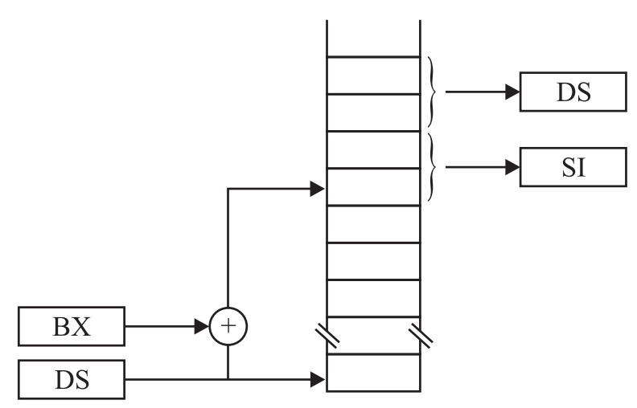
INSTRUCTION SET OF 8086
Data Transfer Instructions.
LDS Rd, M; Load pointer and DS register
LDS SI, [BX]; SI is set to [BX : BX+1] and DS is set to [BX +2 : BX + 3].
The Flag remains unchanged.

Slide 43
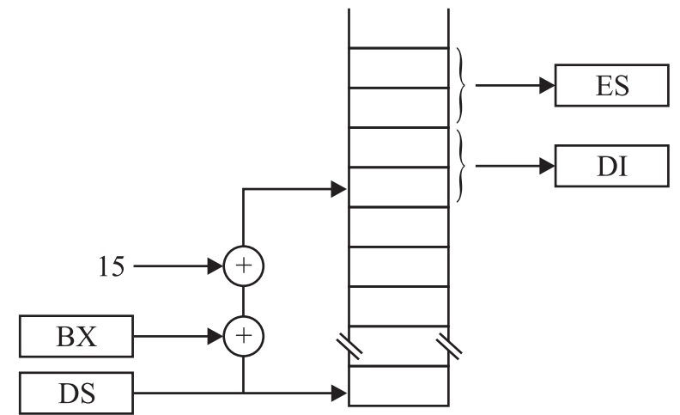
INSTRUCTION SET OF 8086
Data Transfer Instructions.
LES Rd, M; Load pointer and ES address
LES DI, [BX+15]; DI is set to [BX+15 : BX+16] and ES is set to [BX +17 : BX + 18].
The Flag remains unchanged.

Slide 44
INSTRUCTION SET OF 8086
Data Transfer Instructions.
LEA Rd, M; Load effective address
LEA DI, 3[SI] ; Copies address of the memory location 3[SI] into DI register.
The Flag remains unchanged.
XCHG: Exchange
Operand Rd,M
Rd, Rs
M, Rs; Exchange the values of two operands.
PUSH: Push the content on to stack top
Operands REG/SREG/memory
After PUSH instruction content of SP is decreased by 2 and source value copied to SS:SP. The Flags remains unchanged.

Slide 45
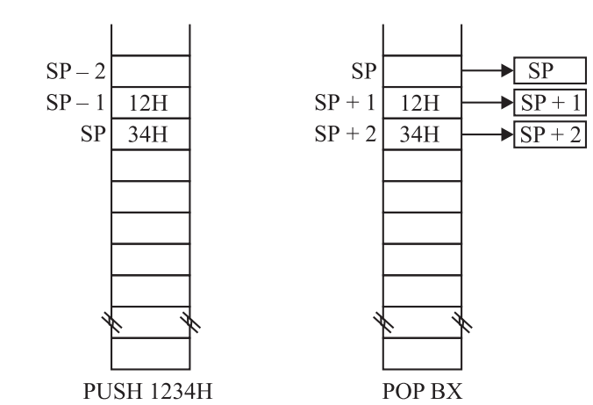
INSTRUCTION SET OF 8086
Data Transfer Instructions.
POP: Pop off the content of from the top of the stack

Slide 46
INSTRUCTION SET OF 8086
Data Transfer Instructions.
PUSHF: Push Flag on the top of the stack
POPF: Pop off Flag from the top of the stack.
LAHF: Load AH register with the Lower byte of the flag register.
SAHF: Store the AH register in the lower byte of the Flag register.
XLAT: This Instruction translate a value from one coding system to another coding system with the help of Look up table.

Slide 47
INSTRUCTION SET OF 8086
Arithmetic Instructions.
ADD: Add; These instructions add a data from source to a data from destination and store the result in the destination operand. For Ex. ADD AX, BX
ADC: Add with carry; This instruction adds the source to destination with carry. ADC CL, BL
SUB: Subtract; These instructions subtract the number in source from the number in destination and put the result in the destination. SUB CX, BX
SBB: Subtract with borrow; The SBB instruction subtracts the content of source from destination along with carry flag. SBB CH, AL
INC: Increment; The INC instruction adds 1 to a specified register or to a memory location. AF, OF, PF, SF, and ZF are updated, but CF is not affected. INC BL
DEC – Decrement; This instruction subtracts 1 from the destination word or byte. The destination can be a register or a memory location.
DEC CL ; Subtract 1 from content of CL register
DEC BP ; Subtract 1 from content of BP register

Slide 48
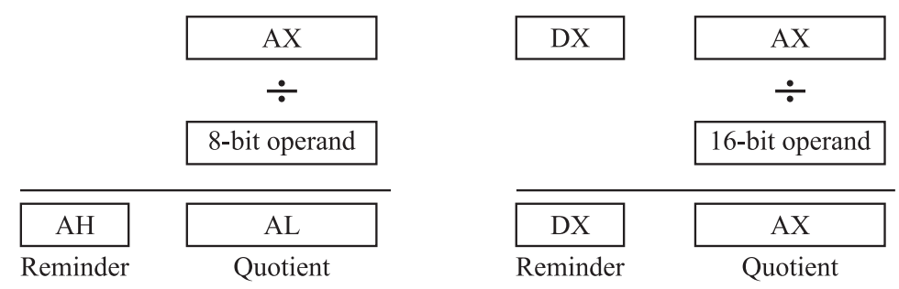
INSTRUCTION SET OF 8086
Arithmetic Instructions.
DIV (Unsigned Division):
IDIV (Signed division):
This instruction is same as DIV except that both operands are signed numbers.
MOV AX, -200H (AX = 0FF38H)
MOV CL,6
IDIV CL; (AL = DFH (-33) and AH = FEH = 02)

Slide 49
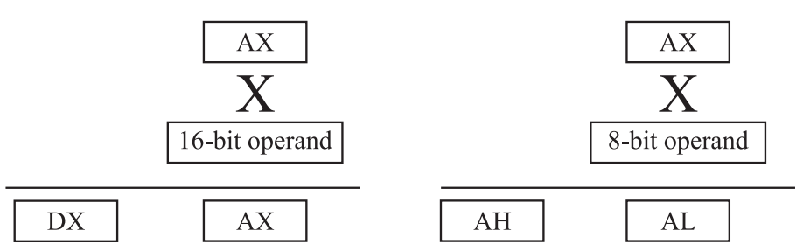
INSTRUCTION SET OF 8086
Arithmetic Instructions.
MUL (Unsigned Multiplication):
IMUL (Signed division):
This instruction is same as MUL except that both operands are signed numbers.
MOV AL, -03H
MOV CL, -05H
IMUL CL; AX= 000FH

Slide 50
INSTRUCTION SET OF 8086
Arithmetic Instructions.
CBW (CONVERT SIGNED BYTE TO SIGNED WORD): This instruction copies the sign bit of the byte in AL to all the bits in AH. AH is then said to be the sign extension of AL. CBW does not affect any flag. Let AX = 00000000 10011011 (–155 decimal)
CBW; Convert signed byte in AL to signed word in AX
AX = 11111111 10011011 (–155 decimal)
CWD (CONVERT SIGNED WORD TO SIGNED DOUBLE WORD): This instruction copies the sign bit of a word in AX to all the bits of the DX register. In other words, it extends the sign of AX into all of DX. CWD affects no flags.
Let DX = 00000000 00000000, and AX = 11110000 11000111 (–3897 decimal)
CWD Convert signed word in AX to signed double word in DX:AX
DX = 11111111 11111111 AX = 11110000 11000111 (–3897 decimal)
NEG (Negate): This Instruction produces 2’s Complement of the specified Operand.

Slide 51
INSTRUCTION SET OF 8086
Logical Instructions.
AND – Performs a bitwise logical AND operation between two operands and stores the result in the destination operand. For ex. AND CX, [SI]
OR – Performs a bitwise logical OR operation between two operands and stores the result in the destination operand. For ex. OR AH, CL
XOR – Performs a bitwise logical XOR (exclusive OR) operation between two operands and stores the result in the destination operand. For ex. XOR CL, BH
NOT – Performs a bitwise logical NOT (negation) operation on the operand and stores the result in the destination operand. For ex. NOT BX
TEST – Performs a bitwise logical AND operation between two operands, but does not store the result. Instead, it sets the condition code flags based on the result of the operation.For ex. TEST AL, BH
CMP – CMP Destination, Source: This instruction compares a byte / word in the specified source with a byte / word in the specified destination. For ex, CMP BX, CX

Slide 52
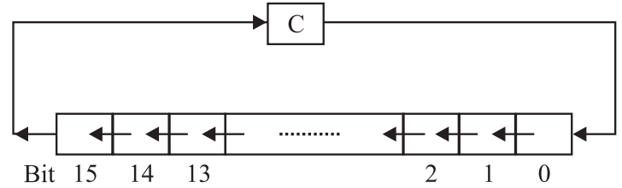
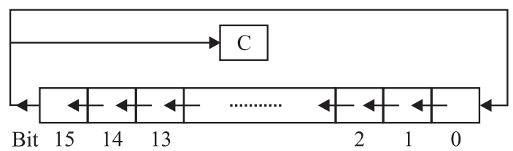
INSTRUCTION SET OF 8086
Shift and Rotate Instructions.
RCL – Rotate left through carry
ROL- Rotate left

Slide 53
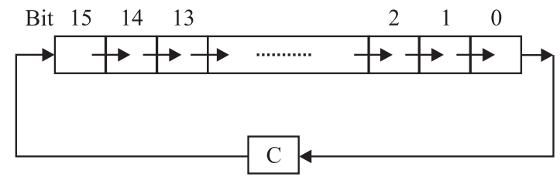
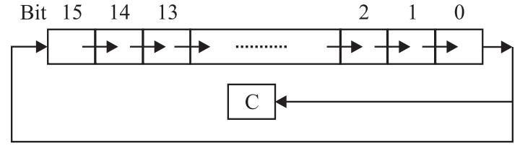
INSTRUCTION SET OF 8086
Shift and Rotate Instructions.
RCR – Rotate right through carry
ROR- Rotate Right

Slide 54
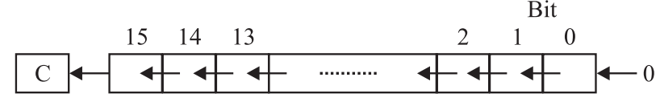
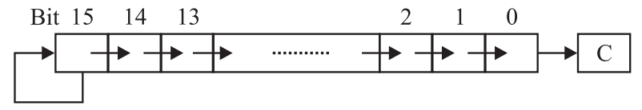
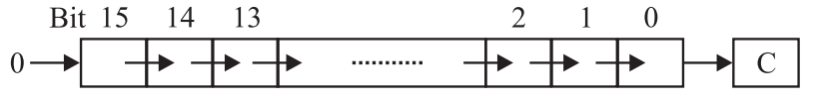
INSTRUCTION SET OF 8086
Shift and Rotate Instructions.
SAL/SHL – Arithmetic/Logical Shift left
SAR- Shift Arithmetically Right
SHR- Logically Shift Right

Slide 55
INSTRUCTION SET OF 8086
String Instructions.
MOVSB Destination String Name, Source String Name / MOVSW Destination String Name, Source String Name
This instruction copies a byte or a word from location in the data segment to a location in the extra segment.
The offset of the source in the data segment must be in the SI register. The offset of the destination in the extra segment must be in the DI register.
LODS / LODSB / LODSW (LOAD STRING BYTE INTO AL OR STRING WORD INTO AX)
This instruction copies a byte from a string location pointed to by SI to AL, or a word from a string location pointed to by SI to AX.
If DF=0, SI is incremented automatically or DF=1, SI is decremented automatically.
STOS / STOSB / STOSW (STORE STRING BYTE OR STRING WORD)
This instruction copies a byte from AL or a word from AX to a memory location in the extra segment pointed to by DI

Slide 56
INSTRUCTION SET OF 8086
String Instructions.
CMPS / CMPSB / CMPSW (COMPARE STRING BYTES OR STRING WORDS):
This instruction can be used to compare a byte / word in one string with a byte / word in another string.
SI is used to hold the offset of the byte or word in the source string, and
DI is used to hold the offset of the byte or word in the destination string.
The CMPS instruction can be used with a REPE or REPNE prefix to compare all the elements of a string.
SCAS / SCASB / SCASW (SCAN A STRING BYTE OR A STRING WORD):
SCAS compares a byte in AL or a word in AX with a byte or a word in ES pointed to by DI. Therefore, the string to be scanned must be in the extra segment, and DI must contain the offset of the byte or the word to be compared.

Slide 57
INSTRUCTION SET OF 8086
String Instructions.
REP / REPE / REPZ / REPNE / REPNZ (PREFIX) (REPEAT STRING INSTRUCTION UNTIL SPECIFIED CONDITIONS EXIST)
REP is a prefix, which is written before one of the string instructions.
It will cause the CX register to be decremented and the string instruction to be repeated until CX = 0.
The instruction REP MOVSB, for example, will continue to copy string bytes until the number of bytes loaded into CX has been copied.
REPE and REPZ are two mnemonics for the same prefix. They stand for repeat if equal and repeat if zero, respectively
REPE CMPSB ;Compare string bytes until ZF=1or CX=0.
REPNE and REPNZ are also two mnemonics for the same prefix. They stand for repeat if not equal and repeat if not zero, respectively.
REPNE SCASW ;Scan a string of word until ZF=0 or CX=0

Slide 58
INSTRUCTION SET OF 8086
Data Adjustment Instructions.
AAA (ASCII ADJUST FOR ADDITION): The numbers 0 to 9 are represented by the ASCII codes 30H to 39H.
Let AL = 0011 0101 (ASCII 5), and BL = 0011 1001 (ASCII 9)
ADD AL, BL ;AL = 0110 1110 (6EH, which is incorrect BCD)
AAA ;AL = 0000 0100 (unpacked BCD 4) CF = 1 indicates answer is 14 decimal. The AAA instruction works only on the AL register
AAS (ASCII ADJUST FOR SUBTRACTION):
➢Let AL = 00111001 (39H or ASCII 9), and BL = 00110101 (35H or ASCII 5)
SUB AL, BL ;AL = 00000100 (BCD 04), and CF = 0
AAS ;AL = 00000100 (BCD 04), and CF = 0 (no borrow required)

Slide 59
INSTRUCTION SET OF 8086
Data Adjustment Instructions.
AAM (BCD ADJUST AFTER MULTIPLY ): Before you can multiply two ASCII digits, you must first mask the upper 4 bit of each
Let AL = 00000101 (unpacked BCD 5), and BH = 00001001 (unpacked BCD 9)
MUL BH ;AL x BH: AX = 00000000 00101101 = 002DH
AAM ;AX = 00000100 00000101 = 0405H (unpacked BCD for 45)
AAD (BCD-TO-BINARY CONVERT BEFORE DIVISION):
Let AX = 0607 (unpacked BCD for 67 decimal), and CH = 09H
AAD ;AX = 0043 (43H = 67 decimal)
DIV CH ;AL = 07; AH = 04; Flags undefined after DIV

Slide 60
INSTRUCTION SET OF 8086
Data Adjustment Instructions.
DAA (DECIMAL ADJUST AFTER BCD ADDITION): This instruction is used to make sure the result of adding two packed BCD numbers is adjusted to be a legal BCD number. The result of the addition must be in AL for DAA to work correctly.
If the lower nibble in AL after an addition is greater than 9 or AF was set by the addition, then the DAA instruction will add 6 to the lower nibble in AL.
If the result in the upper nibble of AL in now greater than 9 or if the carry flag was set by the addition or correction, then the DAA instruction will add 60H to AL.
➢ Let AL = 59 BCD, and BL = 35 BCD
ADD AL, BL ;AL = 8EH; lower nibble > 9, add 06H to AL
DAA ; AL = 94 BCD, CF = 0

Slide 61
INSTRUCTION SET OF 8086
Data Adjustment Instructions.
DAS (DECIMAL ADJUST AFTER BCD SUBTRACTION): This instruction is used after subtracting one packed BCD number from another packed BCD number, to make sure the result is correct packed BCD.
The result of the subtraction must be in AL for DAS to work correctly. If the lower nibble in AL after a subtraction is greater than 9 or the AF was set by the subtraction, then the DAS instruction will subtract 6 from the lower nibble AL.
If the result in the upper nibble is now greater than 9 or if the carry flag was set, the DAS instruction will subtract 60 from AL.
Let AL = 49 BCD, and BH = 72 BCD
SUB AL, BH ;AL = D7H; upper nibble > 9, subtract 60H from AL
DAS ;AL = 77 BCD, CF = 1 (borrow is needed)

Slide 62
INSTRUCTION SET OF 8086
Flag related Instructions.
STC (SET CARRY FLAG)
CLC (CLEAR CARRY FLAG)
CMC (COMPLEMENT CARRY FLAG)
STD (SET DIRECTION FLAG)
CLD (CLEAR DIRECTION FLAG)
STI (SET INTERRUPT FLAG)
CLI (CLEAR INTERRUPT FLAG)
LAHF (COPY LOW BYTE OF FLAG REGISTER TO AH REGISTER)
SAHF (COPY AH REGISTER TO LOW BYTE OF FLAG REGISTER)

Slide 63
INSTRUCTION SET OF 8086
Control transfer Instructions.
JMP (UNCONDITIONAL JUMP TO SPECIFIED DESTINATION):This instruction will fetch the next instruction from the location specified in the instruction rather than from the next location after the JMP instruction.
CALL (CALL A PROCEDURE): The CALL instruction is used to transfer execution to a subprogram or a procedure. There two basic type of calls near and far.
RET (RETURN EXECUTION FROM PROCEDURE TO CALLING PROGRAM): The RET instruction will return execution from a procedure to the next instruction.
INT – INT TYPE The term type in the instruction format refers to a number between 0 and 255, which identify the interrupt.
INTO (INTERRUPT ON OVERFLOW): If the overflow flag (OF) is set, this instruction causes the 8086 to do an indirect far call to a procedure.
IRET (INTERRUPT RETURN): The IRET instruction is used at the end of the interrupt service procedure to return execution to the interrupted program.

Slide 64
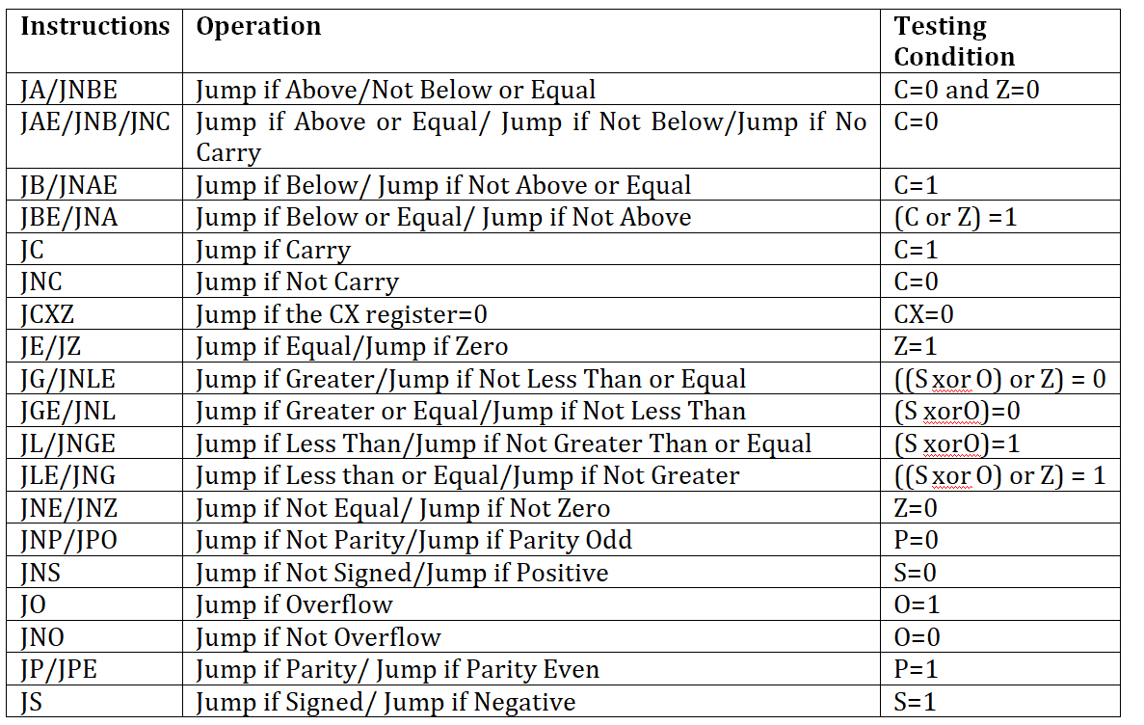
INSTRUCTION SET OF 8086
Control transfer Instructions.
Jump
Conditional

Slide 65
INSTRUCTION SET OF 8086
Control transfer Instructions.
LOOP (JUMP TO SPECIFIED LABEL IF CX ≠ 0 AFTER AUTO DECREMENT): This instruction is used to repeat a series of instructions some number of times. The number of times the instruction sequence is to be repeated is loaded into CX.
Each time the LOOP instruction executes, CX is automatically decremented by 1.
LOOPE / LOOPZ (LOOP WHILE CX ≠ 0 AND ZF = 1): This instruction is used to repeat a group of instructions some number of times, or until the zero flag becomes 0. The two ways to exit the loop are CX = 0 or ZF = 0.
LOOPNE / LOOPNZ (LOOP WHILE CX ≠ 0 AND ZF = 0): This instruction is used to repeat a group of instructions some number of times, or until the zero flag becomes a 1. The two ways to exit the loop are CX = 0 or ZF = 1.

Slide 66
INSTRUCTION SET OF 8086
Process Control Instructions(MISCELLANEOUS INSTRUCTIONS)
NOP (PERFORM NO OPERATION): This instruction simply uses up three clock cycles. The NOP instruction can be used to increase the delay of a delay loop.
ESC (ESCAPE): This instruction is used to pass instructions to a coprocessor, such as the 8087 Math coprocessor, which shares the address and data bus with 8086.
HLT (HALT PROCESSING): The HLT instruction causes the 8086 to stop fetching and executing instructions.
WAIT – WAIT FOR SIGNAL OR INTERRUPT SIGNAL: When this instruction is executed, the 8086 enters an idle condition in which it is doing no processing.
LOCK – ASSERT BUS LOCK SIGNAL: This instruction prevents the other processor rom acquiring the buses during execution of an instruction.
While Executing MOV AX, 2000H DMA controller request buses then Microprocessor stops this data transfer execution.
But, while LOCK MOV AX, 2000H, processor will not release the buses before execution.

Slide 67
ASSEMBLY LANGUAGE
Assembly language is symbolic representation of Machine language.
Assembly language is more user friendly than machine language because it uses English alphabets instead of bits.
An assembly language program is sequence of statements, there are three classes of statements:
Instructions
Psuedo Operations and
Directives
An assembly statement contain four fields:
Label
Opcode
Operands
Comments

Slide 68
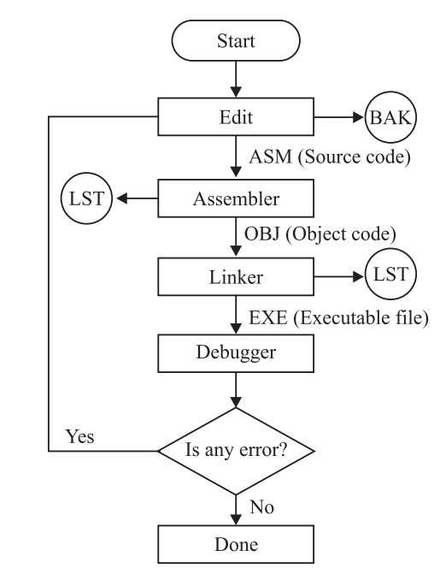
ASSEMBLY LANGUAGE PROGRAM DEVELOPMENT TOOLS
Assembly language program development tools are the components that are used to write and execute an assembly program.
These tools are:
Editor
Assembler
Linker
Loader
Debugger
Flowchart of the steps:

Slide 69
ASSEMBLY LANGUAGE PROGRAM DEVELOPMENT TOOLS
Editor:
An Editor is a program which is used to edit compile and debug a file containing the assembly language program.
This file is called a source file.
Assembler:
An Assembler is used to translate the assembly language mnemonics into machine language( i.e binary codes).
The assembler generates two files . The first file is the Object file with the extension .OBJ.
The second file is the assembler list file with the extension .LST.
Linker:
A linker is a program used to connect several object files into one large object file.
The linkers which come with TASM or MASM assemblers produce link files with the .EXE extension.

Slide 70
ASSEMBLY LANGUAGE PROGRAM DEVELOPMENT TOOLS
Loader:
A loader/locator is a program used to assign the specific addresses of where the segments of object code are to be loaded into memory.
Debugger:
A debugger is a program which allows to load your object code program into system memory, execute the program, and troubleshoot or debug it.
Some debuggers allows to stop the program after each instruction so that you can check or alter memory and register contents. This is called single step debug.
A debugger also allows to set a breakpoint at any point in the program.

Slide 71
ASSEMBLER DIRECTIVES
Assembler directives are the directions to the assembler.
These are also called pseudo operations which are not executable by the microprocessor.
1. ASSUME : The ASSUME directive is used to inform the assembler the name of the logical segment it should use for a specified segment.
Ex: ASSUME DS: DATA tells the assembler that for any program instruction which refers to the data segment ,it should use the logical segment called DATA.
2.DB -Define byte. It is used to declare a byte variable or set aside one or more storage locations of type byte in memory.
For example, CURRENT_VALUE DB 36H tells the assembler to reserve 1 byte of memory for a variable named CURRENT_ VALUE and to put the value 36 H in that memory location when the program is loaded into RAM .
3. DW -Define word. It tells the assembler to define a variable of type word or to reserve storage locations of type word in memory.

Slide 72
ASSEMBLER DIRECTIVES
4. DD(define double word) :This directive is used to declare a variable of type double word or restore memory locations which can be accessed as type double word.
5.DQ (define quadword) :This directive is used to tell the assembler to declare a variable 4 words in length or to reserve 4 words of storage in memory .
6.DT (define ten bytes):It is used to inform the assembler to define a variable which is 10 bytes in length or to reserve 10 bytes of storage in memory.
7. EQU –Equate It is used to give a name to some value or symbol. Every time the assembler finds the given name in the program, it will replace the name with the value or symbol we have equated with that name
8.ORG -Originate : The ORG statement changes the starting offset address of the data.
It allows to set the location counter to a desired value at any point in the program.For example the statement ORG 3000H tells the assembler to set the location counter to 3000H.

Slide 73
ASSEMBLER DIRECTIVES
9 .PROC- Procedure: It is used to identify the start of a procedure. Or subroutine.
10. END- End program .This directive indicates the assembler that this is the end of the program module.The assembler ignores any statements after an END directive.
11. ENDP- End procedure: It indicates the end of the procedure (subroutine) to the assembler.
12.ENDS-End Segment: This directive is used with the name of the segment to indicate the end of that logical segment.
Ex: CODE SEGMENT : Start of logical segment containing code
CODE ENDS : End of the segment named CODE.

Slide 74
Thank You

