Slide 1

Programming in 8086
Marwadi University
Subject Code:01CE0509
Subject Name: Fundamental of Processors
B.Tech. Year–III
Unit- 4

Slide 2

Outline
Introduction
Flow chart
Programming steps
Programmable Peripheral IC:
Intel 8255,
Intel 8255A Pin Description,
8279 Keyboard and Display Controller,
8259A Programmable Interrupt Controller,
DMA and 8237 DMA Controller
Looping

Slide 3
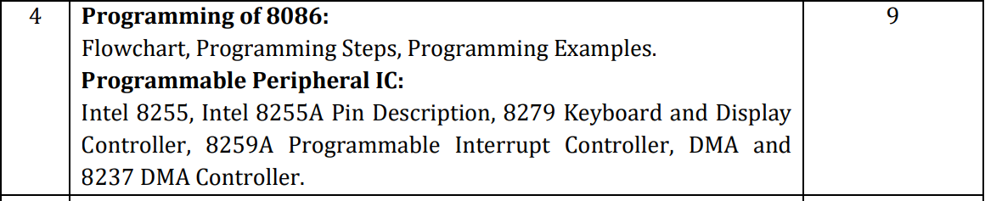
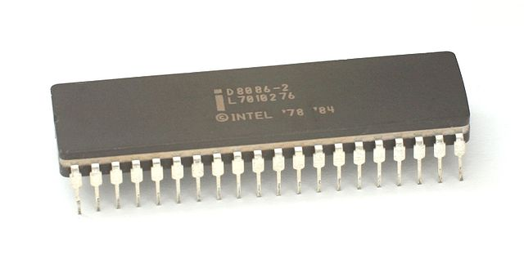
Syllabus

Slide 4
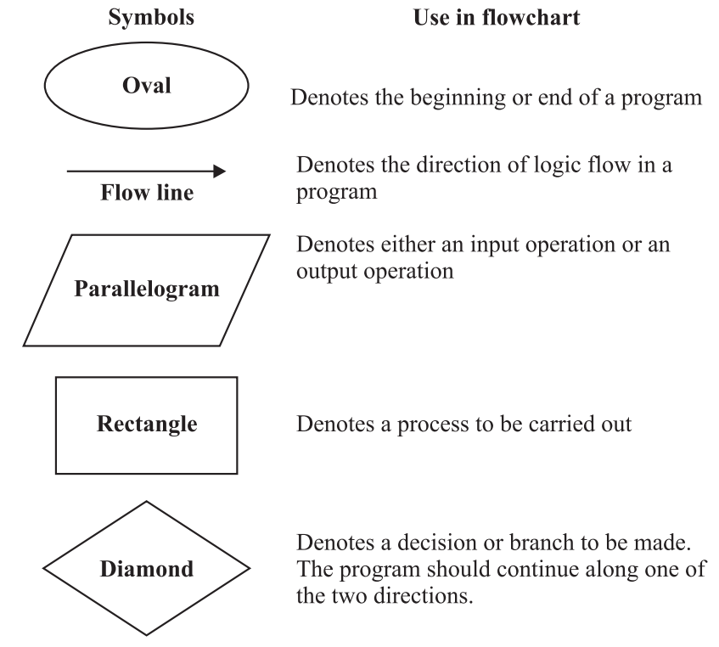
Flowchart
Flow chart is graphical representation of a flow of data and sequence of events during the execution of program.

Slide 5
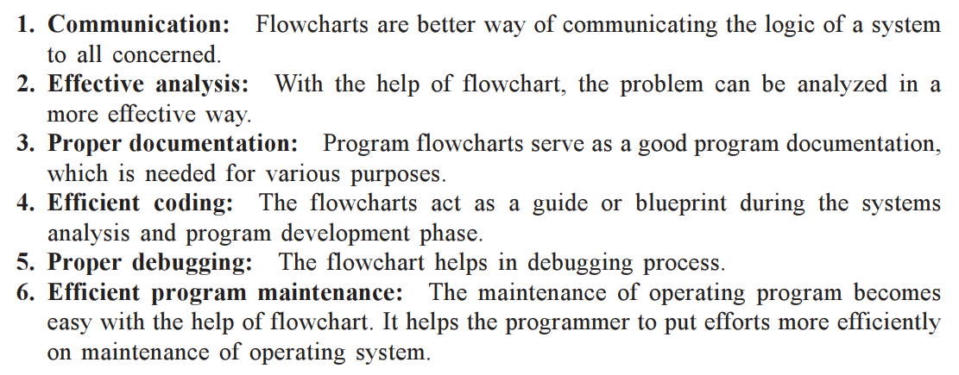
Flowchart
Advantages of using flowchart:

Slide 6
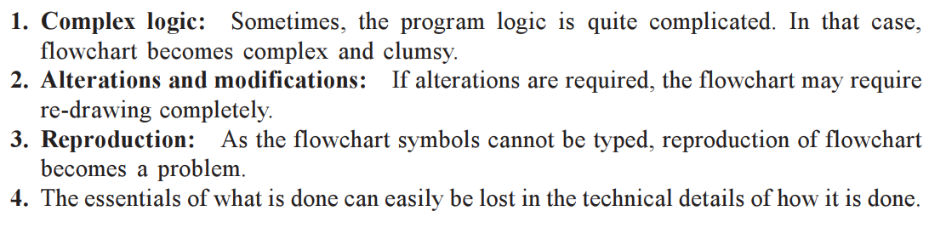
Flowchart
Limitations of using flowchart:

Slide 7
Programming steps
Define the Problem to be solved: the problem for which you are preparing the program, the different terms must be clearly mentioned such as,
What are the inputs to your program?
What is the operation you are expecting?
Where you want the output?
Solution Plan: The plan to solve the program should be prepared like
How are you taking input data?
Which method you are using to solve the problem and steps?
How will you output the results?

Slide 8
Programming steps
Flowchart: Prepare the flowchart for the plan you have decide to give the exact idea of how program should flow to be flow to get correct result.
Program: Go on putting the Instructions in the place of flowchart blocks.
Check the result: Now find the codes for instructions Processor and execute the program. It will give you result.
If the result is correct, the program you have prepared is correct.

Slide 9
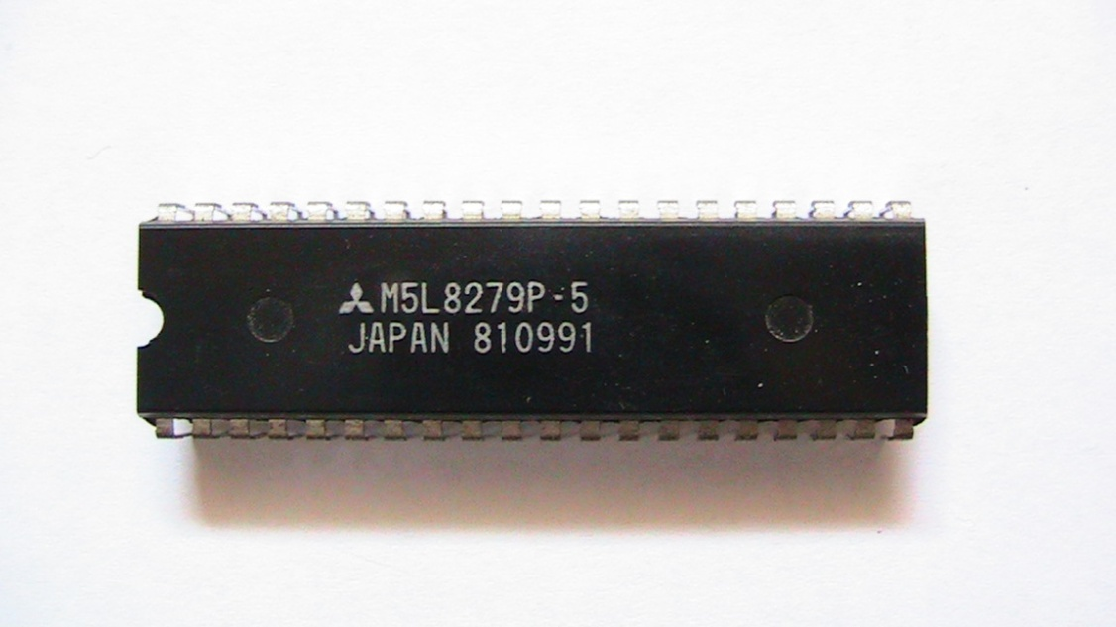
8279- Keyboard and Display Controller
8279 programmable keyboard/display controller is designed by Intel that interfaces a keyboard with the CPU.
The 8279 first scans the keyboard and identifies if any key has been pressed.
It then sends their relative response of the pressed key to the CPU and vice-a-versa.

Slide 10
8279- Keyboard and Display Controller
How Many Ways the Keyboard is Interfaced with the CPU?
The Keyboard can be interfaced either in the interrupt or the polled mode. In the Interrupt mode, the processor is requested service only if any key is pressed, otherwise the CPU will continue with its main task.
In the Polled mode, the CPU periodically reads an internal flag of 8279 to check whether any key is pressed or not with key pressure.

Slide 11
8279- Keyboard and Display Controller
How Does 8279 Keyboard Work?
The keyboard consists of maximum 64 keys, which are interfaced with the CPU by using the key-codes.
These key-codes are de-bounced and stored in an 8-byte FIFO RAM, which can be accessed by the CPU.
If more than 8 characters are entered in the FIFO, then it means more than eight keys are pressed at a time.
This is when the overrun status is set.

Slide 12
8279- Keyboard and Display Controller
How Does 8279 Keyboard Work?
If a FIFO contains a valid key entry, then the CPU is interrupted in an interrupt mode
else the CPU checks the status in polling to read the entry.
Once the CPU reads a key entry, then FIFO is updated,
and the key entry is pushed out of the FIFO to generate space for new entries.

Slide 13
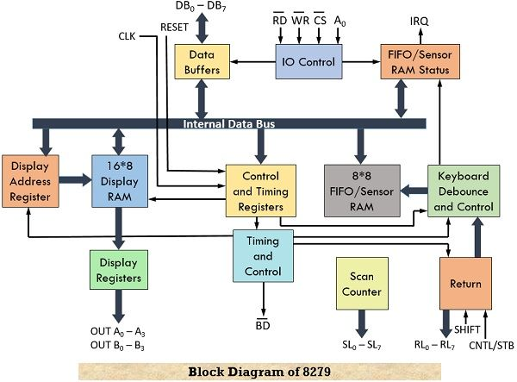
8279- Keyboard and Display Controller
Architecture and Description:

Slide 14
8279- Keyboard and Display Controller
Architecture and Description:
Let us understand the operation of this architecture by considering its 4 separate sections.
Keyboard Section:
This section is composed of Return Buffer and Keyboard De-bounce and Control.
It holds the 8 return lines denoted by RL₀ to RL₇ that forms the column of the keyboard matrix.
Shift and Control/Strobe are the two additional inputs provided to this unit.

Slide 15
8279- Keyboard and Display Controller
Architecture and Description:
It has 8*8 FIFO RAM that works on the First–In–First–Out approach and can store 8 keycodes (code of pressed key) at a time in a sequential manner.
The status of two additional input keys i.e., shift and control are also stored within FIFO RAM.

Slide 16
8279- Keyboard and Display Controller
Architecture and Description:
In scan keyboard mode,
8 keycodes are stored and anytime whenever an entry is made in the FIFO RAM then 8279 generates an interrupt signal that tells the processor to perform FIFO read operation till the time everything within FIFO is serviced.
While in sensor matrix mode, the FIFO RAM holds the condition of 64 switches within it regarding whether these are open or closed. Whenever the condition of any switch is changed then 8279 generates an interrupt request for the processor.

Slide 17
8279- Keyboard and Display Controller
Architecture and Description:
2. Display Section: This section is constituted by display address registers and display RAM.
This section contains 8 output lines i.e., A₀-A₃ and B₀-B₃ and these are connected to the 7-segment LEDs.
There is a 16*8 display RAM and the processor simply performs read and write operations within this RAM.
The display address registers contain the address of that word on which the processor is currently performing the read/write operation.

Slide 18
8279- Keyboard and Display Controller
Architecture and Description:
3. Scan Section: The scan counter and four scan lines (SL₀ to SL₃) are part of this section.
There are two modes of scan counter namely, encode and decode.
In encode mode, a binary count will be obtained as the output of scan lines and this requires external decoding to give rise to decoded output.
These output scan lines are the same for the keyboard and display and 4 scan lines can drive up to 16 displays.

Slide 19
8279- Keyboard and Display Controller
Architecture and Description:
However, in decode scan mode, internal decoding is performed that will provide a decoded 1 out of 4 scan lines and thus can drive up to 4 displays.
Through scan lines, rows of the matrix keyboard are formed, and also it forms the connection to the drivers of the display unit.

Slide 20
8279- Keyboard and Display Controller
Architecture and Description:
4. CPU Interface Section:
This section is composed of I/O control and Data Buffers along with Timing and Control Registers.
The timing and control unit is also a part of this unit.
This section is responsible for data transfer between 8279 and the CPU and hence consists of bidirectional data lines DB₀ to DB₇.

Slide 21
8279- Keyboard and Display Controller
Architecture and Description:
There are two internal addresses whose specified value i.e., either 0 or 1 makes the selection for either data buffer or control register.
Here we have pins A₀, CS, RD, and WR that are used for command, status, read and write operations.
The IRQ is an interrupt request line that is specified for data transfer that is associated with generated interrupt requests.

Slide 22
8279- Keyboard and Display Controller
Architecture and Description:
It operates on an internal clock frequency of 100 kHz. The RESET signal provided to the 8279 is responsible for setting its 16-character display. The control and timing register holds the modes and operating conditions which program the CPU.

Slide 23
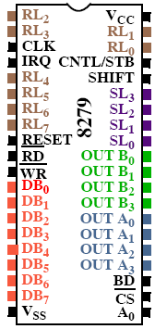
8279- Keyboard and Display Controller
PIN DESCRIPTION:
A0: Selects data (0) or control/status (1) for reads and writes between micro and 8279.
Output that blanks the displays.
CLK: Used internally for timing. Max is 3 MHz.
CN/ST: Control/strobe, connected to the control key on the keyboard.
Chip select that enables programming, reading the keyboard, etc.
DB7-DB0: Consists of bi-directional pins that connect to data bus on micro.

Slide 24

8279- Keyboard and Display Controller
PIN DESCRIPTION:
IRQ: Interrupt request, becomes 1 when a key is pressed, data is available.
OUT A3-A0/B3-B0: Outputs that sends data to the most significant/least significant nibble of display.
IRQ: Interrupt request, becomes 1 when a key is pressed, data is available.
OUT A3-A0/B3-B0: Outputs that sends data to the most significant/least significant nibble of display.
: Connects to micro's IORC or RD signal, reads data/status registers.
RESET: Connects to system RESET.
RL7-RL0: Return lines are inputs used to sense key depression in the keyboard matrix.
Shift: Shift connects to Shift key on keyboard.
SL3-SL0: Scan line outputs scan both the keyboard and displays.
: Connects to micro's IORC or RD signal, reads data/status registers.
RESET: Connects to system RESET.
RL7-RL0: Return lines are inputs used to sense key depression in the keyboard matrix.
Shift: Shift connects to Shift key on keyboard.
SL3-SL0: Scan line outputs scan both the keyboard and displays.

Slide 25
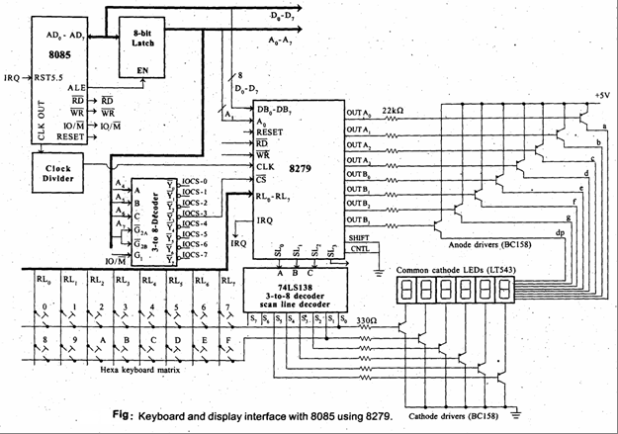
8279- Keyboard and Display Controller

Slide 26
DMA and 8237 DMA Controller.
Introduction: DMA stands for Direct Memory Access.
It is designed by Intel to transfer data at the fastest rate.
It allows the device to transfer the data directly to/from memory without any interference of the CPU.
Suppose any device which is connected to input-output port wants to transfer data to memory,
first of all it will send input-output port address and control signal, input-output read to input-output port,
then it will send memory address and memory write signal to memory where data has to be transferred.

Slide 27
DMA and 8237 DMA Controller.
In normal input-output technique the processor becomes busy in checking whether any input-output operation is completed or not for next input-output operation, therefore this technique is slow.
This problem of slow data transfer between input-output port and memory or between two memory is avoided by implementing Direct Memory Access (DMA) technique.
This is faster as the microprocessor/computer is bypassed and the control of address bus and data bus is given to the DMA controller.

Slide 28
DMA and 8237 DMA Controller.
8237 is a high-performance programmable DMA controller. Some of the important features of 8237 DMA controllers are mentioned below:
Features of 8237 DMA Controller:
It provides various modes of Direct memory access (DMA).
It provides on-chip four independent DMA channels. The number of channels can be increased by cascading DMA controller chips.
Each channel can be used in auto initialization mode.

Slide 29
DMA and 8237 DMA Controller.
It can transfer data between two memory blocks in DMA mode i.e. memory to memory transfer.
In memory-to-memory transfer, a single word can be written into all locations of memory blocks.
The address of memory is either incremented or decremented after each DM cycle depending upon the mode.
The clock frequency is 3 MHz (8237 DMA C0ntroller) or 5 MHz (8237-2 DMA Controller).
The data transfer rate is very high i.e. 1.6 Mbytes/second for 8237-2 at 5 MHz.

Slide 30
DMA and 8237 DMA Controller.
Directly expandable to any number of channels. It doesn’t require any additional chip for cascading. There are no limitations in cascading.
The DMA can be requested by setting an appropriate bit for the request register.
It provides compressed timings to improve the throughput of the system. It can compress the transfer time to two cycles (2s).

Slide 31
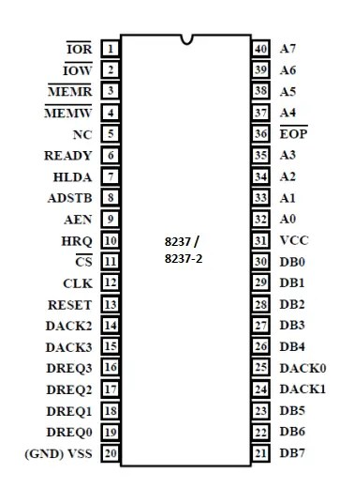
DMA and 8237 DMA Controller.
Pin Configuration:
CLK: This is the clock input line.
The data transfer rate depends upon the frequency of this signal.
CS: Select the 8237 chip for communication between the CPU and 8237
Reset: It is an asynchronous input line. This signal clears the command, status, request, and temporary register

Slide 32
DMA and 8237 DMA Controller.
Pin Configuration:
READY: this signal is used to add wait states into the DMA cycle.
HRQ: It is a hold request output line. It is connected to hold the input of the CPU. it is used to request control of the system bus.
HLDA: It is a hold acknowledge input line. This signal is generated by the CPU.

Slide 33
DMA and 8237 DMA Controller.
Pin Configuration:
IOR:It is an active low bi-directional tristate line.
This signal is generated during the DMA cycle to read data from the I/O device.
IOW: It is an active low bi-directional tristate line.
This signal is generated during the DMA read cycle to write data into the I/O device.

Slide 34
DMA and 8237 DMA Controller.
Pin Configuration:
A₀ – A₃These are bi-directional, address lines. the 8237 provides lower bits of memory address on these lines.
A₄ – A₇These are tristate address output lines.
the 8237 transfers higher bits of memory addressed on these lines.

Slide 35
DMA and 8237 DMA Controller.
Pin Configuration:
MEMR: It is an active low tristate output line.
during memory to memory transfer cycle to read the contents of source memory.
MEMWIt is an active low tristate output line.
during the memory-to-memory transfer cycle to write data into destination memory.

Slide 36
DMA and 8237 DMA Controller.
Pin Configuration:
DB₀ – DB₇These are bi-directional tristate buffered data lines.
these lines are used to transfer data between the CPU and 8237 registers.
DREQ₀ –DREQ₃ :These are asynchronous DMA channel request lines used by the peripheral. these lines can be used as either active high or active low input. –

Slide 37
DMA and 8237 DMA Controller.
Pin Configuration:
DACK₀–DACK₃:These are DMA acknowledge output lines.
The signal indicates that the requesting peripheral has been granted for the DMA cycle.
EOP: End of Process: It is an active low bi-directional signal.
This line is also used to terminate the DMA cycle.

Slide 38
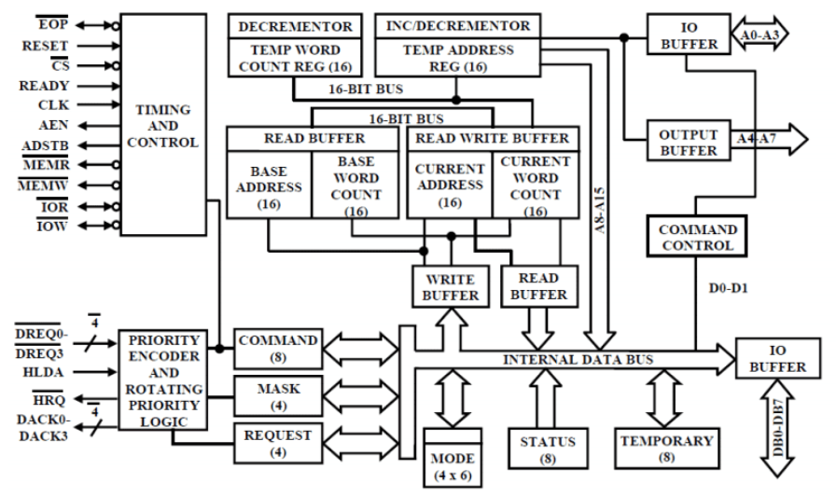
DMA and 8237 DMA Controller.
Block Diagram:

Slide 39
Thank You

