Slide 1

Advance Processors
Marwadi University
Subject Code:01CE0509
Subject Name: Fundamental of Processors
B.Tech. Year–III
Unit- 5

Slide 2

Outline
Syllabus
80286 Basic features
80386 Basic features
80486 Basic features
Pentium Basic features
Comparison Pentium and ARM processors
Looping

Slide 3
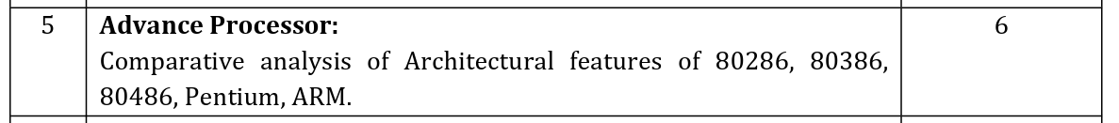
Syllabus

Slide 4
80286 Basic Features
Microprocessor 80286 was introduced in 1982.
80286 microprocessor is an advanced version of the 8086 microprocessor that is designed for multi user and multitasking environments.
It is 16 bit microprocessor and it has 24 address lines.
The 80286 addresses 16 MB of physical memory and 1G Bytes of virtual memory by using its memory-management system.
The 80286 is basically an 8086 that is optimized to execute instructions in fewer clocking periods than the 8086.

Slide 5
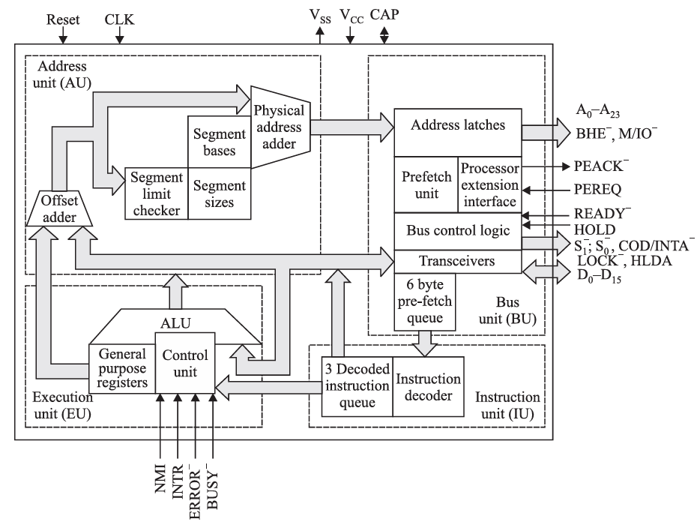
80286 Architecture
The CPU, central processing unit of 80286 microprocessor, consists of 4 functional block:
Address Unit
Bus Unit
Instruction Unit
Execution Unit

Slide 6
80286 Basic Features
The 80286 operates in both the real and protected modes.
In the real mode, the 80286 addresses a 1MB memory address space and is virtually identical to 8086.
In the protected mode, the 80286 addresses a 16MB memory
In protected mode, it is possible to protect memory and other system resources. Address unit becomes complete memory management unit in protected mode.
The 80286 contains the same instructions except for a handful of additional instructions that control the memory-management unit

Slide 7
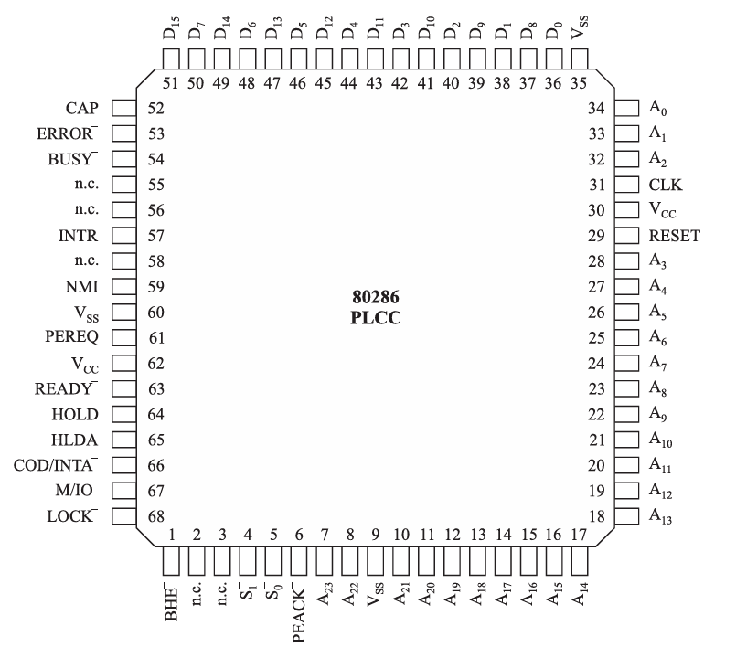
Pin description of 80286
68 pins, PLCC package
Address bus and data bus are not multiplexed.
Most of the pins are the same as that of in 8086.
It has total 12 flags
6 Status flags (Same as 8086)
3 Control flags (Same as 8086)
3 Special field flags

Slide 8
80386 Basic Features
The 80386 microprocessor is an enhanced version of the 80286 microprocessor and includes a memory-management unit is enhanced to provide memory paging.
The 80386 also includes 32-bit extended registers and a 32-bit address and data bus.
The 80386 has a physical memory size of 4GB that can be addressed as a virtual memory with up to 64TBytes.
The 80386 is operated in the pipelined mode, it sends the address of the next instruction or memory data to the memory system prior to completing the execution of the current instruction

Slide 9
80386 Basic Features
This allows the memory system to begin fetching the next instruction or data before the current is completed.
This increases access time, thus reducing the speed of the memory.
The I/O structure of the 80386 is almost identical to the 80286, except that I/O can be inhibited when the 80386 is operated in the protected mode through the I/O bit protection map.
The register set of the 80386 contains extended versions of the registers introduced on the 80286 microprocessor. These extended registers include EAX, EBX, ECX, EDX, EBP, ESP, EDI, ESI, EIP and EFLAGS.
All 32 bit Registers and 32 bit instruction queue.

Slide 10
80386 Basic Features
The instruction set of the 80386 is enhanced to include instructions that address the 32-bit extended register set.
Interrupts, in the 80386 microprocessor, have been expanded to include additional predefined interrupts in the interrupt vector table.
The 80386 memory manager is similar to the 80286, except the physical addresses generated by the MMU are 32 bits wide instead of 24-bits.
The 80386 is also capable of paging. Page size is 4KB
The 80386 is operated in the real mode (i.e. 8086 mode) when it is reset.
The real mode allows the microprocessor to address data in the first 1MByte of memory.

Slide 11
80386 Basic Features
In the protected mode, 80386 addresses any location in its 4G bytes of physical address space.
It has 32 bit address bus and 32 bit data bus which are not multiplexed.
We can broadly divide internal architecture into 3 sections:
Central processing unit
Memory Management unit
Bus Interface Unit

Slide 12
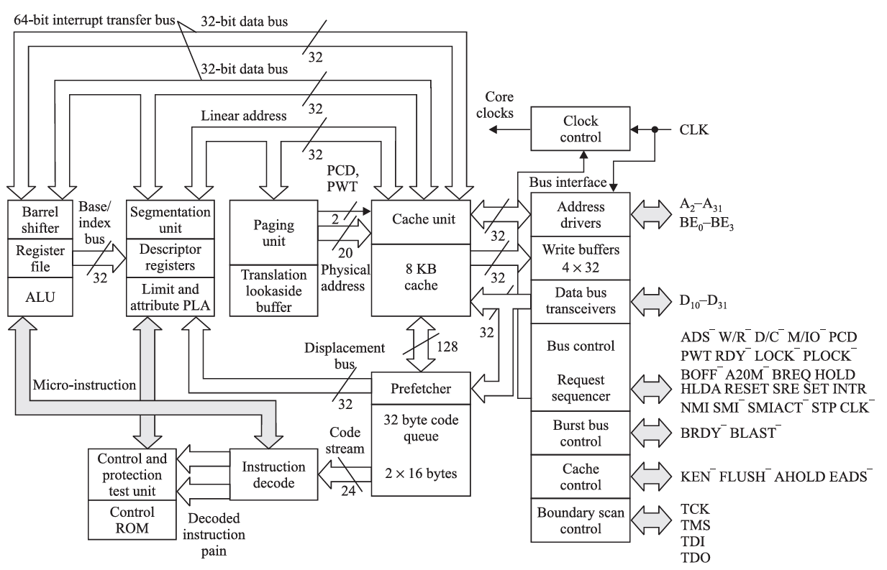
80386 Block Diagram

Slide 13
80386 Basic Features
80386 Consists of
Eight 32 bit general purpose registers
One 32 bit Flag Register
Six Segment Register
Four Control Register
Four Memory Management Registers for Protected mode
Eight Debug Registers

Slide 14
80486 Basic Features
The 80486 is a 32 bit microprocessor.
One of the most obvious feature included in 80486 is a built-in math co-processor. Which is same as 80387 used with a 80386.
80486 have 8KB code and data cache.
80486 packaged in a 168 pin, Pin grid array package.
80486 integrated Floating Point Unit(FPU) on chip.
32 bit Extended general purpose register, Flag Register, address bus and data bus.
The Physical memory of 80486 is 32 bit wide which are set up as four 8 bit banks: bank0, bank1, bank2, bank3. and all bank contain one extra parity bit.

Slide 15
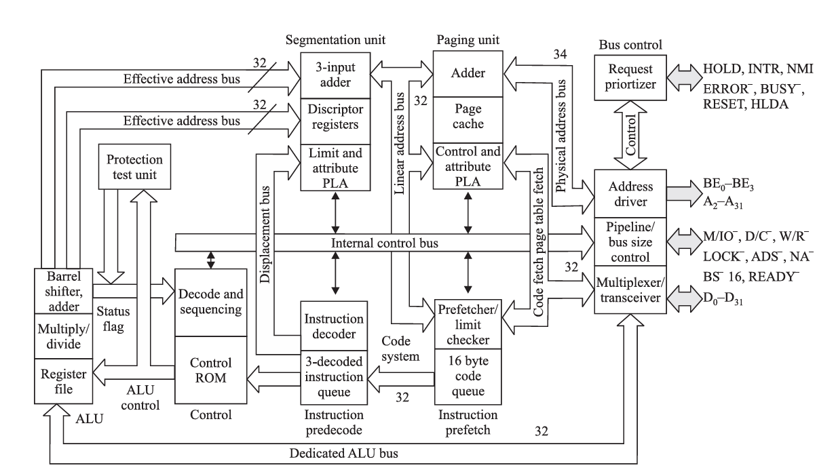
80486 Block diagram

Slide 16
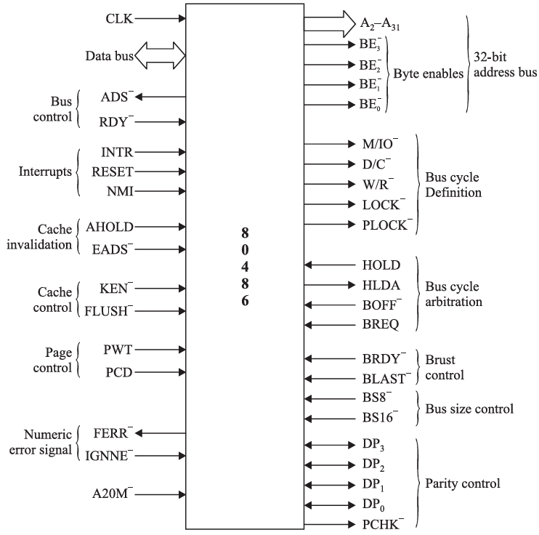
80486 Pin Diagram

Slide 17
Pentium Processor basic features
The Pentium microprocessor is 32 bit processor and almost identical to the earlier 80386 and 80486 microprocessors.
It introduces second execution pipeline to achieve superscalar performance and execute two instruction per clock cycle using two independent ALU named ‘U’ and ‘V’. It has Two core execution unit.
The main difference is that the Pentium has been modified internally to contain a dual cache of 16KB (code 8KB and data 8KB) and a dual integer unit.
The Pentium also operates at a higher clock speed of 66 MHz.
The data bus on the Pentium is 64 – bits wide and contains eight 8 byte-wide memory banks selected with bank enable signals.

Slide 18
Pentium Processor basic features
Memory access time, without wait states, is only about 18 ns in the 66 MHz Pentium.
The superscalar structure of the Pentium contains three independent processing units: a floating point processor and two integer processing units.
A new mode of operation called the System Memory Management (SMM) mode has been added to the Pentium. It is intended for high-level system functions such as power management and security.
The Built-in Self-test (BIST) allows the Pentium to be tested when power is first applied to the system.
Allows 4MByte memory pages instead of the 4KByte pages

Slide 19
Pentium Processor basic features
Pentium Processor have:
Superscalar Architecture
Dynamic Branch prediction
Pipelined floating point unit
Separate code and data caches
64-bit data bus
Bus cycle pipelining
Address parity
Internal Parity Checking

Slide 20
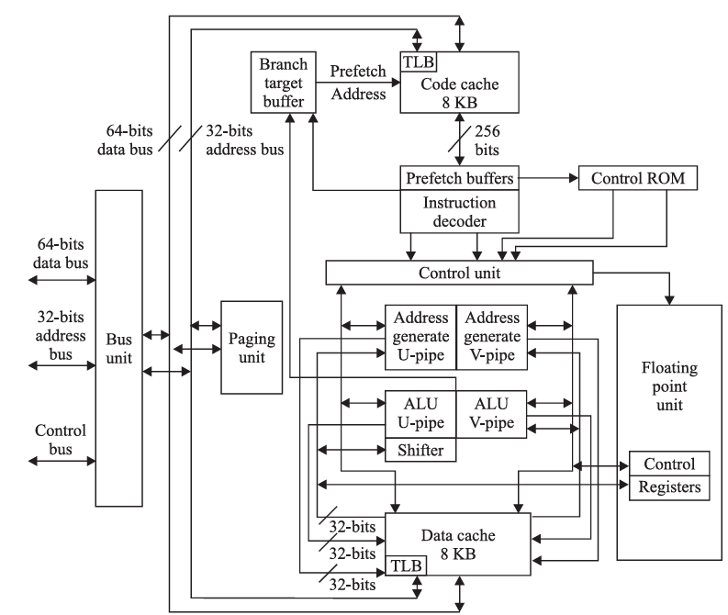
Pentium Processor Functional Block diagram

Slide 21
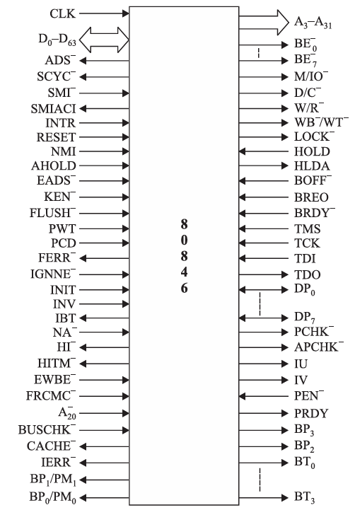
Pentium Processor Pin Diagram

Slide 22
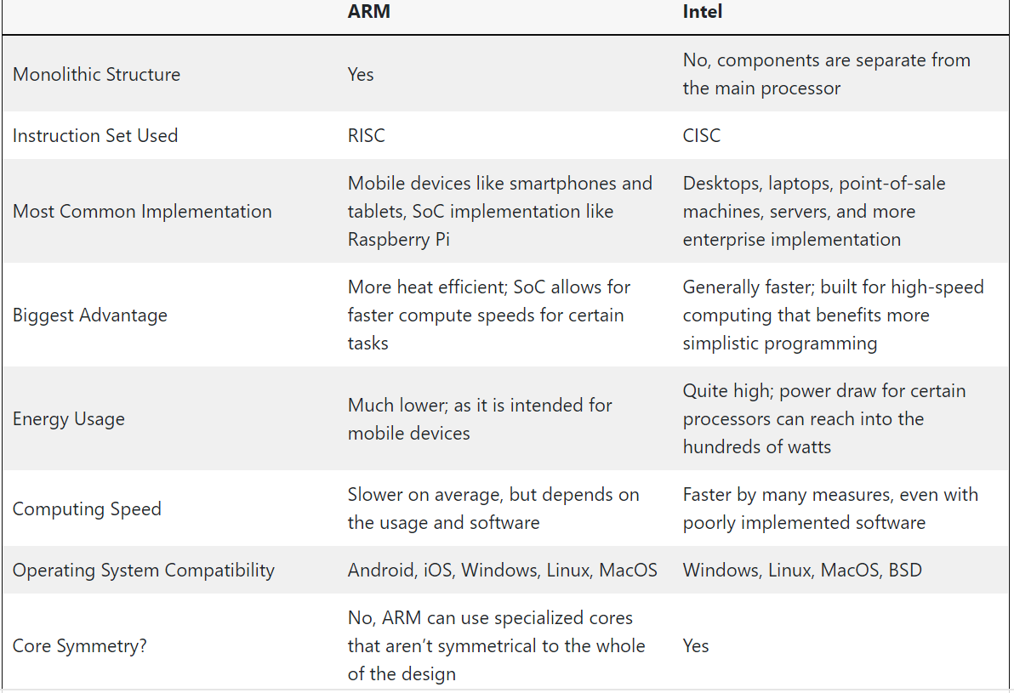
ARM vs. Intel Processors: Side-by-Side Comparison

Slide 23
Thank You

