Slide 1

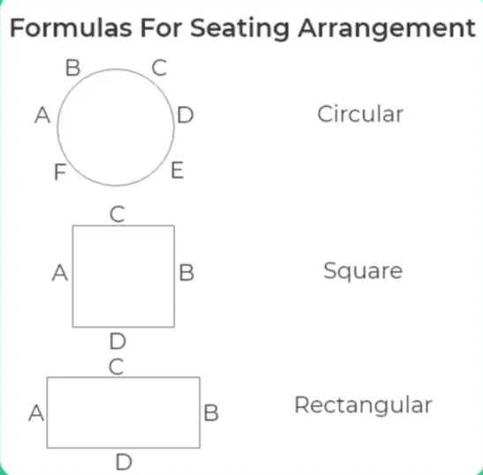
Seating Arrangement - 2

Slide 2

Puzzle of the day..
Answer the questions based on the following information:
A B A C
+ B D A
+ A E
_____________________________
G D F E
In the above notation, the letters represent distinct digits from 2 to 9. Out of C, A and E two numbers multiply to yield the third number.
GDFE when divided by E gives the remainder of:
(a) 0 (b) 1 (c) 2 (d) 3
Ans : C

Slide 3
Puzzle of the day..
Answer the questions based on the following information:
A B A C
+ B D A
+ A E
_____________________________
G D F E
In the above notation, the letters represent distinct digits from 2 to 9. Out of C, A and E two numbers multiply to yield the third number.
Which of the following represent a perfect cube?
(a) A (b) B (c) E (d) F
Ans : A

Slide 4
Ranking Arrangement
In a class, Krishna is ranked 8th from the top and 48th from the bottom. How many students are there in his class?
A ranks 5th from the top in the class. B is 8th from the last. If C is ranked 6th after A and just in the middle of A and B, how many students are there in the class?
In a row of certain persons, Pradip is sitting 463 from the left end and 531 from the right end. Find out the total number of persons in that row?
Ans : 55
Ans : 24
Ans : 993

Slide 5
Data Arrangement
Directions for questions 1 to 5 :
P, Q, R, S, T, U and V are seven professors. Each one teaches a different subject from Physics, Chemistry, Biology, English, Mathematics, Economics and Geography, not necessarily in the same order. Each of them teaches one day each on seven days of the week from Monday to Sunday not necessarily in the same order.
R teaches Biology on Friday. Q teaches Mathematics on the previous day of the day on which the professor teaches Physics. V teaches on Sunday but does not teach Chemistry or English. S teaches Economics on the previous day on which U teaches. P teaches Geography on Tuesday. T does not teach English.

Slide 6
Data Arrangement
Which subject does T teach?
(a) Chemistry (b) Physics (c) Biology (d) Mathematics
Which subject does U teach?
(a) Physics (b) English (c) Biology (d) Mathematics
On which day does T teach?
(a) Monday (b) Wednesday (c) Thursday (d) None
On which day does U teach?
Wednesday (b) Thursday (c) Friday (d)Saturday
5. Which subject does V teach?
(a) Chemistry (b) English (c) Biology (d) None
Ans: (1) A (2) B (3) A (4) C (5) D

Slide 7
Data Arrangement
Directions for questions 6 to 10 :
B, M, T, R, K, H and D are travelling in a train compartment with III-tier sleeper berth. Each of them has a different profession of Engineer, Doctor, Architect, Pharmacist, Lawyer, Journalist and Pathologist. They occupied two lower berths, three middle berths and two upper berths.
B, the engineer , is not on the upper berth. The architect is the only other person who occupies the same type of berth as that of B.
M and H are not on the middle berth and their professions are Pathologist and Lawyer respectively.
T is a Pharmacist. D is neither a Journalist nor an Architect. K occupies the same type of berth as that of the Doctor.

Slide 8
Data Arrangement
Who is the Architect?
(a) D (b) H (c) R (d) None
What is D’s profession?
(a) Pharmacist (b) Lawyer (c) Engineer (d) None
Which of the following pairs occupy the lower berth?
(a) BT (b) BD (c) BK (d) None
Which of the following groups occupies the middle berth?
(a) DKT (b) HKT (c) DKR (d) DHT
Who is the pharmacist?
(a) R (b) T (c) U (d) None
Ans: (6) C (7) D (8) D (9) A (10) B

Slide 9


