Slide 1
Answer the questions on the basis of the information given below.
A, B, C, D, E, F and G are consecutive integers, not necessarily in the particular order, such that the lowest of these numbers is greater than 50 and the highest number is less than 60.
Additional information given:
E – D + 11 = G/4.
B is the highest number and is a prime number.
C – D = B – A.
A is an odd number and C is an even number.
The value of E-A:
a) 5 b) 4
c) 3 d) 2

Slide 2
Answer the questions on the basis of the information given below.
A, B, C, D, E, F and G are consecutive integers, not necessarily in the particular order, such that the lowest of these numbers is greater than 50 and the highest number is less than 60.
Additional information given:
E – D + 11 = G/4.
B is the highest number and is a prime number.
C – D = B – A.
A is an odd number and C is an even number.
The smallest number is:
a) A b) D
c) E d) F

Slide 3

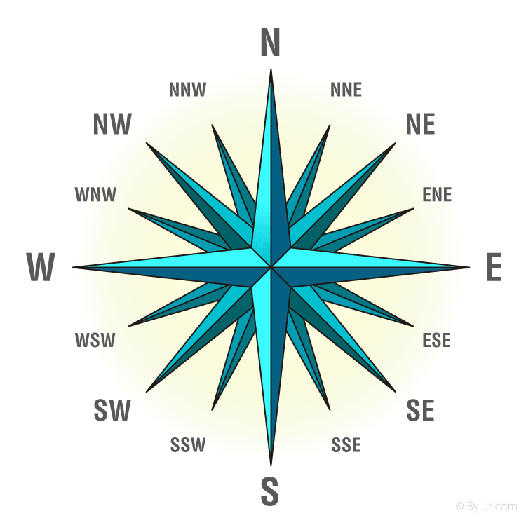
Direction Sense
Concepts
Finding Distance
Finding Direction
Coded Base Questions

Slide 4

Questions on Distance
Dev, Kumar, Nilesh, Ankur and Pintu are standing facing to the North in a playground such as given below:
Kumar is at 40m to the right of Ankur. Dev is 60m in the South of Kumar.
Nilesh is at a distance of 25 m in the west of Ankur.
Pintu is at a distance of 90 m in the North of Dev.
Which one is in the North-East of the person who is to the left of Kumar?
(a) Dev (b) Nilesh (c) Ankur (d) Pintu
D
If a boy starting from Nilesh, met to Ankur and then to Kumar and after this he to Dev and then to Pintu and whole the time he walked in a straight line, then how much total distance did he cover?
(a) 215 metres (b) 155 metres
(c) 245 metres (d) 185 metres
A

Slide 5
Questions on Direction
A man is facing north. He turns 90 degree in the clockwise direction and then another 45 degree in the same direction and then 180 degree in the anticlockwise direction. Find which direction is he facing now?
(a) NW (b) NE
(c) SE (d) SW
A
A man facing some direction. He turns 135° in the clockwise direction, then 90° in the anticlockwise direction and then another 135° in the same direction. If at the end he faced North direction, then from which direction he started?
(a) North (b) South
(c) East (d) West
C

Slide 6
Questions on Coded
Study the following information to answer the given questions: A * B - means B is 1m east to A, A @ B - means B is 1m west to A,
A # B - means B is 1m south to A, A % B - means B is 1m north to A,
A ! B - means B is 2m east to A, If M#N*P%U, is definitely true, then in which direction is M with respect to U?
(a) North (b) South (c) East (d) West
D
One day Pranav left home and walked 6 km northwards, turned right and walked for 8km and turned left and walked 6 km more and finally turned left and walked 8km. How many kilometres will he have to walk to reach his home straight?
(a) 6 km (b) 8 km
(c) 12 km (d) 16 km
C

Slide 7
Questions on Mix
A starts from his office and walks 3 km towards north. He then turns right and walks 2 km and then turns right and walks 5 km. he then turns right and walks 2 km and then again turns right and walks 2 km. in which direction is he from the starting point?
(a) North (b) South
(c) At the same point (d) None of these
C
Manish started from his house towards North. After covering a distance of 8 km. he turned towards left and covered a distance of 6 km. What is the shortest distance now from his house?
(a) 10 km (b) 16 km
(c) 14 km (d) 8 km
A

Slide 8
Questions on Mix
If South-East becomes North, North-East becomes West and so on. What will West become?
(a) North-East (b) South-West
(c) South-East (d) North-West
C
Rahul put his timepiece on the table in such a way that at 6 P.M. hour hand points to North. In which direction the minute hand will point at 9.15 P.M. ?
(a) North (b) West
(c) East (d) South
B

Slide 9


