Slide 1

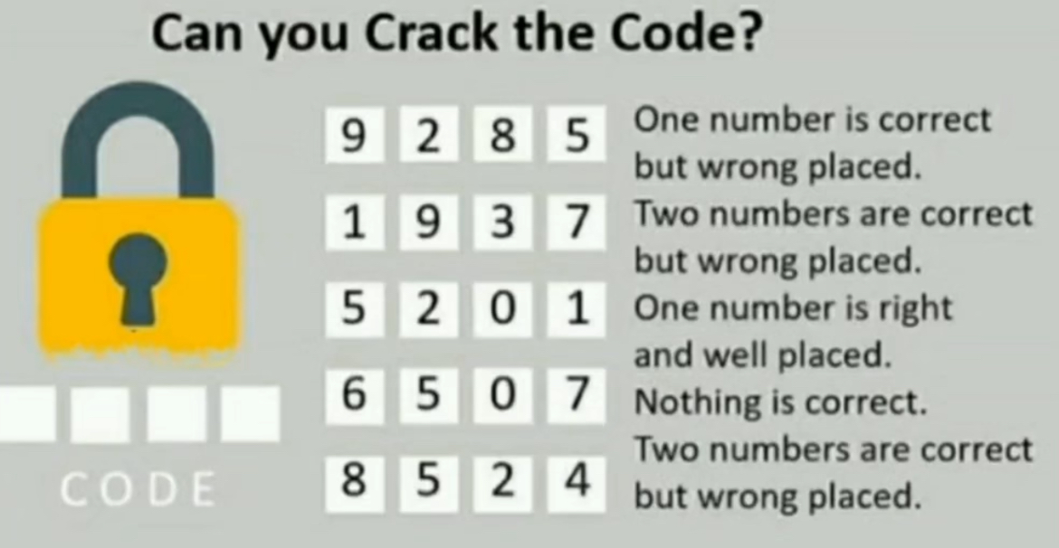

Slide 2
ONE + ONE + ONE
+ ONE
______
TEN
In the above notation each letter represents a distinct digit from 0 to 9, thus ONE and TEN are 3 digit numbers.
Find the value of | T – N |.

Slide 3
Count total number of Triangles in the given below diagram
45
48
54
63

Slide 4
Coding and Decoding
Concepts
Letter coding
Word and Sentence coding

Slide 5

Questions
In a certain code language, HONOUR is coded as RUONOH. In the same language, what will be the code for TOPS?
(a) SPOT (b) POST
(c) POTS (d) STOP
A
If MACROBYTE is written as BYETMAORC, then what will be the code for FUTUREMAP?
(a) EMPAFUTUR (b) EMPAUFRUT
(c) MEPAFURUT (d) EMPAFURUT
D

Slide 6
Questions
In a certain code language, TEAM is written as USFDBZNL. How should WORK be written in that code?
(a) XVPNQSJL (b) VXNPQSJL
(c) XVPNSQLJ (d) VXPNSQLJ
C
If RAJA is coded as 1 10 1 18, then how will QUEEN be coded in the same code language?
(a) 13 4 5 20 16 (b) 14 5 5 21 17
(c) 15 6 5 22 17 (d) 15 3 5 20 19
B

Slide 7
Questions
In a certain code language, TEACHER is coded as 9543658 and UNFIT is coded as 01729. How will FURNITURE be coded in that code language?
(a) 708229085 (b) 708179085
(c) 708129085 (d) 708126085
C
In a certain code language, SERIES is coded as 5625 and PIPE is coded as 2116. How will WAP be coded in the same code language?
(a) 1331 (b) 1600
(c) 1726 (d) 4096
B

Slide 8
Questions
In a certain code language, ‘red’ is called ‘rage’, ‘rage’ is called ‘passion’, ‘passion’ is called ‘bike’, ‘bike’ is called ‘honda’ and ‘honda’ is called ‘craze’. What is the code for ‘honda passion’?
(a) red bike (b) red rage
(c) red passion (d) craze bike
D
In a certain code language, CLATEXAM is coded as UBMDLZWD. What will be the code for FORECAST in the same code language?
(a) FSPGSRZB (b) FSPGSRYB
(c) FSPGSTZB (d) FSPGUTBD
A

Slide 9


