Slide 1

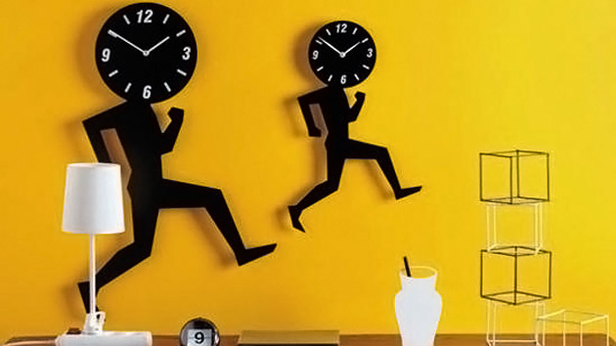
Clocks
Concepts
Angle Between hour and minute hand at a particular time
Time at a particular angle
Accurate and Inaccurate Clocks

Slide 2

Types of Questions
Calculate the angle between minute hand and hour hand
At a particular angle between 2 specific hours find the time when the angle strikes
Mirror Image of a time
Gaining and Losing examples

Slide 3
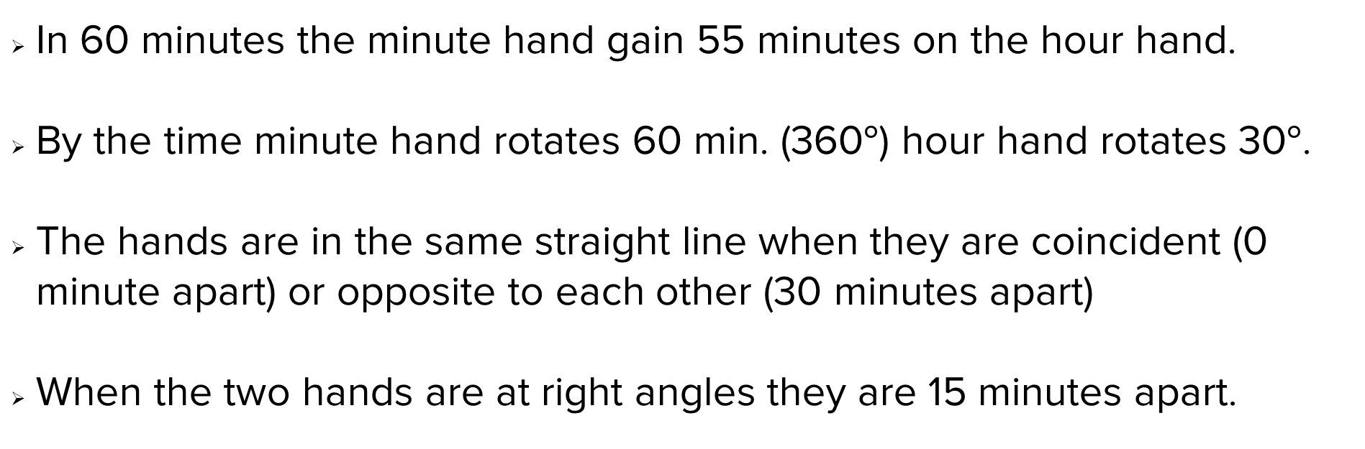
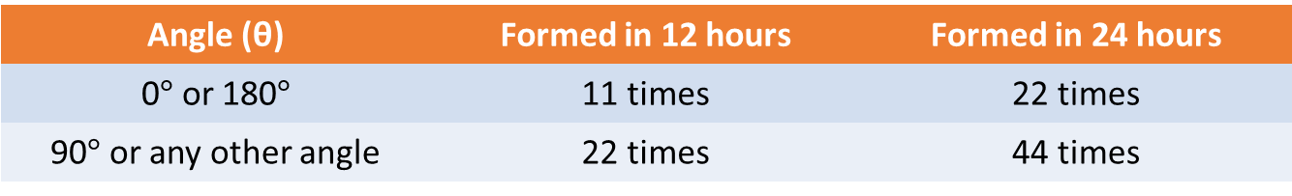
Concepts- Angles and Hands of a clock
In 60 minutes the minute hand gain 55 minutes on the hour hand.
By the time minute hand rotates 60 min. (360$°$) hour hand rotates 30$°$.
The hands are in the same straight line when they are coincident (0 minute apart) or opposite to each other (30 minutes apart)
When the two hands are at right angles they are 15 minutes apart.
Angle (θ) | Formed in 12 hours | Formed in 24 hours
0$°$ or 180$°$ | 11 times | 22 times
90$°$ or any other angle | 22 times | 44 times

Slide 4
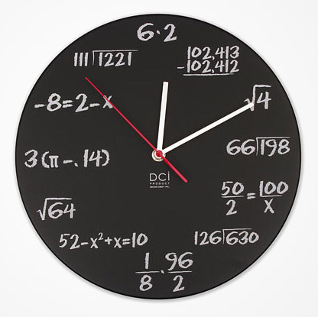
Find the angle between hour hand and minute hand
At 04:00 o’clock
At 07:30 o’clock
At 03:30 o’clock
At 01:15 o’clock
At 09:50 o’clock
03:25 o’clock
120°
45°
75°
52.5°
5°
47.5°

Slide 5
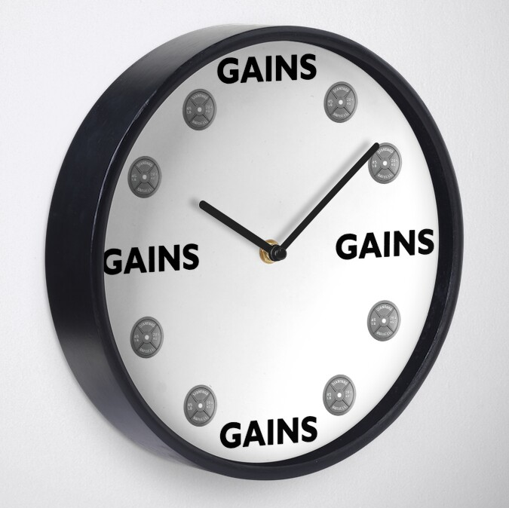
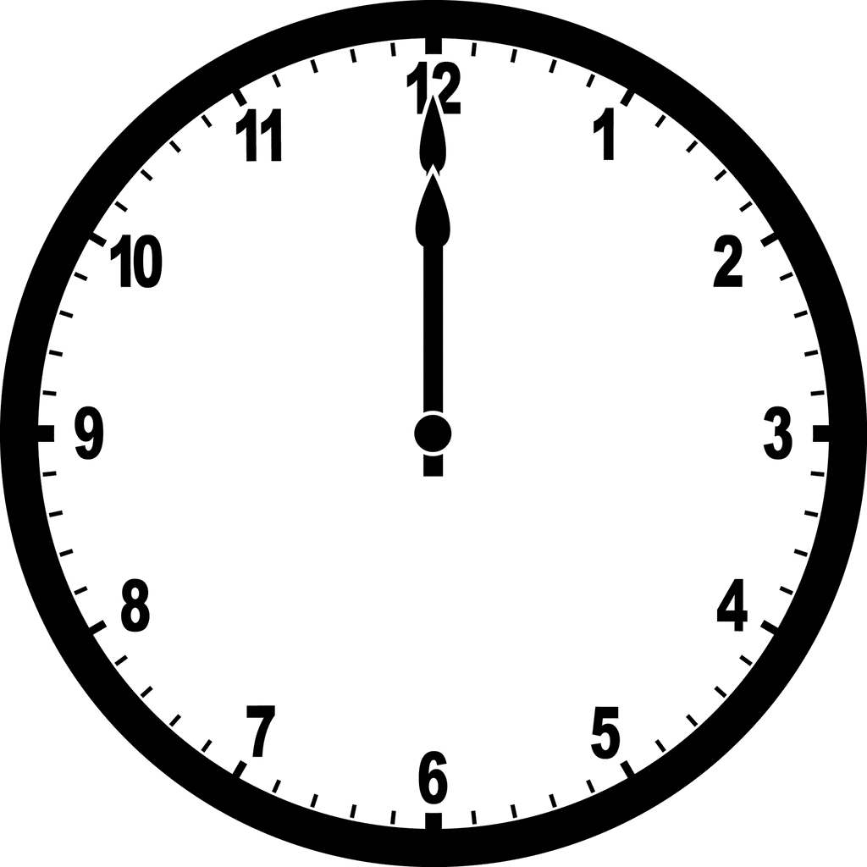
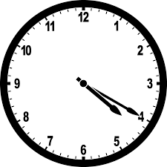
Some other questions
A clock gains 4 seconds every minute. Find the angle traversed by the minute hand in one hour.
(a) 360° (b) 366°
(c) 384° (d) 396°
C
A clock is started at noon. By what angle has the hour hand turned through by 4:20 p.m. the same day?
(a) 130° (b) 120°
(c) 140° (d) 150°
A

Slide 6
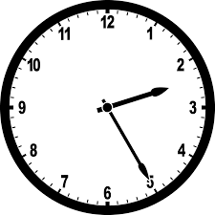
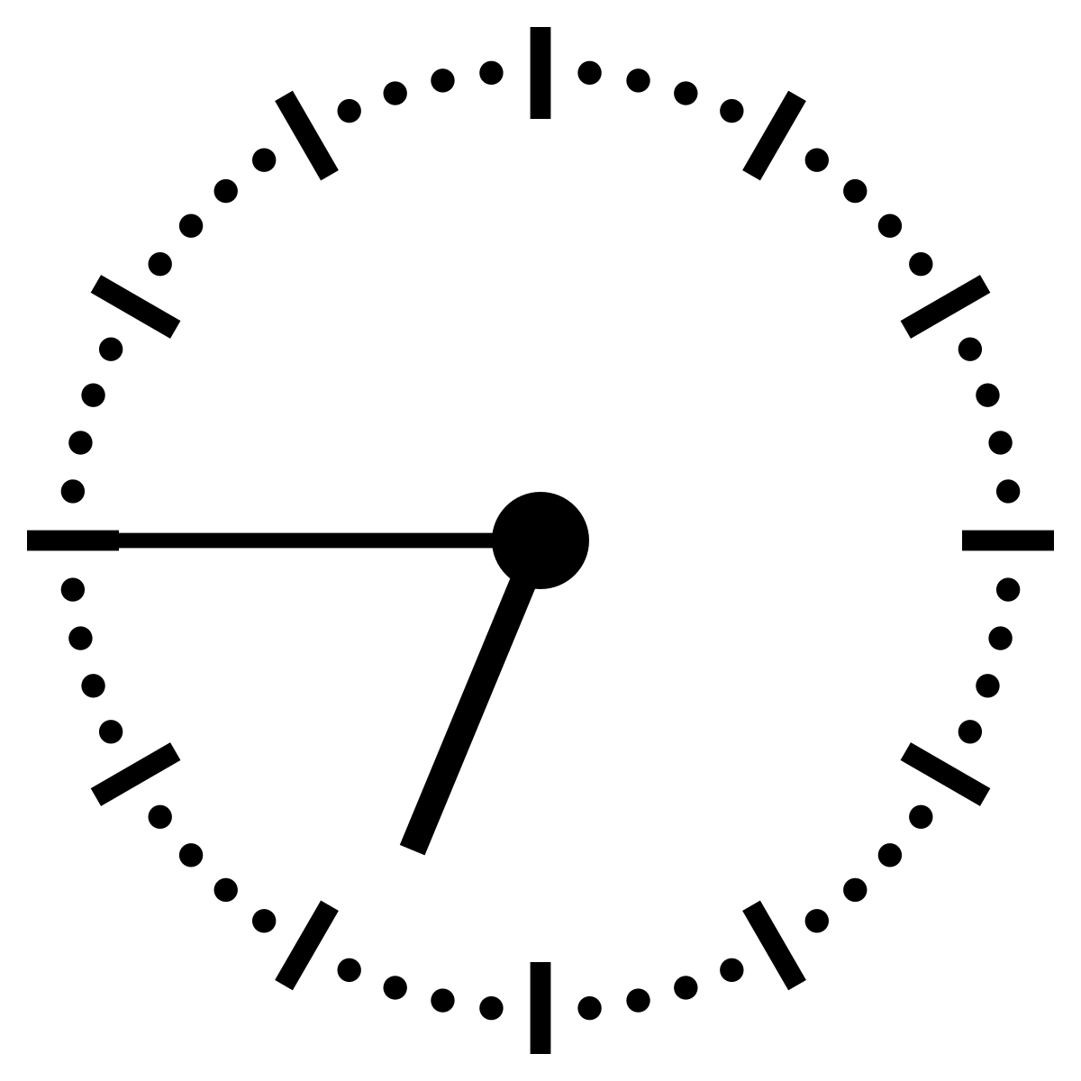
Some other questions
What is the angle between the minute hand and the hour hand of a clock at 25 minutes past 2?
(a) 75° (b) 80°
(c) 72.5° (d) 77.5°
D
If the time in a clock is 6 hours 45 minutes, then what time does it show on the mirror?
(a) 12 h 15 min (b) 5 h 15 min
(c) 9 h 15 min (d) None of these
B

Slide 7
Some other questions
A clock which gains uniformly is 3 minutes behind at 10 a.m. on Sunday and is 5 minutes 36 seconds ahead at 7 p.m. on the following Friday. When was it showing the correct time?
(a) 6 am Tue (b) 6 am Wed
(c) 7 am Tue (d) 7 am Wed
C
A clock is set right at 10:00 a.m. on Monday. It loses uniformly 12 minutes in 24 hours. What will be the true time if the clock indicates 9:30 p.m. the following Wednesday ?
(a) 10 pm (b) 9 pm
(c) 10:12 pm (d) 9:45 pm
A

Slide 8


