Slide 1


Calendar

Slide 2

History
Before today’s Gregorian calendar was adopted, the older Julian calendar was used. It was admirably close to the actual length of the year, as it turns out, but the Julian calendar was not so perfect that it didn’t slowly shift off track over the following centuries. But, hundreds of years later, monks were the only ones with any free time for scholarly pursuits – and they were discouraged from thinking about the matter of "secular time" for any reason beyond figuring out when to observe Easter.
It wasn’t until 1582, by which time Caesar’s calendar had drifted a full 10 days off course, that Pope Gregory XIII (1502 - 1585) finally reformed the Julian calendar. Ironically, by the time the Catholic church buckled under the weight of the scientific reasoning that pointed out the error, it had lost much of its power to implement the fix. Protestant tract writers responded to Gregory’s calendar by calling him the "Roman Antichrist" and claiming that its real purpose was to keep true Christians from worshiping on the correct days. The "new" calendar, as we know it today, was not adopted uniformly across Europe until well into the 18th century.

Slide 3
Calendar – Q1 to Q5
If today is Monday then what is the day of the week on 21st day?
If today is Tuesday then what is the day of the week on 67th day?
If today is Wednesday then what is the day of the week on 117th day?
If today is Thursday then what is the day of the week on 191st day?
If today is Friday then what is the day of the week on 225th day?

Slide 4
Explanation
Calculation for Gregorian Calendar:
No. of Extra Days in a regular year (365 days)= 1
No. of Extra Days in a leap year (366 days)= 2
No. of extra days in 1 century (100 years) = 5
No. of extra days in 2 centuries (200 years) = 3 (or 10)
No. of extra days in 3 centuries (300 years) = 1 (or 15)
No. of extra days in 4 centuries (400 years) = 0 (instead of 20 there are 21 extra days)
Extra days at the end:
1 | 2 | 3 | 4 | 5 | 6 | 7/0
Mon | Tue | Wed | Thu | Fri | Sat | Sun

Slide 5
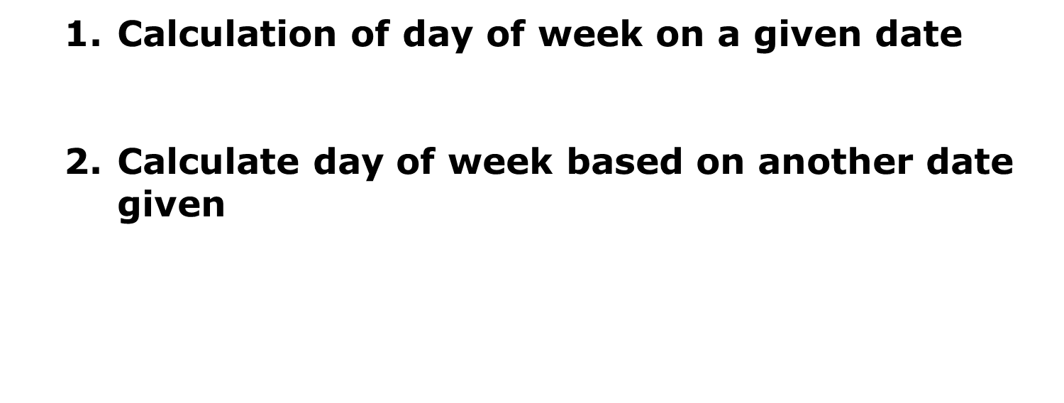
Concepts

Slide 6
Day of the week on given date
1. On which day of the week was on 14th June 1994 ?
No. of extra days in 1 century (100 years) = 5
No. of extra days in 2 centuries (200 years) = 10 or 3
No. of extra days in 3 centuries (300 years) = 15 or 1
No. of extra days in 4 centuries (400 years) = 21 or 0
1 | 2 | 3 | 4 | 5 | 6 | 7/0
Mon | Tue | Wed | Thu | Fri | Sat | Sun

Slide 7
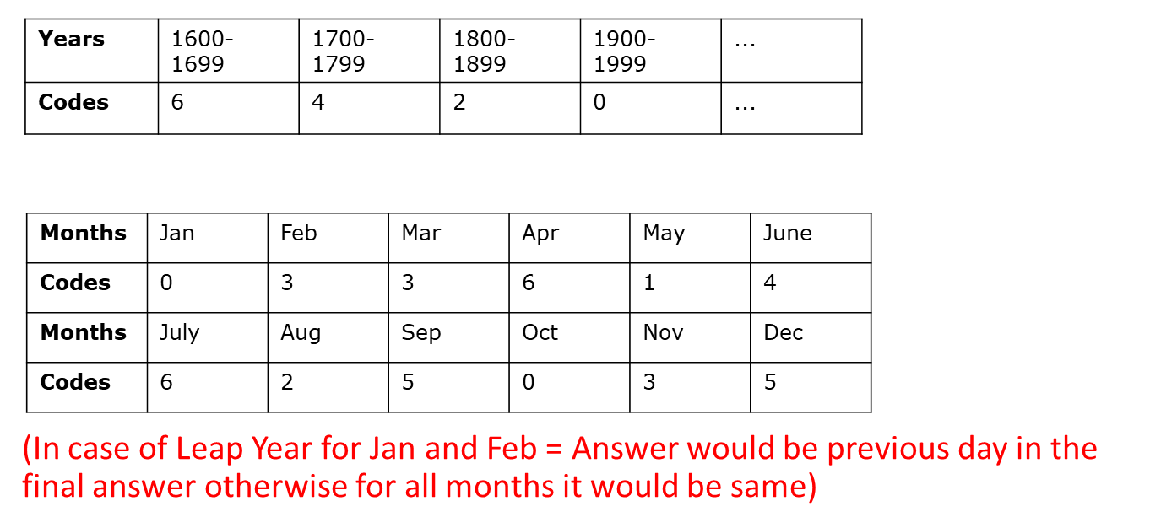
Calendar – Concept - 1
1. On which day of the week was Christmas celebrated in 1994 ?

Slide 8
Short – cut tricks

Slide 9
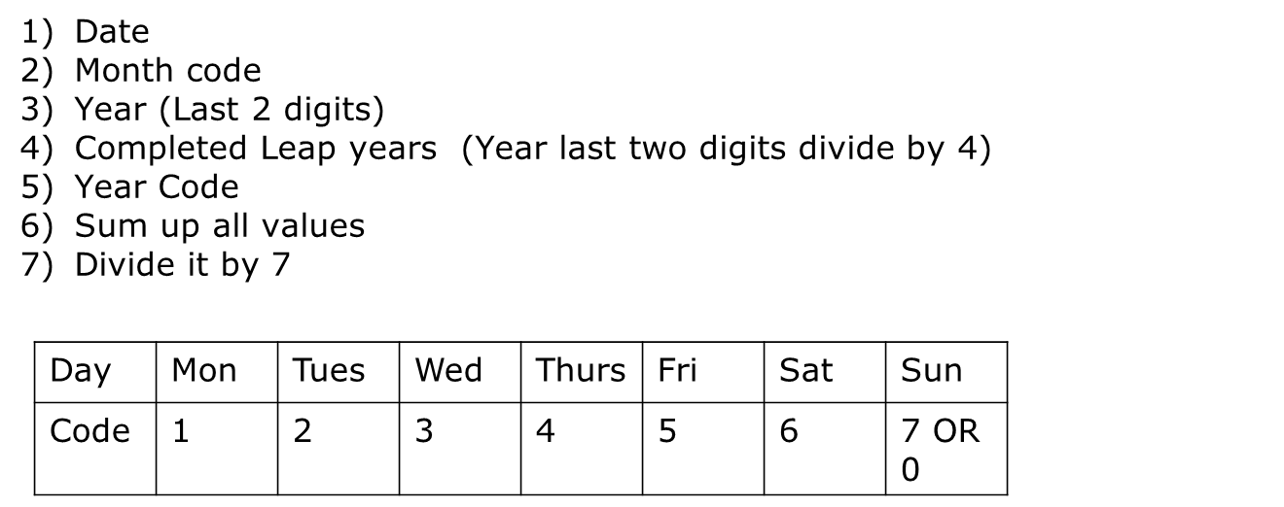
Problem solving steps

Slide 10
Calendar – Concept - 2
2. January 1st ,2006 was a Sunday. What day of the week was January 1st , 2010?

Slide 11
Calendar
The first November of a year is a Tuesday. What day of the week will be 1st March of the same year?

Slide 12
Calendar
What was the last day of 2nd Century?

Slide 13
Calendar
Today is Friday. After 125 days , it will be?

Slide 14
Calendar
The year next to 2013 having the same calendar as that of 2013 is ?

Slide 15
Calendar
7. Which dates of March, 2010 were Wednesdays ?

Slide 16
Reference Books Available In Library
Quantitative Aptitude By Dr. R. S. Aggarwal
Library Code : 153.9 AGG FT0003477
How to prepare for Quantitative Aptitude
By Arun Sharma
Library Code : 153.9 SHA 0015658
A Modern Approach to Verbal & Non-Verbal Reasoning
By Dr. R. S. Aggarwal
Library Code : 153.9 AGG FT0003533

Slide 17

Thank you...
Location : MB307

