Slide 1

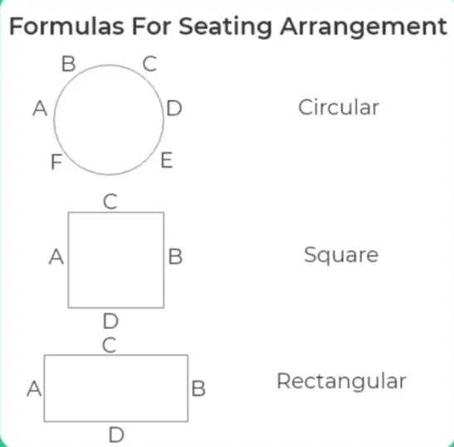
Seating Arrangement - 1

Slide 2

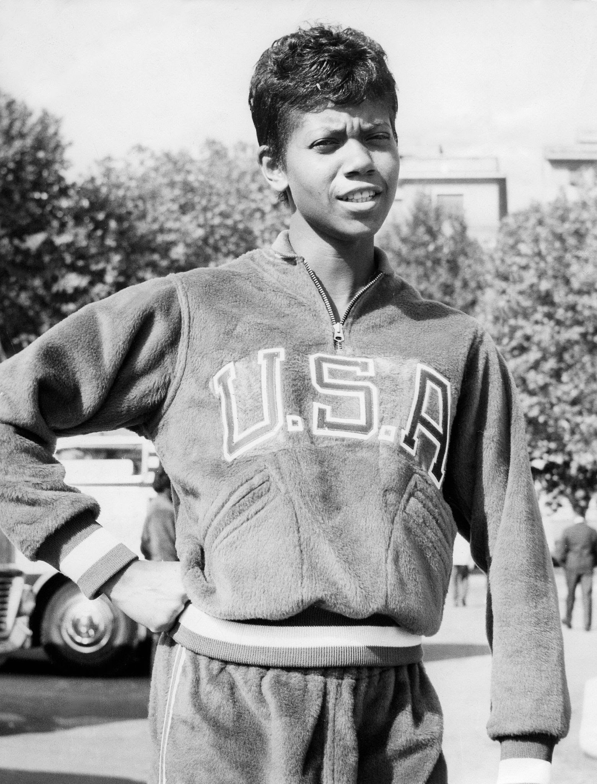
Quitting is not any option!
Despite being told as a child she would never walk again, she relentlessly pursued her dreams becoming an international track and field star. At the height of her career, “the fastest woman in the world” used her platform to shed light on social issues.
She was born on June 23, 1940 in Saint Bethlehem, Tennessee. As one of 22 children, she was constantly surrounded by support and care, which she needed given her poor health. Rudolph survived bouts of polio and scarlet fever. Her illness forced her to wear a brace on her leg. Her diagnosis was very bleak, “my doctor told me I would never walk again. My mother told me I would. I believed my mother.” Together, her parents and siblings took turns taking care of her.

Slide 3
Quitting is not any option!
They would often remove her leg brace and massage her injured leg. At the age of six, she began to hop on one leg. By eight she could move around with a leg brace. At the age of 11, her mother discovered her playing basketball outside. She quickly turned to sports, becoming a natural athlete. She was nominated as All-American in basketball during high school. However, after a chance meeting with a college coach she turned to track and field.
While still in high school she competed on the collegiate level. She competed in the 1956 Olympic games and won a bronze medal in 4x100 relay. Four years later, she headed to the 1960 summer Olympics determined to get gold. Her performance in Rome cemented her as one of the greatest athletes of the 20th century. She won three gold medals and broke at least three world records. Rudolph became the first American woman to win three gold medals in track and field at the same Olympic game. Her performance also earned her the title of “the fastest woman in the world.”

Slide 4
Row Arrangement
Directions for questions 1 to 5 : Answer the questions based on the following information.
A , B , C , D , E , F and G are sitting on a bench and all of them are facing East.
C is to the immediate right of D, but not next to F.
B is at the extreme end and has E as his neighbor.
G is between E and F.
D is sitting third from the south end.

Slide 5
Row Arrangement
Who is sitting to the immediate right of E?
(a) A (b) C (c) D (d) G (e) None
Which of the following pairs is sitting at the extreme ends?
(a) A, B (b) A,E (c) C,B (d) F, B (e) None
The person sitting third from the North end is ?
(a) E (b) F (c) G (d) D (e) A
Between which of the following pairs is D sitting?
(a) A,C (b) A, F (c) C, E (d) C,F (e) None
5. Which of the conditions from I to v given above is not required to find out the place where A is sitting?
(a) i (b) ii (c) iii (d) i & ii
(e) All are required
Ans : (1) G (2) A , B (3) G (4) C, F (5) E

Slide 6
Circular Arrangement
Directions for questions 6 to 10 : Answer the questions based on the following information.
Six persons A, B , C , D , E and F are sitting around a circular table facing the center
C is sitting exactly between A and F.
B is sitting two places to the left of E.
D is sitting two places to the right of F.

Slide 7
Circular Arrangement
Between which two persons is D sitting?
(a) F & B (b) E & B (c) C & B (d) A & B
Who is sitting opposite A?
(a) F (b) C (c) A (d) None of these
Which of the following is A’s neighbor to his right?
(a) C (b) F (c) B (d) D
Who is sitting opposite to E?
(a) A (b) B (c) C (d) F
Between which two persons is F sitting?
(a) C & D (b) C & A (c) D & A (d) C & B
Ans : (6)- (B) (7)- (D) (8)- (A) (9)- (D) (10)- (D)

Slide 8
Data Arrangement
Directions for questions 11 to 15 : Answer the questions based on the following information.
Five gentlemen (Mr. Ajay, Mr. Bijay, Mr.Vinay, Mr.Sanjay and Mr. Akshay) are practicing five different professions (Engineering, Medical, Law, Chartered Accountancy and Architecture). Each One of the five different instrumentals : Tabla, Violin, Sarod, Sitar and Flute.
Mr. Ajay is a Doctor and can play Sarod.
The Sitarist is not an Engineer.
Mr. Vinay and Mr. Bijay are not Architects and Vinay cannot play Tabla.
Mr. Bijay can play Violin.
Mr. Akshay is a Lawyer and can play Flute.

Slide 9
Data Arrangement
Which instrument does Mr. Vinay play?
(a) Sarod (b) Sitar (c) Violin (d) Flute (e) Tabl
What is the profession of Mr. Bijay?
(a) Architect (b) Doctor (c) Lawyer (d) Engineer (e) None
Who is an Architect?
(a) Mr.Ajay (b) Mr.Bijay (c) Mr.Vinay (d) Mr.Sanjay (e)Mr. Akshay
What is the profession of Mr. Vinay?
(a) Architect (b) Doctor (c) Lawyer (d) Engineer (e) None
Which instrument can the Doctor learn from the Architect?
(a) Sarod (b) Sitar (c) Violin (d) Flute (e) Tabla
Ans : (11)- (B) (12)- (D) (13)- (D) (14)- (E) (15)- (E)

Slide 10
Sample Question
A, P, R, X, S and Z are sitting in a row. S and Z are in the centre. A and P are at the ends. R is sitting to the left of A. Who is to the right of P?
A
X
S
Z
Ans : B

Slide 11
Sample Question
There are 8 houses in a line and in each house only one boy lives with the conditions as given below:
Jack is not the neighbour Siman.
Harry is just next to the left of Larry.
There is at least one to the left of Larry.
Paul lives in one of the two houses in the middle. Mike lives in between Paul and Larry.
If at least one lives to the right of Robert and Harry is not between Taud and Larry, then which one of the following statement is not correct ?
Robert is not at the left end.
Robert is in between Simon and Taud.
Taud is in between Paul and Jack.
There are three persons to the right of Paul.
Ans : C

Slide 12
Data Arrangement
A, B, C, D and E are sitting on a bench. A is sitting next to B, C is sitting next to D, D is not sitting with E who is on the left end of the bench. C is on the second position from the right. A is to the right of B and E. In which position A is sitting ?
Between B and D
Between B and C
Between E and D
Between C and E
Ans : B

Slide 13


