Slide 1
NAME :ASIF ALAM ENROLLMENT: 92200103311 G.R. NO: 120381 CLASS: 4EC1 CPI PRESENTATION

Slide 2
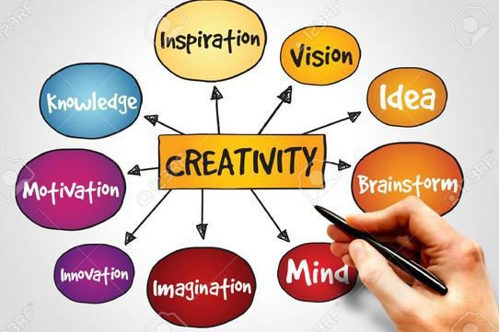
WEEK 1:Creativity as a teachable skill & Various types of thinking
Yadshakti + Samajshakti + Vicharshakti + Kalpanashakti
All these four human abilities are involved in what is
generally known as skill for Creativity, Problem Solving
and Innovation.
Raising curiosity and teaching how to think creatively is
the essence of this course. It attempts to give you ways of
developing these abilities of your brain by exposing to you
many strategies and illustrative videos.

Slide 3

WEEK 2:Ask Questions
All creative persons in arts and sciences ask questions.
Einstein was like a wonder-filled child, always asking the
obvious questions about space, time, and God.
He once said that the ordinary person could learn all the
physics he or she will ever need to learn if the person
could learn to understand the mind of a child.
Isolate the challenge you want to think about.

Slide 4

WEEK 3:Learning and its importance
When you master the discipline of learning, you find
yourself naturally absorbing new information like a
sponge.
You learn everything about what has come before,
what other people have tried, what has and hasn't
worked.
You're always ready to move beyond what you already
know, or what the world already believes.
The four practices in this class;
Practice Deliberately,
Master Your Domain,
Learn Forever, and
Balance Specialty with Generality

Slide 5
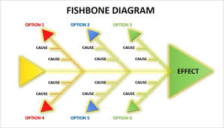
WEEK 4:Strategy of Knowing how to see Mapping of mind, Fishbone diagram
Before you brainstorm any problem, restate the problem at
least five to ten times to generate multiple perspectives. The
emphasis is not so much on the right problem definition but
on alternative problem definitions. Sooner or later, you'll find
one that you are comfortable with.
Following are several different ways to restructure your
problem:
Make it more global and specific.
Separate the parts from the whole.
Change the words in some fashion.
Make positive action statements.
Switch perspective.
Use multiple perspectives.
Use questions.

Slide 6
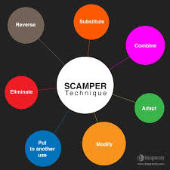
WEEK 5:Strategy of Thinking Fluency for idea generation. SCAMPER Technique
Defer judgment while generating ideas.
Generate as many ideas as possible.
Record ideas as they occur.
Elaborate or improve upon ideas

Slide 7

WEEK 6: Strategy of Fusing of ideas,Making novel combinations
Combining sugar and sesame seeds (Tal)
gets you a new candy
not very surprising
Combine a potato chip and a magazine?
that is a surprising creation
Force Fuse:
1. Make Remote Associations
2. Combine Concepts
3. Cook on All Burners

Slide 8

WEEK 7: Strategy of Looking at the other side,looking in other world, finding what you are not looking for and following it up.
In tackling a problem, people commonly assume a set of
boundaries to limit the solution.
The boundaries of the problem are defined by assumptions
and then, within those boundaries, conventional thinking is
used to find a solution.
Very often, however, the boundaries are imaginary, and the
solution may lie outside them.

Slide 9

WEEK 8: Strategy of Play, Importance of play; Relaxation; Break; Diversion; Stop thinking and do activities for JOY. Let subconscious figure it out.
Play is when you let your mind wander.
You put aside the hard work of the other
harder strategies, you relax, and you give
your subconscious time to work its magic.
Play is when you enter the province of
the imagination. Instead of dealing in
precut, dry, dusty old facts, you envision
what's possible.
You create alternate worlds, making them
more colorful and interesting, smarter
and more meaningful, than the current
reality.

Slide 10

WEEK 9: Strategy of Awakening the collaborative spirit. Collaborative thinking, brain storming, brain writing
This was also true in India
during ancient open debate
(Vad Vivad as Thesis,
Anti-thesis)and dialogue
(Samvad as Synthesis)
tradition especially within and
between Jain, Buddhist and
Hindu scholars.
Please note that debate
usually is between opposing
viewpoints while dialogues
usually is a collaborative
discussion expressing various
view points towards better
understanding of a subject.

Slide 11
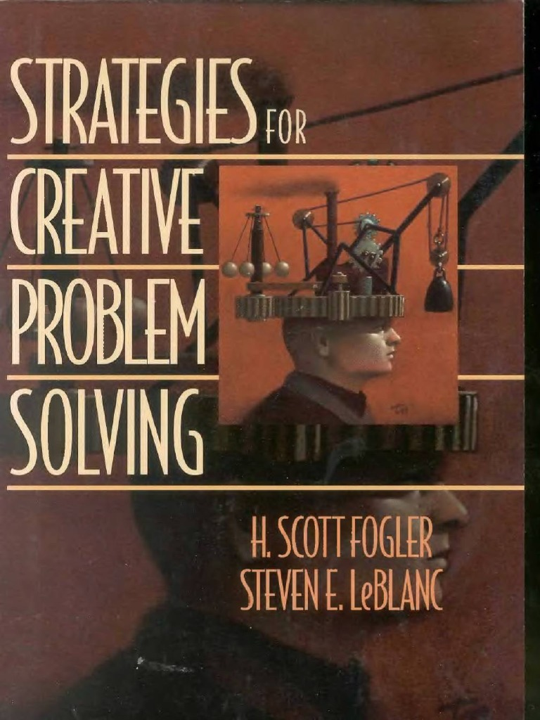
WEEK 10: Review Strategies for Creative problem solving methods. Five building blocks as per Fogler & LeBlanc. Stanford d school approach.
Problem definition is a common but difficult task
because true problems are often disguised in a variety
of ways.
It takes a skillful individual to analyze a situation and
extract the real problem from a sea of information.
Ill-defined or poorly posed problems can lead
novice-and not-so-novice-problem solvers down the
wrong path to a series of impossible or spurious
solutions.
Defining the real problem is-critical to find a workable
solution.
Sometimes we can be "tricked" into treating the symptoms
instead of solving the root problem.

Slide 12
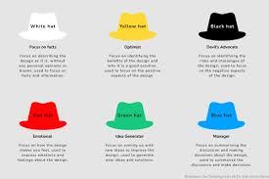
WEEK 11: “Six thinking hats”.
The Six Thinking Hats, a method by Edward de Bono, Harnesses diverse perspectives, like a creative chateau. White for facts, Red for emotions, Green for ideas anew, Yellow for optimism, Black for caution, Blue for overview true. Each hat worn in turn, a structured approach to thinking, Enhancing decision-making, innovation, and problem-solving linking.

Slide 13
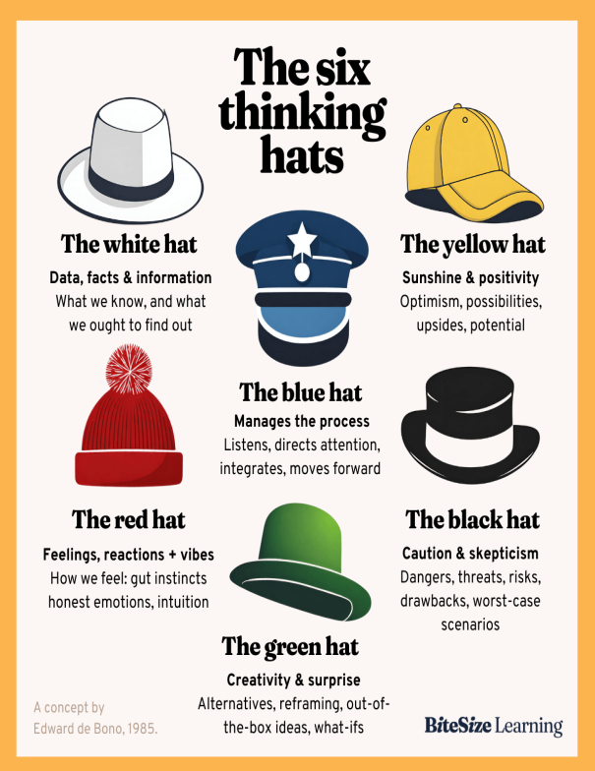
WEEK 12: This is Edward de Bono day with himself explaining and teaching his ideas on Lateral thinking, PO, Six thinking hats
Edward de Bono’s views were accepted and
used by several very successful
corporations and people all over the world
since late 1960’s. Thus we will examine
them as he nicely explains through his live
video presentations.

Slide 14
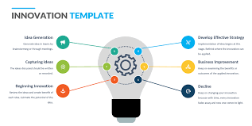
WEEK 13:Strategy for Making; From idea to innovation
A powerful reason that the world looks to Silicon Valley for
game-changing innovation is a new approach to product
innovation called Design Thinking.
Design thinking is thinking made visible, thinking through
making.
At the center of this new approach is the world's most famous
product design firm, IDEO-next door to Stanford, Apple, and
Google, smack in the middle of a dense cluster of world famous
technology firms.

Slide 15


