Slide 1

Department of Computer Engineering
Unit-2
Basic Computer Organization and Design
Computer Organization and Architecture-01CE1402
Prof. Kishan Makadiya

Slide 2
Outline
Instruction codes
Computer registers
Computer instructions
Timing and Control
Instruction cycle
Memory-Reference Instructions
Input- output and interrupt
Complete description
Design of Basic Computer
Design of Accumulator Logic

Slide 3
Instruction Codes
Program
A program is a set of instructions that specify the operations, operands and the sequence by which processing has to occur.
Computer Instruction
A computer instruction is a binary code that specifies a sequence of microoperations for the computer.
The computer reads each instruction from memory and places it in a control register.
The control then interprets the binary code of the instruction and proceeds to execute it by issuing a sequence of microoperations.

Slide 4
Instruction Codes
Instruction Code
An instruction code is a group of bits that instruct the computer to perform a specific operation.
Example
Operation Code (Opcode)
The operation code of an instruction is a group of bits that define such operations as add, subtract, multiply, shift, and complement.
The number of bits required for the operation code of an instruction depends on the total number of operations available in the computer.
The operation code must consist of at least n bits for a given 2^{n} (or less) distinct operations.
Unique Binary code is assigned to every OpCode
ADD 1547

Slide 5
Stored Program Organization
Memory
4096 x 16
15
12
11
0
Opcode
Address
Instructions
(program)
Instruction Format
Operand
(data)
15
0
Binary Operand
Processor Register (accumulator or AC)

Slide 6
Stored Program Organization
The simplest way to organize a computer is to have one processor register(AC) and an instruction code format with two parts.
The first part specifies the operation (opcode) to be performed and the second specifies an address (operand).
The memory address tells the control where to find an operand in memory.
This operand is read from memory and used as the data to be operated on together with the data stored in the processor register.

Slide 7
Stored Program Organization
Instructions are stored in one section of memory and data in another.
For a memory unit with 4096 words, we need 12 bits to specify an address since 2¹² = 4096.
If we store each instruction code in one 16-bit memory word, we have available four bits for operation code (opcode) to specify one out of 16 possible operations, and 12 bits to specify the address of an operand.

Slide 8
Stored Program Organization
The control reads a 16-bit instruction from the program portion of memory.
It uses the 12-bit address part of the instruction to read a 16-bit operand from the data portion of memory.
It then executes the operation specified by the operation code.

Slide 9
Instruction format of basic computer
Instruction Format
15
14
12
11
0
I
Opcode
Address
0 | 0 | 0 | 1 | 0 | 1 | 0 | 0 | 0 | 1 | 0 | 1 | 0 | 1 | 1 | 1
Add Instruction – ADD 457

Slide 10
Direct & Indirect Addressing of Memory
Memory
Memory
22
0
ADD
457
35
1
ADD
300
300
1350
457
Operand
1350
Operand
+
+
AC
AC
Direct Address
Indirect Address

Slide 11
Direct & Indirect Addressing of Memory
If the second part of an instruction format specifies the address of an operand, the instruction is said to have a direct address.
In Indirect address, the bits in the second part of the instruction designate an address of a memory word in which the address of the operand is found.

Slide 12
Direct & Indirect Addressing of Memory
One bit of the instruction code can be used to distinguish between a direct and an indirect address.
It consists of a 3-bit operation code, a 12-bit address, and an indirect address mode bit designated by I.
The mode bit is 0 for a direct address and 1 for an indirect address.

Slide 13
Direct & Indirect Addressing of Memory
15
14
12
11
0
22
0
ADD
457
A direct address instruction is placed at address 22 in memory.
The I bit is 0, so the instruction is recognized as a direct address instruction.
The opcode specifies an ADD instruction, and the address part is the binary equivalent of 457.
The control finds the operand in memory at address 457 and adds it to the content of AC.

Slide 14
Direct & Indirect Addressing of Memory
15
14
12
11
0
35
1
ADD
300
The instruction in address 35 has a mode bit I = 1, recognized as an indirect address instruction.
The address part is the binary equivalent of 300.
The control goes to address 300 to find the address of the operand.
The address of the operand in this case is 1350.
The operand found in address 1350 is then added to the content of AC.

Slide 15
Direct & Indirect Addressing of Memory
The indirect address instruction needs two references to memory to fetch an operand.
The first reference is needed to read the address of the operand.
Second reference is for the operand itself.
The memory word that holds the address of the operand in an indirect address instruction is used as a pointer to an array of data.

Slide 16
Computer Registers
11
0
Program Counter(12)
PC
Holds address of instruction
11
0
Address Register(12)
AR
Holds address for memory
15
0
Instruction Register(16)
IR
Holds instruction code
15
0
Temporary Register(16)
TR
Holds temporary data
15
0
Data Register(16)
DR
Holds memory operand

Slide 17
Computer Registers
15
0
Accumulator(16)
AC
Processor Register
7
0
Output Register(8)
OUTR
Holds output character
7
0
Input Register(8)
INPR
Holds input character
Memory
4096 words
16 bits per word

Slide 18
Common bus system of basic computer
Common bus

Slide 19
S₂
Memory
4096 x 16
S₁
Bus
S₀
7
Address
Write
Read
AR
1
LD
INR
CLR
PC
2
LD
INR
CLR
DR
3
LD
INR
CLR
Adder & Logic
E
4
AC
LD
INR
CLR
INPR
IR
5
LD
TR
6
LD
INR
CLR
OUTR
LD
Clock

Slide 20
Types of Computer Instructions
Memory Reference Instruction
Register Reference Instruction
Input – Output Instruction
15
14
12
11
0
1
Opcode
Address
15
14
13
12
11
0
0
1
1
1
Register Operation
15
14
13
12
11
0
1
1
1
1
I/O Operation

Slide 21
Types of Computer Instructions
Memory Reference Instruction
15
14
12
11
0
I
Opcode
Address
0 | 0 | 0 | 0 | Address
1
1
1
1
0xxx
8xxx
AND
AND the content of memory to AC
1xxx
9xxx
ADD
Add the content of memory to AC
2xxx
Axxx
LDA
Load memory word to AC
3xxx
Bxxx
STA
Store content of AC in memory
4xxx
Cxxx
BUN
Branch unconditionally
5xxx
Dxxx
BSA
Branch and save return address
6xxx
Exxx
ISZ
Increment and skip if zero

Slide 22
Types of Computer Instructions
Register Reference Instruction
15
14
13
12
11
0
0
1
1
1
Register Operation
0 | 1 | 1 | 1 | 0 | 0 | 0 | 0 | 0 | 0 | 0 | 0 | 0 | 0 | 0 | 0
1
1
1
1
1
1
1
7800
CLA
Clear AC
7400
CLE
Clear E
7200
CMA
Complement AC
7100
CME
Complement E
7080
CIR
Circulate right AC and E
7040
CIL
Circulate left AC and E
7020
INC
Increment AC

Slide 23
Types of Computer Instructions
Register Reference Instruction
15
14
13
12
11
0
0
1
1
1
Register Operation
0 | 1 | 1 | 1 | 0 | 0 | 0 | 0 | 0 | 0 | 0 | 0 | 0 | 0 | 0 | 0
1
1
1
1
1
7010
SPA
Skip next instruction if AC is positive
7008
SNA
Skip next instruction if AC is negative
7004
SZA
Skip next instruction if AC is zero
7002
SZE
Skip next instruction if E is zero
7001
HLT
Halt computer

Slide 24
Types of Computer Instructions
Input – Output Instruction
15
14
13
12
11
0
1
1
1
1
I/O Operation
1 | 1 | 1 | 1 | 0 | 0 | 0 | 0 | 0 | 0 | 0 | 0 | 0 | 0 | 0 | 0
1
1
1
1
1
1
F800
INP
Input character to AC
F400
OUT
Output character from AC
F200
SKI
Skip on input flag
F100
SKO
Skip on output flag
F080
ION
Interrupt on
F040
IOF
Interrupt off

Slide 25
Instruction Set Completeness
Instruction set is said to be complete if it includes sufficient number of instructions in each of the following categories:
Arithmetic, logical and shift instructions
Instructions for moving information to and from memory and processor registers
Program control instructions together with instructions that check status conditions
Input and output instructions

Slide 26
Control Unit of Basic Computer
0 | 0 | 0 | 1 | 0 | 1 | 0 | 0 | 0 | 1 | 0 | 1 | 0 | 1 | 1 | 1
Instruction Register
Other inputs
15 | 14 | 13 | 12 | 11 - 0
0
0
0
1
Control Logic Gates
3 x 8
Decoder
7 6 5 4 3 2 1 0
D₀
Control O/p
I
D₁
D₇
T₁₅
T₀
15 14 . . . 2 1 0
4 x 16
Decoder
4-bit sequence counter (SC)
Increment (INR)
Clear (CLR)
Clock

Slide 27
Control Unit
Components of Control unit are
Two decoders
A sequence counter
Control logic gates
An instruction read from memory is placed in the instruction register (IR).
In control unit the IR is divided into three parts: I bit, the operation code (12-14)bit, and bits 0 through 11.
The operation code in bits 12 through 14 are decoded with a 3 x 8 decoder.
Bit-15 of the instruction is transferred to a flip-flop designated by the symbol I.

Slide 28
Control Unit
The eight outputs of the decoder are designated by the symbols D₀ through D₇.
Bits 0 through 11 are applied to the control logic gates.
The 4‐bit sequence counter can count in binary from 0 through 15. The outputs of counter are decoded into 16 timing signals T₀ through T₁₅.
The sequence counter SC can be incremented or cleared synchronously.
Most of the time, the counter is incremented to provide the sequence of timing signals out of 4 X 16 decoder.
Once in awhile, the counter is cleared to 0, causing the next timing signal to be T₀.

Slide 29
Control Unit
As an example, consider the case where SC is incremented to provide timing signals T₀, T₁, T₂, T₃ and T₄ in sequence. At time T₄, SC is cleared to 0 if decoder output D₃ is active. This is expressed symbolically by the statement
D₃T₄: SC ← 0
Initially, the CLR input of SC is active.
The first positive transition of the clock clears SC to 0, which in turn activates the timing T₀ out of the decoder.
T₀ is active during one clock cycle.
The positive clock transition labeled T₀ in the diagram will trigger only those registers whose control inputs are connected to timing signal T₀.
SC is incremented with every positive clock transition, unless its CLR input is active.
This procedures the sequence of timing signals T₀, T₁, T₂, T₃ and T₄, and so on. If SC is not cleared, the timing signals will continue with T₅, T₆, up to T₁₅ and back to T₀.

Slide 30












Timing Cycle for D₃T₄: SC ← 0
$$T_{0}$$
$$T_{1}$$
$$T_{2}$$
$$T_{3}$$
$$T_{4}$$
$$T_{5}$$
Clock
$$T_{0}$$
$$T_{1}$$
$$T_{2}$$
$$T_{3}$$
$$T_{4}$$
$$D_{3}$$
CLR SC

Slide 31
Control Unit
The last three waveforms shows how SC is cleared when D₃T₄ = 1.
Output D₃ from the operation decoder becomes active at the end of timing signal T₂.
When timing signal T₄ becomes active, the output of the AND gate that implements the control function D₃T₄ becomes active.
This signal is applied to the CLR input of SC.
On the next positive clock transition the counter is cleared to 0.
This causes the timing signal T₀ to become active instead of T₅ that would have been active if SC were incremented instead of cleared.

Slide 32
Control Organization
Hardwired Control
The control logic is implemented with gates, flips-flops, decoders and other digital circuits.
It can be optimized to produce a fast mode of operation.
It requires changes in the wiring among the various components if the design has to be modified or changed.
Microprogrammed Control
The control information is stored in a control memory.
The control memory is programmed to initiate the required sequence of micro-operations.
Any required changes or modifications can be done by updating the microprogram in control memory.

Slide 33
Instruction Cycle
A program residing in the memory unit of the computer consists of a sequence of instructions. In the basic computer each instruction cycle consists of the following phases:
Fetch an instruction from memory.
Decode the instruction.
Read the effective address from memory if the instruction has an indirect address.
Execute the instruction.
After step 4, the control goes back to step 1 to fetch, decode and execute the next instruction.
This process continues unless a HALT instruction is encountered.

Slide 34


Instruction Cycle
Fetch & Decode
PC is loaded with the address of the first instruction in the program.
The micro-operations for fetch and decode phases are as follows:
$$T_{0} : AR←PC$$
$$T_{1} :IR←M\left[AR\right], PC←PC+1$$
$$T_{2} :D_{0},…,D_{7}←Decode IR\left(12−14\right), AR←IR\left(0−11\right), I←IR(15)$$

Slide 35
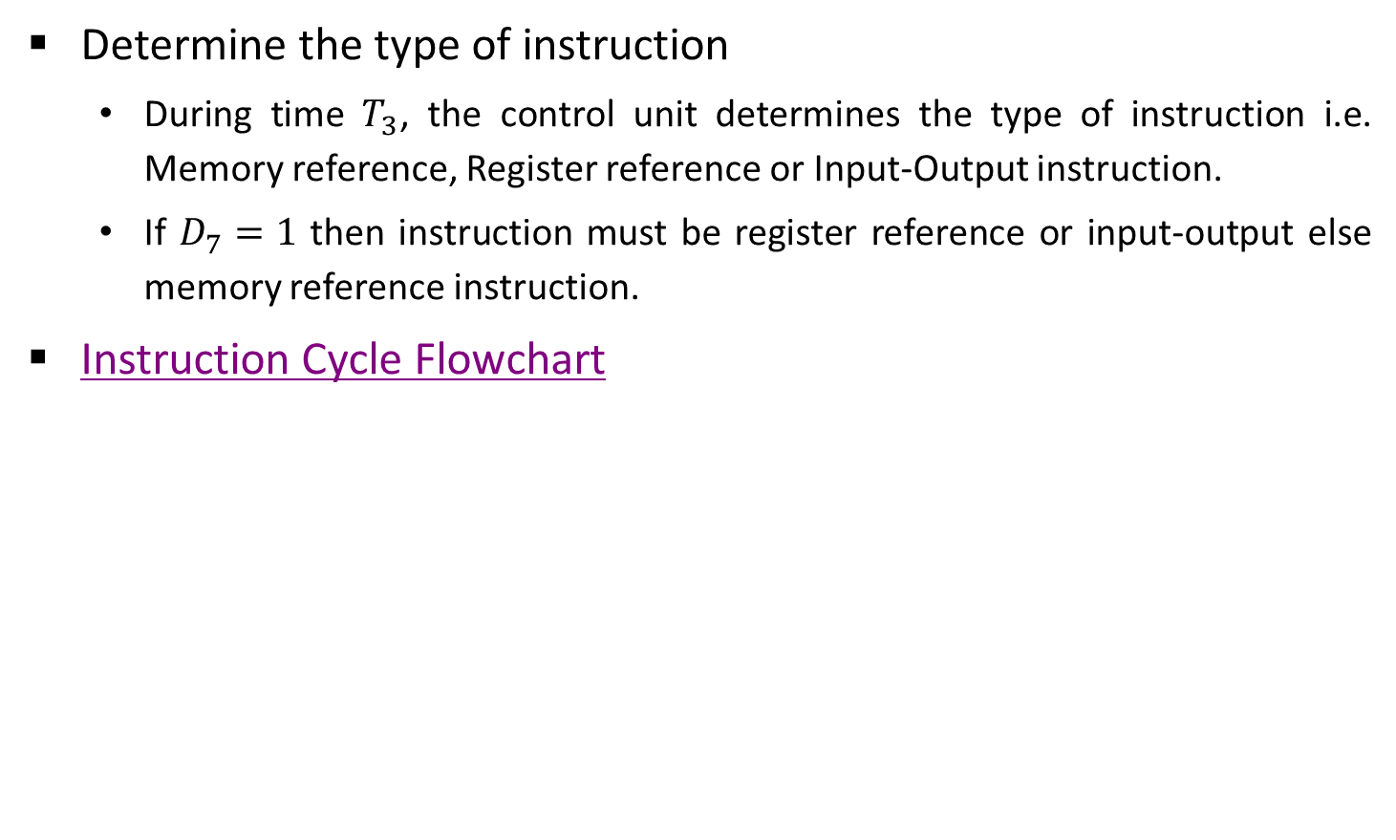
Instruction Cycle
Determine the type of instruction
During time $T_{3}$, the control unit determines the type of instruction i.e. Memory reference, Register reference or Input-Output instruction.
If $D_{7}=1$ then instruction must be register reference or input-output else memory reference instruction.
Instruction Cycle Flowchart

Slide 36





Start
SC ← 0
$$T_{0}$$
AR ← PC
$$T_{1}$$
IR ← M[AR], PC ← PC + 1
$$T_{2}$$
Decode operation code in IR(12-14)
AR ← IR(0-11), I ← IR(15)
(Register or I/O) = 1
D₇
= 0 (Memory-reference)
(I/O) = 1
I
= 0 (register)
(indirect) = 1
I
= 0 (direct)
$$T_{3}$$
$$T_{3}$$
$$T_{3}$$
$$T_{3}$$
Execute input-output instruction
SC ← 0
Execute
register-reference instruction
SC ← 0
AR ← M[AR]
Nothing
Execute
memory-reference instruction
SC ← 0

Slide 37
Register Reference Instruction
D₇I’T₃ = r (common to all register reference instructions)
IR(i) = B_{i} [bit in IR(0-11) that specifies the operation]
CLA
rB₁₁
AC ← 0
Clear AC
CLE
rB₁₀
E ← 0
Clear E
CMA
rB₉
AC ← AC’
Complement AC
CME
rB₈
E ← E’
Complement E
CIR
rB₇
AC ← shr AC, AC(15) ← E, E ← AC(0)
Circulate right
CIL
rB₆
AC ← shl AC, AC(0) ← E, E ← AC(15)
Circulate left
INC
rB₅
AC ← AC + 1
Increment AC
SPA
rB₄
If (AC(15) = 0) then (PC ← PC + 1)
Skip if AC is positive
SNA
rB₃
If (AC(15) = 1) then (PC ← PC + 1)
Skip if AC is negative
SZA
rB₂
If (AC = 0) then (PC ← PC + 1)
Skip if AC is zero
SZE
rB₁
If (E = 0) then (PC ← PC + 1)
Skip if E is zero
HLT
rB₀
S ← 0 (S is a start-stop flip-flop)
Halt Computer

Slide 38
Memory Reference Instructions
AND: AND to AC
This is an instruction that performs the AND logic operation on pairs of bits in AC and the memory word specified by the effective address. The result of the operation is transferred to AC.
D₀T₄: DR←M[AR]
D₀T₅: AC ← AC ∧ DR, SC ← 0

Slide 39
Memory Reference Instructions
ADD: ADD to AC
This instruction adds the content of the memory word specified by the effective address to the value of AC. The sum is transferred into AC and the output carry C_{out} is transferred to the E (extended accumulator) flip-flop.
D₁T₄: DR←M[AR]
D₁T₅: AC ← AC + DR, E ← C_{out}, SC ← 0

Slide 40
Memory Reference Instructions
LDA: Load to AC
This instruction transfers the memory word specified by the effective address to AC.
D₂T₄: DR←M[AR]
D₂T₅: AC ← DR, SC ← 0

Slide 41
Memory Reference Instructions
STA: Store AC
This instruction stores the content of AC into the memory word specified by the effective address.
D₃T₄: M[AR] ← AC, SC ← 0

Slide 42
Memory Reference Instructions
BUN: Branch Unconditionally
This instruction transfers the program to instruction specified by the effective address. The BUN instruction allows the programmer to specify an instruction out of sequence and the program branches (or jumps) unconditionally.
D₄T₄: PC ← AR, SC ← 0

Slide 43
Memory Reference Instructions
BSA: Branch and Save Return Address
This instruction is useful for branching to a portion of the program called a subroutine or procedure. When executed, the BSA instruction stores the address of the next instruction in sequence (which is available in PC) into a memory location specified by the effective address.
D₅T₄: M[AR] ← PC, AR ← AR + 1
D₅T₅: PC ← AR, SC ← 0

Slide 44
BSA
20
0 BSA 135
20
0 BSA 135
PC = 21
Next Instruction
21
Next Instruction
AR = 135
135
21
136
Subroutine
PC = 136
Subroutine
1 BUN 135
1 BUN 135
Memory, PC and AR at Time T₄
Memory and PC after execution
D₅T₄: M[135] ← 21, AR ← 135 + 1
D₅T₅: PC ← 136, SC ← 0

Slide 45
Memory Reference Instructions
ISZ: Increment and Skip if Zero
These instruction increments the word specified by the effective address, and if the incremented value is equal to 0, PC is incremented by 1. Since it is not possible to increment a word inside the memory, it is necessary to read the word into DR, increment DR, and store the word back into memory.
D₆T₄: DR ← M[AR]
D₆T₅: DR ← DR + 1
D₆T₆: M[AR] ← DR, if (DR = 0) then (PC ← PC + 1),
SC ← 0

Slide 46
Flowchart for Memory Reference Instructions
Memory-reference instruction
AND
ADD
LDA
STA
D T
4
D T
D T
D T
0
1
4
2
4
3
4
DR ← M[AR]
DR ← M[AR]
DR ← M[AR]
M[AR] ← AC
SC ← 0
D T
D T
D T
0
5
1
5
2
5
AC ← AC /\ DR
AC ← AC + DR
AC ← DR
SC ← 0
E ← Cout
SC ← 0
SC ← 0
BUN
BSA
ISZ
D T
D T
D T
4
4
5
4
6
4
PC ← AR
M[AR] ← PC
DR ← M[AR]
SC ← 0
AR ← AR + 1
D T
D T
5
5
6
5
PC ← AR
DR ← DR + 1
SC ← 0
D T
6
6
M[AR] ← DR
If (DR = 0)
then (PC ← PC + 1)
SC ← 0

Slide 47
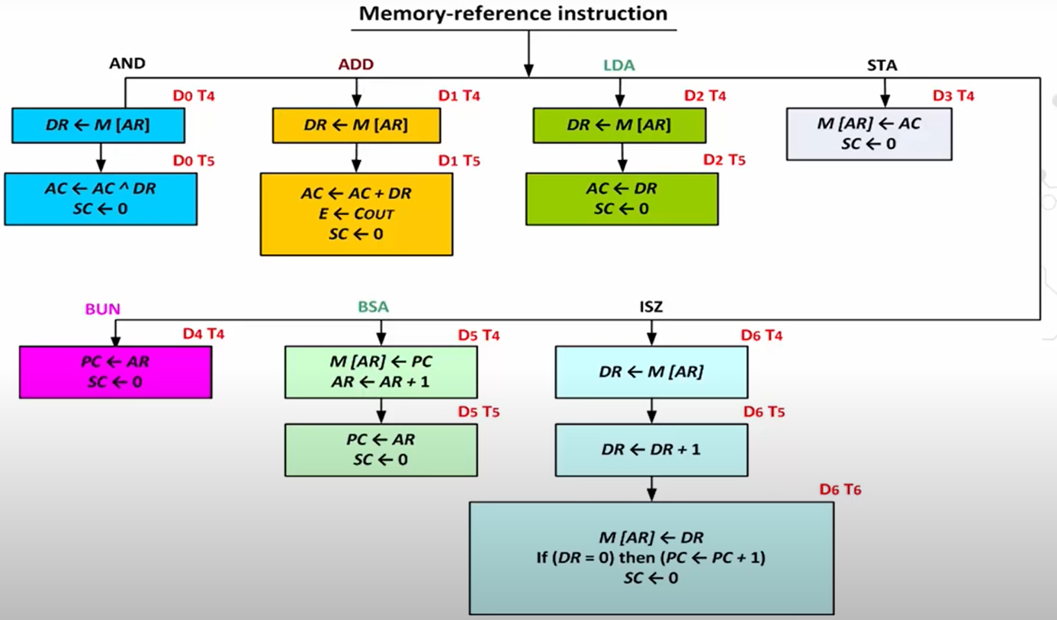

Slide 48
Input-Output of basic computer
Input-Output terminal
Serial communication interface
Computer registers and flip-flop
FGO
=1
=0
Printer
Receiver Interface
OUTR
AC
Keyboard
Transmitter Interface
INPR
FGI
=0
=1

Slide 49
Input-Output of basic computer
A computer can serve no useful purpose unless it communicates with the external environment.
To exhibit the most basic requirements for input and output communication, we will use a terminal unit with a keyboard and printer.
The terminal sends and receives serial information and each quantity of information has eight bits of an alphanumeric code.
The serial information from the keyboard is shifted into the input register INPR.
The serial information for the printer is stored in the output register OUTR.
These two registers communicate with a communication interface serially and with the AC in parallel.

Slide 50
Process of input information transfer
Initially, the input flag FGI is cleared to 0. When a key is struck in the keyboard, an 8-bit alphanumeric code is shifted into INPR and the input flag FGI is set to 1.
As long as the flag is set, the information in INPR cannot be changed by striking another key. The computer checks the flag bit; if it is 1, the information from INPR is transferred in parallel into AC and FGI is cleared to 0.
Once the flag is cleared, new information can be shifted into INPR by striking another key.

Slide 51
Process of outputting information
The output register OUTR works similarly but the direction of information flow is reversed.
Initially, the output flag FGO is set to 1. The computer checks the flag bit; if it is 1, the information from AC is transferred in parallel to OUTR and FGO is cleared to 0. The output device accepts the coded information, prints the corresponding character, and when the operation is completed, it sets FGO to 1.
The computer does not load a new character into OUTR when FGO is 0 because this condition indicates that the output device is in the process of printing the character.

Slide 52
Input-Output Instruction
D₇IT₃ = p (common to all input-output instructions)
IR(i) = B_{i} [bit in IR(6-11) that specifies the operation]
INP
pB₁₁
AC(0-7) ← INPR, FGI ← 0
Input Character
OUT
pB₁₀
OUTR ← AC(0-7), FGO ← 0
Output Character
SKI
pB₉
If (FGI = 1) then (PC ← PC + 1)
Skip on input flag
SKO
pB₈
If (FGO = 1) then (PC ← PC + 1)
Skip on output flag
ION
pB₇
IEN ← 1
Interrupt enable on
IOF
pB₆
IEN ← 0
Interrupt enable off

Slide 53
Interrupt Cycle
Instruction cycle
= 0
R
= 1
Interrupt cycle
Fetch & Decode instruction
Store return address in location 0
M[0] ← PC
Execute instruction
IEN
= 0
= 1
Branch to location 1
PC ← 1
= 1
FGI
= 0
= 1
IEN ← 0
R ← 0
FGO
= 0
R ← 1

Slide 54
Interrupt Cycle
The interrupt cycle is a hardware implementation of a branch and save return address operation.
An interrupt flip-flop R is included in the computer.
When R = 0, the computer goes through an instruction cycle.

Slide 55
Interrupt Cycle
During the execute phase of the instruction cycle IEN is checked by the control.
If it is 0, it indicates that the programmer does not want to use the interrupt, so control continues with the next instruction cycle.
If IEN is 1, control checks the flag bits.
If both flags are 0, it indicates that neither the input nor the output registers are ready for transfer of information.
In this case, control continues with the next instruction cycle. If either flag is set to 1 while IEN = 1, flip-flop R is set to 1.
At the end of the execute phase, control checks the value of R, and if it is equal to 1, it goes to an interrupt cycle instead of an instruction cycle.

Slide 56
Register transfer statements for Interrupt cycle
The flip-flop is set to 1 if IEN = 1 and either FGI or FGO are equal to 1. This can happen with any clock transition except when timing signals T₀, T₁ or T₂ are active.
The condition for setting flip-flop R= 1 can be expressed with the following register transfer statement:
T₀′T₁′T₂ ′ (IEN) (FGI + FGO): R ← 1
The symbol + between FGI and FGO in the control function designates a logic OR operation. This is AND with IEN and T₀′T₁′ T₂′.

Slide 57
Register transfer statements for Interrupt cycle
The fetch and decode phases of the instruction cycle must be modified and Replace T₀, T₁, T₂ with R'T₀, R'T₁, R'T₂
Therefore the interrupt cycle statements are :
RT₀ : AR ← 0, TR ← PC
RT₁ : M[AR] ← TR, PC ← 0
RT₂ : PC ← PC + 1, IEN ← 0, R ← 0, SC ← 0

Slide 58
Register transfer statements for Interrupt cycle
During the first timing signal AR is cleared to 0, and the content of PC is transferred to the temporary register TR.
With the second timing signal, the return address is stored in memory at location 0 and PC is cleared to 0.
The third timing signal increments PC to 1, clears IEN and R, and control goes back to T₀ by clearing SC to 0.
The beginning of the next instruction cycle has the condition RT₀ and the content of PC is equal to 1. The control then goes through an instruction cycle that fetches and executes the BUN instruction in location 1.

Slide 59
Demonstration of Interrupt Cycle
256
0
0
1
0 BUN 1120
PC = 1
0 BUN 1120
Main Program
Main Program
255
255
PC = 256
256
1120
I/O program
1120
I/O program
1 BUN 0
1 BUN 0
Before Interrupt
After Interrupt

Slide 60
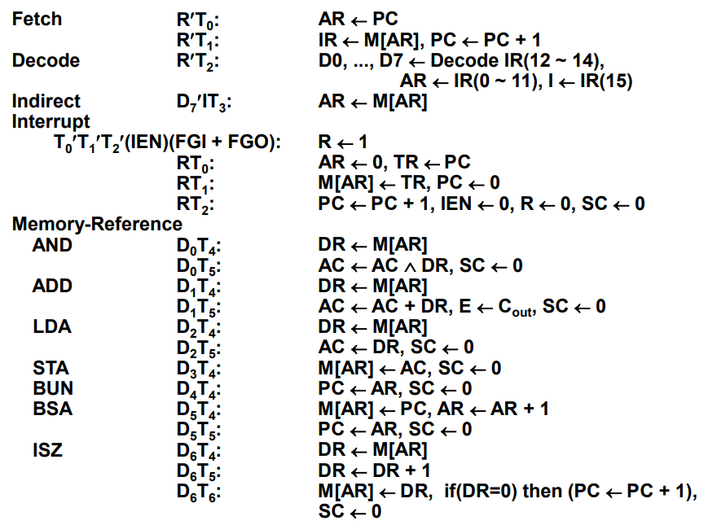
Complete Computer Description (Micro-operations)

Slide 61
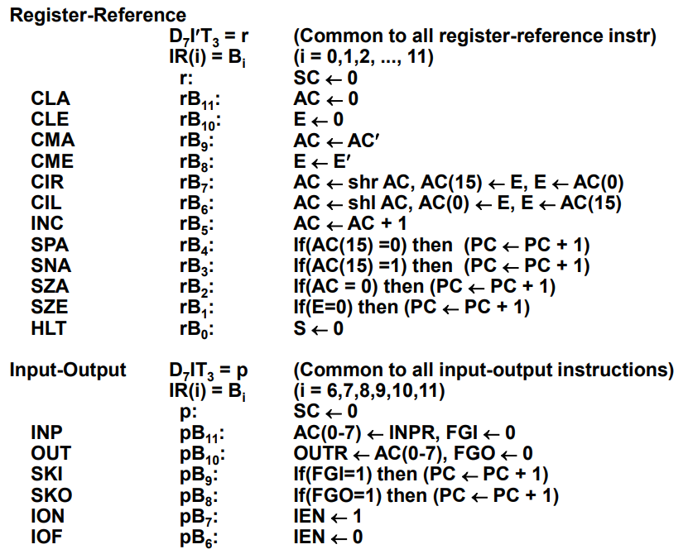
Complete Computer Description (Micro-operations)

Slide 62
Design of Basic Computer
Hardware Components of Basic Computer
A memory unit: 4096 x 16.
Registers: AR, PC, DR, AC, IR, TR, OUTR, INPR, and SC
Flip-Flops(Status): I, S, E, R, IEN, FGI, and FGO
Decoders: a 3x8 Opcode decoder & a 4x16 timing decoder
Common bus: 16 bits
Adder and Logic circuit: Connected to AC
Control Logic Gates:
Input Controls of the nine registers
Read and Write Controls of memory
Set, Clear, or Complement Controls of the flip-flops
S2, S1, S0 Controls to select a register for the bus
AC, and Adder and Logic circuit

Slide 63
Design of Basic Computer
Basic Computer

Slide 64









Start
SC ← 0, IEN ← 0, R ← 0
(Instruction cycle) = 0
R
(Interrupt cycle) = 1
$${R′T}_{0}$$
$${RT}_{0}$$
AR ← PC
AR ← 0, TR ← PC
$${R′T}_{1}$$
$${RT}_{1}$$
IR ← M[AR], PC ← PC + 1
M[AR] ← TR, PC ← 0
$${R′T}_{2}$$
$${RT}_{2}$$
Decode operation code in IR(12-14)
AR ← IR(0-11), I ← IR(15)
PC ← PC + 1, IEN ← 0, R ← 0, SC ← 0
(Register or I/O) = 1
= 0 (Memory-reference)
D₇
(I/O) = 1
I
= 0 (register)
(indirect) = 1
I
= 0 (direct)
$$T_{3}$$
$$T_{3}$$
$$T_{3}$$
$$T_{3}$$
Execute input-output instruction
SC ← 0
Execute
register-reference instruction
SC ← 0
AR ← M[AR]
Nothing
Execute
memory-reference instruction
SC ← 0

Slide 65
Design of Accumulator Unit
In order to design the logic associated with AC, it is necessary to extract all the statements that change the content of AC.
D₀T₅: AC ← AC ∧ DR, SC ← 0
AND with DR
D₁T₅: AC ← AC + DR, SC ← 0
ADD with DR
D₂T₅: AC ← DR
Transfer from DR
pB₁₁: AC(0-7) ← INPR, FGI ← 0
Transfer from INPR
rB₉: AC ← AC’
Complement
rB₇: AC ← shr AC, AC(15) ← E
Shift right
rB₆: AC ← shl AC, AC(0) ← E
Shift left
rB₁₁: AC ← 0
Clear
rB₅: AC ← AC + 1
Increment

Slide 66
Design of Accumulator Logic
Circuit associated with AC
16
Adder and logic circuit
Accumulator register (AC)
16
16
16
From DR
8
To bus
From INPR
LD
INR
CLR
Clock
Control gates

Slide 67
Design of Accumulator Logic
Gate structure for controlling LD, INR and CLR of AC
D₀
AND
T₅
16
AC
16
D₁
ADD
From Adder & Logic
To bus
D₂
DR
LD
INR
CLR
Clock
T₅
p
B₁₁
INPR
r
B₉
CMA
SHR
B₇
SHL
B₆
INC
B₅
CLR
B₁₁

Slide 68
Thank You

