Slide 1



3140702
Operating System
Unit – 5
Deadlock

Slide 2
Topics to be covered
Deadlock and its Principles
Four Necessary Conditions of Deadlock
Deadlock Prevention
Resource Allocation Graph (RAG)
Deadlock Avoidance - Banker’s algorithm
Deadlock Detection & Recovery.

Slide 3
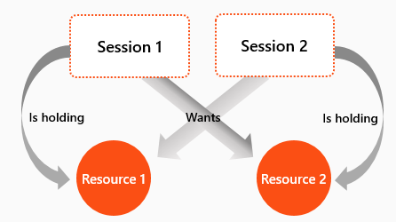
What is Deadlock?

Slide 4
Definition of Deadlock
A deadlock consists of a set of blocked processes, each holding a resource and waiting to acquire a resource held by another process in the set.
For Example:
two processes each want to record a scanned document on a CD.
process 1 requests for scanner & gets it
process 2 requests for CD writer & gets it
process 1 requests CD writer but is blocked
process 2 requests scanner but is blocked.
At this point both processes are blocked and will remain so forever,
This situation is called a deadlock

Slide 5
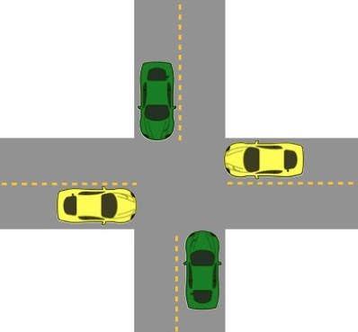
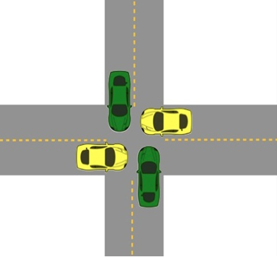
Deadlock
The processes are the cars.
The resources are the spaces occupied by the cars
Deadlock possible
Deadlock occurred

Slide 6


Deadlock v/s Starvation
Deadlock | Starvation

Slide 7
Deadlock v/s Starvation
Deadlock | Starvation
All processes keep waiting for each other to complete and none get executed. | High priority process keep executing and low priority process are blocked.
Resources are blocked by the process. | Resources are continuously utilized by the higher priority process.
Necessary conditions are mutual exclusion, hold and wait, no preemption, circular wait. | Priorities are assigned to the process.
Also known as circular wait. | Also known as lived lock.
It can be prevented by avoiding the necessary conditions for deadlock. | It can be prevented by Aging.

Slide 8
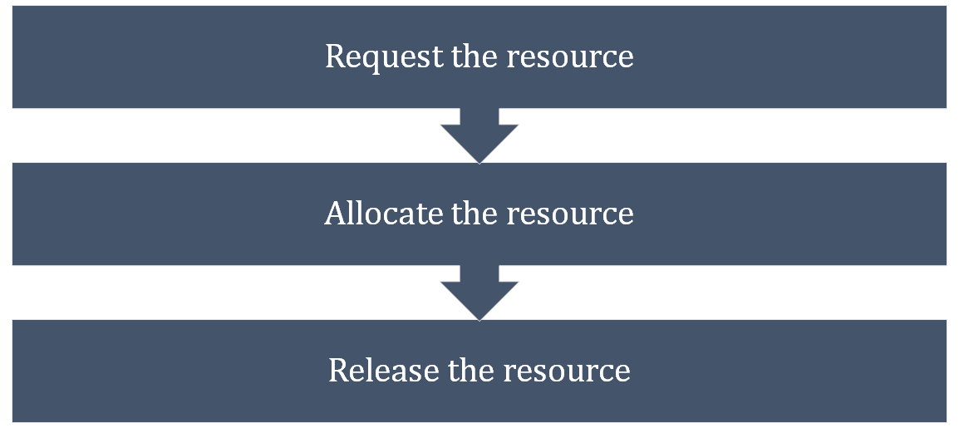
Sequence of events to use a Resource

Slide 9
Necessary Conditions for Deadlock
Mutual exclusion:
At least one resource type in the system which can be used in non-shareable mode (i.e., one at a time) for example printer.
Because many resource can be shared by more than one process at a time (e.g., Memory location).
Hold and Wait:
Processes are allowed to request for new resources without releasing the resources they are currently holding.
No pre-emption:
A resource can be released only voluntarily by the process holding it after that process has completed its task.

Slide 10
Necessary Conditions for Deadlock
Circular wait:
Two or more processes must form a circular chain in which each process is waiting for a resource that is held by the next member of the chain.
All four of these conditions must hold simultaneously in a system for a deadlock to occur.

Slide 11
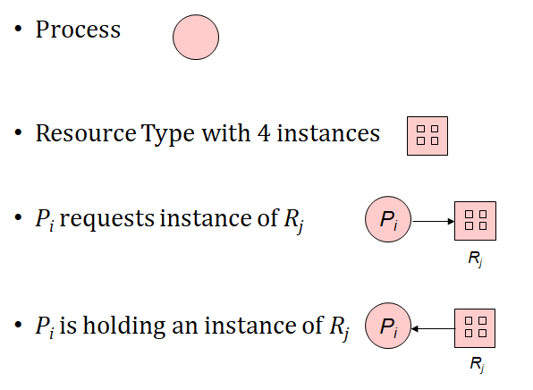
Deadlock Modeling
For Deadlock modeling a directed graph, called Resource Allocation Graph (RAG) is used.
Notation used for representation of RAG -

Slide 12
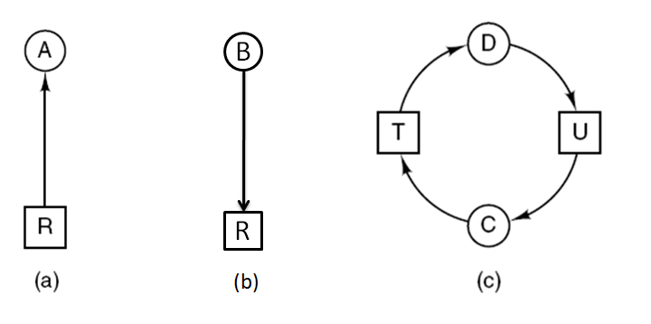
Construction of Resource Allocation Graph
B
R
(b)
Figure : Resource allocation graphs
(a) Holding a resource. (b) Requesting a resource. (c) Deadlock.

Slide 13
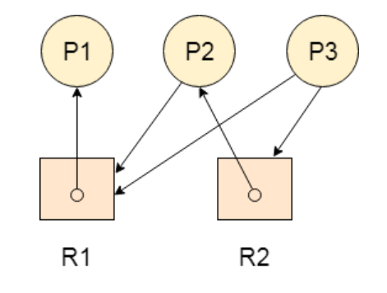
Resource Allocation Graph
Problem-1 : Find the system is in a deadlock state or not?
Deadlock Free

Slide 14
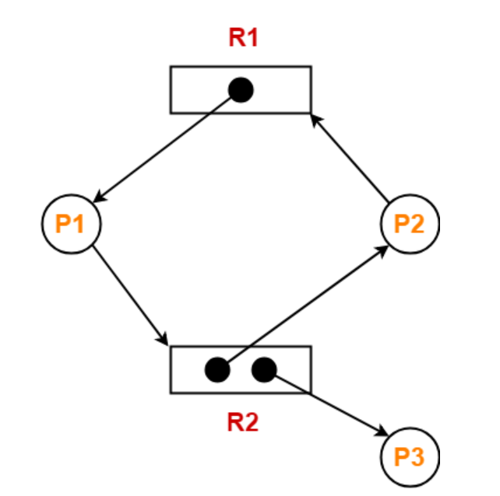
Resource Allocation Graph
Problem-2 : Find the system is in a deadlock state or not?
Deadlock Free

Slide 15
Handling Deadlocks In DOS

Slide 16
Handling Deadlocks In DOS
Handling of deadlocks in distributed systems is more complex than in centralized systems.
Because the resources, the processes, and other relevant information are scattered on different nodes of the system.
Strategies to handle deadlocks:
Prevention – constraints are imposed on the way in which processes request resources in order to prevent deadlocks.
Avoidance – resources are carefully allocated to avoid deadlocks.
Detection and recovery – deadlocks are allowed to occur, and a detection algorithm is used to detect them. After deadlock is detected, it is resolved by certain means.
Ignore – do nothing, just ignore the problem.

Slide 17
Deadlock Prevention

Slide 18
Deadlock Prevention
Deadlock can be prevented by violating the one of the four conditions that leads to deadlock.
Attacking the Mutual Exclusion Condition
Attacking the Hold and Wait Condition
Attacking the No Preemption Condition
Attacking the Circular Wait Condition

Slide 19
Violation of Mutual Exclusion Condition
No deadlock if each resource can be assigned to more than one process.
This can violate the hardware properties of a resource.
We can not assign some resources to more than one process at a time such as printer.
Not feasible

Slide 20
Violation of Hold and Wait Condition
Conservative Approach : Process is allowed to start execution if and only if it has acquired all the resources (less efficient, not implementable, easy, deadlock independence)
A process is allowed to run if all resources it needed is available. Otherwise, nothing will be allocated, and it will just wait.
Problem with this strategy is that a process may not know required resources at start of run.
Resource will not be used optimally.
It may cause starvation of a process that needs may resources.

Slide 21
Violation of Hold and Wait Condition
2. Do not Hold: A process will acquire all desired resources but before making any fresh request it must release all the resources that it currently hold (efficient, implementable)
3. Wait Timeout: We place a maximum time up to which a process can wait after which process and release all the holding resources.

Slide 22
Violation of No Preemption Condition
Forcefully Pre-emption: We allow a process to forcefully pre-empt the resource by other processes
For example - When a process request for a resource that is currently not available, all the resources held by the process are taken away from it and process is blocked.
This method may be used by high priority process or system process.
The process which are in waiting state must be selected as a victim instead of process in the running state.

Slide 23
Violation of Circular Wait Condition
To provide a global numbering of all the resources.
Processes can request resources whenever they want to, but all requests must be made in increasing or decreasing order.
A process need not acquire them all at once.
Circular wait is prevented if a process holding resource n cannot wait for resource m, if m > n.
1.Printer, 2.Scanner, 3.Plotter, 4.Tape drive, 5.CD ROM
A process may request 1st a CD ROM drive, then tape drive. But it may not request 1st a plotter, then a Tape drive.
Resource graph can never have cycle.

Slide 24
Deadlock Avoidance

Slide 25
Safe and unsafe states
A state is said to be safe if it is not deadlocked and there is some scheduling order in which every process can run to completion even if all of them suddenly request their maximum number of resources immediately.
Total resources are 10
7 resources already allocated
So, there are 3 still free
A need 6 resources more to complete it.
B need 2 resources more to complete it.
C need 5 resources more to complete it.
Process | Has / Hold | Max required
A | 3 | 9
B | 2 | 4
C | 2 | 7
Free : 3

Slide 26
Safe state
Process | Has / Hold | Max required
A | 3 | 9
B | 2 | 4
C | 2 | 7
Free : 3
Process | Has / Hold | Max required
A | 3 | 9
B | 4 | 4
C | 2 | 7
Free : 1
Process | Has / Hold | Max required
A | 3 | 9
B | 0 | -
C | 2 | 7
Free : 5
2
4
Process | Has / Hold | Max required
A | 3 | 9
B | 0 | -
C | 7 | 7
Free : 0
5
Process | Has / Hold | Max required
A | 3 | 9
B | 0 | -
C | 0 | -
Free : 7
Process | Has / Hold | Max required
A | 9 | 9
B | 0 | -
C | 0 | -
Free : 1
6
7

Slide 27
Unsafe state
Process | Has / Hold | Max required
A | 3 | 9
B | 2 | 4
C | 2 | 7
Free : 3
Process | Has / Hold | Max required
A | 4 | 9
B | 2 | 4
C | 2 | 7
Free : 2
Process | Has / Hold | Max required
A | 4 | 9
B | 4 | 4
C | 2 | 7
Free : 0
1
2
Process | Has / Hold | Max required
A | 4 | 9
B | 0 | -
C | 2 | 7
Free : 4
4
Unsafe State

Slide 28
Deadlock avoidance
Deadlock can be avoided by allocating resources carefully.
Carefully analyze each resource request to see if it can be safely granted.
Need an algorithm that can always avoid deadlock by making right choice all the time (Banker’s algorithm).
Banker’s algorithm for single resource
Banker’s algorithm for multiple resource

Slide 29
Banker’s algorithm for single resource
What the algorithm does is check to see if granting the request leads to an unsafe state. If it does, the request is denied.
If granting the request leads to a safe state, it is carried out.
If we have situation as per figure
then it is safe state
because with 10 free units
one by one all customers can be served.
Process | Has / Hold | Max required
A | 0 | 6
B | 0 | 5
C | 0 | 4
D | 0 | 7
Free : 10

Slide 30
Banker’s algorithm for single resource (safe state)
Process | Has / Hold | Max required
A | 1 | 6
B | 1 | 5
C | 2 | 4
D | 4 | 7
Free : 2
Process | Has / Hold | Max required
A | 1 | 6
B | 1 | 5
C | 4 | 4
D | 4 | 7
Free : 0
Process | Has / Hold | Max required
A | 1 | 6
B | 1 | 5
C | 0 | -
D | 4 | 7
Free : 4
2
3
Process | Has / Hold | Max required
A | 1 | 6
B | 1 | 5
C | 0 | -
D | 7 | 7
Free : 1
Process | Has / Hold | Max required
A | 1 | 6
B | 1 | 5
C | 0 | -
D | 0 | -
Free : 8
Process | Has / Hold | Max required
A | 1 | 6
B | 5 | 5
C | 0 | -
D | 0 | -
Free : 4
4

Slide 31
Banker’s algorithm for single resource (safe state)
Process | Has / Hold | Max required
A | 1 | 6
B | 0 | -
C | 0 | -
D | 0 | -
Free : 9
Process | Has / Hold | Max required
A | 6 | 6
B | 0 | -
C | 0 | -
D | 0 | -
Free : 4
Process | Has / Hold | Max required
A | 0 | -
B | 0 | -
C | 0 | -
D | 0 | -
Free : 10
5
Safe State
The order of execution is C, D, B, A. So, if we can find proper order of execution then there is no deadlock.

Slide 32
Banker’s algorithm for single resource (unsafe state)
Process | Has / Hold | Max required
A | 1 | 6
B | 2 | 5
C | 2 | 4
D | 4 | 7
Free : 1
Unsafe State

Slide 33
Banker’s algorithm for multiple resource
Tape Drives | Plotters | Scanners | CD Roms
6 | 3 | 4 | 2
Tape Drives | Plotters | Scanners | CD Roms
5 | 3 | 2 | 2
Tape Drives | Plotters | Scanners | CD Roms
1 | 0 | 2 | 0
total no of each resource
resources hold
available (free) resources
Process | Tape Drives | Plotters | Scanners | CD Roms
P1 | 3 | 0 | 1 | 1
P2 | 0 | 1 | 0 | 0
P3 | 1 | 1 | 1 | 0
P4 | 1 | 1 | 0 | 1
P5 | 0 | 0 | 0 | 0
Process | Tape Drives | Plotters | Scanners | CD Roms
P1 | 1 | 1 | 0 | 0
P2 | 0 | 1 | 1 | 2
P3 | 3 | 1 | 0 | 0
P4 | 0 | 0 | 1 | 0
P5 | 2 | 1 | 1 | 0
no of resources held by each process
no of resources still needed by each process to proceed

Slide 34
Banker’s algorithm for multiple resource
Tape Drives | Plotters | Scanners | CD Roms
6 | 3 | 4 | 2
Tape Drives | Plotters | Scanners | CD Roms
5 | 3 | 2 | 2
Tape Drives | Plotters | Scanners | CD Roms
1 | 0 | 1 | 0
total no of each resource
resources hold
available (free) resources
Process | Tape Drives | Plotters | Scanners | CD Roms
P1 | 3 | 0 | 1 | 1
P2 | 0 | 1 | 0 | 0
P3 | 1 | 1 | 1 | 0
P4 | 1 | 1 | 1 | 1
P5 | 0 | 0 | 0 | 0
Process | Tape Drives | Plotters | Scanners | CD Roms
P1 | 1 | 1 | 0 | 0
P2 | 0 | 1 | 1 | 2
P3 | 3 | 1 | 0 | 0
P4 | 0 | 0 | 0 | 0
P5 | 2 | 1 | 1 | 0
no of resources held by each process
no of resources still needed by each process to proceed

Slide 35
Banker’s algorithm for multiple resource
Tape Drives | Plotters | Scanners | CD Roms
6 | 3 | 4 | 2
Tape Drives | Plotters | Scanners | CD Roms
5 | 3 | 2 | 2
Tape Drives | Plotters | Scanners | CD Roms
2 | 1 | 2 | 1
total no of each resource
resources hold
available (free) resources
Process | Tape Drives | Plotters | Scanners | CD Roms
P1 | 3 | 0 | 1 | 1
P2 | 0 | 1 | 0 | 0
P3 | 1 | 1 | 1 | 0
P4 | - | - | - | -
P5 | 0 | 0 | 0 | 0
Process | Tape Drives | Plotters | Scanners | CD Roms
P1 | 1 | 1 | 0 | 0
P2 | 0 | 1 | 1 | 2
P3 | 3 | 1 | 0 | 0
P4 | 0 | 0 | 0 | 0
P5 | 2 | 1 | 1 | 0
no of resources held by each process
no of resources still needed by each process to proceed

Slide 36
Banker’s algorithm for multiple resource
Tape Drives | Plotters | Scanners | CD Roms
6 | 3 | 4 | 2
Tape Drives | Plotters | Scanners | CD Roms
5 | 3 | 2 | 2
Tape Drives | Plotters | Scanners | CD Roms
1 | 0 | 2 | 1
total no of each resource
resources hold
available (free) resources
Process | Tape Drives | Plotters | Scanners | CD Roms
P1 | 4 | 1 | 1 | 1
P2 | 0 | 1 | 0 | 0
P3 | 1 | 1 | 1 | 0
P4 | - | - | - | -
P5 | 0 | 0 | 0 | 0
Process | Tape Drives | Plotters | Scanners | CD Roms
P1 | 0 | 0 | 0 | 0
P2 | 0 | 1 | 1 | 2
P3 | 3 | 1 | 0 | 0
P4 | 0 | 0 | 0 | 0
P5 | 2 | 1 | 1 | 0
no of resources held by each process
no of resources still needed by each process to proceed

Slide 37
Banker’s algorithm for multiple resource
Tape Drives | Plotters | Scanners | CD Roms
6 | 3 | 4 | 2
Tape Drives | Plotters | Scanners | CD Roms
5 | 3 | 2 | 2
Tape Drives | Plotters | Scanners | CD Roms
5 | 1 | 3 | 2
total no of each resource
resources hold
available (free) resources
Process | Tape Drives | Plotters | Scanners | CD Roms
P1 | - | - | - | -
P2 | 0 | 1 | 0 | 0
P3 | 1 | 1 | 1 | 0
P4 | - | - | - | -
P5 | 0 | 0 | 0 | 0
Process | Tape Drives | Plotters | Scanners | CD Roms
P1 | 0 | 0 | 0 | 0
P2 | 0 | 1 | 1 | 2
P3 | 3 | 1 | 0 | 0
P4 | 0 | 0 | 0 | 0
P5 | 2 | 1 | 1 | 0
no of resources held by each process
no of resources still needed by each process to proceed

Slide 38
Banker’s algorithm for multiple resource
Tape Drives | Plotters | Scanners | CD Roms
6 | 3 | 4 | 2
Tape Drives | Plotters | Scanners | CD Roms
5 | 3 | 2 | 2
Tape Drives | Plotters | Scanners | CD Roms
5 | 0 | 2 | 0
total no of each resource
resources hold
available (free) resources
Process | Tape Drives | Plotters | Scanners | CD Roms
P1 | - | - | - | -
P2 | 0 | 2 | 1 | 2
P3 | 1 | 1 | 1 | 0
P4 | - | - | - | -
P5 | 0 | 0 | 0 | 0
Process | Tape Drives | Plotters | Scanners | CD Roms
P1 | 0 | 0 | 0 | 0
P2 | 0 | 0 | 0 | 0
P3 | 3 | 1 | 0 | 0
P4 | 0 | 0 | 0 | 0
P5 | 2 | 1 | 1 | 0
no of resources held by each process
no of resources still needed by each process to proceed

Slide 39
Banker’s algorithm for multiple resource
Tape Drives | Plotters | Scanners | CD Roms
6 | 3 | 4 | 2
Tape Drives | Plotters | Scanners | CD Roms
5 | 3 | 2 | 2
Tape Drives | Plotters | Scanners | CD Roms
5 | 2 | 3 | 2
total no of each resource
resources hold
available (free) resources
Process | Tape Drives | Plotters | Scanners | CD Roms
P1 | - | - | - | -
P2 | - | - | - | -
P3 | 1 | 1 | 1 | 0
P4 | - | - | - | -
P5 | 0 | 0 | 0 | 0
Process | Tape Drives | Plotters | Scanners | CD Roms
P1 | 0 | 0 | 0 | 0
P2 | 0 | 0 | 0 | 0
P3 | 3 | 1 | 0 | 0
P4 | 0 | 0 | 0 | 0
P5 | 2 | 1 | 1 | 0
no of resources held by each process
no of resources still needed by each process to proceed

Slide 40
Banker’s algorithm for multiple resource
Tape Drives | Plotters | Scanners | CD Roms
6 | 3 | 4 | 2
Tape Drives | Plotters | Scanners | CD Roms
5 | 3 | 2 | 2
Tape Drives | Plotters | Scanners | CD Roms
2 | 1 | 3 | 2
total no of each resource
resources hold
available (free) resources
Process | Tape Drives | Plotters | Scanners | CD Roms
P1 | - | - | - | -
P2 | - | - | - | -
P3 | 4 | 2 | 1 | 0
P4 | - | - | - | -
P5 | 0 | 0 | 0 | 0
Process | Tape Drives | Plotters | Scanners | CD Roms
P1 | 0 | 0 | 0 | 0
P2 | 0 | 0 | 0 | 0
P3 | 0 | 0 | 0 | 0
P4 | 0 | 0 | 0 | 0
P5 | 2 | 1 | 1 | 0
no of resources held by each process
no of resources still needed by each process to proceed

Slide 41
Banker’s algorithm for multiple resource
Tape Drives | Plotters | Scanners | CD Roms
6 | 3 | 4 | 2
Tape Drives | Plotters | Scanners | CD Roms
5 | 3 | 2 | 2
Tape Drives | Plotters | Scanners | CD Roms
6 | 3 | 4 | 2
total no of each resource
resources hold
available (free) resources
Process | Tape Drives | Plotters | Scanners | CD Roms
P1 | - | - | - | -
P2 | - | - | - | -
P3 | - | - | - | -
P4 | - | - | - | -
P5 | 0 | 0 | 0 | 0
Process | Tape Drives | Plotters | Scanners | CD Roms
P1 | 0 | 0 | 0 | 0
P2 | 0 | 0 | 0 | 0
P3 | 0 | 0 | 0 | 0
P4 | 0 | 0 | 0 | 0
P5 | 2 | 1 | 1 | 0
no of resources held by each process
no of resources still needed by each process to proceed

Slide 42
Banker’s algorithm for multiple resource
Tape Drives | Plotters | Scanners | CD Roms
6 | 3 | 4 | 2
Tape Drives | Plotters | Scanners | CD Roms
5 | 3 | 2 | 2
Tape Drives | Plotters | Scanners | CD Roms
4 | 2 | 3 | 2
total no of each resource
resources hold
available (free) resources
Process | Tape Drives | Plotters | Scanners | CD Roms
P1 | - | - | - | -
P2 | - | - | - | -
P3 | - | - | - | -
P4 | - | - | - | -
P5 | 2 | 1 | 1 | 0
Process | Tape Drives | Plotters | Scanners | CD Roms
P1 | 0 | 0 | 0 | 0
P2 | 0 | 0 | 0 | 0
P3 | 0 | 0 | 0 | 0
P4 | 0 | 0 | 0 | 0
P5 | 0 | 0 | 0 | 0
no of resources held by each process
no of resources still needed by each process to proceed

Slide 43
Banker’s algorithm for multiple resource
Tape Drives | Plotters | Scanners | CD Roms
6 | 3 | 4 | 2
Tape Drives | Plotters | Scanners | CD Roms
5 | 3 | 2 | 2
Tape Drives | Plotters | Scanners | CD Roms
6 | 3 | 4 | 2
total no of each resource
resources hold
available (free) resources
Process | Tape Drives | Plotters | Scanners | CD Roms
P1 | - | - | - | -
P2 | - | - | - | -
P3 | - | - | - | -
P4 | - | - | - | -
P5 | - | - | - | -
Process | Tape Drives | Plotters | Scanners | CD Roms
P1 | 0 | 0 | 0 | 0
P2 | 0 | 0 | 0 | 0
P3 | 0 | 0 | 0 | 0
P4 | 0 | 0 | 0 | 0
P5 | 0 | 0 | 0 | 0
no of resources held by each process
no of resources still needed by each process to proceed
Safe State

Slide 44
Banker’s algorithm for multiple resource
Tape Drives | Plotters | Scanners | CD Roms
6 | 3 | 4 | 2
Tape Drives | Plotters | Scanners | CD Roms
5 | 3 | 2 | 2
Tape Drives | Plotters | Scanners | CD Roms
1 | 0 | 2 | 0
total no of each resource
resources hold
available (free) resources
Process | Tape Drives | Plotters | Scanners | CD Roms
P1 | 3 | 0 | 1 | 1
P2 | 0 | 1 | 0 | 0
P3 | 1 | 1 | 1 | 0
P4 | 1 | 1 | 0 | 1
P5 | 0 | 0 | 0 | 0
Process | Tape Drives | Plotters | Scanners | CD Roms
P1 | 1 | 1 | 0 | 0
P2 | 0 | 1 | 1 | 2
P3 | 3 | 1 | 0 | 0
P4 | 0 | 0 | 1 | 1
P5 | 2 | 1 | 1 | 0
Unsafe State
no of resources held by each process
no of resources still needed by each process to proceed

Slide 45
Deadlock Detection

Slide 46
Deadlock Detection
When this technique is used, the system does not attempt to prevent deadlocks from occurring.
Instead, it lets them occur, tries to detect when this happens, and then takes some action to recover after the fact.
For deadlock detection, the system must provide
An algorithm that examines the state of the system to detect whether a deadlock has occurred
And an algorithm to recover from the deadlock

Slide 47
Deadlock detection for single resource (RAG)
We are starting from node D.
Empty list L = ()
Add current node so Empty list = (D).
From this node there is one outgoing arc to T so add T to list.
So list become L = (D, T).
Continue this step….so we get list as below
L = (D, T, E)………… L = (D, T, E, V, G, U, D)
In the above step in list the node D appears twice, so deadlock.
R
A
B
C
S
D
T
E
F
U
DEADLOCK
V
W
G

Slide 48
Deadlock detection for single resource (RAG)
Algorithm for detecting deadlock for single resource
For each node, N in the graph, perform the following five steps with N as the starting node.
Initialize L to the empty list, designate all arcs as unmarked.
Add current node to end of L, check to see if node now appears in L two times. If it does, graph contains a cycle (listed in L), algorithm terminates.
From given node, see if any unmarked outgoing arcs. If so, go to step 4; if not, go to step 5.
Pick an unmarked outgoing arc at random and mark it. Then follow it to the new current node and go to step 2.
If this is initial node, graph does not contain any cycles, algorithm terminates. Otherwise, dead end. Remove it, go back to previous node, make that one current node, go to step 2.

Slide 49
Deadlock detection for multiple resources
Tape Drives | Plotters | Scanners | CD Roms
4 | 2 | 3 | 1
Tape Drives | Plotters | Scanners | CD Roms
2 | 1 | 0 | 0
T =
A =
total no of each resource
no of resources that are available (free)
Process | Tape Drives | Plotters | Scanners | CD Roms
P1 | 0 | 0 | 1 | 0
P2 | 2 | 0 | 0 | 1
P3 | 0 | 1 | 2 | 0
Process | Tape Drives | Plotters | Scanners | CD Roms
P1 | 2 | 0 | 0 | 1
P2 | 1 | 0 | 1 | 1
P3 | 2 | 1 | 0 | 0
C =
R =
no of resources held by each process
no of resources still needed by each process to proceed

Slide 50
Deadlock detection for multiple resources
Tape Drives | Plotters | Scanners | CD Roms
4 | 2 | 3 | 1
Tape Drives | Plotters | Scanners | CD Roms
0 | 0 | 0 | 0
T =
A =
total no of each resource
no of resources that are available (free)
Process | Tape Drives | Plotters | Scanners | CD Roms
P1 | 0 | 0 | 1 | 0
P2 | 2 | 0 | 0 | 1
P3 | 2 | 2 | 2 | 0
Process | Tape Drives | Plotters | Scanners | CD Roms
P1 | 2 | 0 | 0 | 1
P2 | 1 | 0 | 1 | 1
P3 | 2 | 1 | 0 | 0
C =
R =
no of resources held by each process
no of resources still needed by each process to proceed

Slide 51
Deadlock detection for multiple resources
Tape Drives | Plotters | Scanners | CD Roms
4 | 2 | 3 | 1
Tape Drives | Plotters | Scanners | CD Roms
2 | 2 | 2 | 0
T =
A =
total no of each resource
no of resources that are available (free)
Process | Tape Drives | Plotters | Scanners | CD Roms
P1 | 0 | 0 | 1 | 0
P2 | 2 | 0 | 0 | 1
P3 | 0 | 0 | 0 | 0
Process | Tape Drives | Plotters | Scanners | CD Roms
P1 | 2 | 0 | 0 | 1
P2 | 1 | 0 | 1 | 1
P3 | 2 | 1 | 0 | 0
C =
R =
DEADLOCK
no of resources held by each process
no of resources still needed by each process to proceed

Slide 52
Deadlock recovery

Slide 53
Deadlock Recovery
Recovery through preemption
Recovery through rollback
Recovery through killing processes

Slide 54
Deadlock Recovery
Recovery through preemption
In some cases, it may be possible to temporarily take a resource away from its current owner and give it to another process.
Recovering this way is frequently difficult or impossible.
Choosing the process to suspend depends largely on which ones have resources that can easily be taken back.
P₁
R₁
R₂
P₂

Slide 55
Deadlock Recovery
Recovery through killing processes
The simplest way to break a deadlock is to kill one or more processes.
Kill all the process involved in deadlock.
Kill process one by one.
After killing each process check for deadlock.
If deadlock recovered, then stop killing more process.
Otherwise kill another process.

Slide 56
Deadlock Recovery
Recovery through rollback
Checkpoint a process periodically.
Check pointing a process means that its state is written to a file so that it can be restarted later.
When deadlock is detected, rollback the preempted process up to the previous safe state before it acquired that resource.

Slide 57


