Slide 1


Concurrency Control (IPC)
Unit-3
Operating System/01CE1401
Department of Computer Engineering
Prof. Pranav Tank

Slide 2
Unit-3 Interprocess Communication (CO - 3)
After completion of this course, student will be able to
Understanding the role of operating system with its function and services.
Application and comparison of various CPU scheduling and memory management algorithms.
Apply various concepts and asses the requirement for inter process communication and deadlock.
Comprehend the mechanism of I/O and File Management
Implement algorithms and acquire a detailed understanding of various Unix commands

Slide 3
Topics Covered
Process Synchronization
Critical Section Problem
Classic problem of Synchronization
Software Solutions for Synchronization problem
Hardware Solutions for Synchronization problem
Synchronization and their application

Slide 4
Topics Covered
Process Synchronization
Critical Section Problem
Classic problem of Synchronization
Software Solutions for Synchronization problem
Hardware Solutions for Synchronization problem
Synchronization and their application

Slide 5
Interprocess Communication
WHAT?
Introduction:
Process in system can be both independent or cooperating.
Independent process: It cannot affect or be affected by the execution of another process
Cooperating process: It can affect or be affected by the execution of another process.
Definition:
Interprocess communication is the mechanism provided by the operating system that allows processes to communicate with each other.

Slide 6
Interprocess Communication
HOW?
Working:
This communication could involve a process letting another process know that some event has occurred or the transferring of data from one process to another.
Processes may be running on one or more computers connected by a network.
IPC may also be referred to as inter-thread communication and inter-application communication.

Slide 7
Interprocess Communication
WHY?
Need of IPC:
Information Sharing
Computational Speed-up
Modularity
Convenience
Note: IPC is very important to design process for Microkernels and Nanokernels

Slide 8
Interprocess Communication
Challenges (Issues) of IPC:
Data Corruption
Deadlock
Increased Complexity
Requires process to synchronize their processing

Slide 9
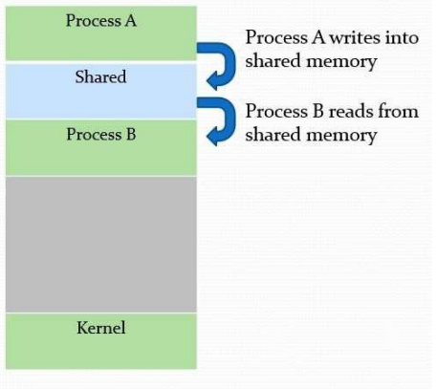
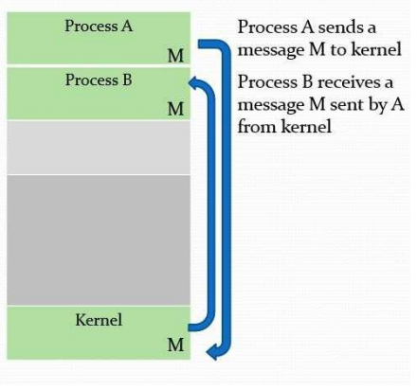
Interprocess Communication
Models for IPC:
(a) Shared Memory
(b) Message Passing

Slide 10
Topics Covered
Process Synchronization
Critical Section Problem
Classic problem of Synchronization
Software Solutions for Synchronization problem
Hardware Solutions for Synchronization problem
Synchronization and their application

Slide 11
Race condition
Definition:
A Race condition is an undesirable situation that occurs when a device or system attempts to perform two or more operations at the same time.
Race conditions arise in software when separate processes or threads of execution depend on some shared state.
Operations upon shared states are critical sections that must be mutually exclusive. Failure to do so opens up the possibility of corrupting the shared state.
Reasons:
Exact instruction execution order cannot be predicted.
Resource(file, memory, data) sharing.

Slide 12
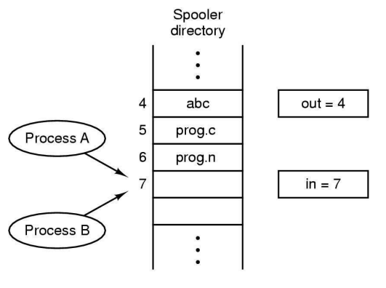
Race condition
Example: Print Spooler directory; where 2 processes wants to access shared memory at same time.

Slide 13
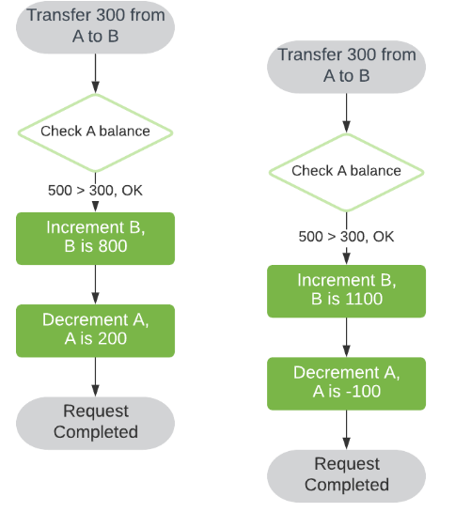
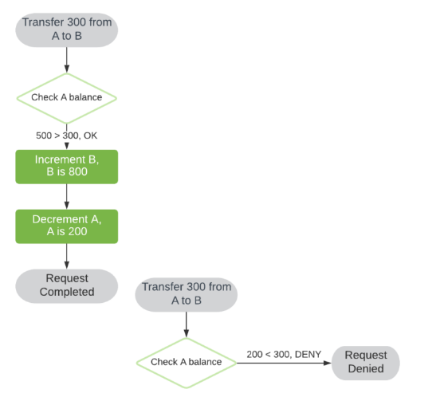
Race condition
Example 2: Bank Transaction
Scenario - 1
Scenario - 2

Slide 14
Race condition
How to avoid Race condition:
There are different proposed solutions to overcome Race Condition:
Immutable Objects: The basic logic to avoid Race Condition is to use immutable objects as much as possible.
Synchronizing process: Critical section is the best example to implement and achieve synchronization
Atomic operations: Applying higher-level lock-free abstractions is a way to achieve concept of Atomic operation

Slide 15
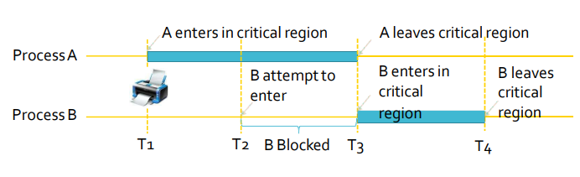
Critical Section
Definition:
The part of program where the shared resource is accessed is called critical section or critical region.

Slide 16
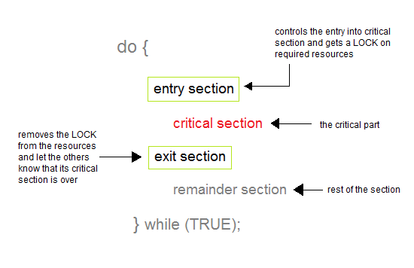
Critical Section
Understanding different regions

Slide 17


Critical Section (Real World Example)
Flight Booking
Booking a movie ticket

Slide 18
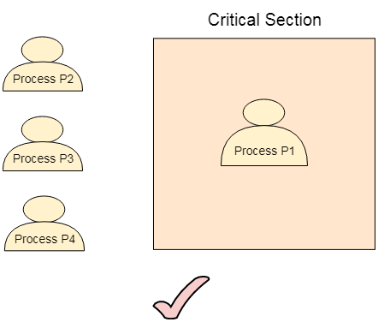
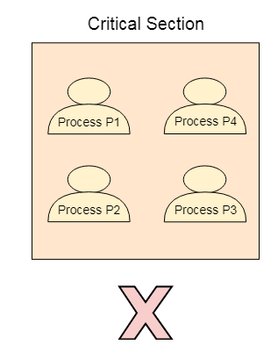
Critical Section
How to achieve Synchronization of Process
Mutual Exclusion: If one process is executing inside critical section then the other process must not enter in the critical section.

Slide 19
Critical Section
Bounded Wait: The process must not be endlessly waiting for getting into the critical section.
Progress: No process running outside the critical region may block other process
Arbitrary Speed: No assumption can be made about relative speed of different processes.

Slide 20
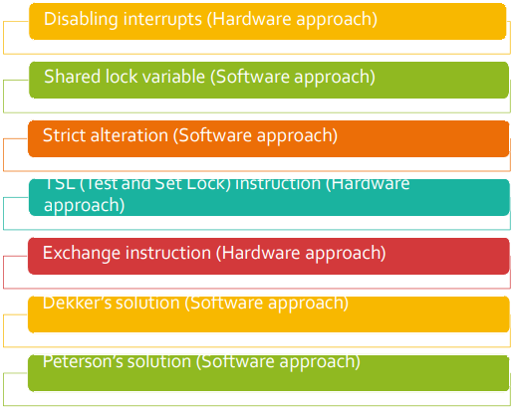
Mutual Exclusion

Slide 21
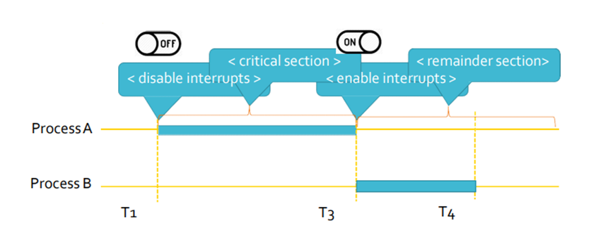
Mutual Exclusion with busy waiting
Disabling interrupts (Hardware Approach)
while (true)
{
< disabled interrupts >;
< critical section >;
< enable interrupts >;
< remainder section >;
}

Slide 22
Mutual Exclusion with busy waiting
Disabling interrupts (Hardware Approach)
Problems:
Unattractive or unwise to give user processes the power to turn off interrupts.
What if one of them did it (disable interrupt) and never turned them on (enable interrupt) again? That could be the end of the system.
If the system is a multiprocessor, with two or more CPUs, disabling interrupts affects only the CPU that executed the disable instruction.
The other process will continue running and can access the shared memory.

Slide 23
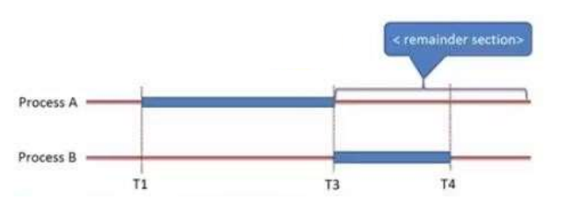
Mutual Exclusion with busy waiting
Shared lock variable (Software Approach)
while (true)
{
< set shared variable to 1 >;
< critical section >;
< set shared variable to 0 >;
< remainder section >;
}

Slide 24
Mutual Exclusion with busy waiting
Shared lock variable (Software Approach)
A shared variable lock having value 0 or 1.
Before entering into critical region a process checks a shared variable lock’s value.
If the value of lock is 0 then set it to 1 before entering the critical section and enters into critical section and set it to 0 immediately after leaving the critical section.
If the value of lock is 1 then wait until it becomes 0 by some other process which is in critical section.

Slide 25
Mutual Exclusion with busy waiting
Shared lock variable (Software Approach)
Problem:
If process P0 sees the value of lock variable 0andbefore it can set it to 1 context switch occurs.
Now process P1 runs and finds value of lock variable 0, so it sets value to 1, enters critical region.
At some point of time P0 resumes, sets the value of lock variable to 1, enters critical region.
Now two processes are in their critical regions accessing the same shared memory, which violates the mutual exclusion condition.

Slide 26
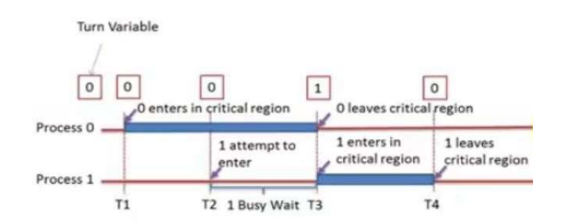
Mutual Exclusion with busy waiting
Strict Alteration (Software Approach) – Runs at user mode
Process – 0 Process – 1
while (true) while (true)
{ {
while(turn != 0); while(turn != 1);
critical_region(); critical_region();
turn = 1; turn = 0;
noncritical_region(); noncritical_region();
} }

Slide 27
Mutual Exclusion with busy waiting
Strict Alteration (Software Approach)
Integer variable 'turn' keeps track of whose turn is to enter the critical section.
Initially turn=0. Process 0 inspects turn, finds it to be 0 and enters in its critical section.
Process 1 also finds it to be 0 and therefore sits in a loop continually testing 'turn' to see when it becomes 1.
Continuously testing a variable waiting for some event to appear is called the busy waiting.
When process 0 exits from critical region it sets turn to 1and now process 1 can find it to be 1 and enters in to critical region.

Slide 28
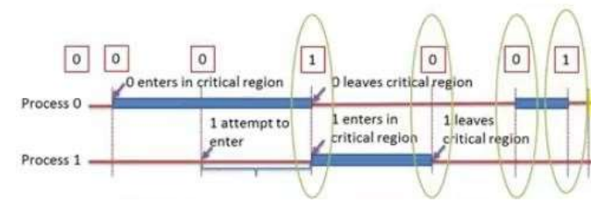
Mutual Exclusion with busy waiting
Strict Alteration (Software Approach)
Problem:
Consider the following situation of two Process P0 and P1.
P0 leaves its critical region, set turn to 1, enters non-critical region.
P1 enters and finishes its critical region, set turn to 0.
Now both are in non-critical region.
P0 finishes non critical region, enters critical region and leaves this region, set turn to 1.

Slide 29
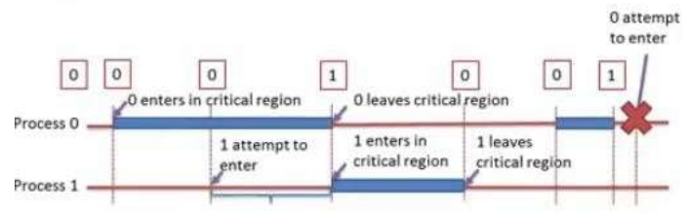
Mutual Exclusion with busy waiting
Strict Alteration (Software Approach)
Disadvantage:
Taking turn is not good idea when one of the process is much slower than the other.
P0 finishes non-critical region but cannot enter its critical region because turn =1 and it is turn of P1 to enter the critical region.
Hence P0 will be blocked by a process P1 which is not in critical region.
It wastes CPU time, so we should avoid busy waiting as much as we can.

Slide 30
Mutual Exclusion with busy waiting
Strict Alteration (Software Approach)
Solution: (Petersons Solution)
Peterson's algorithm (or Peterson's solution) is a concurrent programming algorithm for mutual exclusion that allows two or more processes to share a single-use resource without conflict, using only shared memory for communication.
It uses two variables, a bool array flag of size 2 and an int variable turn to accomplish it.
bool flag[2] = {false, false};
int turn;

Slide 31
Mutual Exclusion with busy waiting
bool flag[2] = {false, false};
int turn;
P0: flag[0] = true; P0_gate: turn = 1; while (flag[1] && turn == 1) { // busy wait } // critical section ... // end of critical section flag[0] = false; | P1: flag[1] = true; P1_gate: turn = 0; while (flag[0] && turn == 0) { // busy wait } // critical section ... // end of critical section flag[1] = false;

Slide 32
Peterson’s Solution
Peterson's solution is a classic solution to the critical section problem. The critical section problem ensures that no two processes change or modify a resource’s value simultaneously.
May not work properly in modern computer architecture.
However it addresses the requirements of mutual exclusion, progress and bounded waiting.
Peterson’s solution is limited to two process that alternate execution between their critical section and remainder sections.

Slide 33
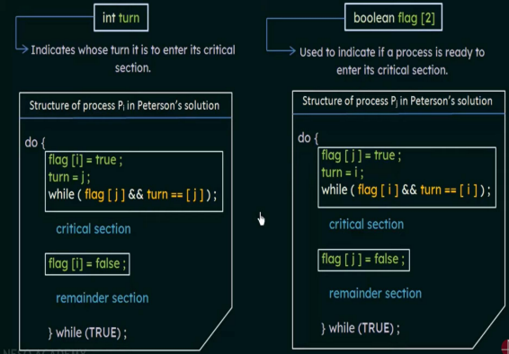
Peterson’s Solution
Note: Peterson's solution requires two data items to be shared between two process.

Slide 34
Peterson’s Solution
Peterson's solution provides a solution to the following problems:
1. It ensures that if a process is in the critical section, no other process must be allowed to enter it. This property is termed mutual exclusion.
2. If more than one process wants to enter the critical section, the process that should enter the critical region first must be established. This is termed progress.
3. There is a limit to the number of requests that processors can make to enter the critical region, provided that a process has already requested to enter and is waiting. This is termed bounding.
4. It provides platform neutrality as this solution is developed to run in user mode, which doesn't require any permission from the kernel.

Slide 35
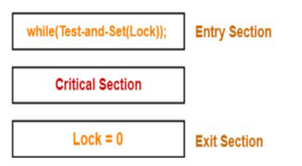
Test and Set Lock (TSL)
Test and set algorithm uses a boolean variable 'lock' which is initially initialized to false. This lock variable determines the entry of the process inside the critical section of the code.
Lock value = 0 means the critical section is currently vacant and no process is present inside it.
Lock value = 1 means the critical section is currently occupied and a process is present inside it.

Slide 36
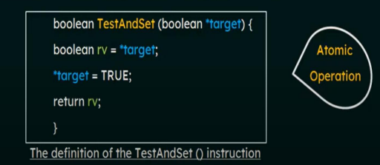
Test and Set Lock (TSL)
There is a shared lock variable which can take either of the two values 0 or 1.
Before entering into the critical section, a process inquires about the lock.
If it is locked, it keeps on waiting till it becomes free.
If it is not locked, it takes the lock and execute the critical section.
TSL is atomic. Memory bus is locked until it is finished executing.

Slide 37
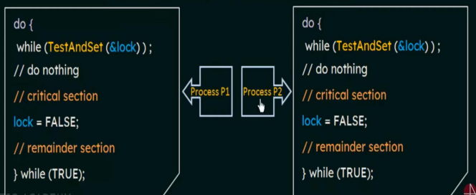
Test and Set Lock (TSL)

Slide 38
XCHG or SWAP instruction
Swap function uses two boolean variables lock and key. Both lock and key variables are initially initialized to false.
Swap algorithm is the same as lock and set algorithm.
The Swap algorithm uses a temporary variable to set the lock to true when a process enters the critical section of the program.

Slide 39
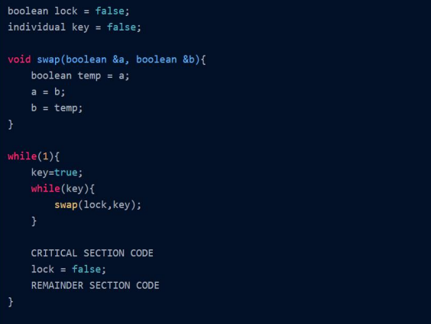
XCHG or SWAP instruction

Slide 40
XCHG or SWAP instruction
In the code above when a process P1 enters the critical section of the program it first executes the while loop
while(key)
{
swap(lock,key);
}
As key value is set to true just before the for loop so swap(lock, key) swaps the value of lock and key. Lock becomes true and the key becomes false. In the next iteration of the while loop breaks and the process, P1 enters the critical section.

Slide 41
Priority Inversion Problem
Priority inversion means the execution of a high priority process / thread is blocked by a lower priority process/thread.
Consider a computer with two processes, H, with high priority and L, with low priority.
The scheduling rules are such that H is run whenever it is in ready state.
At a certain moment, with L in its critical region, H becomes ready to run (e.g., an I/O operation completes).
H now begins busy waiting, but since L is never scheduled while H is running, L never gets the chance to leave its critical region, so H loops forever.
This situation is sometimes referred to as the priority inversion problem.

Slide 42
Challenges faced by Peterson’s, TSL and XCHG
When a process wants to enter its critical region, it checks to see if the entry is allowed.
If it is not, the process just sits in a tight loop waiting until it is allowed to enter
Problem : Busy waiting-waste of CPU time!
Solution: To avoid busy waiting we have IPC primitives (pair of sleep and wakeup). That means, Replace busy waiting by blocking calls.
Sleep (blocks process): it is a system call that causes the caller to block, that is, be suspended until another process wakes it up.
Wakeup (unblocks process):The wakeup call has one parameter, the process to be awakened.

Slide 43
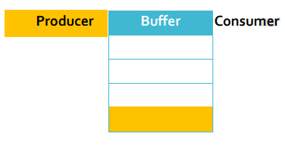
Producer Consumer Problem
It is multi-process synchronization.
It is also known as bounded buffer problem.
This problem describes two processes producer and consumer, who share common, fixed size buffer.
Producer process: It produce some information and
put it into buffer.
Consumer process: It consumes this information.

Slide 44
Producer Consumer Approach
The problem is to make sure that the producer won’t try to add data (information) into the buffer if it is full and consumer won’t try to remove data (information) from the an empty buffer.
Solution for producer: Producer either go to sleep or discard data if the buffer is full. Once the consumer removes an item from the buffer, it notifies (wakeups) the producer to put the data into buffer.
Solution for consumer: Consumer can go to sleep if the buffer is empty. Once the producer puts data into buffer, it notifies (wakeups) the consumer to remove (use) data from buffer.

Slide 45
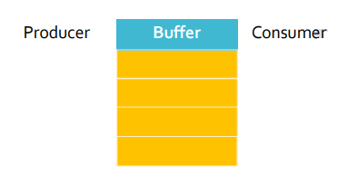
Producer Consumer Approach
Buffer is empty
Producer want to produce
Consumer want to consume
Buffer is full
Producer want to produce
Consumer want to consume
Buffer is partial filled
Producer want to produce
Consumer want to consume

Slide 46
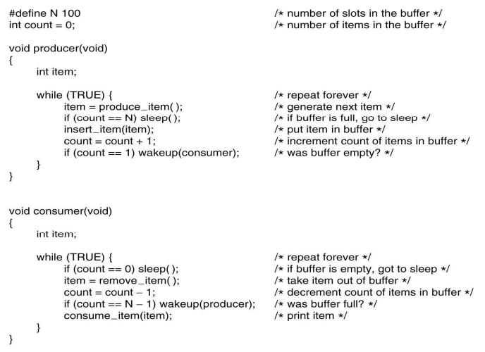
Producer Consumer Approach

Slide 47
Issue in Producer Consumer Problem
The consumer has just read the variable count, noticed it's zero and is just about to move inside the if block.
Just before calling sleep, the consumer is suspended and the producer is resumed.
The producer creates an item, puts it into the buffer, and increases count.
Because the buffer was empty prior to the last addition, the producer tries to wake up the consumer.
Unfortunately the consumer wasn't yet sleeping, and the wakeup call is lost.
When the consumer resumes, it goes to sleep and will never be awakened again. This is because the consumer is only awakened by the producer when count is equal to 1.
The producer will loop until the buffer is full, after which it will also go to sleep.
Finally, both the processes will sleep forever. This solution therefore is unsatisfactory.

Slide 48
Semaphore
A semaphore is a variable that provides a simple but useful abstraction for controlling access (of shared resource) by multiple processes to a common resource in a parallel programming or multi user environment.
So, Semaphore is nothing but a synchronized variable, that contain integer value.
A useful way to think of a semaphore is as a record of how many units of a particular resource are available.

Slide 49
Types of Semaphore
Semaphores which allow an arbitrary resource count are called counting semaphores(can have possible values more than two)
While semaphores which are restricted to the values 0 and 1(or locked/unlocked, unavailable/available, up/down) are called binary semaphores.
Counting semaphore is having value of count and Binary semaphore is having value 0/1.

Slide 50
Counting Semaphore
Counting semaphores are equipped with two operations:
1. V (known as signal() OR up)
2. P (Known as wait() OR down)
Operations V increments the semaphore S and P decrements the semaphore S.
A simple way to understand wait() and signal() operations is:
signal(): Increments the value of semaphore variable by 1.
After the increment, if the pre-increment value was negative(meaning there are processes waiting for a resource), it transfers a blocked process from the semaphore's waiting queue to the ready queue. (like Wake up)
wait(): Decrements the value of semaphore variable by 1.
If the value becomes negative or 0, the process executingwait() is blocked (like sleep), i.e., added to the semaphore’s queue.

Slide 51
Producer Consumer Problem with Semaphore
3 semaphores: full, empty and Mutex
Full counts-number of full(filled) slots (initially 0)
Empty counts-number of empty slots (initially N)
Mutex protects variable which contains the items produced and consumed

Slide 52
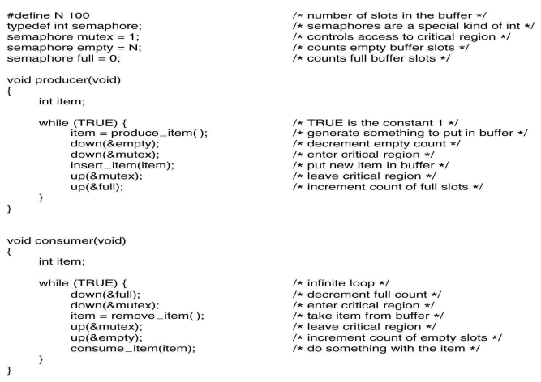
Producer Consumer Problem with Semaphore

Slide 53

Dining Philosopher Problem
Philosopher eat and think
To eat, they must first acquire left fork and then right fork (or vice versa).
Then they eat.
Then they put down the forks.
Then they think.
Go to 1.

Slide 54

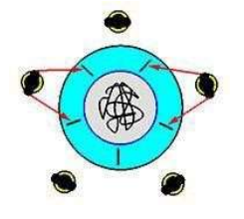
Dining Philosopher Problem
Problems:
Deadlock
Starvation

Slide 55


