Slide 1


Memory Management
Unit-4
Operating System/01CE1401
Department of Computer Engineering
Prof. Pranav Tank

Slide 2
Unit-3 Interprocess Communication (CO - 2)
After completion of this course, student will be able to
Understanding the role of operating system with its function and services.
Application and comparison of various CPU scheduling and memory management algorithms.
Apply various concepts and asses the requirement for inter process communication and deadlock.
Comprehend the mechanism of I/O and File Management
Implement algorithms and acquire a detailed understanding of various Unix commands

Slide 3
Topics Covered
Memory: Swapping, Contiguous memory allocation, Non-contiguous memory allocation
Paging: Page table, Segmentation, Demand Paging
Virtual Memory: Basics of Virtual Memory – Hardware and control structures, Locality of Reference, Page Fault, Dirty Bit
Page Replacement Policies: Least Recently Used (LRU), Optimal (OPT), Second Chance (SC), First In First Out (FIFO), Not Recently Used (NRU)

Slide 4
Topics Covered
Memory: Swapping, Contiguous memory allocation, Non-contiguous memory allocation
Paging: Page table, Segmentation, Demand Paging
Virtual Memory: Basics of Virtual Memory – Hardware and control structures, Locality of Reference, Page Fault, Dirty Bit
Page Replacement Policies: Least Recently Used (LRU), Optimal (OPT), Second Chance (SC), First In First Out (FIFO), Not Recently Used (NRU)

Slide 5
Memory Concept
Introduction:
Second major component of computer system is memory after processors.
CPU can only access main memory and register.
To access any data than that data must be fetched into main memory from disk.
Definition: Computer memory is the physical device, capable to store information in a temporary or permanent mode.

Slide 6
Memory Concept
Types of Memory:
Random Access Memory (RAM), is a volatile memory that loses its content when computer or hardware device loses power.
Read Only Memory (ROM), is a non-volatile memory sometimes abbreviated as NVRAM, is a memory that keep its content even if the power is lost.
Computer uses special ROM called BIOS (Basic Input Output System) which permanently stores the software needed to access computer hardware such as hard disk.
Programmable Read Only Memory (PROM), is a memory chip on which you can store a program. You cannot wipe it clean and use it to store something else. E.g CD-R
Erasable Programmable Read Only Memory (EPROM), is a special type of PROM that can be erased by exposing it to ultraviolet light. E.g CD-RW.
Electrically Erasable Programmable Read Only Memory (EEPROM), is a special type of PROM that can be erased by exposing it to an electrical charge. E.g Pendrive

Slide 7
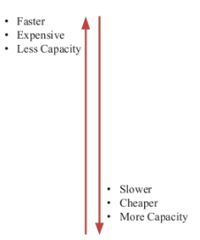
Memory Hierarchy
The Hierarchy arrangement of storage is called memory hierarchy.

Slide 8
Logical and Physical address map
Logical / Virtual Address
address generated by the CPU
• Range of logical address are limited to the size of processor.
• Example: 32-bit processor then address range would be up to 2^32 (4GB).
Physical / Real Address
• Address seen by Main memory unit.
• Range is depend on the size of memory.
The basic difference between Logical and physical address is that Logical address is generated by CPU in perspective of a program. On the other hand, the physical address is a location that exists in the memory unit.

Slide 9
Logical and Physical address map
Logical / Virtual Address Space
The set of all logical addresses generated by a program is known as logical address space.
Physical Address
The set of all physical addresses corresponding to the logical addresses is known as physical address space.

Slide 10
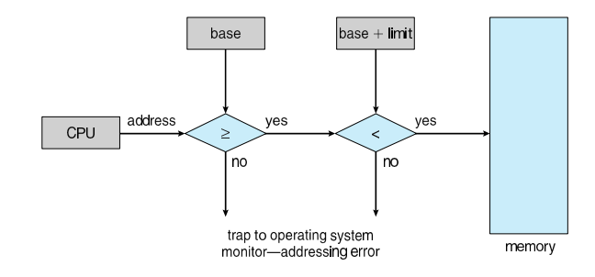
Logical and Physical address map
Hardware Address Protection
Base register: Starting Legal address
Limit register: Size of range

Slide 11
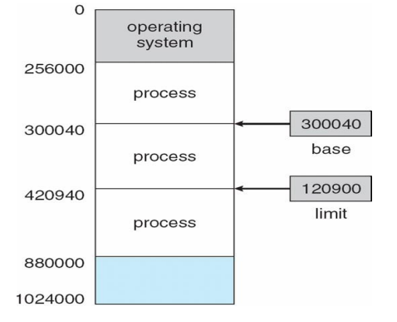
Logical and Physical address map
Hardware Address Protection

Slide 12
Logical and Physical address map
For any process to get executed it should remain in main memory.
Whenever process is fetched in the main memory, it requires some storage space.
In main memory physical address of process may not exactly match with the logical address and that is why we need mapping between logical and physical address.
Part of OS manages the main memory is known as Memory Management Unit (MMU).

Slide 13
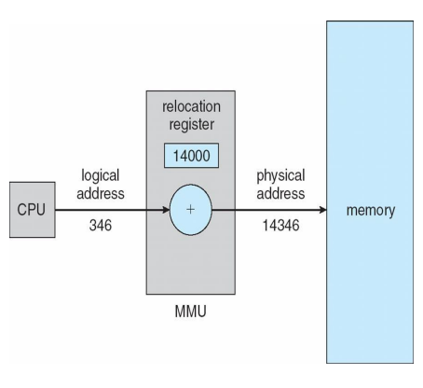
Logical and Physical address map
Base register is known as Relocation register.
The value in the relocation register added to every address generated by a user when process is send to memory.

Slide 14
Memory Abstraction
What is Memory Abstraction?
The hardware and OS memory manager makes you see the memory as a single contiguous
entity.
What is the need of Memory Abstraction?

Slide 15
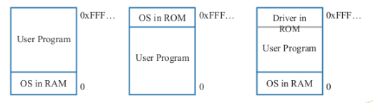
No Memory Abstraction
In this model the memory presented to the programmer was simply a single block of
physical memory.
having a set of addresses from 0 to some maximum
with each address corresponding to a cell containing some number of bits, commonly eight.
When program execute instruction like MOV REGISTER1, 1000
If at the same time another program execute same instruction then value of first program will be overwrite. So only one process at a time can be running.

Slide 16
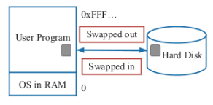
No Memory Abstraction
What if we want to run multiple program?
OS saves entire memory on disk
OS brings next program
OS runs next program
We can use swapping to run multiple programs concurrently.
The process of bringing in each process in its entirely in to memory, running it for a while and then putting it back on the disk is called swapping.

Slide 17
Topics Covered
Memory: Swapping, Contiguous memory allocation, Non-contiguous memory allocation
Paging: Page table, Segmentation, Demand Paging
Virtual Memory: Basics of Virtual Memory – Hardware and control structures, Locality of Reference, Page Fault, Dirty Bit
Page Replacement Policies: Least Recently Used (LRU), Optimal (OPT), Second Chance (SC), First In First Out (FIFO), Not Recently Used (NRU)

Slide 18
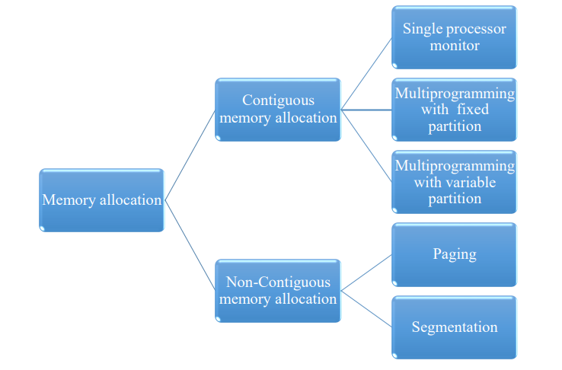
Memory allocation

Slide 19
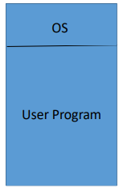
Contiguous memory allocation
Simple and old method.
Here each process occupies contiguous block of memory.
When process is brought in memory, a memory is searched to find a chunk of free memory having enough size to hold a process.
Single Processor monitor
Simplest schema
Only one processor run
Multiprogramming with fixed partition
Multiple process run simultaneously.
Memory is divided in fixed partition.
Each partition contains exactly one process

Slide 20
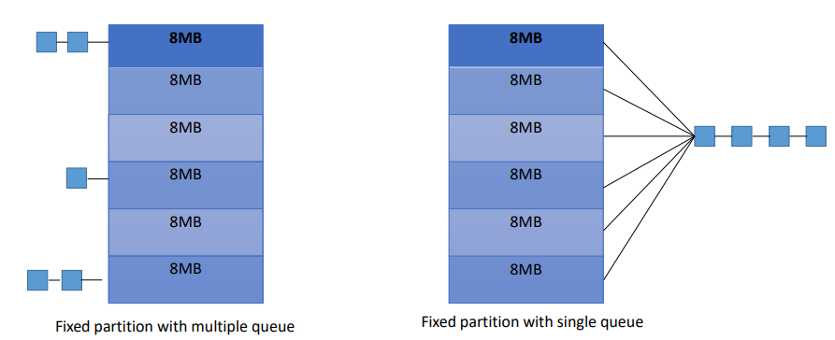
Contiguous memory allocation

Slide 21
Multiprogramming with fixed partition
Simple and old method.
Here each process occupies contiguous block of memory.
When process is brought in memory, a memory is searched to find a chunk of free memory having enough size to hold a process.
Single Processor monitor
Simplest schema
Only one processor run
Multiprogramming with fixed partition
Multiple process run simultaneously.
Memory is divided in fixed partition.
Each partition contains exactly one process

Slide 22
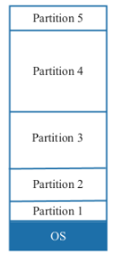
Multiprogramming with fixed partitions
Here memory is divided into fixed sized partitions.
Size can be equal or unequal for different partitions.
Generally unequal partitions are used for better utilizations.
Each partition can accommodate exactly one process, means only single process can be placed in one partition.
Whenever any program needs to be loaded in memory, a free partition big enough to hold the program is found. This partition will be allocated to that program or process.
If there is no free partition available of required size, then the process needs to wait. Such process will be put in a queue.

Slide 23
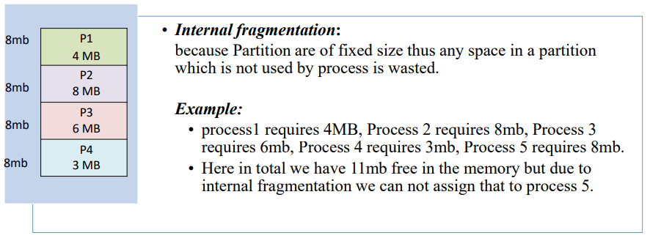
Multiprogramming with fixed partitions
Advantages:
Implementation is simple.
Processing overhead is low.
Disadvantages:
Degree of Multiprogramming is fixed because memory is divided into fixed partition and each partition can contain one process.
Internal Fragmentation because partition of fixed size.

Slide 24

Multiprogramming with dynamic partitions
Initially, the entire available memory is treated as a single free partition.
Process is allocated exactly as much memory as it requires.
Whenever any process enters in a system, a chunk of free memory big enough to fit the process is found and allocated. The remaining unoccupied space is treated as another free partition.
If enough free memory is not available to fit the process, process needs to wait until required memory becomes available.
Whenever any process gets terminate, it releases the space occupied. If the released free space is contiguous to another free partition, both the free partitions are merged together in to single free partition.
Better utilization of memory than fixed sized size partition.

Slide 25
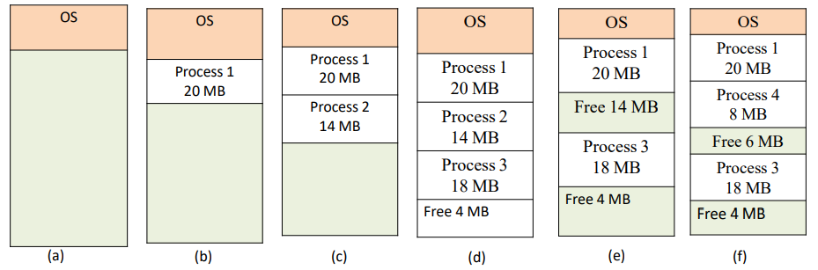
Multiprogramming with dynamic partitions
Advantages:
Better utilization of memory.
No Internal Fragmentation.
There is no limitation on size of processes.
Disadvantages:
External Fragmentation because partition of fixed size.

Slide 26
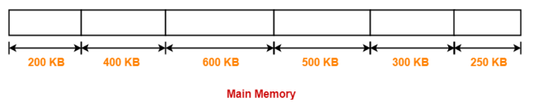
Problem on Fragmentation
Consider six memory partitions of size 200 KB, 400 KB, 600 KB, 500 KB, 300 KB and 250 KB. These partitions need to be allocated to four processes of sizes 357 KB, 210 KB, 468 KB and 491 KB in that order. Perform the allocation of processes using
1.First Fit Algorithm
2.Best Fit Algorithm
3.Worst Fit Algorithm
Solution
Process P1 = 357KB Process P2 = 210KB
Process P3 = 468KB Process P4 = 491KB

Slide 27
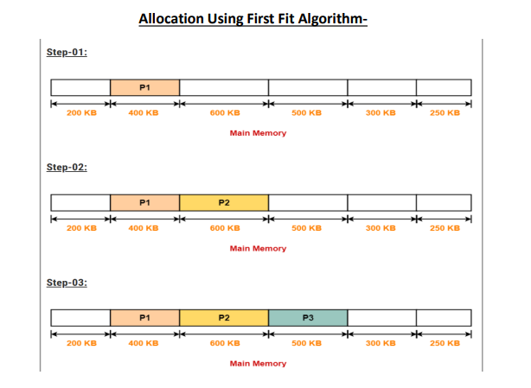
Problem on Fragmentation

Slide 28
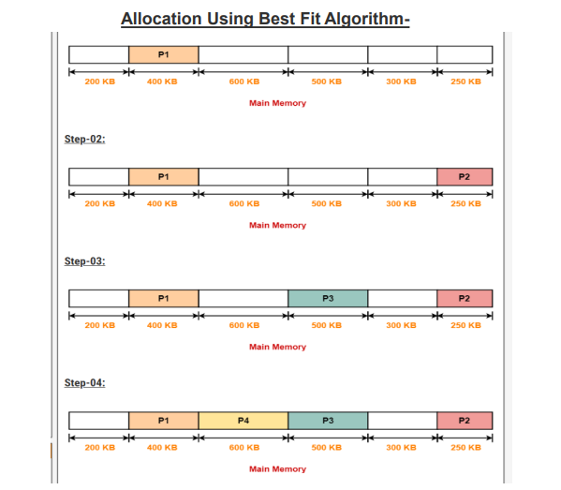
Problem on Fragmentation

Slide 29
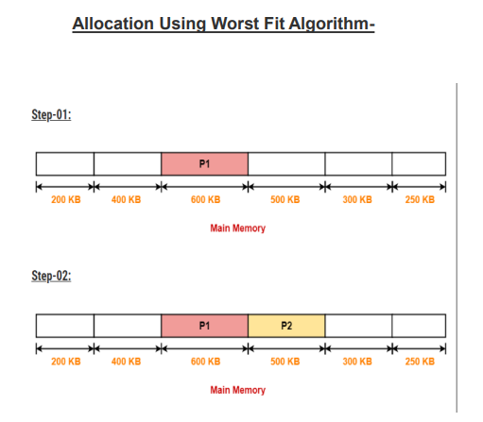
Problem on Fragmentation

Slide 30
Topics Covered
Memory: Swapping, Contiguous memory allocation, Non-contiguous memory allocation
Paging: Page table, Segmentation, Demand Paging
Virtual Memory: Basics of Virtual Memory – Hardware and control structures, Locality of Reference, Page Fault, Dirty Bit
Page Replacement Policies: Least Recently Used (LRU), Optimal (OPT), Second Chance (SC), First In First Out (FIFO), Not Recently Used (NRU)

Slide 31
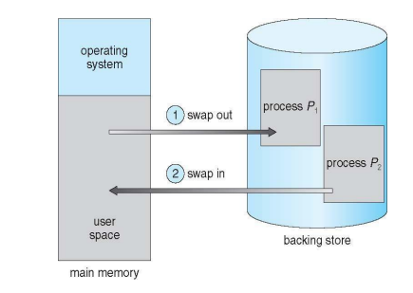
Swapping

Slide 32
Topics Covered
Memory: Swapping, Contiguous memory allocation, Non-contiguous memory allocation
Paging: Page table, Segmentation, Demand Paging
Virtual Memory: Basics of Virtual Memory – Hardware and control structures, Locality of Reference, Page Fault, Dirty Bit
Page Replacement Policies: Least Recently Used (LRU), Optimal (OPT), Second Chance (SC), First In First Out (FIFO), Not Recently Used (NRU)

Slide 33
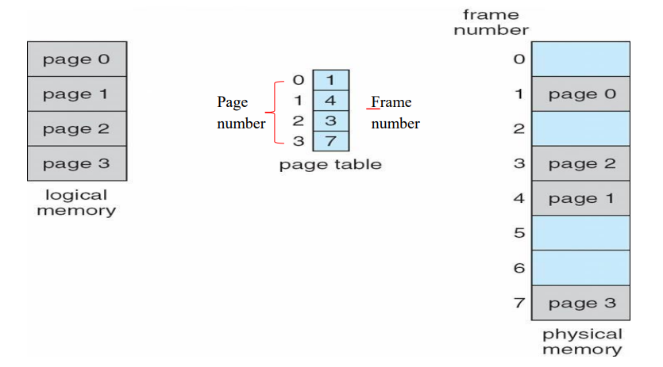
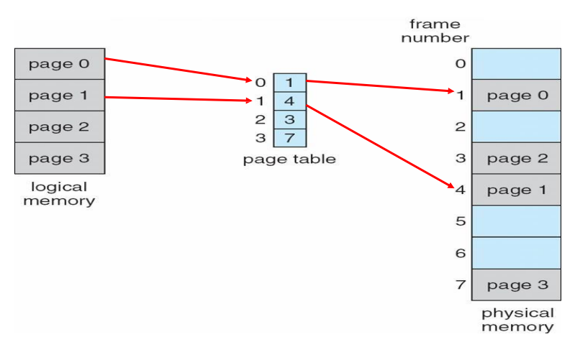
Paging
Definition: The task is to find the free frame in the main memory.
OS maintains a table called Page Table, for each process.
Page table is indexed by page number and stores the information about frame number.

Slide 34
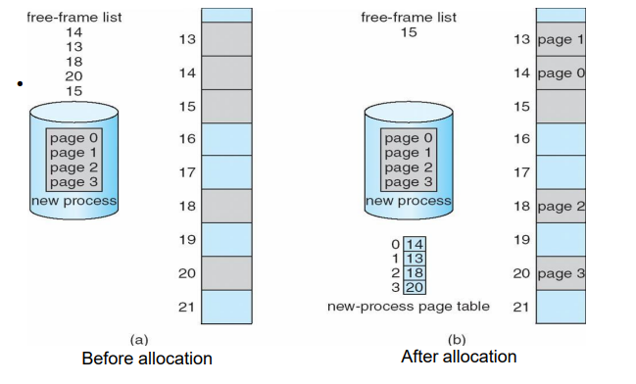
Page allocation in Paging

Slide 35

Paging: Hardware Support
Logical address is divided into two parts:
Page number (p)
Offset (d)
Physical address is divided into two parts:
Frame number (f)
Offset (d)
Offset (d) is a part of both address and is always same.
Frame number (f) can be searched from page number and will provide the exact location of the object.

Slide 36
Variation in Paging
Translation look aside buffer (TLB)
Hierarchical Paging
Inverted Page Table

Slide 37
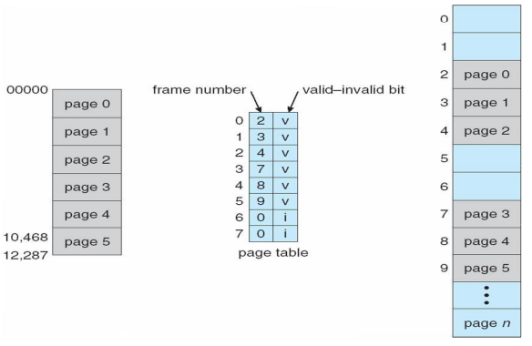
Protection in Paging

Slide 38
Topics Covered
Memory: Swapping, Contiguous memory allocation, Non-contiguous memory allocation
Paging: Page table, Segmentation, Demand Paging
Virtual Memory: Basics of Virtual Memory – Hardware and control structures, Locality of Reference, Page Fault, Dirty Bit
Page Replacement Policies: Least Recently Used (LRU), Optimal (OPT), Second Chance (SC), First In First Out (FIFO), Not Recently Used (NRU)

Slide 39
Segmentation
From the user point of view, logical address space of any process is a collection of code, data and stack.
Code can be comprise of main function, user define function and library function.
Data can be local variable, global variable, array and other data structure.
The logical address space of a process is divided into blocks of varying size, called segments.
When ever a process is to be executed, its segments are moved from secondary storage to the main memory.
Each segment is allocated a chunk of free memory of the size equal to that segment.
OS maintains one table known as segment table, for each process. It includes size of segment and location in memory where the segment has been loaded.

Slide 40
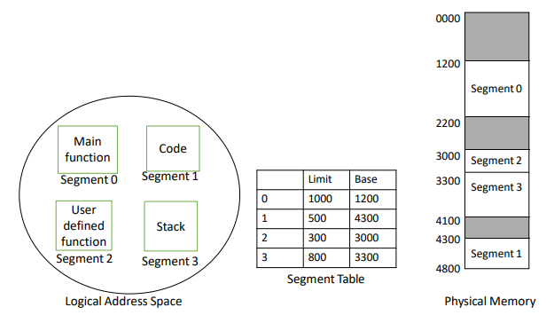
Segmentation
Logical Address is divided into two parts:
Segment number
Offset

Slide 41
Topics Covered
Memory: Swapping, Contiguous memory allocation, Non-contiguous memory allocation
Paging: Page table, Segmentation, Demand Paging
Virtual Memory: Basics of Virtual Memory – Hardware and control structures, Locality of Reference, Page Fault, Dirty Bit
Page Replacement Policies: Least Recently Used (LRU), Optimal (OPT), Second Chance (SC), First In First Out (FIFO), Not Recently Used (NRU)

Slide 42
Virtual Memory
Memory is hardware that your computer uses to load the operating system and run programs.
Computer consists of one or more RAM chips that each have several memory modules.
The amount of real memory in a computer is limited to the amount of RAM installed. Common memory sizes are 1GB, 2GB, and 4GB.
Because your computer has a finite amount of RAM, it is possible to run out of memory when too many programs are running at one time.
This is where virtual memory comes into the picture.

Slide 43
Virtual Memory
Virtual memory increases the available memory of your computer by enlarging the "address space," or places in memory where data can be stored.
It does this by using hard disk space for additional memory allocation.
However, since the hard drive is much slower than the RAM, data stored in virtual memory must be mapped back to real memory in order to be used.

Slide 44
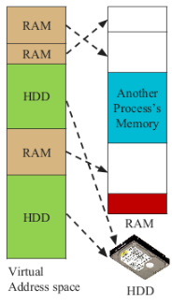
Virtual Memory
Each program has its own address space, which is broken up into pages.
Each page is a contiguous range of addresses.
These pages are mapped onto the physical memory but, to run the program, all pages are not required to be present in the physical memory.
The operating system keeps those parts of the program currently in use in main memory, and the rest on the disk.
In a system using virtual memory, the physical memory is divided into page frames and the virtual address space is divided in into equally-sized partitions called pages.

Slide 45
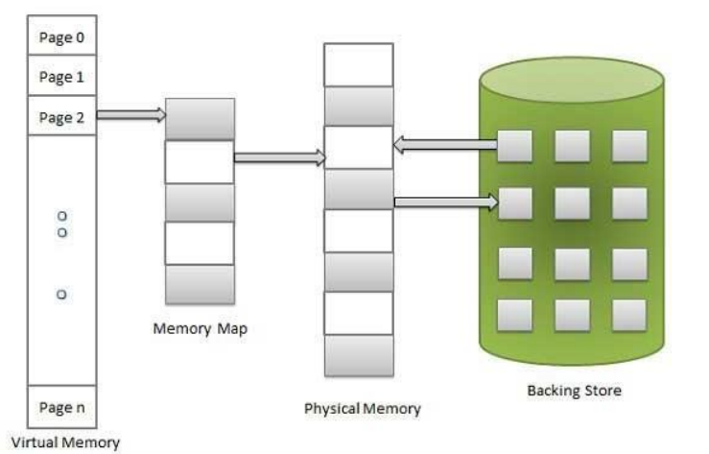
Virtual Memory: Hardware & Control Structures
Virtual memory involves the separation of logical memory perceived(aware) by user from physical memory
This separation allows extremely large virtual memory to be provided for programmers when only smaller amount of physical memory is available.
Thus programmer need not to worry about the amount of memory available.

Slide 46
Virtual Memory: Hardware & Control Structures
Virtual Memory Implemented
Demand Paging
Segmentation
Paging

Slide 47
Topics Covered
Memory: Swapping, Contiguous memory allocation, Non-contiguous memory allocation
Paging: Page table, Segmentation, Demand Paging
Virtual Memory: Basics of Virtual Memory – Hardware and control structures, Locality of Reference, Page Fault, Dirty Bit
Page Replacement Policies: Least Recently Used (LRU), Optimal (OPT), Second Chance (SC), First In First Out (FIFO), Not Recently Used (NRU)

Slide 48
Demand Paging
Demand paging is similar to a paging system with swapping where processes may reside in secondary memory. When we want to execute a process, we swap it into the main memory.
Rather than swapping entire process into memory we use lazy swapper.
A lazy swapper never swaps page into memory, unless that page will be needed.
If some process is needs to be swap in, then pager(page table handler) brings only those pages which will be used by process.
Thus avoid reading unused pages and decrease swap time and amount of physical memory needed.

Slide 49
Demand Paging
Demand paging is similar to a paging system with swapping where processes may reside in secondary memory. When we want to execute a process, we swap it into the main memory.
Rather than swapping entire process into memory we use lazy swapper.
A lazy swapper never swaps page into memory, unless that page will be needed.
If some process is needs to be swap in, then pager(page table handler) brings only those pages which will be used by process.
Thus avoid reading unused pages and decrease swap time and amount of physical memory needed.

Slide 50
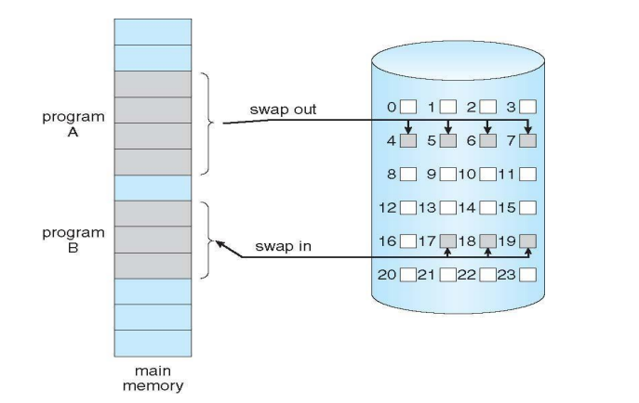
Demand Paging

Slide 51
Topics Covered
Memory: Swapping, Contiguous memory allocation, Non-contiguous memory allocation
Paging: Page table, Segmentation, Demand Paging
Virtual Memory: Basics of Virtual Memory – Hardware and control structures, Locality of Reference, Page Fault, Dirty Bit
Page Replacement Policies: Least Recently Used (LRU), Optimal (OPT), Second Chance (SC), First In First Out (FIFO), Not Recently Used (NRU)

Slide 52
Demand Paging – Page Fault
If a process tries to access a page that is not in main memory then it causes page fault.
Page Table includes the valid-invalid bit for each page entry.
If the bit is valid then the page is currently available in the memory.
If it is set to invalid then page is either invalid or not present in the main memory.
Whenever logical address is generated the system operates as follows
Page table is searched if the validity bit is set to valid then physical address is determined
If page validity is invalid then OS read that page into free from disk.

Slide 53
Demand Paging – Page Fault
Following steps are followed to manage page fault:
1. Check page table for the process to determine whether the reference is valid or invalid.
2. If the page is invalid then terminate the process, but if the page is valid but currently not available in main memory, then generate trap instruction.
3. OS determines the location of that page on swap area.
4. Then it will use free frame list to find out free frame. OS will schedule disk operation to read desired page into newly allocated memory.
5. When disk read is complete modify the page table and set reference bit to valid.
6. Restart the instruction.

Slide 54
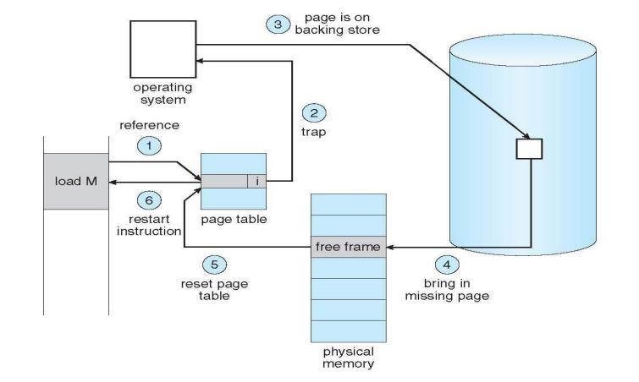
Demand Paging – Page Fault

Slide 55
Locality of reference
Locality is set of pages that are actively used together. A program generally composed of different localities.
Example, when function is called it defines new locality, and we exit the function the process leaves its locality. Process may return to this locality later.
Locality of reference (often abbreviated simply as locality) is an extremely important concept in systems.
The basic idea is that programs don’t just access memory randomly, a program tends to use small amount of data for a while and then move on to another small chunk of data.

Slide 56
Working set
Definition: A working set is the set of pages that will be used by the process in the near future.
The pages in the most recent page references is the working set.
If the page is active in use then it will be in the working set but if it is no longer being used then it will dropped working set after some time later. Thus working set is approximation of the program locality.

Slide 57
Dirty Page / Dirty Bit
Definition: One bit for each page frame, set by hardware whenever the page is modified.
If a dirty page is replaced, it must be written to disk before its page frame is reused.
It is cheaper to pick a clean page for replacement than a dirty page:
The clean page can be simply discarded when it is replaced, whereas the dirty page must be written back to disk.
Therefore, the page replacement policy will prefer to replace a clean pages over a dirty page.

Slide 58
Topics Covered
Memory: Swapping, Contiguous memory allocation, Non-contiguous memory allocation
Paging: Page table, Segmentation, Demand Paging
Virtual Memory: Basics of Virtual Memory – Hardware and control structures, Locality of Reference, Page Fault, Dirty Bit
Page Replacement Policies: Least Recently Used (LRU), Optimal (OPT), Second Chance (SC), First In First Out (FIFO), Not Recently Used (NRU)

Slide 59
Demand Paging – Page Fault

Slide 60
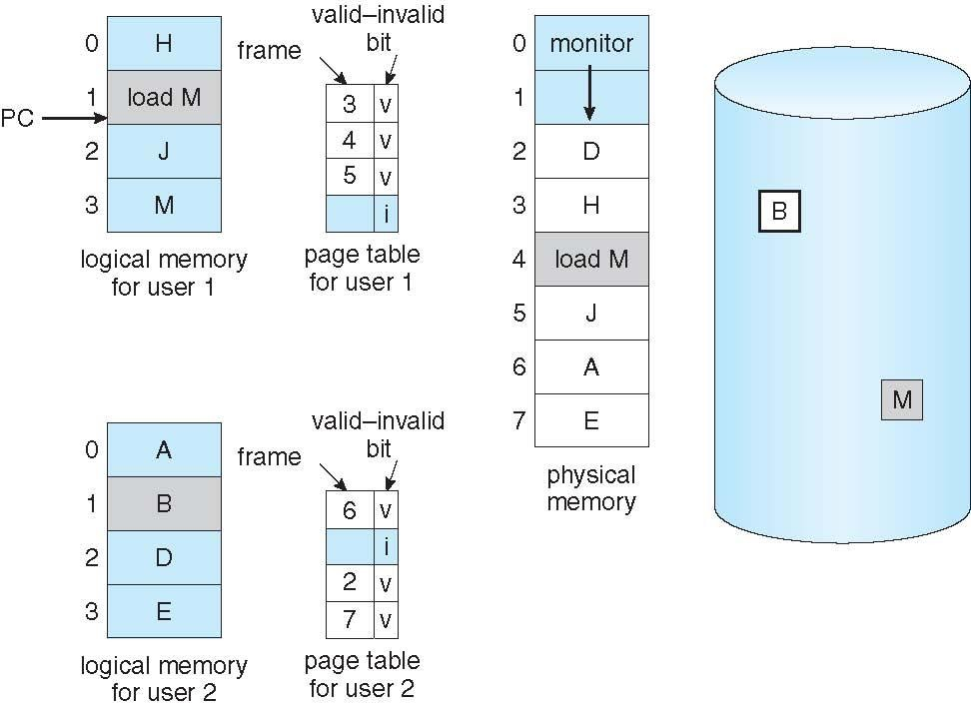
Page Replacement policies: Need
M
Secondary Memory-Disk
When a process has more number of pages and there are not enough frames available in the physical memory we need page replacement.

Slide 61
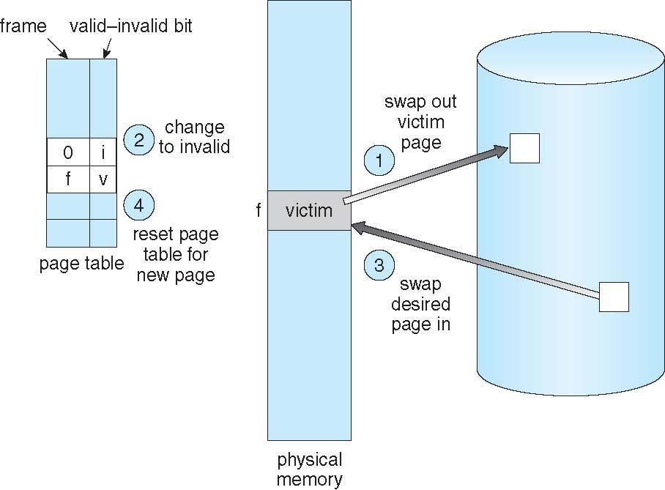
Page Replacement Working
Find the location of the desired page on disk.
Find a free frame:
If there is a free frame, use it.
If there is no free frame, use
a page replacement algorithm
to select a victim frame.
Write victim frame to disk if dirty
Bring the desired page into the
(newly) free frame; update the
page and frame tables
Continue the process by
restarting the instruction that
caused the trap
Secondary Memory-Disk

Slide 62
1. First in First Out (FIFO)
The simplest page replacement algorithm.
When the page must be replaced the oldest page is chosen.
One FIFO queue is maintained to hold all pages in memory.
Replace the page which at the top of the queue and add new pages from rear end (tail)of the queue.

Slide 63
FIFO- Example
Q.1 String : 232152453252
Only 3 frames (3 pages can be in memory at a time per process)
Find the no. of page faults using FIFO?
Also find the Hit Ratio and Miss Ratio?

Slide 64
First in First Out (FIFO)
Page Miss=Total no. of Page Faults
Page Hit=Total number of references – Total number of page misses or page faults
Hit Ratio= Total number of page hits / Total number of references
Miss Ratio=1-Hit Ratio

Slide 65
First in First Out (FIFO)
String : 232152453252
3 frames (3 pages can be in memory at a time per process)
String | 2 | 3 | 2 | 1 | 5 | 2 | 4 | 5 | 3 | 2 | 5 | 2
3 |  |  |  | 1 | 1 | 1 | 4 | 4 | 4 | 4 | 4 | 2
2 |  | 3 | 3 | 3 | 3 | 2 | 2 | 2 | 2 | 2 | 5 | 5
1 | 2 | 2 | 2 | 2 | 5 | 5 | 5 | 5 | 3 | 3 | 3 | 3
Page Fault | F | F |  | F | F | F | F |  | F |  | F | F
Answer: 9 Page faults

Slide 66
First in First Out (FIFO)
Page Miss=Total no. of Page Faults (9)
Page Hit=Total number of references – Total number of page misses or page faults
(12-9 = 3)
Hit Ratio= Total number of page hits / Total number of references (3/12 = 0.25)
Miss Ratio=1-Hit Ratio (1 – 0.25 = 0.75)

Slide 67
First in First Out (FIFO)
Solution.1
Page Miss=9
Page Hit=12-9 =3
Hit Ratio= 3/12
=0.25
Miss Ratio=1-0.25
=0.75

Slide 68
FIFO- Example
Q.2 String : 232152453252
Only 4 frames (4 pages can be in memory at a time per process)
Find the No of Page Faults using FIFO?

Slide 69
Belady’s (or FIFO) Anomaly
Generally, on increasing the number of frames to a process’ virtual memory, its execution becomes faster as fewer page faults occur. Sometimes the reverse happens, i.e. more page faults occur when more frames are allocated to a process. This most unexpected result is termed Belady’s Anomaly.
Belady’s anomaly is the name given to the phenomenon where increasing the number of page frames results in an increase in the number of page faults for a given memory access pattern.

Slide 70
Q.3 String : 0 1 2 3 0 1 4 0 1 2 3 4
3 frames (3 pages can be in memory at a time per process) 4frames (4 pages can be in memory at a time per process) Find the No of Page Faults using FIFO?
FIFO- Example

Slide 71
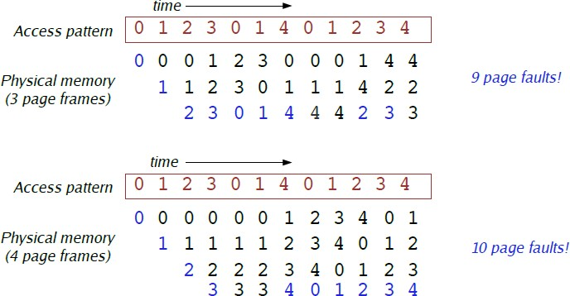
Belady’s (or FIFO) Anomaly
Certain page reference patterns actually cause more page faults when number of page frames allocated to a process is increased

Slide 72
FIFO- Example
Q.4 A system uses 3 page frames for storing process pages in main memory. It uses the First in First out (FIFO) page replacement policy. Assume that all the page frames are initially empty.
What is the total number of page faults that will occur while processing the page reference string given below-
4 , 7, 6, 1, 7, 6, 1, 2, 7, 2
Also calculate the hit ratio and miss ratio.

Slide 73
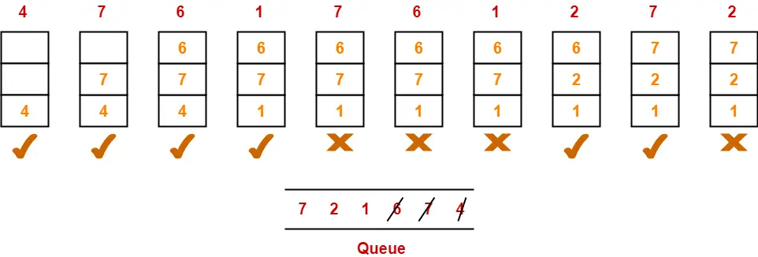
FIFO
Solution 4
Calculating Miss ratio-
Total number of page misses or page faults = 6
Thus, Miss ratio
= Total number of page misses / Total number of references
=6/10 = 0.6 or 60%
Alternatively,
Miss ratio
= 1 – Hit ratio
= 1 – 0.4
= 0.6 or 60%
Calculating Hit ratio-
Total number of page hits
= Total number of references – Total number of page misses or page faults
= 10 – 6
= 4
Thus, Hit ratio
= Total number of page hits / Total number of references
= 4 / 10
= 0.4 or 40%

Slide 74
First in First Out (FIFO)
Q. 5 Reference string: 7,0,1,2,0,3,0,4,2,3,0,3,0,3,2,1,2,0,1,7,0,1
3 frames (3 pages can be in memory at a time per process)
4 frames (4 pages can be in memory at a time per process)
Find the No of Page Faults using FIFO?

Slide 75
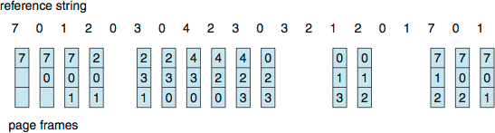
First in First Out (FIFO)
Solution.5 Reference string: 7,0,1,2,0,3,0,4,2,3,0,3,0,3,2,1,2,0,1,7,0,1
3 frames (3 pages can be in memory at a time per process)
15 page faults

Slide 76
First in First Out (FIFO)
Solution 5
Reference string: 7,0,1,2,0,3,0,4,2,3,0,3,0,3,2,1,2,0,1,7,0,1
4 frames (4 pages can be in memory at a time per process)
Answer: 10 page fault

Slide 77
FIFO- Example
Question 6.
Reference string: 1, 2, 3, 4, 1, 2, 5, 1, 2, 3, 4, 5
3 frames (3 pages can be in memory at a time per process)
4 frames (4 pages can be in memory at a time per process)

Slide 78
FIFO
Solution 6
Reference string: 1, 2, 3, 4, 1, 2, 5, 1, 2, 3, 4, 5
3 frames (3 pages can be in memory at a time per process):
1
2
1
2
3
4 | 5
1 | 3 | 9 page faults
2 | 4
5 | 4
1 | 5 | 10 page faults
2
3
3
4 frames:
1
2
1
2
3
4
3
4
FIFO Replacement manifests Belady’s Anomaly:
more frames = more page faults

Slide 79
First in First Out (FIFO)
Advantages
Easy to understand and implement: The FIFO page replacement algorithm is very straightforward and easy to understand, making it a simple algorithm to implement.
Low overhead: The algorithm has low overhead and does not require any additional data structures to maintain information about page references.
Disadvantages
Poor performance: FIFO page replacement algorithm can suffer from poor performance, especially when the number of page faults is high.
Belady’s Anomaly: FIFO page replacement algorithm can result in a situation known as Belady’s Anomaly, where the number of page faults can increase as the number of frames increases.
Does not consider page usage frequency: The FIFO algorithm does not take into account how frequently a page is used, and thus, pages that are heavily used may be replaced by pages that are rarely used.

Slide 80
2. Optimal Page Replacement
It is the best page replacement algorithm.
The Optimal policy selects for replacement the page that will not be used for longest period of time.
Impossible to implement (need to know the future) but serves as a standard to compare with the other algorithms we shall study.

Slide 81
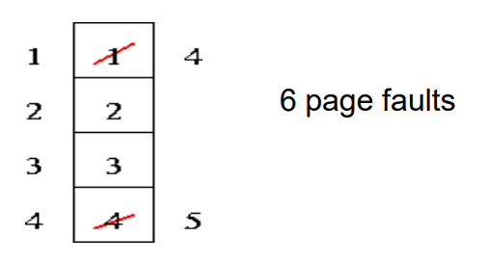
Optimal Page Replacement - Example
Reference string : 1, 2, 3, 4, 1, 2, 5, 1, 2, 3, 4, 5(check next pages)
4 frames example

Slide 82
Optimal Page Replacement - Example
Reference string: 7,0,1,2,0,3,0,4,2,3,0,3,0,3,2,1,2,0,1,7,0,1
3 frames (3 pages can be in memory at a time per process)

Slide 83
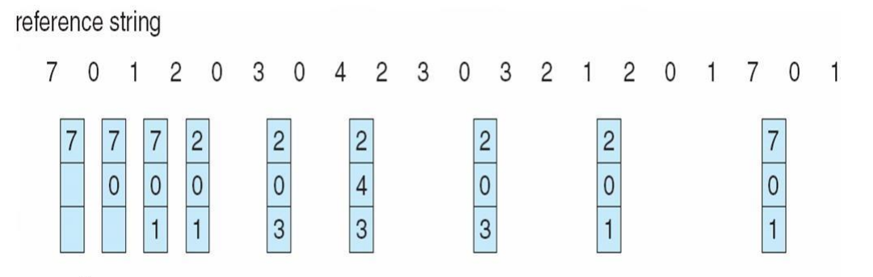
Optimal Page Replacement - Example
9 Page faults

Slide 84
Optimal Page Replacement - Example
• Reference string: 7,0,1,2,0,3,0,4,2,3,0,3,0,3,2,1,2,0,1,7,0,1
• 4 frames (4 pages can be in memory at a time per process)
• 8 page fault

Slide 85
Optimal Page Replacement - Example
Reference string: 1,2,3,4,2,1,5,6,2,1,2,3,7,6,3,2,1,2,3,6
• 4 frames (4 pages can be in memory at a time per process)
• 3 frames (3 pages can be in memory at a time per process)

Slide 86
Optimal Page Replacement - Example
Reference string: 1 2 3 2 1 5 2 1 6 2 5 6 3 1 3 6 1 2 4 3
• 3 frames (3 pages can be in memory at a time per process)

Slide 87
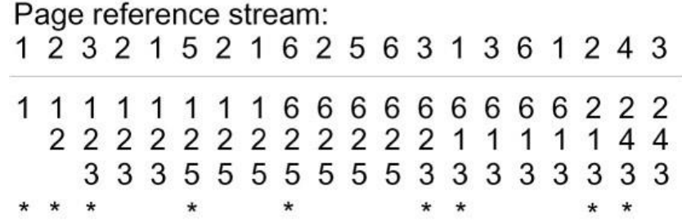
Optimal Page Replacement - Example
Total 9 Page Faults

Slide 88
Optimal Page Replacement - Example
Reference string: 1 2 3 2 1 5 2 1 6 2 5 6 3 1 3 6 1 2 4 3
• 4 frames (4 pages can be in memory at a time per process)

Slide 89
Optimal Page Replacement - Example
Reference string: 1 2 3 2 1 5 2 1 6 2 5 6 3 1 3 6 1 2 4 3
• 4 frames (4 pages can be in memory at a time per process)
Total 7 Page Faults

Slide 90
Optimal Page Replacement - Example
• Reference string: 1, 2, 3, 4, 1, 2, 5, 1, 2, 3, 4, 5
• 3 frames (3 pages can be in memory at a time per process)
• 4 frames (4 pages can be in memory at a time per process)

Slide 91
Optimal Page Replacement - Example
• Reference string: 1, 2, 3, 4, 1, 2, 5, 1, 2, 3, 4, 5
• 3 frames (3 pages can be in memory at a time per process) – 7 Page Fault
• 4 frames (4 pages can be in memory at a time per process) – 6 Page Fault

Slide 92
Least Recently Used (LRU)
It is based on the observation that if pages that have been heavily used in the last few instructions will probably be heavily used again in the next few.
Conversely, pages that have not been used for ages will probably remain unused for a long time.
This idea suggests a realizable algorithm: when a page fault occurs, throw out the page that has been unused for the longest time.

Slide 93
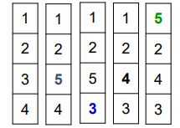
Least Recently Used (LRU) - Example
• Reference string: 1, 2, 3, 4, 1, 2, 5, 1, 2, 3, 4, 5(check past pages)
4 frame – 8 page fault
3 frame – 10 page fault

Slide 94
Least Recently Used (LRU) - Example
Reference string: 7,0,1,2,0,3,0,4,2,3,0,3,0,3,2,1,2,0,1,7,0,1
3frames (3 pages can be in memory at a time per process)
4frames (4 pages can be in memory at a time per process)

Slide 95
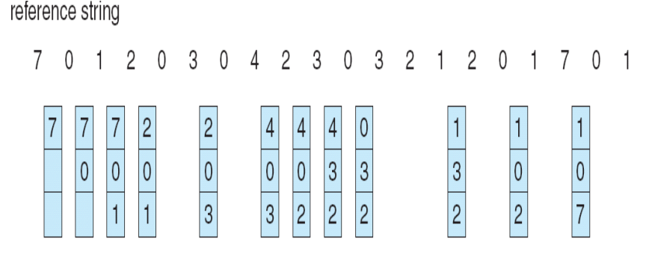
Least Recently Used (LRU) - Example
Reference string: 7,0,1,2,0,3,0,4,2,3,0,3,0,3,2,1,2,0,1,7,0,1
3frames (3 pages can be in memory at a time per process)
4frames (4 pages can be in memory at a time per process)

Slide 96
Least Recently Used (LRU) - Example
Reference string: 7,0,1,2,0,3,0,4,2,3,0,3,0,3,2,1,2,0,1,7,0,1
3frames (3 pages can be in memory at a time per process) – 12 fault

Slide 97
Least Recently Used (LRU) - Example
Reference string: 7,0,1,2,0,3,0,4,2,3,0,3,0,3,2,1,2,0,1,7,0,1
3frames (3 pages can be in memory at a time per process) – 12 fault
4frames (4 pages can be in memory at a time per process) – 8 fault

Slide 98
Least Recently Used (LRU) - Example
Reference string: 232152453252
3frames (3 pages can be in memory at a time per process)
Perform LRU and Optimal Page Replacement algorithm

Slide 99
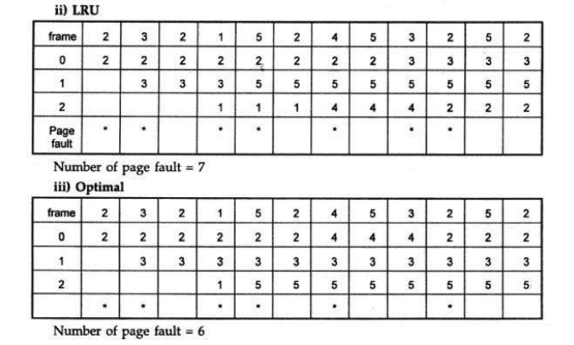
Least Recently Used (LRU) - Example
Reference string: 232152453252
3frames (3 pages can be in memory at a time per process)

Slide 100


