Slide 1


File System Interface & I/O Systems
Unit-6
Operating System / 01CE1401
Department of Computer Engineering
Prof. Pranav Tank

Slide 2
Unit-6 File system Interface and I/O system (CO - 5)
After completion of this course, student will be able to
Understanding the role of operating system with its function and services.
Application and comparison of various CPU scheduling and memory management algorithms.
Apply various concepts and asses the requirement for inter process communication and deadlock.
Comprehend the mechanism of I/O and File Management
Implement algorithms and acquire a detailed understanding of various Unix commands

Slide 3
Topics Covered
File Concept, Access Method, File types, operation, File System Structure, Directory Structure
Allocation Method: Contiguous, Linked, Indexed
File System Mounting, File protection and sharing

Slide 4
Topics Covered
File Concept, Access Method, File types, operation, File System Structure, Directory Structure
Allocation Method: Contiguous, Linked, Indexed
File System Mounting, File protection and sharing

Slide 5
File Concept
Problems:
All computer applications need to store and retrieve information. While a process is running, it can store a limited amount of information within its own address space.
A second problem with keeping information within a process’ address space is that when the process terminates, the information is lost.
A third problem is that it is frequently necessary for multiple processes to access (parts of) the information at the same time.
A computer file is defined as a medium used for saving and managing data in the computer system. The data stored in the computer system is completely in digital format.

Slide 6
File Concept
Definition:
A file system is a method an operating system uses to store, organize, and manage files and directories on a storage device.
OR
A file is a collection of related information that is recorded on secondary storage. Or file is a collection of logically related entities.

Slide 7
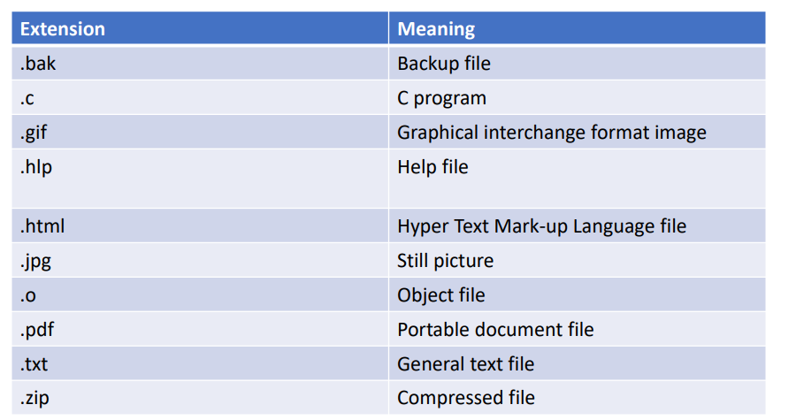
File naming

Slide 8
File types
Types of Files:
FAT (File Allocation Table): An older file system used by older versions of Windows and other operating systems.
NTFS (New Technology File System): A modern file system used by Windows. It supports features such as file and folder permissions, compression, and encryption.
ext (Extended File System): A file system commonly used on Linux and Unix-based operating systems.
HFS (Hierarchical File System): A file system used by macOS.
APFS (Apple File System): A new file system introduced by Apple for their Macs and iOS devices.

Slide 9
Operation of File
The operations of file are performed by the user by using the commands provided by the operating system. Some common operations are as follows:
Create operation: This operation is used to create a file in the file system. To create a new file of a particular type the associated application program calls the file system. This file system allocates space to the file.
Open operation: Once the file is created, it must be opened before performing the file processing operations. When the user wants to open a file, it provides a file name to open the particular file in the file system. It tells the operating system to invoke the open system call and passes the file name to the file system.
Write operation: This operation is used to write the information into a file. A system call write is issued that specifies the name of the file and the length of the data has to be written to the file.

Slide 10
Operation of File
Read operation: This operation reads the contents from a file. A Read pointer is maintained by the OS, pointing to the position up to which the data has been read.
Seek operation: The seek system call re-positions the file pointers from the current position to a specific place in the file i.e. forward or backward depending upon the user's requirement.
Delete operation: Deleting the file will not only delete all the data stored inside the file it is also used so that disk space occupied by it is freed. In order to delete the specified file the directory is searched.
Truncate operation: Truncating is simply deleting the file except deleting attributes. The file is not completely deleted although the information stored inside the file gets replaced.

Slide 11
Operation of File
Truncate operation: Truncating is simply deleting the file except deleting attributes. The file is not completely deleted although the information stored inside the file gets replaced.
Close operation: When the processing of the file is complete, it should be closed so that all the changes made permanent and all the resources occupied should be released. On closing it deallocates all the internal descriptors that were created when the file was opened.
Append operation: This operation adds data to the end of the file.
Rename operation: This operation is used to rename the existing file.

Slide 12
File System Structure
File System provide efficient access to the disk by allowing data to be stored, located and retrieved in a convenient way. A file System must be able to store the file, locate the file and retrieve the file.

Slide 13
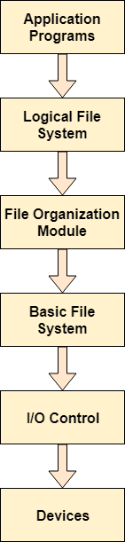
File System Structure
When an application program asks for a file, the first request is directed to the logical file system. The logical file system contains the Meta data of the file and directory structure. If the application program doesn't have the required permissions of the file then this layer will throw an error. Logical file systems also verify the path to the file.
Generally, files are divided into various logical blocks. Files are to be stored in the hard disk and to be retrieved from the hard disk. Hard disk is divided into various tracks and sectors. Therefore, in order to store and retrieve the files, the logical blocks need to be mapped to physical blocks.

Slide 14
Directory System Structure
When an application program asks for a file, the first request is directed to the logical file system. The logical file system contains the Meta data of the file and directory structure. If the application program doesn't have the required permissions of the file then this layer will throw an error. Logical file systems also verify the path to the file.
Generally, files are divided into various logical blocks. Files are to be stored in the hard disk and to be retrieved from the hard disk. Hard disk is divided into various tracks and sectors. Therefore, in order to store and retrieve the files, the logical blocks need to be mapped to physical blocks.

Slide 15
Topics Covered
File Concept, Access Method, File types, operation, File System Structure, Directory Structure
Allocation Method: Contiguous, Linked, Indexed
File System Mounting, File protection and sharing

Slide 16
File Allocation
The allocation methods define how the files are stored in the disk blocks. There are three main disk space or file allocation methods.
Contiguous Allocation
Linked Allocation
Indexed Allocation
The main idea behind these methods is to provide:
Efficient disk space utilization.
Fast access to the file blocks.

Slide 17
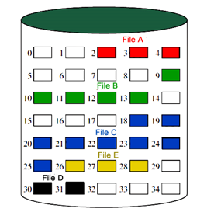
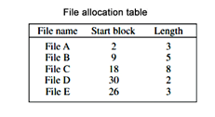
File Allocation
Contiguous Allocation
A single continuous set of blocks is allocated to a file at the time of file creation. Thus, this is a pre-allocation strategy, using variable size portions. The file allocation table needs just a single entry for each file, showing the starting block and the length of the file.
This method is best from the point of view of the individual sequential file. Multiple blocks can be read in at a time to improve I/O performance for sequential processing. It is also easy to retrieve a single block.

Slide 18
Contiguous Allocation
Disadvantages:
External Fragmentation will occur.
With pre-allocation, need to declare size of file at time of creation.

Slide 19
File Allocation
Linked Allocation
It is also known as Non – Contiguous Allocation.
Allocation is on an individual block basis. Each block contains a pointer to the next block in the chain. Again the file table needs just a single entry for each file, showing the starting block and the length of the file.
Any free block can be added to the chain. The blocks need not be continuous. An increase in file size is always possible if a free disk block is available.

Slide 20
Linked Allocation
Disadvantages:
Internal Fragmentation will occur.
Overhead of maintaining pointer in every disk block.
If pointer of any file gets lost, then the file will be truncated.
Supports only sequential access of file.

Slide 21
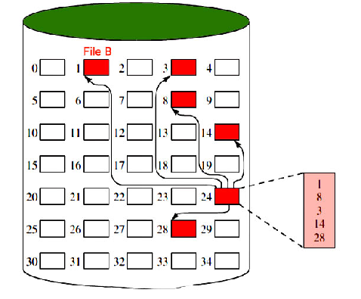
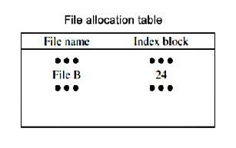
File Allocation
Indexed Allocation
It addresses many of the problems of contiguous and chained allocation.
The file allocation table contains a separate one-level index for each file: The index has one entry for each block allocated to the file. The allocation may be on the basis of fixed-size blocks or variable-sized blocks.

Slide 22
File Allocation
Indexed Allocation
It addresses many of the problems of contiguous and chained allocation.
The file allocation table contains a separate one-level index for each file: The index has one entry for each block allocated to the file. The allocation may be on the basis of fixed-size blocks or variable-sized blocks.

Slide 23

Directory Structure
Single - level directory systems:
The simplest form of directory system is having one directory containing all the files. Sometimes it is called the root directory.
The advantages of this scheme are its simplicity and the ability to locate files quickly—there is only one place to look, after all.
A single-level directory system containing four files, owned by three different people, A , B , and C .

Slide 24
Directory Structure
Two - level directory systems:
To avoid conflicts caused by different users choosing the same file name for their own files, the next step up is giving each user a private directory.
A way, names chosen by one user do not interfere with names chosen by a different user and there is no problem caused by the same name occurring in two or more directories

Slide 25
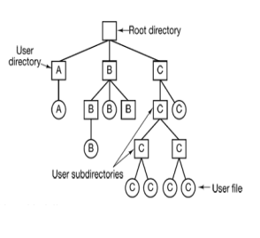
Directory Structure
Hierarchical directory systems:
The simplest form of directory system is having one directory containing all the files. Sometimes it is called the root directory.
The advantages of this scheme are its simplicity and the ability to locate files quickly—there is only one place to look, after all.
A single-level directory system containing four files, owned by three different people, A , B , and C .

Slide 26
File Mounting
Introduction:
Mounting is a process in which the operating system adds the directories and files from a storage device to the user’s computer file system.
Terminologies used in File System Mounting
File System: It is the method used by the operating system to manage data storage in a storage device. So, a user can access and organize the directories and files in an efficient manner.
Device name: It is a name/identifier given to a storage partition. In windows, for example, “D:” in windows.
Mount point: It is an empty directory in which we are adding the file system during the process of mounting.

Slide 27
Topics Covered
I/O Management
Principles of I/O Hardware:
• I/O devices
• Device controllers
• Direct memory access
Principles of I/O Software:
• Goals of Interrupt handlers
• Device drivers
• Device independent I/O software
Secondary-Storage Structure:
• Disk structure
• Disk scheduling algorithm

Slide 28
Principles of I/O Hardware: I/O device
storage devices (disks, tapes)
Computers operate a great many kinds of devices. Most fit into the general categories:
transmission devices (network cards, modems)
human-interface devices (screen, keyboard, mouse).

Slide 29
Principles of I/O Hardware: I/O device
Types of I/O device
• Block, character
• It is one that stores information in fixed-size blocks each one with its on address.
• Can read blocks independently of one another
• Hard disks, CD-ROMs, USB sticks
• 512 bytes to 32,768 bytes
Block device:
• accepts characters without regard to block structure
• Printers, mouse, network interfaces
Character device:
Not everything fits:
• e.g. clocks don’t fit

Slide 30
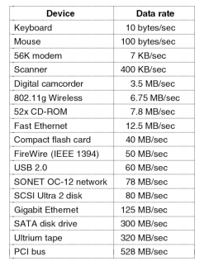
I/O device
Figure : Some typical device network, and bus data rates.

Slide 31
Device Controller
I/O unit has two components
• Mechanical Component
Device itself
• Electronic Component
Known as device controller or adapter

Slide 32
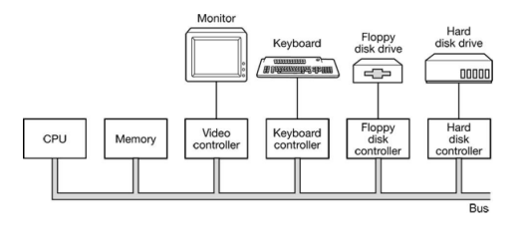
Device Controller

Slide 33
Direct Memory Access
CPU could request data one byte at a time from I/O
controller, Big waste of time. So other schema can be
used DMA
DMA controller can access system bus independent of CPU. DMA contains serval registers that can be
written and read by CPU.
• Memory address register
• Byte count register
• Control registers-I/O port

Slide 34
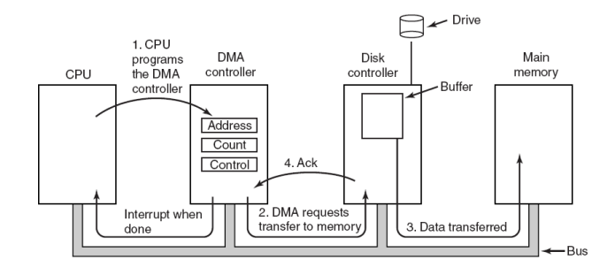
How DMA works

Slide 35
How DMA works
Step 1: When DMA is used, the procedure is different. First the CPU programs the DMA controller by setting its registers so it knows what to transfer where.
Step 2: The DMA controller initiates the transfer by issuing a read request over the bus to the disk controller
Step 3: The write to memory is another standard bus cycle
Step 4: When the write is complete, the disk controller sends an acknowledgement signal to the disk controller, also over the bus

Slide 36
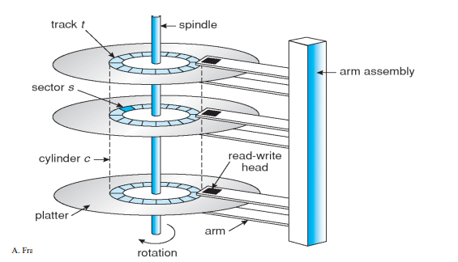
Disc Mechanism

Slide 37
Disc Arm Scheduling Algorithm
First Come First Serve
Shortest Seek Time First
Disk Arm Scheduling Algorithm
Elevator / SCAN
C-SCAN
C-LOOK

Slide 38
First Come First Serve (FCFS)
Handle I/O requests sequentially.
Fair to all processes.
Approaches random performance if there scheduling in are many processes/requests.
Suffers Zigzag effect

Slide 39
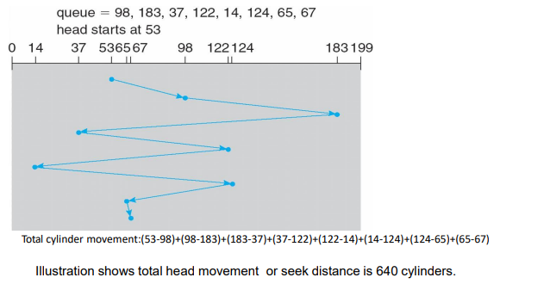
First Come First Serve (FCFS)
We illustrate them with a I/O request queue (cylinders are between 0-199):
queue = 98, 183, 37, 122, 14, 124, 65, 67
head starts at 53

Slide 40
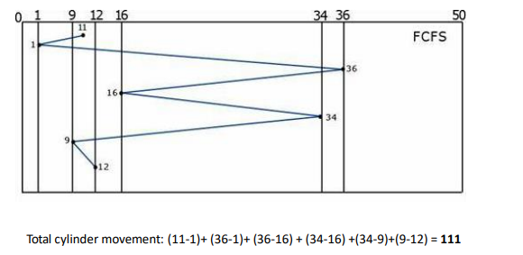
First Come First Serve (FCFS)
New requests come in for cylinders 1, 36, 16, 34, 9, and 12 Starting from the current head position 11, what is the total distance (in cylinders)

Slide 41
Shortest Seek Time First (SSTF)
Selects the request with the minimum seek time from the current head position.
Also called Shortest Seek Distance First (SSDF) – It’s easier to compute distances.
It’s biased in favor of the middle cylinders requests.
SSTF scheduling is a form of SJF scheduling; may cause starvation of some requests.

Slide 42
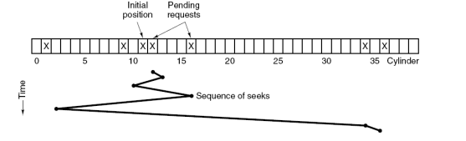
Shortest Seek Time First (SSTF)
While head is on cylinder 11, requests for 1,36,16,34,9,12 come in
FCFS would result in total of 111 cylinders
SSF would require Total cylinder movement: (12-11) + (12-9) + (16-9) + (16-1) + (34-1) + (36-34)
1+3+7+15+33+2 =61 cylinders

Slide 43
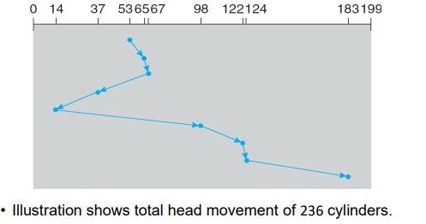
Shortest Seek Time First (SSTF)
We illustrate them with a I/O request queue (cylinders are between 0-199):
queue = 98, 183, 37, 122, 14, 124, 65, 67
head starts at 53

Slide 44
SCAN (Elevator) algorithm
In SCAN disk scheduling algorithm, head starts from one end of the disk and moves towards the other end, servicing requests in between one by one and reach the other end.
Then the direction of the head is reversed and the process continues as head continuously scan back and forth to access the disk.
So, this algorithm works as an elevator and hence also known as the elevator algorithm.

Slide 45
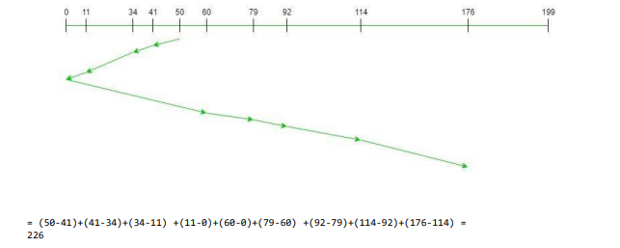
SCAN (Elevator) algorithm
We illustrate them with a I/O request queue (cylinders are between 0-199):
queue = 176, 79, 34, 60, 92, 11, 41, 114
head starts at 50

Slide 46
C-SCAN algorithm
Provides a more uniform wait time than SCAN.
The head moves from one end of the disk to the other. servicing requests as it goes. When it reaches the other end, however, it immediately returns to the beginning of the disk, without servicing any requests on the return trip.
Treats the cylinders as a circular list that wraps around from the last cylinder to the first one.

Slide 47
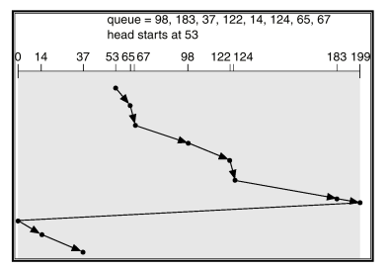
C-SCAN algorithm
We illustrate them with a I/O request queue (cylinders are between 0-199):
queue = 98, 183, 37, 122, 14, 124, 65, 67
head starts at 53

Slide 48
C-LOOK algorithm
Version of C-SCAN.
Arm only goes as far as the last request in each direction, then reverses direction immediately, without first going all the way to the end of the disk.

Slide 49
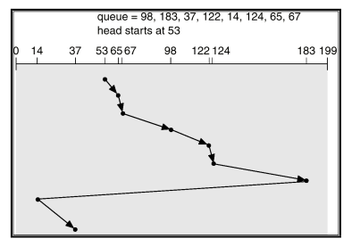
C-LOOK algorithm
We illustrate them with a I/O request queue (cylinders are between 0-199):
queue = 98, 183, 37, 122, 14, 124, 65, 67
head starts at 53

Slide 50


