Slide 1

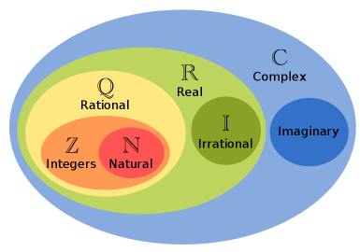
Types of number & Divisibility

Slide 2
Types Of Numbers & Fraction Form
Sub-Topics
1
2
Classification of types of numbers
Divisibility rules & examples
3
Converting a number into fraction form

Slide 3
Types Of Numbers & Fraction Form
Real Numbers
Rational
Integers
Fractions
Irrational
Whole Numbers
Natural Numbers
Even Numbers
Odd Numbers
Prime Numbers
Composite Numbers

Slide 4
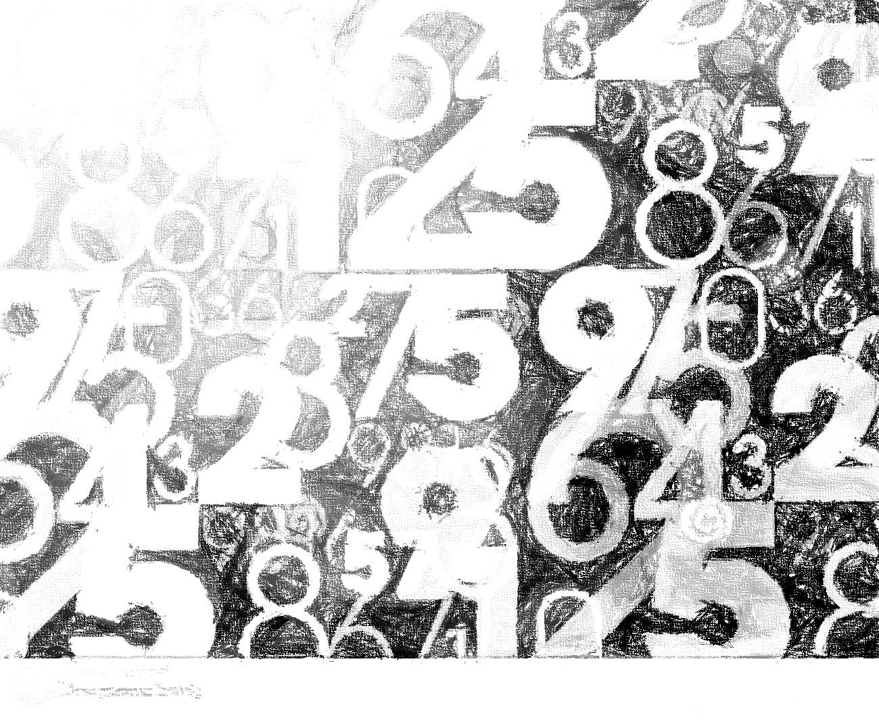
Divisibility
No. | Test | Example
2 | Unit digit of the given number should be even(0, 2, 4, 6, 8) | Check for 4596780:: here unit digit is 0 (even). 4596780
3 | Sum of all the digits of the given number should be divisible by 3. | Check for 769845678:: here sum of 7+6+9+8+4+5+6+7+8=60, which is divisible by 3, hence the original number 769845678 is also divisible by 3.
4 | Last two digits of the number is divisible by 4 (Icluding 00) Note: as 2^1=2, hence cosnidered only last digit. Now we have 2^2=4 therefore we will consider last two digits. | Check for 7698456784:: here last two digits are 84, which is divisible by 4, hence the original number 7698456784 is also divisible by 4.
5 | Last digit must be "0" or "5", because 5 × odd number= Last digit of the product is 5. And like wise 5 × even number=Last digit of the product is 0 | Check for 5647921785:: here unit digit is 5 hence the original number is divisible by 5.
6 | There is no indepent test of 6. But we can say that if the given number is divisible by 2 and 3 then the original number is divisible by 6. | Check for:: 257896343898. here first check by 2 we have unit digit even and sum of all the digits of the given number is 72, thus the number satisfied both the test of 2 and 3. hence the original number is divisible by 6
4

Slide 5

Divisibility
No. | Test | Example
7 | Subtract 2 times the last digit from remaining truncated number. Repeat the step as necessary. If the result is divisible by 7, the original number is also divisible by 7 | Check for 945: : 94-(2*5)=84. Since 84 is divisible by 7, the original no. 945 is also divisible
8 | This test is same as the 2 and 4. Since 2^3=8. Then if last three digits are divisible by 8 then the original number | Check for 75979896:: Here last three digits are 896, which is divisible by 8.
9 | This test is same as 3, like if the sum of all the digits of the given number must be divisible by 9. (Not by 3) | Check for 34788654:: Here sum of all the digits of the given number is 45. Since which is divisible by 9, therefore the given number is divisible by 9.
10 | Unit digit of the given number has to be 0. | Check for 4579937870:: In the given number the unit digit is '0", thus the number is divisible by 10
11 | The difference between sum all odd placed digits and that of even placed digits must be multiple of 11 (including 0). | Check for 1683:: Here sum of odd place digits is (3+6=9) 9 which is same as sum of even placed digits (1+8=9) 9. Thus difference between them is 9-9=0. Which is multiple of 11. Therefore the given number is divisible by 11.
5

Slide 6
Divisibility
No. | Test | Example
12 | There is no indepent test of 12. But we can say that if the given number is divisible by 3 and 4 then the original number is divisible by 12. | Check for 1678896:: Here last two digits are 96 which is divisible by 4 and the sum of all the digits of the given number is 45, which is divisible by 3. Thus the original number is divisible by 12.
13 | Add 4 times the last digit to the remaining truncated number. Repeat the step as necessary. If the result is divisible by 13, the original number is also divisible by 13 | Check for 3146:: 314+ (4*6) = 338:: 33+(4*8) = 65. Since 65 is divisible by 13, the original no. 3146 is also divisible
14 | If the given number is divisible by 2 and 7 both then the number is divisible by 14 | Check for 798:: Here unit digit is 8 hence divisible by 2. and the 79-16=63, thus divisible by 7. Hence the given number is divisible by 14.
15 | If the given number is divisible by 3 and 5, then the given divisible by 15. | Check for 7005:: Here the given number has 5 as unit digit and the sum of all the number is 7+0+0+5=12, which is divisible by 3. Thus the given number is divisible by 15.
16 | If last 4 digits are divisible by 16, then the given number is divisible by 16. | Check for the given number 78941968:: Here the last 4 digits are 1968, which is divisible by 16, thus the given number is divisible by 16.
6

Slide 7


