Slide 1

Techpoint ORM
@Nicolas Anderlini

Slide 2
Reminder d'enregistrement pour les absents

Slide 3
Part 1, concept
Notes:
T: à votre avis ?

Slide 4
Goal
Object-Relational Mapping (ORM) is a programming technique that facilitates the interaction between a (relational) database and a programming language.
My Database
ORM
My App
C# Examples with Entity Framework, the MS opensource ORM along .NET

Slide 5
Configuration
Configuring an ORM is telling it how it can retrieve the data from the DB
Explaining how DB values translate into class and instances in the app
My Database
What I want here
Reflects here
My App
The data leads to the code, not the opposite

Slide 6
Request generator
It translate code action into sql requests
The connector gives implementation for the chosen DB
Request generation depends on the DB capabilities and the connector richness
Distinct in linq
Groupby in sql

Slide 7
Mapping and tracker
It maps request result into program object instances…
…And maps instance into sql commands
Tracker keep tabs on these instances
My Database
Transform the data here
Into instances
My App
And vis versa

Slide 8
Part 2, let’s dig into EF
Notes:
T: à votre avis ?

Slide 9
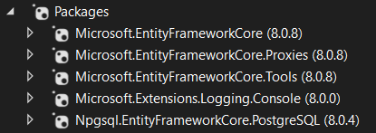
Setup
Proxies: only to use lazy mode
Tools : only needed for migration script and actions
Console : only for debugging the request generation
The mandatory connector, in this case PosgreSQL

Slide 10
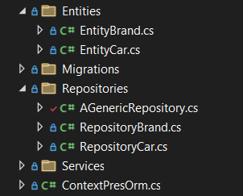

Context, Entities and Repositories
DBContext is a virtual, ephemere and single connection class representation of the database
An Entity is a class representation a set of value from the database
Repository is a pattern to organize and specialize requests for entities

Slide 11
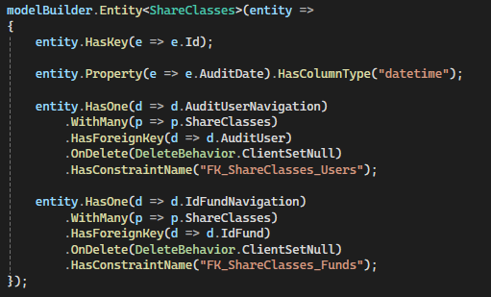
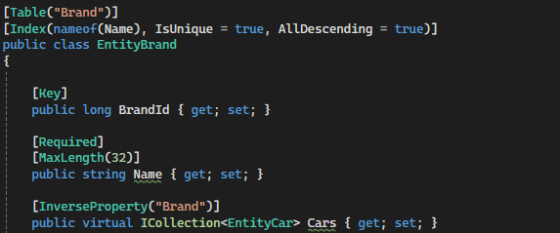
EF Configuration
Configuration by code
Configuration by annotation

Slide 12

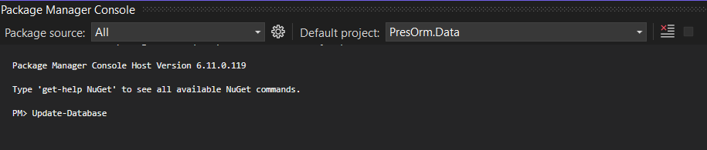
Database generation
EF can generate the schema creation/update script from the class model
PMC or dotnet command have plugins to generate and apply migrations

Slide 13
Context life time with WEB API
DBContext lifetime begin when you start using it, most likely when receiving a request.
It Ends when the request scope is destroyed.
Context is not thread safe, 1 request => 1 thread
Context is not a cache
Client
Http request
Created
Destroyed
Server

Slide 14
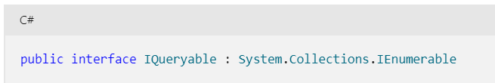
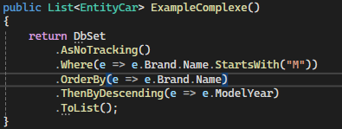
Linq and IQueryable
IQueryable is not IEnumerable, but...
EQueryable Sets from table or view
Create, Read, Update and Delete (CRUD)
detached mode => better performance, more specialized requests
attached mode => less work to "reattach", less work to look into related tables

Slide 15

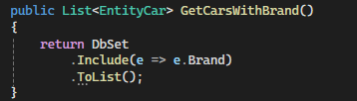
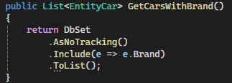
Lazy/Eager, Tracker
Lazy / 2 sql requests
Lazy via EF Proxies
Tracker != Proxy
Don’t track when read only
Eager / only 1 sql request
Eager / No tracking

Slide 16
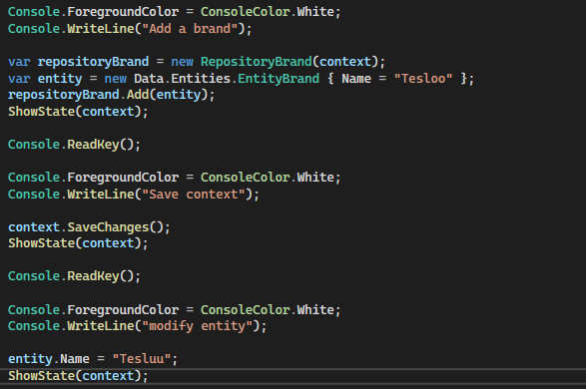
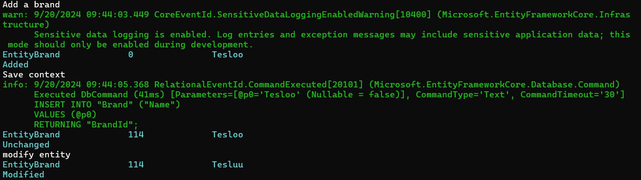
Entity State
Tracker keep state

Slide 17
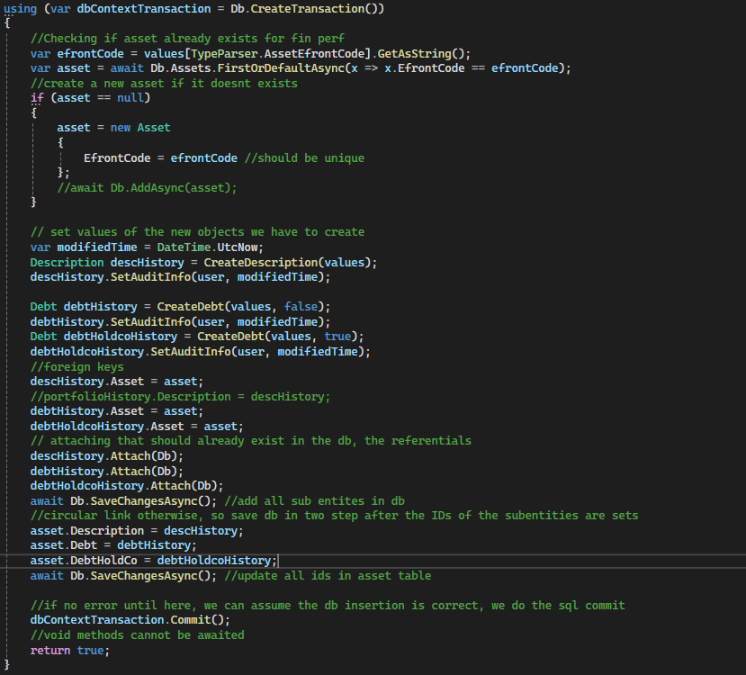
Questions ?
Transactions
A transaction can be cancelled
Circular reference

Slide 18
Conclusion
Can't do better than:
https://stackoverflow.com/questions/1279613/what-is-an-orm-how-does-it-work-and-how-should-i-use-one
Using ORM saves a lot of time because:
DRY: You write your data model in only one place, and it's easier to update, maintain, and reuse the code.
A lot of stuff is done automatically, from database handling to I18N.
It forces you to write MVC code, which, in the end, makes your code a little cleaner.
You don't have to write poorly-formed SQL (most Web programmers really suck at it, because SQL is treated like a "sub" language, when in reality it's a very powerful and complex one).
Sanitizing; using prepared statements or transactions are as easy as calling a method.
Using an ORM library is more flexible because:
It fits in your natural way of coding (it's your language!).
It abstracts the DB system, so you can change it whenever you want.
The model is weakly bound to the rest of the application, so you can change it or use it anywhere else.
It lets you use OOP goodness like data inheritance without a headache.
But ORM can be a pain:
You have to learn it, and ORM libraries are not lightweight tools;
You have to set it up. Same problem.
Performance is OK for usual queries, but a SQL master will always do better with his own SQL for big projects. (Note nico: but TESTS)
It abstracts the DB. While it's OK if you know what's happening behind the scene, it's a trap for new programmers that can write very greedy statements, like a heavy hit in a for loop.

Slide 19
Questions ?

Slide 20
Notes:
Tristan Nitot: loi d'erooM (Effort radicalement organisé d'optimisation en masse) - Enterrer la loi de Moore

