Slide 1
Battery-Checker Alarm
Vinit Mundra - 1811026
Chintan Modi - 1811025

Slide 2
Overview:-

Slide 3
This tkinter application is small idea behind to help/save the laptops/computers of every user.
Actually this idea clicked bcoz my earlier laptop lost its ability of standing without battery for long time, as I didn’t charged it time to time, and let the battery reach the 0%
Thus we thought of making a tkinter application which will help a user to set a battery limit below which the user doesn’t wants to get his/her battery percentage. And without worrying about the battery (charge!!) the user can continue doing his/her work.
And as soon as the battery percentage reaches the limit set by the user, the tkinter application will generate a alarm- like a warning sound (beep beep ….) which will make the user know that his/her battery has reached a certain limit set, and should charge the laptop/computer now….

Slide 4
Functionalities and
Tools Used….

Slide 5
GUI:
The app has a simple, straightforward and easy to use GUI.
We use Label widget which implements a display box where one can write the battery percentage limit which he/she wants to set and then click the Start Countdown button and rest process will be handled by the tkinter application.

Slide 6
Main Page:
The Main Page has a simple Entry box in which the user has to input the battery percentage he wants an alarm to be turned on.
So if the user enters a battery percentage greater than the current battery percentage of the laptop , a warning label will be displayed.
And whenever the limit reaches the current battery percentage of the laptop an alarm sound will ring for 7 seconds.

Slide 7
Tools Used:

Slide 8
Tools:
Tkinter For GUI.
Vscode for python code.

Slide 9
Output:

Slide 10
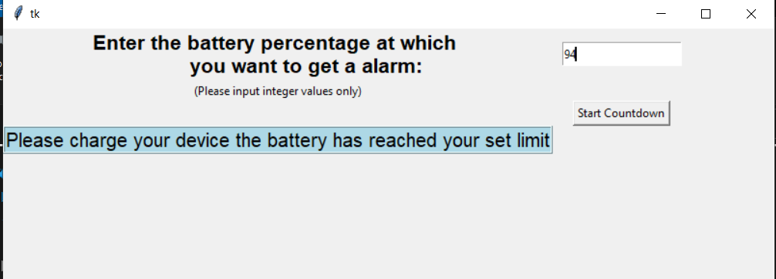
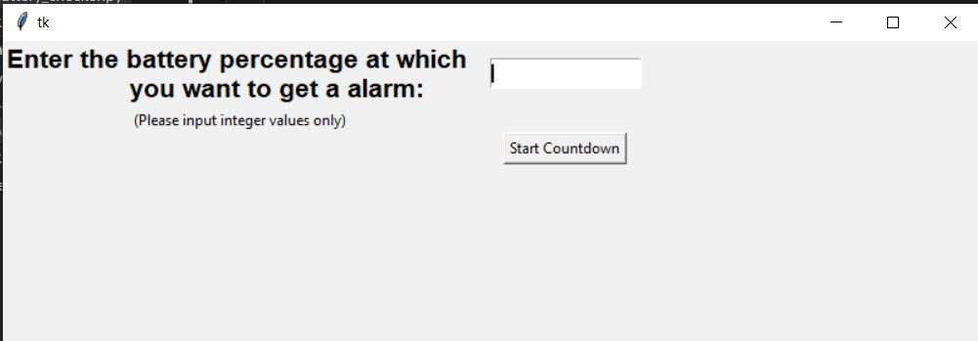
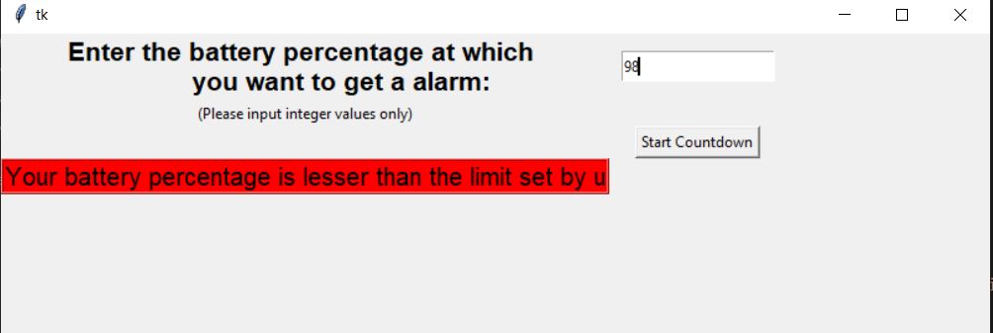
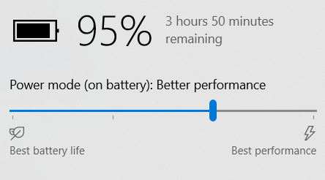
Main Page

Slide 14
User Manual

Slide 15
Link of User Manual:
https://drive.google.com/open?id=1ihkAq7MnBfJLXYS-vuzw6yZ38XkKFlz1

Slide 16
Demonstration using video:

Slide 17
Link of video:
https://drive.google.com/open?id=1056Mto-bFlF32QSGnxefx1t12kzh7sVz

Slide 18
Report:

Slide 19
Link of Report:-
https://drive.google.com/open?id=1ju-H6fgrWmoZ33KBoZc7NB9CLxOx5cTG

Slide 20
Thank You!!

