Slide 1
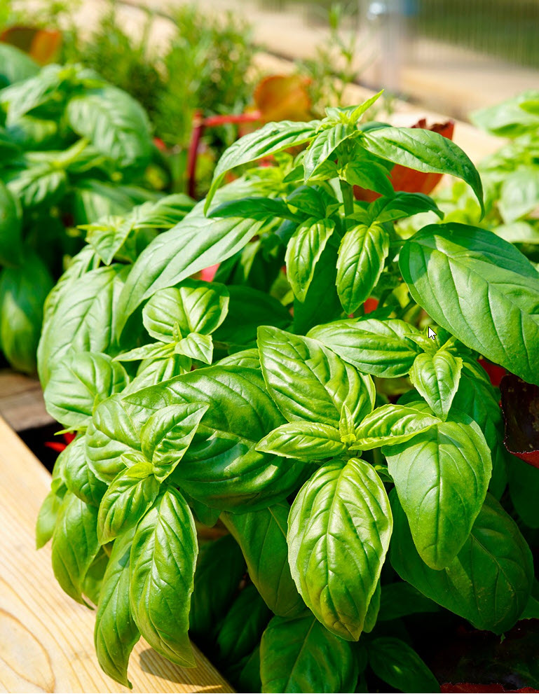
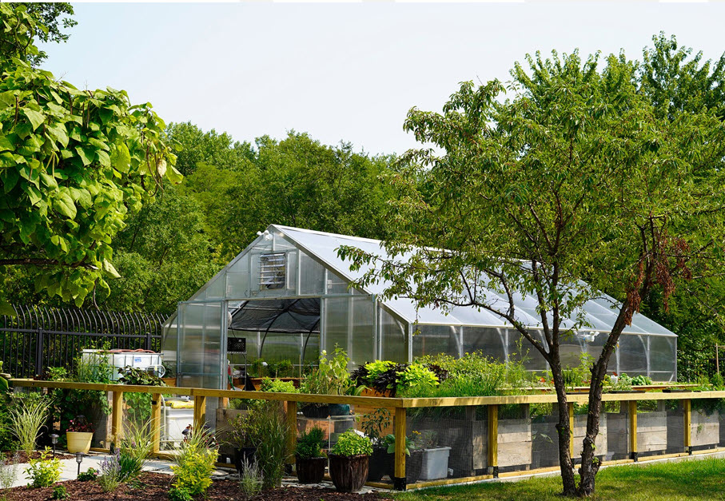
ON-SITE GREENHOUSE
WE SOURCE INGREDIENTS FROM OUR ON-SITE...
At Paramount Events, our green-forward initiatives...
fresh
SUSTAINABILITY
WE FOCUS ON SUSTAINABILITY & GREEN-CERTIFIED...
Our sustainability efforts include composting on-site...

Slide 2
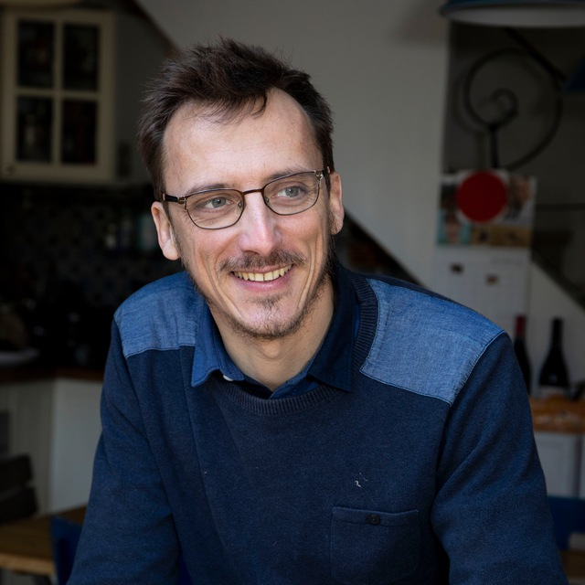
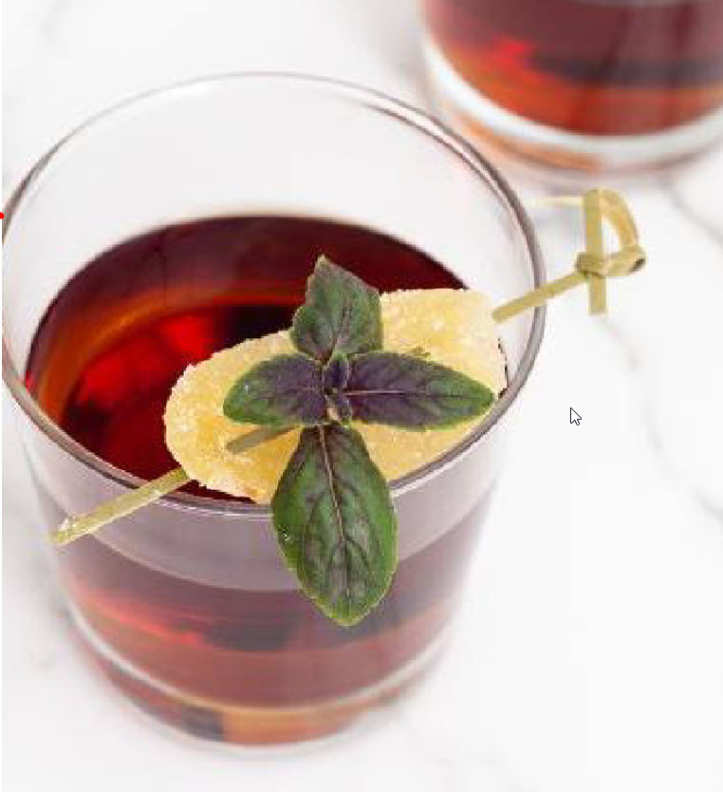
A FLAWLESS EXPERIENCE
WE UNDERSTAND THE IMPORTANCE OF PULLING...
No matter the guest count, venue, or reason for celebrating...
HI, I'M CHLOE BRYNIARSKI!
I'll be your catering experience manager. Based on...
CALL CHLOE BRYNIARSKI OR EMAIL CBRYNIARSKI@PARAMOUNTEVENTSCHICAGO.COM
Our team

Slide 3
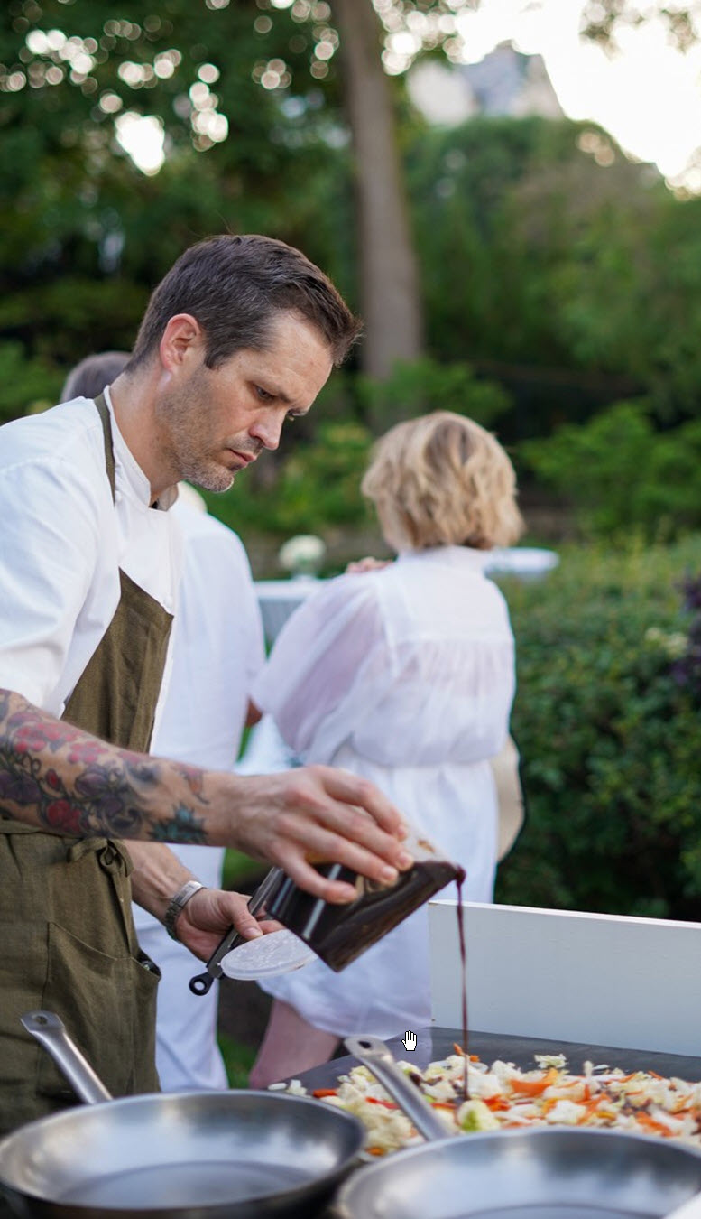

An Overview of your Event
Client Information
Client Name
Client Email
Date
Saturday, May 5, 2029
Venue Information
Chicago History Museum
1601 N. Clark St
Illinois, Chicago, 60614
Sample Timeline
3:00pm | Paramount Events Team Arrives for Set Up
6:00pm | Cocktail Reception Begins
 | Bars Open
 | Hors D'ouvre Passing Begins
6:30 | Hors D'ouvre Stations Open
7:00pm | Hors D'ouvre Passing Concludes
8:00pm | Event Concludes
 | Event Concludes
 | Event Concludes
9:00pm | Paramount Events Completes Breakdown
Guest Count
600

