Slide 1


H.K.E SOCIETY’S
P.D.A COLLEGE OF ENGINEERING
DEPARTMENT OF COMPUTER SCIENCE AND ENGINEERING
Topic- AirSketch: Gesture Based Virtual Drawing
Under the Guidance of: Dr. Anita Harsoor
Presented by:
Hisham Khuram (USN-3PD23CS050)
Md Ahmed Raza Sofi (USN- 3PD23CS065)
Mohammed Abdul Maaz Hanan (USN-3PD23CS070)

Slide 2
ABSTRACT
AirSketch is an interactive web application that allows users to draw on a digital canvas using hand gestures detected through a webcam. By converting these gestures into drawing actions, the system eliminates the need for physical input devices while providing a smooth and responsive drawing experience.
Users will be able to draw by extending a single finger, change colors by performing specific gestures, switch to eraser mode, and clear the canvas and so on.
The system also promotes accessibility by enabling physically challenged users to interact with the application using simple hand and finger gestures. By eliminating the need for traditional input devices such as a mouse or stylus.

Slide 3
❏ INTRODUCTION
❏ LITERATURE SURVEY
❏ PROBLEM STATEMENT
❏ OBJECTIVES
❏ EXISTING SYSTEM
❏ PROPOSED SYSTEM
❏ METHODOLOGY
❏ CONCLUSION
❏ REFERENCES
TABLE OF CONTENTS

Slide 4
INTRODUCTION
Hand gesture recognition is one of the most widely studied approaches in this field. By detecting and analyzing the movement and position of fingers and hands, computer systems can interpret specific gestures as commands. This technology has been used in various applications such as virtual reality environments, interactive gaming systems, smart classrooms, sign language recognition, and touchless control interfaces.
AirSketch aims to develop an interactive web application that enables users to draw on a digital canvas using hand gestures. The system will track hand movements, identify specific finger configurations, and translate these gestures into drawing actions.

Slide 5
LITERATURE SURVEY
[1]Skeleton-based Online Micro Hand Gesture Recognition Authors: H. Chang, P. Ren, B. Zhang, D. Li, T. Han, H. Zhang, L. Xie, H. Chen, and E. Yin,2026:
The work by Haochen Chang et al. presents OMG-Bench, a large-scale dataset for skeleton-based online micro hand gesture recognition. It introduces HMATr, a transformer model with hierarchical memory, enabling accurate real-time detection of subtle gestures, supporting precise and responsive interaction systems relevant to the AirSketch project. It implements real time hand tracking using MediaPipe and OpenCV. However it is sensitive to camera based lighting and digital noises.
[2]Dynamic LIBRAS Gesture Recognition via CNN over Spatiotemporal Matrix Representation. Authors: J. Moreira, 2026
The study by J. Moreira proposes a CNN-based approach using spatiotemporal matrix representation for dynamic LIBRAS gesture recognition. It effectively captures motion patterns and improves classification accuracy. However, it is computationally intensive and less suitable for real-time applications. Overall, it demonstrates strong performance but faces scalability and deployment limitations in practical systems.

Slide 6
[3] Painting with Hand Gestures using MediaPipe Authors: R. Vasavi, N. Rahul, A. Snigdha, K. J. Moses, and S. V. Simha, 2022.
The study by R. Vasavi et al. presents a hand gesture–based virtual painting system using MediaPipe. It enables real-time hand tracking and intuitive drawing without physical contact. However, performance is affected by lighting conditions and occlusions. Overall, it is efficient, user-friendly, and highly relevant for interactive systems like AirSketch.
[4] Air Canvas Hand Tracking, Authors: A. Swathi, 2024.
The work by A. Swathi presents an Air Canvas system using hand tracking for virtual drawing. It enables real-time, touchless interaction using computer vision techniques. However, performance is sensitive to lighting, background noise, and camera quality. Overall, it is practical, low-cost, and relevant for gesture-based systems like AirSketch.

Slide 7
[5]A Deep Learning-based Multimodal Depth-Aware Dynamic Hand Gesture Recognition System Authors: H. Mahmud, M. M. Morshed, and Md. et al., " 2022.
The study by H. Mahmud et al. proposes a deep learning-based multimodal, depth-aware system for dynamic hand gesture recognition. It combines RGB and depth data to improve accuracy and robustness. However, it requires specialized sensors and higher computation. Overall, it achieves strong performance but limits scalability in low-cost, real-time applications like AirSketch.
[6]Hand Gesture Recognition using Image Processing and Feature Extraction Techniques, Authors: A. Sharma, A. Mittal, S. Singh, and V. Awatramani, 2020.
The study by A. Sharma et al. presents a hand gesture recognition system using image processing and feature extraction techniques. It identifies gestures through contour and shape analysis. However, it is sensitive to background noise and lighting variations. Overall, it is simple and effective but less robust for complex, real-time AirSketch applications.

Slide 8
[7] Computer Vision-based Hand Gesture Recognition for Human-Robot Interaction Authors: J. Qi, L. Ma, Z. Cui, and Y. Yu, 2023.
The study by J. Qi et al. provides a comprehensive overview of computer vision–based hand gesture recognition for human-robot interaction. It discusses traditional and deep learning methods, datasets, and challenges. However, real-time robustness and generalization remain issues. Overall, it highlights key gaps relevant to AirSketch development.
[8] Hand Gesture and Voice-controlled Mouse for Physically Challenged using Computer Vision, Authors:A. Morajkar, A. M. James, M. Bagwe, and A. S. James, 2022.
The study by A. Morajkar et al. presents a system combining hand gestures and voice commands to control a computer mouse using computer vision. It improves accessibility for physically challenged users. However, accuracy depends on environmental conditions and speech clarity. Overall, it is practical but limited in robustness and scalability.

Slide 9
[9] MediaPipe-LSTM-Enhanced Framework for Real-Time Dynamic Sign Language Recognition in Inclusive Communication Systems, Authors: N. Anithadevi, S. Palanisamy, S. S. Rubini, and S. Shrestha 2024.
The study by N. Anithadevi et al. proposes a MediaPipe-LSTM based framework for real-time dynamic sign language recognition. It combines spatial hand tracking with temporal sequence learning for improved accuracy. However, it requires stable input conditions and computational resources. Overall, it enhances real-time performance for inclusive systems like AirSketch.
[10] Towards Understanding the Faults of JavaScript-Based Deep Learning Systems, Authors: L. Quan, Q. Guo, X. Xie, S. Chen, X. Li, and Y. Liu, 2023.
The study by L. Quan et al. investigates faults in JavaScript-based deep learning systems. It identifies common issues in model implementation, debugging, and performance inconsistencies. However, findings are limited to JavaScript environments. Overall, it highlights reliability challenges and the need for robust development practices in AI-based applications like AirSketch.

Slide 10
No. | Research papers | Conclusion & Drawback | Relevance for our system | Published By
1 | A New Challenging Benchmark for Skeleton based Micro Hand Gesture Recognition. 2026 | C. Real time hand tracking using MediaPipe and OpenCV. D. Dependancy on camera based tracking sensitive to lighting and background variations | Accurate hand tracking with simple gesture mapping can enable a responsive real-time air drawing system | ScienceOpen
2 | Dynamic LIBRAS Gesture recognition using cnn 2026 | C. Improves user interaction and enables accurate air writing on virtual canvases D.Struggles with variability in hand movements and lack of tactile feedback | Combining fingertip detection with preprocessing enhance accuracy
3 | Painting with hand gestures using media pipe 2024 | C. Effective real-time hand gesture painting system by tracking fingertip movements. D. Sensitive to lighting conditions and background noise which can reduce drawing accuracy. | Simple fingertip tracking and gesture mapping can be used to build an air drawing system, which we can enhance with better accuracy and stability. | IJISRT
4 | Air Canvas Handtracking 2022 | C. Virtual air canvas system built using color-based object tracking D. Reliance on colored markers, making it less natural and less flexible | Simpler color detection methods can reduce computational complexity, | JETIR
Cornell University

Slide 11
No. | Research papers | Conclusion & Drawback | Relevance for our system | Published By
5 | Deep Learning based Dynamic Hand Gesture Recognition System 2022 | C. Deep learning significantly improves accuracy and efficiency D. Complex multimodal fusion and depth data processing, increasing system complexity | Combining multiple data modalities (depth + skeleton) enhances gesture understanding, | ResearchGate
6 | Hand Gesture Recognition using Image Processing and Feature Extraction Techniques 2020 | C. Combining image preprocessing with feature extraction improves hand gesture recognition accuracy D. Complex feature extraction and multiple processing steps | Effective preprocessing and feature extraction are crucial for improving recognition accuracy | ResearchGate
7 | Computer vision-based hand gesture recognition for human-robot interaction: a review 2022 | C. human–robot interaction stages like detection, segmentation, and classification. D. challenges such as gesture variability, environmental sensitivity, and high computational complexity. | Complete pipeline (data acquisition → detection → feature extraction → classification). | SpringerNature
8 | Hand gesture and voice-controlled mouse for physically challenged using computer vision 2023 | C. creates a multimodal system for hands-free and accessible computer control. D. Synchronizing gesture and voice inputs and may suffer from reduced accuracy due to noise, lighting conditions etc | Integrating multiple input modalities (gesture + voice) improves usability and accessibility | ResearchGate

Slide 12
No. | Research Papers | Conclusion & Drawback | Relevance for our system | Published By
9 | Enhanced Framework for Real-Time Dynamic Sign Language Recognition 2024 | C. Integrating Deep Learning with hand tracking enables more accurate recognition. D. Increases computational cost and makes real-time deployment on low-end devices challenging | Temporal modeling of gestures improves recognition of dynamic movements | WILEY
10 | Faults of JavaScript-Based Deep Learning Systems 2023 | C. Deep learning recognition models can effectively capture complex hand movements and improve interaction accuracy D. Requires large datasets and high computational resources | Advanced deep learning improves gesture understanding and motivates us to design a lightweight and efficient system | Cornell University

Slide 13
PROBLEM STATEMENT
Traditional digital drawing systems rely heavily on physical input devices such as a mouse, stylus, or touchscreen. These methods require direct physical interaction, which may not always be intuitive.
Existing gesture-based systems often focus only on basic functionalities, lacking a complete and interactive drawing experience suitable for
real-world applications. Additionally, individuals with physical disabilities or hand movement limitations face challenges in using conventional input devices.
There is a need for an intuitive, touchless, and accessible system that leverages computer vision and hand gesture recognition to provide a natural and inclusive digital drawing experience.

Slide 14
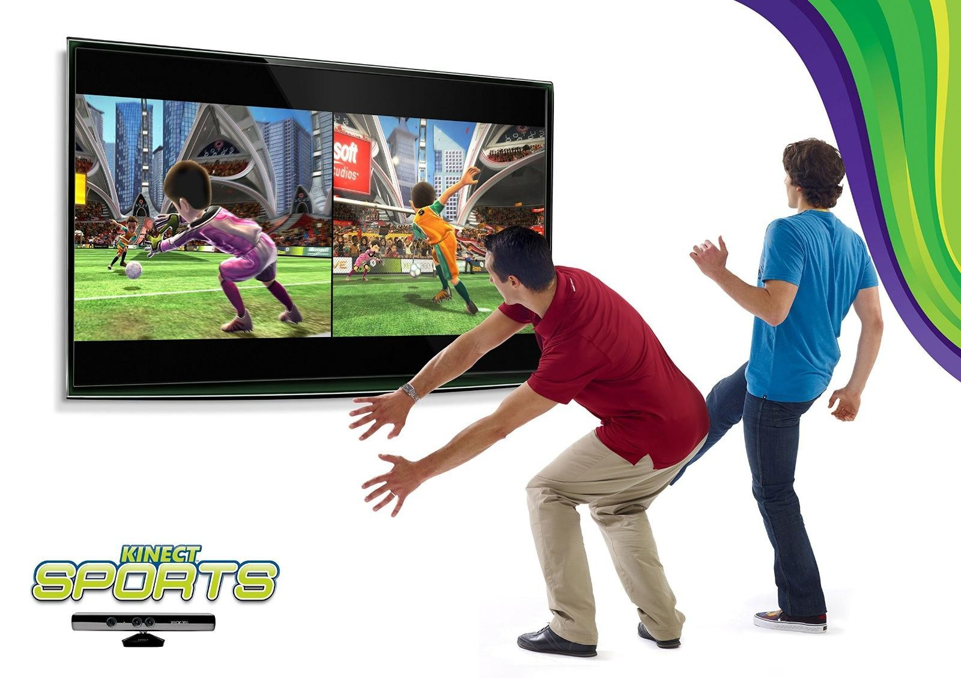
EXISTING SYSTEMS
Microsoft Kinect:
A motion-sensing system developed by Microsoft that uses a combination of RGB cameras, depth sensors, and infrared technology to track full-body movements, including hand gestures. It enables users to interact with systems without physical controllers and is widely used in gaming, virtual reality, rehabilitation, and interactive installations.
However, it requires specialized and costly hardware, has limited portability, and is not suitable for lightweight or web-based applications. Additionally, its setup can be complex and may not perform efficiently in all environments.

Slide 15
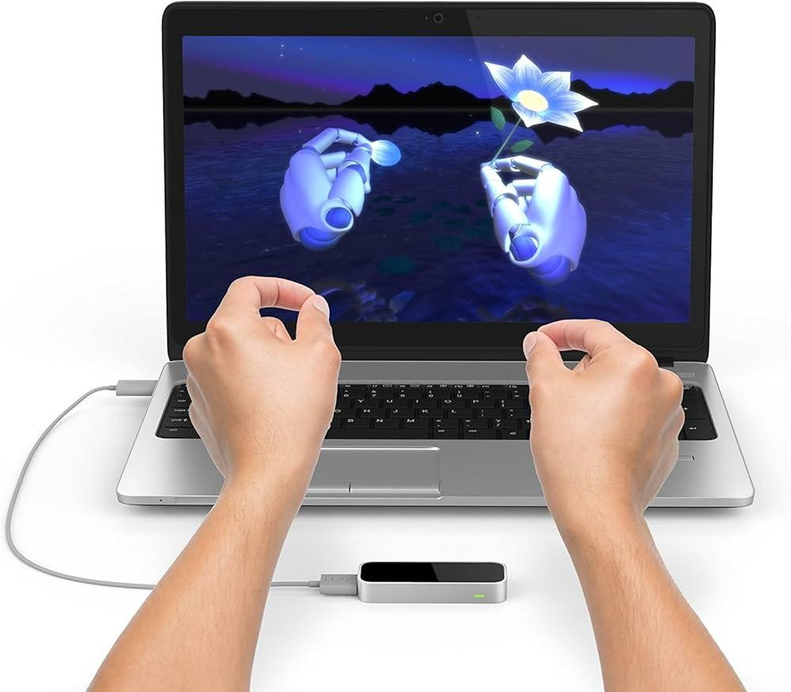
Leap Motion controller:
A hardware-based gesture recognition system that uses infrared cameras and optical sensors to capture highly precise hand and finger movements in real time. It can track individual fingers, hand orientation, and complex gestures with high accuracy, making it suitable for applications in virtual reality, augmented reality, 3D modeling, medical training, and interactive simulations
However, it requires dedicated external hardware, increasing the overall cost and limiting accessibility for general users. Additionally, it needs proper setup and positioning, has a limited interaction range, and is not easily scalable for web-based or lightweight applications compared to webcam-based solutions.

Slide 16
PROPOSED SYSTEM
AirSketch: Gesture Based Virtual Drawing
AirSketch is a web-based application that enables users to draw on a digital canvas using real-time hand gestures captured through a webcam. By tracking the position of the user’s fingertip, the system converts gestures into drawing actions like creating lines and shapes on the canvas.
The platform provides an interactive and user-friendly interface with features such as color selection, brush size adjustment, eraser mode, and canvas clearing through predefined gestures. Real-time processing ensures that user movements are instantly reflected on the screen, creating a smooth and natural drawing experience.
Additionally, the system promotes accessibility by enabling touchless interaction, making it especially useful for individuals with physical disabilities or hand mobility limitations. Overall, AirSketch offers a cost-effective, accessible, and intuitive solution that enhances human–computer interaction through gesture-based control.

Slide 17



OBJECTIVES
To develop a gesture-based virtual drawing platform that detects and interprets hand gestures in real time for touchless interaction
To enhance accessibility by enabling users with physical limitations to interact without traditional input devices
To demonstrate the practical use of AI-driven human–computer interaction systems
To provide an interactive and user-friendly interface with features such as drawing, color selection, erasing, and canvas clearing

Slide 18
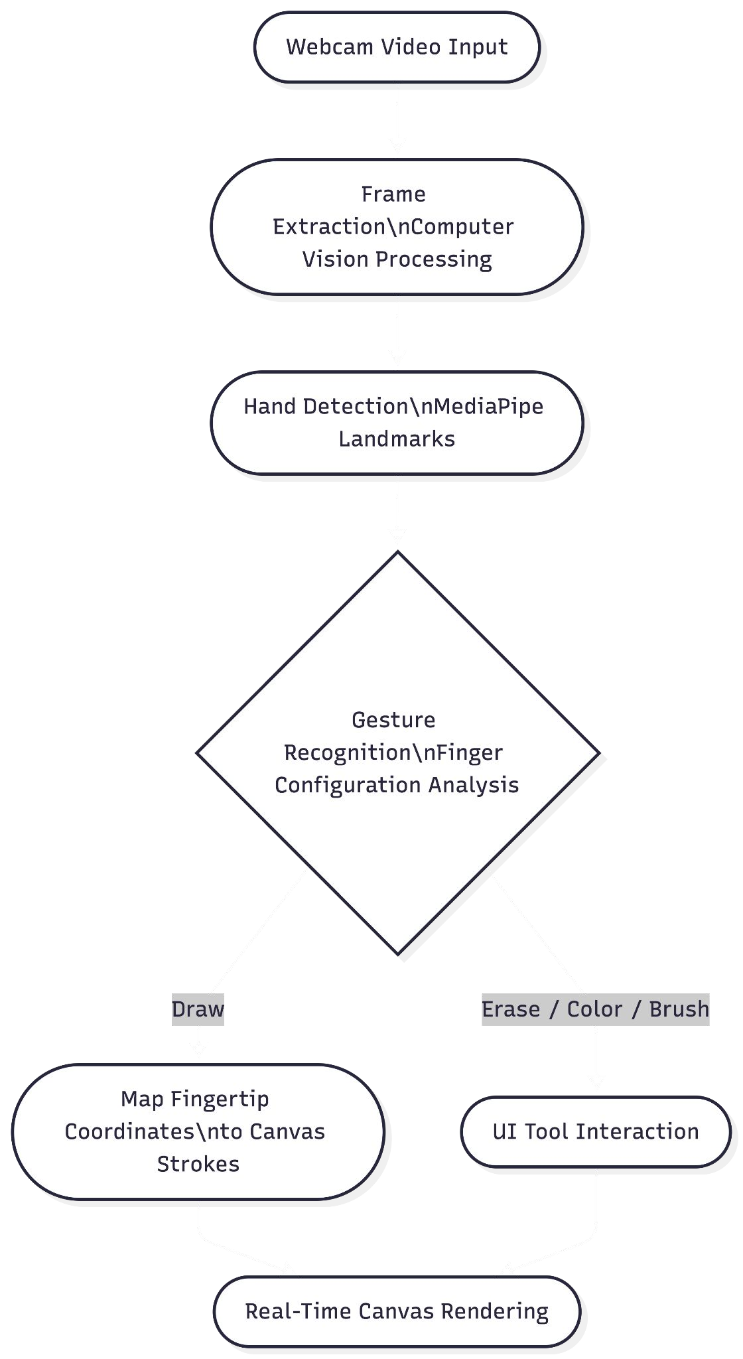
Process Implementation and Methodology
Fig: Process Of Implementaion

Slide 19
METHODOLOGY
❏ Live Video Input and Data Capture:
The system begins by capturing real-time video input through the user’s webcam. The continuous video stream is divided into frames. Each frame is analyzed using computer vision techniques to detect the presence of a hand and extract relevant visual information.
❏
Hand Detection and Gesture Recognition
Once the hand is detected, frameworks like MediaPipe are used to identify key hand landmarks such as fingertips and joints. Based on the position and movement of these landmarks, the system recognizes specific gestures by interpreting finger configurations as commands for different actions.

Slide 20
❏ Drawing and System Implementation
The detected fingertip coordinates are mapped onto the digital canvas to generate drawing strokes in real time. The system also provides a user interface for tool interaction such as color selection, brush size adjustment, and erasing through gestures.
❏ Technical Stack:
Frontend: React + Typescript
Computer Vision: MediaPipe
AI Processing: TensorFlow.js
Build Tool: Vite
Runtime Environment: Node.js
Input Device: Webcam
Platform:Web Browser (Chrome,Firefox)
Styling: Tailwind CSS

Slide 21
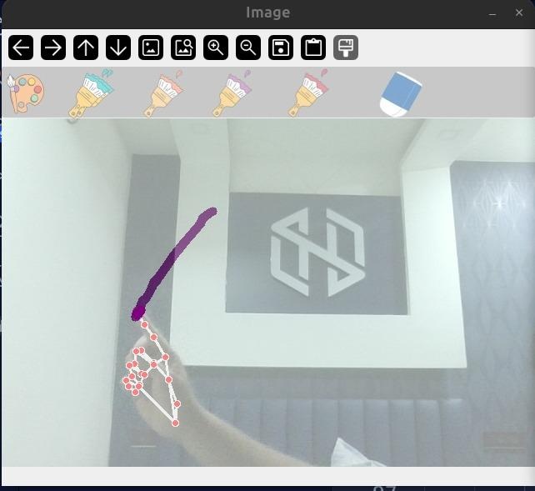
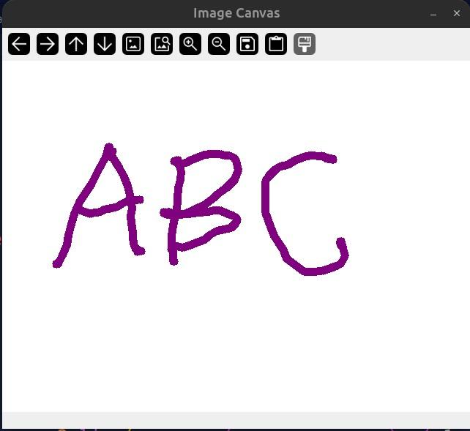
RESULTS & DISCUSSION
Fig1:Hand Detection
Fig2:AirSketch Canvas
The output demonstrates the successful implementation of the AirSketch system using hand gesture tracking and virtual drawing techniques. The system accurately detects finger movements in real time and allows users to draw characters and shapes in the air without physical contact. Different drawing tools and color options were also integrated, showing smooth interaction, responsive performance, and an intuitive user experience through computer vision and gesture recognition.

Slide 22
CONCLUSION
The literature survey shows that various techniques such as image processing, feature extraction, deep learning, and real-time hand tracking using MediaPipe and OpenCV have been widely used for hand gesture recognition systems. While deep learning and multimodal approaches improve accuracy, they often increase computational complexity and reduce real-time performance. On the other hand, simpler methods provide faster responses but may lack robustness and precision.
From these research works and our project development, we learned that selecting the right combination of technologies is essential. In our AirSketch system, we adopted efficient hand tracking and gesture detection, focusing on real-time interaction and ease of use rather than heavy computation. We also understood the importance of handling practical challenges such as lighting variations and smooth stroke rendering.
Finally, the AirSketch project successfully combines computer vision, gesture recognition, and real-time interaction to create a touchless virtual drawing system. It demonstrates how AI-based hand tracking can enhance creativity, accessibility, and human-computer interaction in an interactive and user-friendly way.

Slide 23
REFERENCES
[1] OMG-Bench: A New Challenging Benchmark for Skeleton-based Online Micro Hand Gesture Recognition Authors:Haochen Chang, Pengfei Ren, Buyuan Zhang, Da Li, Tianhao Han, Haoyang Zhang, Liang Xie, Hongbo Chen, Erwei Yin, Published on 2026
[2]Dynamic LIBRAS Gesture Recognition via CNN over Spatiotemporal Matrix Representation Authors: Jasmine Moreira, Published on 2026
[3]Painting with Hand Gestures using MediaPipe Authors: R.Vasavi, Nenavath Rahul, A Snigdha, K. Jeffery Moses, S.Vishal Simha, Published on 2022
[4]AIR CANVAS HAND TRACKING Authors: SWATHI. A, Published on 2024
[5]A Deep Learning-based Multimodal Depth-Aware Dynamic Hand Gesture Recognition System Authors:Hasan Mahmud,Mashrur Mahmud Morshed,Md
[6]Hand Gesture Recognition using Image Processing and Feature Extraction Techniques Authors: Ashish Sharma, Anmol Mittal, Savitoj Singh, Vasudev Awatramani, Published on 2020
[7]Computer vision-based hand gesture recognition for human-robot interaction Authors: Jing Qi, Li Ma, Zhenchao Cui & Yushu Yu
[8]Hand gesture and voice-controlled mouse for physically challenged using computer vision Authors: Aarti Morajkar Atheena Mariyam James, Minoli Bagwe, Aleena Sara James
[9]MediaPipe-LSTM-Enhanced Framework for Real-Time Dynamic Sign Language Recognition in Inclusive Communication Systems Authors: N. Anithadevi, SatheeshKumar Palanisamy, S. Saranya Rubini, Sachin Shrestha
[10]Towards Understanding the Faults of JavaScript-Based Deep Learning Systems Authors: Lili Quan, Qianyu Guo, Xiaofei Xie, Sen Chen, Xiaohong Li, Yang Liu

