Slide 1


H.K.E SOCIETY’S
P.D.A COLLEGE OF ENGINEERING
DEPARTMENT OF COMPUTER SCIENCE AND ENGINEERING
Topic- AirSketch: Gesture Based Virtual Drawing
Under the Guidance of: Dr. Anita Harsoor
Presented by:
Hisham Khuram (USN-3PD23CS050)
Md Ahmed Raza Sofi (USN- 3PD23CS065)
Mohammed Abdul Maaz Hanan (USN-3PD23CS070)

Slide 2
ABSTRACT
AirSketch is an interactive application that allows users to draw on a digital canvas using hand gestures detected through a webcam. By converting these gestures into drawing actions, the system eliminates the need for physical input devices while providing a smooth and responsive drawing experience.
Users will be able to draw by extending a single finger, change colors by performing specific gestures, switch to eraser mode, and clear the canvas and so on.
The system also promotes accessibility by enabling physically challenged users to interact with the application using simple hand and finger gestures. By eliminating the need for traditional input devices such as a mouse or stylus.

Slide 3
❏ INTRODUCTION
❏ LITERATURE SURVEY
❏ PROBLEM STATEMENT
❏ OBJECTIVES
❏ EXISTING SYSTEM
❏ PROPOSED SYSTEM
❏ METHODOLOGY
❏ CONCLUSION
❏ REFERENCES
TABLE OF CONTENTS

Slide 4
INTRODUCTION
AirSketch aims to develop an interactive web application that enables users to draw on a digital canvas using hand gestures. The system will track hand movements, identify specific finger configurations, and translate these gestures into drawing actions.
Hand gesture recognition is one of the most widely studied approaches in this field. By detecting and analyzing the movement and position of fingers and hands, computer systems can interpret specific gestures as commands. This technology has been used in various applications such as virtual reality environments, interactive gaming systems, smart classrooms, sign language recognition, and touchless control interfaces.

Slide 5
LITERATURE SURVEY
No. | Research papers | Conclusion & Drawback | Relevance for our system | Published By
1 | A New Challenging Benchmark for Skeleton based Micro Hand Gesture Recognition. 2026 | C. Real time hand tracking using MediaPipe and OpenCV. D. Dependancy on camera based tracking sensitive to lighting and background variations | Accurate hand tracking with simple gesture mapping can enable a responsive real-time air drawing system | ScienceOpen
2 | Dynamic LIBRAS Gesture recognition using cnn 2026 | C. Improves user interaction and enables accurate air writing on virtual canvases D.Struggles with variability in hand movements and lack of tactile feedback | Combining fingertip detection with preprocessing enhance accuracy
3 | Painting with hand gestures using media pipe 2024 | C. Effective real-time hand gesture painting system by tracking fingertip movements. D. Sensitive to lighting conditions and background noise which can reduce drawing accuracy. | Simple fingertip tracking and gesture mapping can be used to build an air drawing system, which we can enhance with better accuracy and stability. | IJISRT
4 | Air Canvas Handtracking 2022 | C. Virtual air canvas system built using color-based object tracking D. Reliance on colored markers, making it less natural and less flexible | Simpler color detection methods can reduce computational complexity, | JETIR
Cornell University

Slide 6
No. | Research papers | Conclusion & Drawback | Relevance for our system | Published By
5 | Deep Learning based Dynamic Hand Gesture Recognition System 2022 | C. Deep learning significantly improves accuracy and efficiency D. Complex multimodal fusion and depth data processing, increasing system complexity | Combining multiple data modalities (depth + skeleton) enhances gesture understanding, | ResearchGate
6 | Hand Gesture Recognition using Image Processing and Feature Extraction Techniques 2020 | C. Combining image preprocessing with feature extraction improves hand gesture recognition accuracy D. Complex feature extraction and multiple processing steps | Effective preprocessing and feature extraction are crucial for improving recognition accuracy | ResearchGate
7 | Computer vision-based hand gesture recognition for human-robot interaction: a review 2022 | C. human–robot interaction stages like detection, segmentation, and classification. D. challenges such as gesture variability, environmental sensitivity, and high computational complexity. | Complete pipeline (data acquisition → detection → feature extraction → classification). | SpringerNature
8 | Hand gesture and voice-controlled mouse for physically challenged using computer vision 2023 | C. creates a multimodal system for hands-free and accessible computer control. D. Synchronizing gesture and voice inputs and may suffer from reduced accuracy due to noise, lighting conditions etc | Integrating multiple input modalities (gesture + voice) improves usability and accessibility | ResearchGate

Slide 7
No. | Research Papers | Conclusion & Drawback | Relevance for our system | Published By
9 | Enhanced Framework for Real-Time Dynamic Sign Language Recognition 2024 | C. Integrating Deep Learning with hand tracking enables more accurate recognition. D. Increases computational cost and makes real-time deployment on low-end devices challenging | Temporal modeling of gestures improves recognition of dynamic movements | WILEY
10 | Faults of JavaScript-Based Deep Learning Systems 2023 | C. Deep learning recognition models can effectively capture complex hand movements and improve interaction accuracy D. Requires large datasets and high computational resources | Advanced deep learning improves gesture understanding and motivates us to design a lightweight and efficient system | Cornell University

Slide 8
PROBLEM STATEMENT
Traditional digital drawing systems rely heavily on physical input devices such as a mouse, stylus, or touchscreen. These methods require direct physical interaction, which may not always be intuitive.
Existing gesture-based systems often focus only on basic functionalities, lacking a complete and interactive drawing experience suitable for
real-world applications. Additionally, individuals with physical disabilities or hand movement limitations face challenges in using conventional input devices.
There is a need for an intuitive, touchless, and accessible system that leverages computer vision and hand gesture recognition to provide a natural and inclusive digital drawing experience.

Slide 9
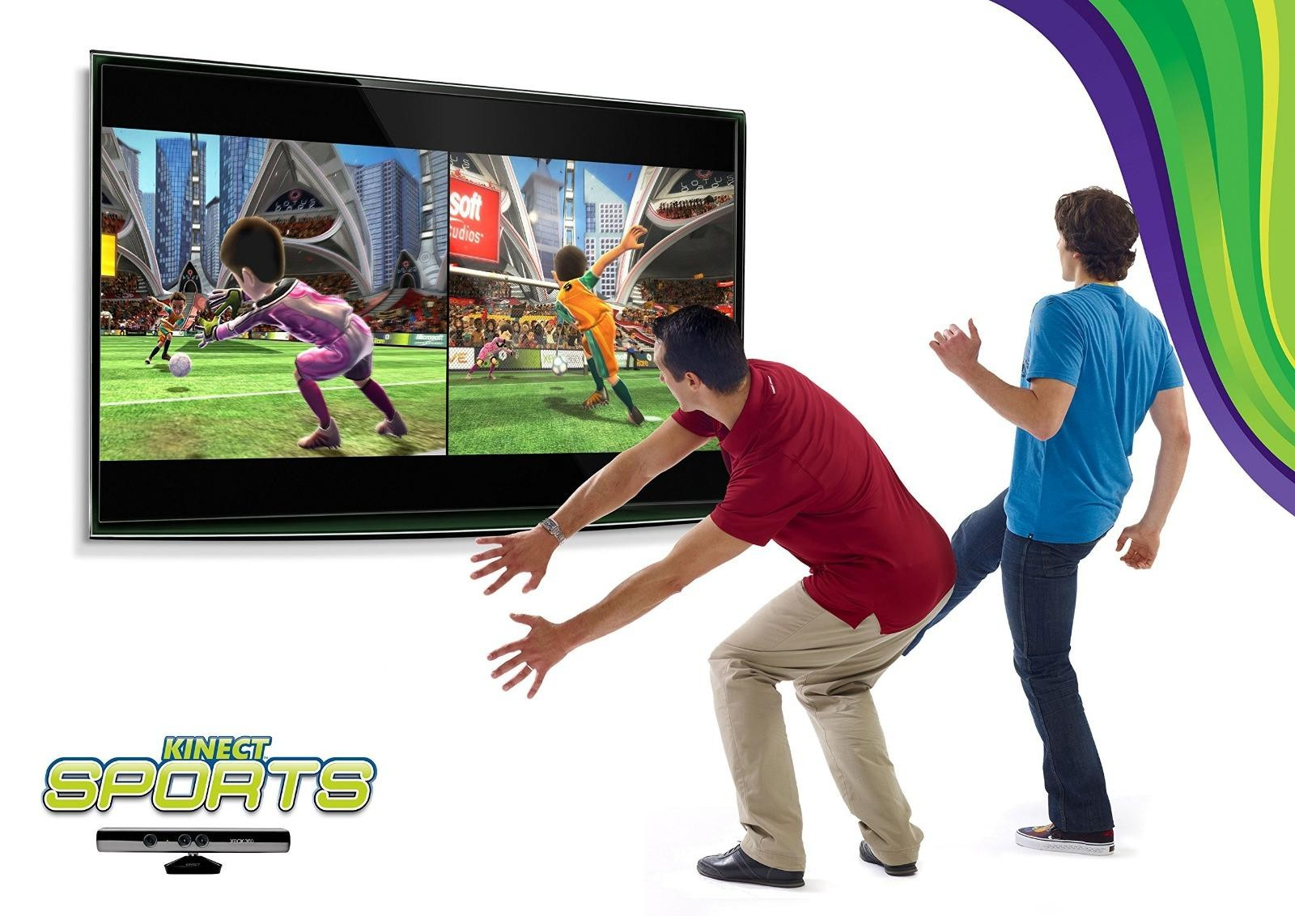
EXISTING SYSTEMS
Microsoft Kinect:
A motion-sensing system developed by Microsoft that uses a combination of RGB cameras, depth sensors, and infrared technology to track full-body movements, including hand gestures. It enables users to interact with systems without physical controllers and is widely used in gaming, virtual reality, rehabilitation, and interactive installations.
However, it requires specialized and costly hardware, has limited portability, and is not suitable for lightweight or web-based applications. Additionally, its setup can be complex and may not perform efficiently in all environments.

Slide 10
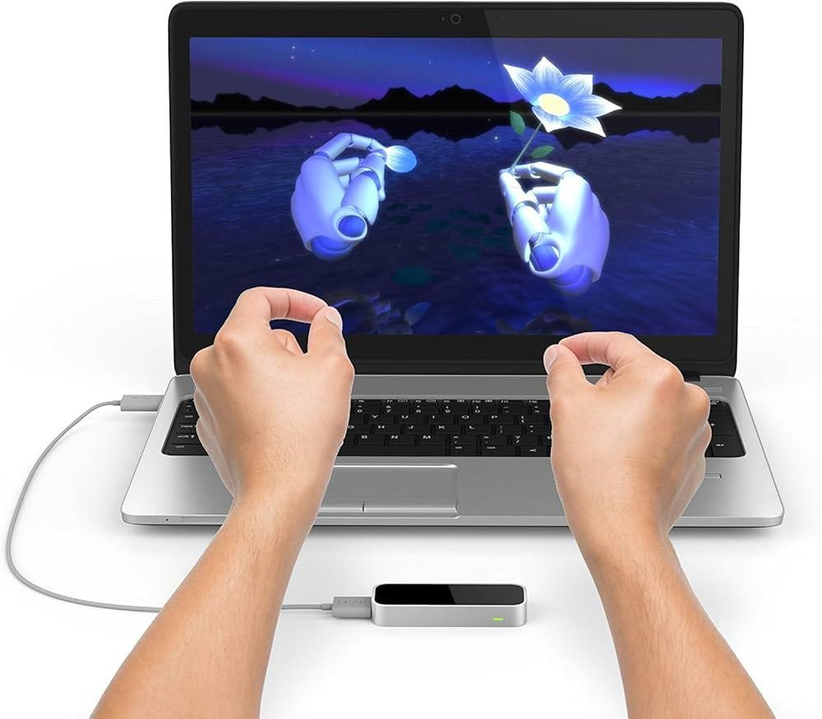
Leap Motion controller:
A hardware-based gesture recognition system that uses infrared cameras and optical sensors to capture highly precise hand and finger movements in real time. It can track individual fingers, hand orientation, and complex gestures with high accuracy, making it suitable for applications in virtual reality, augmented reality, 3D modeling, medical training, and interactive simulations
However, it requires dedicated external hardware, increasing the overall cost and limiting accessibility for general users. Additionally, it needs proper setup and positioning, has a limited interaction range, and is not easily scalable for web-based or lightweight applications compared to webcam-based solutions.

Slide 11
PROPOSED SYSTEM
AirSketch: Gesture Based Virtual Drawing
AirSketch is an application that has enabled users to draw on a digital canvas using real-time hand gestures captured through a webcam. By tracking the position of the user’s fingertip, the system converts gestures into drawing actions like creating lines and shapes on the canvas.
The platform provides an interactive and user-friendly interface with features such as color selection, brush size adjustment, eraser mode, and canvas clearing through predefined gestures. Real-time processing ensures that user movements are instantly reflected on the screen, creating a smooth and natural drawing experience.
Additionally, the system promotes accessibility by enabling touchless interaction, making it especially useful for individuals with physical disabilities or hand mobility limitations. Overall, AirSketch offers a cost-effective, accessible, and intuitive solution that enhances human–computer interaction through gesture-based control.

Slide 12



OBJECTIVES
Developed a gesture-based virtual drawing platform that detects and interprets hand gestures in real time for touchless interaction
Enhanced accessibility by enabling users with physical limitations to interact without traditional input devices
Demonstrated the practical use of AI-driven human–computer interaction systems
Provided an interactive and user-friendly interface with features such as drawing, color selection, erasing, and canvas clearing

Slide 13
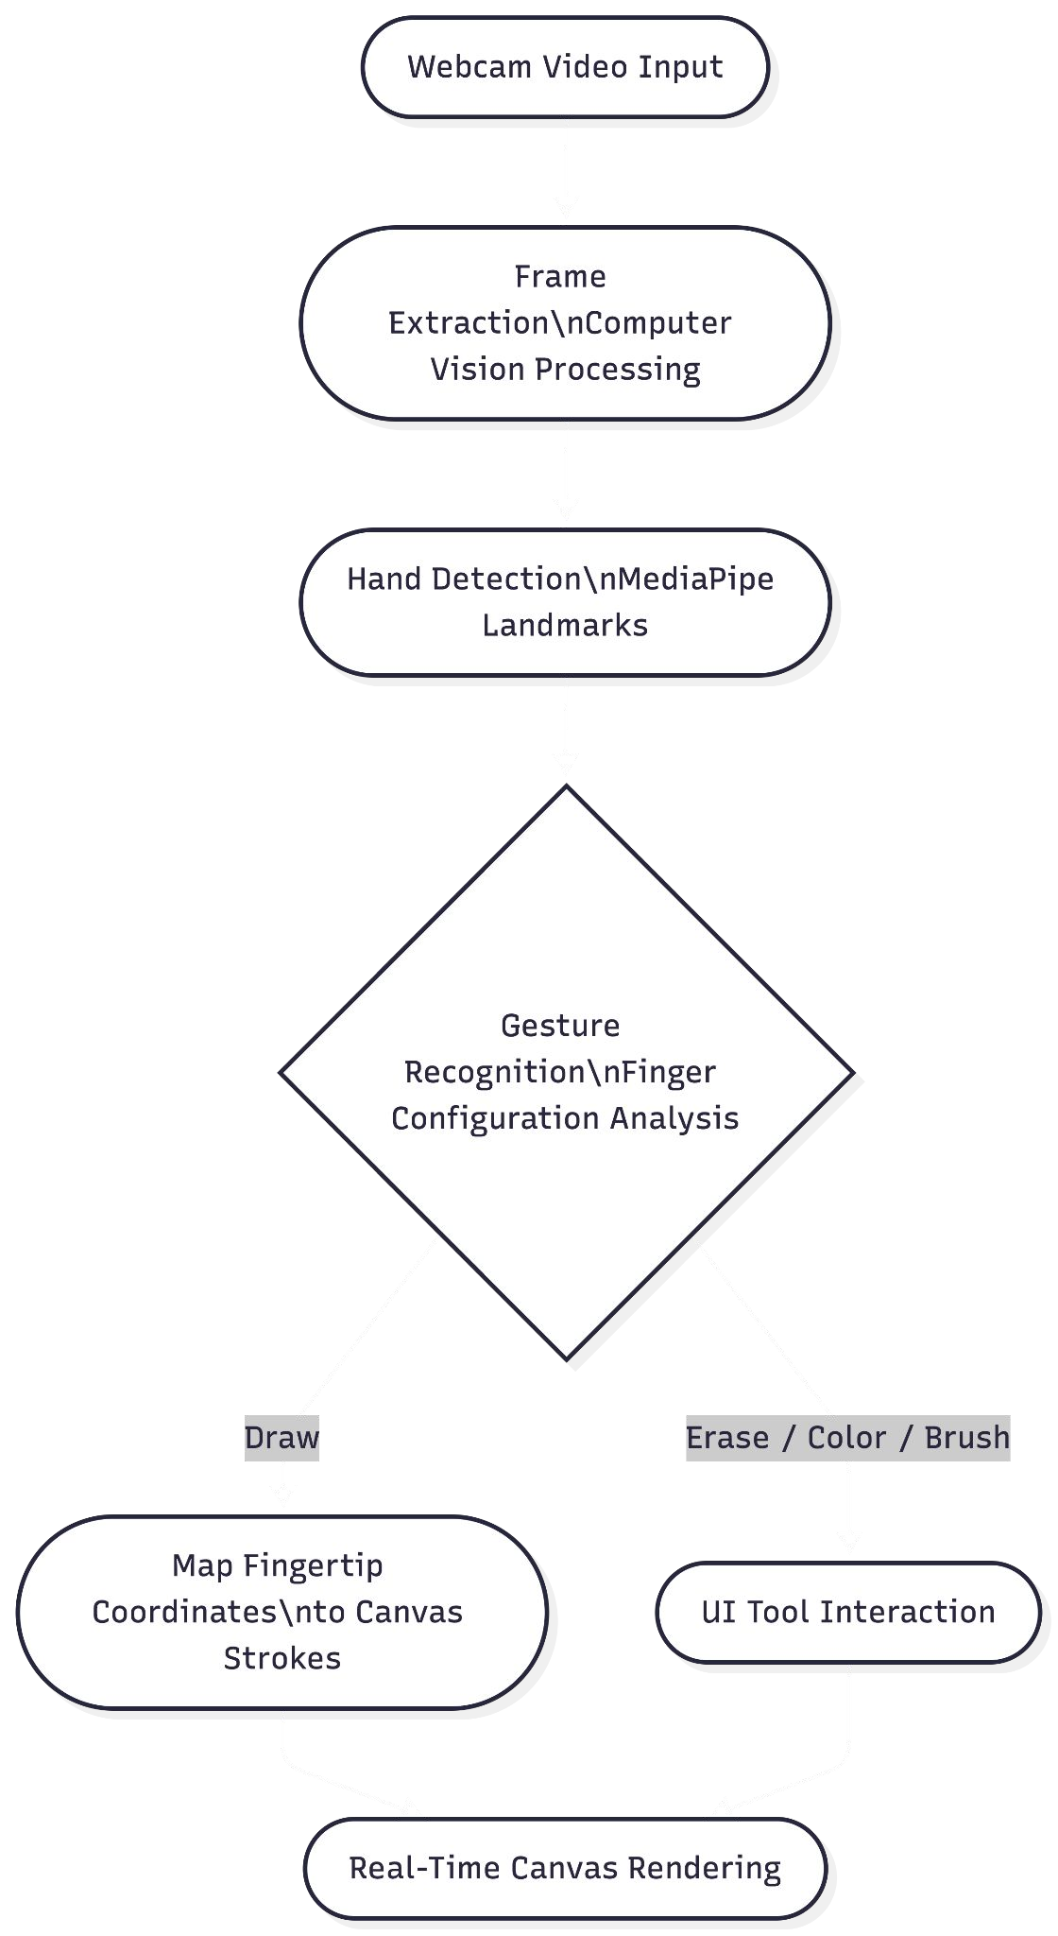
Process Implementation and Methodology
Fig: Process Of Implementaion

Slide 14
METHODOLOGY
❏ Live Video Input and Data Capture:
The system begins by capturing real-time video input through the user’s webcam. The continuous video stream is divided into frames. Each frame is analyzed using computer vision techniques to detect the presence of a hand and extract relevant visual information.
❏
Hand Detection and Gesture Recognition
Once the hand is detected, frameworks like MediaPipe are used to identify key hand landmarks such as fingertips and joints. Based on the position and movement of these landmarks, the system recognizes specific gestures by interpreting finger configurations as commands for different actions.

Slide 15
❏ Drawing and System Implementation
The detected fingertip coordinates are mapped onto the digital canvas to generate drawing strokes in real time. The system also provides a user interface for tool interaction such as color selection, brush size adjustment, and erasing through gestures.
❏ Technical Stack:
Programming Language: Python
Computer Vision: OpenCV
Hand Tracking: MediaPipe
Numerical Processing: NumPy
Input Device: OpenCV MediaCapture

Slide 16
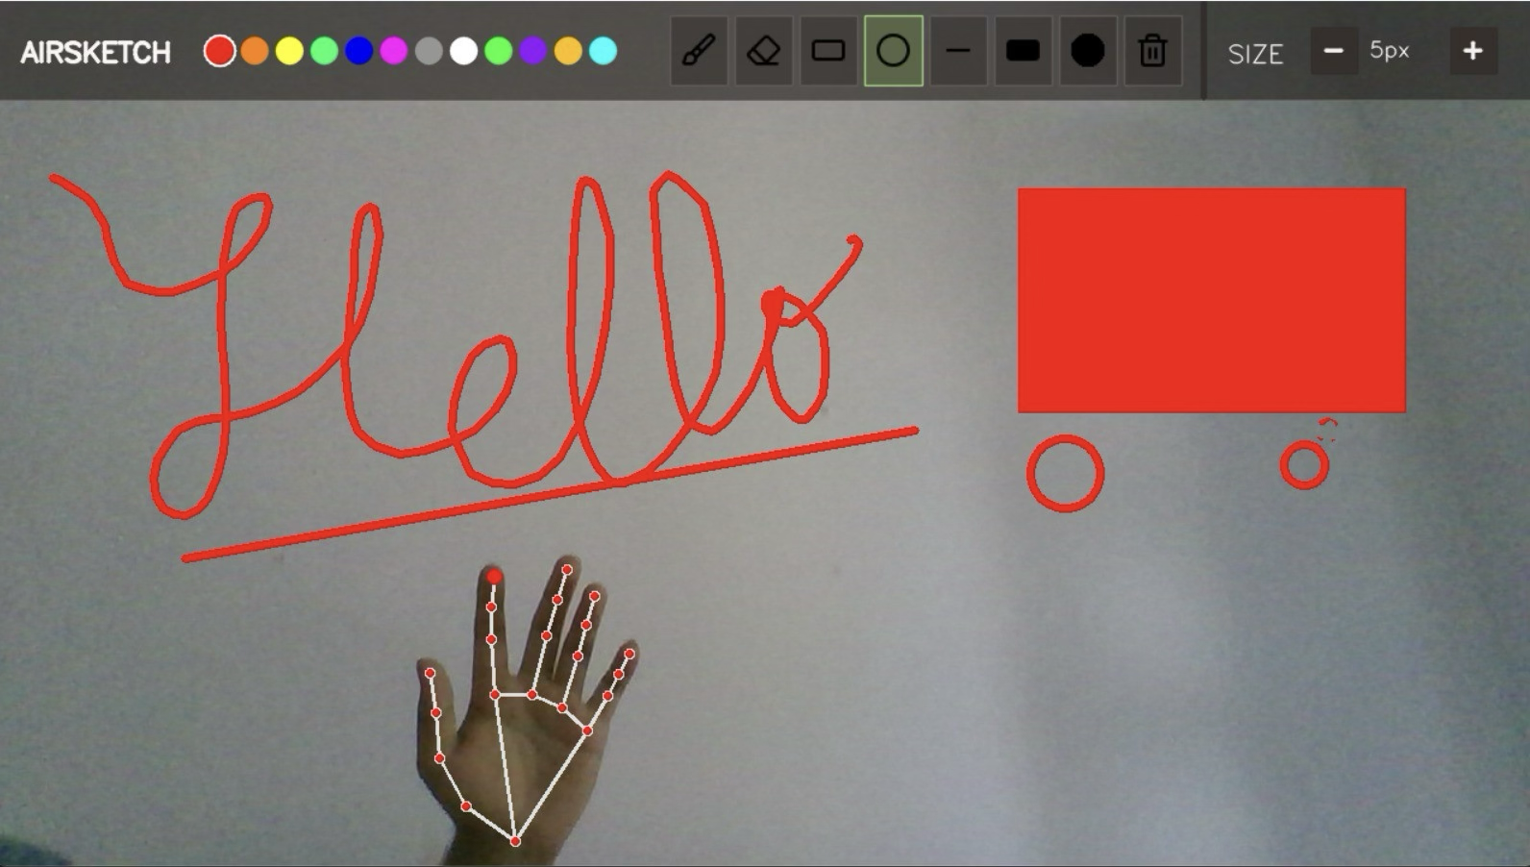
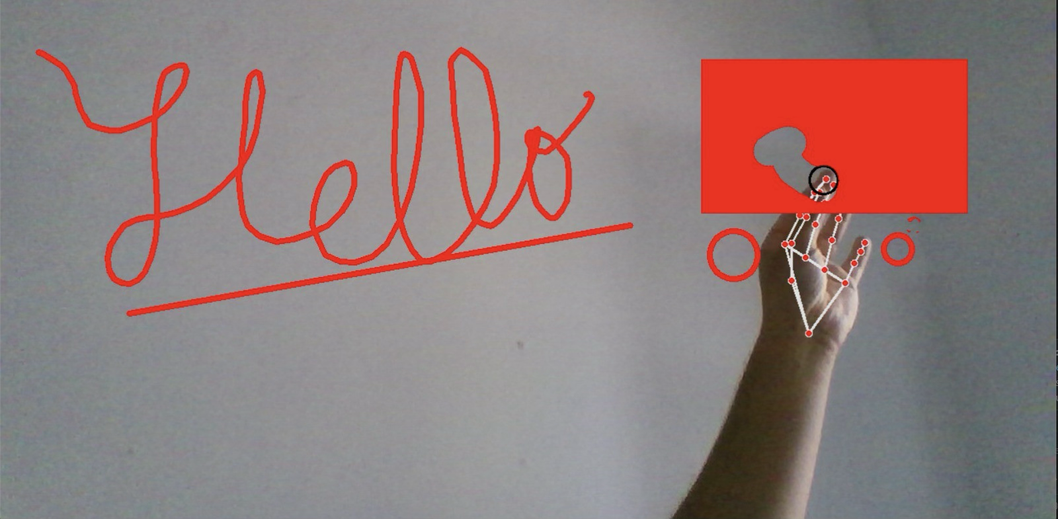
RESULTS & DISCUSSION
Fig1:Hand Detection and Drawing
Fig2: Hand Gesture for Erasing
The output demonstrates the successful implementation of the AirSketch system using hand gesture tracking and virtual drawing techniques. The system accurately detects finger movements in real time and allows users to draw characters and shapes in the air without physical contact. Different drawing tools and color options were also integrated, showing smooth interaction, responsive performance, and an intuitive user experience through computer vision and gesture recognition.

Slide 17
CONCLUSION
The AirSketch system was successfully developed as a real-time, gesture-based virtual drawing application that enables users to interact with a digital canvas using a standard webcam. The implemented system combines OpenCV with MediaPipe hand tracking to detect hand landmarks and interpret fingertip and pinch-based interactions, providing a touch-free alternative to conventional mouse- or stylus-based drawing.
The final product incorporates several drawing and interaction features, including brush and eraser tools, multiple colors, adjustable brush thickness, geometric shapes such as rectangles, circles and lines, filled shapes, and canvas clearing. The system continuously processes webcam frames and maps detected hand movements onto the virtual canvas, resulting in an interactive and responsive drawing experience.
Overall, the completed AirSketch prototype demonstrates that real-time hand tracking can be effectively used to build a low-cost and accessible virtual drawing system without specialized gesture-control hardware. The product successfully converts natural hand movements into practical drawing operations and provides a foundation for further development in touchless human-computer interaction.

Slide 18
REFERENCES
OMG-Bench: A New Challenging Benchmark for Skeleton-based Online Micro Hand Gesture Recognition Authors:Haochen Chang, Pengfei Ren, Buyuan Zhang, Da Li, Tianhao Han, Haoyang Zhang, Liang Xie, Hongbo Chen, Erwei Yin, Published on 2026
Dynamic LIBRAS Gesture Recognition via CNN over Spatiotemporal Matrix Representation Authors: Jasmine Moreira, Published on 2026
Painting with Hand Gestures using MediaPipe Authors: R.Vasavi, Nenavath Rahul, A Snigdha, K. Jeffery Moses, S.Vishal Simha, Published on 2022
AIR CANVAS HAND TRACKING Authors: SWATHI. A, Published on 2024
A Deep Learning-based Multimodal Depth-Aware Dynamic Hand Gesture Recognition System Authors:Hasan Mahmud,Mashrur Mahmud Morshed,Md
Hand Gesture Recognition using Image Processing and Feature Extraction Techniques Authors: Ashish Sharma, Anmol Mittal, Savitoj Singh, Vasudev Awatramani, Published on 2020
Computer vision-based hand gesture recognition for human-robot interaction Authors: Jing Qi, Li Ma, Zhenchao Cui & Yushu Yu
Hand gesture and voice-controlled mouse for physically challenged using computer vision Authors: Aarti Morajkar Atheena Mariyam James, Minoli Bagwe, Aleena Sara James
MediaPipe-LSTM-Enhanced Framework for Real-Time Dynamic Sign Language Recognition in Inclusive Communication Systems Authors: N. Anithadevi, SatheeshKumar Palanisamy, S. Saranya Rubini, Sachin Shrestha
Towards Understanding the Faults of JavaScript-Based Deep Learning Systems Authors: Lili Quan, Qianyu Guo, Xiaofei Xie, Sen Chen, Xiaohong Li, Yang Liu

